Slide 1
Microscope Analysis
High-field solenoid technology for the Muon Collider
ABDEL HAFIZ Mahmoud
16/04/2025

Slide 2
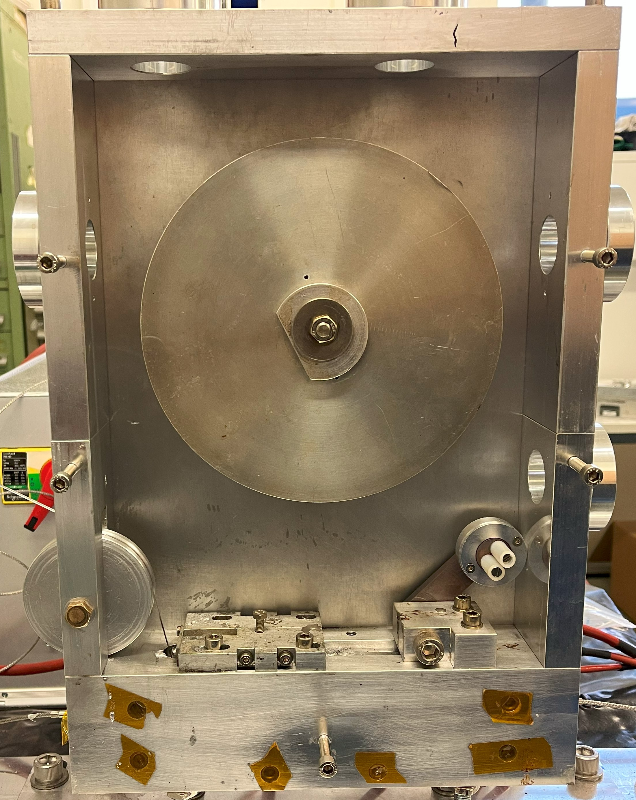
Aim of this study
Summary :
What is the preparation process for microcopy ?
Is there a correlation between thickness of solder and winding tension ?
Does the wipe has an effect on pancake ?
What is the reason for the tape to got stuck ?
What has to be changed ?
4 Pancakes, 2 Parameters
- Force
- Wipe
Pancake | turns | force kg | Wipe | thightening | Stuck
H04 | 23 | 1,8 | yes | yes | yes
H05 | 25 | 2,8 | no | yes | yes
H06 | 23 | 4,2 | no | no | no
H07 | 10 | 3,5 | yes | no | yes
During winding, tape got stuck.
So tightening of winding flinches has been released a bit

Slide 3
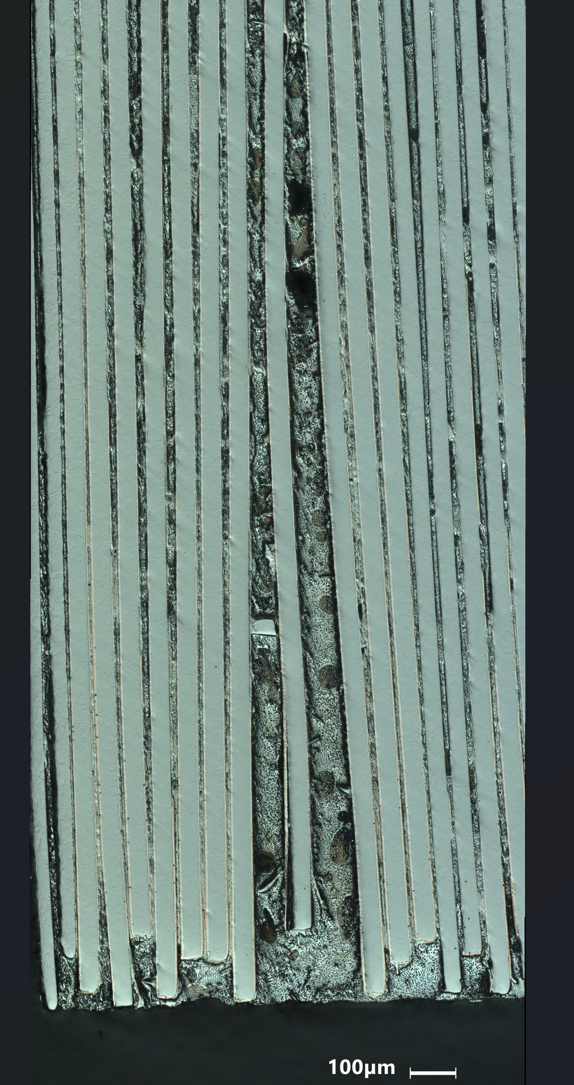
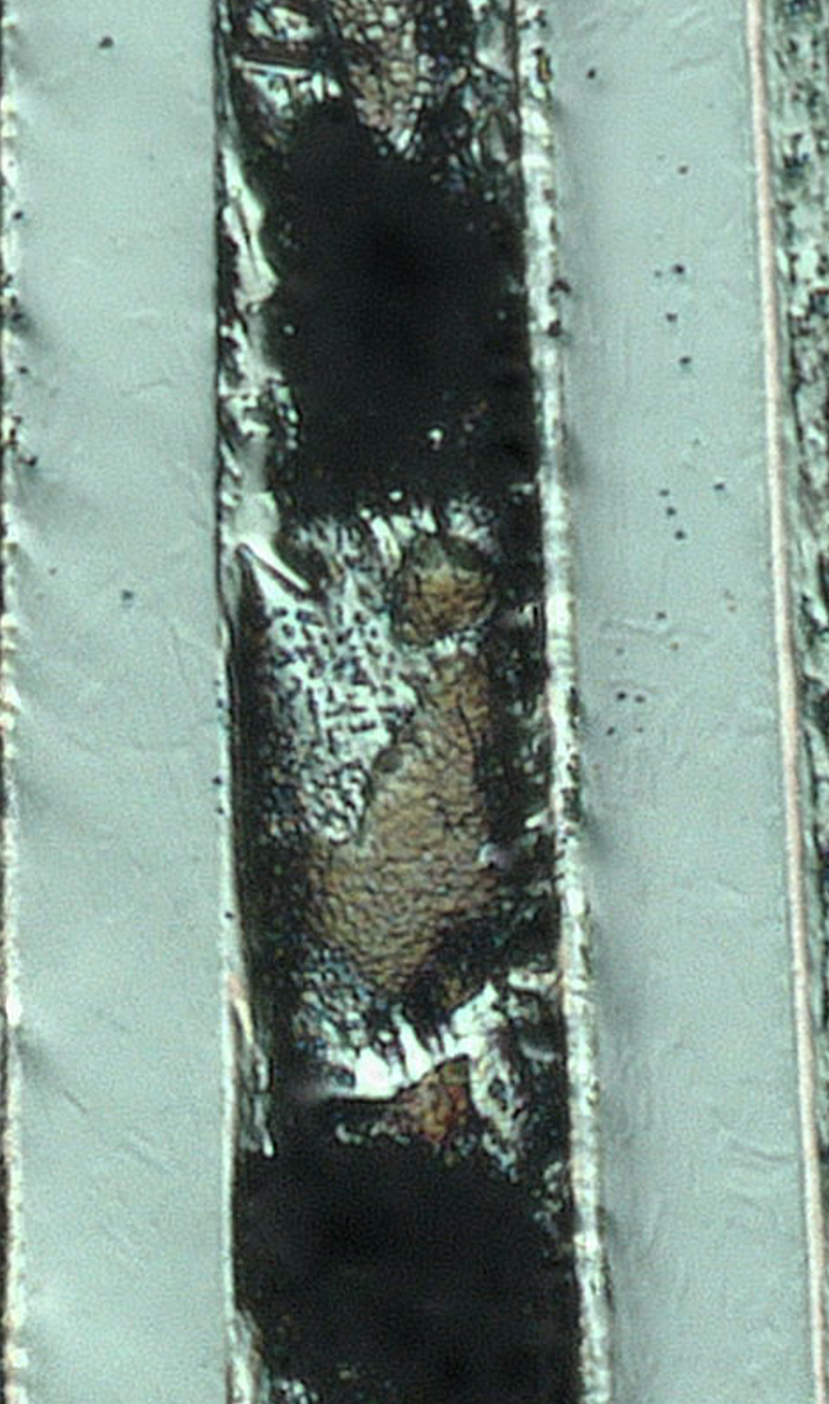
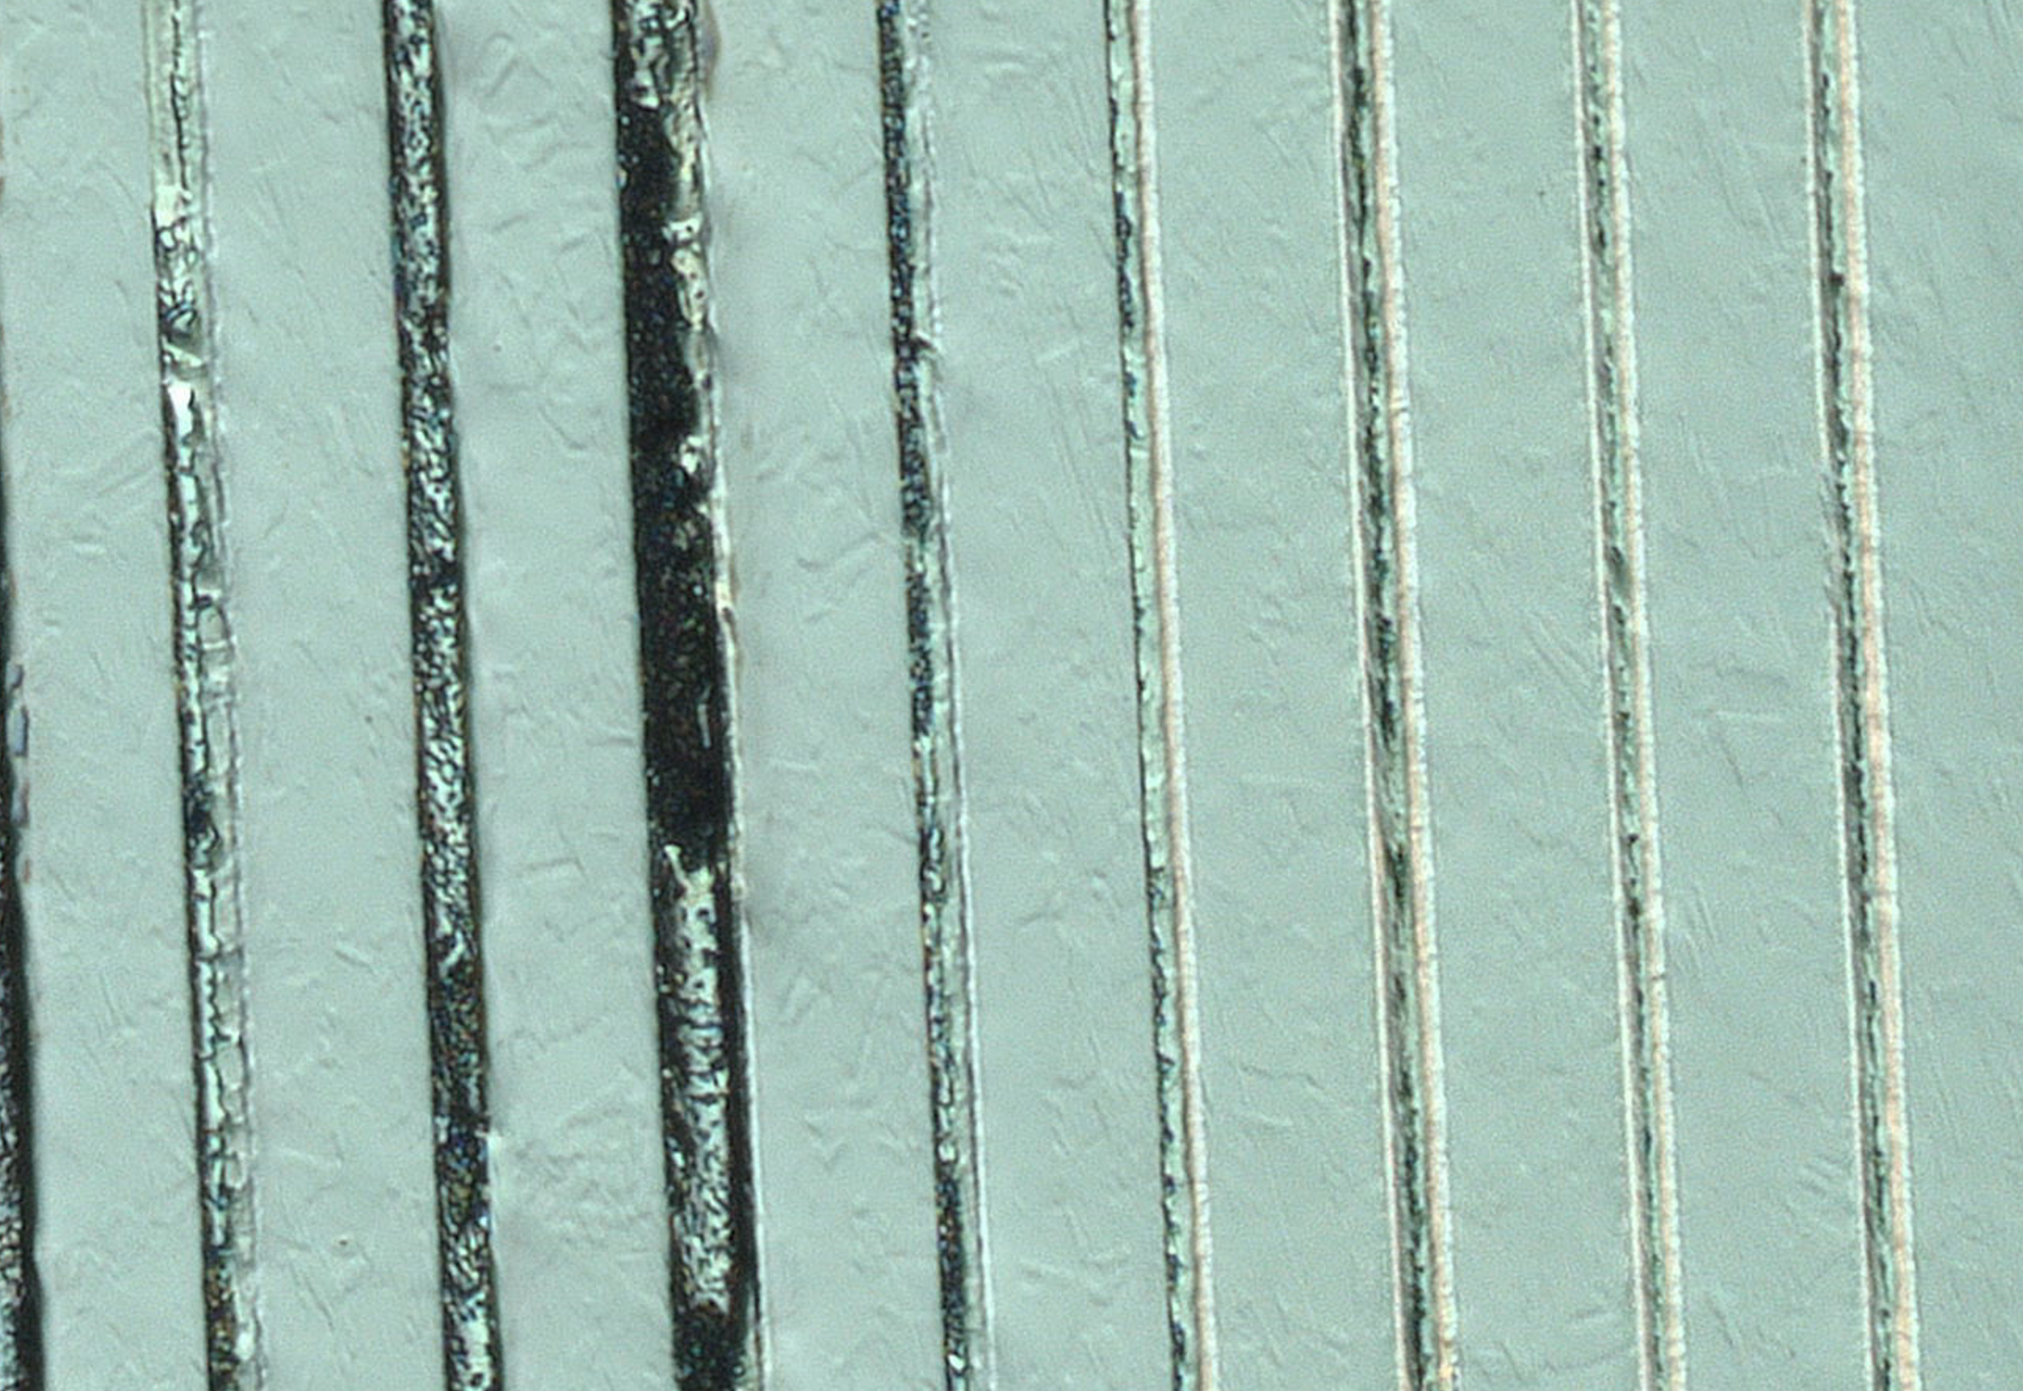
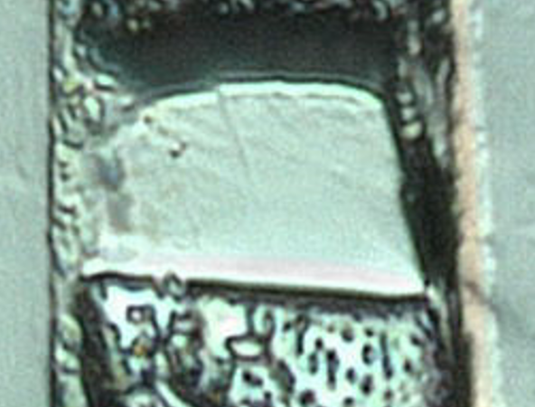
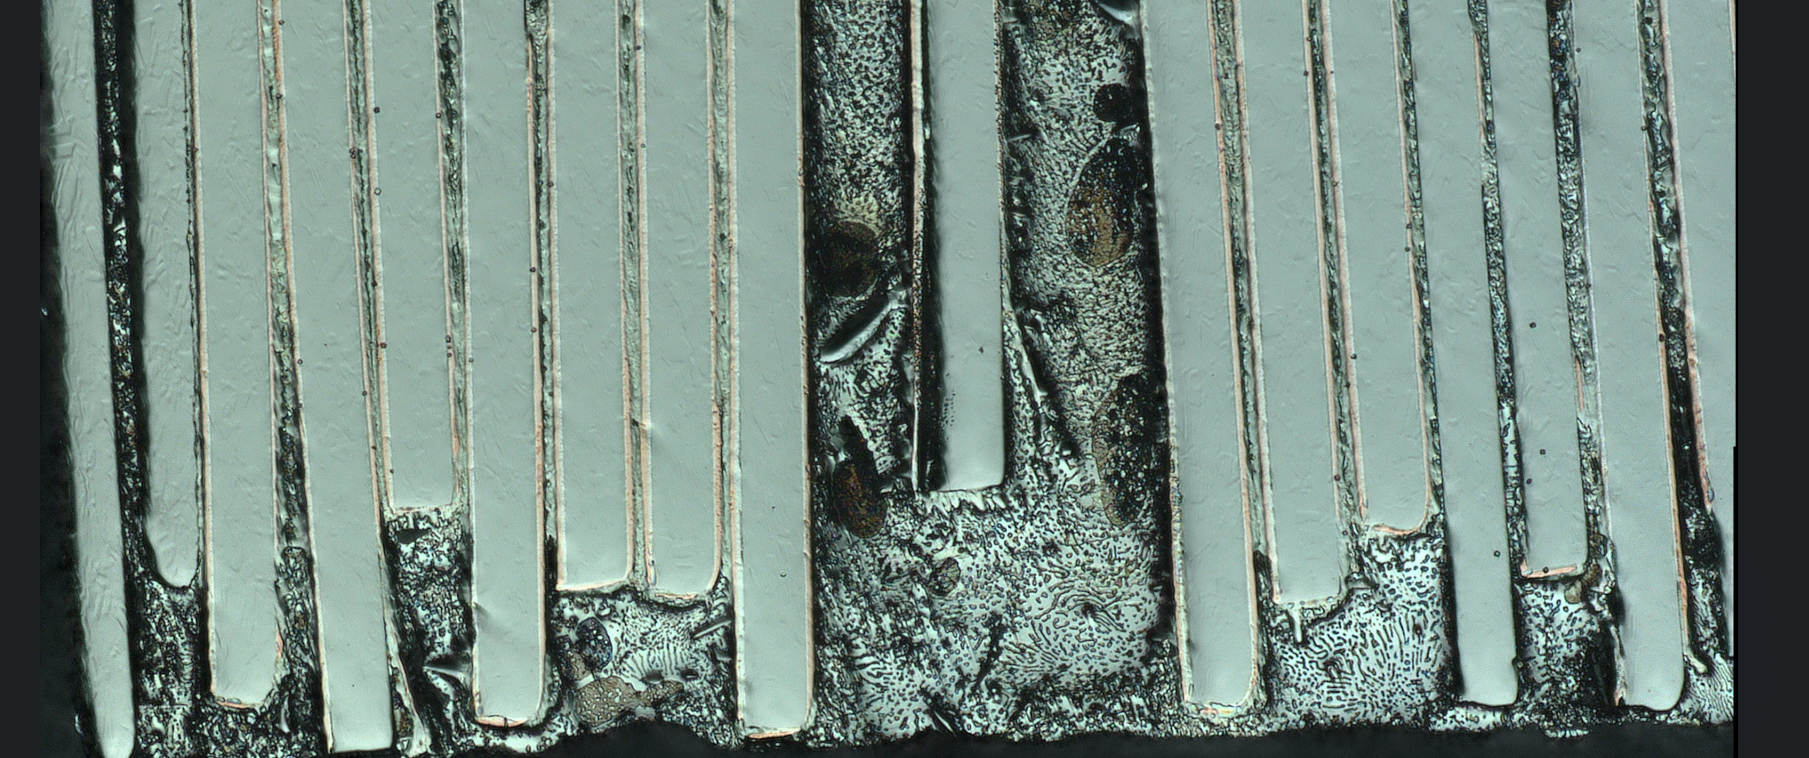
Microscope observations
What is the preparation process for microcopy ?
→ no informations
Big holes
Pancake | turns | force kg | Wipe | thightening | Stuck
H04 | 23 | 1,8 | yes | yes | yes
H05 | 25 | 2,8 | no | yes | yes
H06 | 23 | 4,2 | no | no | no
H07 | 10 | 3,5 | yes | no | yes
Suspecting diamond solution from polishing
Missing Copper
Piece of Hastelloy
?????????
Dissolution of copper ? & Silver ?
H05
Expected filling
Hetereogenity of solder distribution
Non alligned tapes
H05

Slide 4
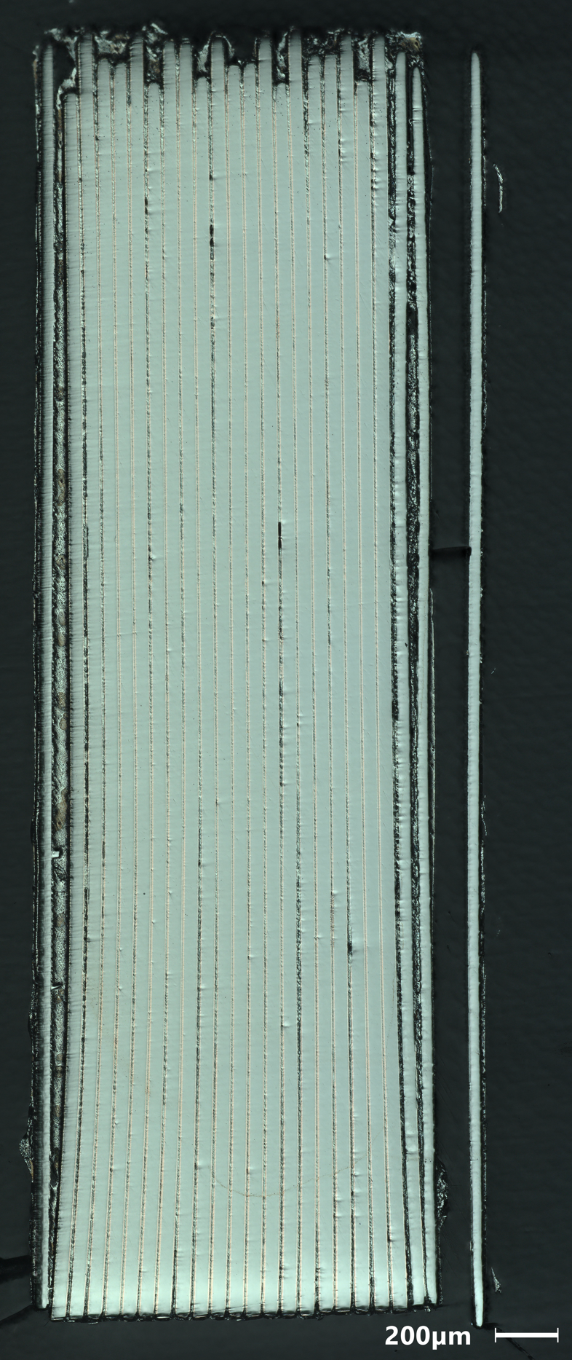
Microscope observations
Pancake | turns | force kg | Wipe | thightening | Stuck
H04 | 23 | 1,8 | yes | yes | yes
H05 | 25 | 2,8 | no | yes | yes
H06 | 23 | 4,2 | no | no | no
H07 | 10 | 3,5 | yes | no | yes
Preliminary conclusion :
Polishing process might have destructive effect on surface. In particular near voids.
  Protocol need to be assessed
  Protocol might need to be enhanced as multilayered samples are particularally difficult to polish
There is a piece of Hastelloy in H05. How did that go there ?
  I suspect piece of tape was damage during winding and slipped in the hole during polishing
Tapes are in general not aligned and not the same width from one turn to another
Solder thickness is heterogeneous, radial and transverse
It seems to have a correlation between solder filling quality & presence of copper on tape
  Void in solder increases with lack of copper
  Stress concentration from void highly increase chance of damage during polishing.
  Is lack of copper is due to polishing damage (prensence of void) or prensence of void due to lack of copper (Low wetability without copper) ?
H06 quality is particularly better than other (only one that did not got stuck)
H06

Slide 5
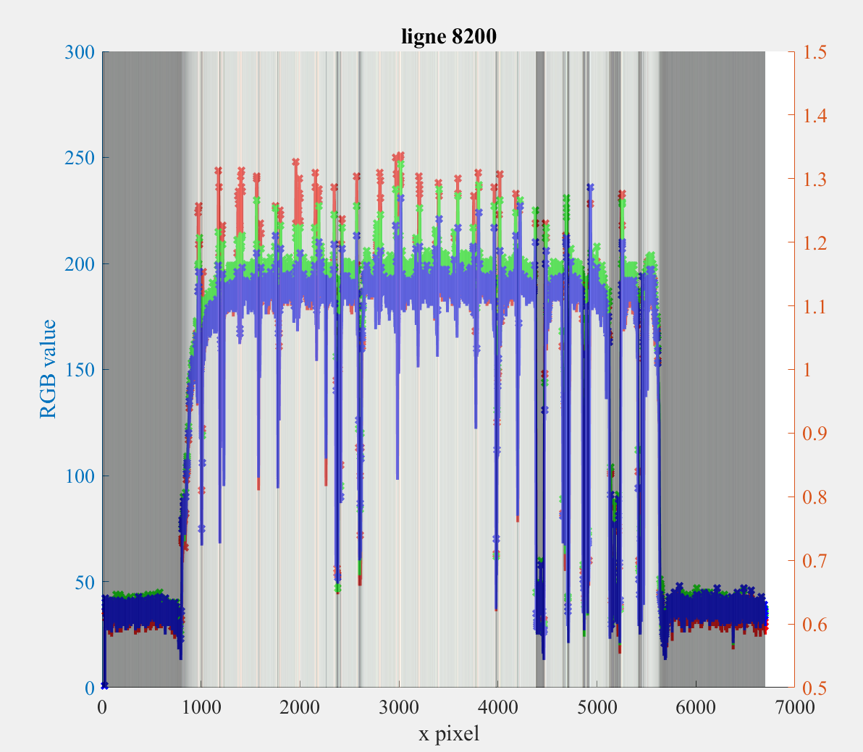
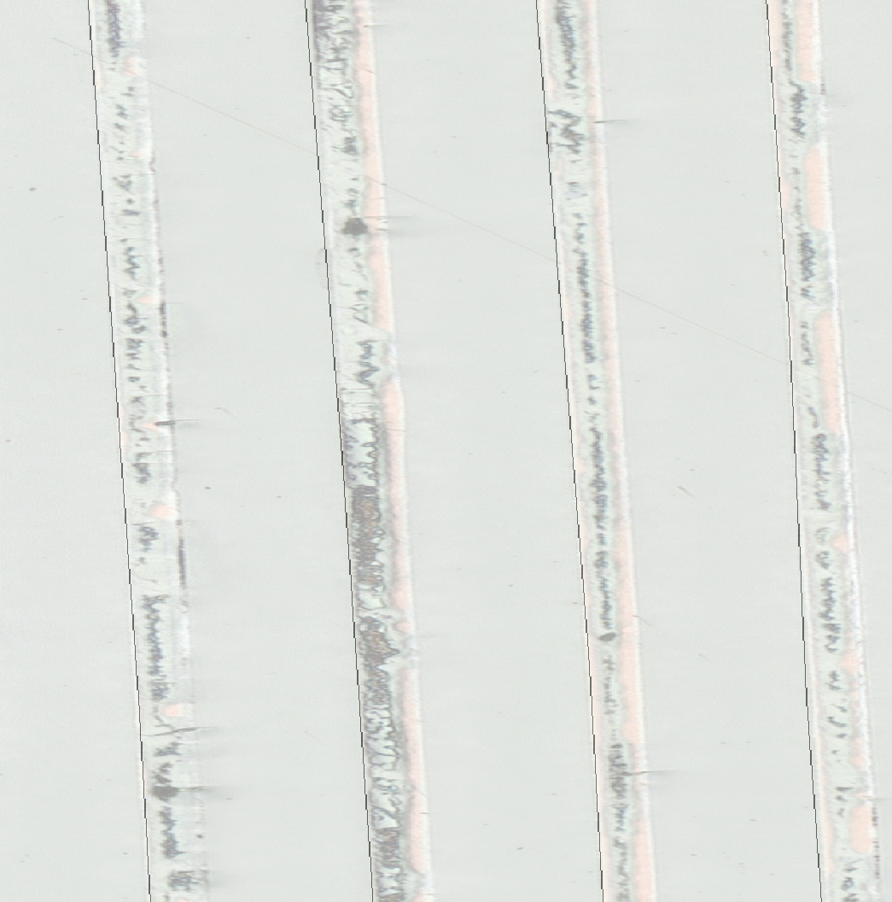
Winding tension effect
Pancake | turns | force kg | Wipe | thightening | Stuck
H04 | 23 | 1,8 | yes | yes | yes
H05 | 25 | 2,8 | no | yes | yes
H06 | 23 | 4,2 | no | no | no
H07 | 10 | 3,5 | yes | no | yes
Does winding tension affect thickness of solder ?
We expect higher tension → higher radial pressure → lower thicnkess
Thickness of solder is not homogeneous
  Radial & transverse
  Is that due to a variation of pressure ?
  Where to measure to assess the value of thickness ?
  → Measure on whole transverse direction
Quality of pancake/image is not good enough (for me. Maybe with higher skill) to do an automatisation of the measurements
  RGB value exploitation has been explored
  Contour detection using contrast
  → Measure linear interpolated points along transverse direction
Solder edges is difficult to determine
    → Measure of equivalent tape thickness from limit Hastelloy/Silver (more accurate) between two turns on the same side
Scanning RGB value for each lign of an image. Local maximums are crossed. Red picks correspond to copper. Most realiable data. Not everywhere.
Black lines represent interpolated lines

Slide 6
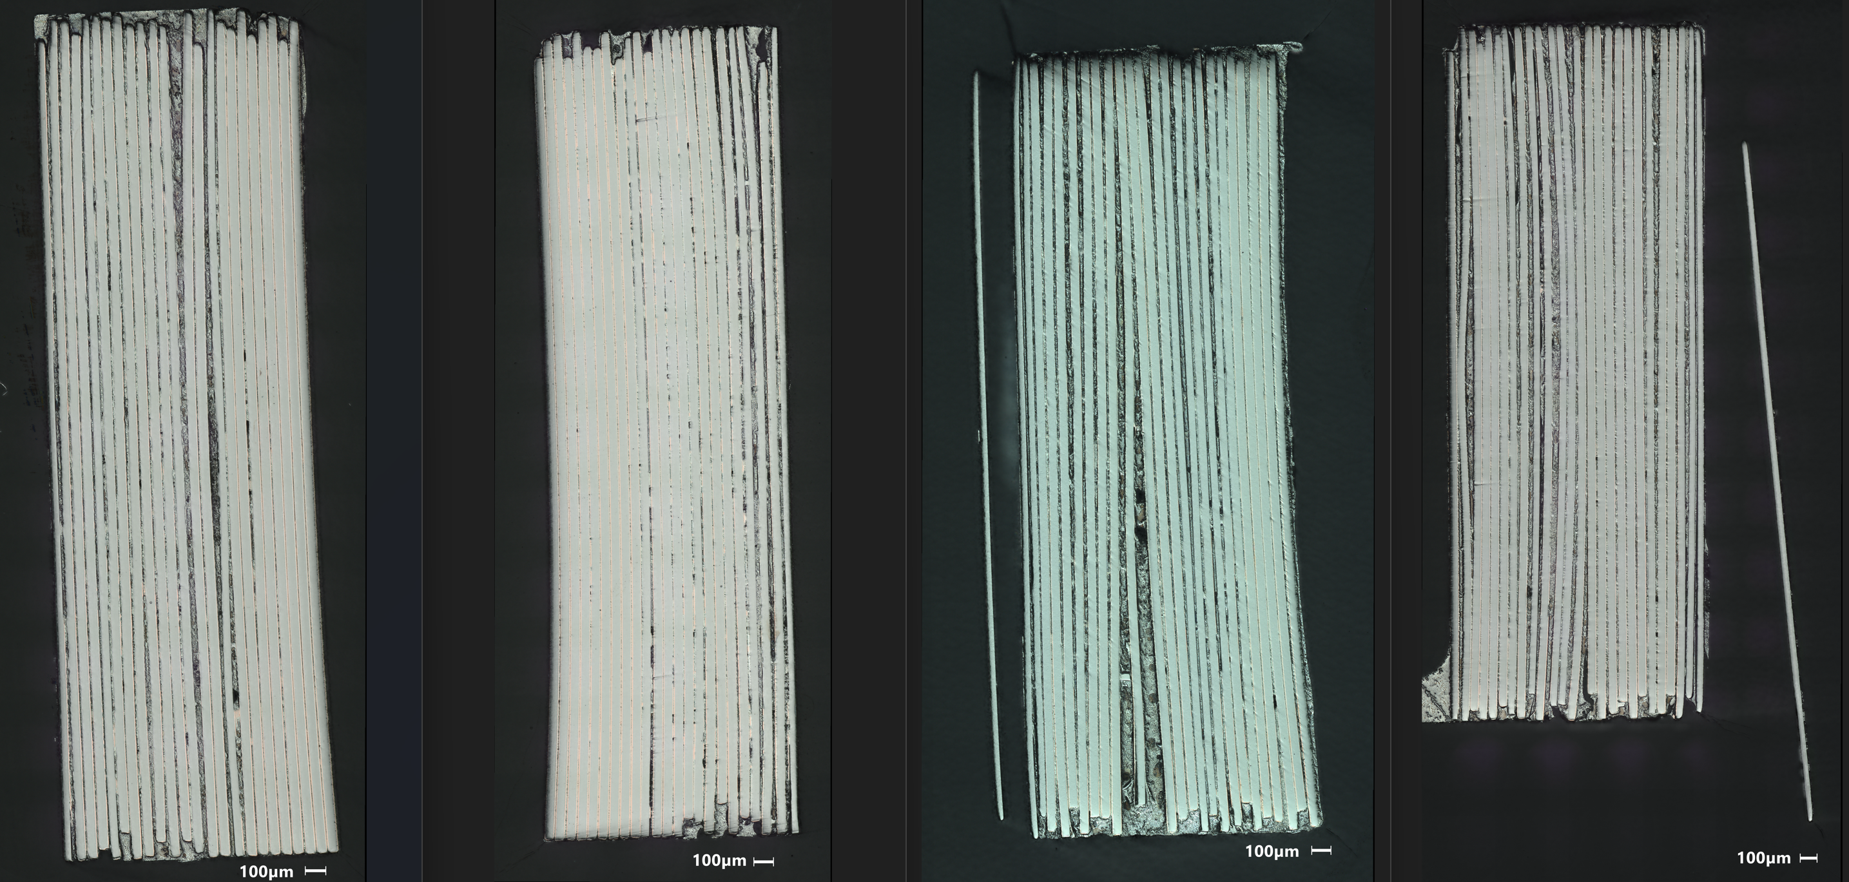
Winding tension effect
Pancake | turns | force kg | Wipe | thightening | Stuck
H04 | 23 | 1,8 | yes | yes | yes
H05 | 25 | 2,8 | no | yes | yes
H06 | 23 | 4,2 | no | no | no
H07 | 10 | 3,5 | yes | no | yes
Problem
Not sure if it is the right direction
Hypothesis
Bended shape tape are inner turns
Note
Median is used to lower high extremum variation
Mean is used for macroscopic value
H04
H05

Slide 7
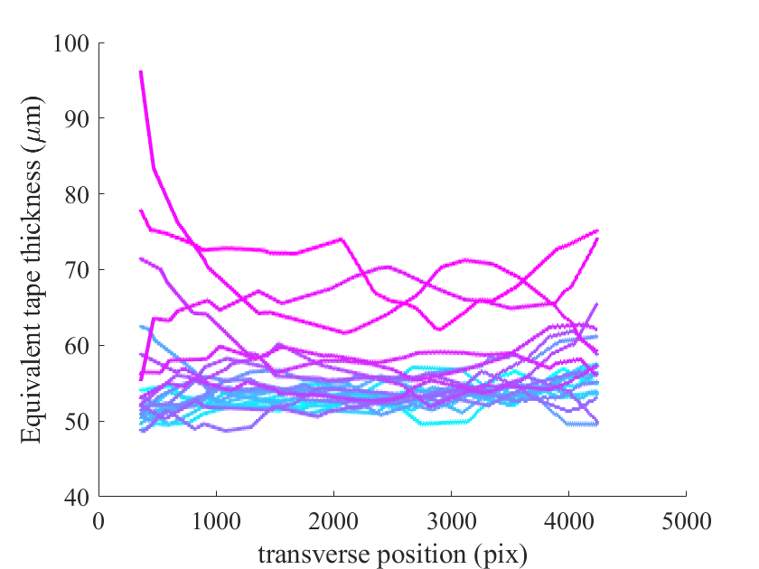
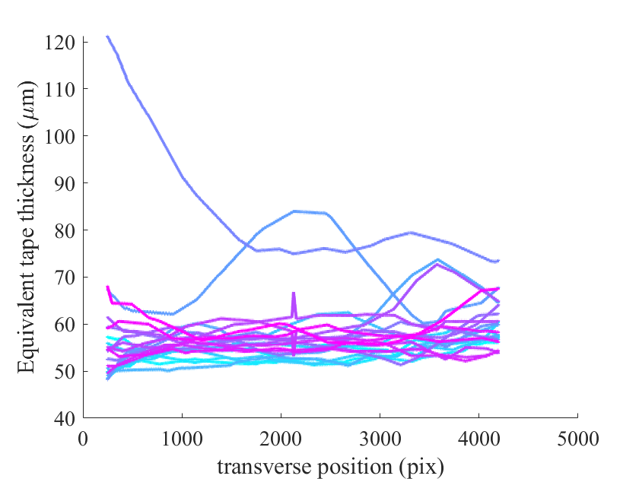
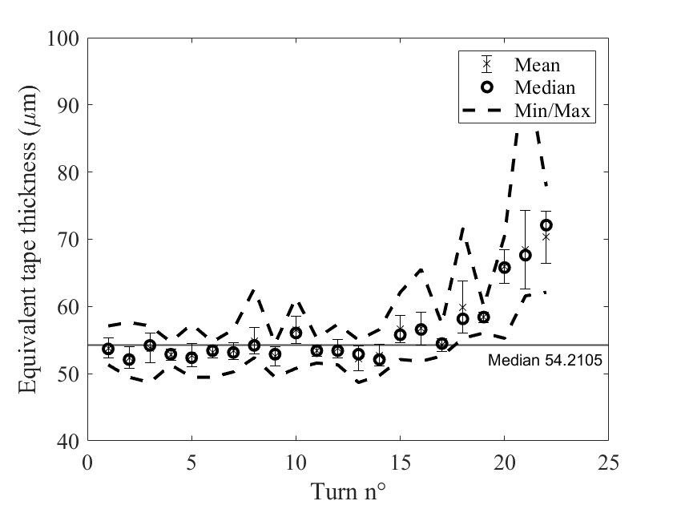
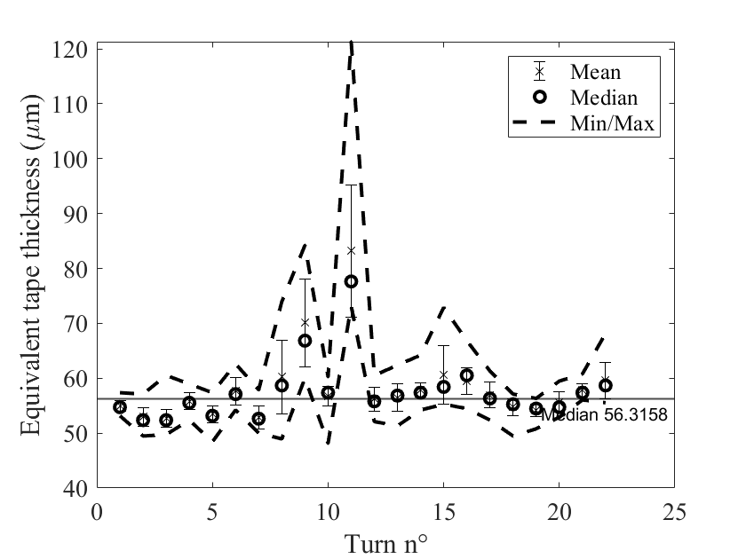
Winding tension effect H04
Pancake | turns | force kg | Wipe | thightening | Stuck
H04 | 23 | 1,8 | yes | yes | yes
H05 | 25 | 2,8 | no | yes | yes
H06 | 23 | 4,2 | no | no | no
H07 | 10 | 3,5 | yes | no | yes
Turn n°
22
1
1
22
Face A
Face B
Face B
Face A

Slide 8
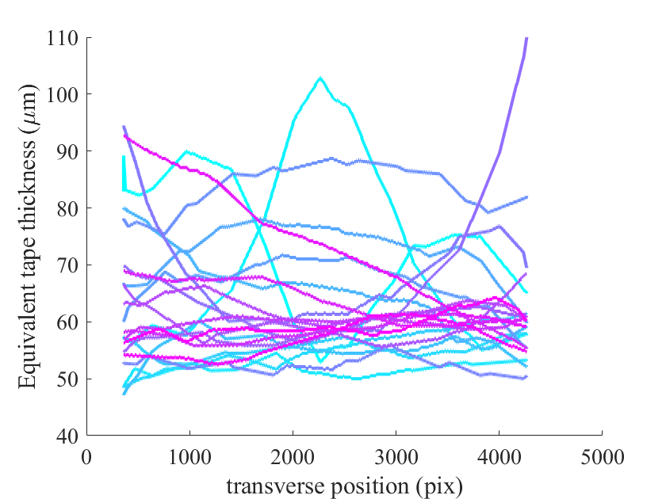
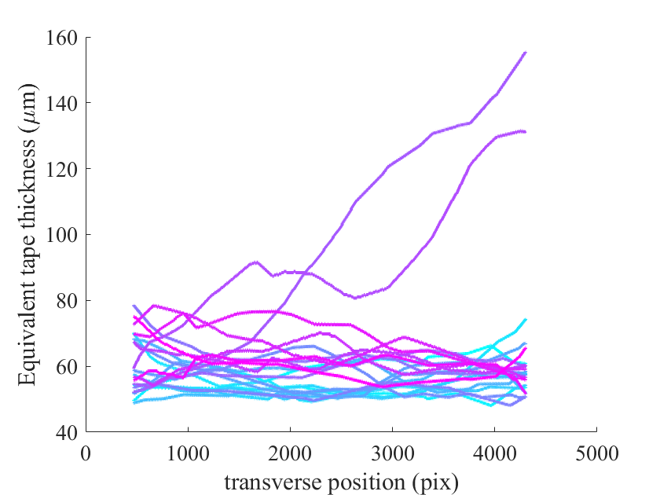
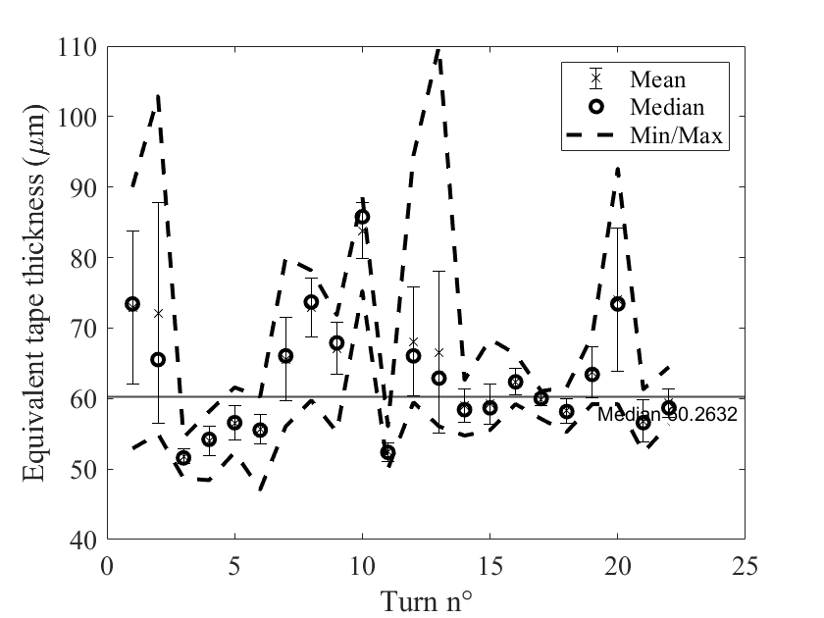
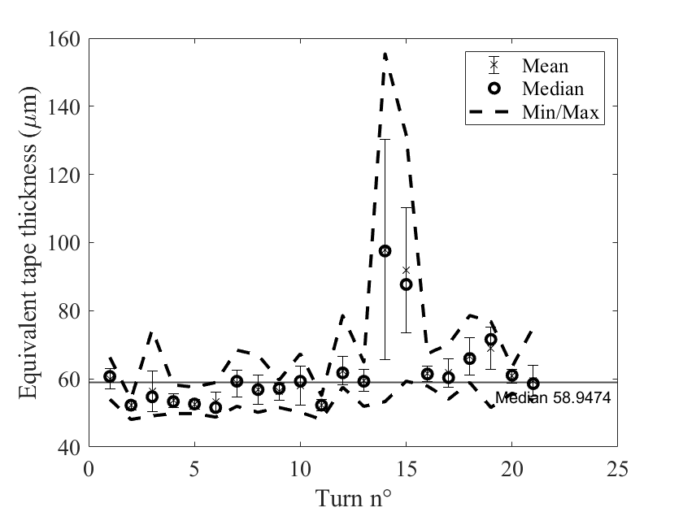
Winding tension effect H05
Pancake | turns | force kg | Wipe | thightening | Stuck
H04 | 23 | 1,8 | yes | yes | yes
H05 | 25 | 2,8 | no | yes | yes
H06 | 23 | 4,2 | no | no | no
H07 | 10 | 3,5 | yes | no | yes
Turn n°
21
1
1
22
Face A
Face B
Face B
Face A

Slide 9
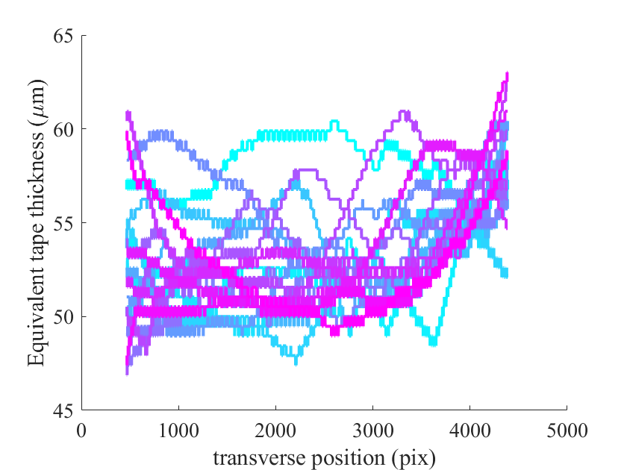
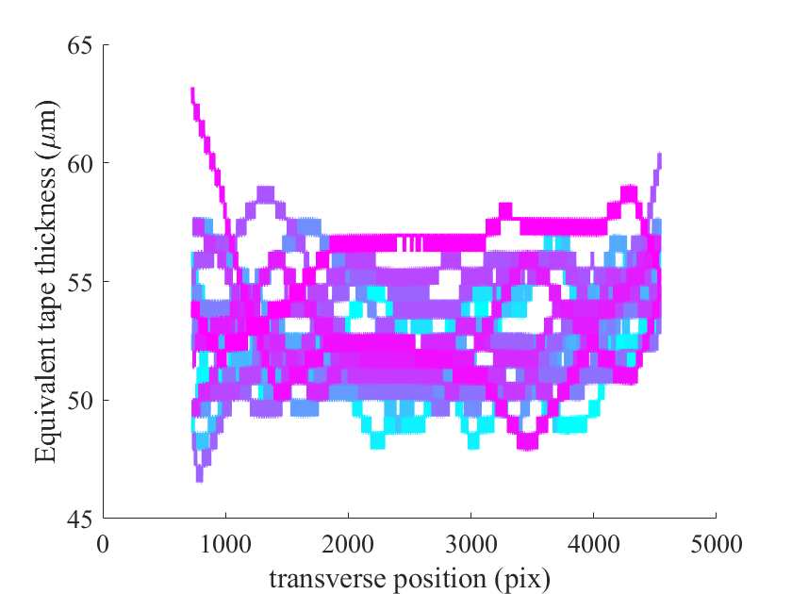
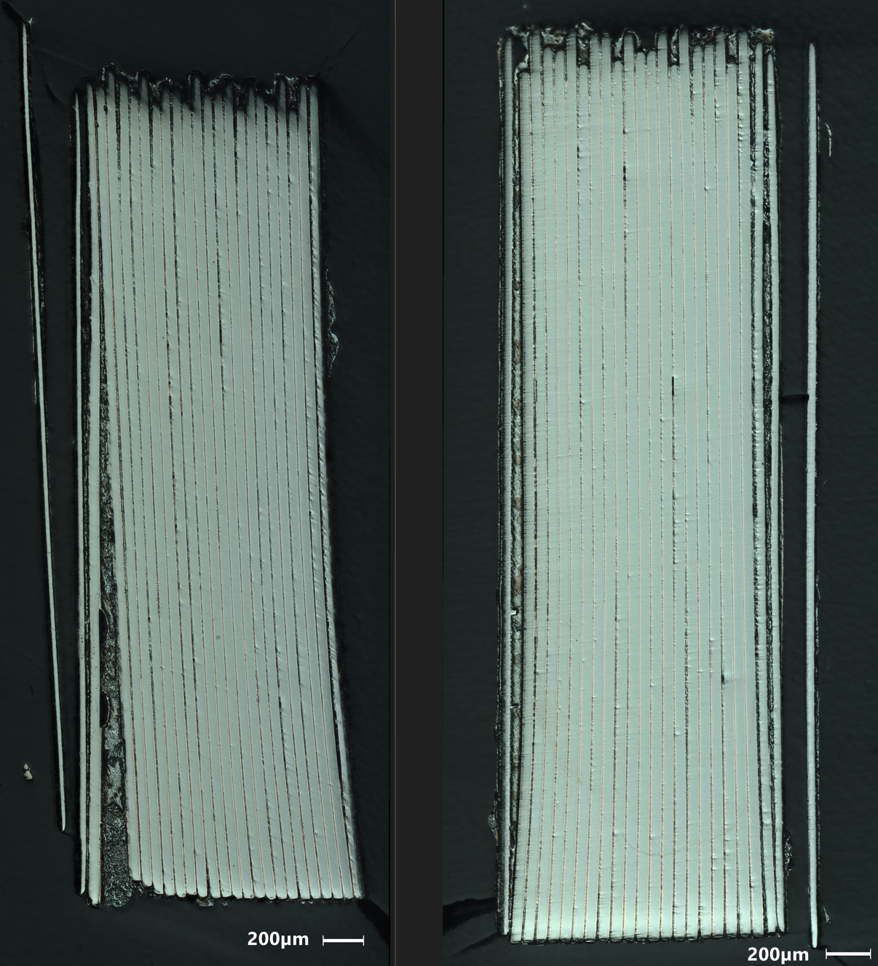
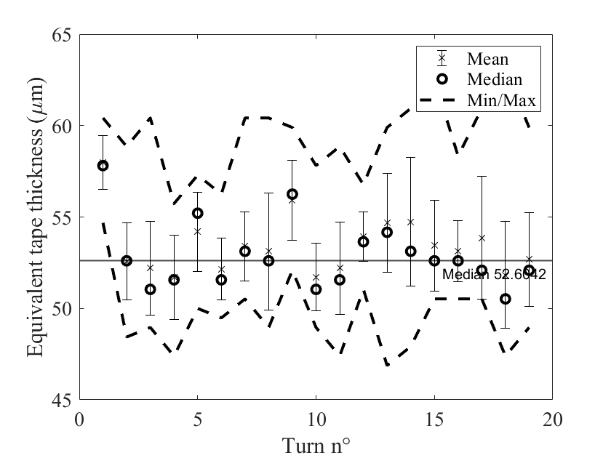
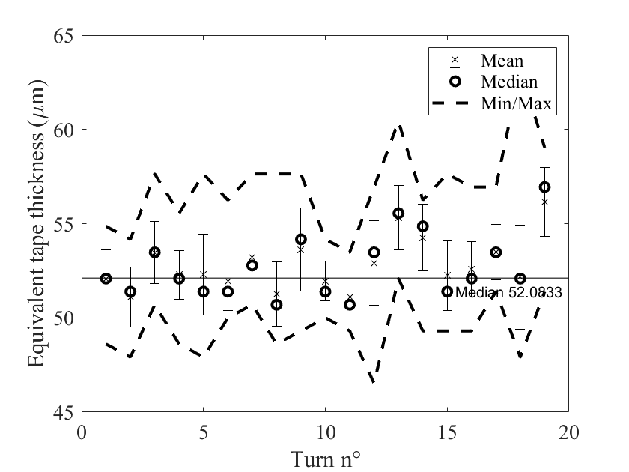
Winding tension effect H06
Pancake | turns | force kg | Wipe | thightening | Stuck
H04 | 23 | 1,8 | yes | yes | yes
H05 | 25 | 2,8 | no | yes | yes
H06 | 23 | 4,2 | no | no | no
H07 | 10 | 3,5 | yes | no | yes
Turn n°
19
1
1
19
Face A
Face B
Face B
Face A

Slide 10
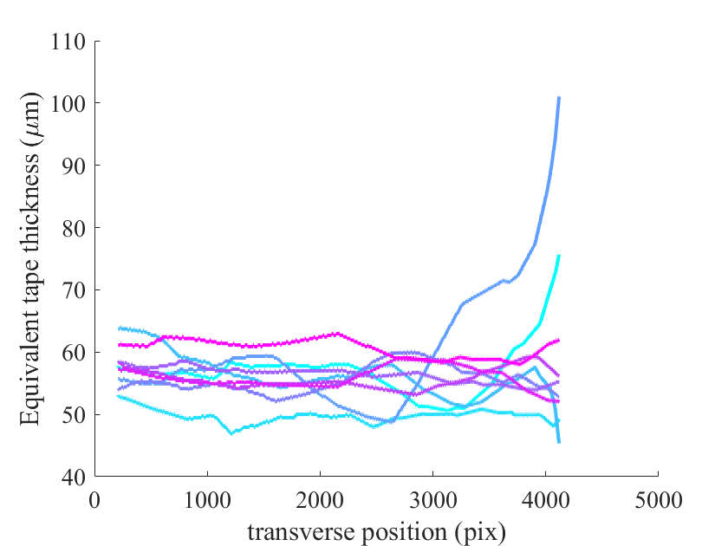
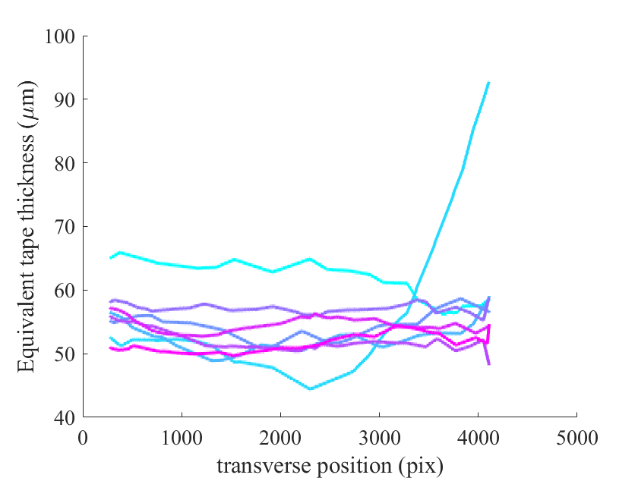
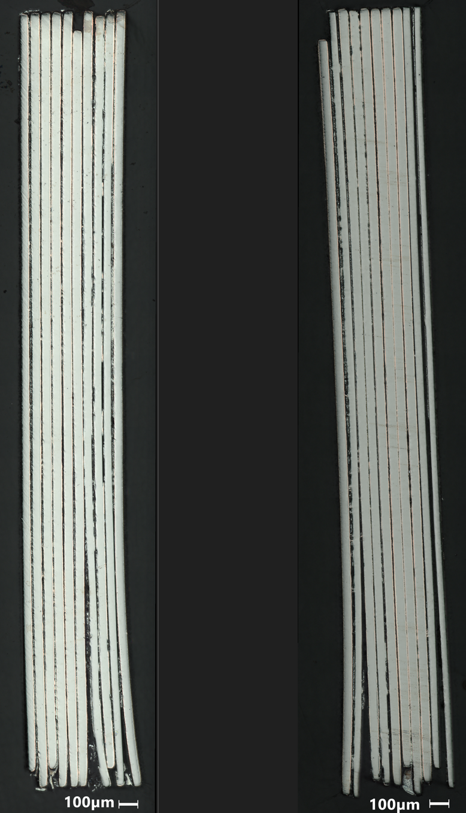
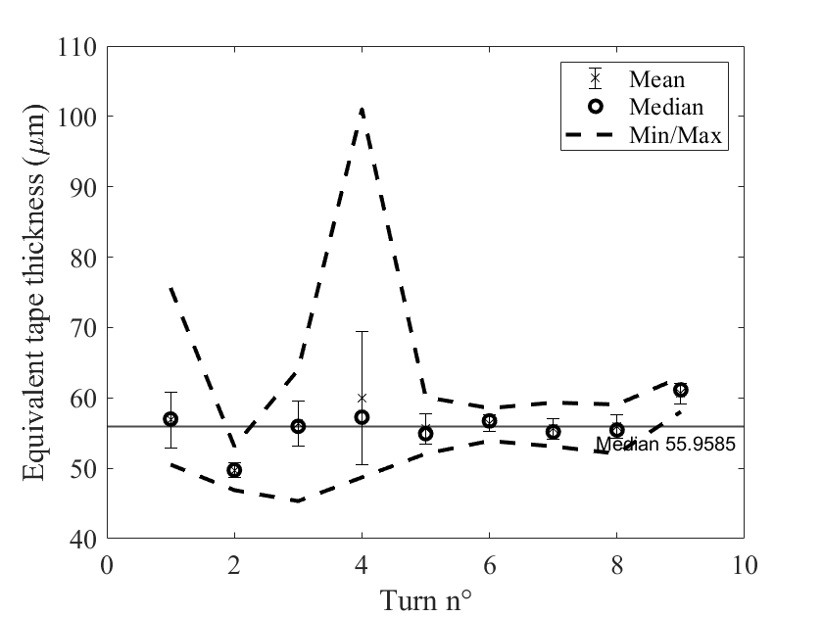
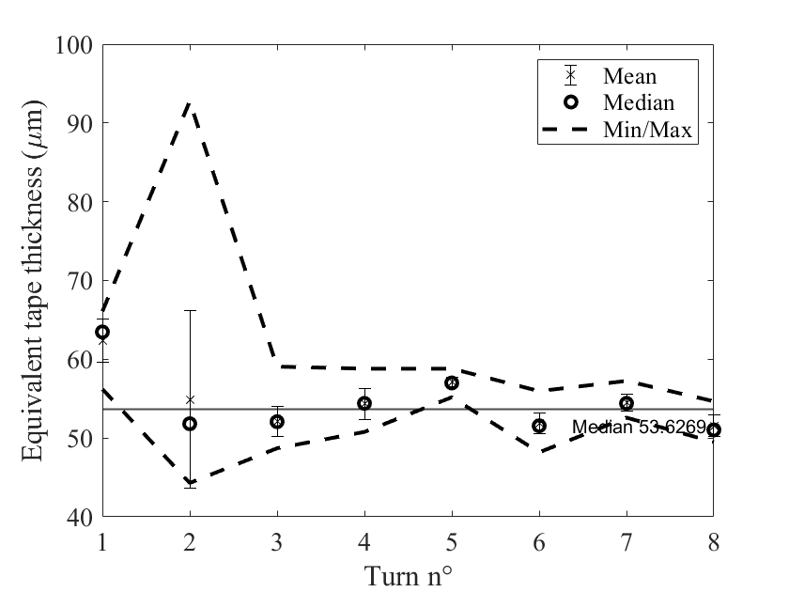
Winding tension effect H07
Pancake | turns | force kg | Wipe | thightening | Stuck
H04 | 23 | 1,8 | yes | yes | yes
H05 | 25 | 2,8 | no | yes | yes
H06 | 23 | 4,2 | no | no | no
H07 | 10 | 3,5 | yes | no | yes
Turn n°
9
1
1
8
Face A
Face B
Face A
Face B

Slide 11
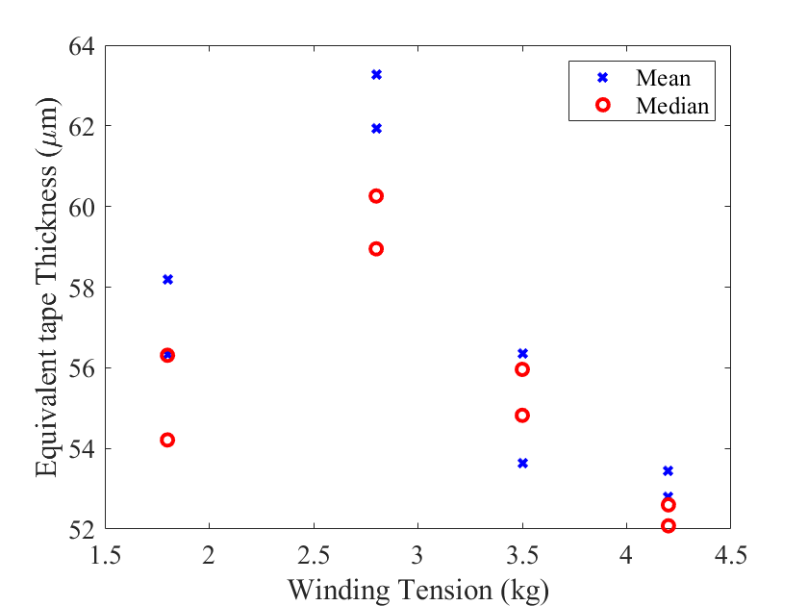
Winding tension effect Macroscopic scale
Pancake | turns | force kg | Wipe | thightening | Stuck
H04 | 23 | 1,8 | yes | yes | yes
H05 | 25 | 2,8 | no | yes | yes
H06 | 23 | 4,2 | no | no | no
H07 | 10 | 3,5 | yes | no | yes
Preliminary conclusion :
Equivalent tape thickness seems to increase with radial position
  Although the quantification is hard as uncertainity is in the same order of magnitude.
  We might distinguish a tendancy (Or am I biased ?)
Winding tension has definitely an effect on equivalent tape thickness
Interpretation
  We made an error with the estimation of H04 – Possible
  Or absence of wipe leads to an excess of melt solder acting as a spring
Can this thickness be link to an equivalent pressure ?
H05
A
B
A
H04
B
B
H07
A
B
A
A
A
B
H06
B
A
B
A
B

Slide 12
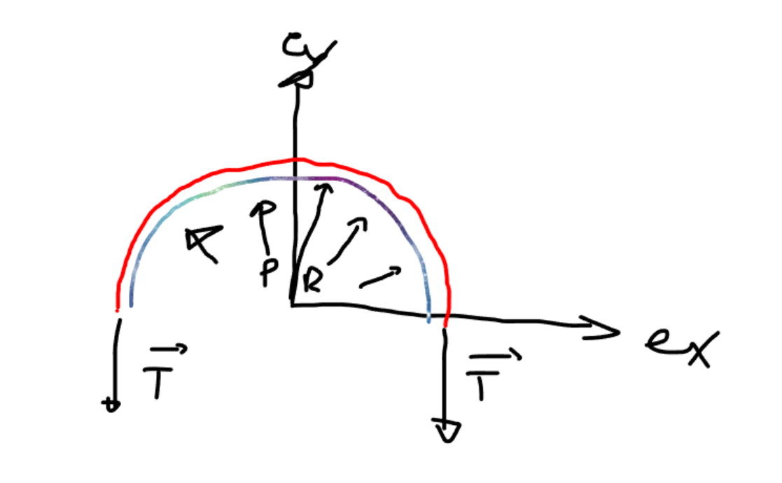
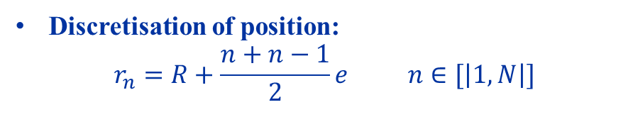
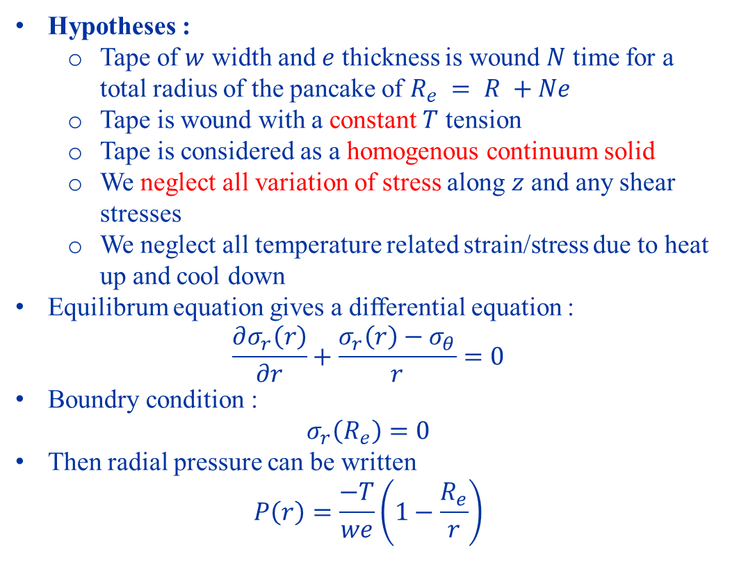
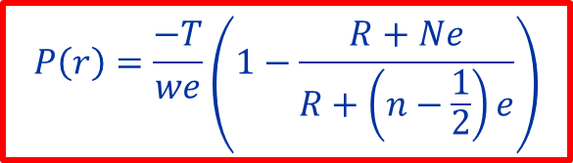
Winding tension effect Radial Pressure estimation
Pancake | turns | force kg | Wipe | thightening | Stuck
H04 | 23 | 1,8 | yes | yes | yes
H05 | 25 | 2,8 | no | yes | yes
H06 | 23 | 4,2 | no | no | no
H07 | 10 | 3,5 | yes | no | yes
Hypotheses :
  Tape of $w$ width and $e$ thickness is wound $N$ time for a total radius of the pancake of $R_{e} = R +Ne$
  Tape is wound with a constant $T$ tension
  Tape is considered as a homogenous continuum solid
  We neglect all variation of stress along $z$ and any shear stresses
  We neglect all temperature related strain/stress due to heat up and cool down
Equilibrum equation gives a differential equation :
$$\frac{∂σ_{r}\left(r\right)}{∂r}+\frac{σ_{r}\left(r\right)−σ_{θ}}{r}=0$$
Boundry condition :
$$σ_{r}\left(R_{e}\right)=0$$
Then radial pressure can be written
$$P\left(r\right)=\frac{−T}{we}\left(1−\frac{R_{e}}{r}\right)$$
Discretisation of position:
$$r_{n}=R+\frac{n+n−1}{2}e n∈[\left|1,N\right|]$$
$$P\left(r\right)=\frac{−T}{we}\left(1−\frac{R+Ne}{R+\left(n−\frac{1}{2}\right)e}\right)$$

Slide 13
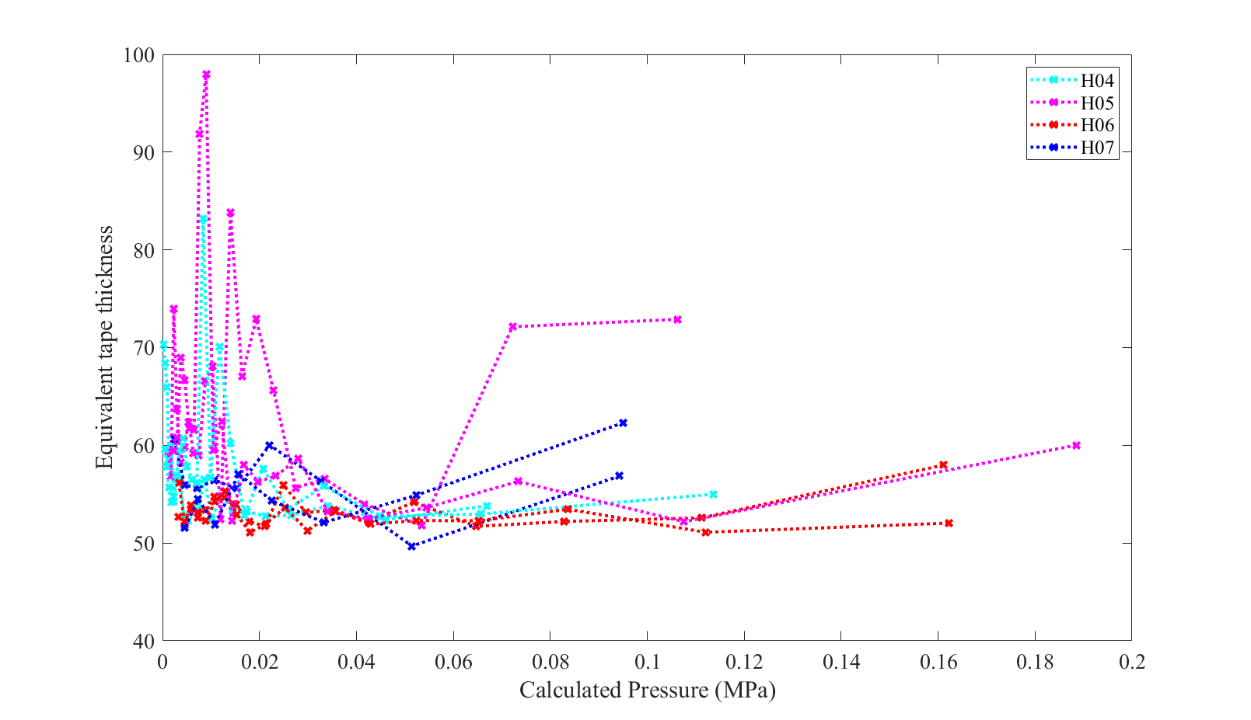
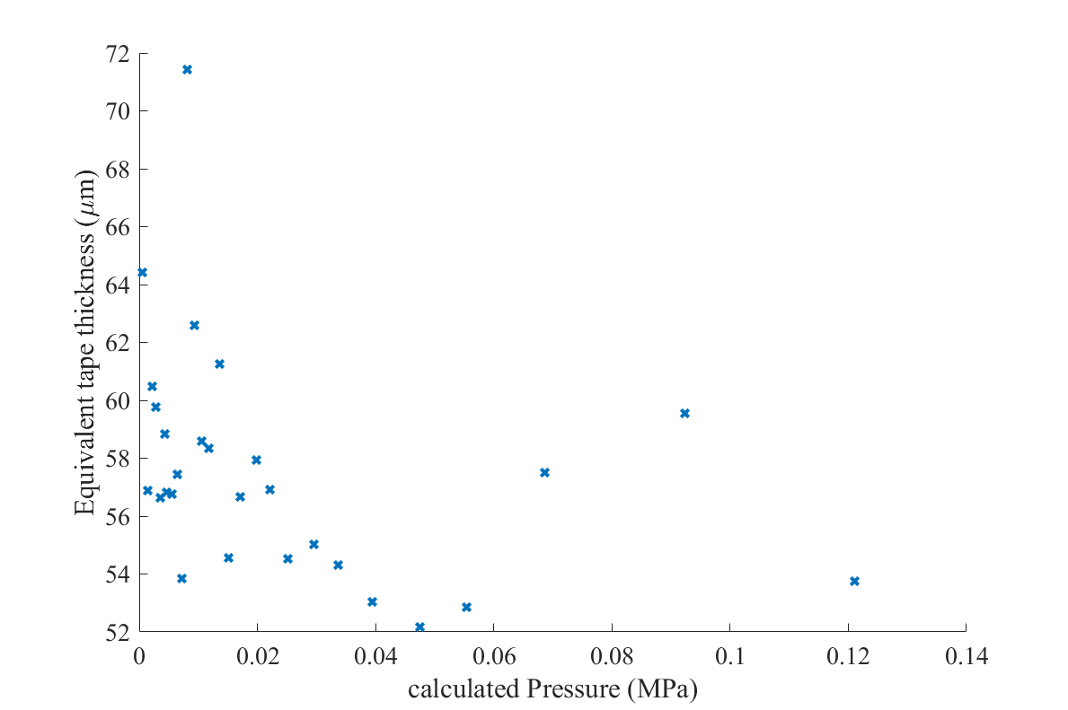
Winding tension effect Radial Pressure estimation
Pancake | turns | force kg | Wipe | thightening | Stuck
H04 | 23 | 1,8 | yes | yes | yes
H05 | 25 | 2,8 | no | yes | yes
H06 | 23 | 4,2 | no | no | no
H07 | 10 | 3,5 | yes | no | yes
Smoothed 5 by 5 points (mean value are taken)
No conclusive interpretation

Slide 14
Wipe effect
Pancake | turns | force kg | Wipe | thightening | Stuck
H04 | 23 | 1,8 | yes | yes | yes
H05 | 25 | 2,8 | no | yes | yes
H06 | 23 | 4,2 | no | no | no
H07 | 10 | 3,5 | yes | no | yes
Block of solder seems to be with less voids
! Probably biased !
I cannot see any other qualitative difference in theese images
H04
H05

Slide 15
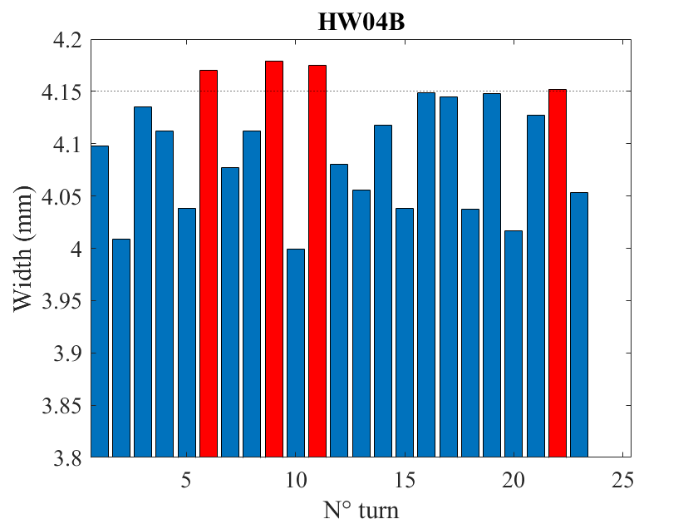
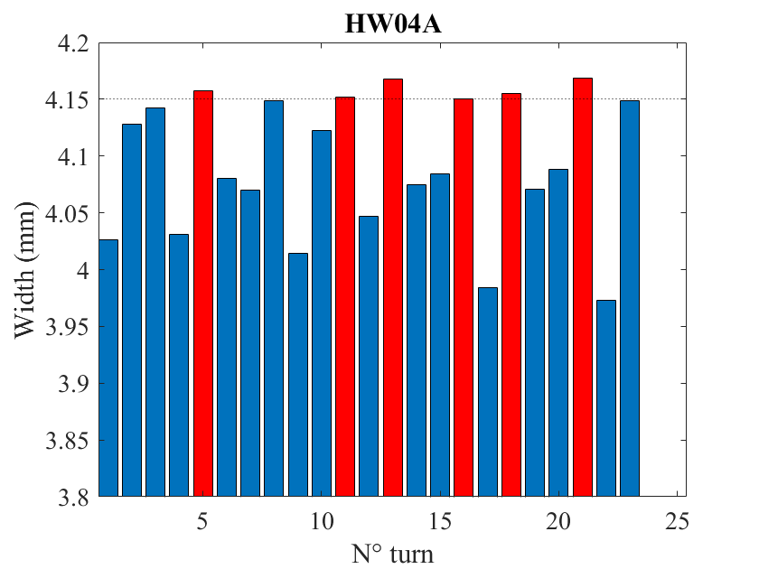
Tape width
Pancake | turns | force kg | Wipe | thightening | Stuck
H04 | 23 | 1,8 | yes | yes | yes
H05 | 25 | 2,8 | no | yes | yes
H06 | 23 | 4,2 | no | no | no
H07 | 10 | 3,5 | yes | no | yes
Face B
Face A

Slide 16
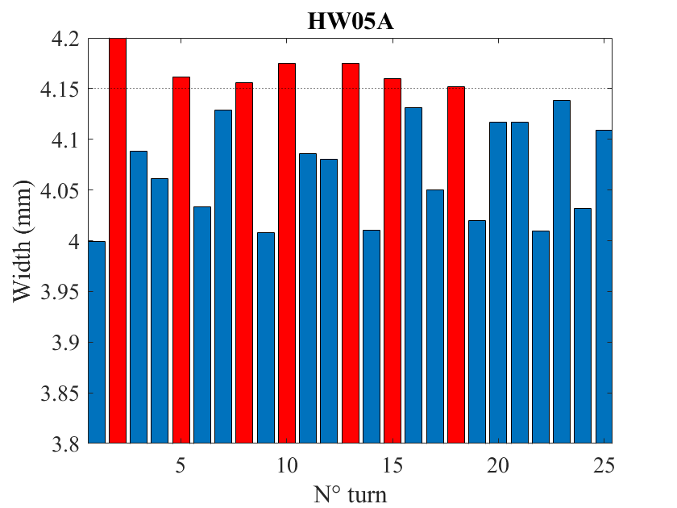
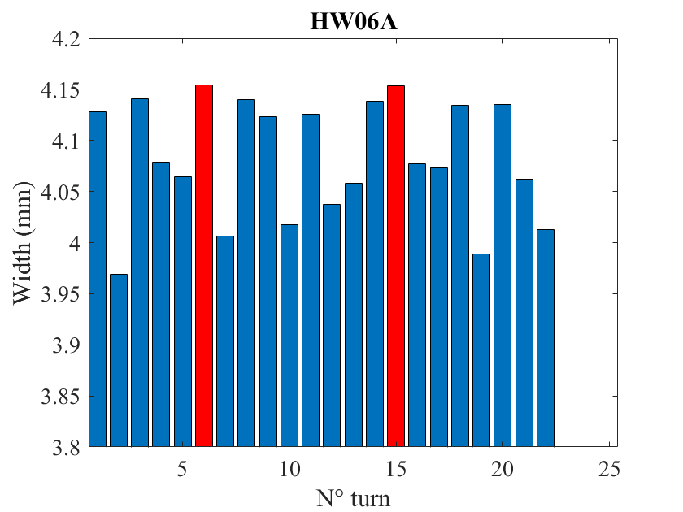
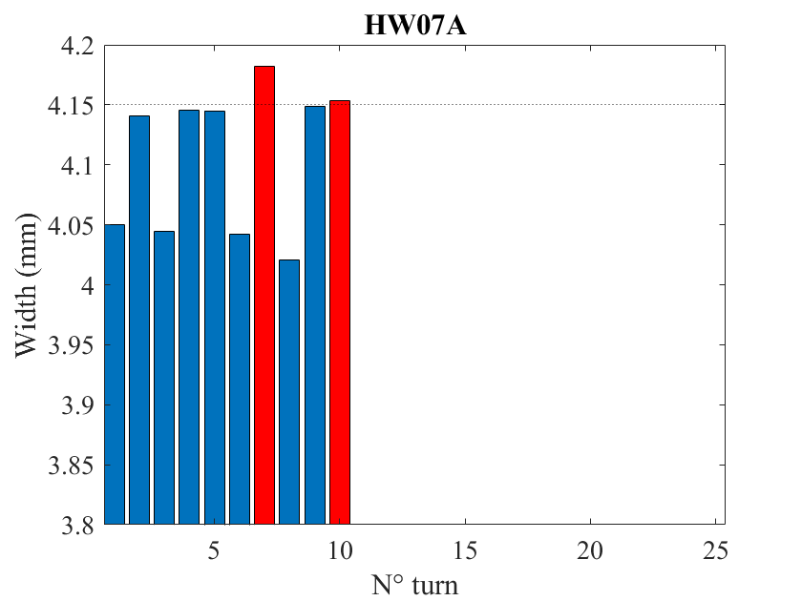
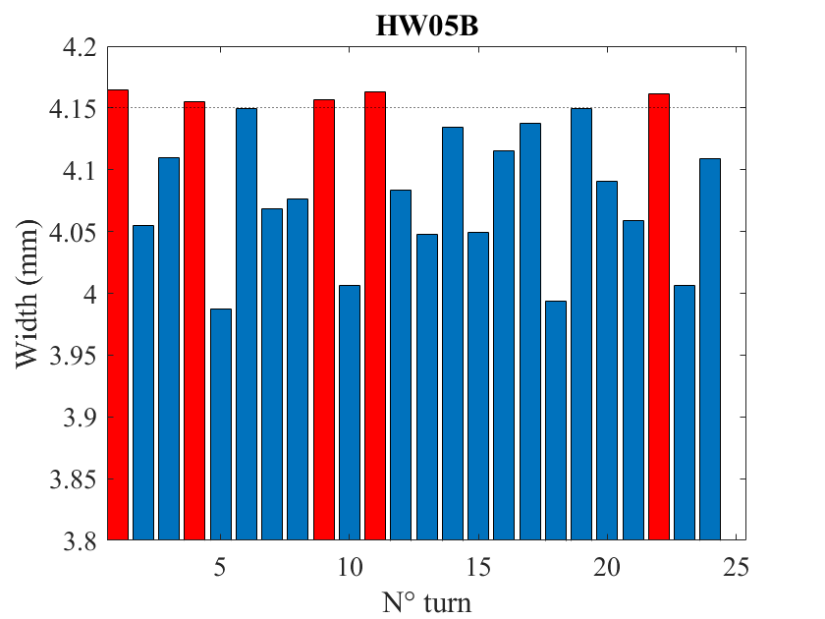
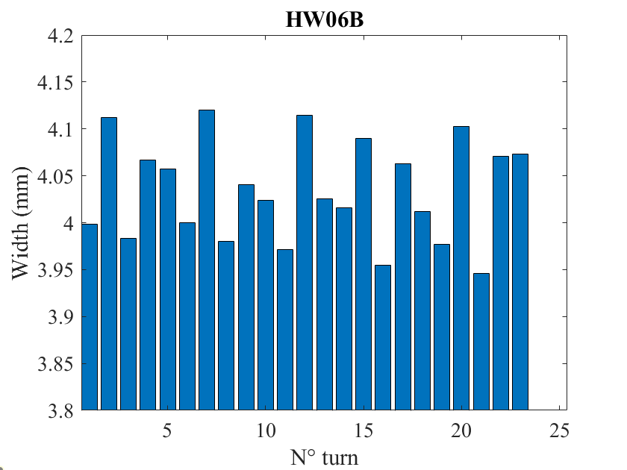
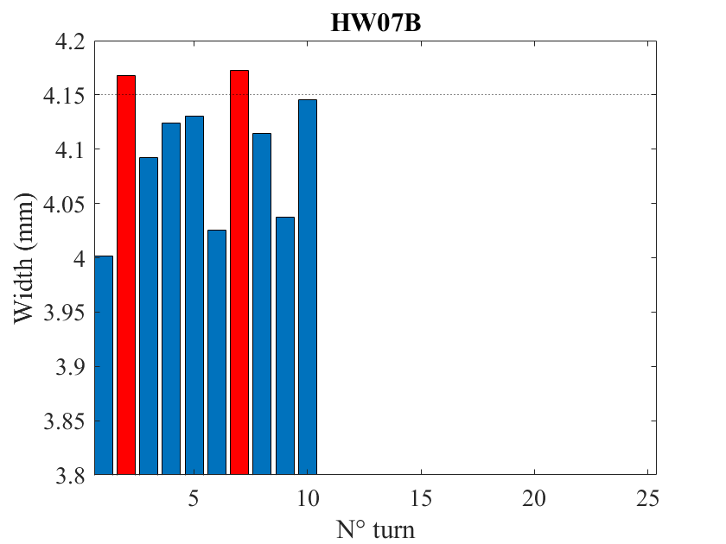
Tape width

