Slide 1




HTS current terminals design proposal
Giuseppe Scarantino,
Mahmoud Abdel Hafiz

Slide 2
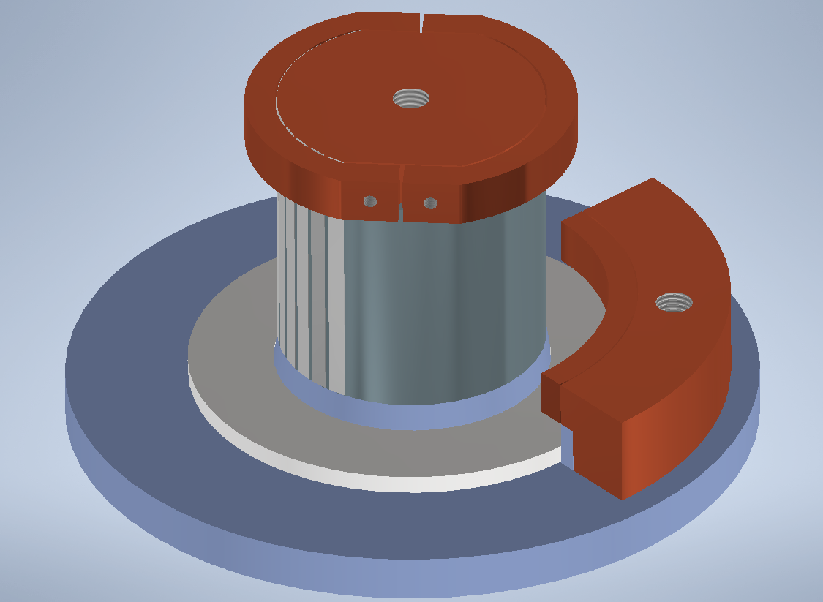
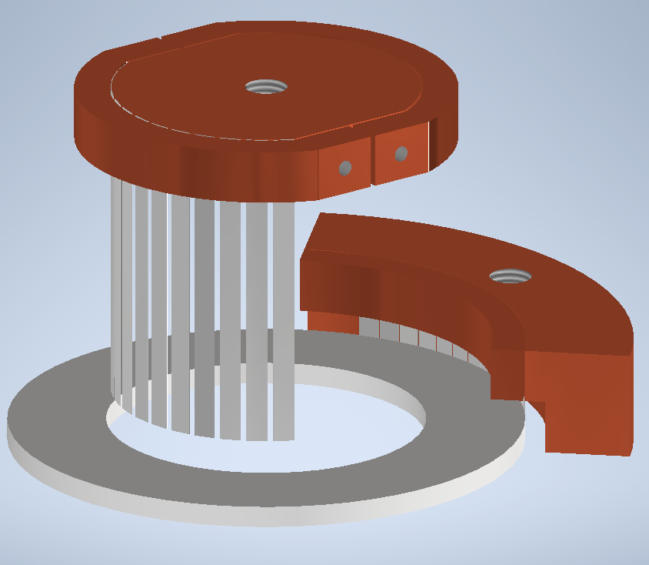
HTS current leads design
IN Cu disk
Cu clamps
G10 support cylinder
13x pre-coated HTS tapes IN
13x pre-coated HTS tapes OUT
OUT Cu block
Coil support plate
Cu clamp
Electrical contacts → low temperature solder (InSn). External tightening on the tape/Cu joints with bolted clamps.

Slide 3
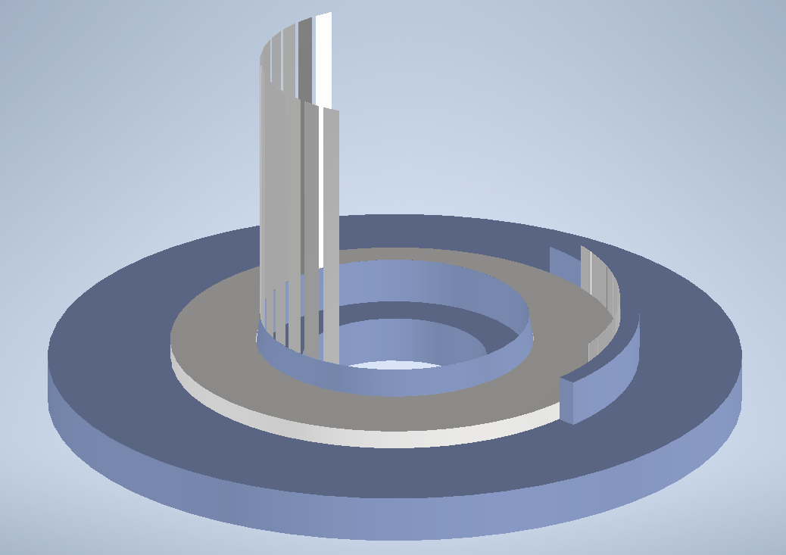
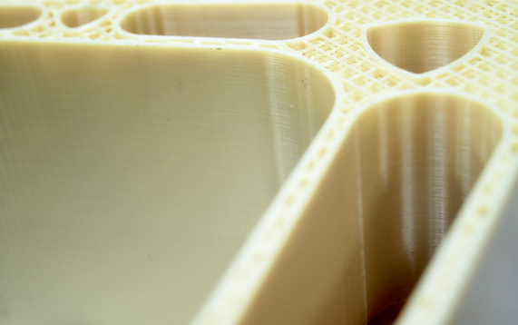
Coil support plate
Wedge-shaped element to place the HTS tapes in contact with the pancake.
0.2 mm gap to be filled with InSn solder.
CERN Polymer Lab recommended printing it in PEI ULTEM:
Melting temperature: 215 deg C.
Suitable for cryogenic applications.
External support.
0.2 mm gap to be filled with InSn solder.

Slide 4
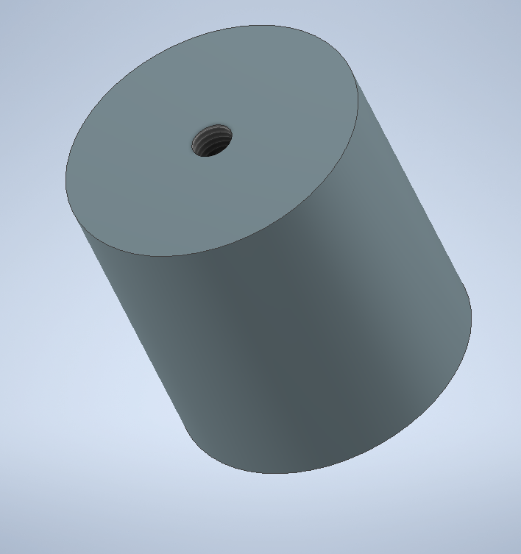
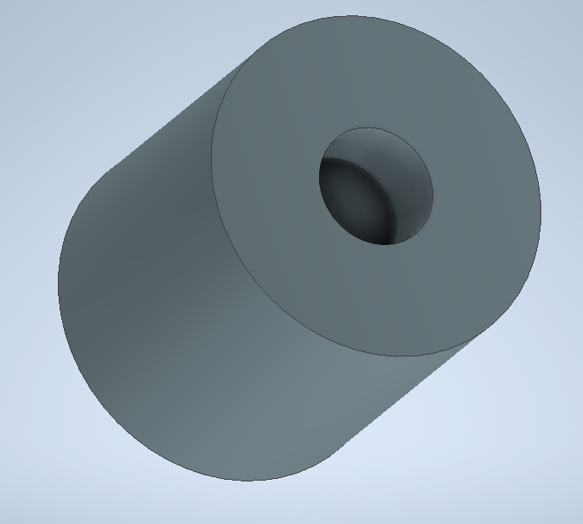
HTS leads inner support
20 mm hole, 15 mm deep to access the coil center for instrumentation.
Support element for Hall probe installation will be placed in this gap.
Hole to connect with the top Cu disk
TOP
BOTTOM
The HTS current leads will be placed along the cylinder. We want to avoid tape movements by mishandling the pancake and by screening currents induced stresses. On the other hand, we want to reduce thermal stresses during cooldown phase.
Possible solutions could be: - Kapton tape to place the leads around the cylinders; - add grooves on the cylinder to fit the tapes and use epoxy to impregnate them; - consider using a brass cylinder and solder the tapes there (?)

Slide 5
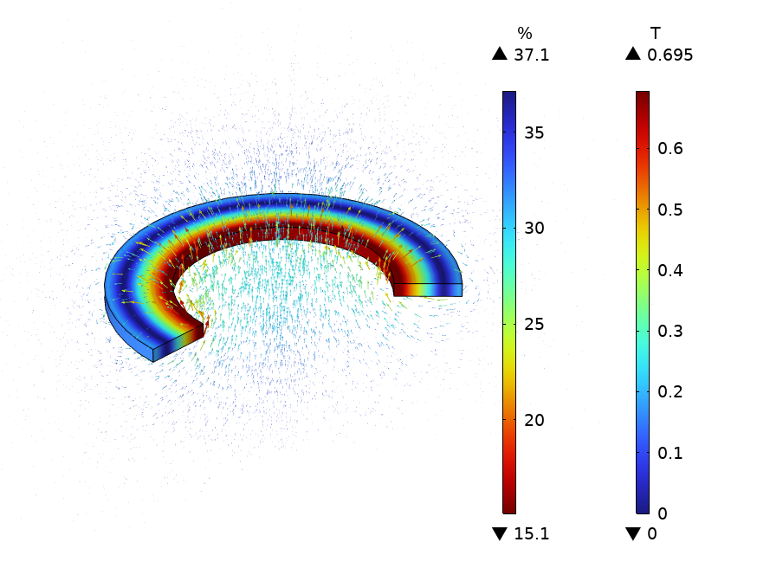
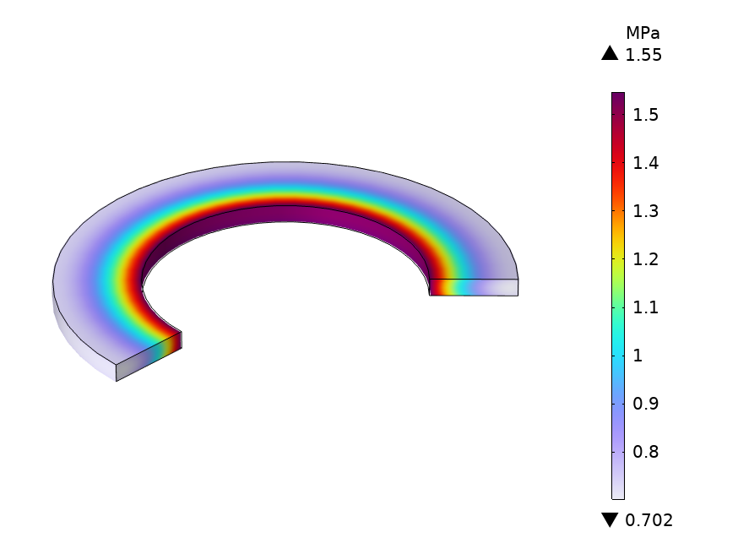
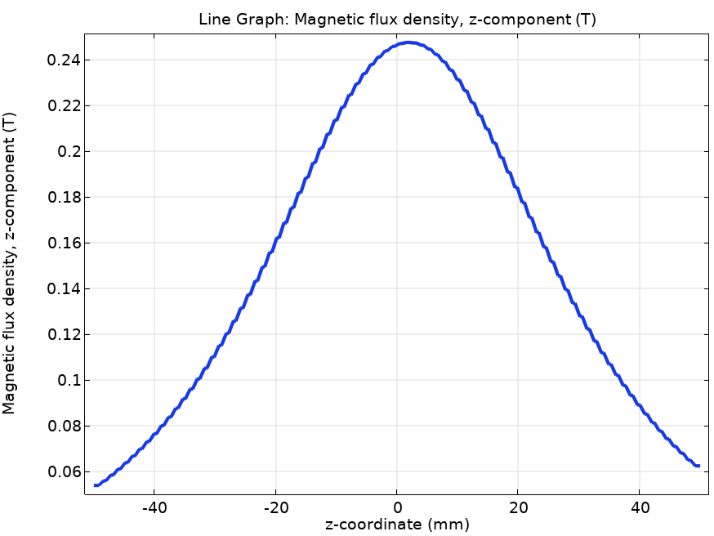
Coil + Terminals Modelling (I)
Jc scaling tape from [1]: “Shanghai Superconductor Low Field High Temperature 2G HTS”.
NOTE: in self-field at 77 K → min. Ic = 219 A. From SST tape datasheet → 260 A.
Assuming this tape performance → operational current (I_op): 55 A → 15% minimum Ic margin.
Surface: Current Margin (I_op = 55 A)
Arrow Volume: Magnetic Flux Density
Coil hoop stress
(energization)
0.25 T center field
[1] University of Victoria Wellington, Robinson HTS critical current database, Shanghai Superconductor Low Field High Temperature 2G HTS data, 2021. [Online]. Available: https://htsdb.wimbush.eu

Slide 6
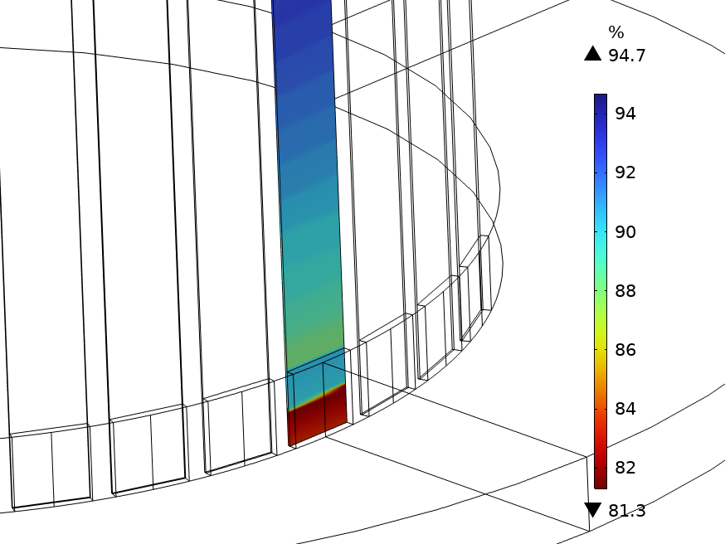
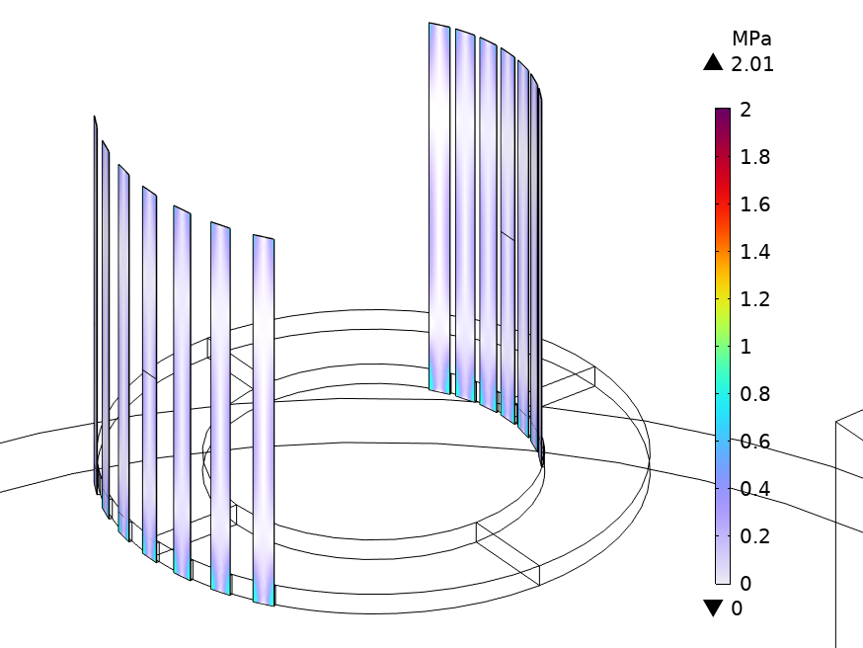
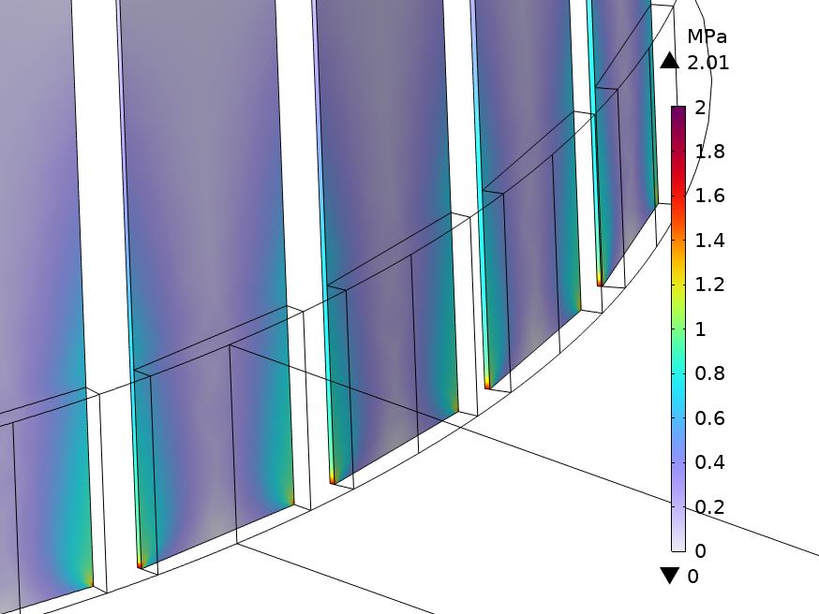
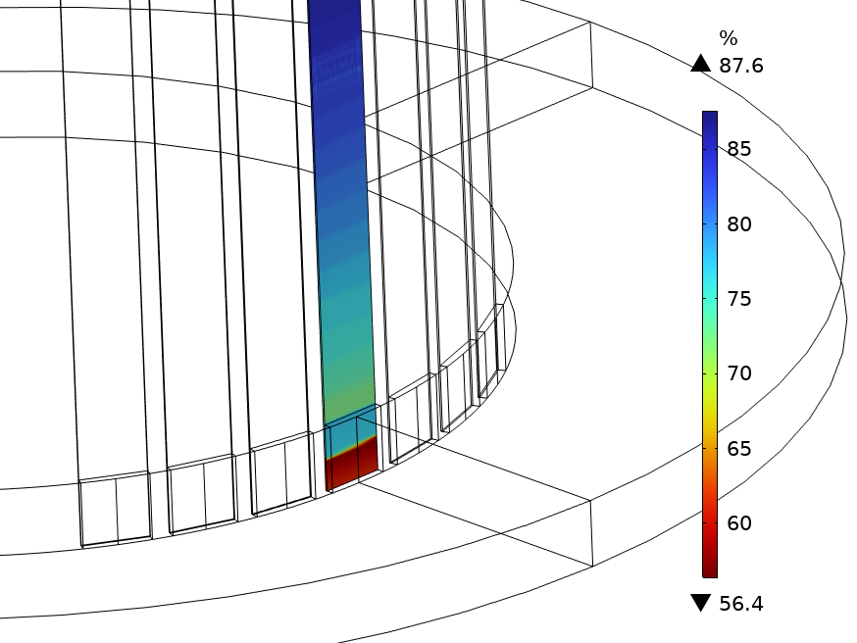
Coil + Terminals Modelling (II)
To avoid quenches in the HTS terminals → number of terminals > 4.
Test with 7 HTS terminals in the IN/OUT part, respectively.
Assuming this tape performance → operational current (I_op): 55 A → 15% minimum Ic margin.
Surface: Current Margin (I_op = 55 A)
Arrow Volume: Magnetic Flux Density
I_terminal = I_op/N_terminal
Stress concentration assuming fixed BCs
I_terminal = I_op/N_terminal*
→ Assuming that 4 out of 7 terminals are not carrying any current.
[1] University of Victoria Wellington, Robinson HTS critical current database, Shanghai Superconductor Low Field High Temperature 2G HTS data, 2021. [Online]. Available: https://htsdb.wimbush.eu

Slide 7
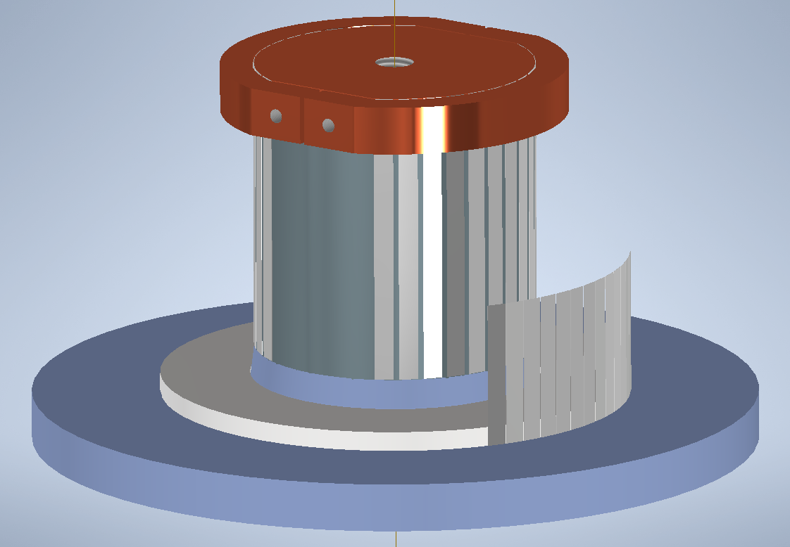
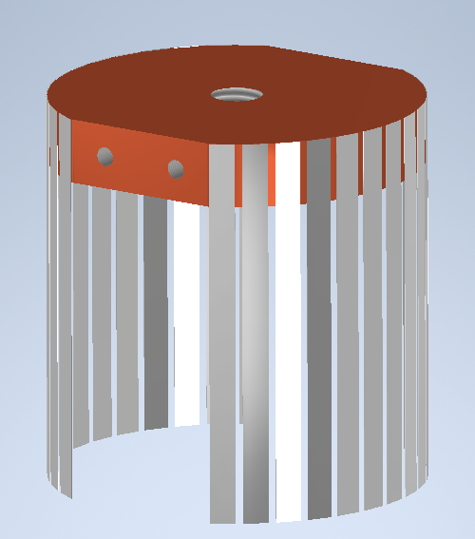
Equally spaced input current feeding
Are there any advantages?

