Slide 1




HTS current terminals design proposal
Giuseppe Scarantino,
Mahmoud Abdel Hafiz

Slide 2
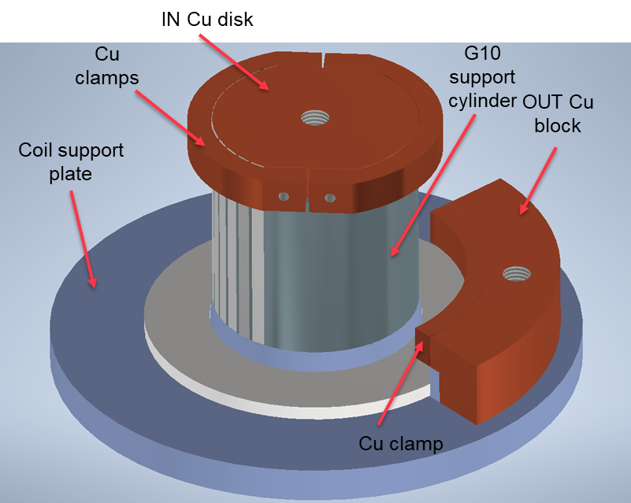
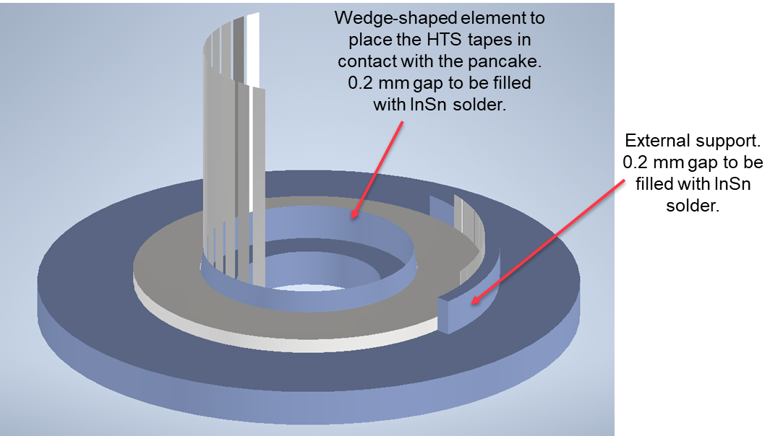
HTS current leads design (old)
Previous design based on ULTEM former with wedge-shaped ring for sliding the tapes in contact with the coil.
→ complex solution, uncertainty on the quality of the soldering…

Slide 3
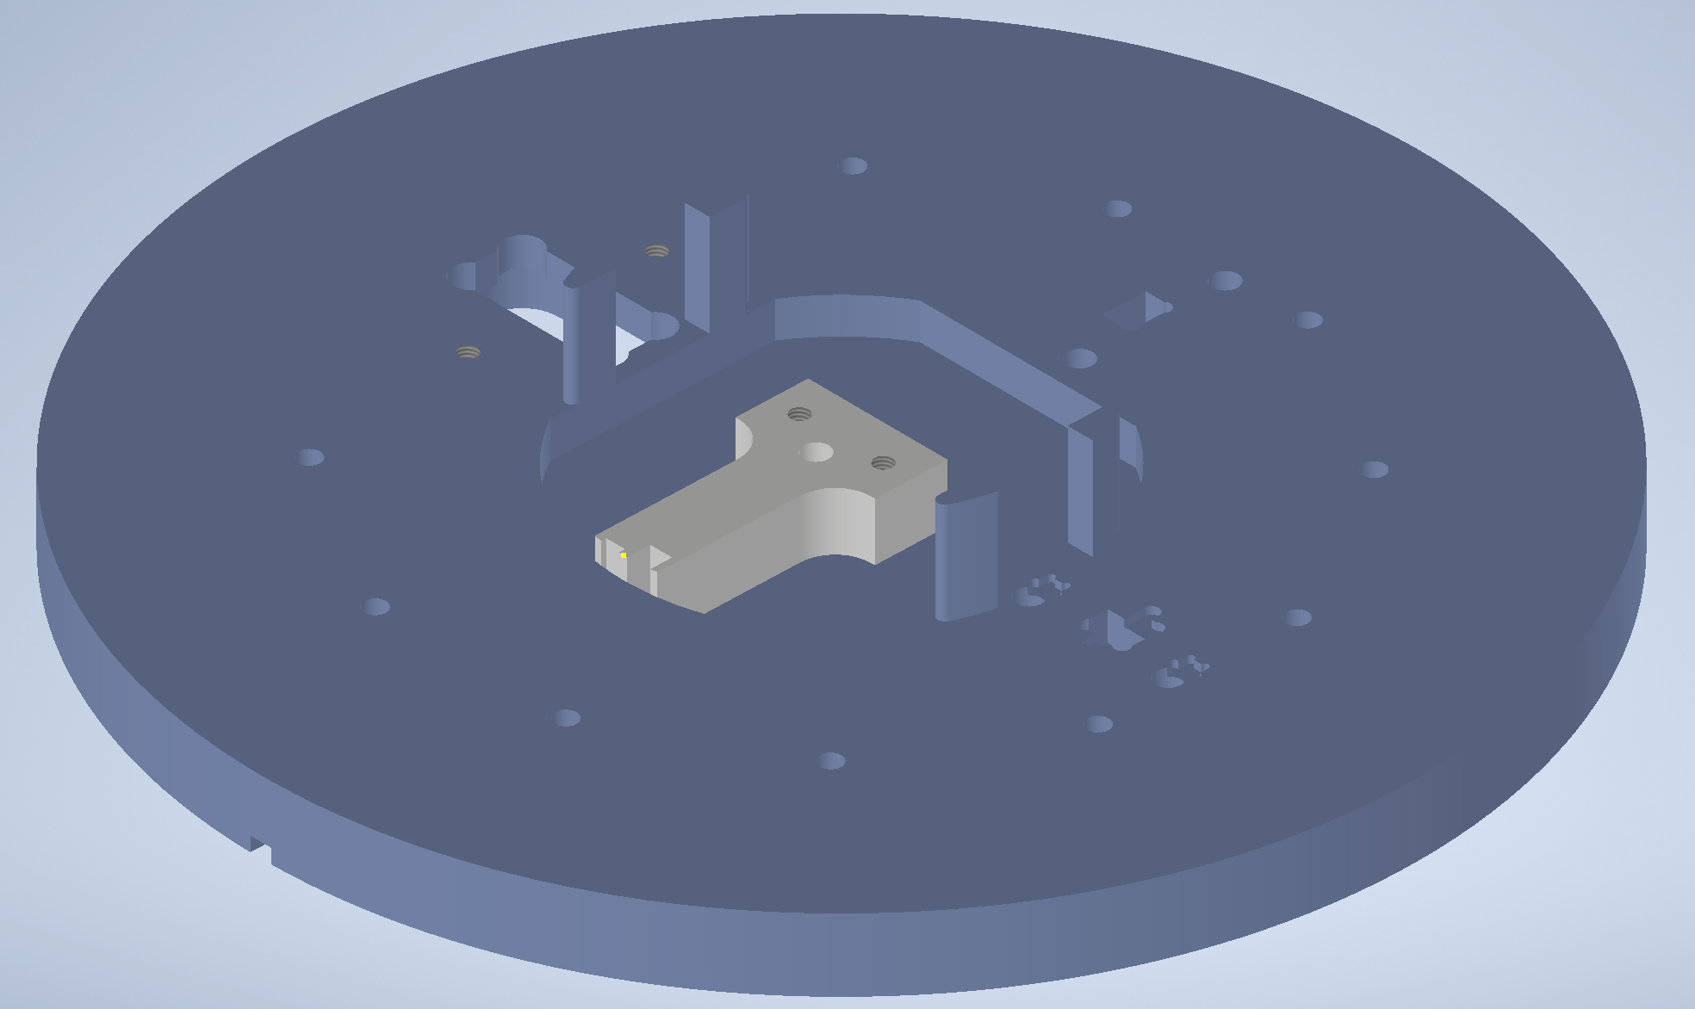
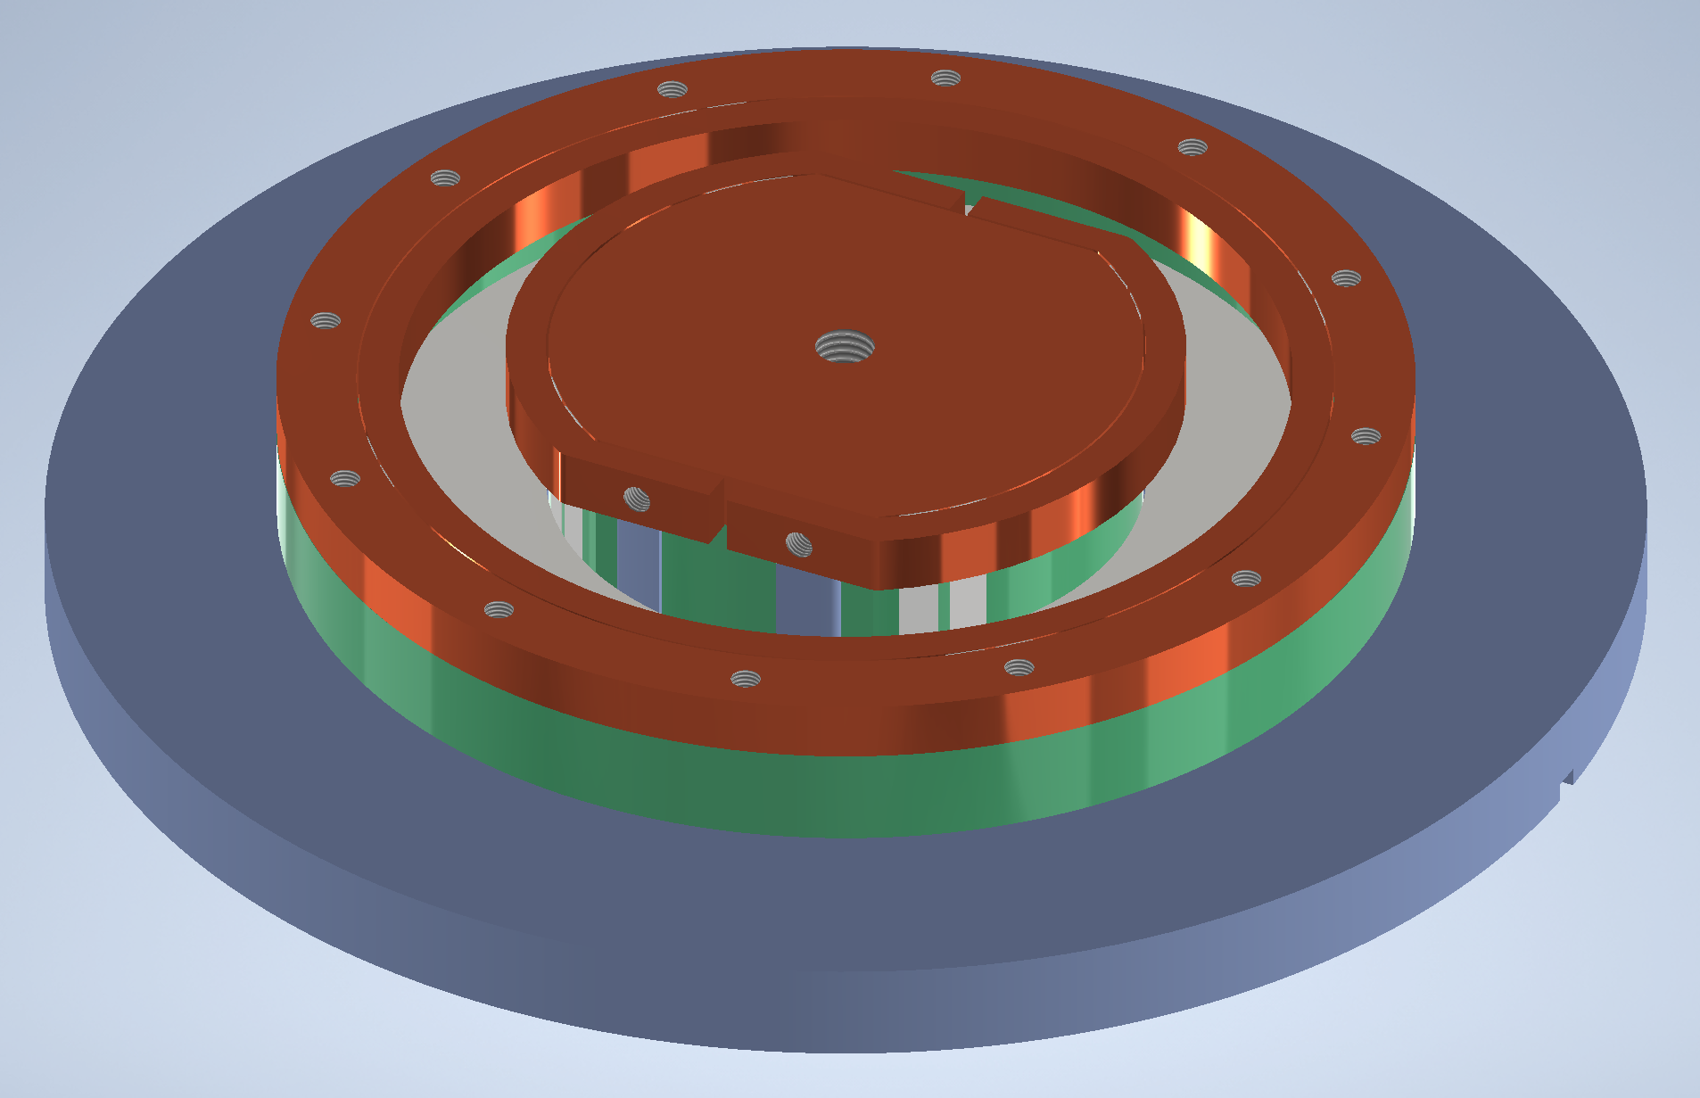
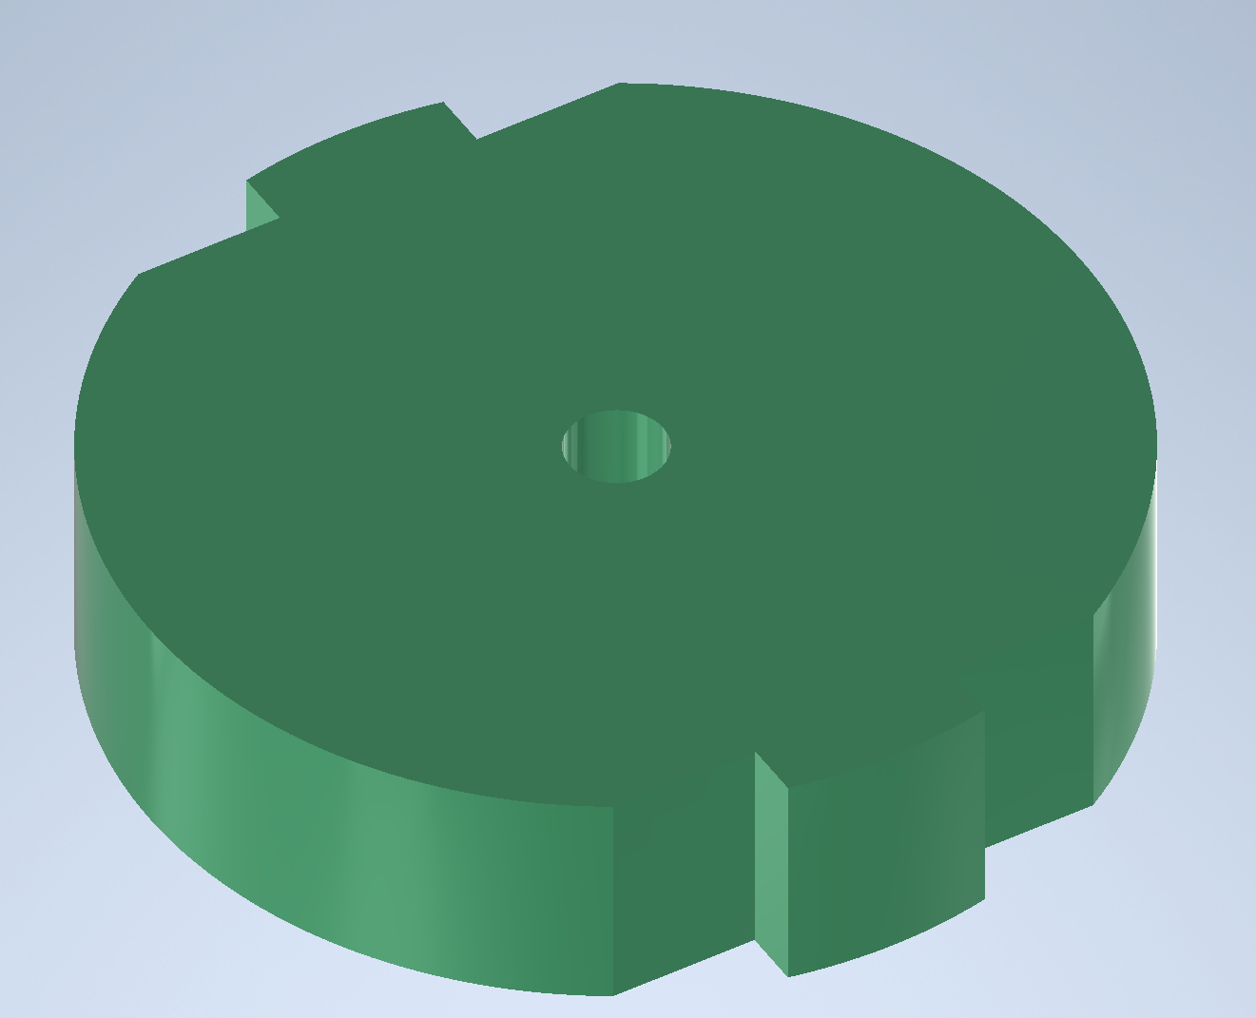
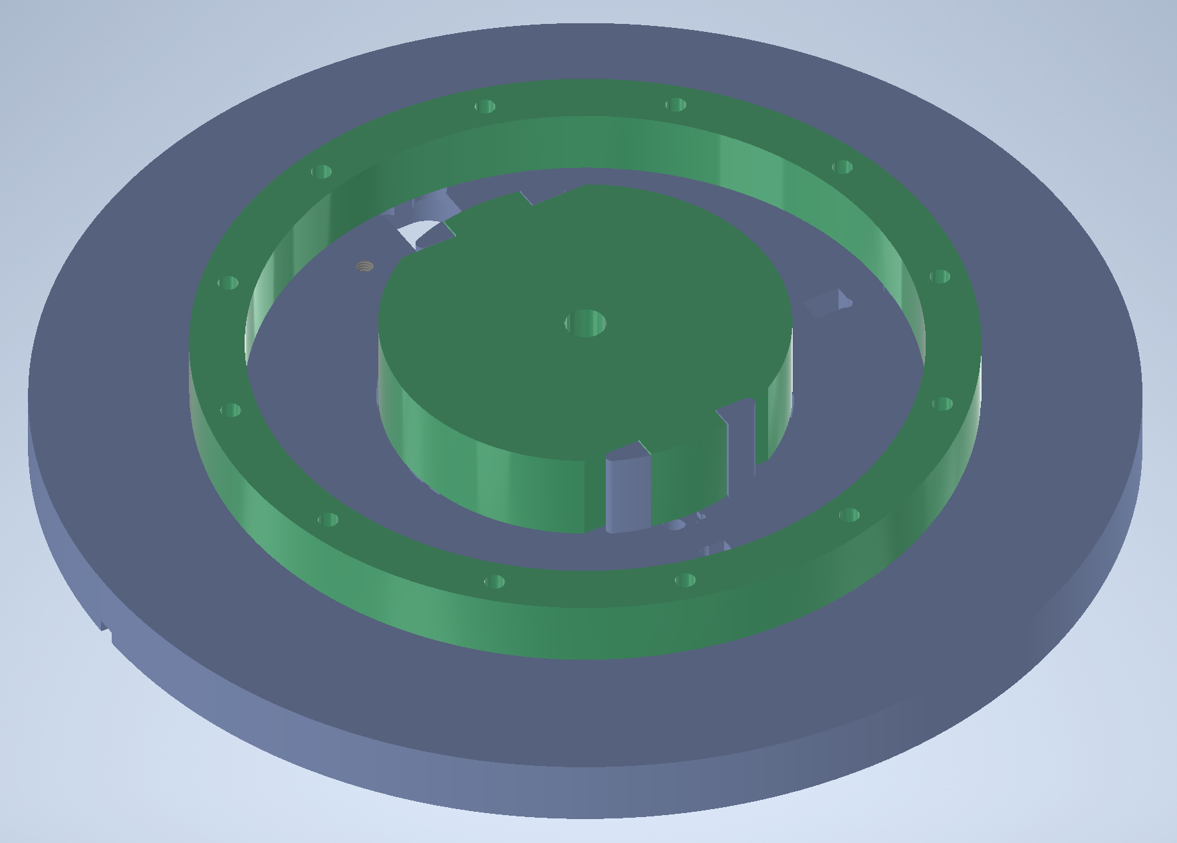
*New* HTS current leads design
R. Unterrainer instrumentation plate design
3D printed pieces: PLA, ULTEM, PEEK
Easy to manufacture and install in the instrumentation plate

Slide 4
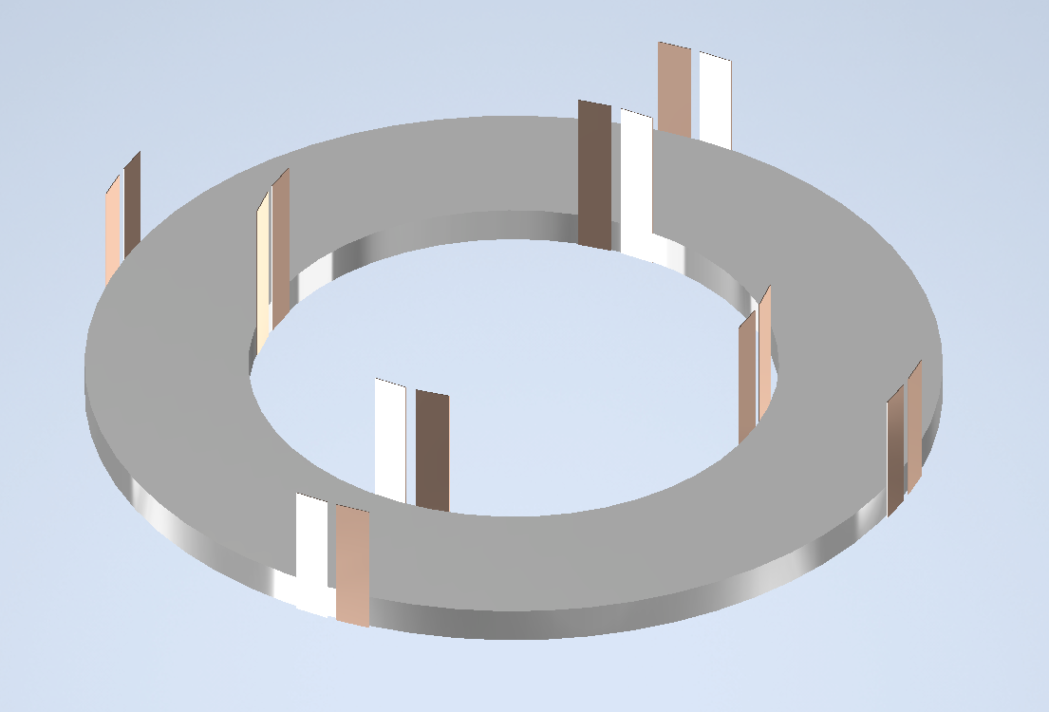
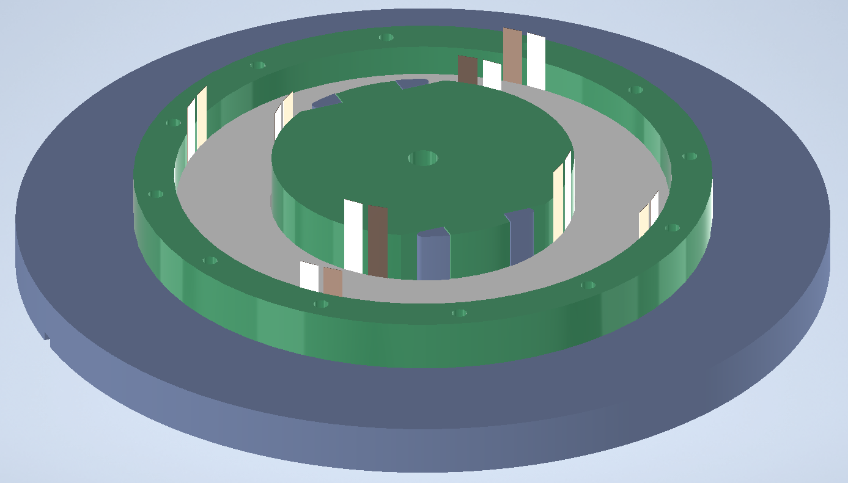
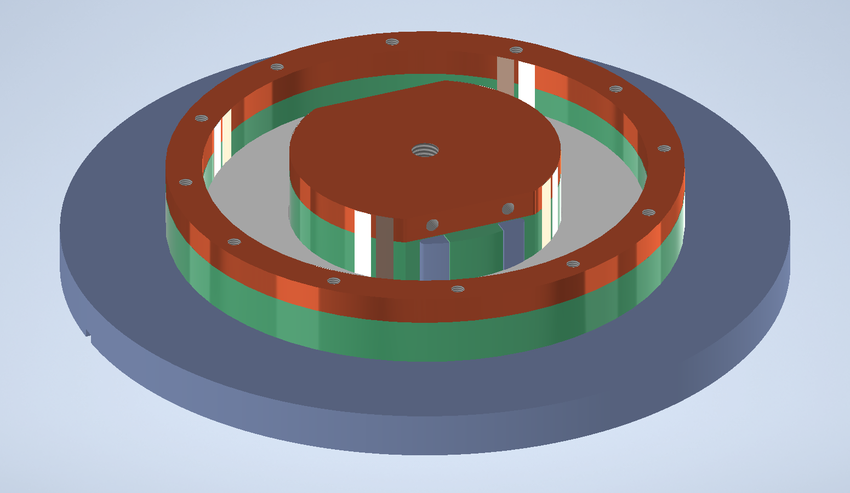
*New* HTS current leads design
From first joint tests, understand it is important to apply pressure during soldering.
After soldering in a oven, remove the copper clamps and mount the coil + tapes to the 3D printed supports
8x HTS tapes IN / OUT
Mechanical contact to the Cu rings → pressure + Indium foil.

Slide 5
Backup

Slide 6
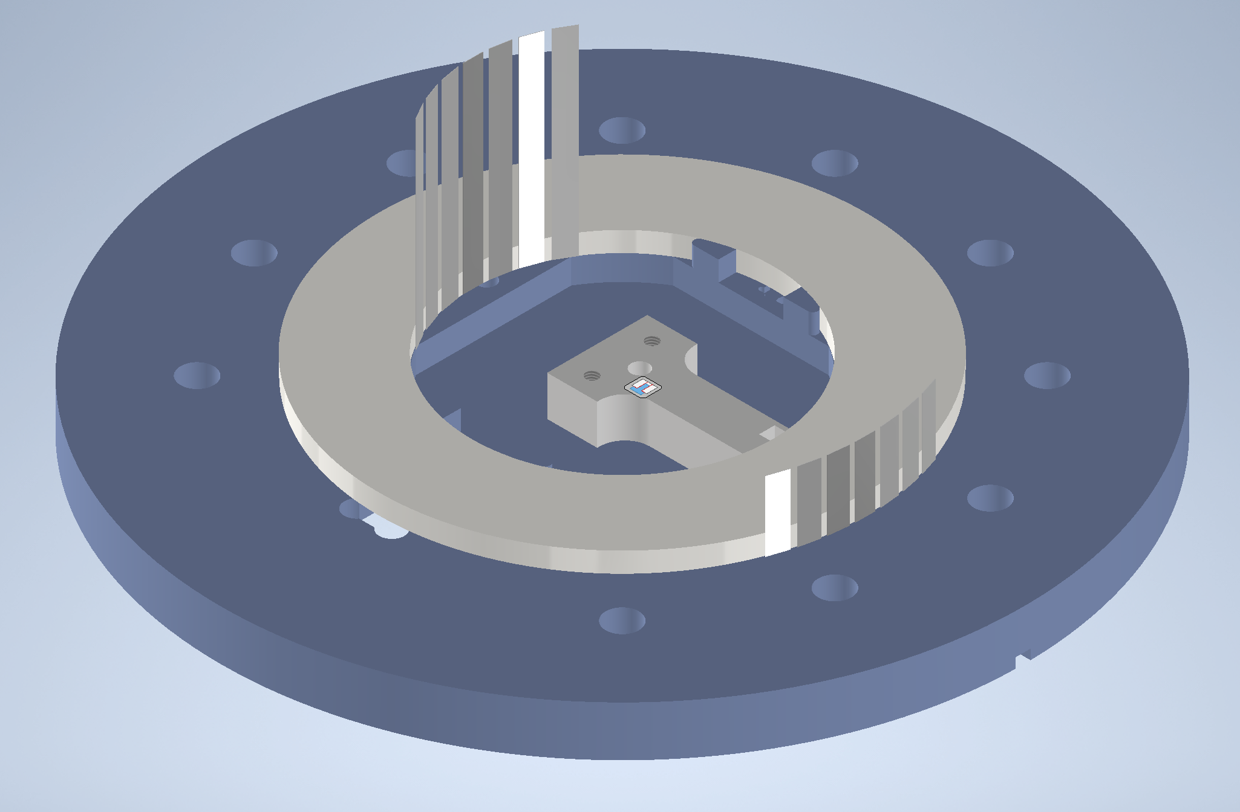
Non-uniformely distributed tapes

