Slide 1


Winding machine upgrade
R. Unterrainer
Final Cooling Solenoid

Slide 2
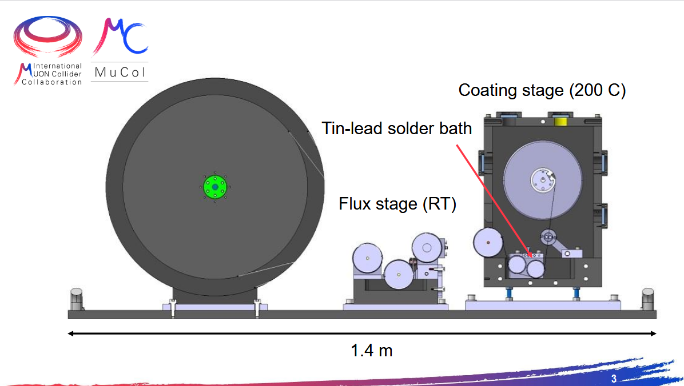
Current Set Up

Slide 3
Upgrade Plan
Pre-cleaning stage
  Copper Oxide Etching Bath
    Citric Acid/Sodiumpersulfate
    brushing
  Washing (deionized water)
  Drying + final cleaning
    Acetone/Isopropyl Alc.
    Brushing
New flux station
  Foam
  Spray
Wave solder / submerged pre-tinning

Slide 4
Upgrade Plan
Pre-cleaning stage
  Copper Oxide Etching Bath
    Citric Acid/Sodiumpersulfate
    brushing
  Washing (deionized water)
  Drying + final cleaning
    Acetone/Isopropyl Alc.
    Brushing
New flux station
  Foam
  Spray
Wave solder / submerged pre-tinning
+ housing for N₂/Ar/O₂ atmosphere

Slide 5
Upgrade Plan
Pre-cleaning stage
  Copper Oxide Etching Bath
    Citric Acid/Sodiumpersulfate
    brushing
  Washing (deionized water)
  Drying + final cleaning
    Acetone/Isopropyl Alc.
    Brushing
New flux station
  Foam
  Spray
Wave solder / submerged pre-tinning
+ housing for N₂/Ar/O₂ atmosphere
Main topic of this meeting

Slide 6
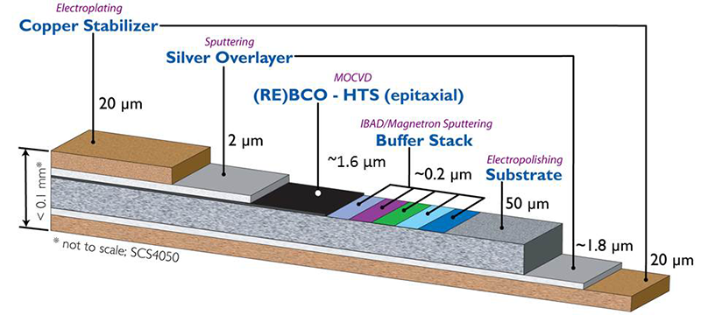
What do we want to solder?
REBCO (rare earth barium copper oxide)
  Stainless steel/Hastelloy substrate
  Thin buffer layers
  1-5 mum of high temperature superconductor (HTS)
  Electrical stabilizer
    1-2 mum silver
    5-30 mum Cu finish
  Overall dimensions (LxWxH)
    Up to 1 km x 12/15 mm x 0.08 mm (80 mum)

Slide 7
Wave Solder
Prerequisites
  “Small” setup/simple wave
  Homogeneous coating thickness on both sides
    Wave needs to have enough height
    Potentially thinking about adding additional surface finishing tech. (HASL/former)
  Coating tapes of up to 15 mm width (Wave height?)
  Multi-solder compatible (Titanium/Coatings? Which alloy)
  Good temperature control (>200 C destructive influence on tape)
  High throughput and low maintenance needs (easy solder dross removal)
  Minimalistic design (prototyp))

Slide 8
Wave Solder
Cleaning stages not drawn
Turn tape into vertical pos
ej. height

Slide 9
V3
Hot winding coils

Slide 10
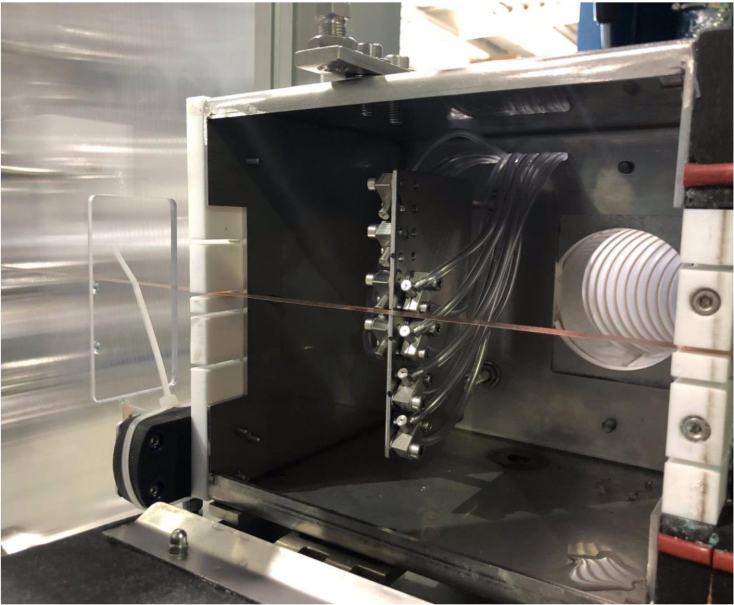
Seho

Slide 11
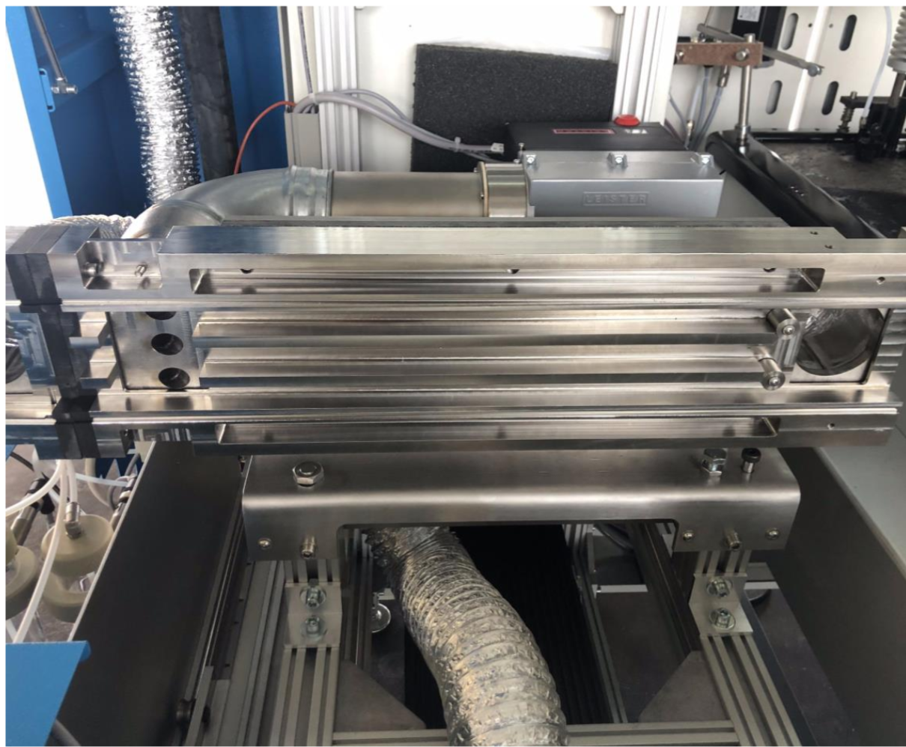
Seho

Slide 12
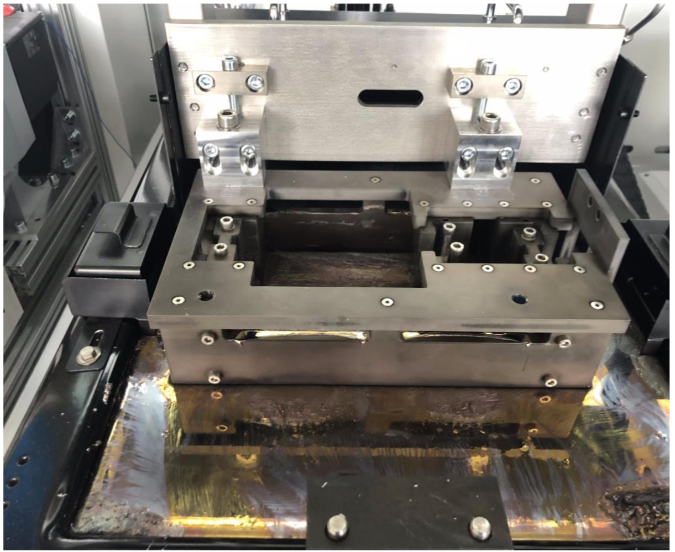
Seho

Slide 13
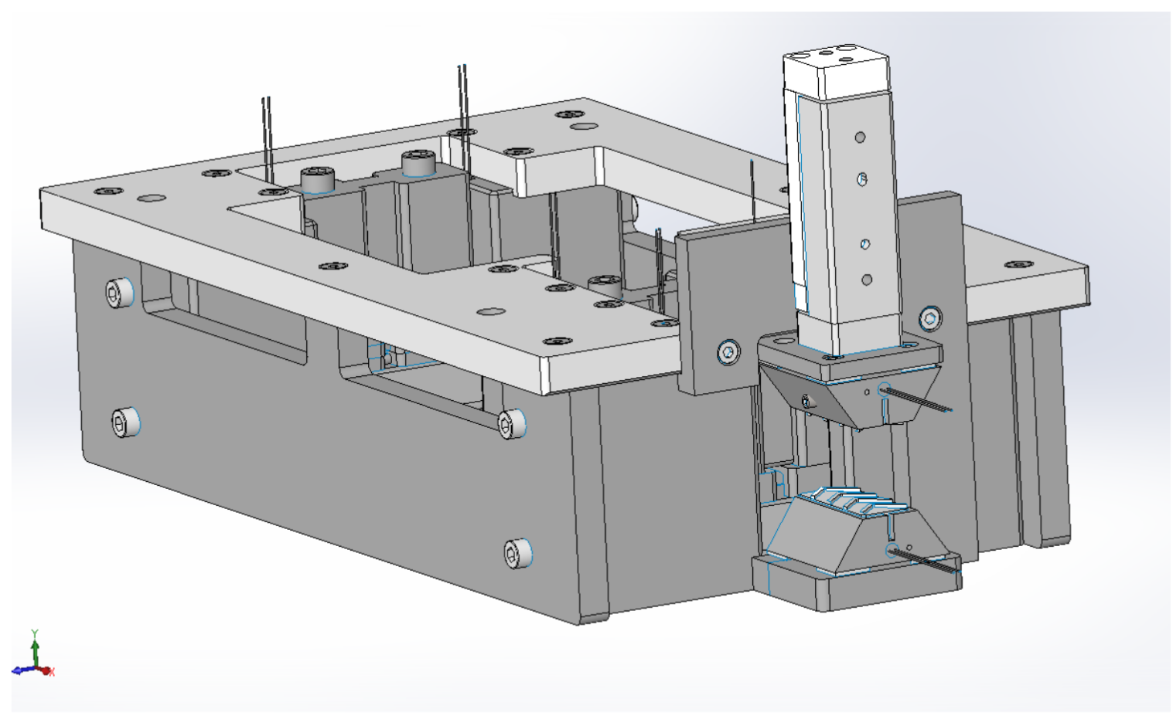
Seho
No silicone!

Slide 14
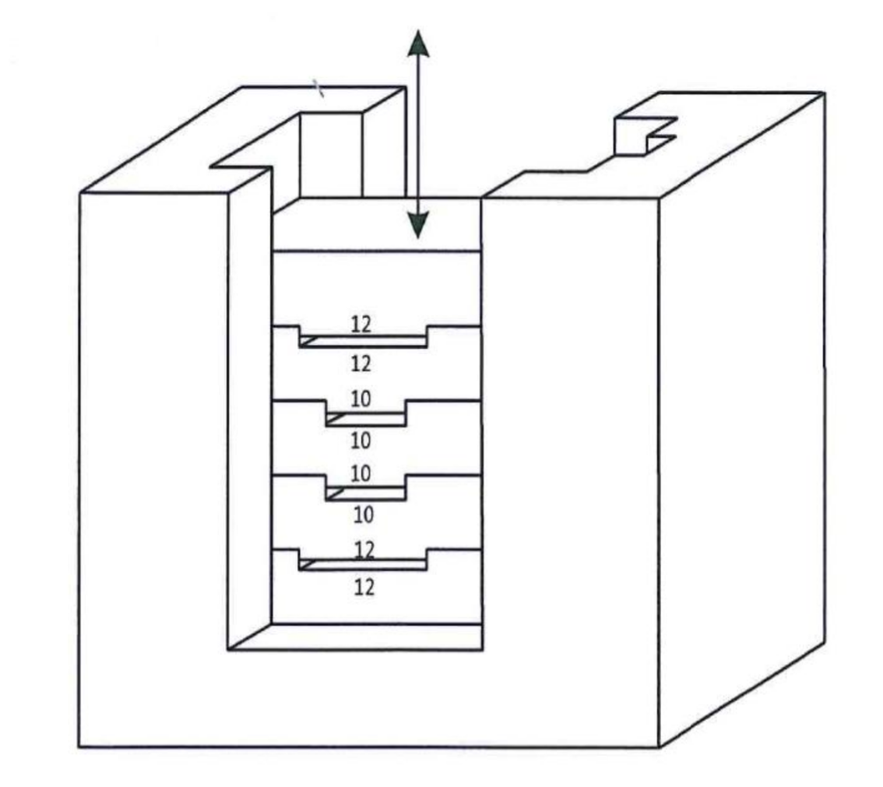
Seho
Flood gates
Almost no tin left
Thermal control

Slide 15
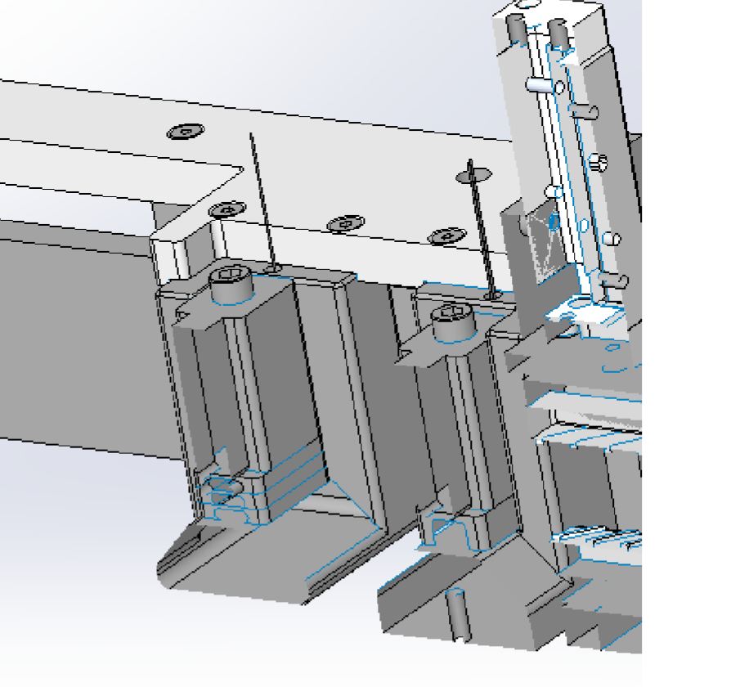
Seho
Flood gates

Slide 16
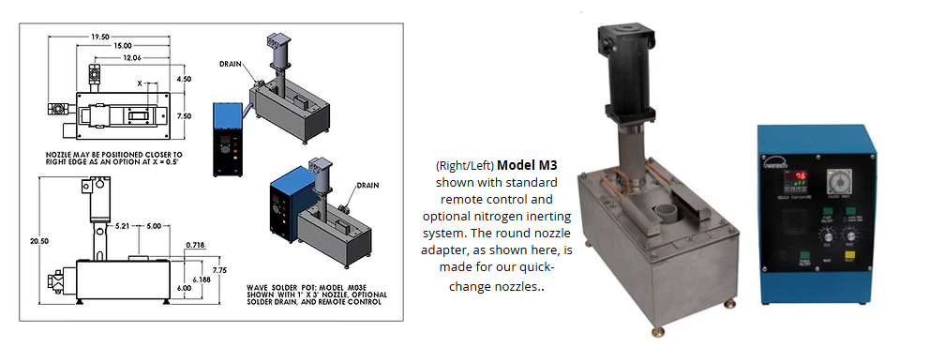
Microptik

Slide 17
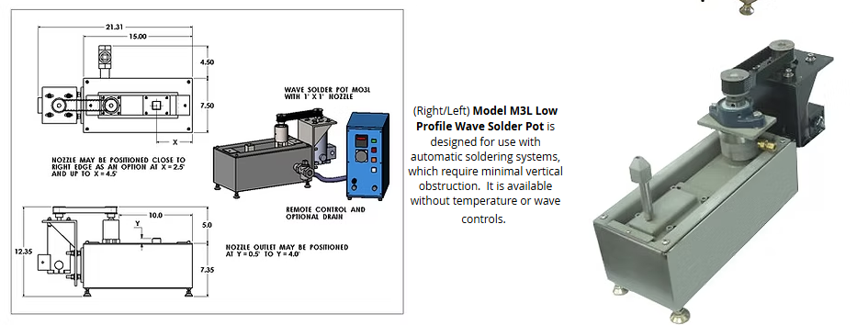
Microptik

