Slide 1
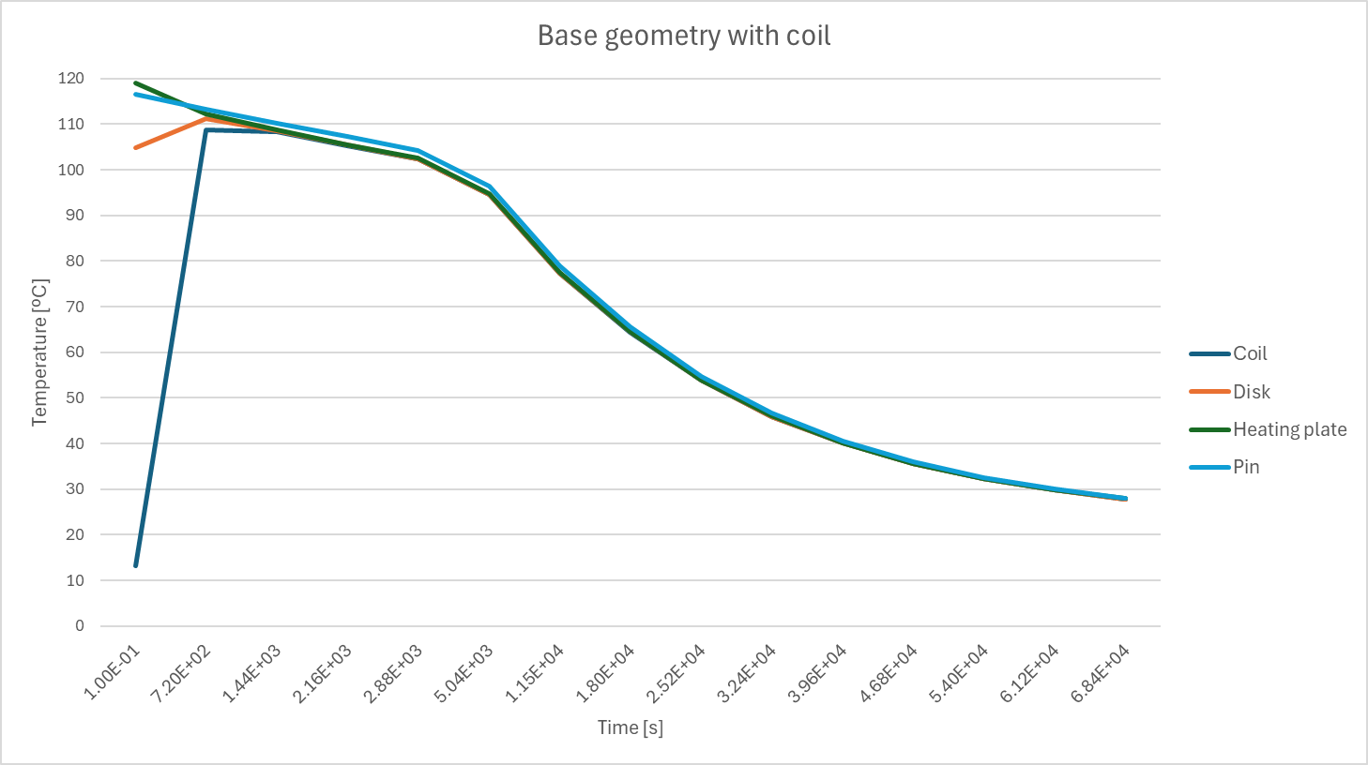
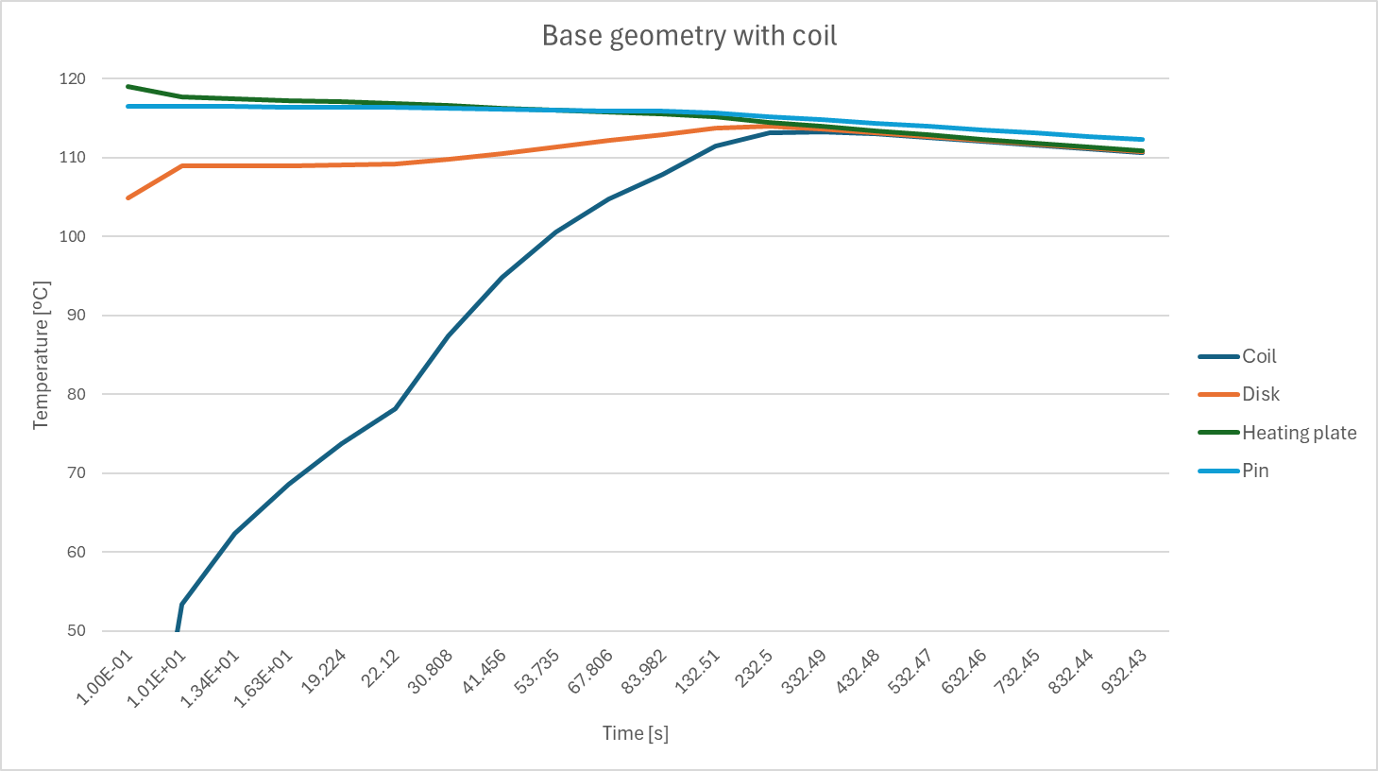
Transient simulation with coil
4x90mm
4x60mm

Slide 2
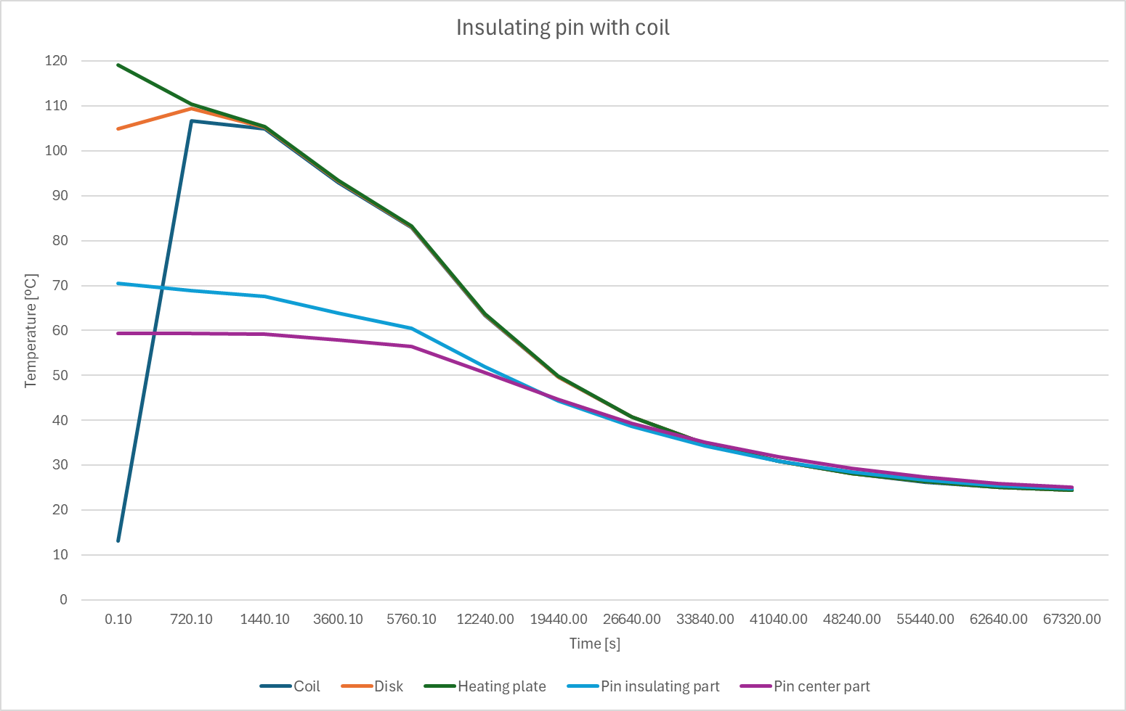
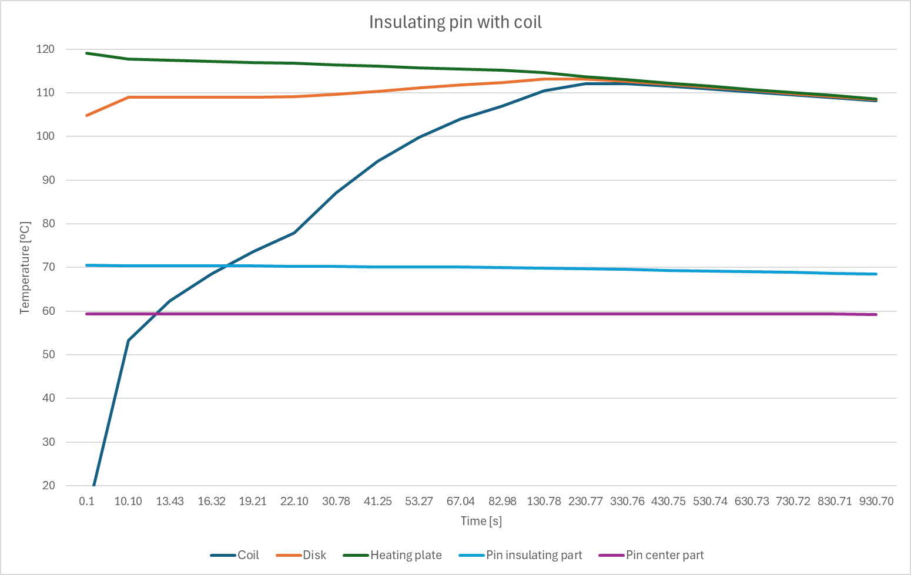
Transient simulation with coil and with insulating pin
4x90mm
4x60mm

Slide 3
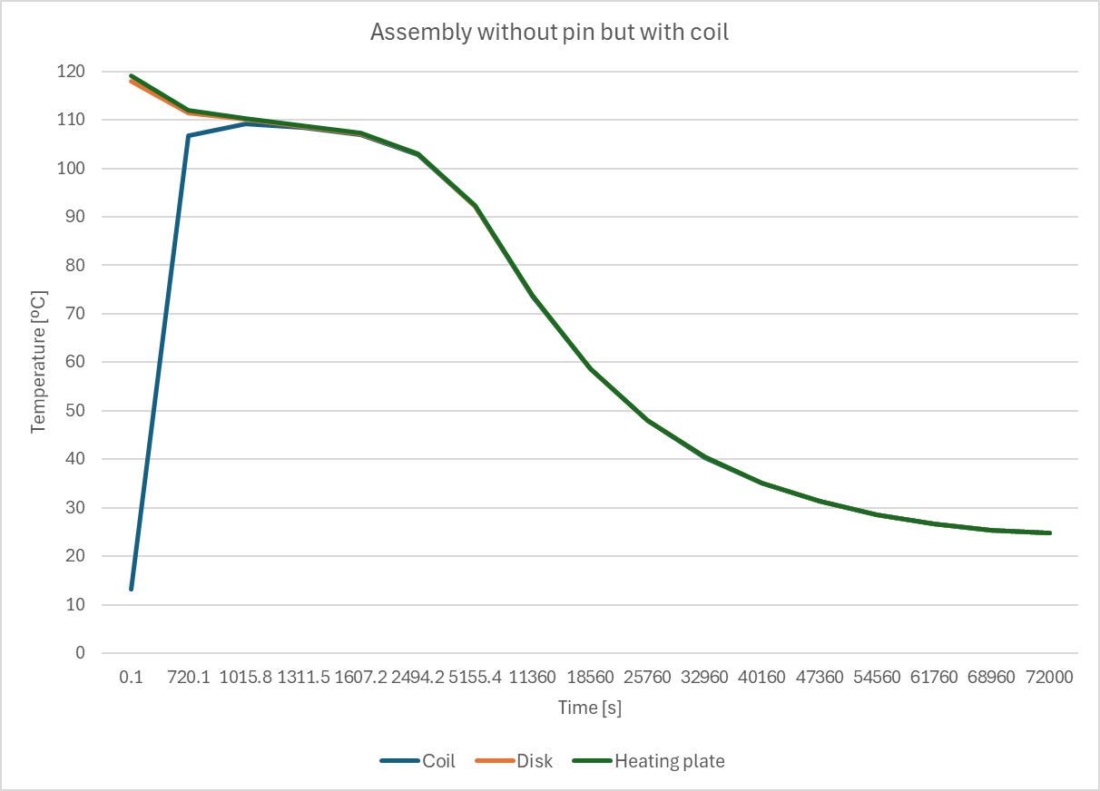
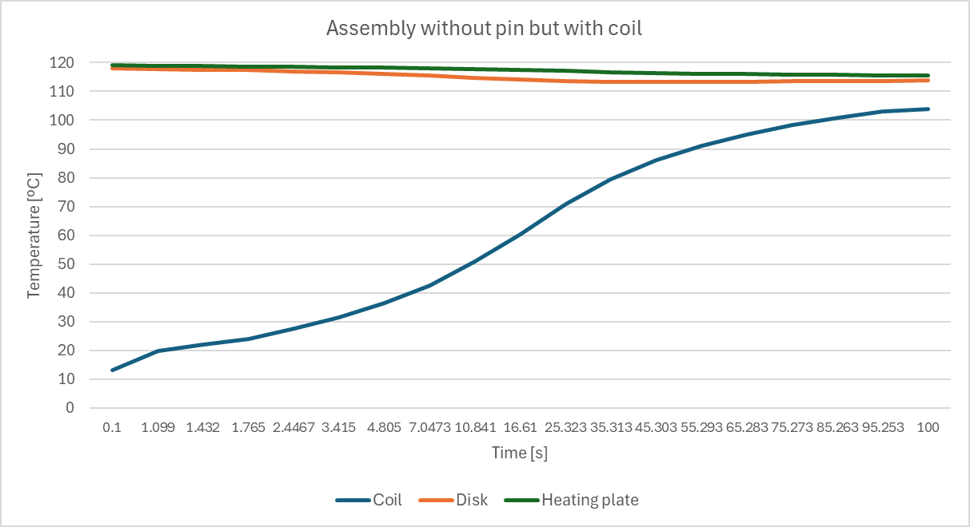
Transient simulation with coil but without pin
4x90mm
4x60mm

Slide 4
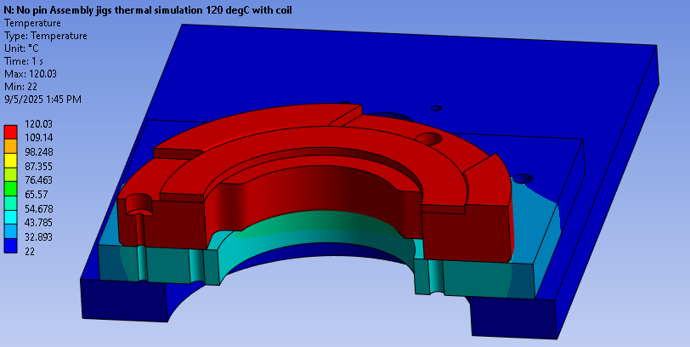
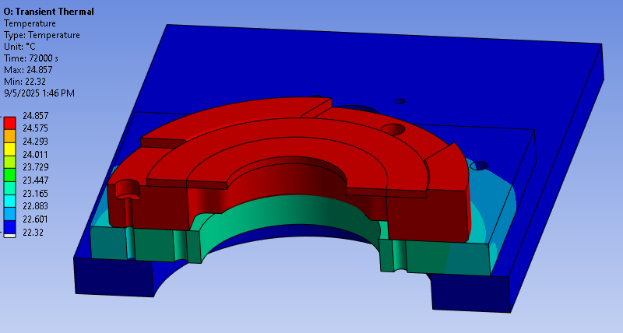
Transient simulation with coil but without pin
4x90mm
4x60mm

Slide 5
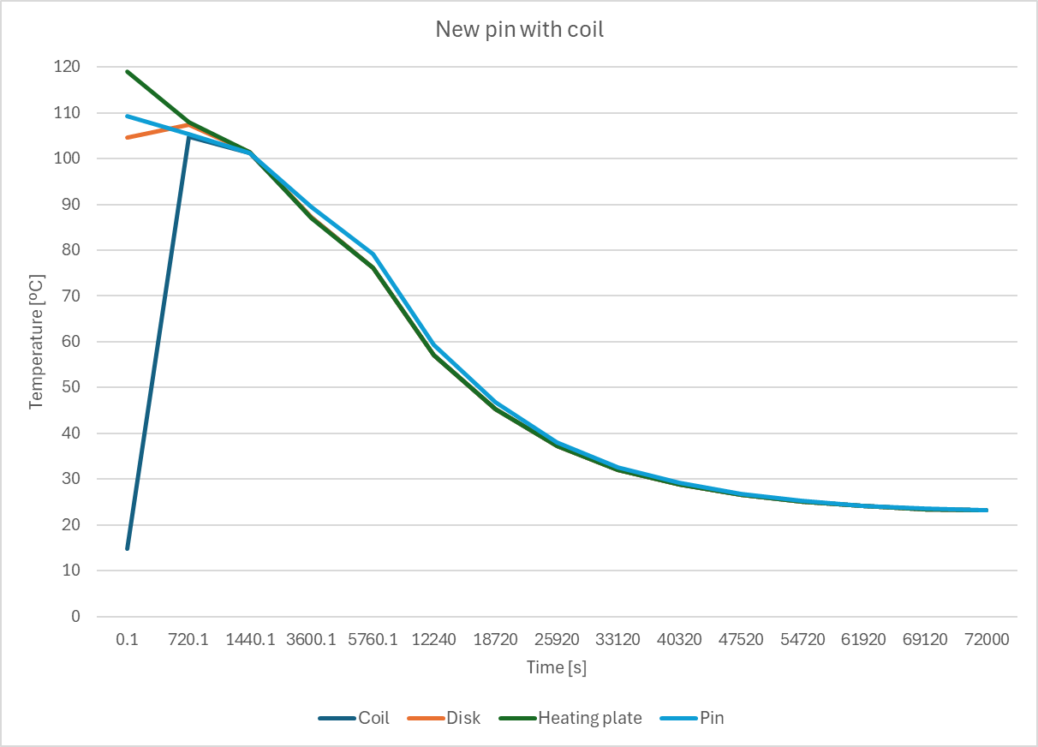
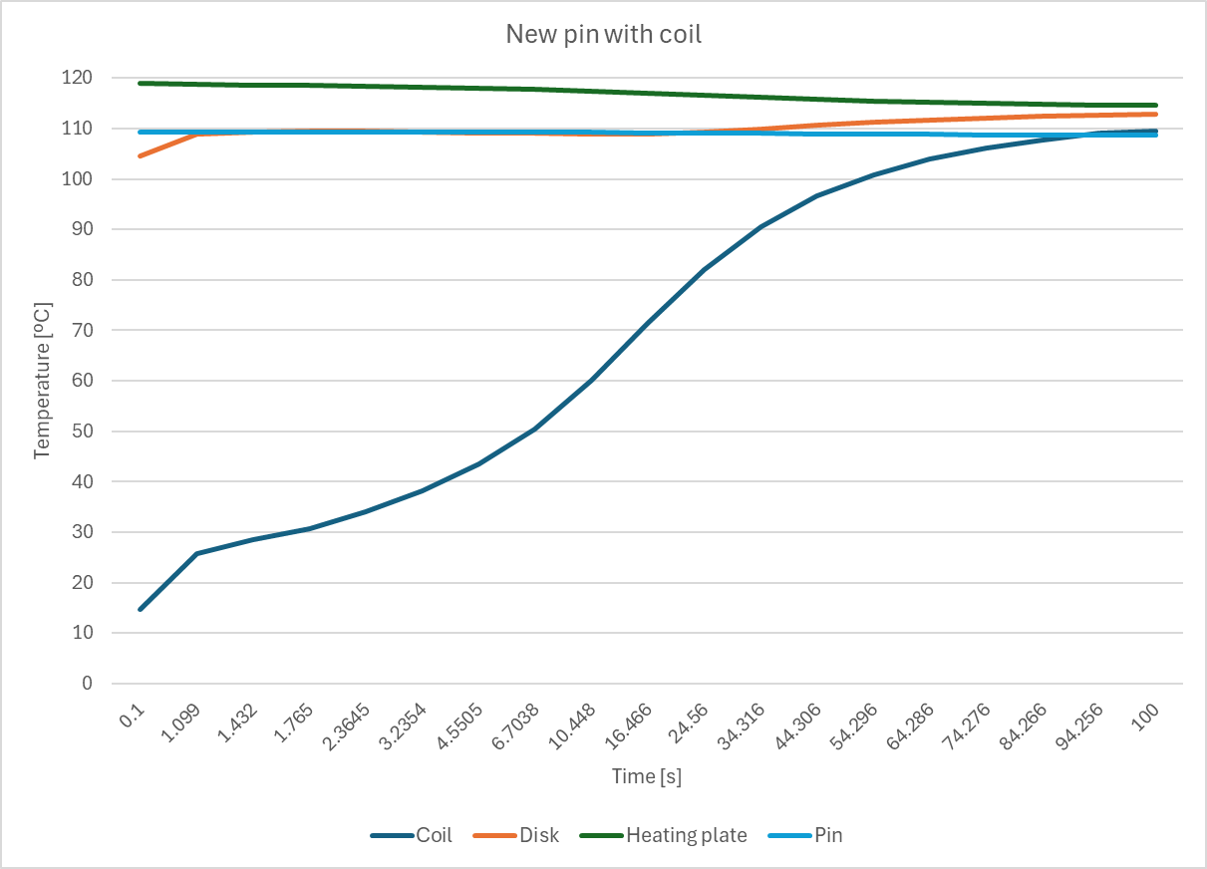
Transient simulation with coil with new pin + convection under pin
4x90mm
4x60mm

Slide 6
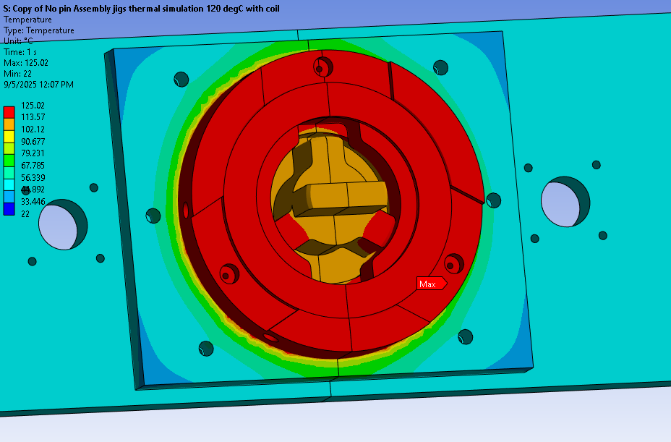
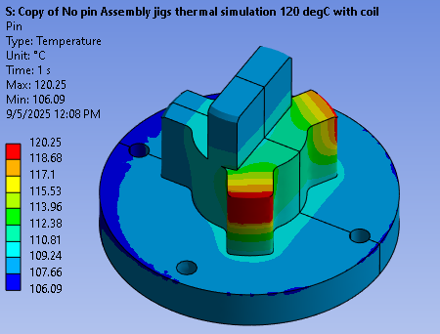
Transient simulation with coil with new pin + convection under pin
4x90mm
4x60mm

Slide 7
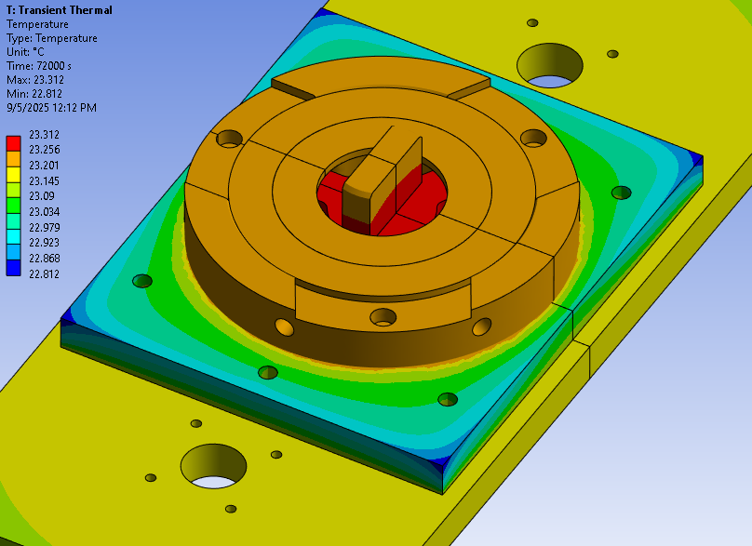
Transient simulation with coil with new pin
4x90mm
4x60mm

Slide 8
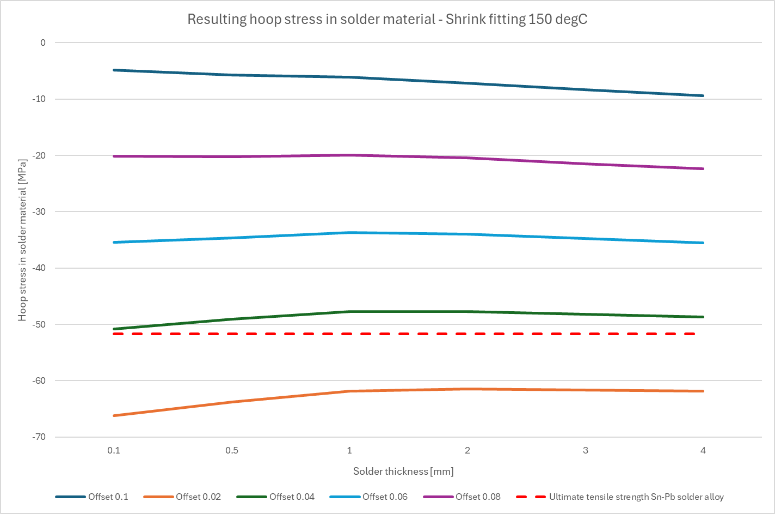
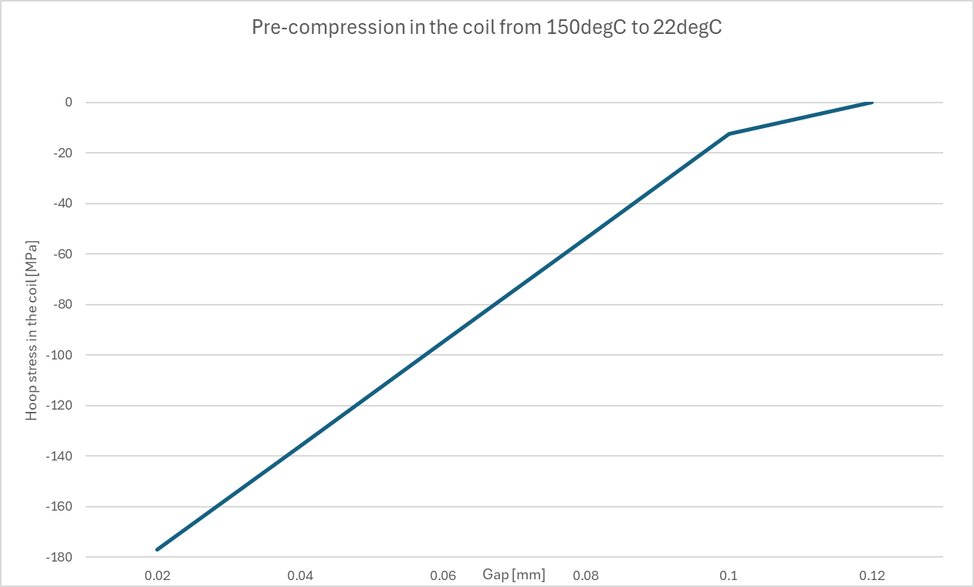
Precompression at 150degC
4x90mm
4x60mm
Offset in mm

Slide 9
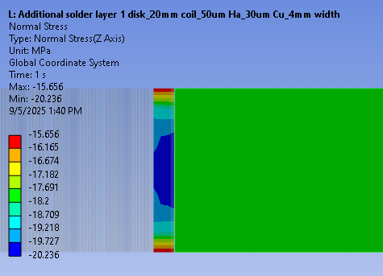


Precompression at 150degC
Solder material and coil
Disk
4x90mm
Gap = 0.08mm
Disk size = 4cm
Solder layer thickness = 0.5mm
4x60mm

Slide 10
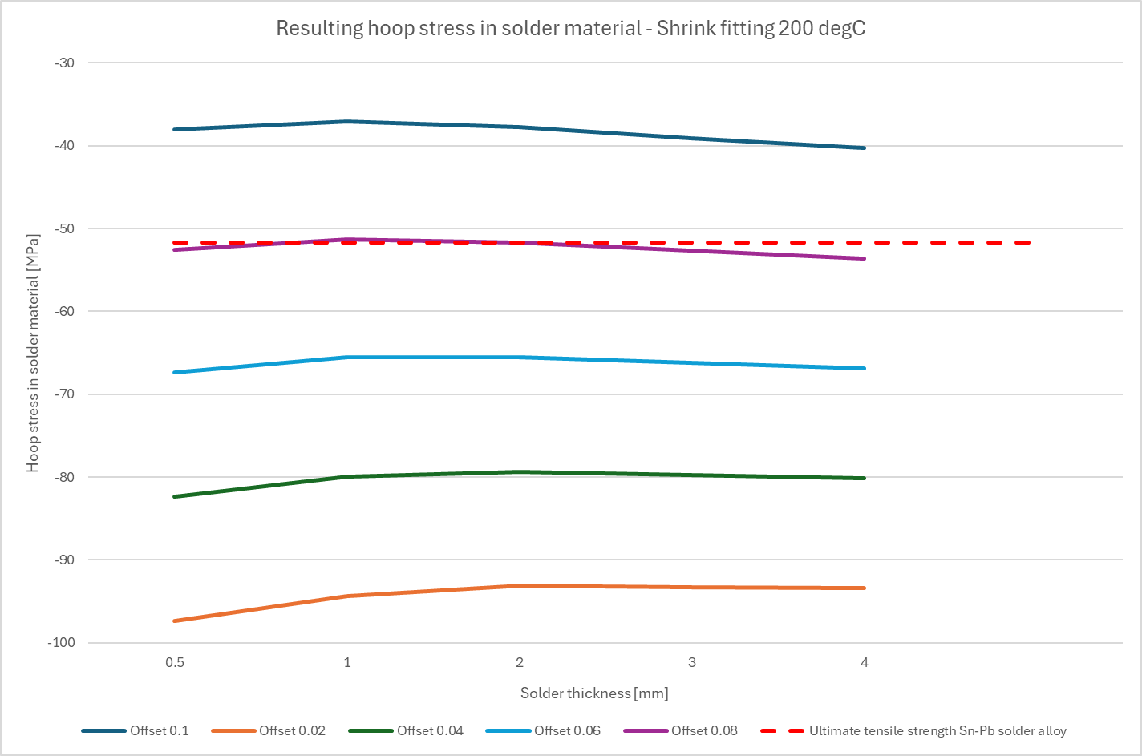
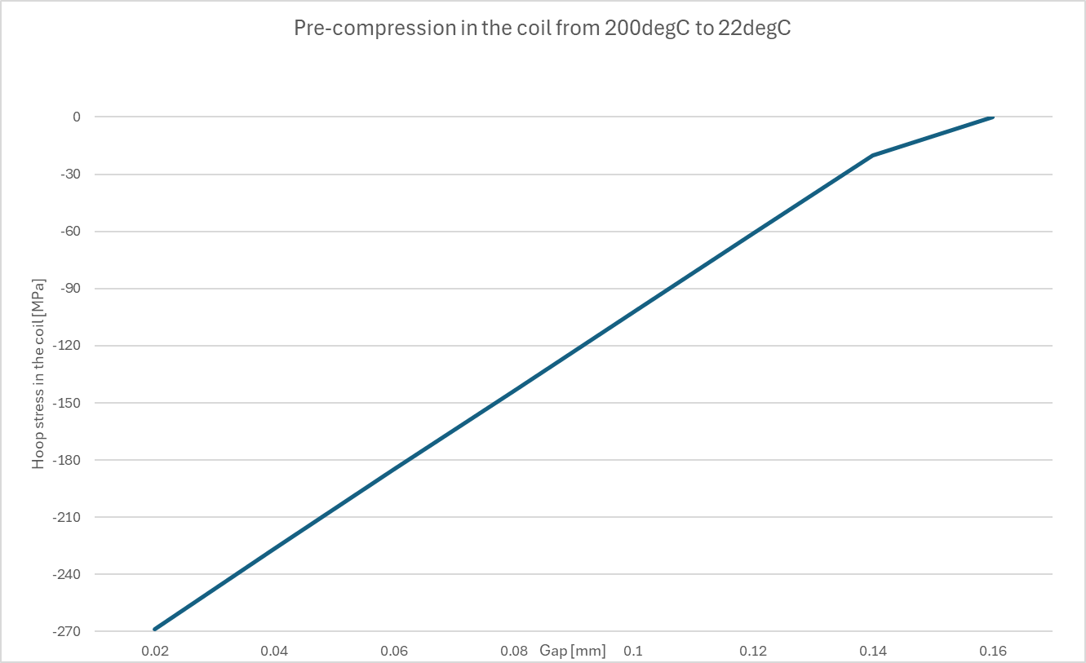
Precompression at 200degC
4x90mm
4x60mm
Offset in mm

Slide 11
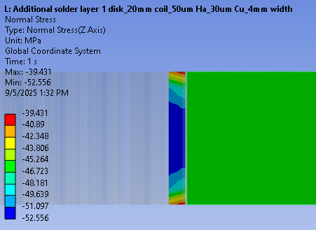
Precompression at 200degC
Solder material and coil
Disk
4x90mm
Gap = 0.08mm
Disk size = 4cm
Solder layer thickness = 0.5mm
4x60mm

