Slide 1
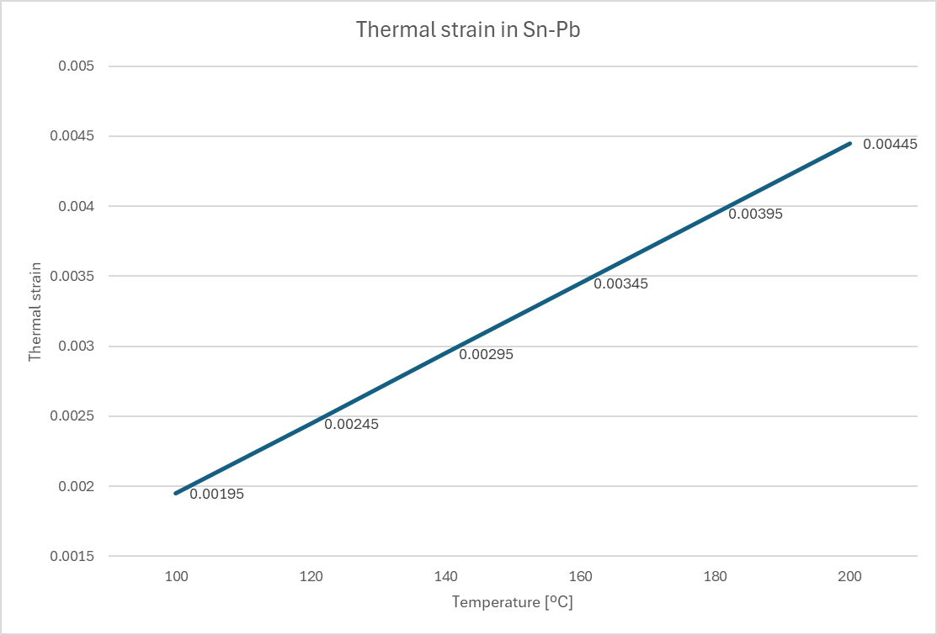
Sn-Pb thermal strain
CTE = 25 [um/(mºC)]
Thermal strain at 180ºC = 0.00395 :
4mm
4.018mm
4x60mm
4x90mm
4mm
4.018mm
1mm
1.0045mm

Slide 2
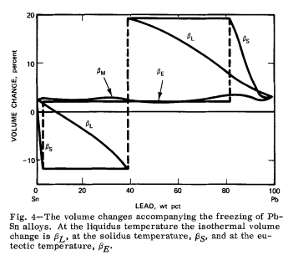
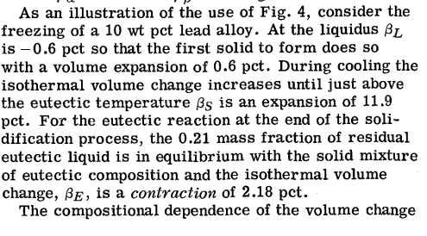

Volume change behaviour during solidification of Sn-Pb alloy
From article : Predicted volume change behavior accompanying the solidification of binary alloys
Book : Metallurgical and Materials Transactions B
Solder we have: ISO-Tin S-Sn63Pb37E-DIN EN -> eutectique
4x90mm

Slide 3
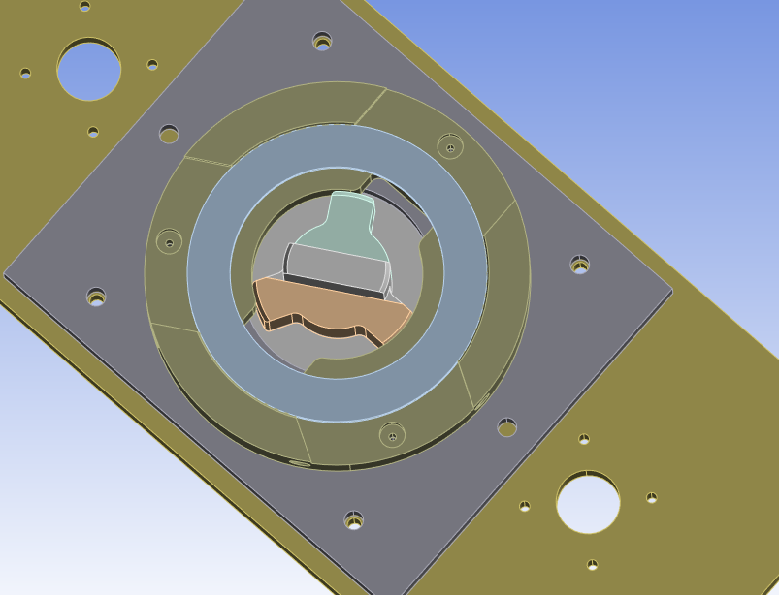
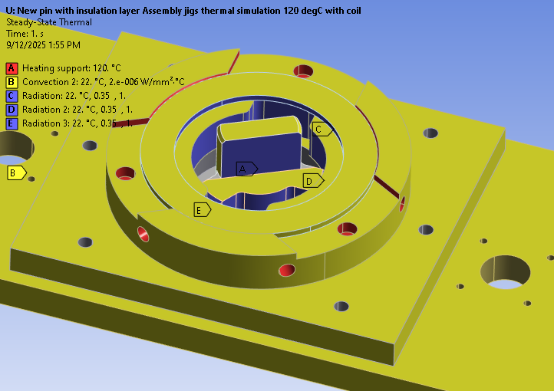
New pin with insulation

Slide 4
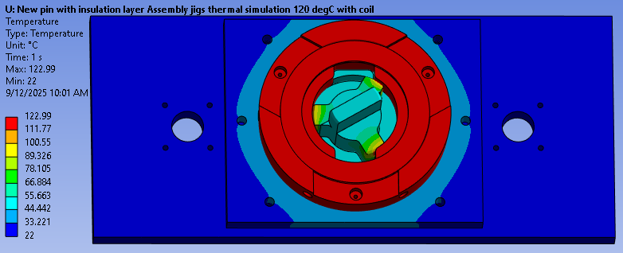
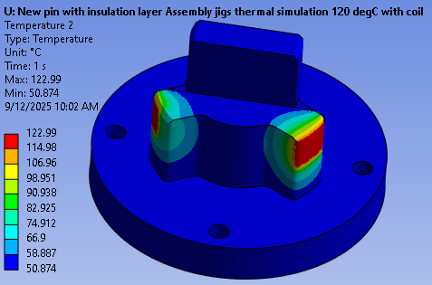
New pin with insulation
CTE copolymer ~ 109 [um/mºC]
CTE stainless steel = 17.8 [um/mºC]

Slide 5
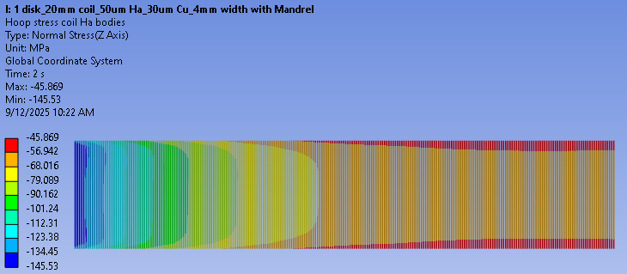
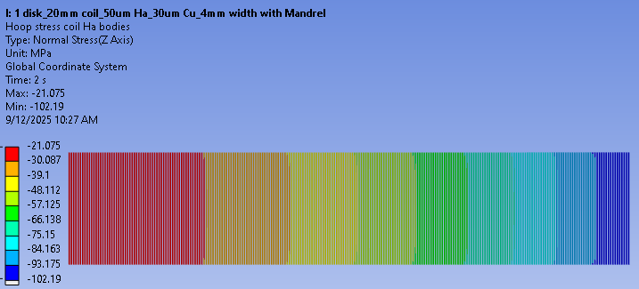
Pre-compression with and without mandrel
2D simulation with mandrel of thickness 4.8[mm] bonded to the inner radius of the coil, offset with disk = -0.1mm
Disk going from 200ºC to 22ºC and coil, connectors and mandrel staying at 22ºC
In the case with the mandrel and the case when the mandrel is supressed the resulting hoop stress in the Ha tape of the coil is the same -> -102.48[Mpa]
When mandrel and coil are at 200ºC, pre-compression is higher in the coil
Mandrel and coil at 200ºC
Mandrel and coil at 22ºC

Slide 6
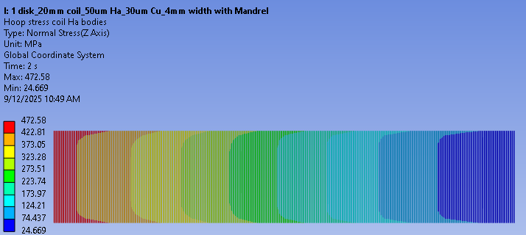
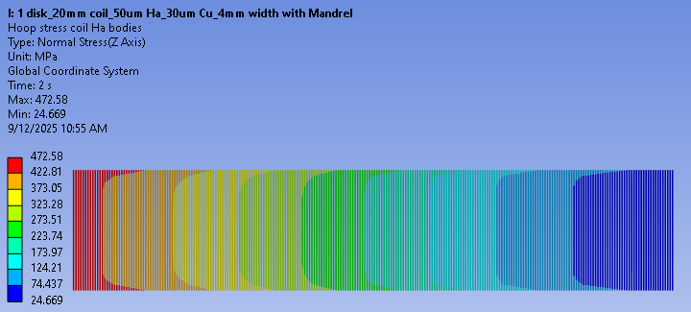
Pre-compression and energization with and without mandrel
Mandrel and coil are heated up to 200ºC
When energization happens mandrel is switched to «dead» status
Final hoop stress in the coil stays the same
Without mandrel

Slide 7
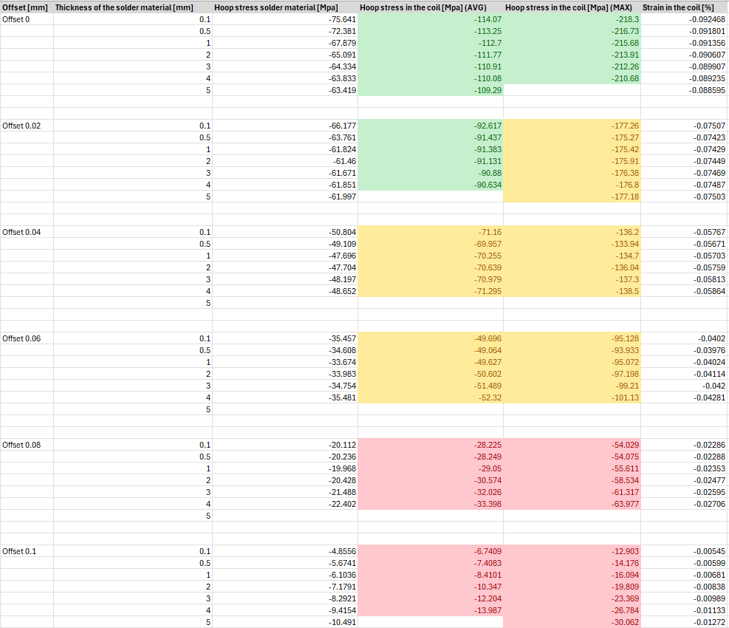
Pre-compression 150ºC with solder layer - update
Gap value linked to inconsistence in the hoop stress

Slide 8
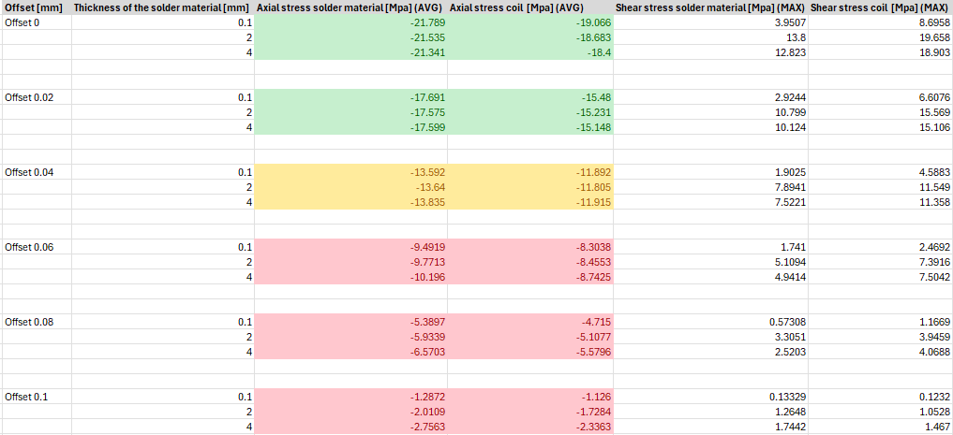
Pre-compression 150ºC with solder layer - update
REBCO shear strength ~ 10MPa ?
Sn-Pb solder alloy shear strength = 42.7MPa

Slide 9
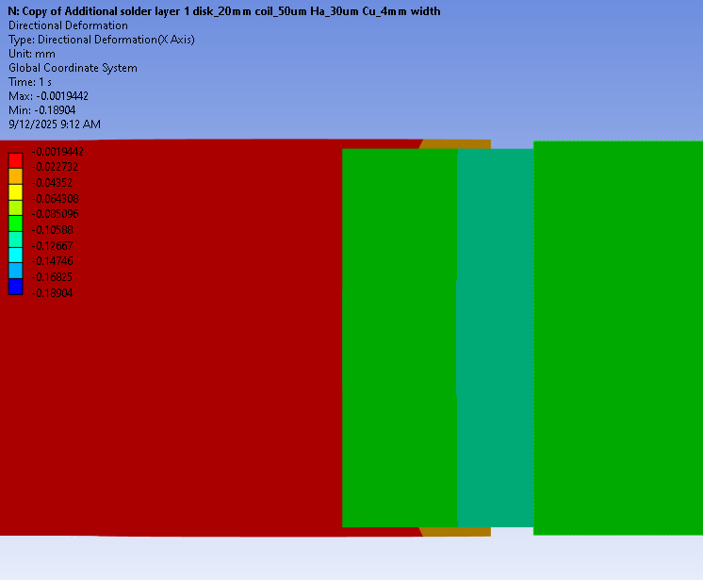
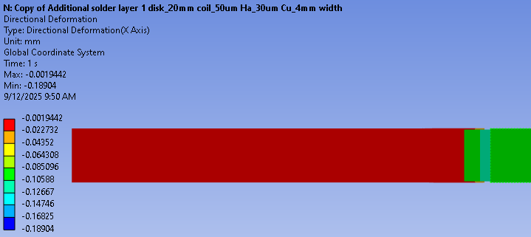
Pre-compression with solder layer - update
Gap 0.08mm

Slide 10
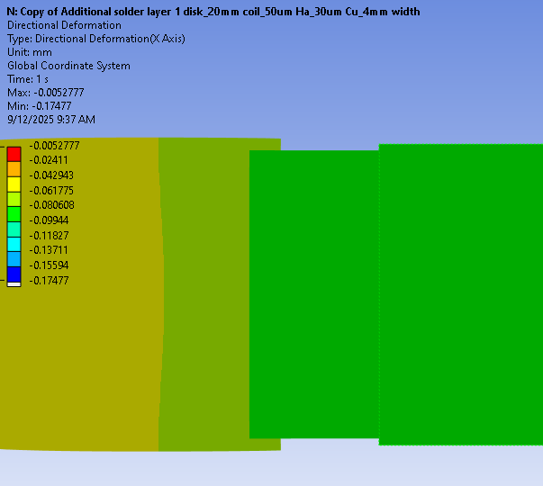
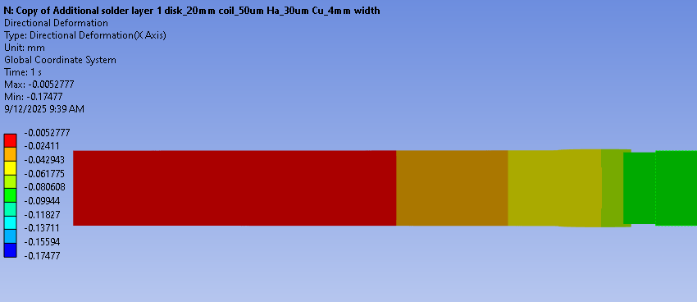
Pre-compression with solder layer - update
Gap 0.02mm

Slide 11
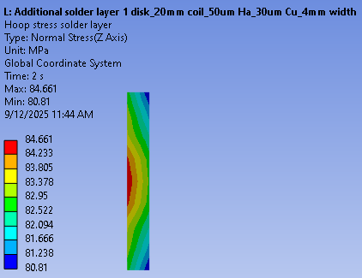
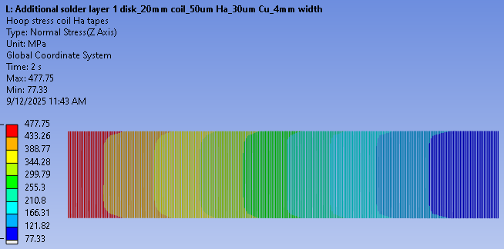
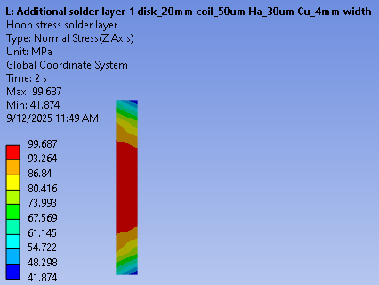
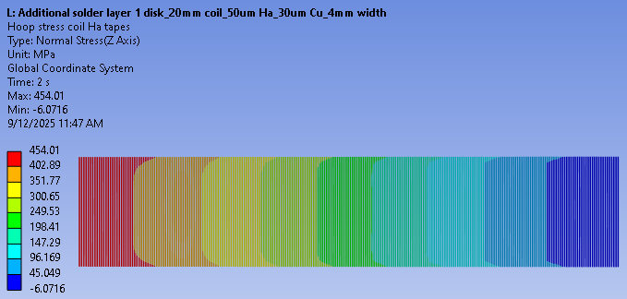
Pre-compression and energization with solder layer – gap 0.1mm
Without precompression
Above limit !!
With precompression
Above limit !!

