Slide 1
Cumulative stresses of REBCO tape during winding
03/10/2025

Slide 2
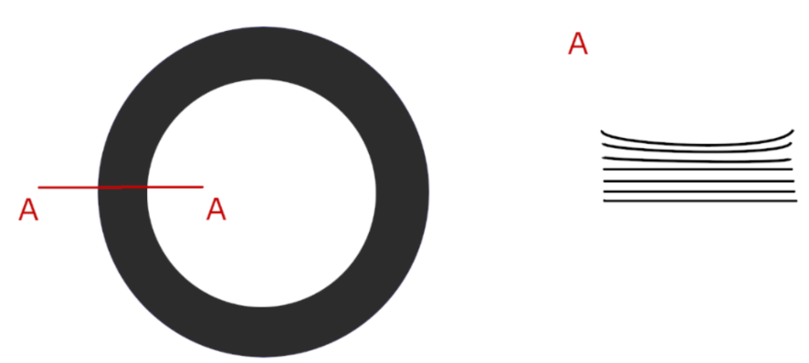
The problem
Stresses due to:
Winding tension
Bending of the tape
Anticlastic curvature due to Poisson’s effect during bending
Courtesy G. Vernassa

Slide 3
Content
Benchmark of FEM model with analytical results (G. Vernassa)
FEM modelling of cumulative stresses

Slide 4

Model geometry and materials
material | total thick. / um | E / GPa | ν
Copper | 40 | 85 | 0.35
Hastelloy | 50 | 197 | 0.3
YBCO | 2.5 | 155 | 0.3
$$ρ$$
YBCO layer facing inwards

Slide 5
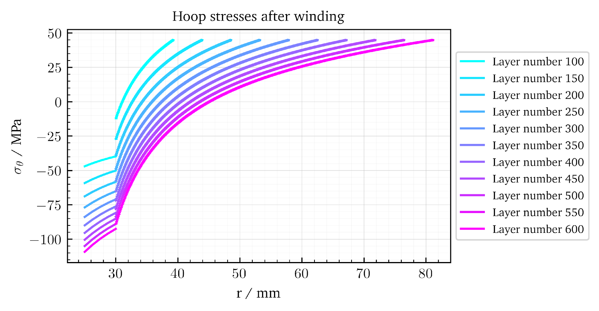
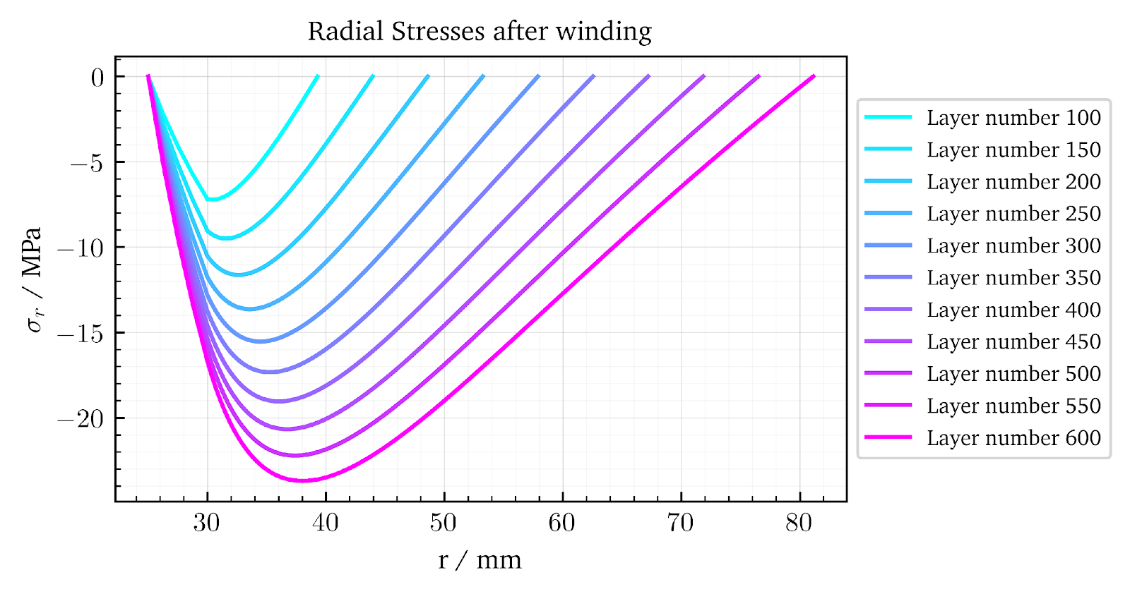
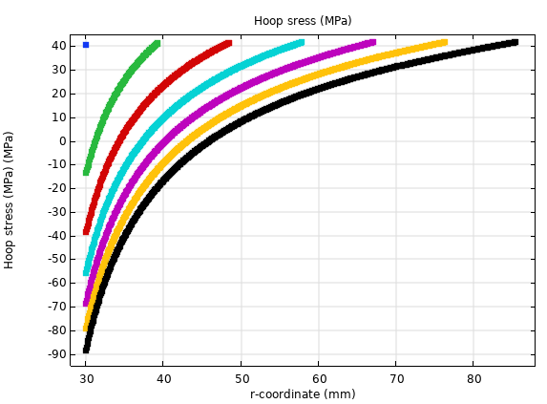
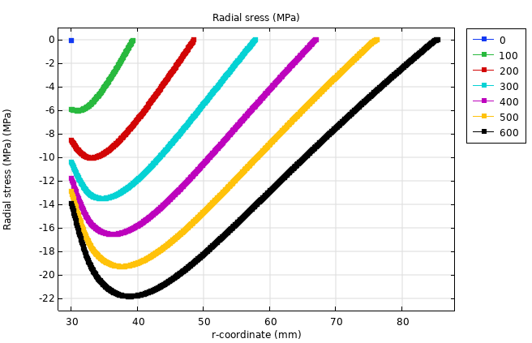
Comulative stresses (longitudinal tension only)
Benchmark data
(G. Vernassa)
Constant winding tension F=50N
*Cu mandrel with internal radius of 25mm and outer radius of 30mm
COMSOL results

Slide 6
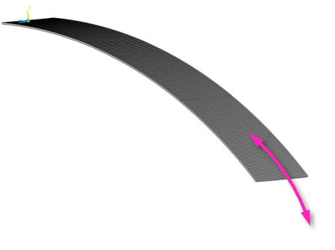
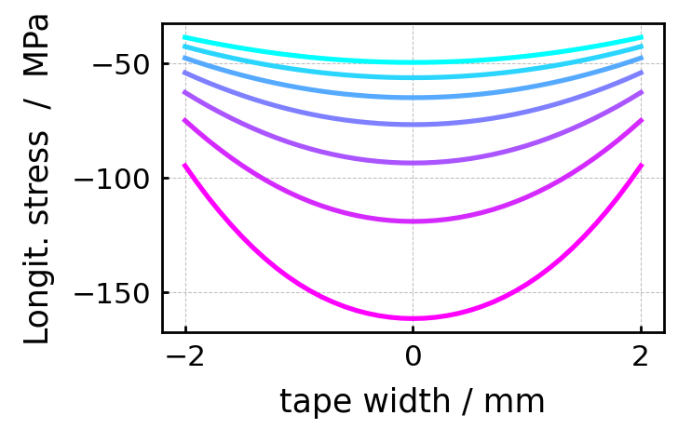
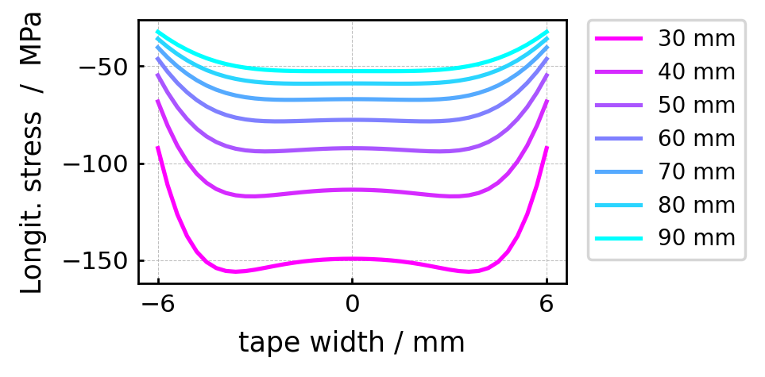
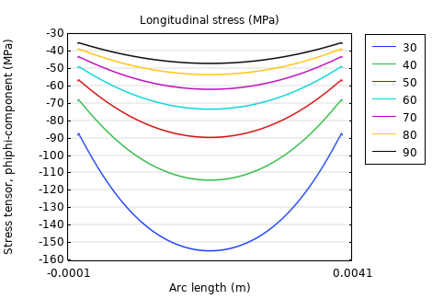
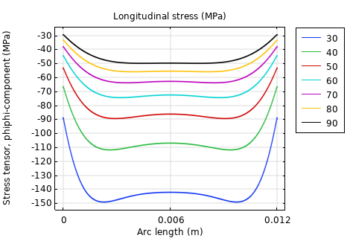
Longitudinal stresses (no longitudinal tension – bending only)
4 mm tape
12 mm tape
σ
Benchmark analytical calculation
(G. Vernassa)
COMSOL results

Slide 7
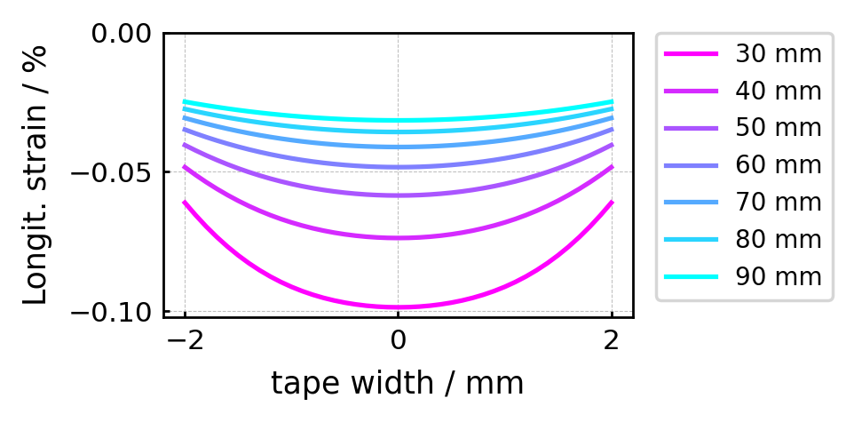
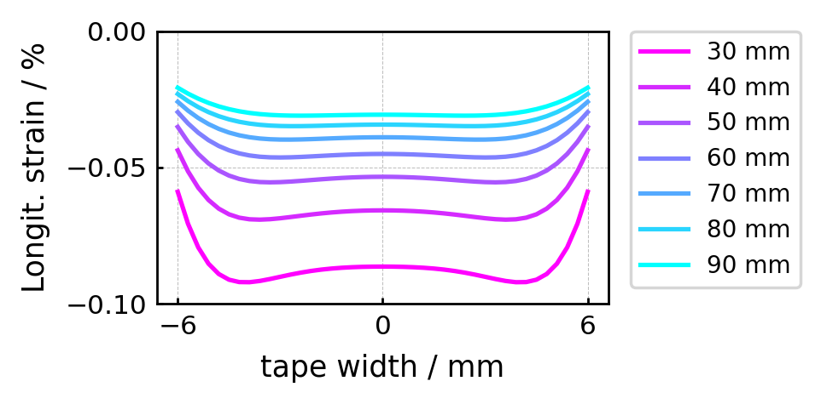
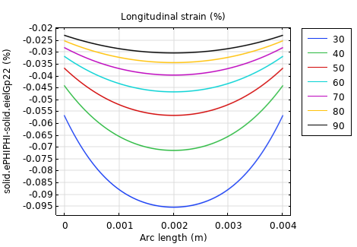
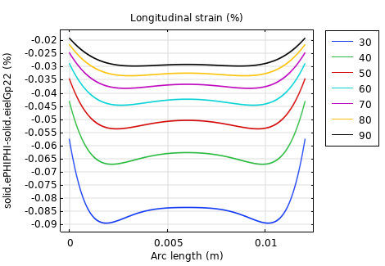
Longitudinal strain (no longitudinal tension – bending only)
4 mm tape
12 mm tape
ε
Benchmark analytical calculation
(G. Vernassa)
COMSOL results

Slide 8
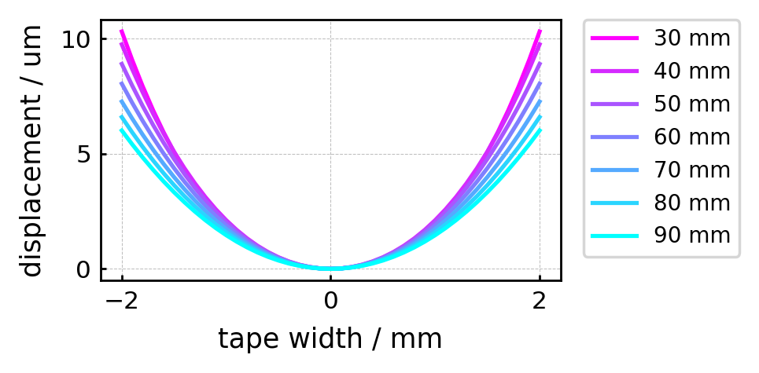
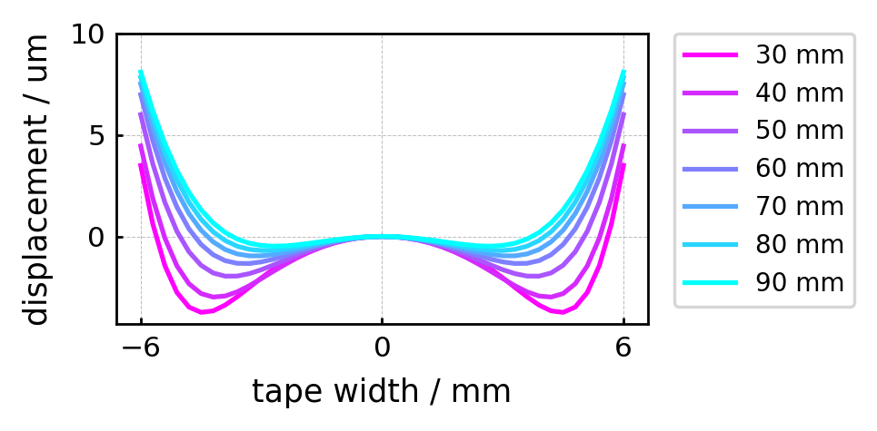
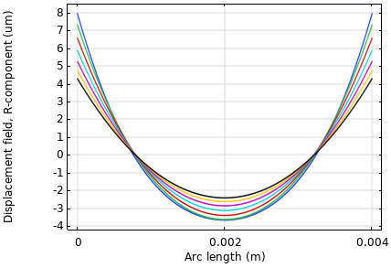
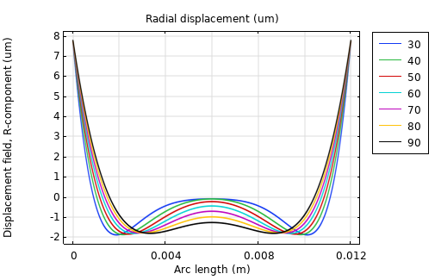
Radial displacement (no longitudinal tension – bending only)
4 mm tape
12 mm tape
Benchmark analytical calculation
(G. Vernassa)
COMSOL results

Slide 9
Cumulative stresses
(bending and winding tension combined)

Slide 10

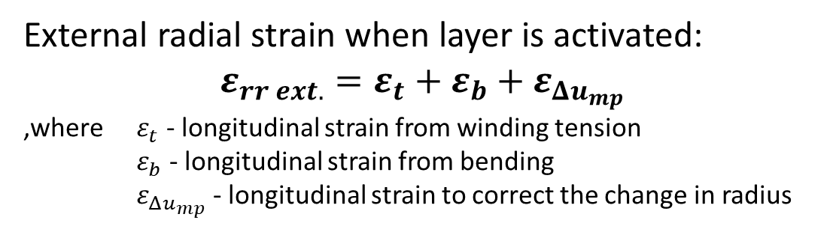
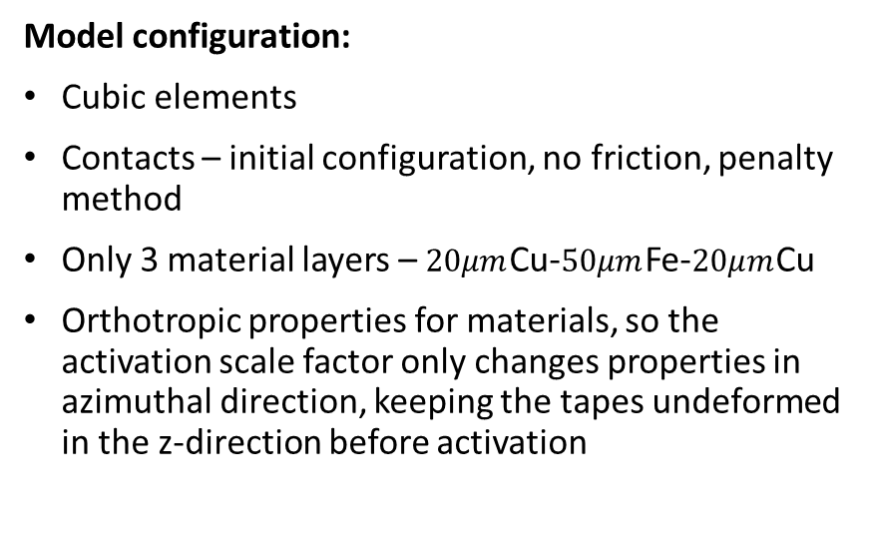

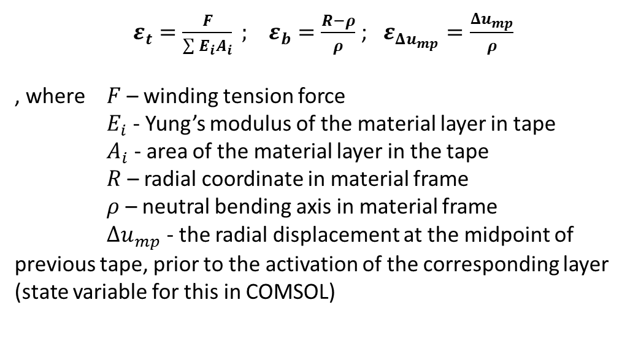
Modelling approach
inactive layers
Material activation in combination with external strain.
$$Δu_{mp}$$
mandrel
External radial strain when layer is activated:
$$ε_{rr ext.}=ε_{t}+ε_{b}+ε_{Δu_{mp}}$$
,where $ε_{t}$ - longitudinal strain from winding tension
$ε_{b}$ - longitudinal strain from bending
$ε_{Δu_{mp}}$ - longitudinal strain to correct the change in radius
activated layers
$ε_{t}=\frac{F}{\sum{E_{i}A_{i}}} ;$ $ε_{b}=\frac{R−ρ}{ρ}$; $ε_{Δu_{mp}}=\frac{Δu_{mp}}{ρ}$
, where $F$ – winding tension force
$E_{i}$ - Yung’s modulus of the material layer in tape
$A_{i}$ - area of the material layer in the tape
$R$ – radial coordinate in material frame
$ρ$ – neutral bending axis in material frame
$Δu_{mp}$ - the radial displacement at the midpoint of previous tape, prior to the activation of the corresponding layer (state variable for this in COMSOL)
Model configuration:
Cubic elements
Contacts – initial configuration, no friction, penalty method
Only 3 material layers – $20μm$Cu-$50μm$Fe-$20μm$Cu
Orthotropic properties for materials, so the activation scale factor only changes properties in azimuthal direction, keeping the tapes undeformed in the z-direction before activation

Slide 11
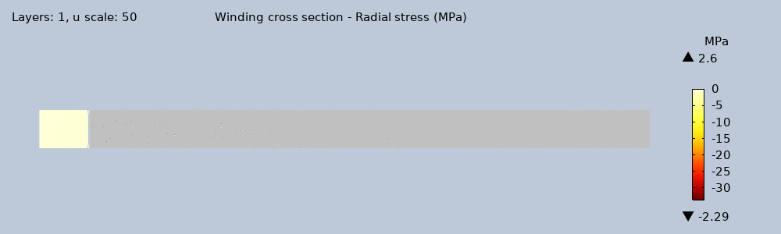
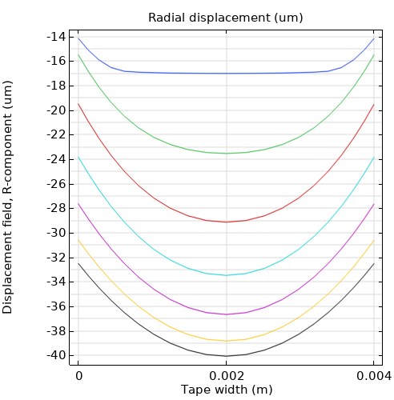
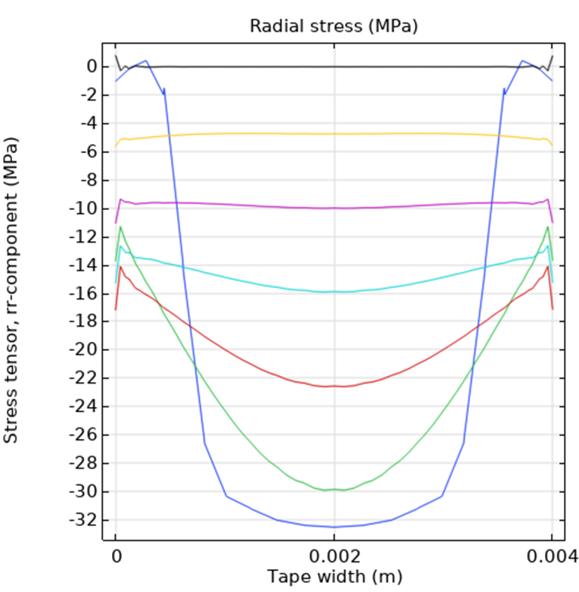
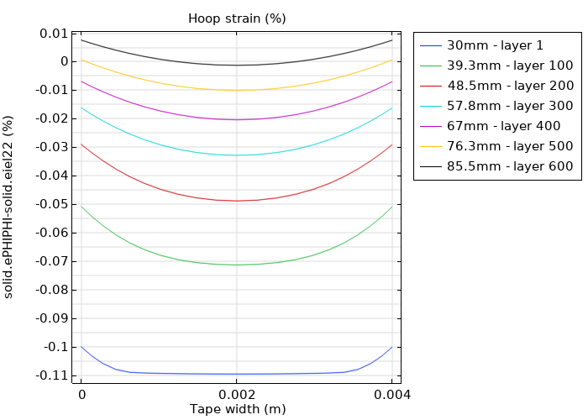
Cumulative stresses (both longitudinal tension and bending)
4mm tape
Fe mandrel – ID 50mm, OD 60mm
50N longitudinal tension
No friction between tapes

Slide 12
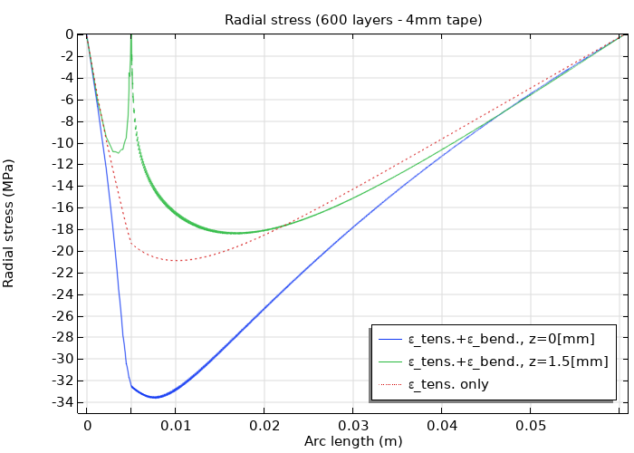
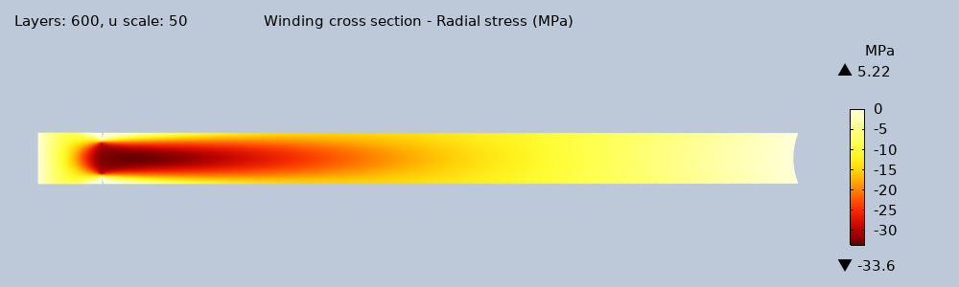
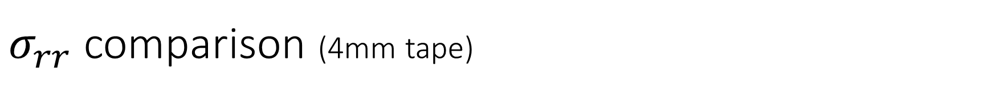
$σ_{rr}$ comparison (4mm tape)
Tension + bending 0.5mm from edge
Tension only
z=1.5[mm]
Tension + bending at the centre
z=0[mm]
$$σ_{rr min}=−33.4 MPa$$

Slide 13
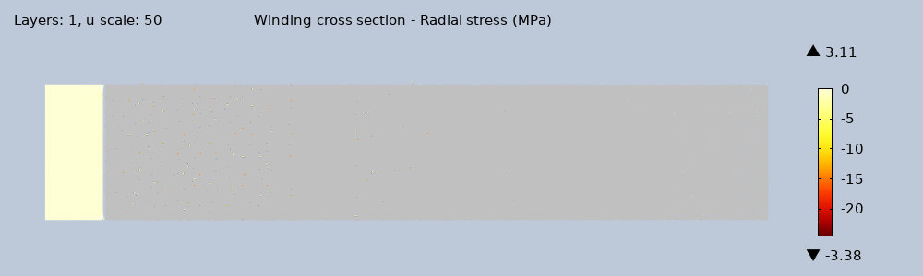
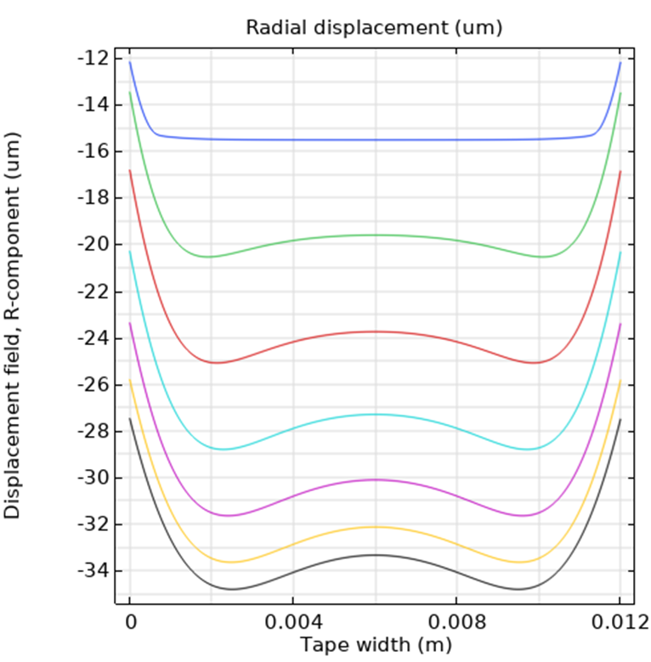
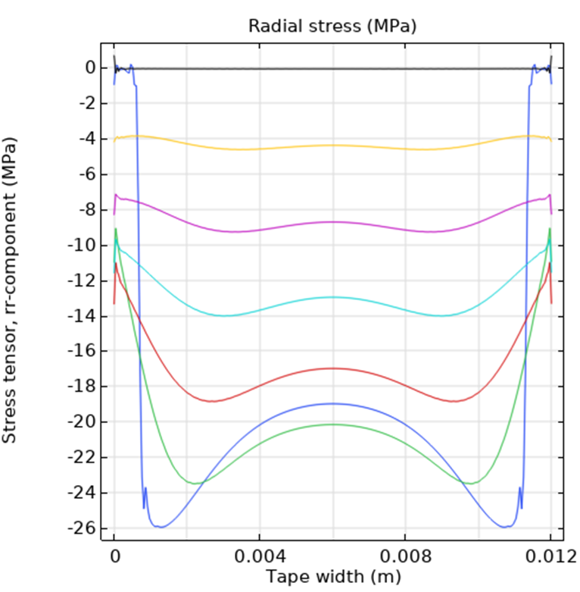
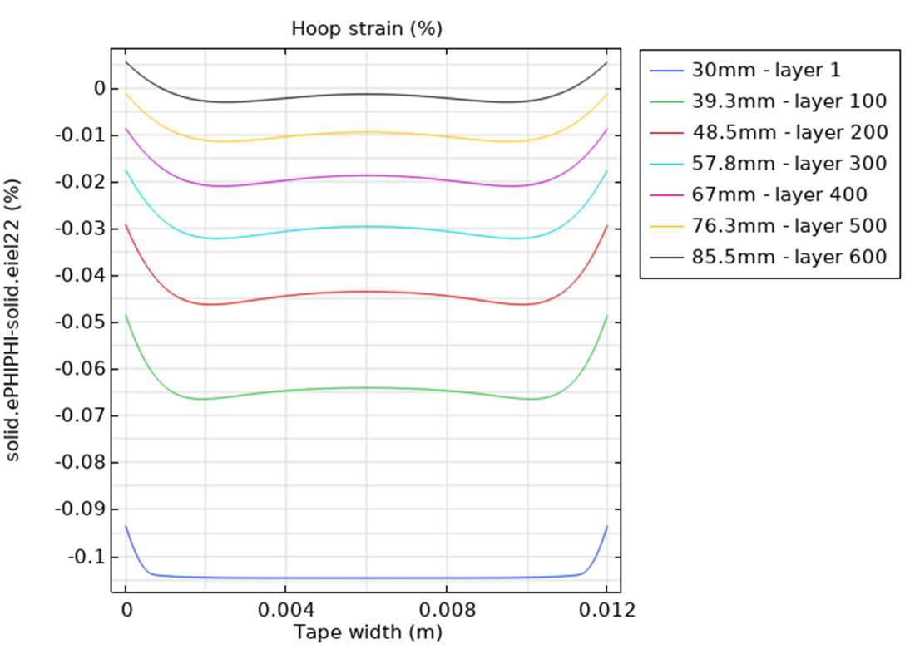
Cumulative stresses (both longitudinal tension and bending)
12mm tape
Fe mandrel – ID 50mm, OD 60mm
50N longitudinal tension
No friction between tapes

Slide 14
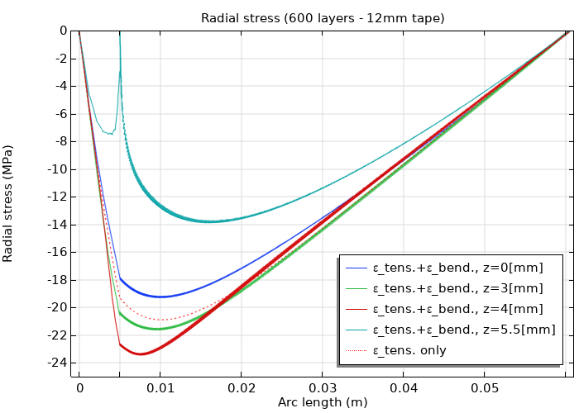
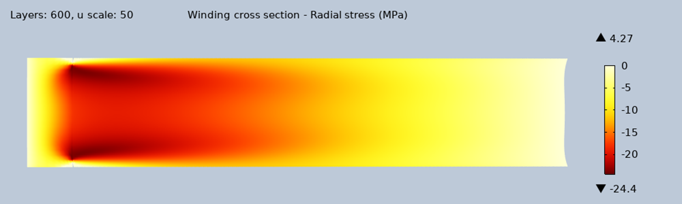
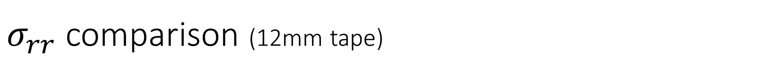

$σ_{rr}$ comparison (12mm tape)
Tension + bending at the centre
z=0[mm]
$$σ_{rr min}=−24.4MPa$$
Tension only

Slide 15
Removal of the mandrel & radial precompression
To model the soldering of the tapes, the Adhesion contact condition is applied, which introduces adhesive elastic traction at the interface between the tapes.
The mandrel is gradually removed by reducing its diameter
Gradually 200MPa radial precompression applied at the outer winding boundary

Slide 16
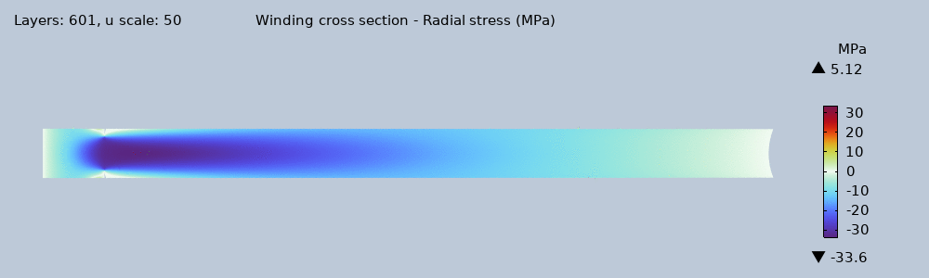
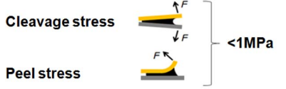
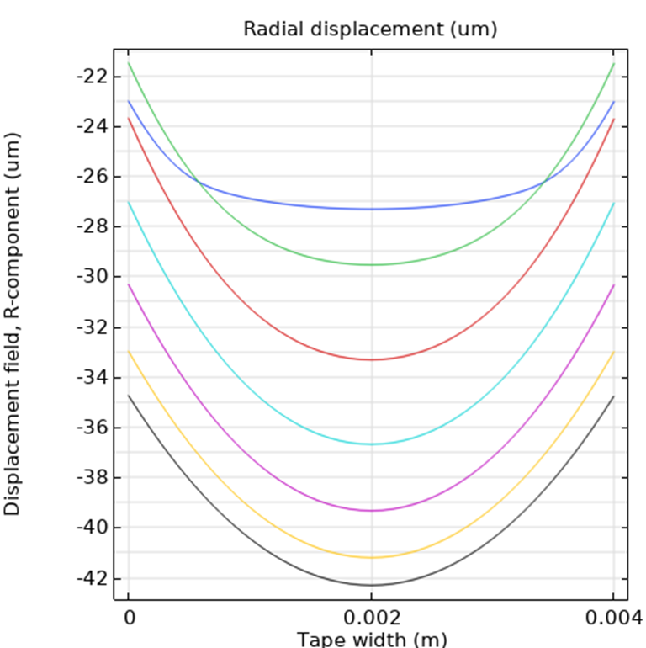
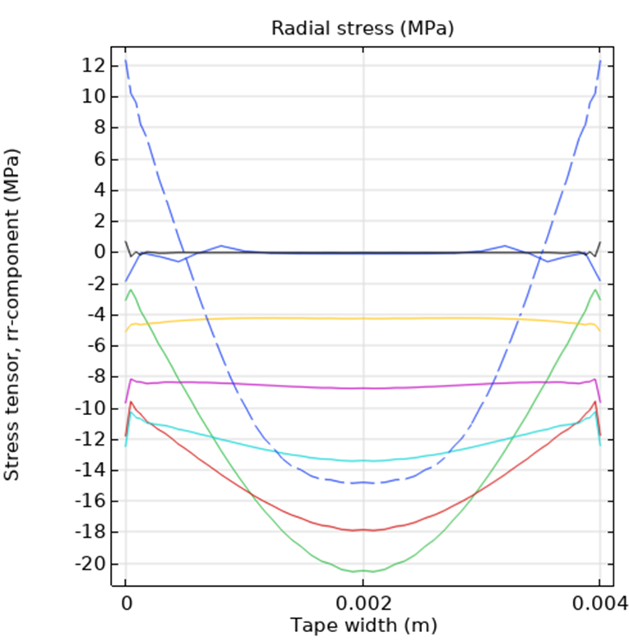
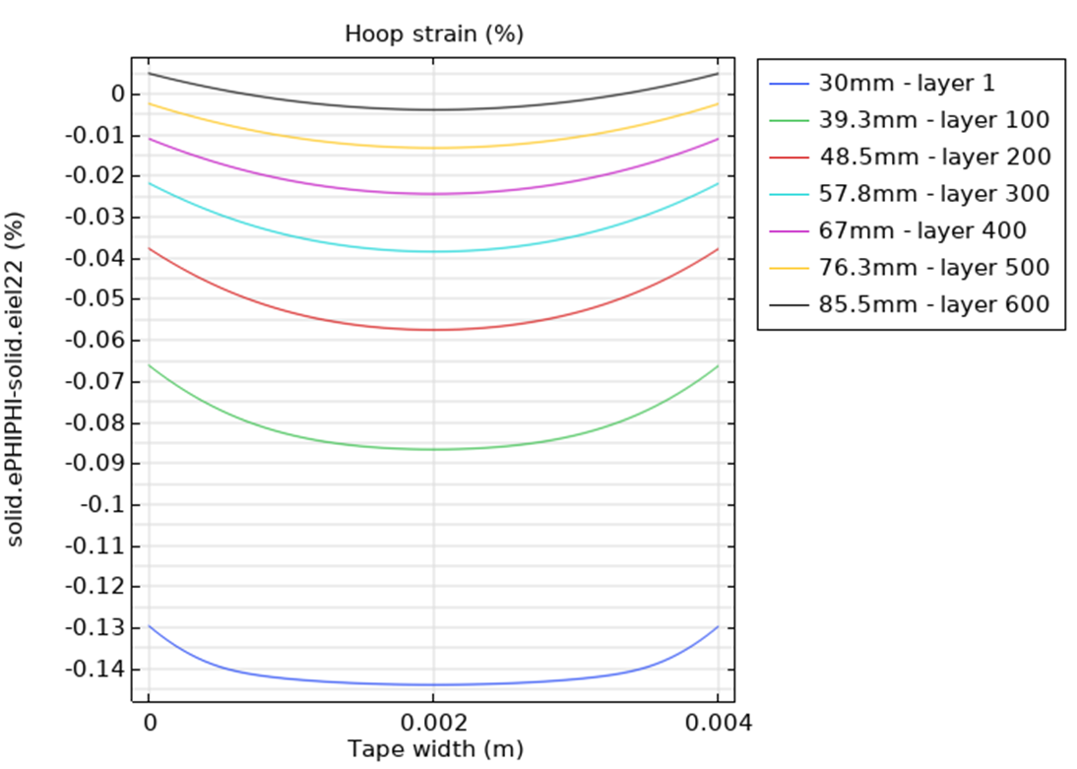
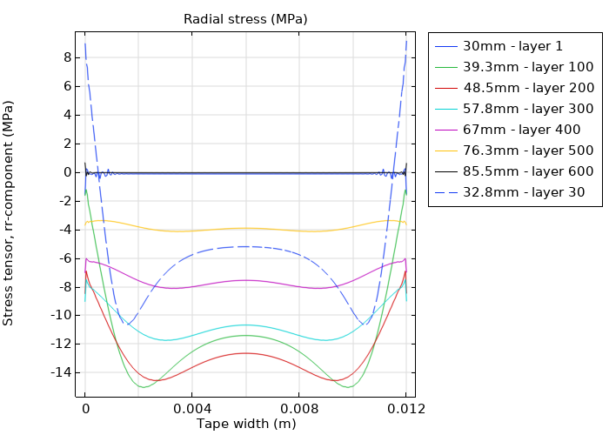
Cumulative stresses – removal of the mandrel
4mm tape
Might be a problem??
(only first <100 layers)

Slide 17
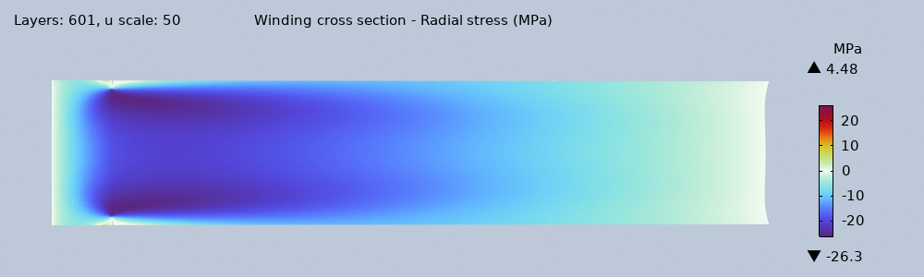
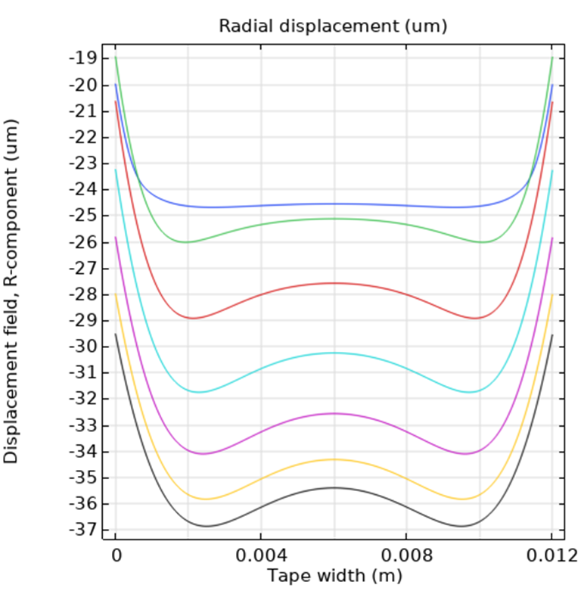
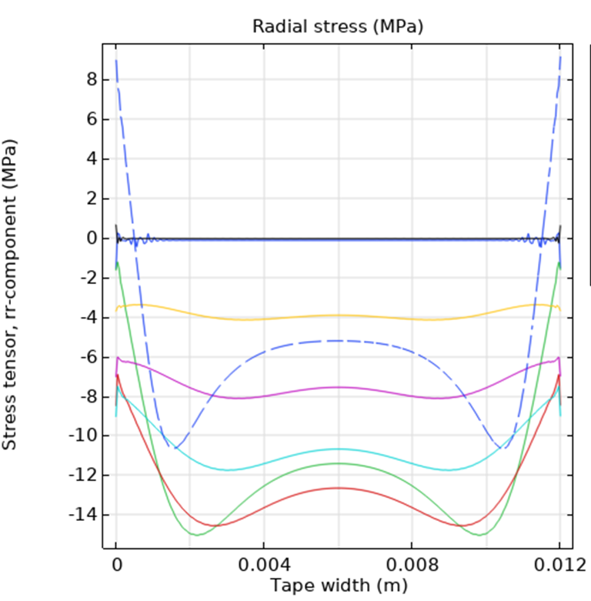
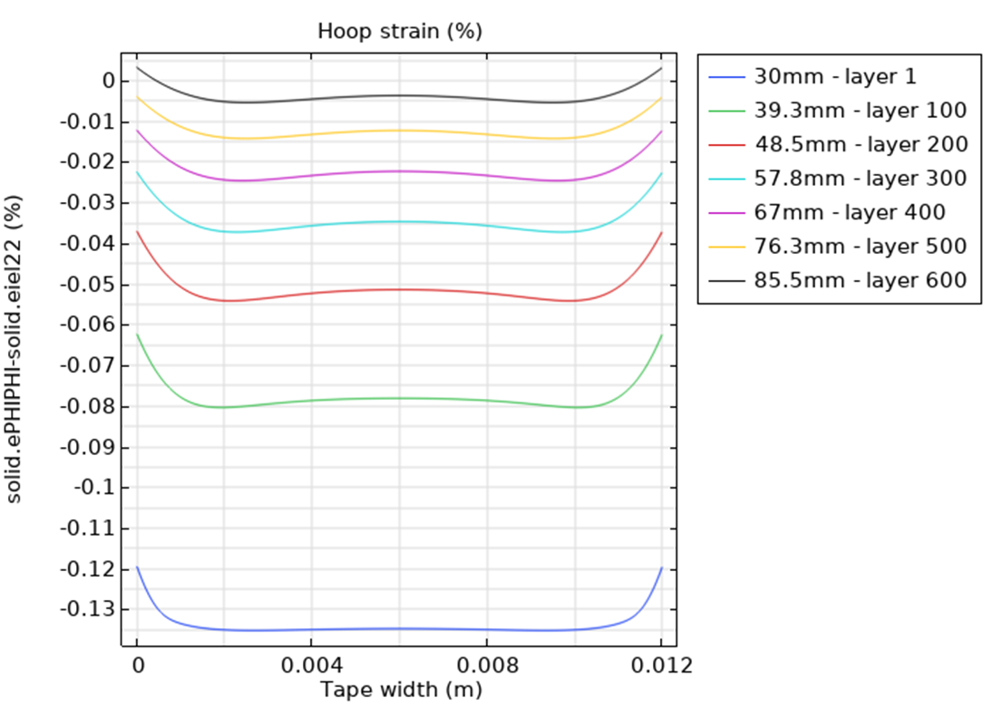
Cumulative stresses – removal of the mandrel
12mm tape

Slide 18
Radial precompression

Slide 19
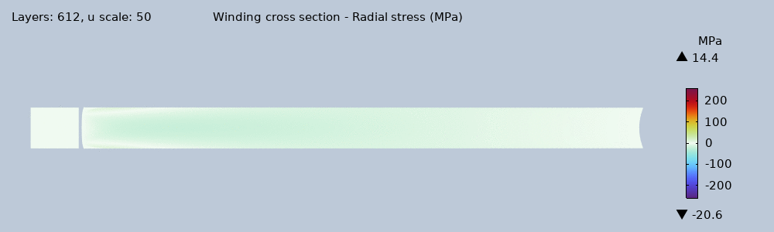
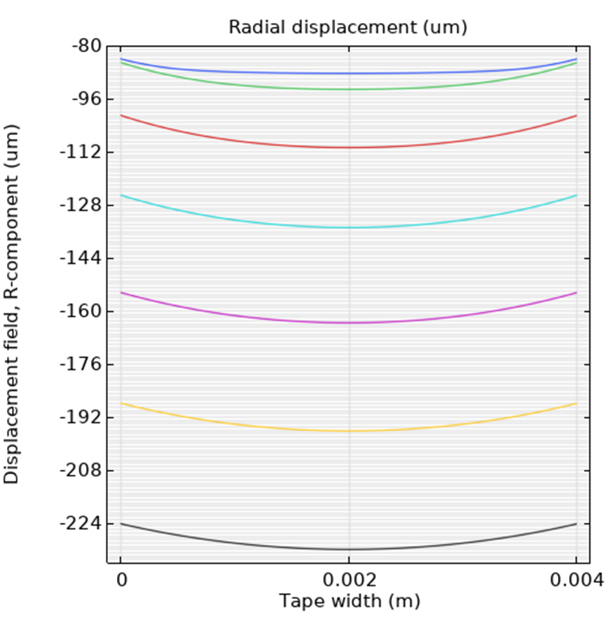
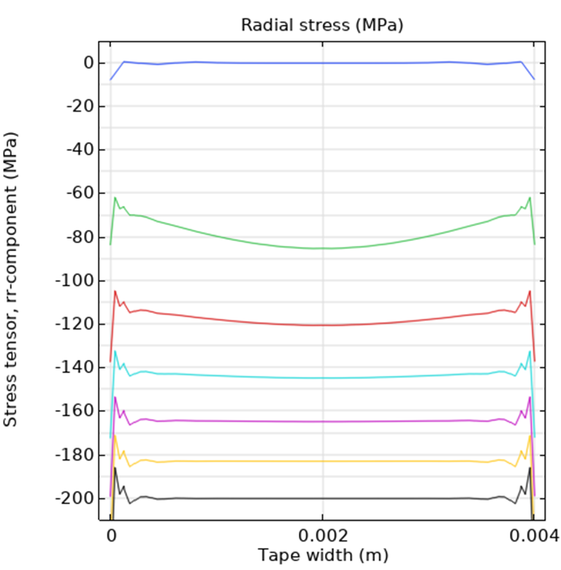
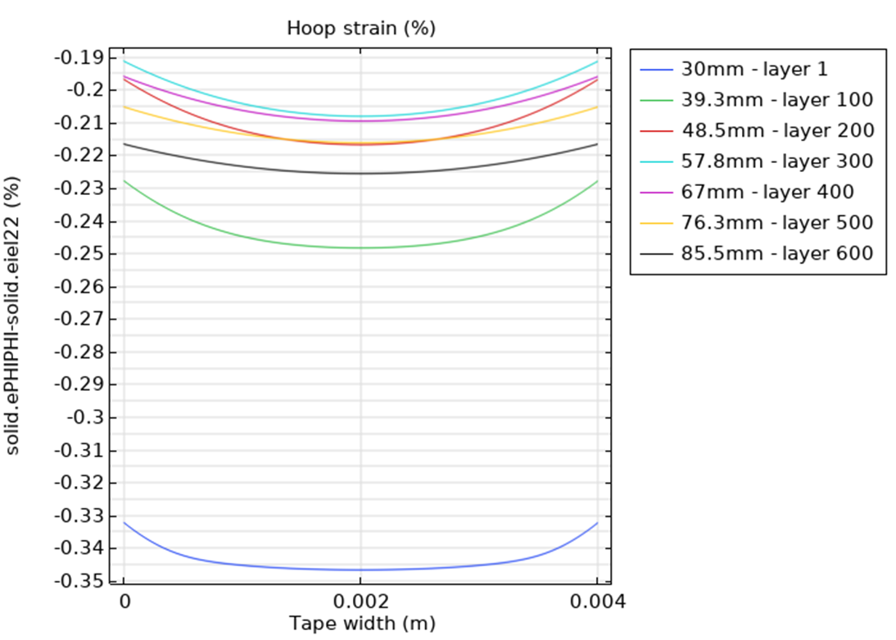
Cumulative stresses – radial precompression
200MPa radial precompression
4mm tape

Slide 20
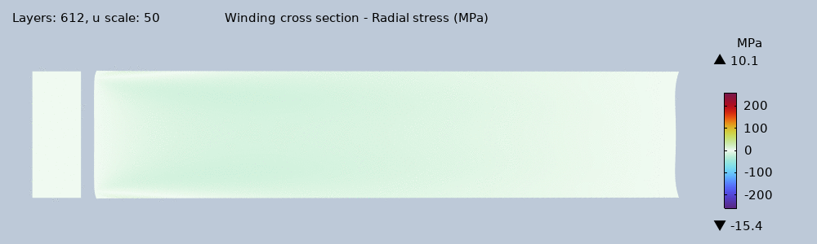



Cumulative stresses – radial precompression
200MPa radial precompression
12mm tape

Slide 21


Hoop strain (in the superconductive layer, measured at the tape centre)

Slide 22

Conclusions
~8 um max. curvature
Edges of the first 100 inner layers may be subjected to positive radial stress - (Max. ~15MPa for 4mm and ~10MPa for 12mm)
Anticlastic curvature effects are minimal; thus, the initial axial stress in the winding can be assumed constant for complete solenoid modelling.
Bending and tension changes the hoop strain distribution
Temperature effects currently not included (now $T=293K$)

Slide 23
Thank you! :)

