Slide 1
Inner joints manufacturing
Jorge GUARDIA (EN-MME Main Workshop)
Muon Collider final cooling solenoid
07-11-2025

Slide 2
Inner joints requirements
Transfer current between pancakes
Help thermal transfer with cooling fluid
Do not induce stress on pancakes (differential thermal expansion)
Easy to manufacture
Pancake coil
Separator (to be defined)
Pancake coil
Inner joint
*Internal radial spring not depicted
Two possible materials:
Copper -> Excellent in all requirements, except for its too high thermal expansion coefficient
Superconducting tape
Two joining methods:
Soldering
Contact pressure

Slide 3
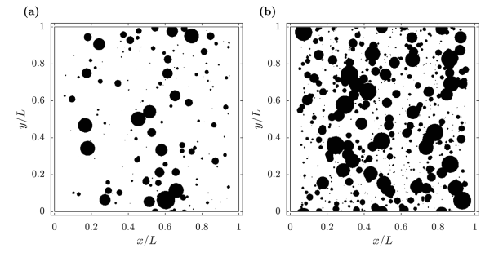
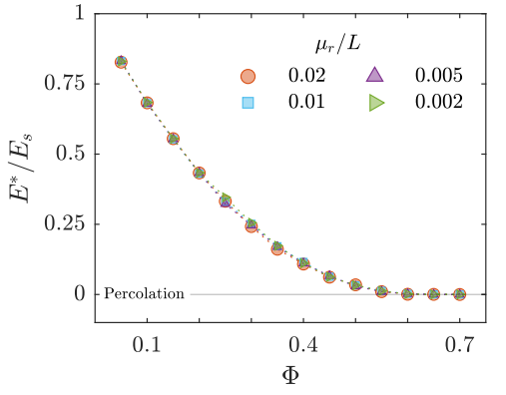
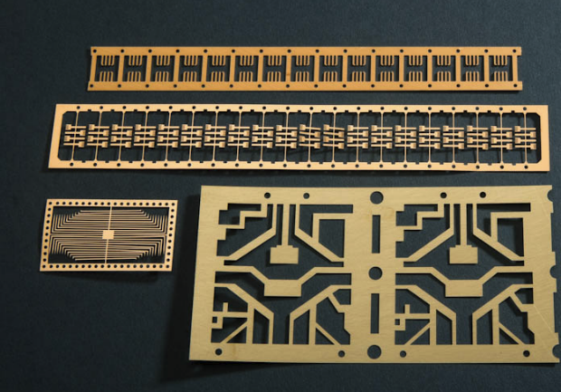
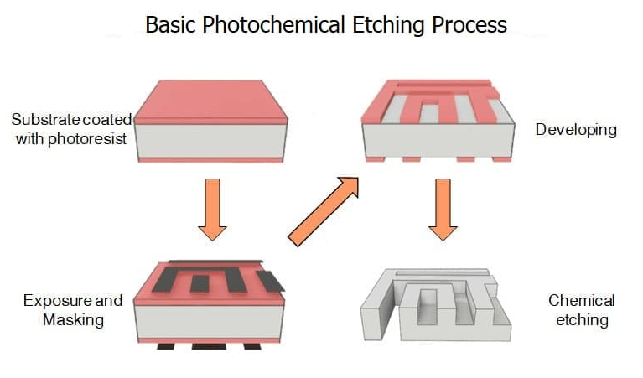
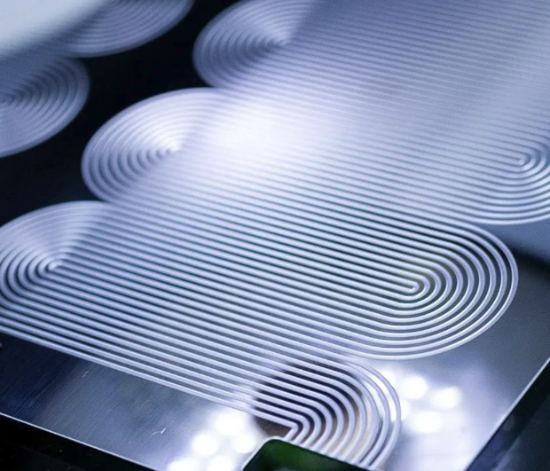
Copper joints: Reducing thermal stresses
Optimise copper thickness
Optimise geometry
Remove material to lower rigidity of the copper foil
→ Chemical etching
Effect of porosity and pore size distribution on elastic modulus of foams
International Journal of Mechanical Sciences 261 (2024) https://doi.org/10.1016/j.ijmecsci.2023.108661

Slide 4
Possible geometries, manufacturable with etching
High precision: For 0.2 mm thick copper foil, the minimum slot/hole size is ~0.3 mm
*Internal radial spring not depicted

Slide 5
Conclusions
Consider copper chemical etching for the inner joints
Define minimum copper thickness required for the current
Define assembly method (solder/ contact pressure)
Define cooling channels requirements
Optimise the geometry with FEM simulations, keeping in mind fabrication and assembly constrains

