Slide 1
WP4 & WP2 Meeting:
Crab Cavity Higher Order Modes Review
Amelia Edwards on behalf of WP4
1st April 2025

Slide 2
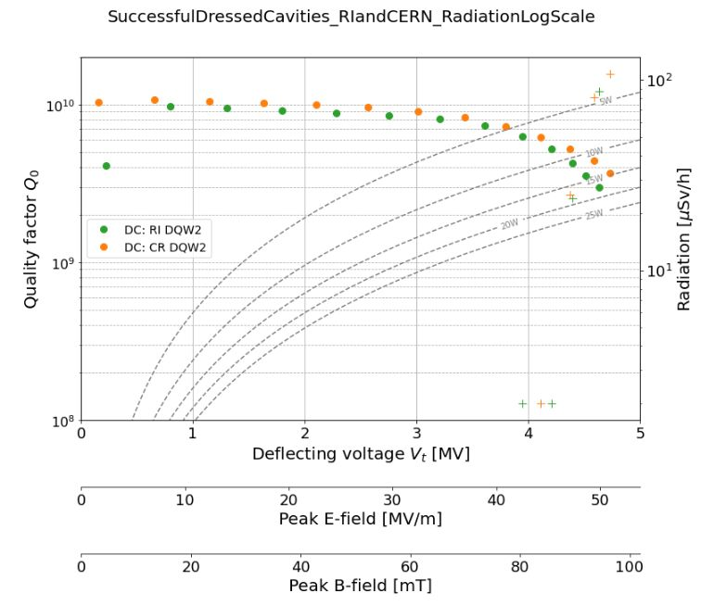
Status:
Two dressed cavities validated – CERN DQW2 & RI DQW2
HOM measurements taken during vertical cold tests with HOM couplers in SM18 to be presented here
HOM impedances calculated from S21 measurements
Adapters used in cold test for 25 Ω to 50 Ω
All port combinations measured
Results shown here present the highest impedance measured between ports - a ‘worst case’ type scenario
R/Q values from simulation… EDMS 1347072
Hom annex: 2488213
Two more cavities under test – CERN DQW1 & RI DQW1

Slide 3
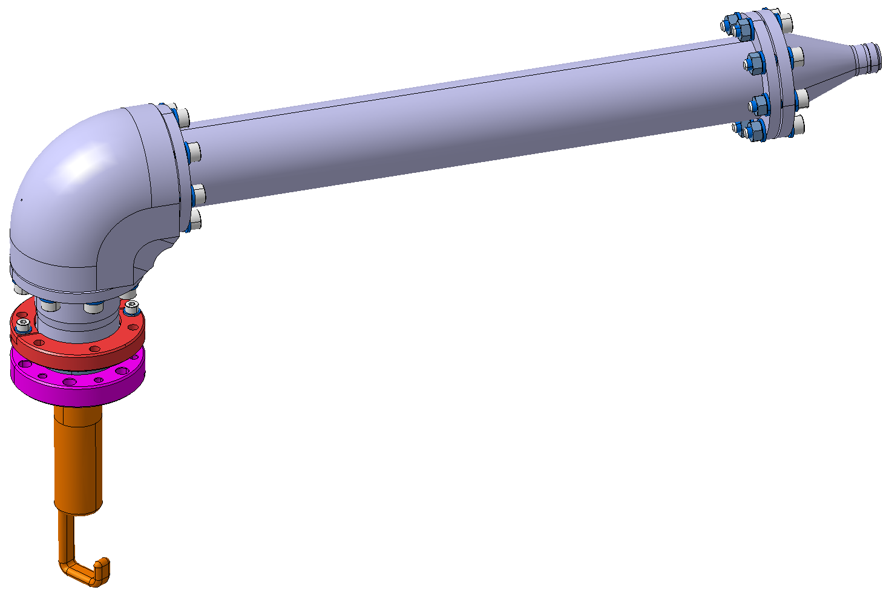
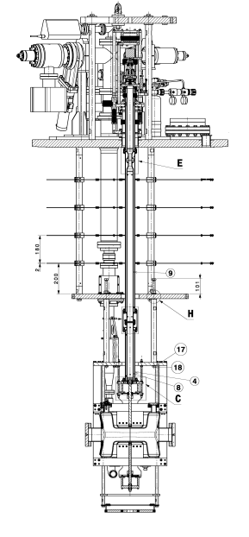
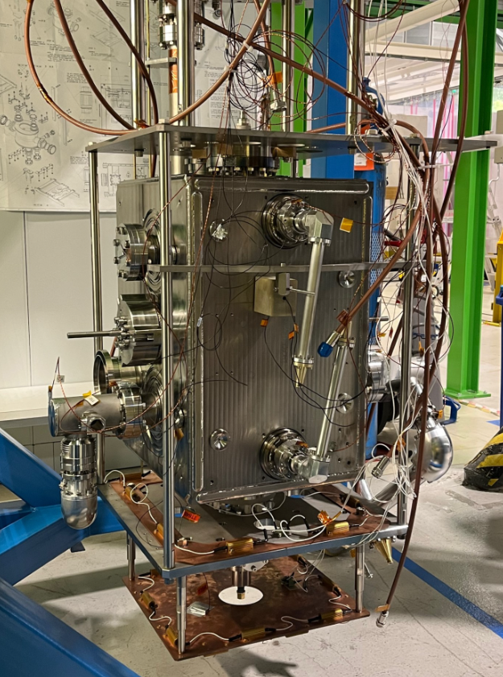
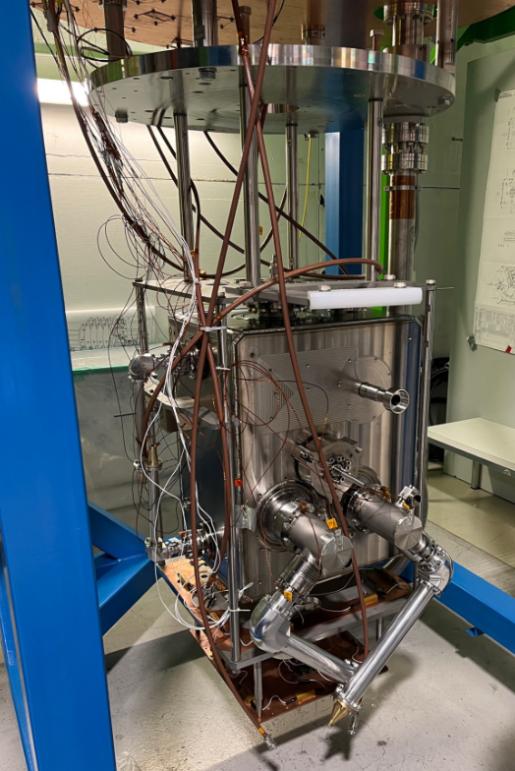
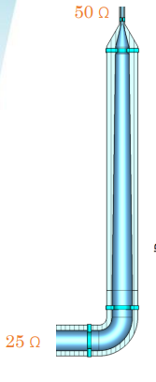
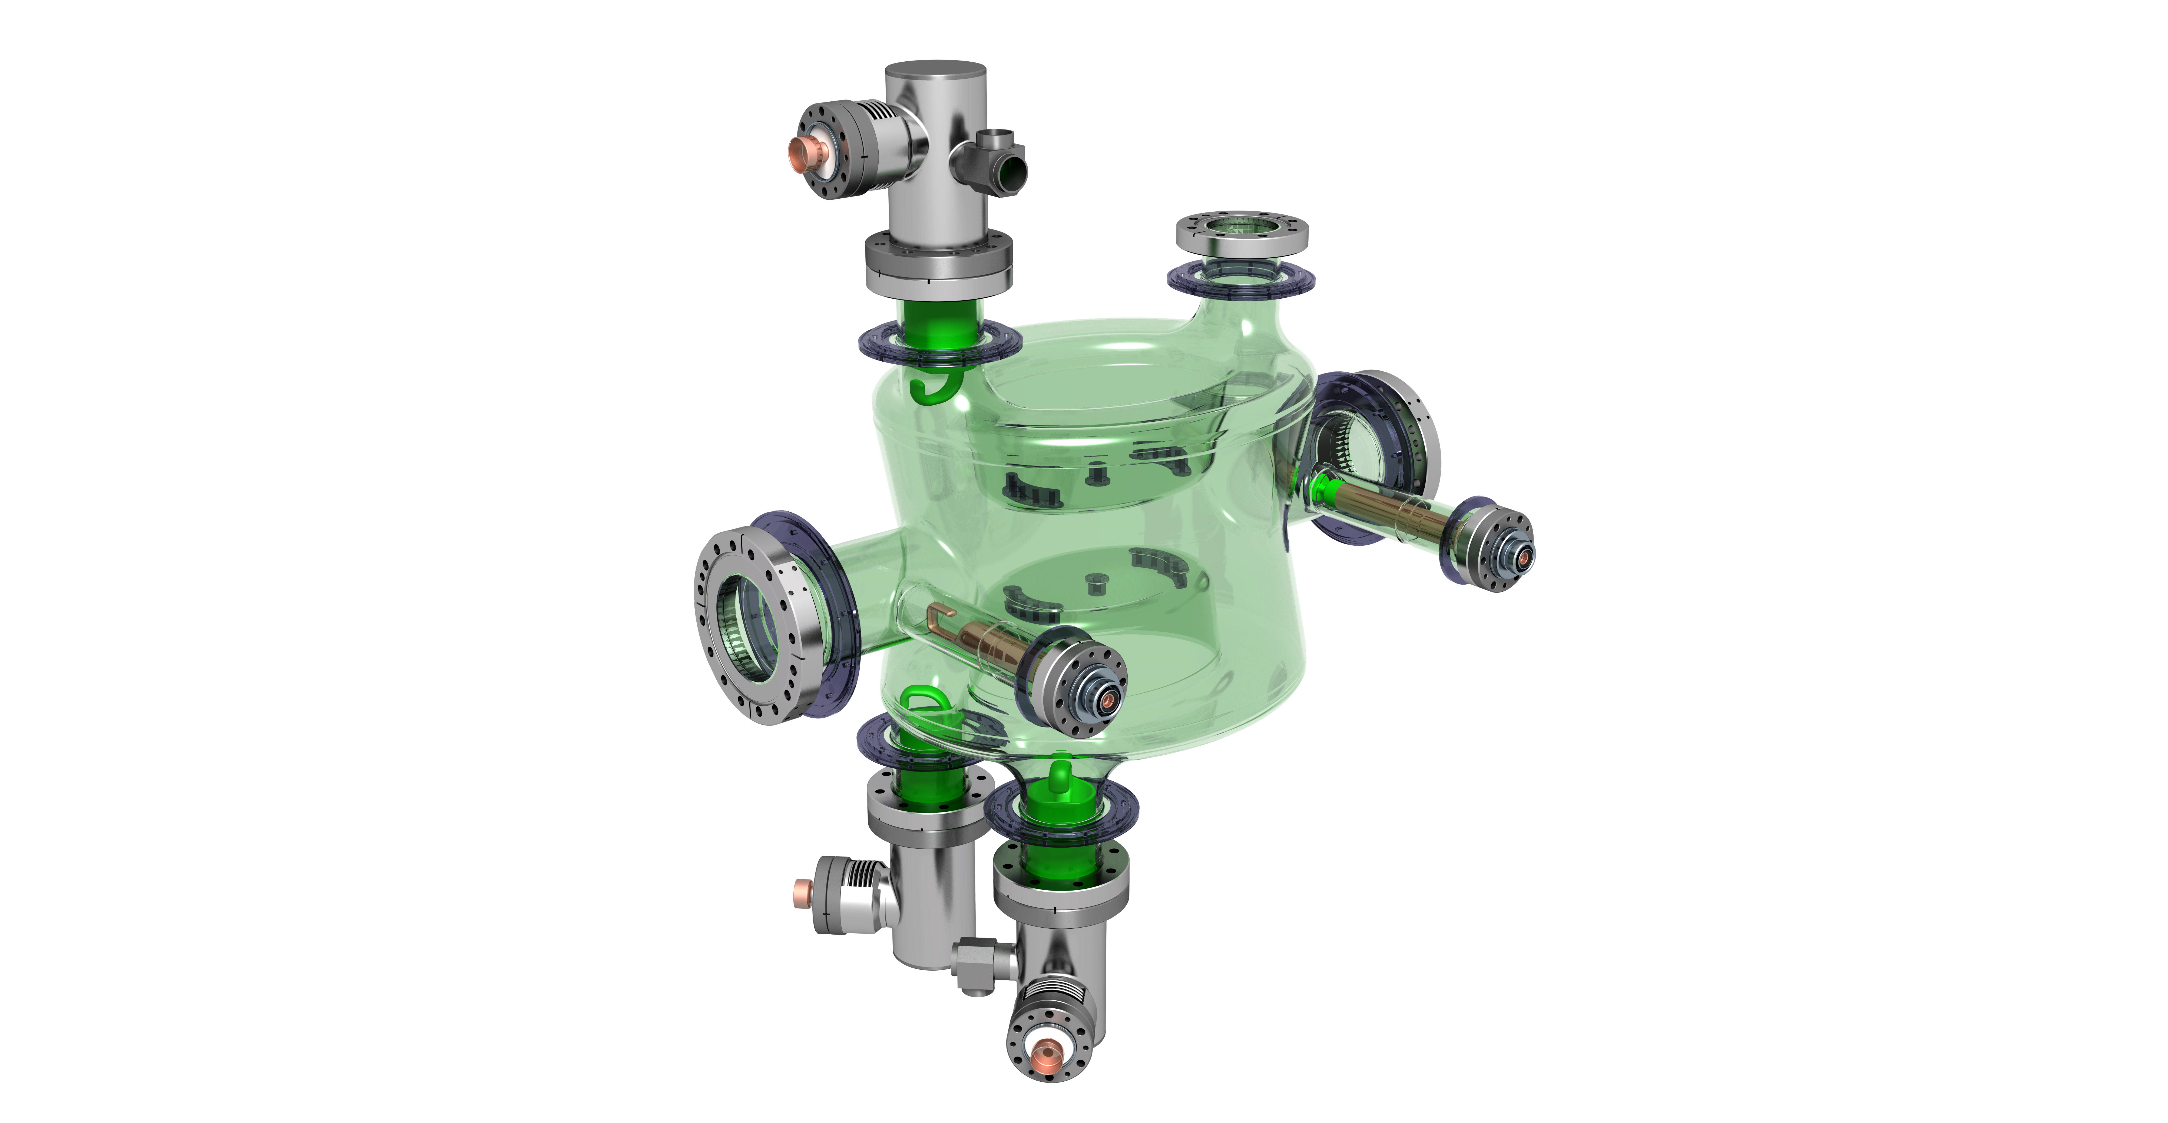
Measurement Setup
VNA
VNA Measurements parameters:
100,001 points
300MHz to 2GHz
IF BW 1kHz
Power 0dBm
S21

Slide 4
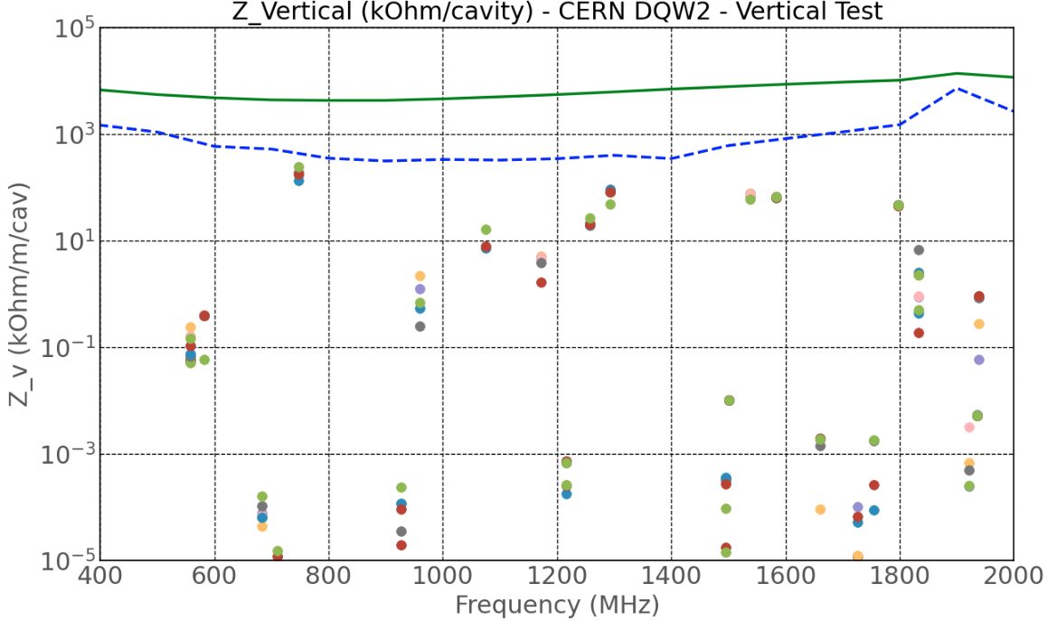
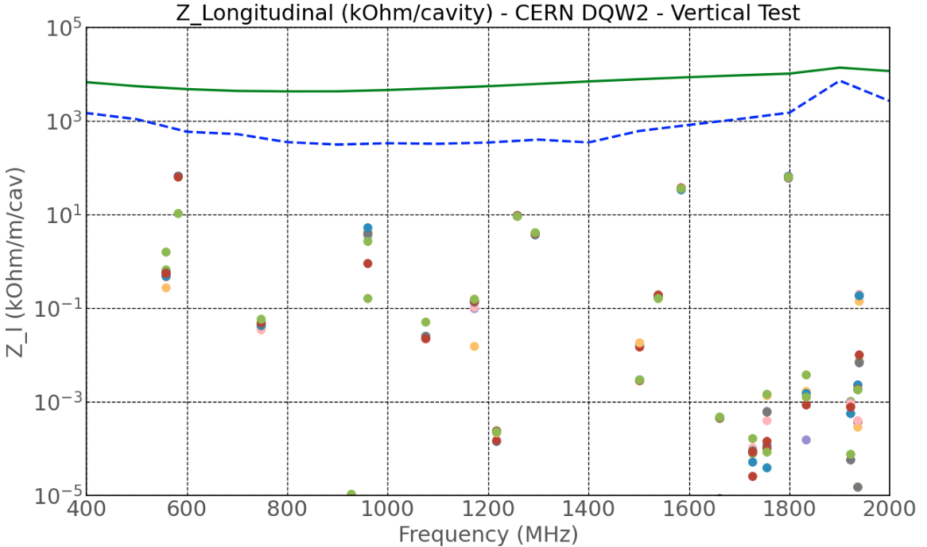
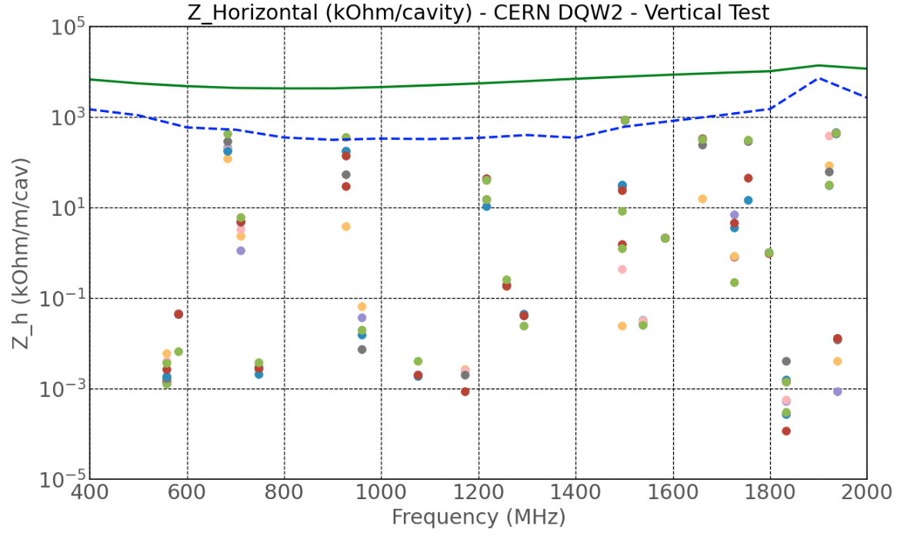
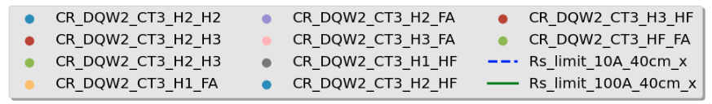
CERN DQW2 – Tested Oct 2023
Validated three cold tests, measurements shown are from the final test (full results in extra slides)

Slide 5
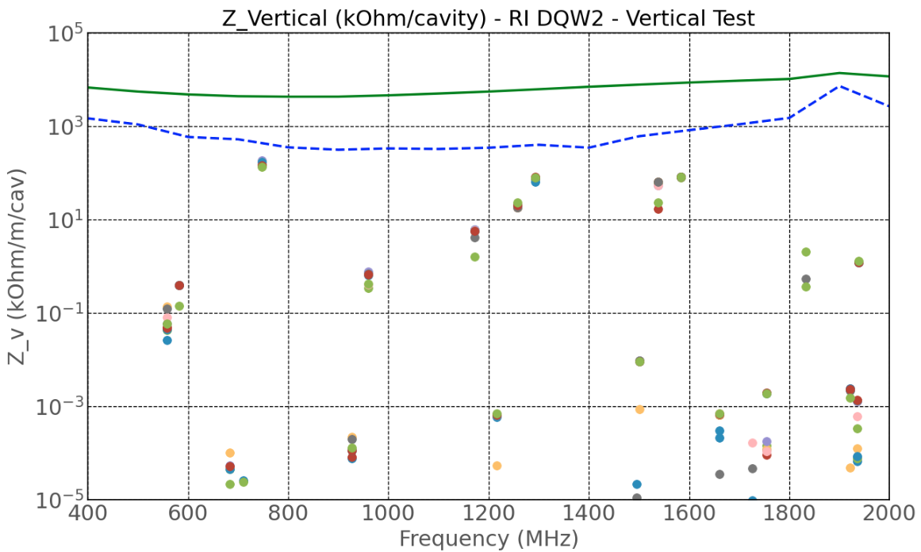
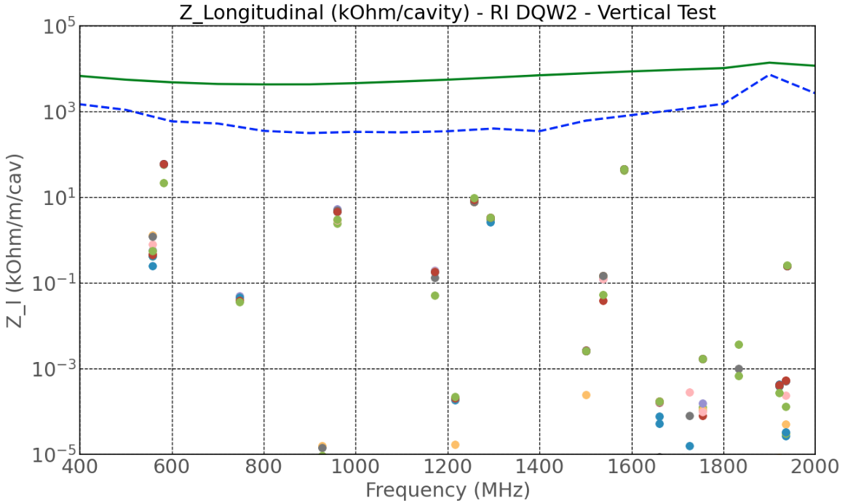
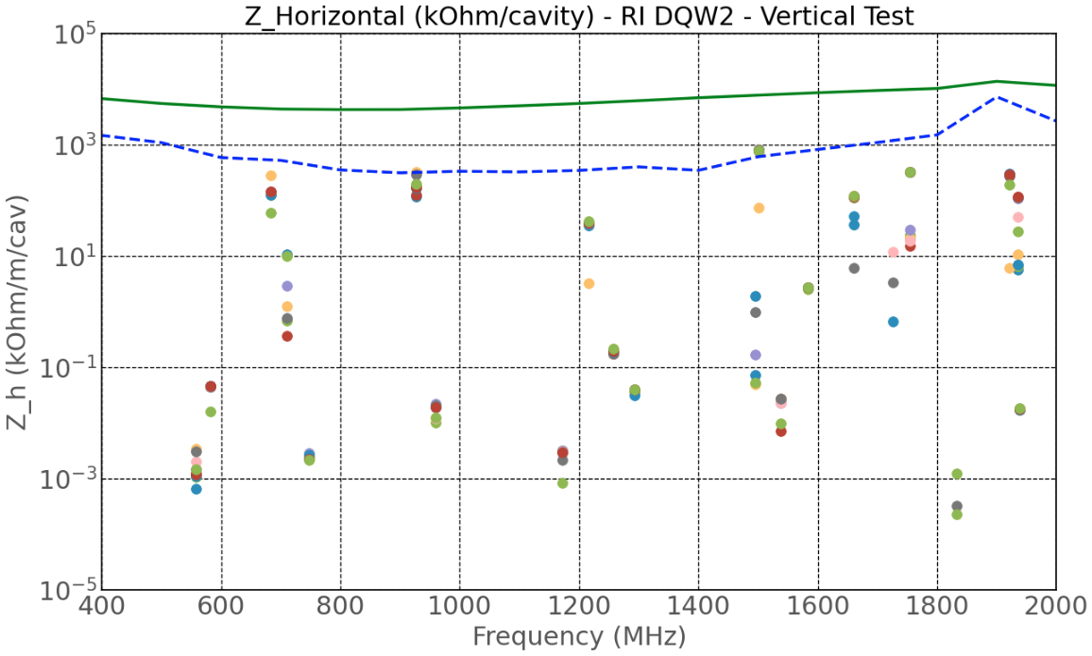
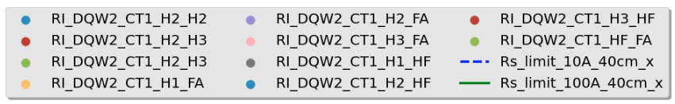
RI DQW2 – Tested Dec 2023
Validated after one cold test

Slide 6
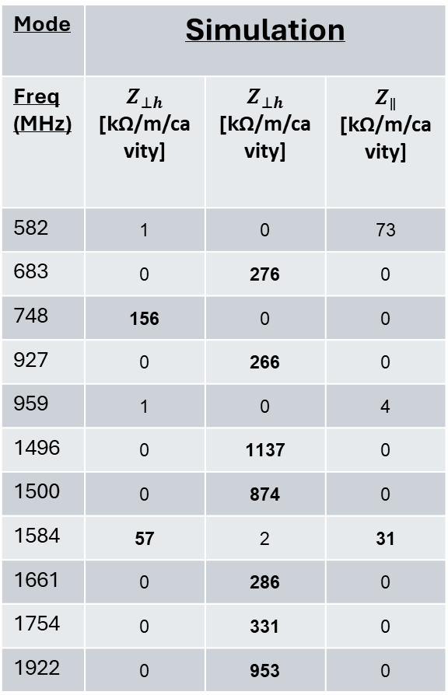
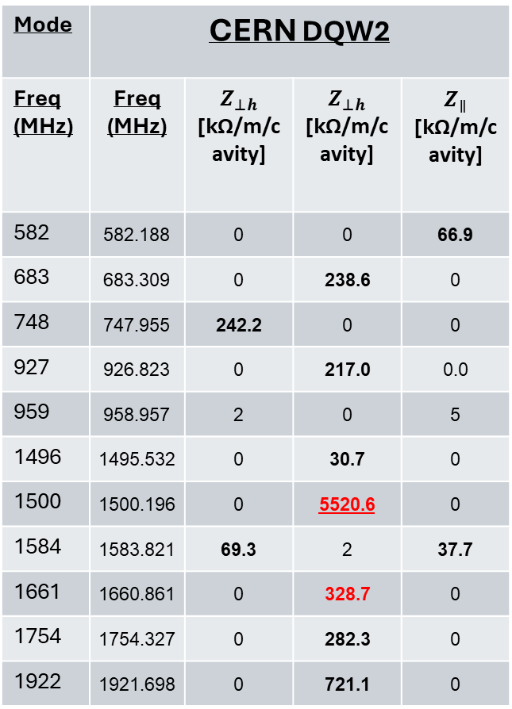
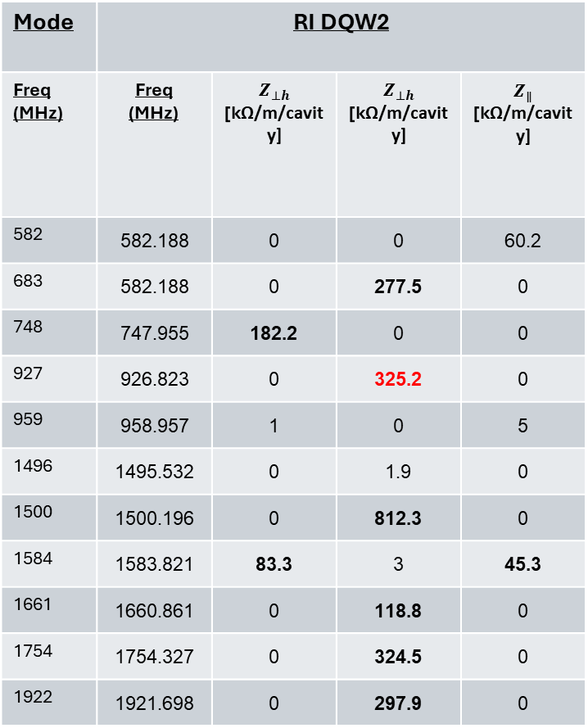
Summary
Mode | Simulation
Freq (MHz) | $$Z_{⊥h}$$ [kΩ/m/cavity] | $$Z_{⊥h}$$ [kΩ/m/cavity] | $$Z_{∥}$$ [kΩ/m/cavity]
582 | 1 | 0 | 73
683 | 0 | 276 | 0
748 | 156 | 0 | 0
927 | 0 | 266 | 0
959 | 1 | 0 | 4
1496 | 0 | 1137 | 0
1500 | 0 | 874 | 0
1584 | 57 | 2 | 31
1661 | 0 | 286 | 0
1754 | 0 | 331 | 0
1922 | 0 | 953 | 0
Mode | CERN DQW2
Freq (MHz) | Freq (MHz) | $$Z_{⊥h}$$ [kΩ/m/cavity] | $$Z_{⊥h}$$ [kΩ/m/cavity] | $$Z_{∥}$$ [kΩ/m/cavity]
582 | 582.188 | 0 | 0 | 66.9
683 | 683.309 | 0 | 238.6 | 0
748 | 747.955 | 242.2 | 0 | 0
927 | 926.823 | 0 | 217.0 | 0.0
959 | 958.957 | 2 | 0 | 5
1496 | 1495.532 | 0 | 30.7 | 0
1500 | 1500.196 | 0 | 5520.6 | 0
1584 | 1583.821 | 69.3 | 2 | 37.7
1661 | 1660.861 | 0 | 328.7 | 0
1754 | 1754.327 | 0 | 282.3 | 0
1922 | 1921.698 | 0 | 721.1 | 0
Mode | RI DQW2
Freq (MHz) | Freq (MHz) | $$Z_{⊥h}$$ [kΩ/m/cavity] | $$Z_{⊥h}$$ [kΩ/m/cavity] | $$Z_{∥}$$ [kΩ/m/cavity]
582 | 582.188 | 0 | 0 | 60.2
683 | 582.188 | 0 | 277.5 | 0
748 | 747.955 | 182.2 | 0 | 0
927 | 926.823 | 0 | 325.2 | 0
959 | 958.957 | 1 | 0 | 5
1496 | 1495.532 | 0 | 1.9 | 0
1500 | 1500.196 | 0 | 812.3 | 0
1584 | 1583.821 | 83.3 | 3 | 45.3
1661 | 1660.861 | 0 | 118.8 | 0
1754 | 1754.327 | 0 | 324.5 | 0
1922 | 1921.698 | 0 | 297.9 | 0

Slide 7
Extra Slides….

Slide 8
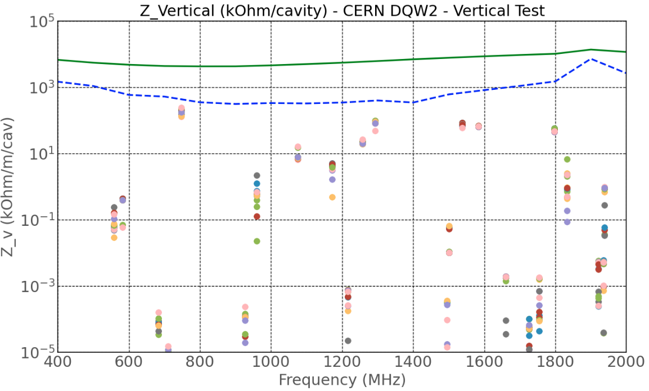
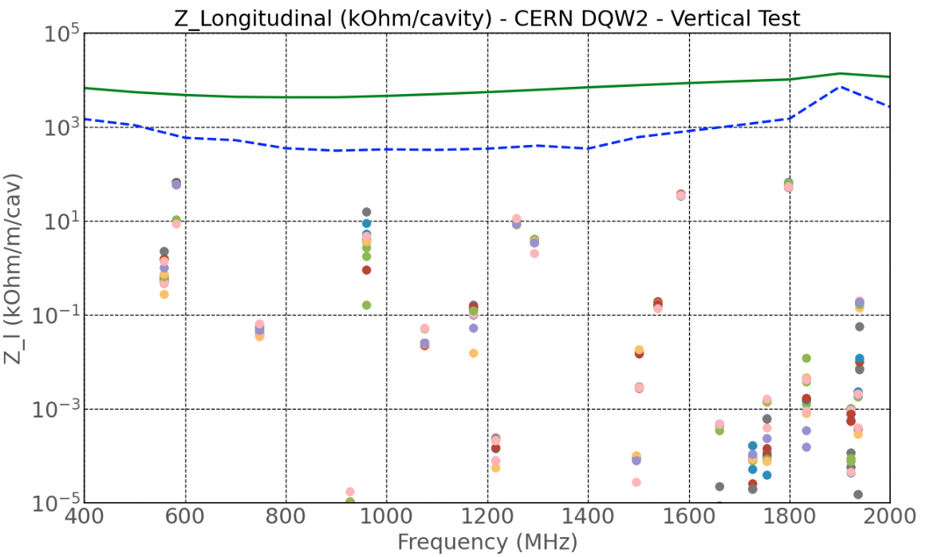
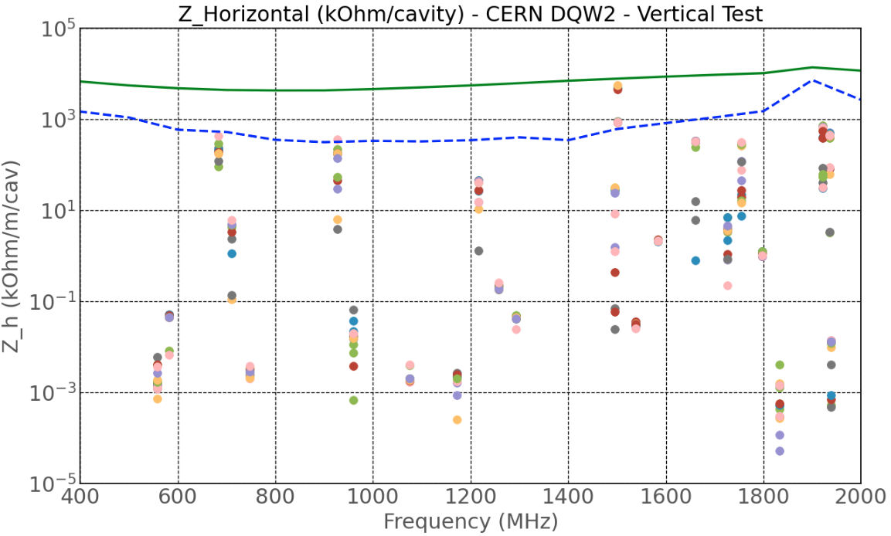
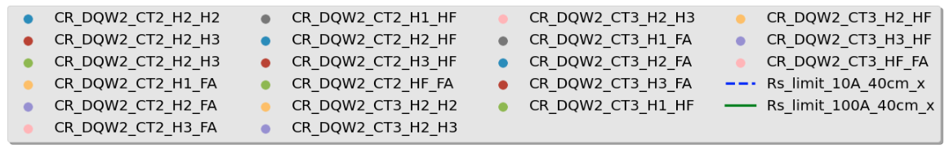
CERN DQW2
Validated three cold tests, measurements are available from the 2nd & 3rd tests

Slide 9
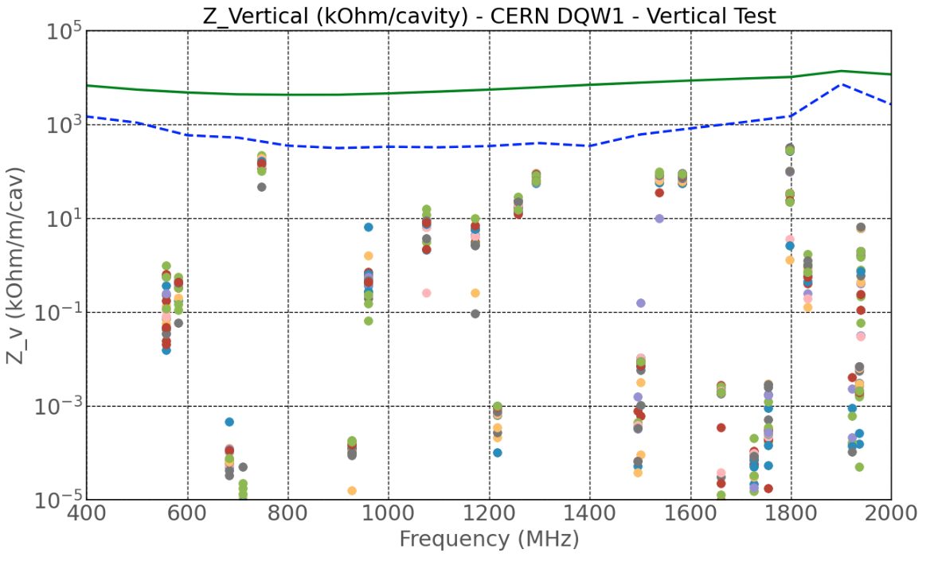
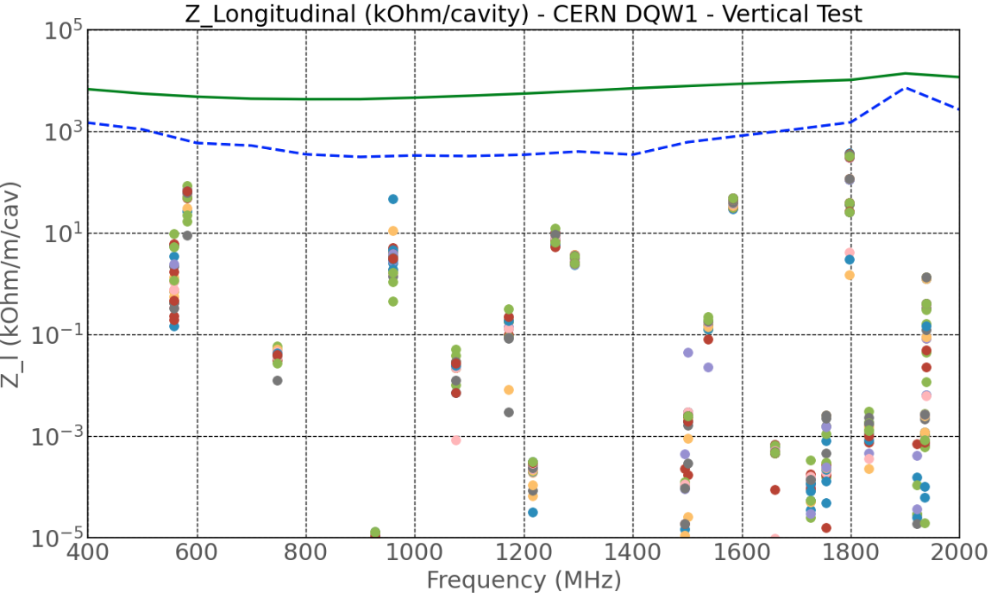
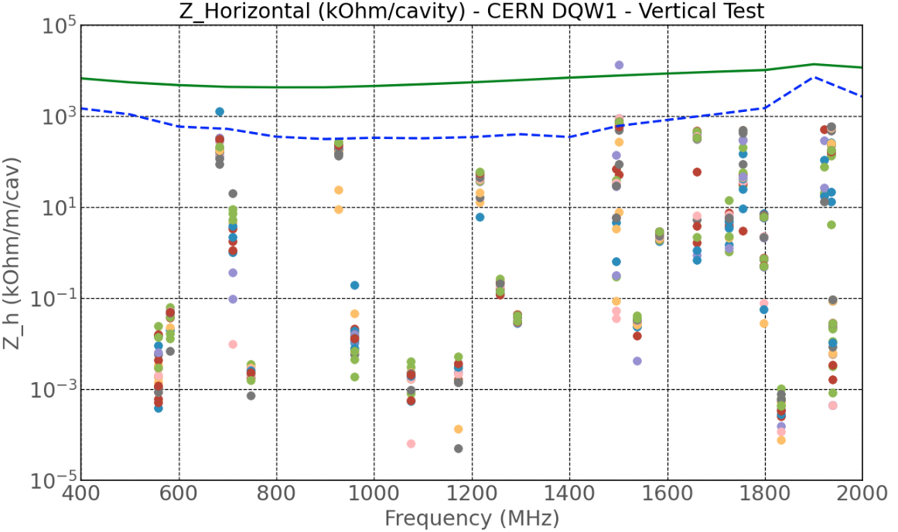
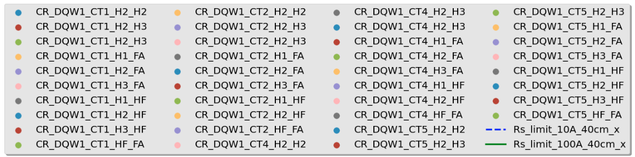
CERN DQW1:
Testing ongoing

Slide 10
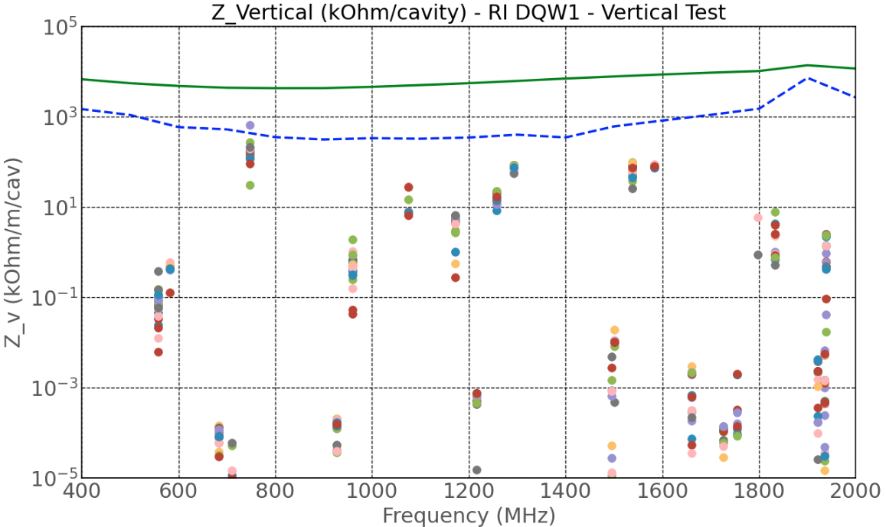
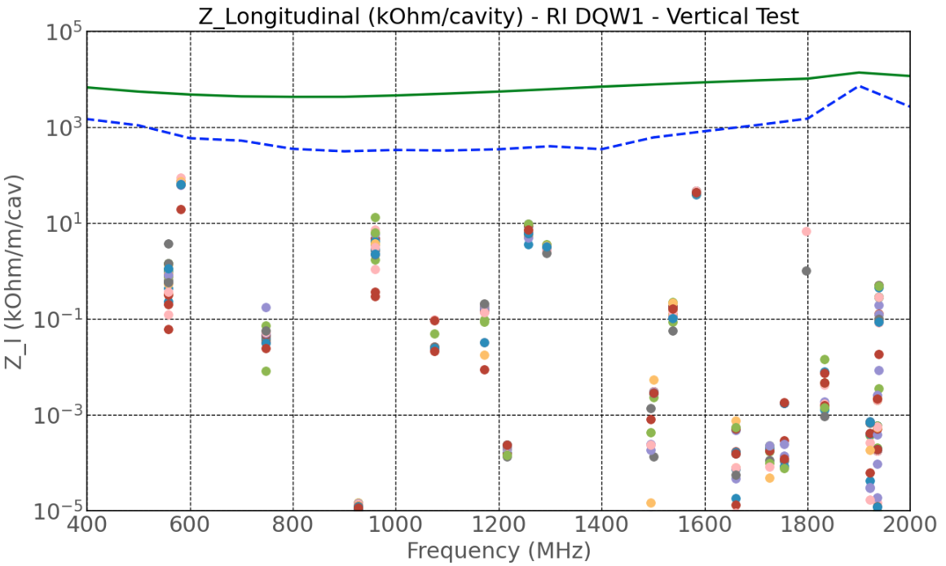
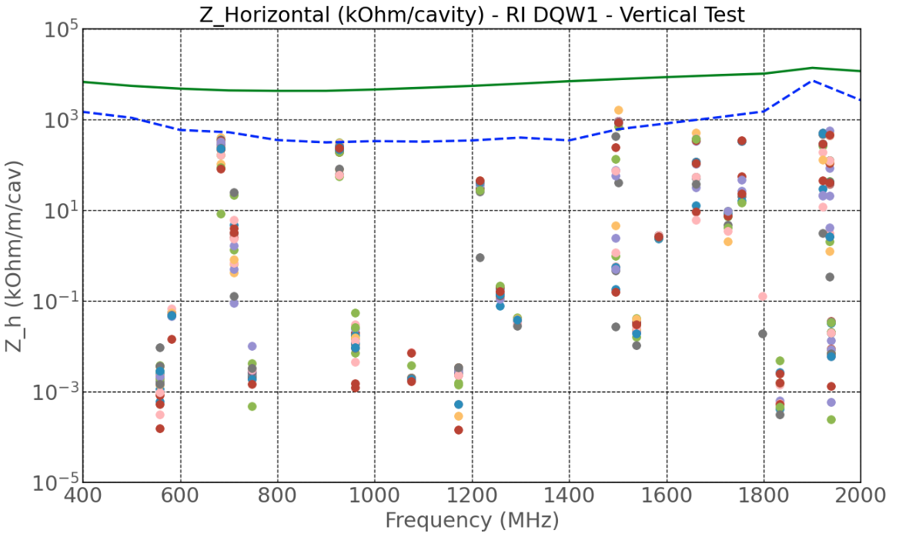
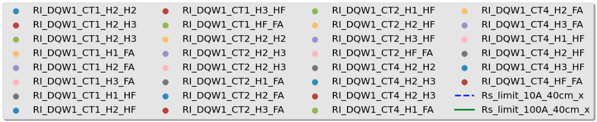
RI DQW1:
Testing ongoing

