Slide 1
WP4 & WP2 Meeting:
SPS Cavity Modifications for HL-LHC: Preliminary Simulations
Amelia Edwards & Teddy Capelli on behalf of WP4
1st April 2025

Slide 2
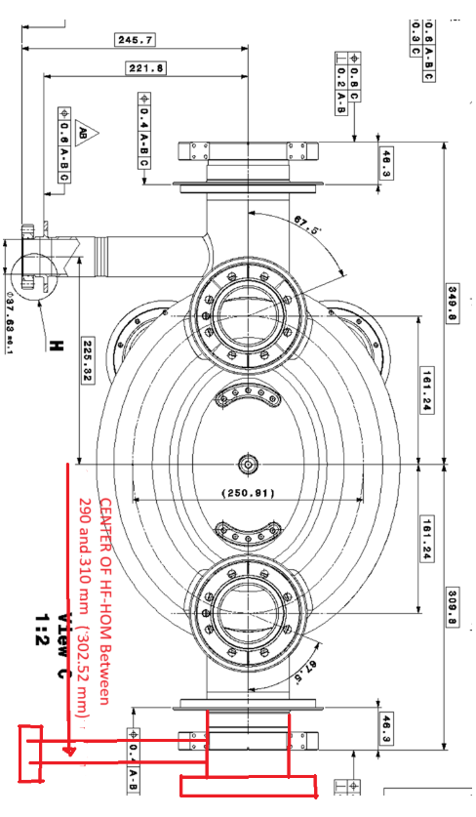
DQW Crab Cavity – SPS to LHC – Amendment to HFHOM Pickup position
From HOM annex (EDMS 2488213) the HF-HOM port is important for damping of two modes at 1500MHz and 1754MHz. The first because cavity, impedance supersedes the traverse threshold and the second because its coupling is longitudinal.
The damping is characterised here by the external quality factor of the mode
For the nominal cavity the distance from the cavity centre to the HFHOM pickup centre (along the beam axis) is 225.32mm. For the proposed design, the distance will increase to 302.52mm
HOM couplers are LHC design
Two main differences to simulate between the cavities:
Addition on second pickup (positioned further away from cavity centre)
Additonal length on HOM ports

Slide 3

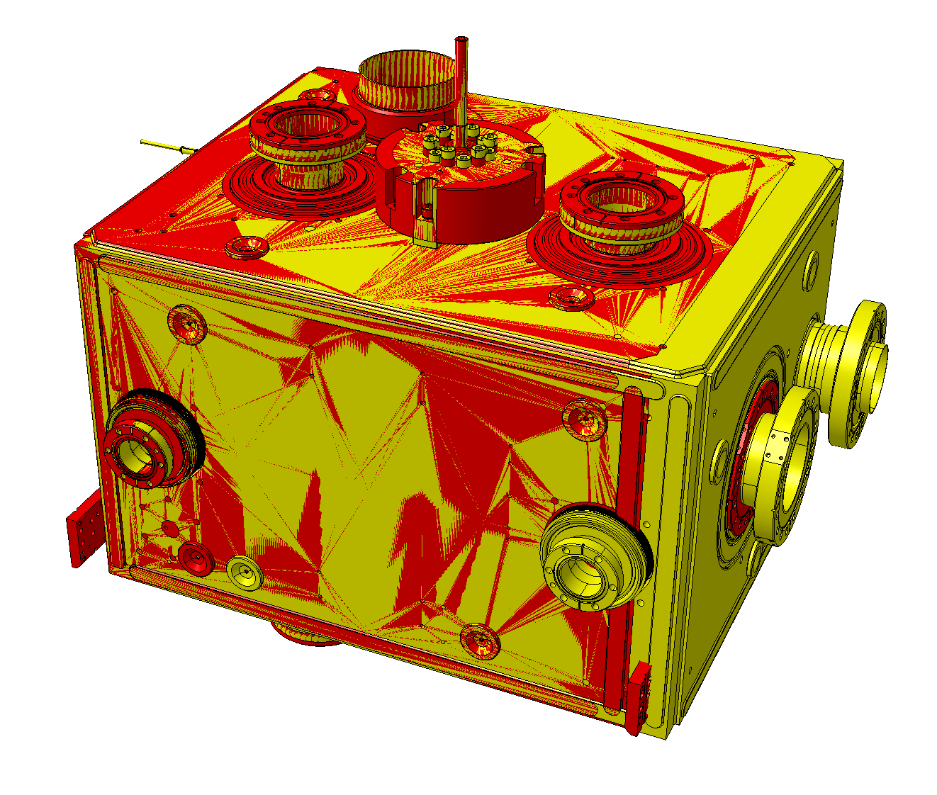

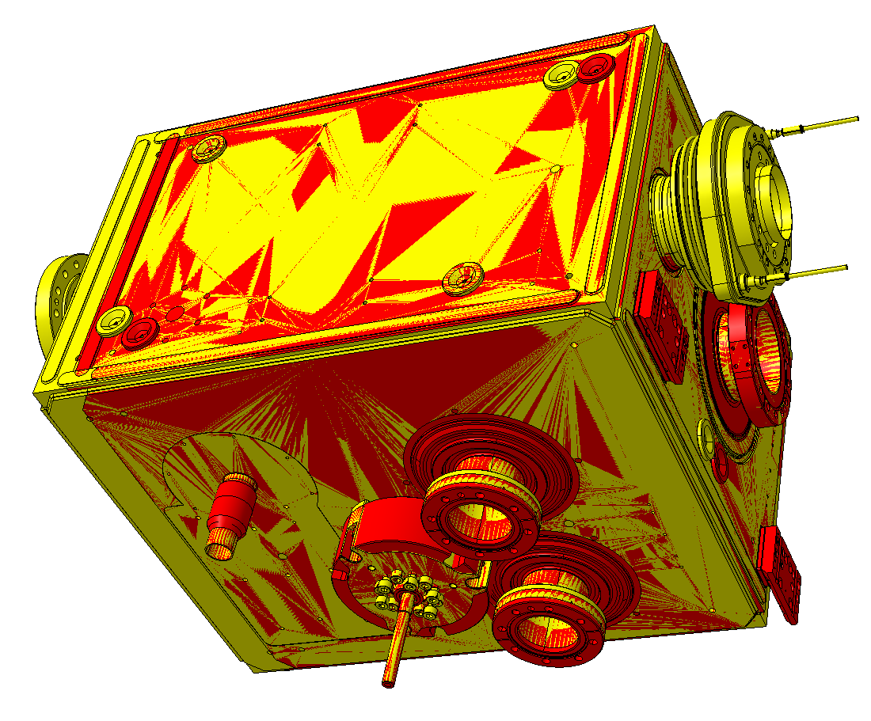
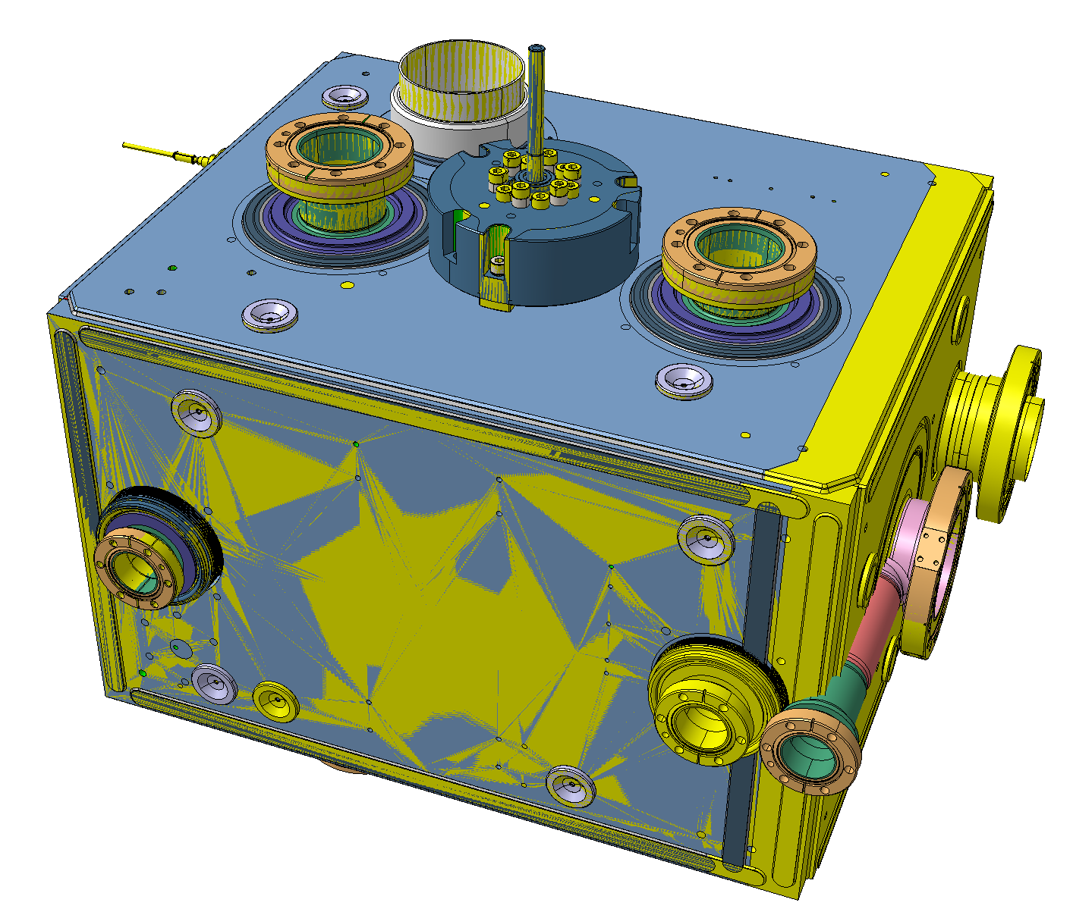
HOM A
Cryo top
Port position comparison
Slide & Information provided by Teddy Capelli
(cavities aligned through beam axis + FPC axis)
FPC
 | Delta Position (mm) SPS/LHC
Description | X | Y | Z
Beam in | 0 | 0 | 0
Beam out | 0 | 0 (-40*) | 0
FPC | 0 | 0 | 0 (4.4**)
HOM A | 0 | 0 | 4.04
HOM B | 0 | 0 | -5.3
HOM C | 0 | 0 | -5.3
Antenna | 0 | -0.78 | 0
HF-HOM (new port) | 0 | 77.2 | 0
Beam out
Antenna
*delta as it is in SPS – becomes 0mm after mod.
HF HOM
**fully compensated by FPC outer pipe
=longer port in SPS than LHC
=longer port in SPS than LHC
=longer port in SPS than LHC
Beam in
2nd pickup containing HFHOM damps modes at 1500MHz & 1754MHz
HOM C
Cryo bottom
HOM B

Slide 4
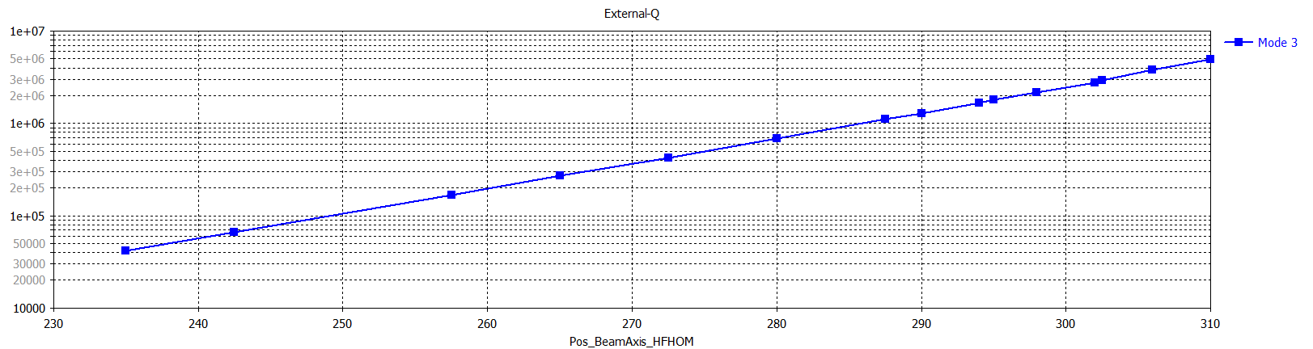
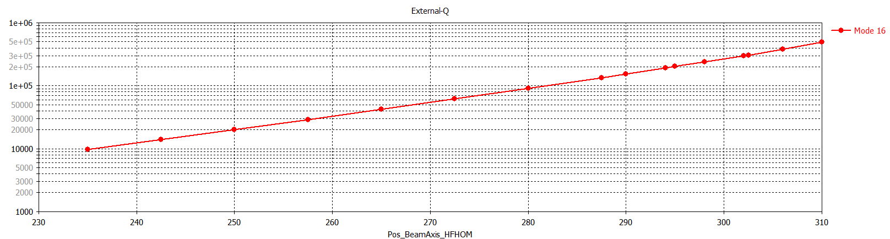
Q Ext – HFHOM
Mode 3 = 1500MHz
**Additional HOM port length also incorporated into this model
Qe
Distance to pickup from Cavity centre (mm)
Mode 16 = 1754MHz
Qe
Distance to pickup from Cavity centre (mm)

Slide 5
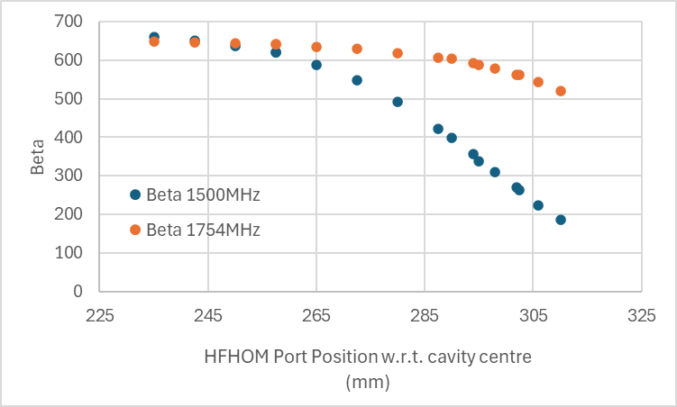

Q Ext – HFHOM
Mode 3 = 1500MHz
Beta
Mode 16 = 1754MHz

Slide 6
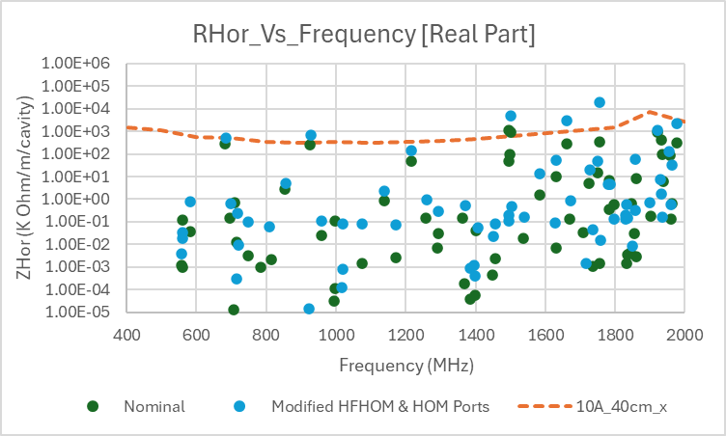
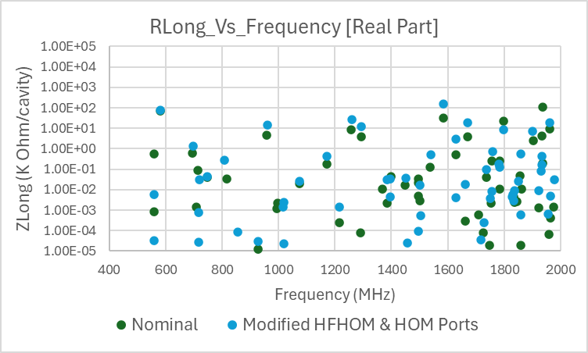
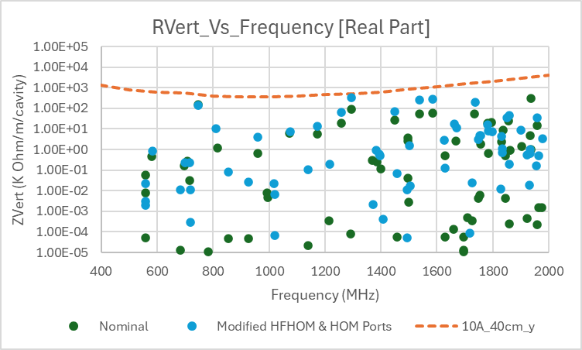
Impedance spectrum – nominal LHC cavity compared with modified SPS cavity
Frequencies over limit:
1500MHz
1661MHz
1754MHz

