Slide 1
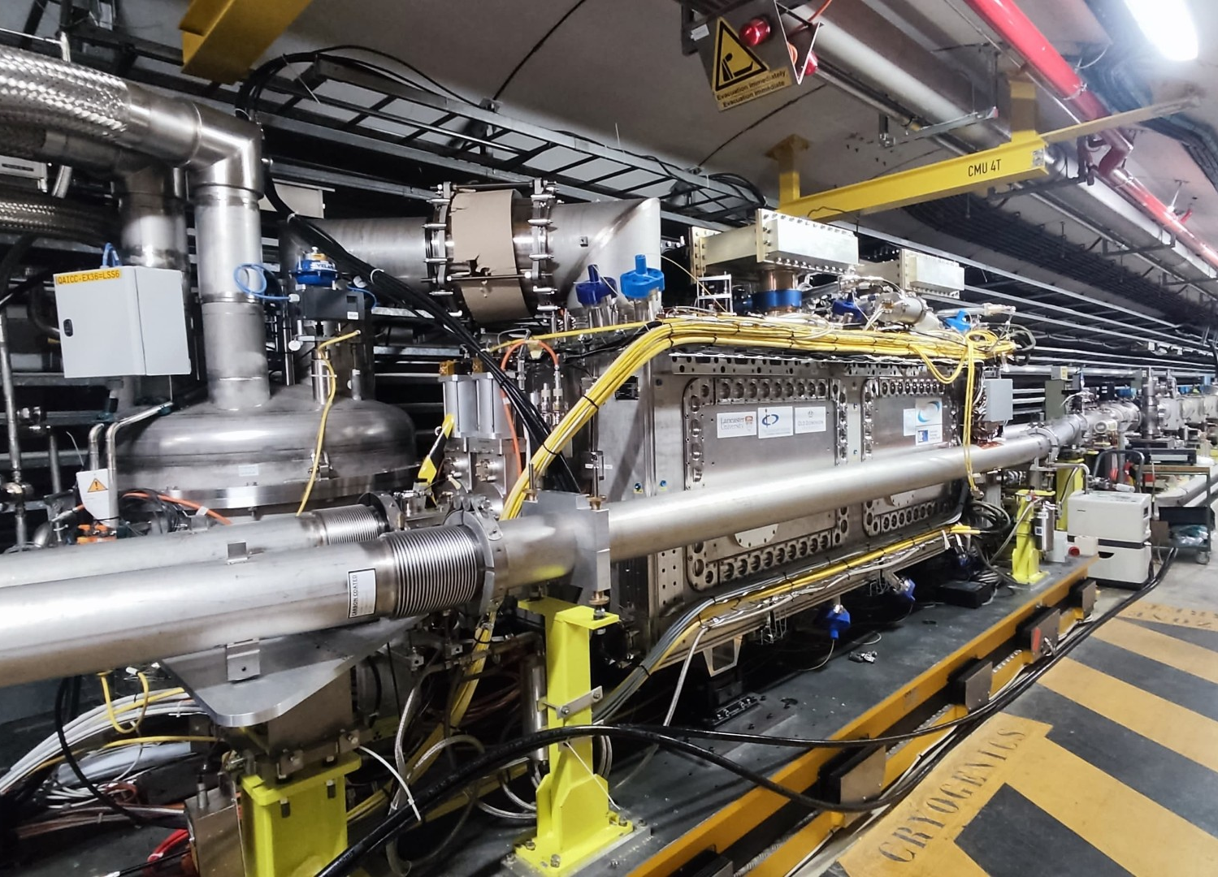
RF Dipole In SPS
Cool-down of the module to started 18-Feb
Crab cavities in during scrubbing run except for periods with NA extraction or MDs

Slide 2
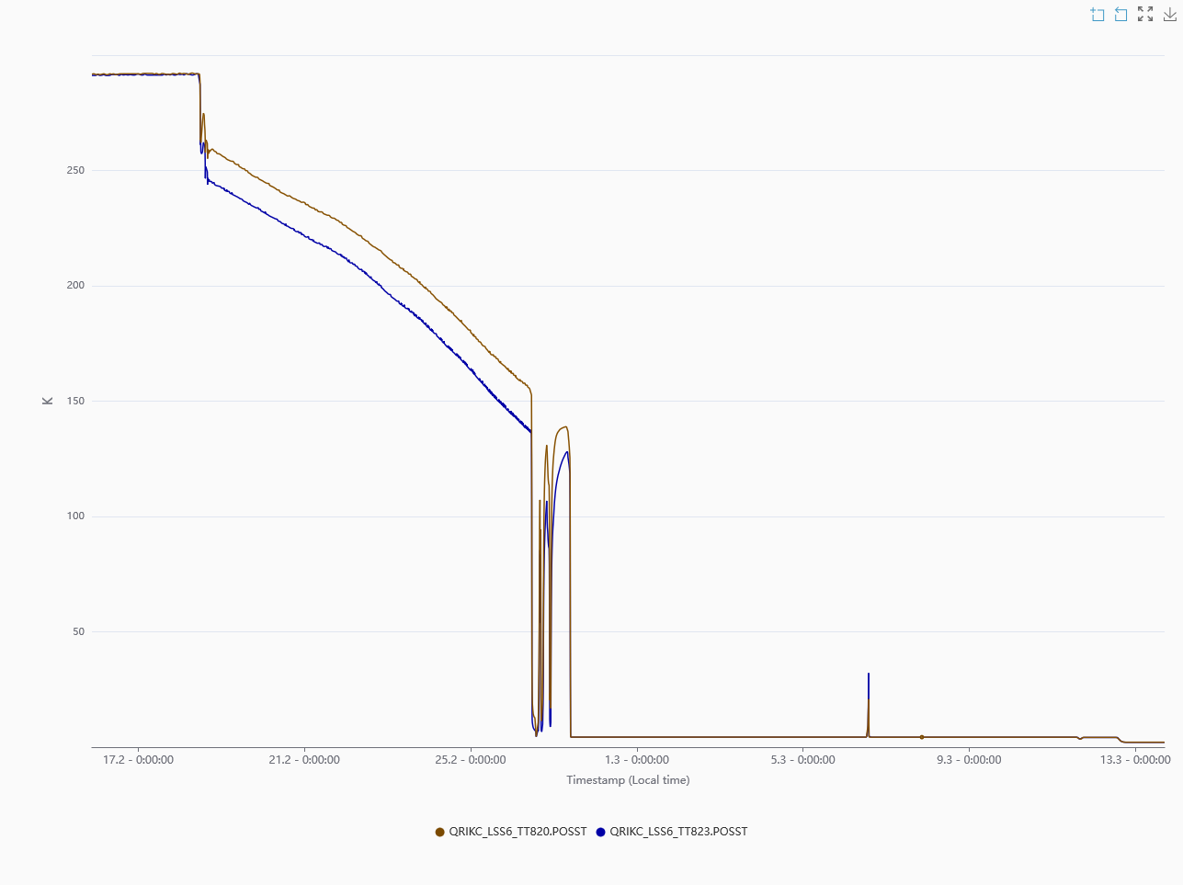
Cavity 1 & 2 Temperature
300K
Pumping capacity at maximum with temperature slightly above the design value of 2.0 K (30 mb)
For now, no issues with operations during scrubbing run and RF conditioning
4.5K
2.3K
17-Feb
13-Mar

Slide 3
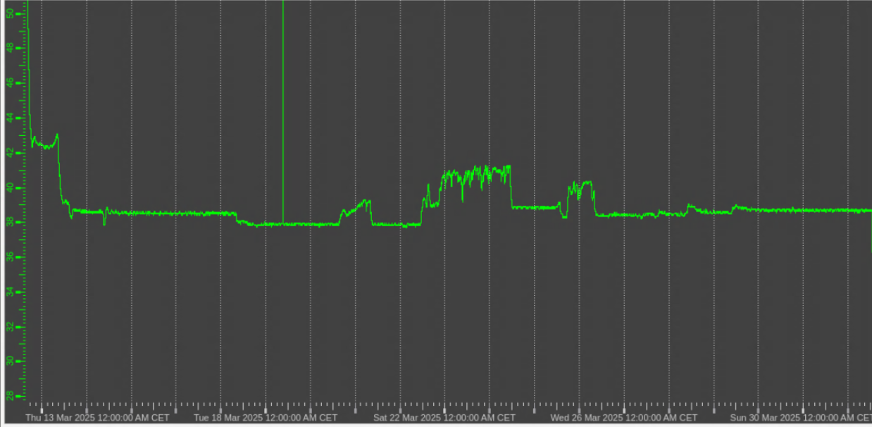
Helium Pressure Regulation
Cryo checking for additional heat load of ~10W now
But we can still operate at this higher pressure for scrubbing & RF conditioning
Already at maximum capacity limit
Nominal operating point

Slide 4
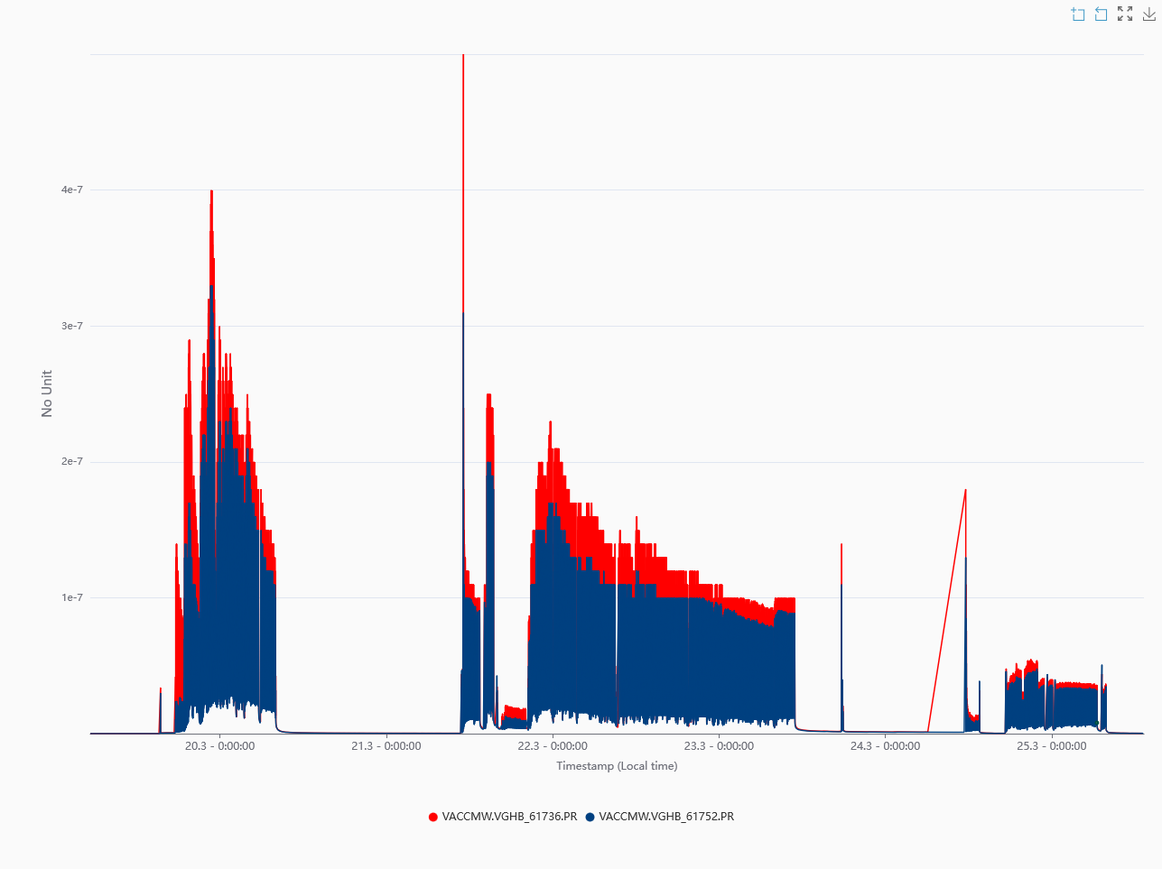
Scrubbing, Vacuum Evolution
Left/right of CM in bypass warm section
48b x 4 batches
Injection
72b x 4 batches
Injection
72b x 2 batches
450 GeV

Slide 5
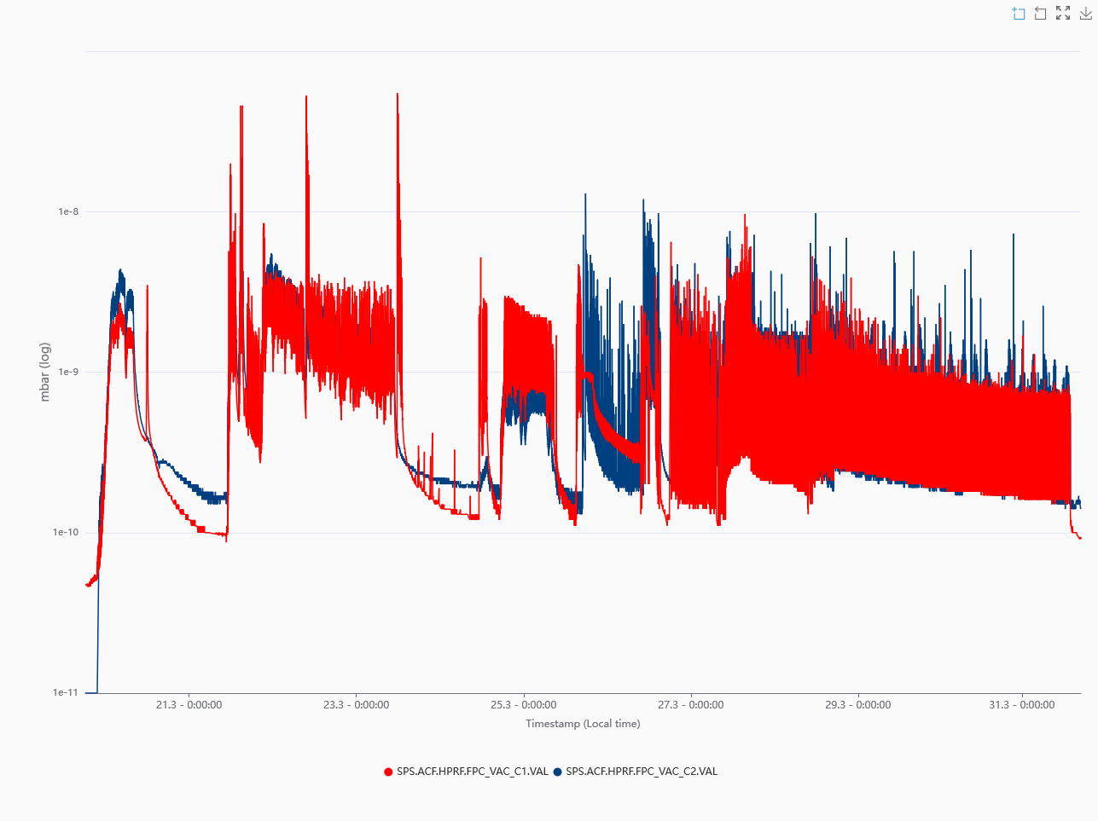
Scrubbing, Vacuum Evolution
In CAV 1&2 at 2.2 K
In beam
RF Conditioning
Quick RF conditioning up to 20 kW in pulsed mode
Moving to cw mode this week

Slide 6
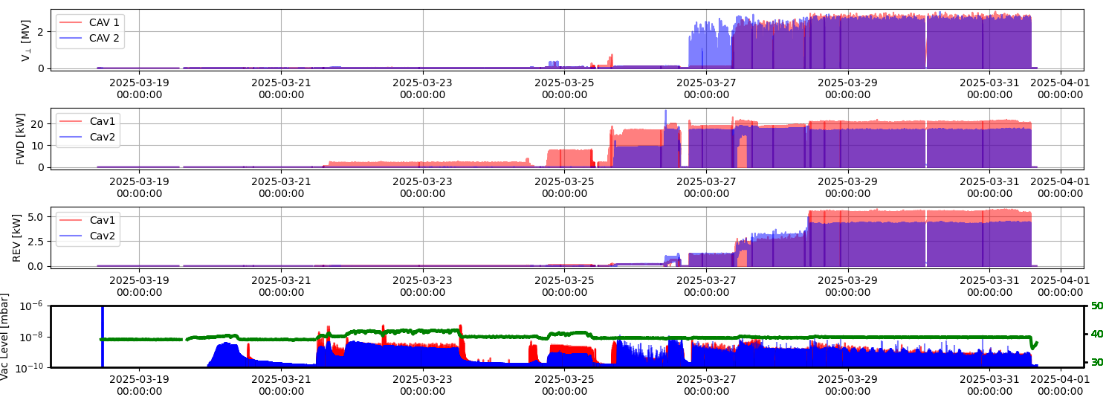
RF conditioning evolution
Upto 10ms pulses
Voltage
RF power

Slide 7
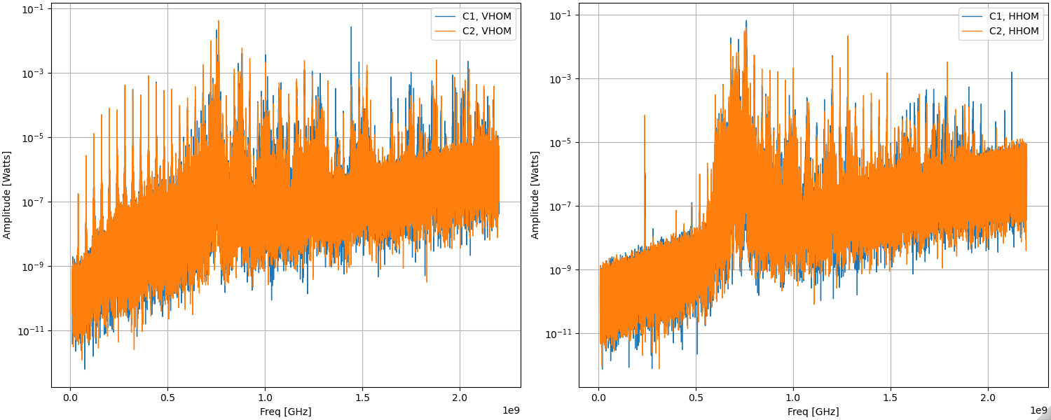
HOMs (26 GeV, 72 x 2batches)
High impedance mode
760 MHz

Slide 8
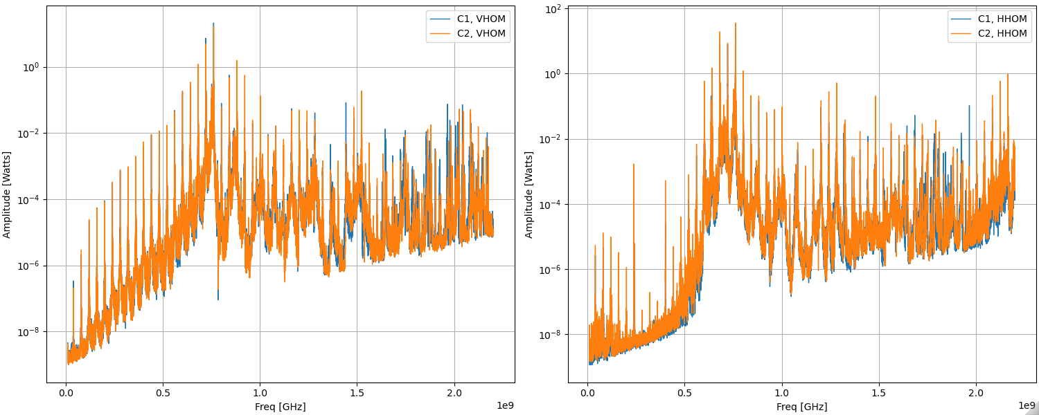
HOMs (450 GeV, 72 x 2batches)
High impedance mode
760 MHz

Slide 9
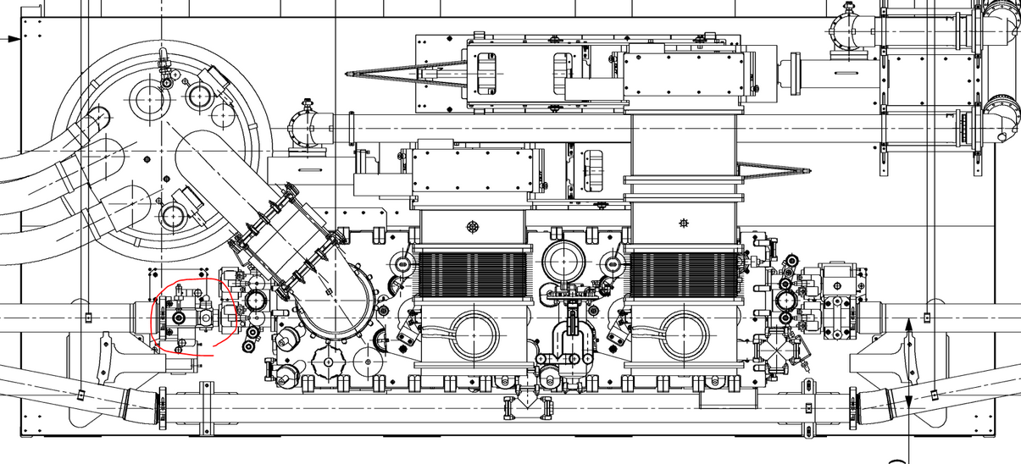
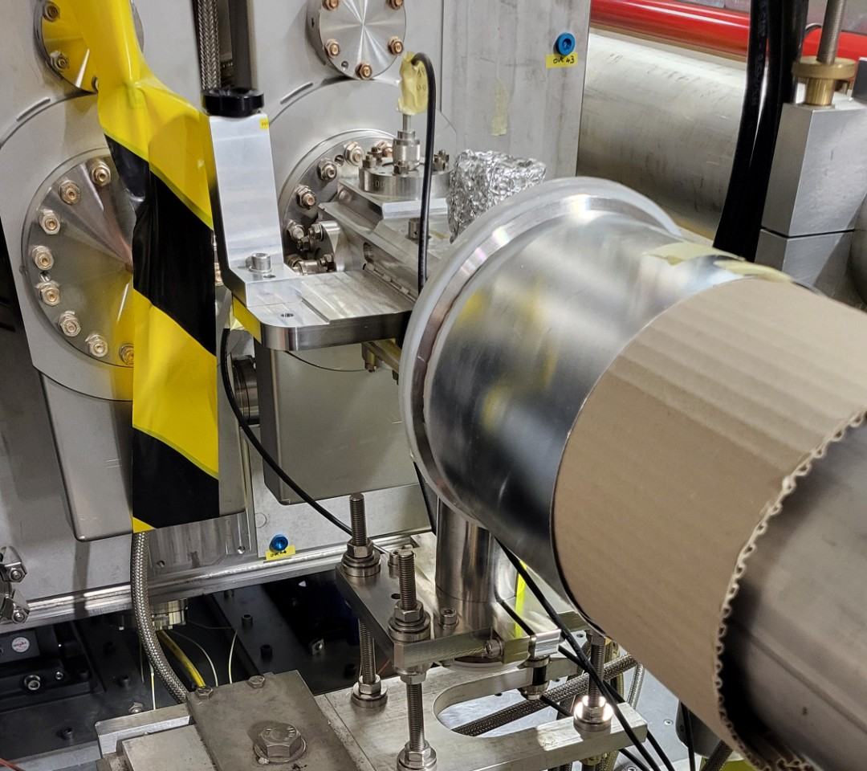
Button PU left of CC

Slide 10
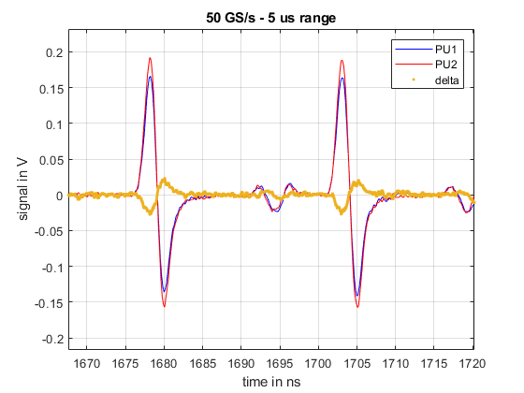
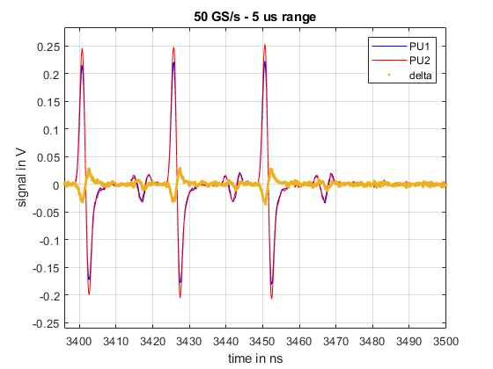
Measurements from PU electrodes
Analysis started on understanding button PU signals (resolution settings, ripple, cable effects etc…)
Start of batch
end of batch
Courtesy: W. Hofle

