Slide 1
Noise feedback subsystem for the Crab-Cavity LLRF
D. Valuch
Progress report at HiLumi Joint WP2/WP4 meeting meeting 1.4.2025

Slide 2
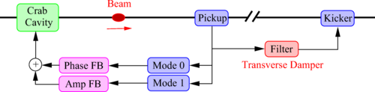
Crab Cavity noise feedback system
Feedback system proposed to mitigate the emittance growth due to the residual amplitude and phase noise of the Crab Cavities
Baudrenghien, P. and Mastoridis, T.: Transverse emittance growth due to rf noise in crab cavities: Theory, measurements, cure, and high luminosity LHC estimates
10.1103/PhysRevAccelBeams.27.051001

Slide 3
Crab Cavity noise feedback system
Performance requirements for the feedback system beam position measurement units:
The measurement noise thresholds are thus σ₀ < 320 nm and σ₁ < 8.3 μrad. These are bunch-by-bunch measurement levels
The above measurement noise thresholds require extremely high precision measurements. Fortunately, the closed loop bandwidth of the crab cavity with LLRF field regulation will only extend to 136 kHz. As a result, the noise bandwidth will also be limited to 136 kHz. In addition, the bunches are spaced every 25 ns and the measurement noise is uncorrelated from bunch to bunch.
Filtering the data with a low-pass filter matching the signal spectrum will scale the measurement noise power by a factor of about 12 (linear) improvement in signal-to-noise ratio.
This increases the actual single bunch resolution threshold to σ₀ < 3.9 μm rms and σ₁ < 100 μrad rms. This is a tight, but achievable specification.
Baudrenghien, P. and Mastoridis, T.: Transverse emittance growth due to rf noise in crab cavities: Theory, measurements, cure, and high luminosity LHC estimates
DOI 10.1103/PhysRevAccelBeams.27.051001

Slide 4
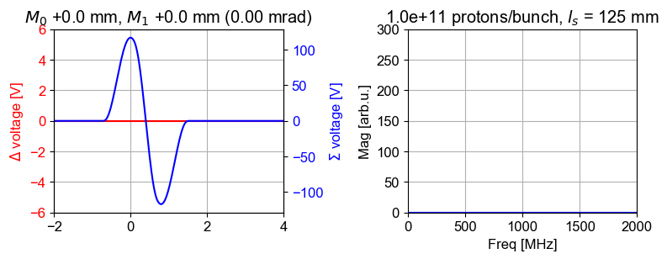
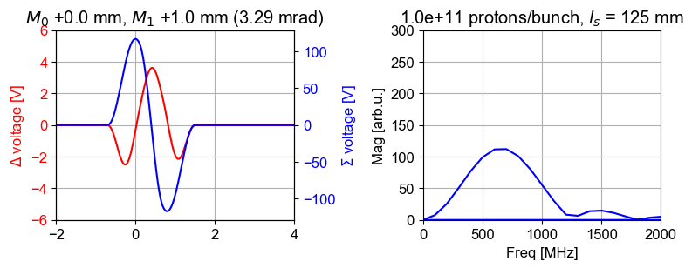
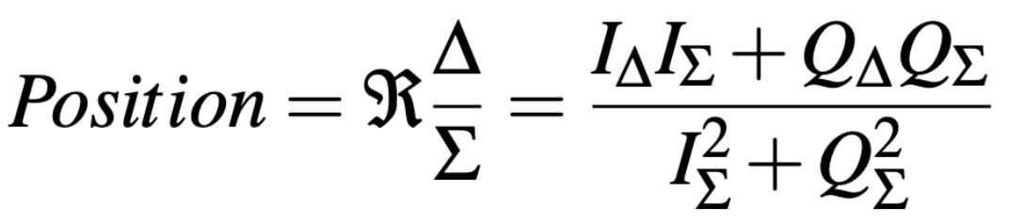
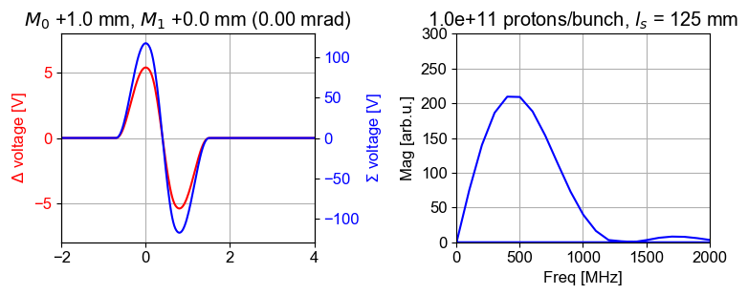
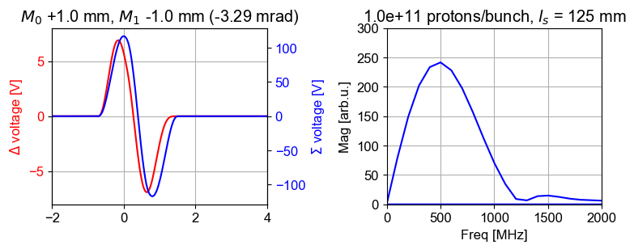
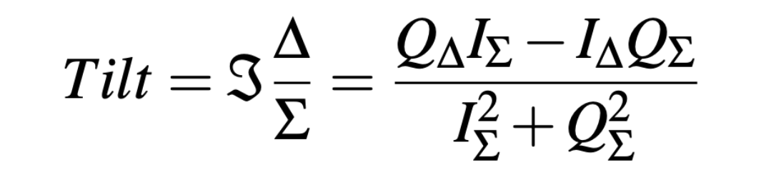
Pickup and position/tilt measurement
Strip-line pickup will be used for the feedback, peak response at 500 MHz, diameter 86.5 mm
Expected beam displacement in operation up to ±2 mm (slow and fast)
Challenge: Δ signal will have a similar amplitude to the 180° hybrid cross-talk

Slide 5
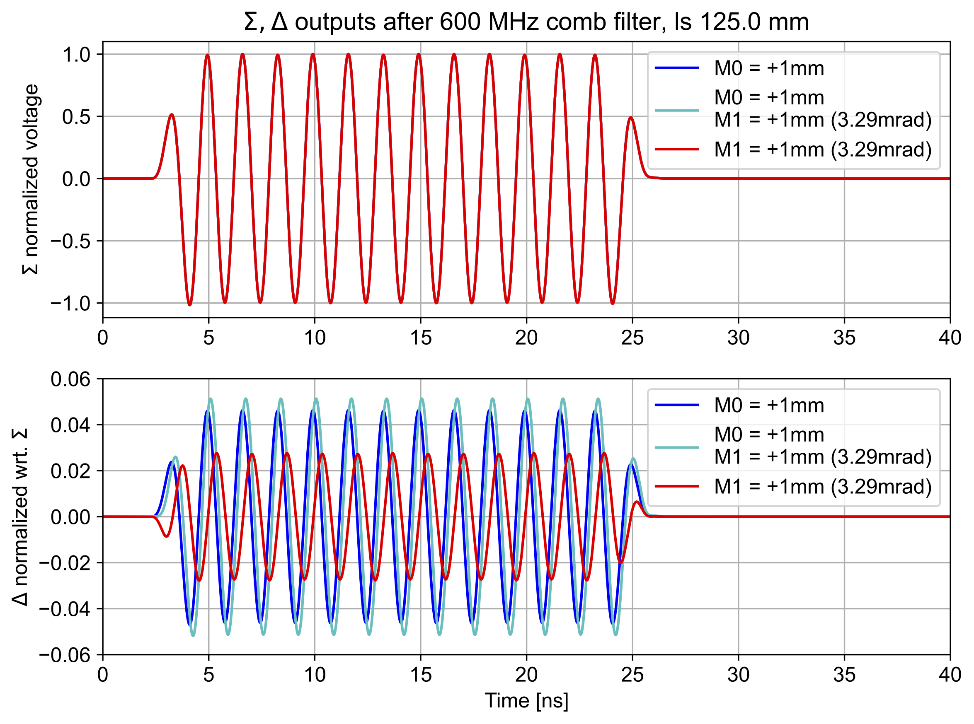
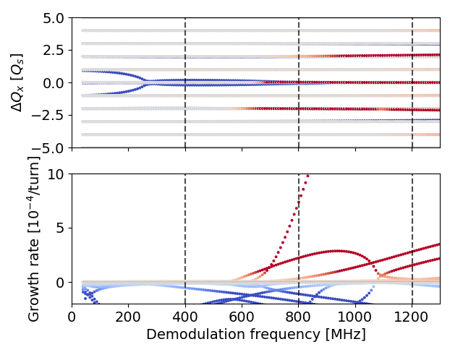
Measurement frequency selection
Technically, we can process the pickup RF signals at any frequency. Stripline pickup has a peak sensitivity at certain frequency. But…
Beam dynamics studies show a presence of two-node head-tail mode in a vicinity of 600 MHz, with a risk to be driven by the noise feedback if the position and tilt measurement will be done above 500 MHz.
Buffat X: Update on stability from the amplitude feedback - Impact of RF curvature and quality factor. HL-LHC WP2 meeting 05.04.2022 https://indico.cern.ch/event/1144197/

Slide 6
RF processing of the pickup signals
Pickup signal processing in RF domain, gain setting, electrical centering
Output is signal still in RF domain
Challenge: the 180° hybrid and digitizer performance

Slide 7
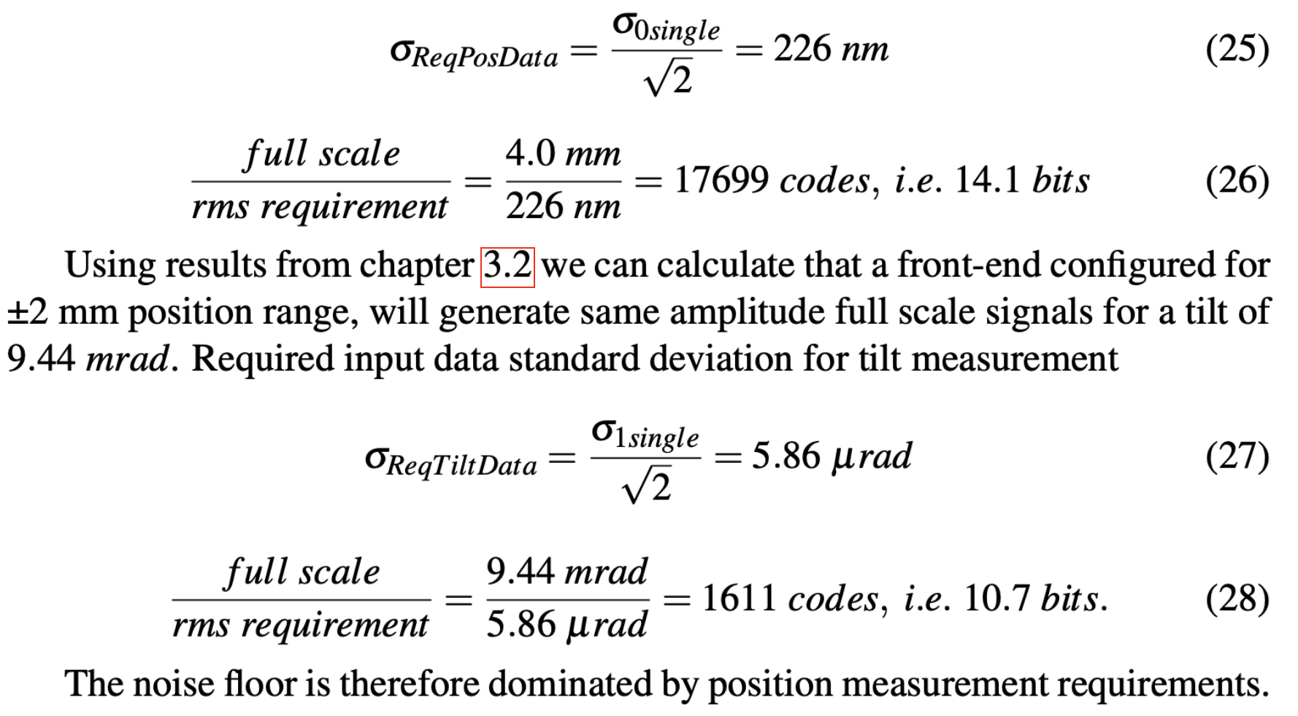
Receiver and digitizer performance requirements
“The measurement noise thresholds are thus σ₀ < 320 nm and σ₁ < 8.3 μrad. These are bunch-by-bunch measurement levels”
How good our signal processing needs to be?
Rather challenging

Slide 8
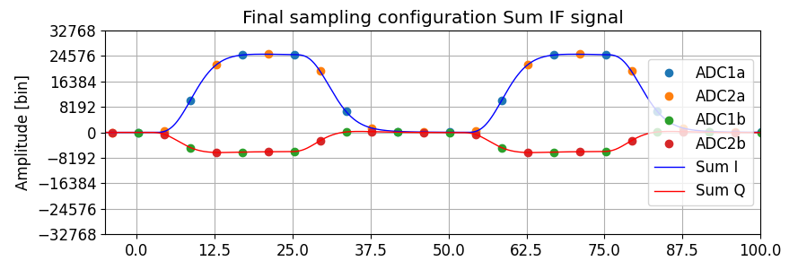
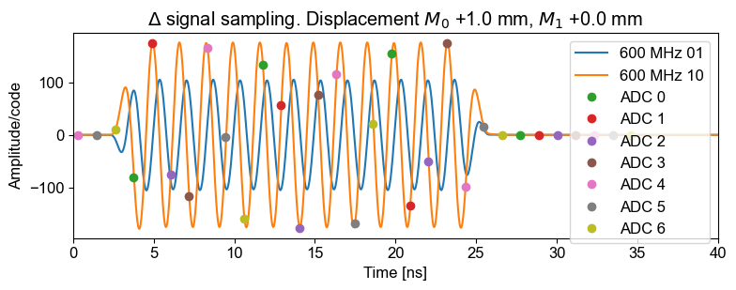
Receiver and digitizer performance requirements
Typical receiver architectures. We are evaluating both. We are trying to use the already existing uTCA modules, but the required performance is extremely challenging
Super heterodyne receiver with analogue quadrature demodulation
Direct RF sampling with digital quadrature demodulation

Slide 9
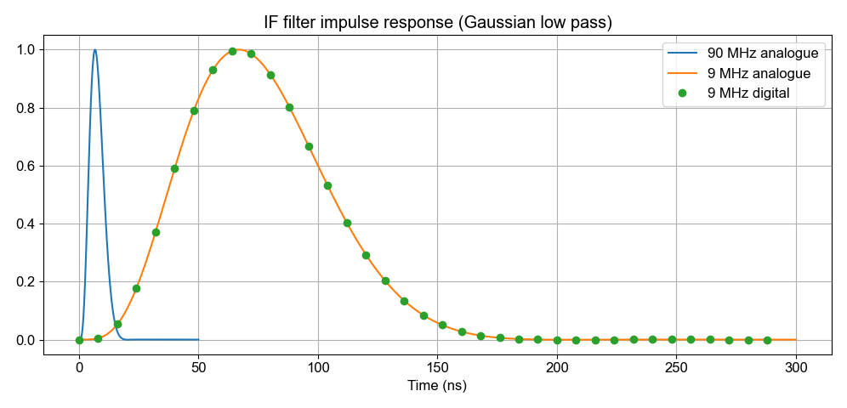
Further processing in digital domain
Output: bunch by bunch, turn by turn calculation of position and tilt…
Very similar to ADT, except we have only two pickups at technically not very favourable places

Slide 10
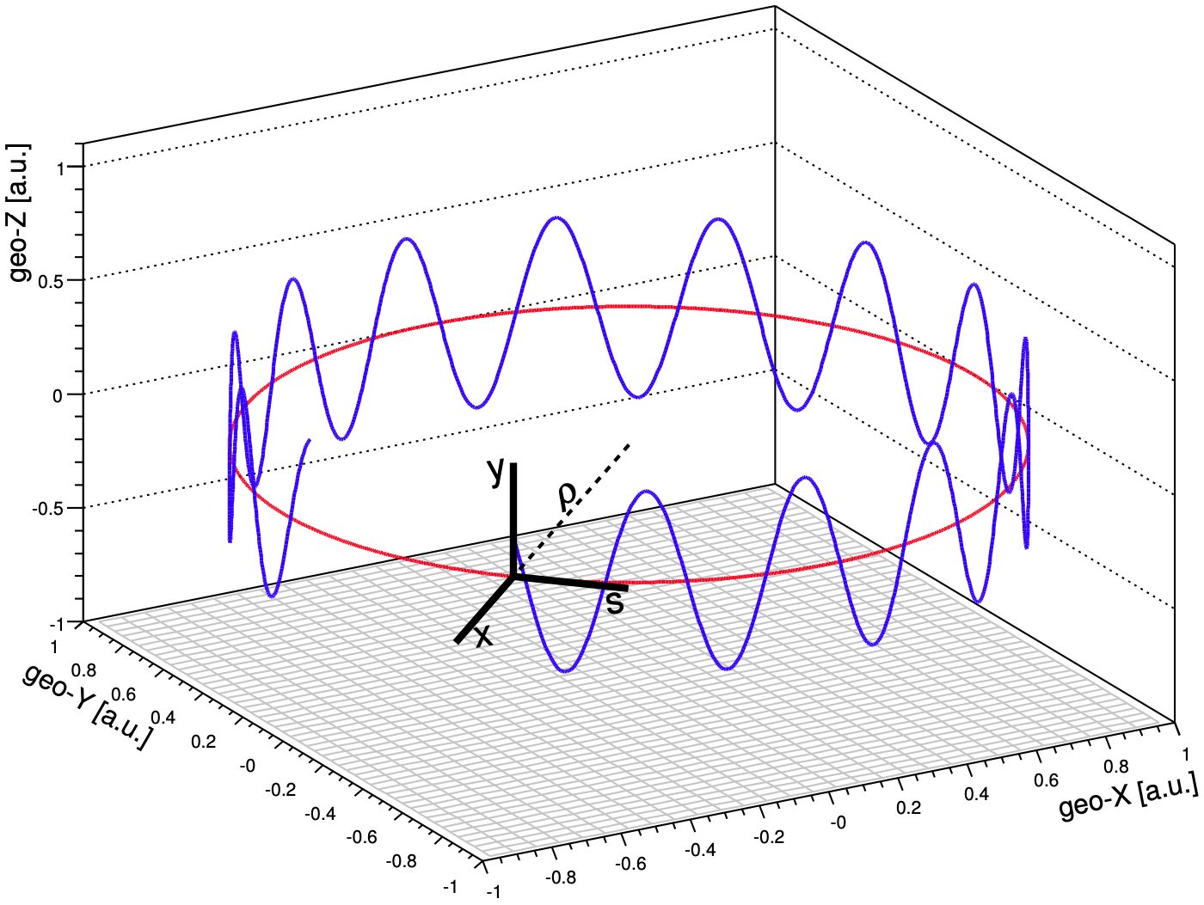
How do we close the feedback loop?

Slide 11
How do we close the feedback loop?
Measure position/tilt of a particular bunch when passing through the pickup
Convert position measurement to a momentum kick
Adjust for pickup to kicker phase advance
Adjust for betatron phase shift the beam had done while we were calculating the correction
Apply kick to that very bunch, when passing through the cavity (kicker)

Slide 12
How do we close the feedback loop?

Slide 13
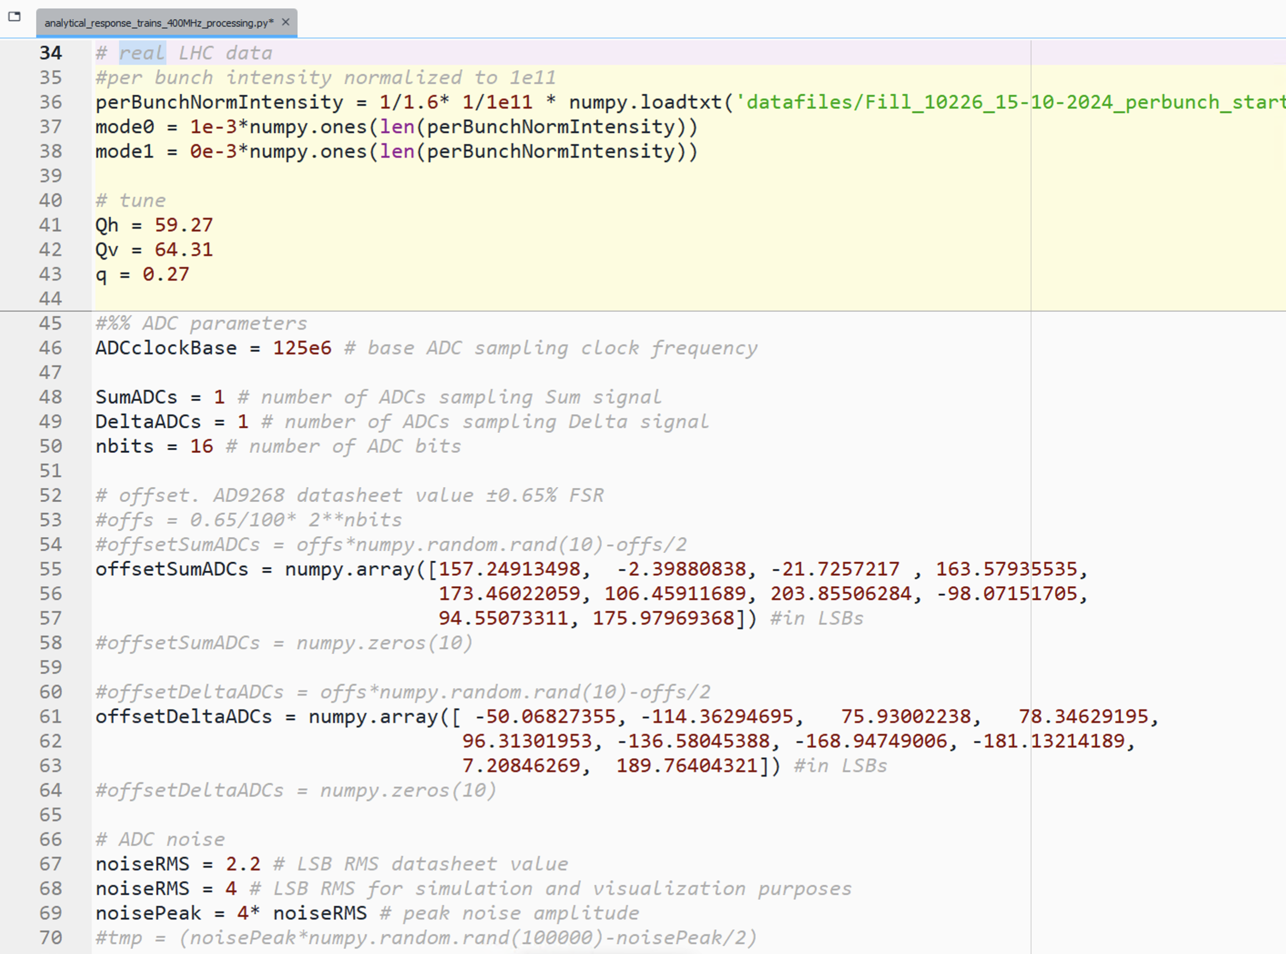
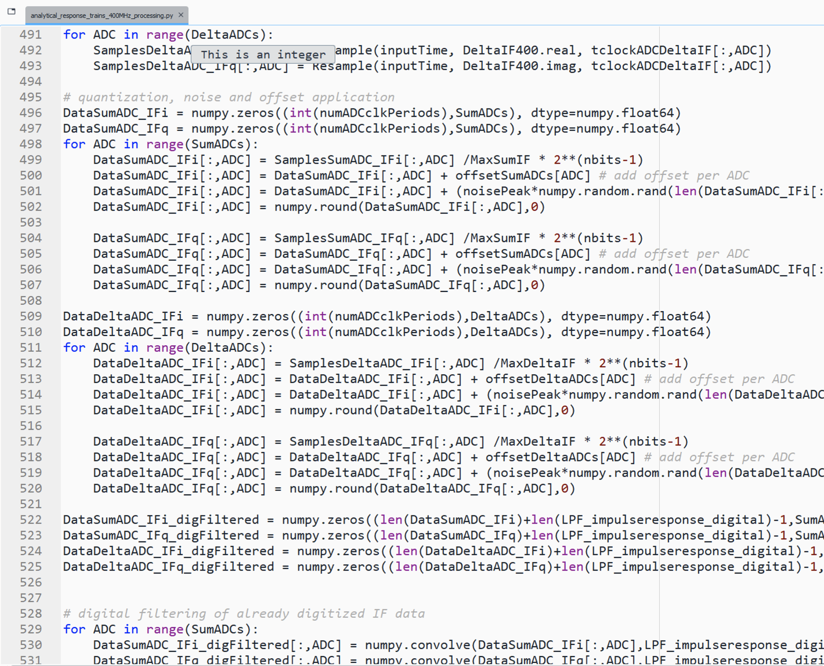
Mathematical model of the noise feedback system
Rather complete mathematical model of the whole noise feedback system was developed
Pickup response, sensitivity. Position modulation.
Beam shape, bunch length, bunch intensity (all bunch by bunch)
RF signal transport, cables
RF comb filters, hybrid with crosstalk
Digitizer parameters fully parametric (sampling frequency, # of ADCs, individual noise, offset…)
Full implementation of receiver with direct RF sampling
Full implementation of receiver with analogue down-conversion to baseband (LO frequency, analogue noise)
Fully parametric RF, IF and digital filtering
Sampling and position/tilt calculation
Work ongoing – notch and Hilbert transformer for the final correction calculation

Slide 14
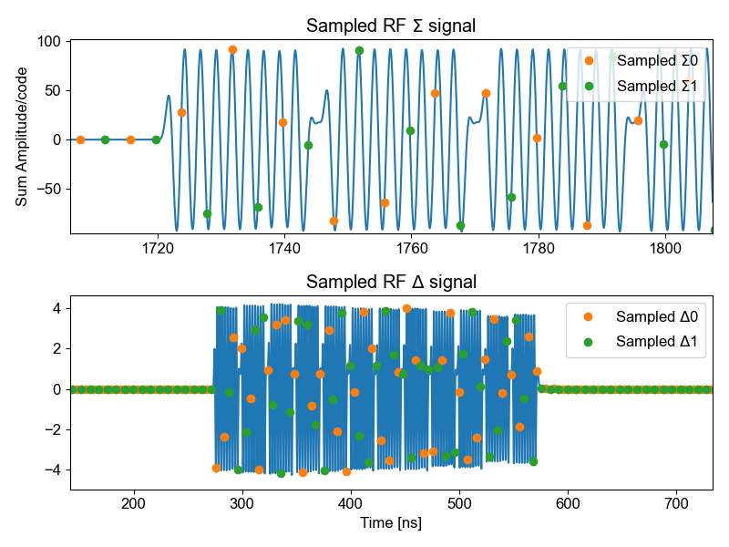
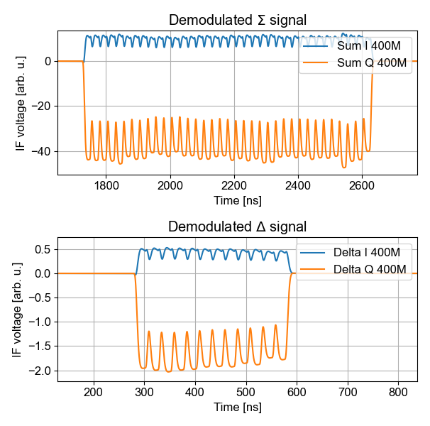
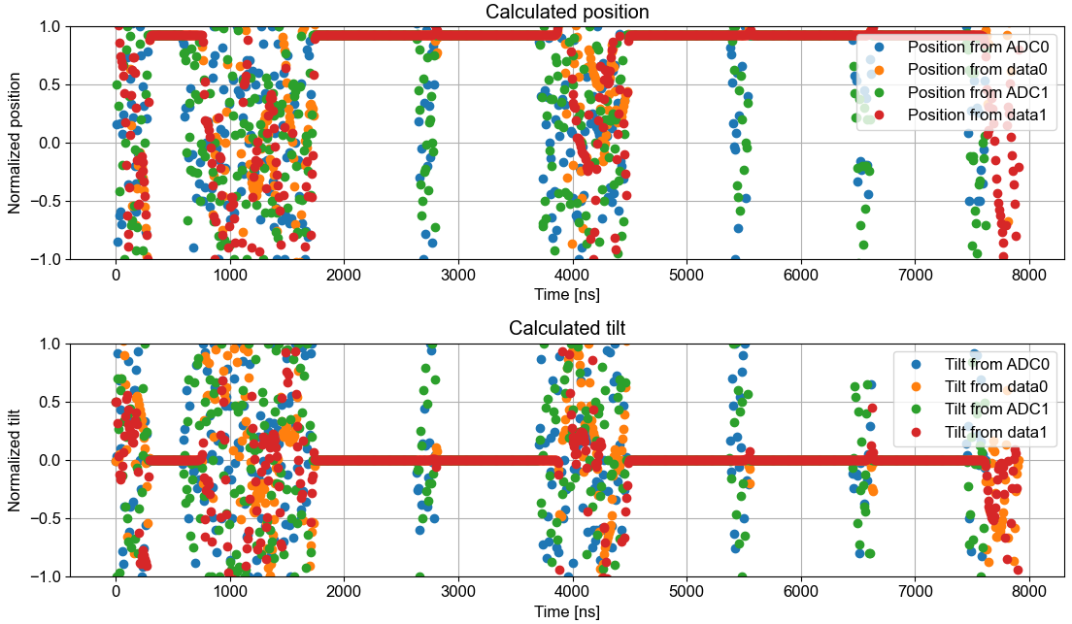
Mathematical model of the noise feedback system
Very efficient to test scenarios like sampling frequency, mixing frequency, all kinds of noise floor, data processing algorithms
Can use ideal noise-free stimulus, or real LHC bunch data
As bunch-by-bunch performance (like ADT) is not in reach, we use the model to develop and test alternative signal processing schemes

Slide 15
Work ongoing
A series of MDs foreseen in SPS
Similar pickups available in LHC P1 and P5 and accessible during operation. Tests with real signals (thanks SY-BI!)
RF SoC digitizer already evaluated ~10 bits at 5 Gsps
Waiting for uTCA digitizer test results to take decision what architecture to use
Evaluating possibility to use also the ADT pickups at P4 to provide more information (4 pickups per beam per plane with good phase advance between them)
As soon any hardware is available – tests with beam, tests with beam, tests with beam…

Slide 16
Thank you for your attention

