Slide 1




High Energy Booster Tuning
Q. Bruant, B. Dalena, T. Da Silva, A. Chancé (CEA irfu and Paris-Saclay University)
A. Ghribi (GANIL, CNRS)
A. Mash’al (IPM)
Thanks to: J.Dilly, R. Tomas, K. Oide, M. Hostettler, D. Gamba, E. Fol
 |  | FCCIS – The Future Circular Collider Innovation Study. This INFRADEV Research and Innovation Action project receives funding from the European Union’s H2020 Framework Programme under grant agreement no. 951754.

Slide 2
Outline
Reminder
New Emittance Tuning Strategy
Errors assignments and correctors’ placement
Results
Conclusion & further steps

Slide 3
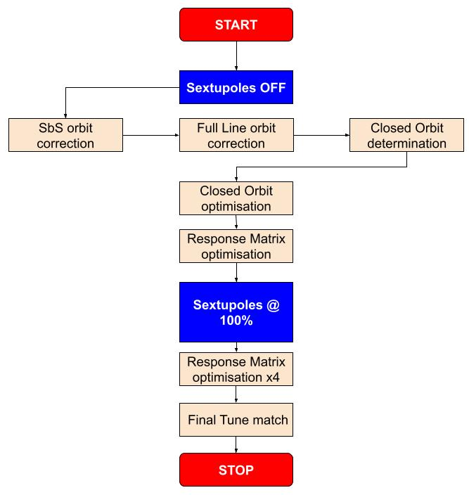
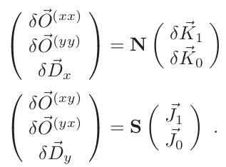
Previous method and errors
Error type | σ value
Dipole relative field error | 10⁻³
Main dipole roll error | 300 μrad
Offset quadrupoles | 200 µm (girder) + 50 µm
Quadrupoles roll | 100 μrad
Offset BPMs | 200 µm (girder) + 50 µm
Offset sextupoles | 200 µm (girder) + 50 µm
Low stability (78% of seeds converging) and assuming perfect field in quads and sextupoles
Main problem:
Tune variation due to errors and sextupole strength interaction

Slide 4
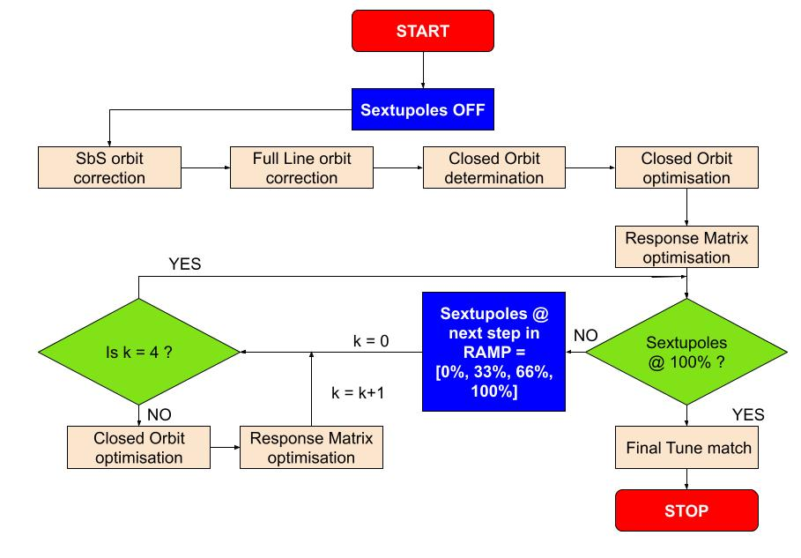
New Correction Strategy
Ensure limited effect due to interplay between sextupole strength and imperfections

Slide 5
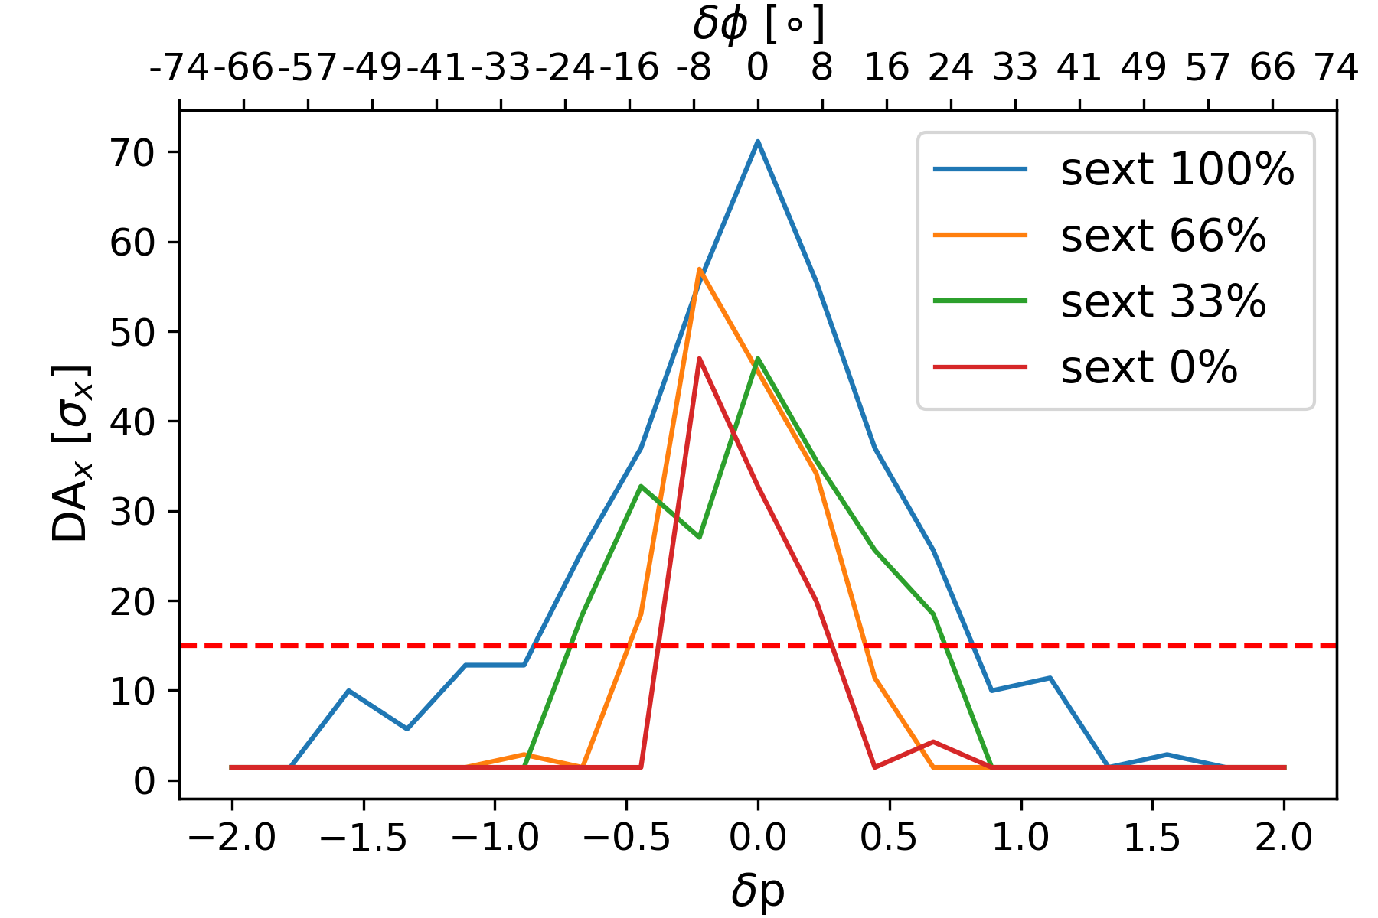
MA wrt sextupole ramp
MA seems to be large enough at each step of the ramp.
High Energy LINAC can provide dedicated single bunches with .05% energy spread.

Slide 6
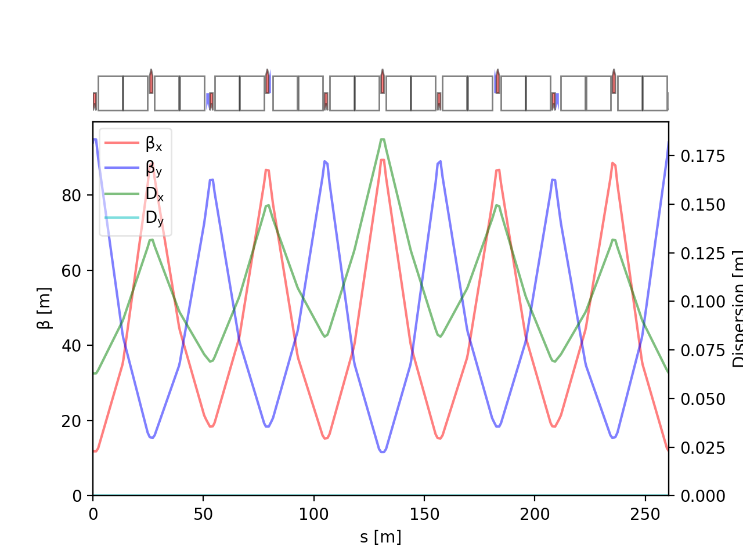
Errors and Correctors
D1
F1
D2
F2
D3
F3
D3
F1
Error type | σ value
Dipole relative field error | 10⁻³
Quadrupole relative field error | 2 x 10⁻⁴
Sextupole relative field error | 2 x 10⁻⁴
Main dipole roll error | 300 μrad
Offset quadrupoles | 200 µm (girder) + 50 µm
Main Quadrupoles roll | 300 μrad
Offset BPMs | 200 µm (girder) + 50 µm
Offset sextupoles | 200 µm (girder) + 50 µm
D2
F2
BPM
MQ
BPM
MS
MQ
MS
All errors are randomly distributed with ± 3 Gaussian rms.
= skew quad corrector
= normal quad corrector
= orbit corrector

Slide 7
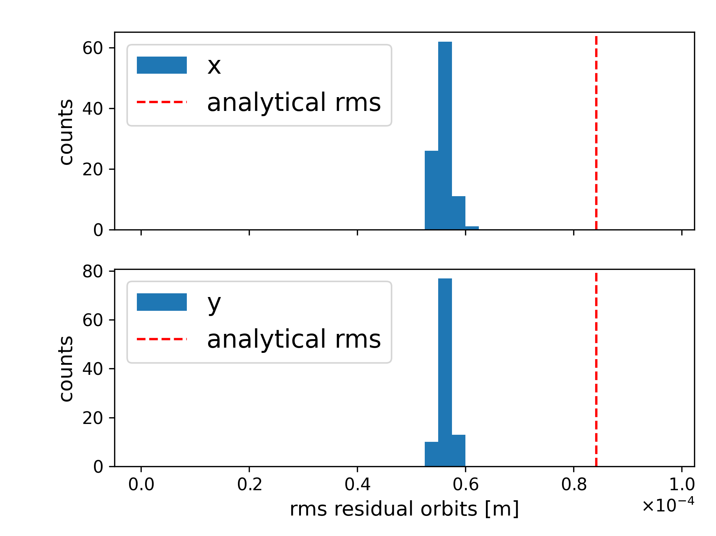
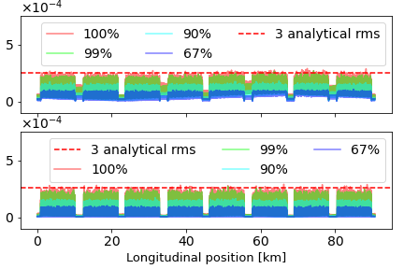
Residual Orbit
|x| [m]
|y| [m]
100 successful seeds

Slide 8
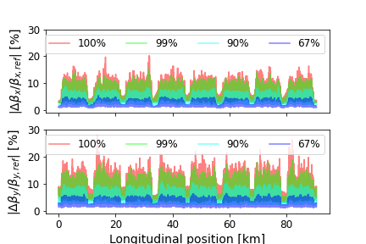
Beta-beating
Limitation of Beta-beating under 20% for 99% of seeds
⅔ of the seeds show Beta-beating below 5% in both planes
Vertical plane seems higher than horizontal
  add correctors in straight sections?
100 successful seeds

Slide 9
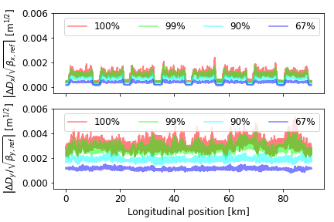
Normalized dispersion
Horizontal normalized dispersion kept under 2x10⁻³ m^{1/2}
Vertical normalized dispersion twice as high as horizontal
  add some skew correctors in straight section ?
  Use full response matrix instead of two separated matrix
100 successful seeds

Slide 10
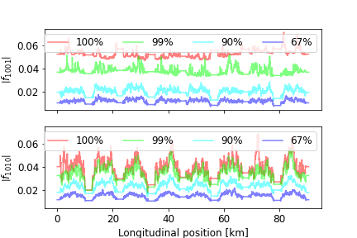
RDTs
90% of modules of coupling RDTs below .04
100 successful seeds

Slide 11
Correctors tolerances
Corrector | E [GeV] | 3 x RMS
Orbit X | 20 (inj) | 2.5 mT.m
 | 182.5 (ttbar) | 23 mT.m
Orbit Y | 20 (inj) | 2.6 mT.m
 | 182.5 (ttbar) | 24 mT.m
Normal Quad | 20 (inj) | 0.11 T.m⁻¹.m
 | 182.5 (ttbar) | 0.96 T.m⁻¹.m
Skew Quad | 20 (inj) | 0.05 T.m⁻¹.m
 | 182.5 (ttbar) | 0.39 T.m⁻¹.m
100 successful seeds

Slide 12
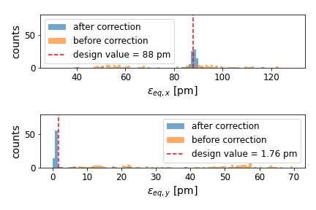
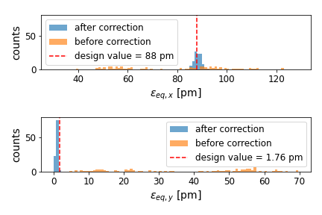
Equilibrium Emittance
Sextupoles ON/OFF (No Quad and sextupole field errors, roll quad 100 𝝁rad)
Sextupoles ramp (Quad and sextupole field errors, roll quad 300 𝝁rad)
78 successful seeds
100 successful seeds

Slide 13
Recap
Change in correction strategy to control tune variation
Orbit excursion kept below 4×10⁻⁴ m in both plane
Beta-beating:
  below 20% in both planes for 99% of seeds
  below 5% in both planes for 67%
Normalized dispersion:
  horizontal: below 2×10⁻³ m^{1/2}
  vertical: twice as high
90% of modules of coupling RDTs below .04
Correctors:
  dipoles: 3×RMS below 25mT.m
  quadrupoles: 3×RMS below 1T.m⁻¹m

Slide 14
Perspectives
Introduce longitudinal misalignment
Introduce tapering at ttbar energy to correct distortion due to SR
Compute DA with errors and corrections
Optimisation of correction scheme:
  Correctors’ position and number,
  Study of correctors’ correlation, non-linear approach

Slide 15
THANKS

