Slide 1
Simulation Study on LER Beam Oscillation
Masaru TAKAO

Slide 2
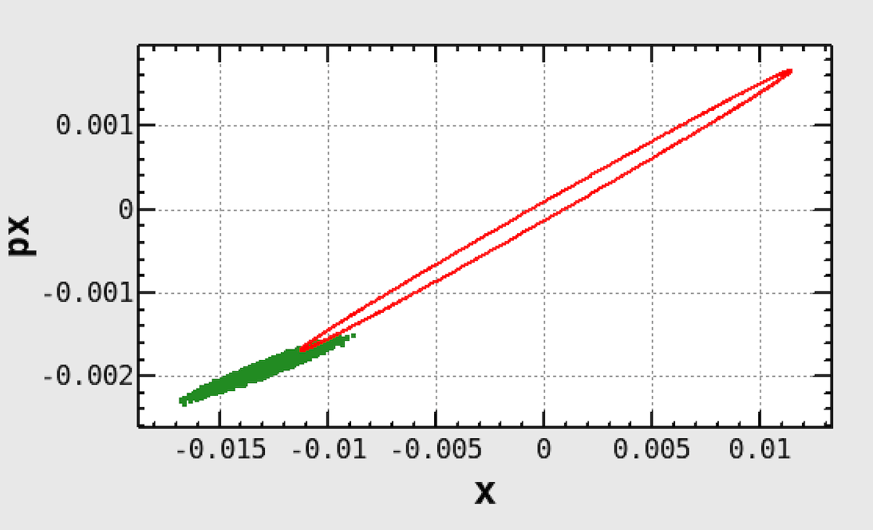


Simulations on Beam Oscillation
Investigation of higher order modes of beam oscillation w/ large amplitude.
Single particle tracking after initial displacement.
Start and monitoring point: Injection point.
  Initial values: $x_{0}$ w/ $p_{x0}=−{αx}_{0}/β$, others $=0$.
Revolution number: 4096.
Lattice parameters
  Betatron tune (x): .525,
  Betatron tune (y): .593,
  Synchrotron tune: .0233.
Injection ellipse
$$\left(x_{0},p_{x0}\right)$$
Injecting beam

Slide 3

Examples of Tracking Simulation
Initial displacement $x_{0}=\text{−13 }\text{mm}$.

Slide 4

Examples of Tracking Simulation
Maximum / minimum / average amplitude vs. initial displacement $x_{0}$.

Slide 5
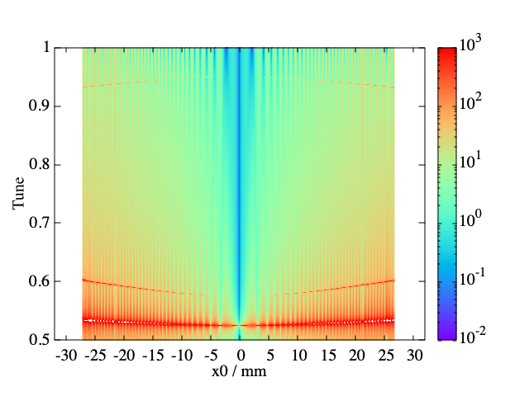
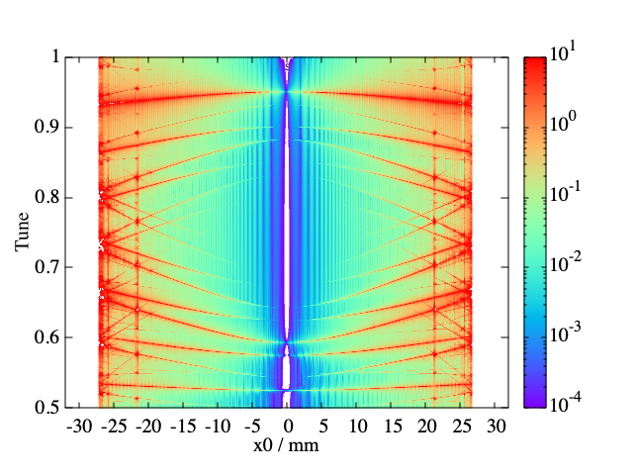








Spectra of Beam Oscillation
Spectrum of horizontal (vertical) beam oscillation @ left (right).
$$−2ν_{x}$$
$$−4ν_{x}$$
$$−6ν_{x}$$
$$5ν_{x}$$
$$3ν_{x}$$
$$ν_{y}$$
$$ν_{x}$$
$$ν_{x}$$

Slide 6
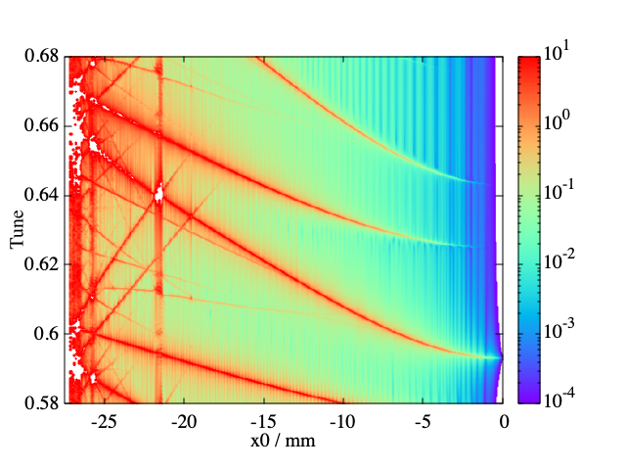








Summary
Influential resonance modes
  11th higher harmonic mode:
  $10ν_{x}+ν_{y}=\text{int}\text{.}$: sum resonance.
  13th higher harmonic mode:
  $12ν_{x}+ν_{y}=\text{int}\text{.}$: sum resonance.
  9th higher harmonic mode:
  $7ν_{x}+2ν_{y}=\text{int}\text{.}$: sum resonance.
$${−10ν}_{x}$$
$$−7ν_{x}−ν_{y}$$
$${−12ν}_{x}$$
$${5ν}_{x}$$
$$ν_{y}$$
$$ν_{y}$$
$${3ν}_{x}$$

Slide 7

Examples of Tracking Simulation w/ Momentum Deviation ($δ_{0}=$7.5e-4)
$x_{0}=\text{−13 }\text{mm}$.

Slide 8

Examples of Tracking Simulation
Maximum/minimum/average amplitude vs. initial displacement $x_{0}$.

Slide 9
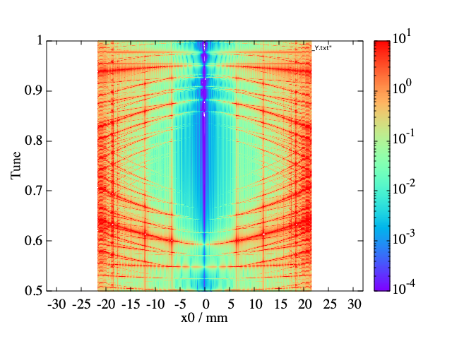



Spectra of Beam Oscillation
Spectra of vertical beam oscillation w/o $δ_{0}=0.0$(left) and w/ $δ_{0}=7.5\text{e}\text{−4}$ (right).
$$ν_{y}$$
$$ν_{y}$$

Slide 10
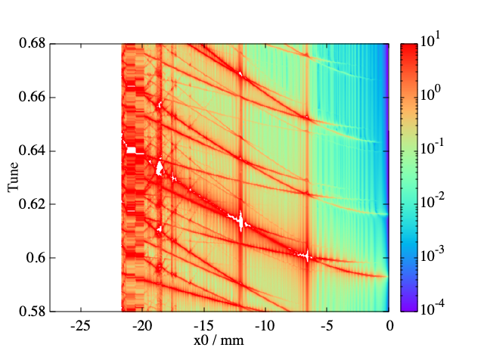














Resonance Modes
Spectra of vertical beam oscillation w/ $δ_{0}=0.0$(left) and $δ_{0}=7.5\text{e}\text{−4}$ (right).
$${−10ν}_{x}$$
$$−7ν_{x}−ν_{y}$$
$$3ν_{x}+2ν_{s}$$
$$−7ν_{x}−ν_{y}$$
$${−12ν}_{x}$$
$${5ν}_{x}$$
$$−12ν_{x}$$
$$5ν_{x}$$
$$ν_{y}$$
$$5ν_{x}−ν_{s}$$
$$3ν_{x}+ν_{s}$$
$${3ν}_{x}$$
$$ν_{y}$$
$${3ν}_{x}$$

Slide 11
Beam Oscillation w/ Beam-Beam Interaction
BEAMBEAM FBMBMP:
  BX = .025
  BY = .0003
  XANGLE = .0415
  EMITX = 4.6e-09
  EMITY = 1.288e-11
  DP = .000637
  SIGZ = .005
  NP = 3.45e+10
  SLICE = 200
  STURN = 10
Particle number @ bunch

Slide 12
Tracking Simulations w/o Beam-Beam Interaction ($δ_{0}=7.5e−4$)
Amplitude and spectrum of vertical beam oscillation:
$$ν_{y}$$

Slide 13
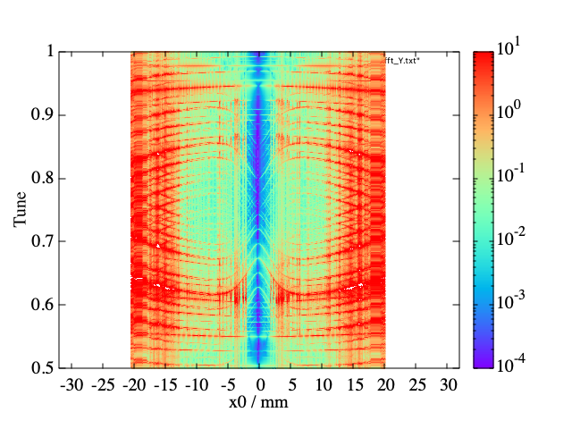

Tracking Simulations w/ Design Beam-Beam Interaction ($δ_{0}=7.5e−4$)
Amplitude and spectrum of vertical beam oscillation of $n_{p}=3.45e+10$:
$$ν_{y}$$

Slide 14
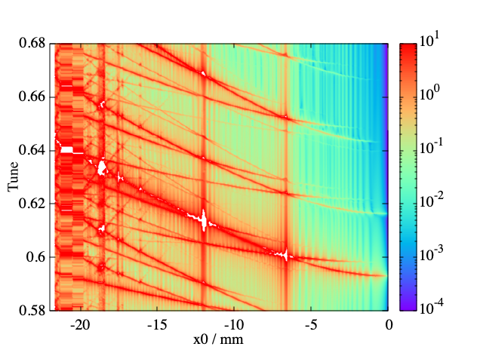
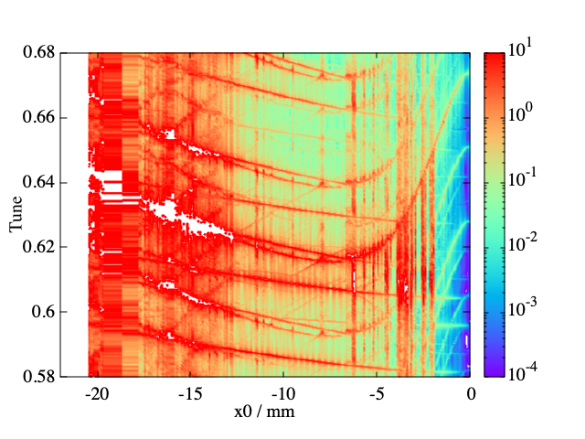
















Resonance Modes
Spectra of vertical beam oscillation w/ $δ_{0}=7.5\text{e}\text{−4}$.
Resonance Modes w/o BB
Resonance Modes w/ BB
$${−10ν}_{x}$$
$$−7ν_{x}−ν_{y}$$
$$−7ν_{x}−ν_{y}$$
$${−12ν}_{x}$$
$${5ν}_{x}$$
$$3ν_{x}+2ν_{s}$$
$$−12ν_{x}$$
$$5ν_{x}$$
$$3ν_{x}+2ν_{s}$$
$$5ν_{x}−ν_{s}$$
$$ν_{y}$$
$$ν_{y}$$
$$5ν_{x}−ν_{s}$$
$$3ν_{x}+ν_{s}$$
$$3ν_{x}+ν_{s}$$
$${3ν}_{x}$$
$$ν_{y}$$
$${3ν}_{x}$$

Slide 15
Summary
The beam-beam interaction not only shifts the tune but also increases the excitation of higher-order modes.

Slide 16
Beam Oscillation w/ Beam-Beam Interaction
 | Design | Actual | w/o Beam-Beam
BX | .025 | .060 | ---
BY | .0003 | .001 | ---
XANGLE | .0415 | .0415 | ---
EMITX | 4.6e-09 | 4.6e-09 | ---
EMITY | 1.288e-11 | 3.0e-11 | ---
DP | .000637 | .000637 | ---
SIGZ | .005 | .006 | ---
NP | 3.45e+10 | 3.45e+10 | ---
SLICE | 200 | 200 | ---
STURN | 10 | 10 | ---

Slide 17
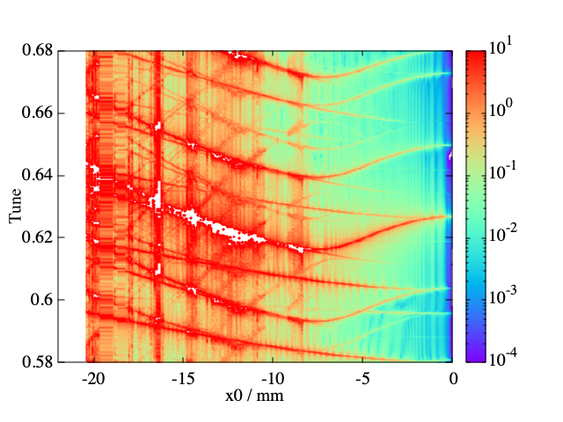

Resonance Modes
Spectra of vertical beam oscillation w/ $δ_{0}=7.5\text{e}\text{−4}$.
Resonance Modes w/ Design BB
Resonance Modes w/ Actual BB
Resonance Modes w/ Actual BB
5$ν_{x}−ν_{s}$
$$ν_{y}$$
$$ν_{y}$$
5$ν_{x}−ν_{s}$
$$3ν_{x}+ν_{s}$$

Slide 18
Summary
The vertical tune shift is reduced by relaxing the vertical betatron function and the emittance.
The excitation of higher-order modes and the resonances is also reduced.

Slide 19
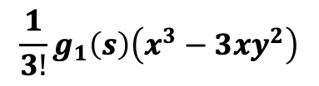
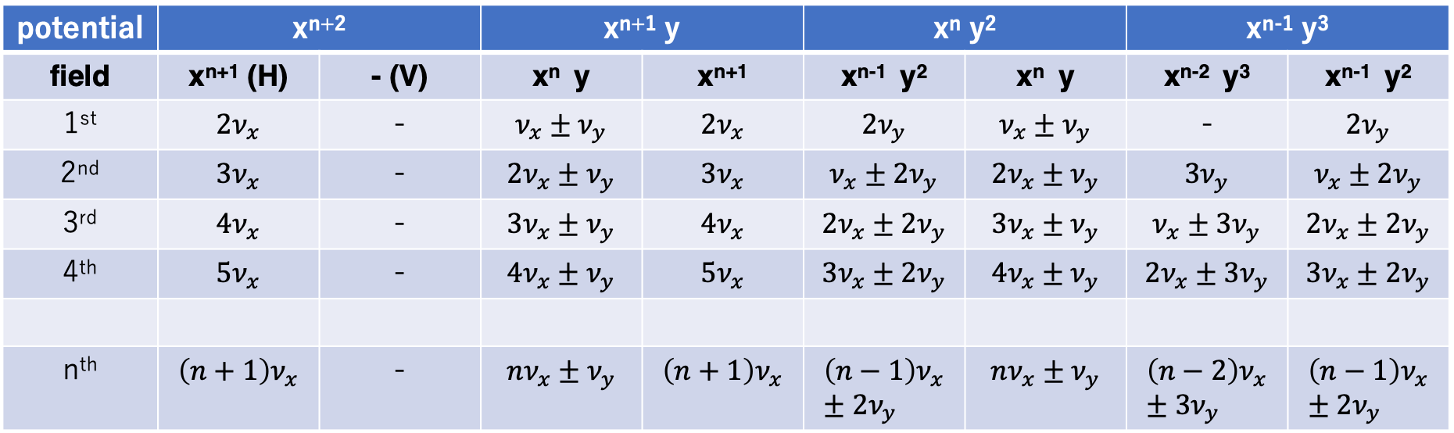
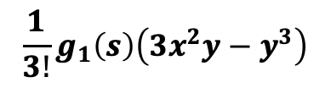
Higher Order Modes of Beam Oscillation
Higher oscillation modes.
  n: order of sextupole perturbation.
potential | x^{n+2} |  | x^{n+1} y |  | x^{n} y² |  | x^{n-1} y³
field | x^{n+1} (H) | - (V) | x^{n} y | x^{n+1} | x^{n-1} y² | x^{n} y | x^{n-2} y³ | x^{n-1} y²
1st | $${2ν}_{x}$$ | - | $$ν_{x}±ν_{y}$$ | $${2ν}_{x}$$ | $${2ν}_{y}$$ | $$ν_{x}±ν_{y}$$ | - | $${2ν}_{y}$$
2nd | $${3ν}_{x}$$ | - | $$2ν_{x}±ν_{y}$$ | $${3ν}_{x}$$ | $$ν_{x}±2ν_{y}$$ | $$2ν_{x}±ν_{y}$$ | $${3ν}_{y}$$ | $$ν_{x}±2ν_{y}$$
3rd | $${4ν}_{x}$$ | - | $$3ν_{x}±ν_{y}$$ | $${4ν}_{x}$$ | $$2ν_{x}±2ν_{y}$$ | $$3ν_{x}±ν_{y}$$ | $$ν_{x}±3ν_{y}$$ | $$2ν_{x}±2ν_{y}$$
4th | $${5ν}_{x}$$ | - | $$4ν_{x}±ν_{y}$$ | $${5ν}_{x}$$ | $$3ν_{x}±2ν_{y}$$ | $$4ν_{x}±ν_{y}$$ | $$2ν_{x}±3ν_{y}$$ | $$3ν_{x}±2ν_{y}$$
n^{th} | $${\left(n+1\right)ν}_{x}$$ | - | $$nν_{x}±ν_{y}$$ | $$\left(n+1\right)ν_{x}$$ | $$\left(n−1\right)ν_{x}±2ν_{y}$$ | $$nν_{x}±ν_{y}$$ | $$\left(n−2\right)ν_{x}±3ν_{y}$$ | $$\left(n−1\right)ν_{x}±2ν_{y}$$
Normal mode
Skew mode
Normal mode
Skew mode
$$\frac{1}{3!}g_{1}\left(s\right)\left(x^{3}−3xy^{2}\right)$$
$$\frac{1}{3!}g_{1}\left(s\right)\left(3x^{2}y−y^{3}\right)$$
Normal sextupole potential:
Skew:

Slide 20

Higher Order Harmonics of Vertical Oscillation 1
Potential of $x^{n+1}y$:
  Skew modes.
  Odd (even) order: difference (sum) mode.

