Slide 1
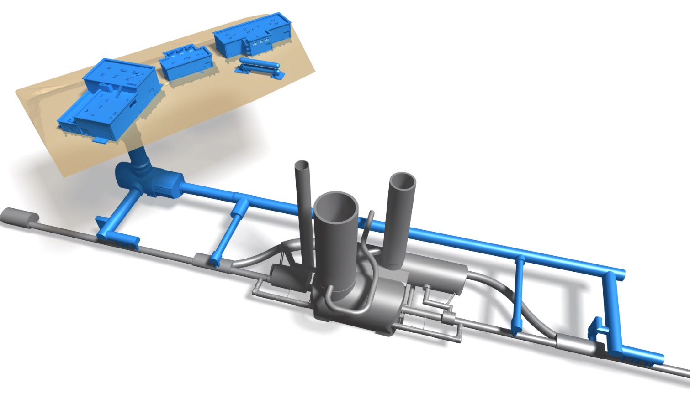
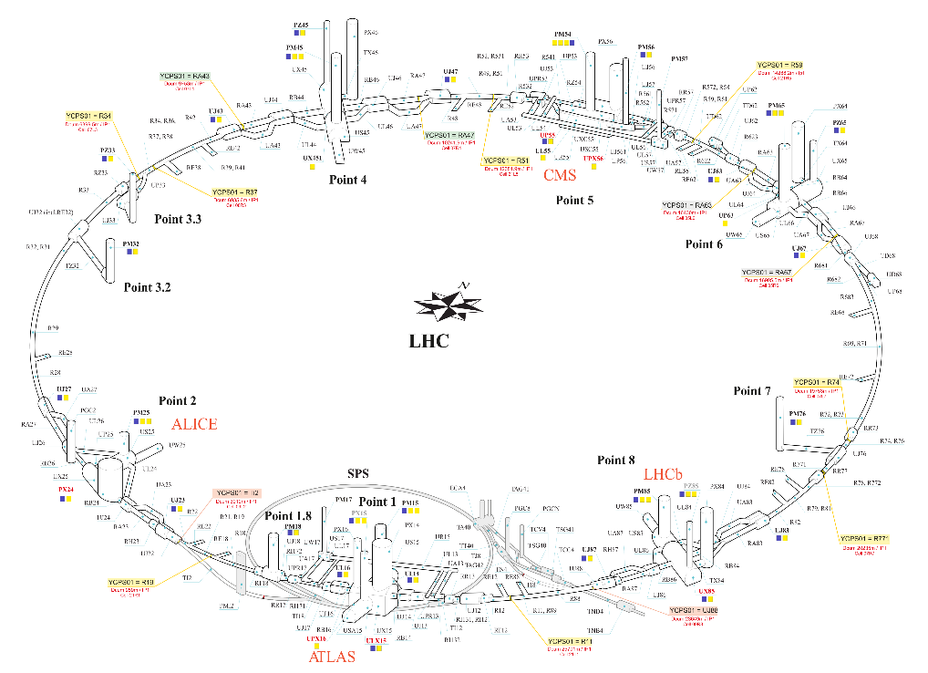
What we need: validation/provide information for RUN3 (2025/6) & LS3 Installation phases of HL-LHC
Installation planning for HL-LHC :
To be discussed: Installation activities details (from start to the completion including partial tests, IST, commissioning):
  During RUN3 (in the new HL-LHC technical galleries)
  During LS3 (in the new HL-LHC technical galleries, in LHC and in the vertical cores region)
Check of the planning: start dates, duration, coherency
Validate/provide comments on the planning
Looking at planning validation, be aware to analyse/consider:
Resource organization inside the groups
Support from other Groups (Transport, Vacuum, Survey, …)
Works perimeter needed and constraints generated (during installation or tests)
Limitations in potential cohabitation/parallelism
What you could install BEFORE the vertical cores excavation (provided an agreement/assurance with SCE that no dust will contaminate the UR and linked galleries).
Worksite services required or impacted during the works and the test phase
(compressed air, nitrogen, communication, water, lighting, electricity, scaffolding, ventilation, other)
Eventual generated risks and, if the case, preventive measures needed (lock-out, authorisations, etc.)

