Slide 1

Notes:
Last spots left for entrepreneurs!

Slide 2
Notes:
Very short introduction of FONGIT for newcomers.

Slide 3
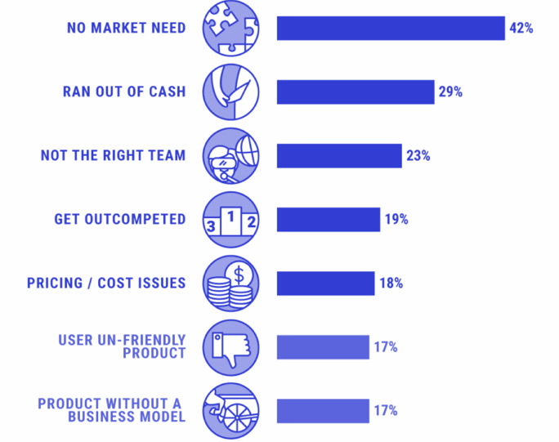
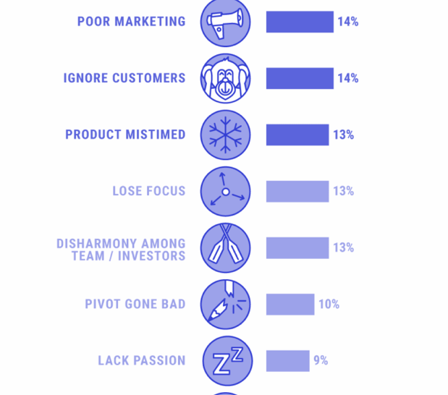
Success… avoiding mistakes
It’s rarely technical issues!
Notes:
In Pierre’s 25 years – it has never been technology
No plan survived contact with a client
Projects need 25+ feedback for B2B, 40+ for B2C
A startup always needs to be able to express their project and be able to pitch it
Pitch maybe not be coherent during an upgrade
Coach quickly 10-12 weeks (modules)
Deadlines increase focus
Pitches and Q&A for each pre-incubation & module-end event
Consistency reduces friction: A lead coach, & a Program, with deliverables, and templates

Slide 4
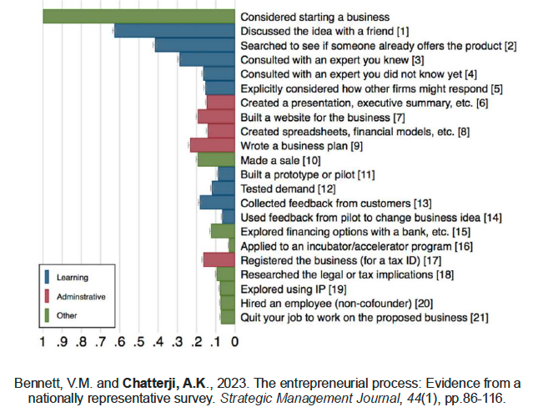
But where are founders focusing?
Coaching to address the key issues

Slide 5
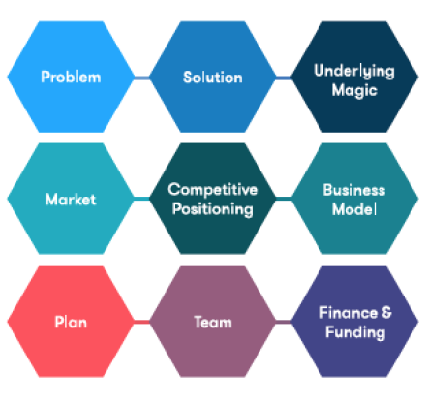
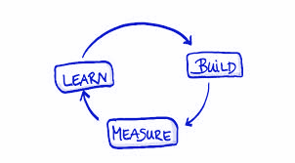

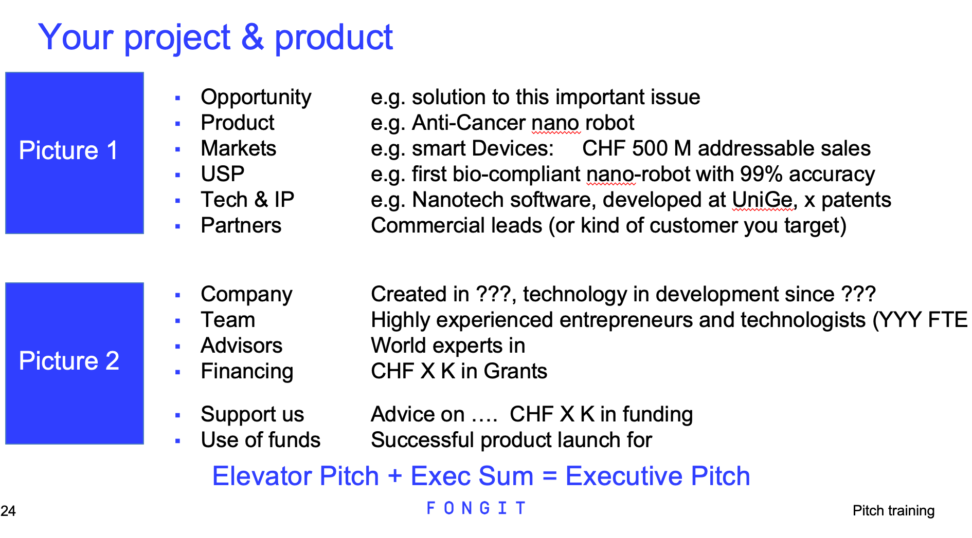
Innovation Initiation
Minimum Viable
Presentation
Value Proposition Canvas
Executive Pitch
1st Full
Pitch Deck
3 months
6+ months
Startup support
25+ stakeholder
feedback
25+ stakeholder
feedback
End of 1st cycle
MVPitch
End of 2nd cycle
Full pitch deck
Problem-solution fit
Product-market fit
Business de-risking
Notes:
Understand what a value proposition is
Express your value proposition
Get feedback from stakeholders
Shape the project
Build a full deck
Get buy in

Slide 6
Our impact

Slide 7
World-class innovators
Notes:
We like to think about our startups as world-class innovators, because they are. You might recognise some of them. They’re very diverse in term of industry: ICT, engineering, fintech, digital health… we are proud to support innovation in various fields.

Slide 8
World-class innovators
Physicist founders
Notes:
We like to think about our startups as world-class innovators, because they are. You might recognise some of them. They’re very diverse in term of industry: ICT, engineering, fintech, digital health… we are proud to support innovation in various fields.

Slide 10
Our support programs

Slide 11
FONGIT Innovation Fund (FIF)
For projects with an SDG impact

Slide 12


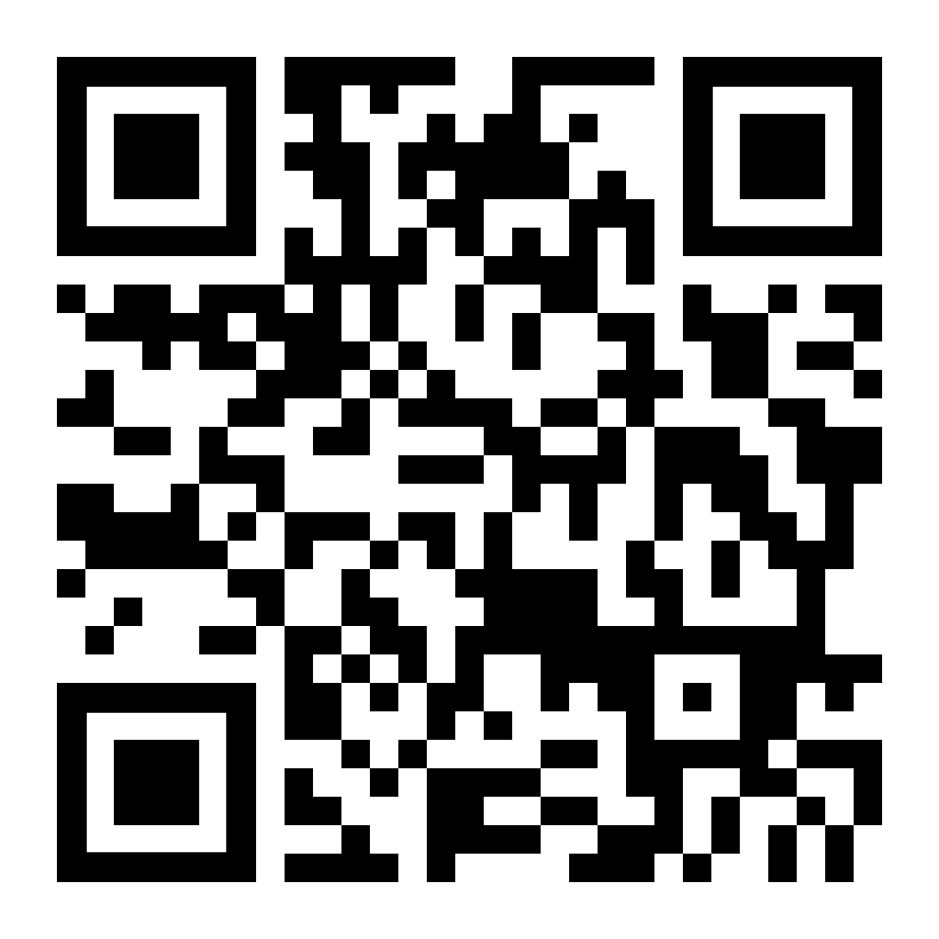



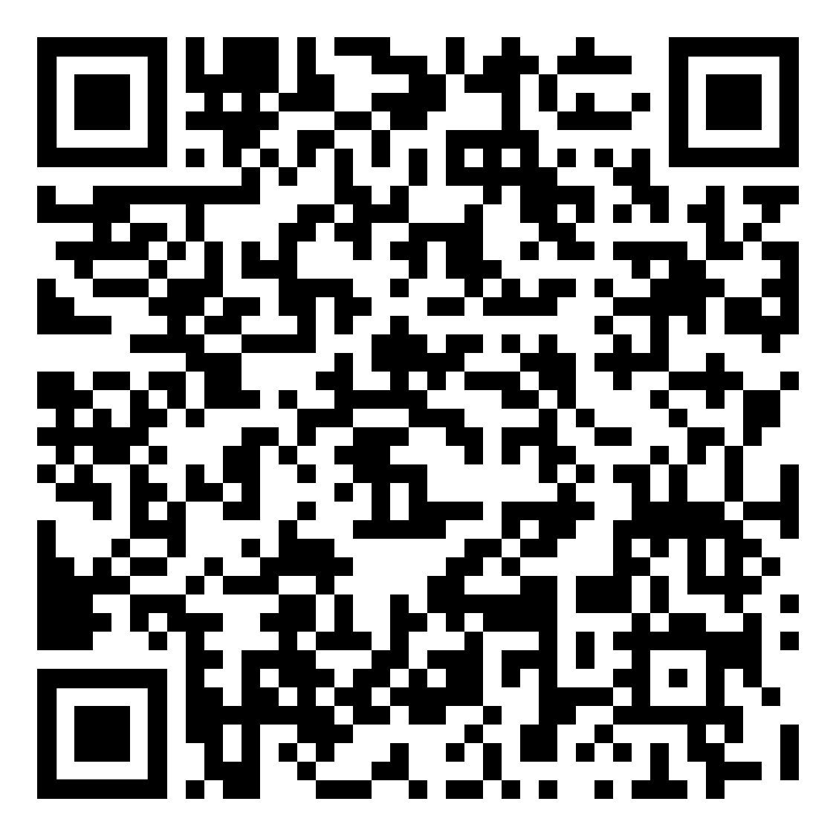

Boost your entrepreneurial skills
Newsletter
Startupticker.ch
Blended learning
startup-accelerator.org
Business concept course
Innosuisse
Your university innovation center & e-clubs
Events and networking
Join us at FONGIT!

Slide 13
EVENTS
YOU WON’T WANT TO MISS
Notes:
AO - staying with events:

Slide 14

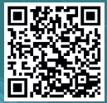

Slide 15


Notes:
AKO

Slide 16

Notes:
AO

Slide 17
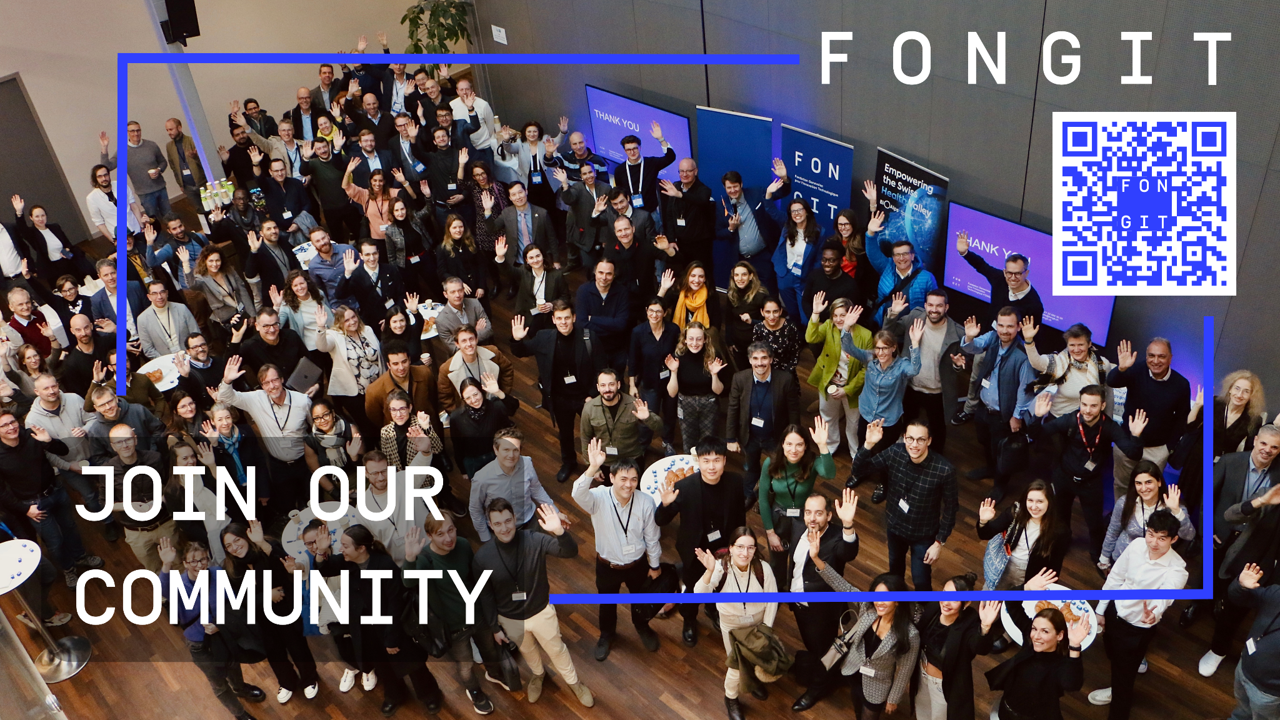
Notes:
thank you for being part of Geneva’s innovation nation.
talk with your neighbour

