Slide 1


Slide 2




Magnetic and optics modelling of the CERN PS-MU and beam-based measurements
Many thanks to:
Ewen Hamish Maclean, Mikko Karppinen, Luke Von Freeden, Tobias Persson, Alexander Huschauer, Rogelio Tomas, Jermie Bauche, Vincenzo Di Capua, Mariano Pentella, Antonio Gilardi, Daniel Shoerling and all the OMC team
Presenter: Vittorio Ferrentino
Date: 28.03.2025

Slide 3
Contents
  Introduction: context and scope
  CERN Proton Synchrotron and its main magnetic units: overview
  PS-MU magnetic modelling
  PS-MU optics modelling
  Beam-based measurements and models validation
  Conclusion and next steps
26 March 2025

Slide 4
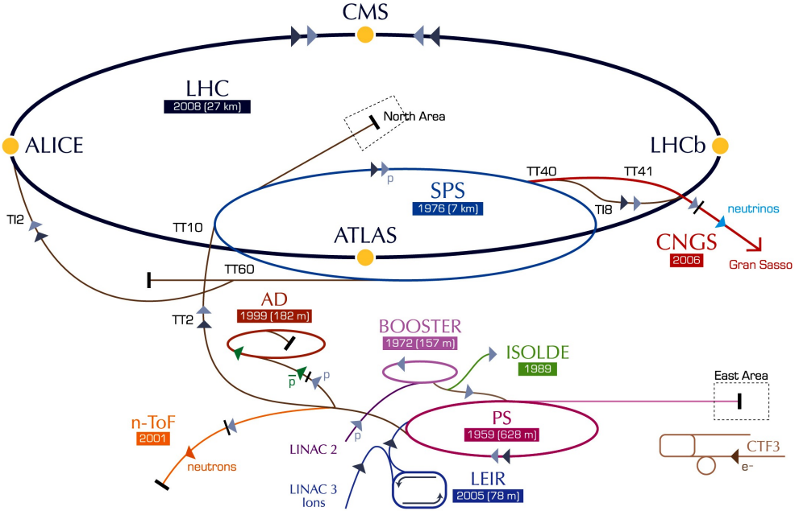
Research area and scope
The research area of interest is the combined magnetic and optics modelling of main magnetic units in particle accelerators, and their validation via beam-based measurements.
The case study is centred on the CERN Proton Synchrotron (PS) accelerators Main Unit (MU) magnets, which is part of Large Hadron Collider’s (LHC) injector chain and plays a vital role in delivering high quality and stable beams to downstream accelerators.
*
[1]
* https://cds.cern.ch/images/CERN-GRAPHICS-2022-001-1
26 March 2025

Slide 5



Research area and scope
General problem – Bridging the gap:
Historically, operation and modeling of the PS main magnets have followed an empirical approach based on beam-based measurements → effective models;
Downstream experiments’ requirements might change throughout the years and operation requires upgrades on the machine → impact on the optics of the circulating beam;
PS now operates in a highly saturated regime with respect to its original design parameters;
Effective models must be repeated whenever hardware changes occur.
Existing models lack predictive capabilities to support operational decisions.
Objective:
Development of predictive magnetic and optics models of the PS main magnets to assess the possibility of predicting the beam dynamics and the beam parameters energy dependence within the PS;
proposed models aim to support operational decisions, aiding in tasks such as establishing new working points, defining power cycle settings, optimizing beam extraction setups, and serving as inputs for adaptive learning approaches
[1]
Methodology:
Development of finite-element magnetic model of PS main magnetic units.
  Computation of field harmonics;
Development of a MU optics model based on predicted harmonics from the magnetic model;
benchmarking of the combined magnetic and optics models’ predictions via beam-based measurements
26 March 2025

Slide 6
Contents
  Introduction: context and scope
  CERN Proton Synchrotron and its main magnetic units: overview
  PS-MU magnetic modelling
  PS-MU optics modelling
  Beam-based measurements and models validation
  Conclusion and next steps
26 March 2025

Slide 7
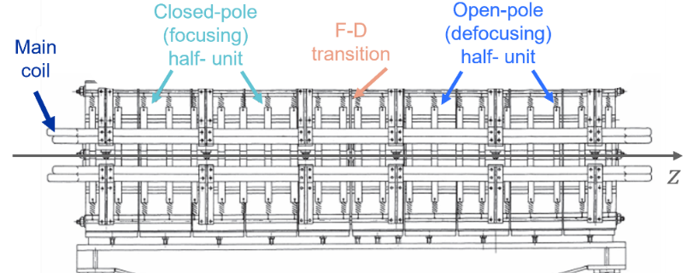
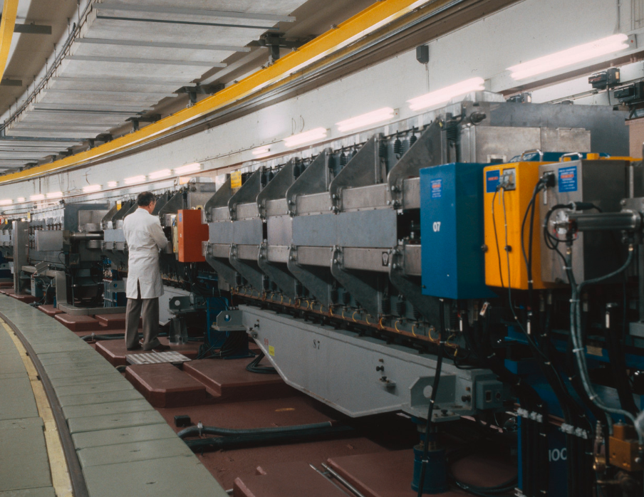
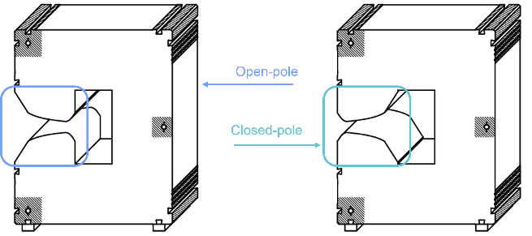
Proton Synchrotron Main Units 1/2
CERN Proton Synchrotron (PS) is the first accelerator built at CERN, accelerating the first protons in 1959. Some accelerator features:
Accelerates proton and heavy ion beams from ~2 GeV/c to ~26 GeV/c;
Circumference of 628 m;
277 room-temperature magnets (dipole main-units, injection magnets, extraction magnets, etc.)
  100 Main-Units (MU) magnets generating the main field in the accelerator to keep the beam circulating.
MU consists in dipolar C-shaped combined-function magnets divided in 10 blocks, 0.417 m each;
  5 focusing (F) and 5 defocusing (D);
  air gaps between each block and in the F/D transition area.
**
*
Alternating-gradient is obtained by means of two different block types, named open-pole (defocusing) and closed-pole blocks.
**
* https://cds.cern.ch/record/2423241;
** Mariusz Juchno. Magnetic Model of the CERN Proton Synchrotron. PhDthesis, IPEP, Lausanne, 2013
26 March 2025

Slide 8
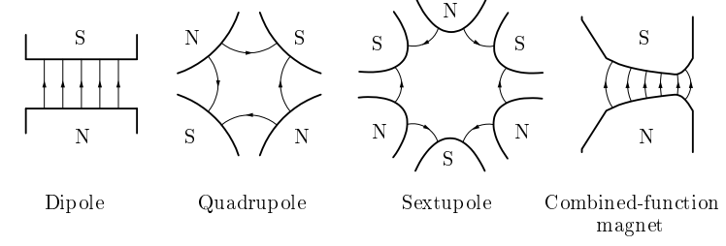
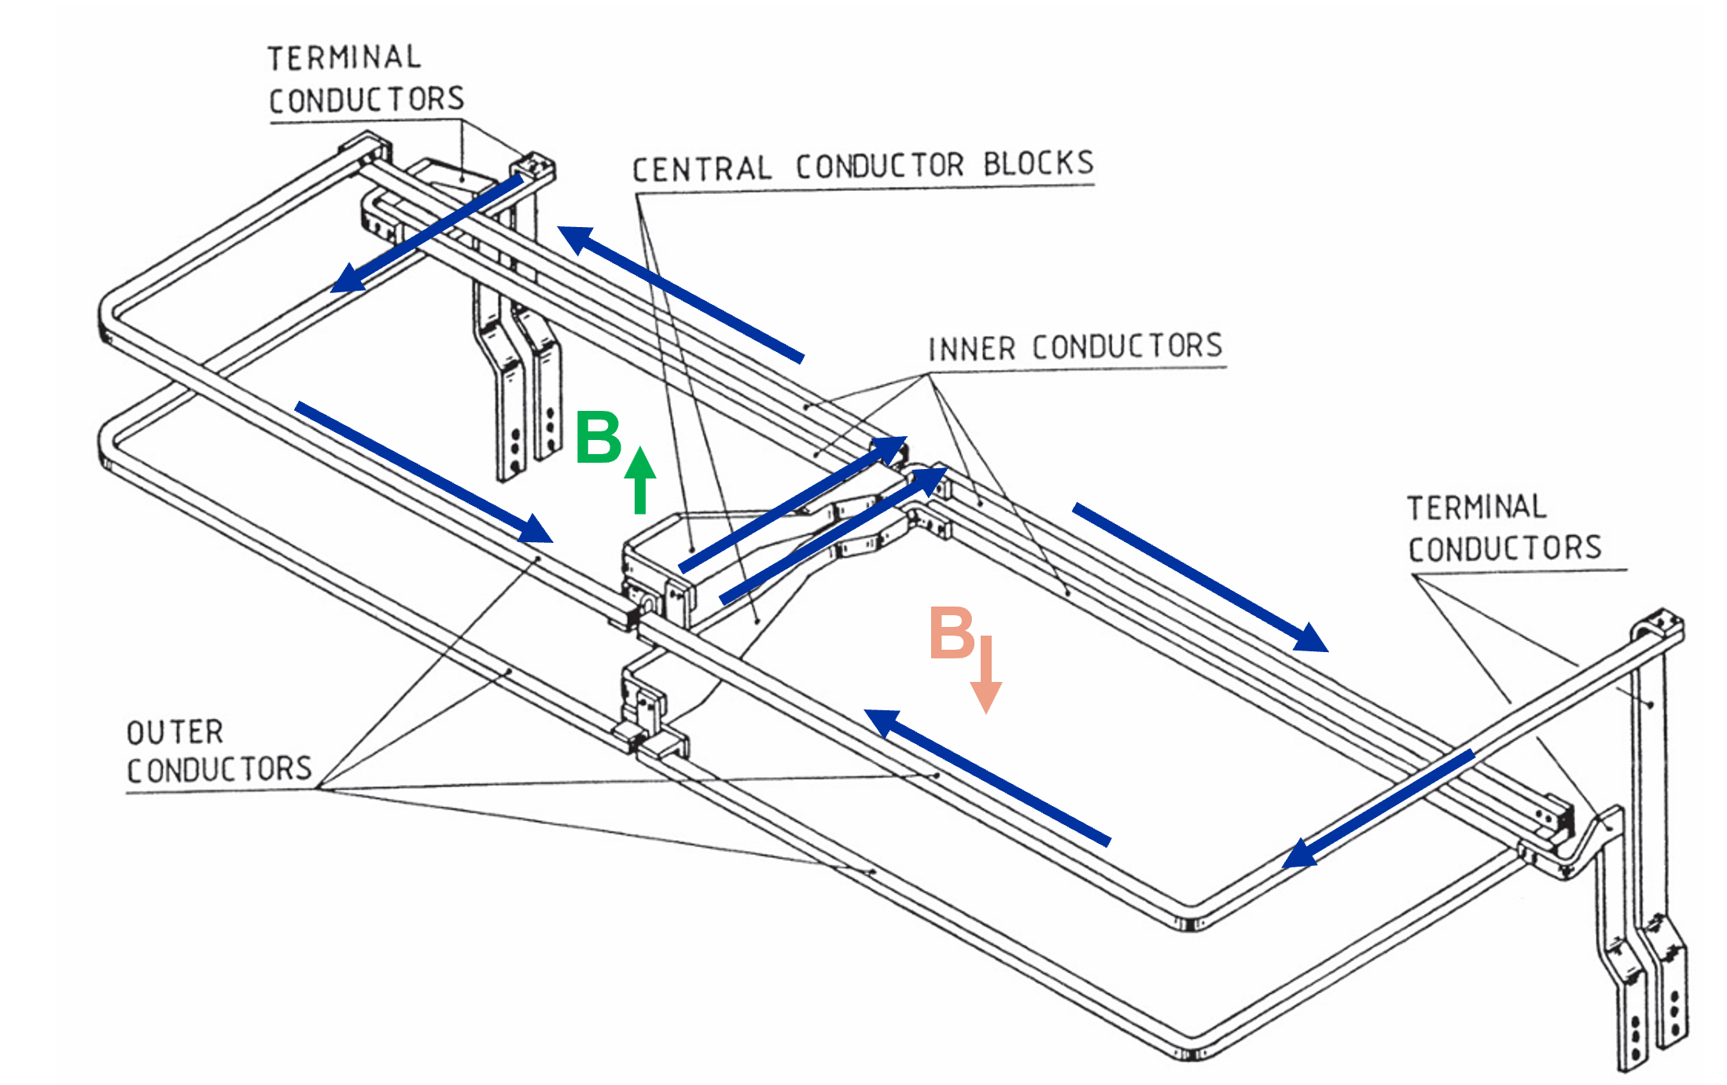
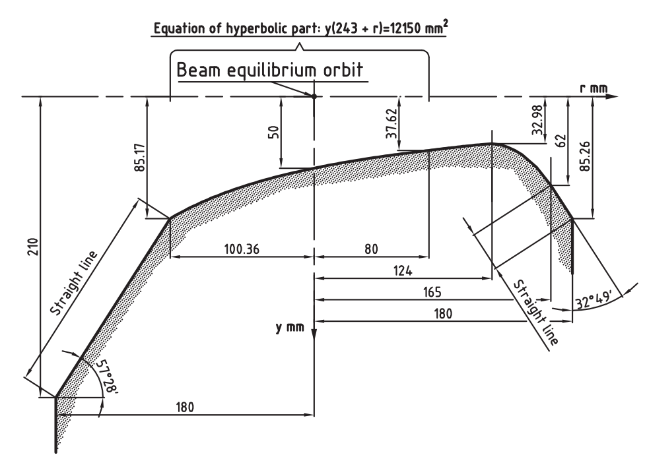
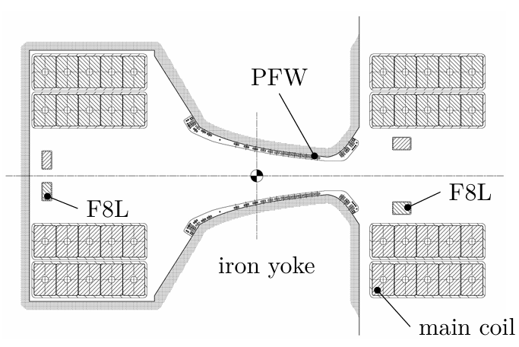
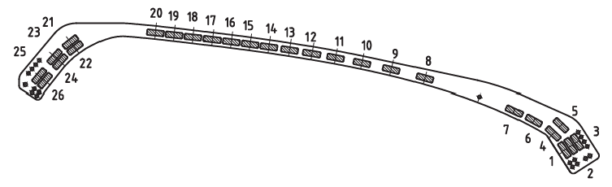
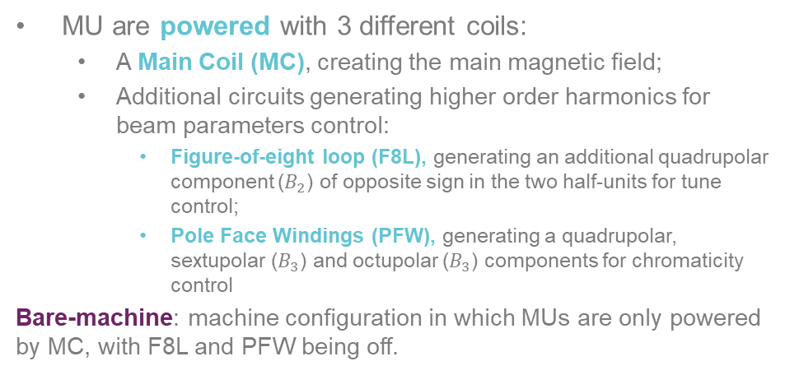
Proton Synchrotron Main Units 2/2
MU are powered with 3 different coils:
  A Main Coil (MC), creating the main magnetic field;
  Additional circuits generating higher order harmonics for beam parameters control:
    Figure-of-eight loop (F8L), generating an additional quadrupolar component ($B_{2}$) of opposite sign in the two half-units for tune control;
    Pole Face Windings (PFW), generating a quadrupolar, sextupolar ($B_{3}$) and octupolar ($B_{3}$) components for chromaticity control
Bare-machine: machine configuration in which MUs are only powered by MC, with F8L and PFW being off.
Hyperbolic pole accurately designed to generate a combined-function magnetic field in the aperture:
  Advantages: Avoid the installation of individual magnets for each magnetic function → Saving space
  Disadvantages: Not possible the control of the individual field harmonics
*
***
**
* https://cds.cern.ch/record/2194332/files/CERN-THESIS-2016-061.pdf
** Mariusz Juchno. Magnetic Model of the CERN Proton Synchrotron. PhDthesis, IPEP, Lausanne, 2013
*** https://cds.cern.ch/record/2832176/files/MPS-Int-DL-63-13.pdf
26 March 2025

Slide 9
Contents
  Introduction: context and scope
  CERN Proton Synchrotron and its main magnetic units: overview
  PS-MU magnetic modelling
  PS-MU optics modelling
  Beam-based measurements and models validation
  Conclusion and next steps
PS-MU:
Magnetic modelling
PS-MU:
optics modelling
Optics
measurements
26 March 2025

Slide 10
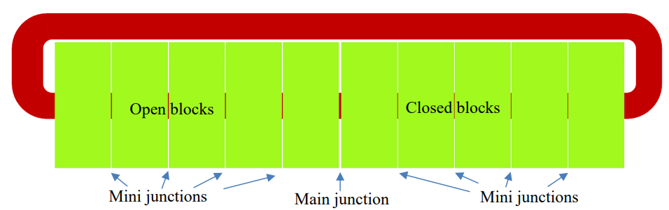

MU magnetic modelling: pre-existing model
First task undertaken in the thesis → to assess the performance of the pre-existing MU magnetic model [1] → critically evaluation of its effectiveness in delivering time-consistent results → identify limitations in the reference model → Asses the cause of these limitations.
The modeling of the PS-MU is a significant engineering challenge:
  complicated pole shape → error in designing hyperbolic pole would impact on the simulated field;
  presence of the air gaps;
  combined-function magnet → multipole harmonics to be predicted;
The finite-element (FE) MU magnetic model developed with Opera 3D [2-3], a widely adopted commercial software, extensively employed in accelerator magnet studies [4–6].
The PS-MU Opera 3D model is straight model, which includes the coils, iron and air.
$$z$$
This model, developed between 2010 and 2020, was maintained at CERN over the years, but not largely used for operational studies. Why?
26 March 2025

Slide 11
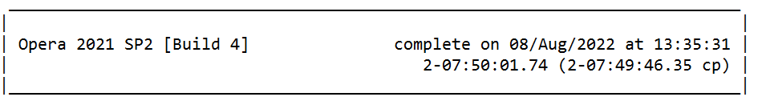
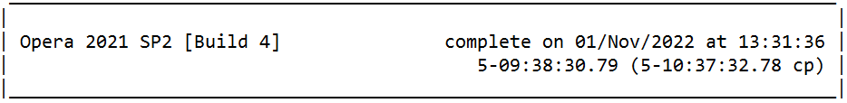
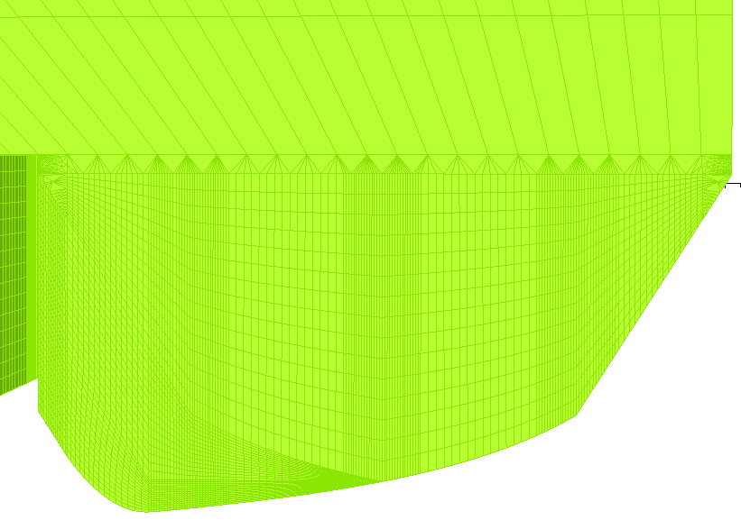
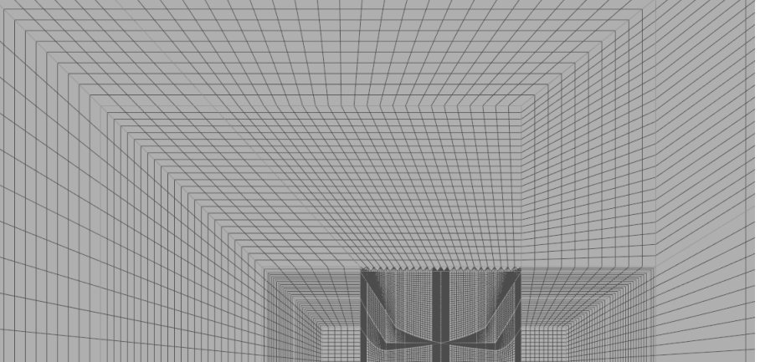

MU pre-existing magnetic model: limitations
Initial simulations with old MU model showed key limitations constraining their applicability:
model extremely resource-intensive during the pre- and post-processing phases;
  slowed down basic operations (mesh generation, selection of specific cells, or to assign boundary conditions) → hindered efficiency;
  Impeding to perform simulations in a reasonable timeframe → simulations extended to several days to complete → impacting the practicality of using the model for routine analysis (operation ideally requires simulations to be completed within approximately 10 hours to allow operators to setup the machine).
After thorough investigations and discussion with experts at CERN, it was determined that primary areas requiring improvement in the pre-existing MU magnetic model were:
the mesh type (hexahedral) used in the model;
inconsistent mesh element densities between neighboring regions across the magnet pole;
  This led to very tiny angles in the boundary region, which might make the solver slow
To meet operational requirements predictions at multiple energy levels in multiple machine configuration (bare-machine and with F8L/PFW) →
Refined magnetic model needed to perform multiple simulations
26 March 2025

Slide 12
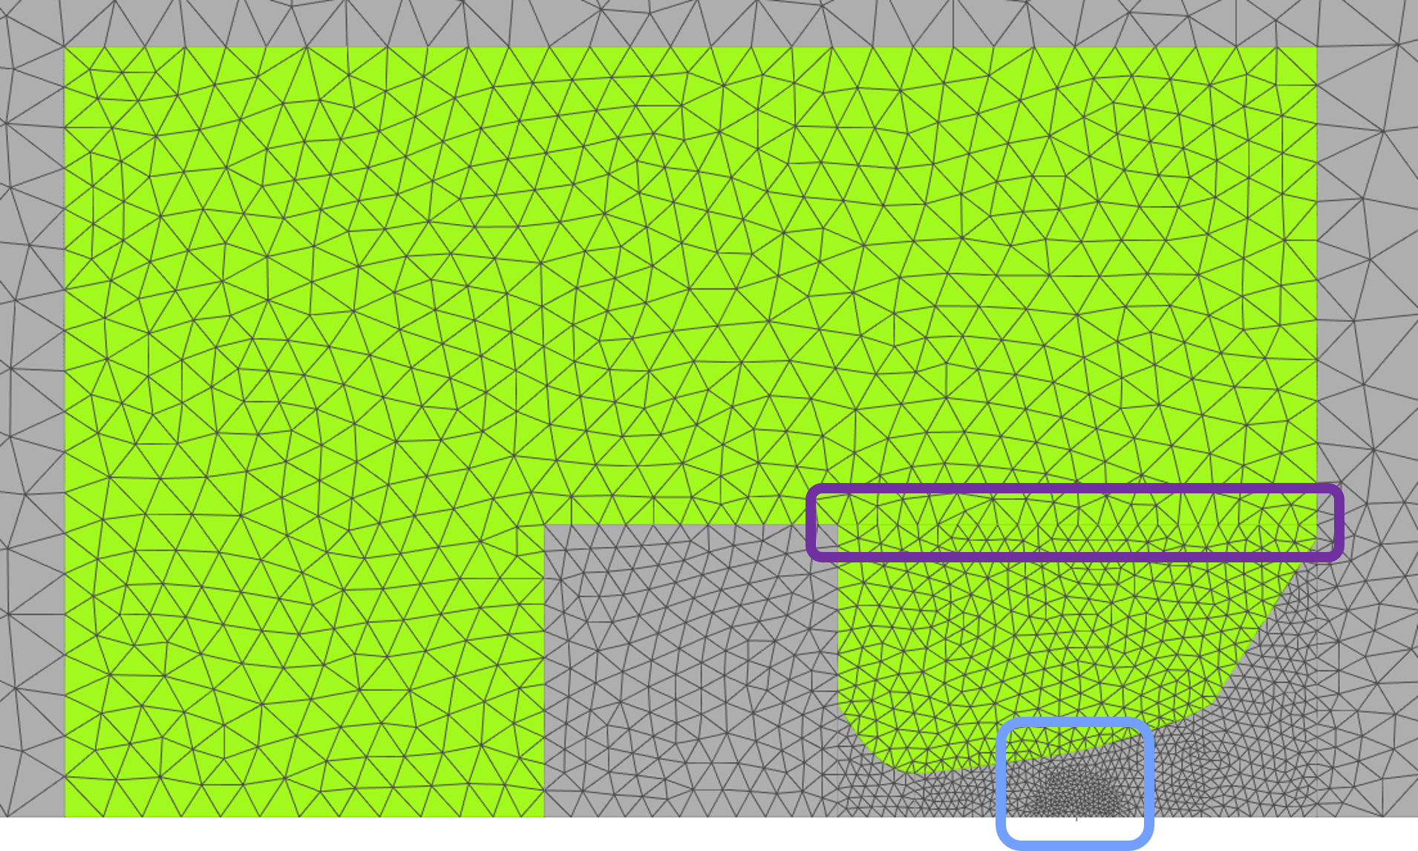
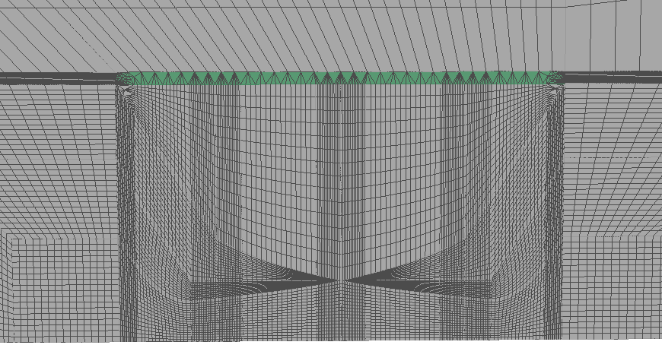
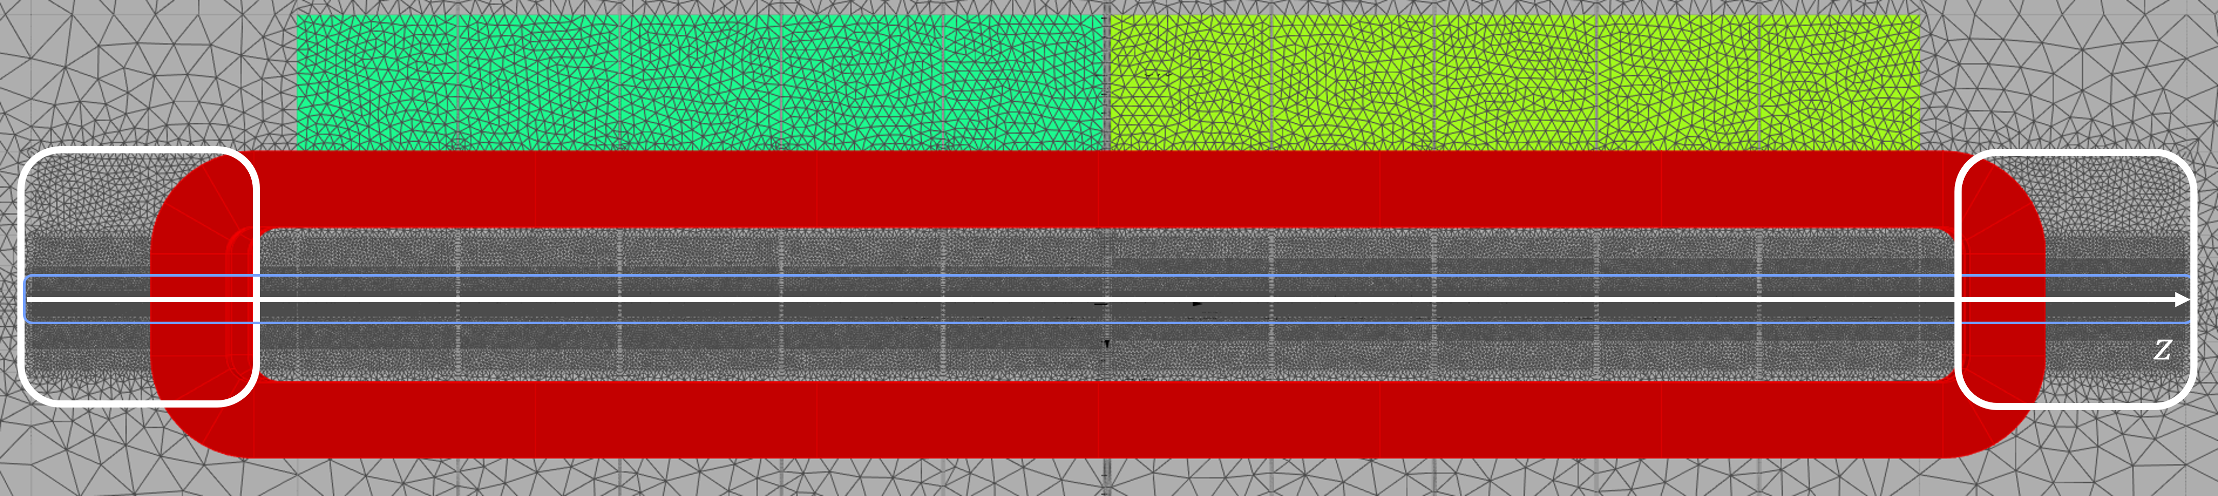
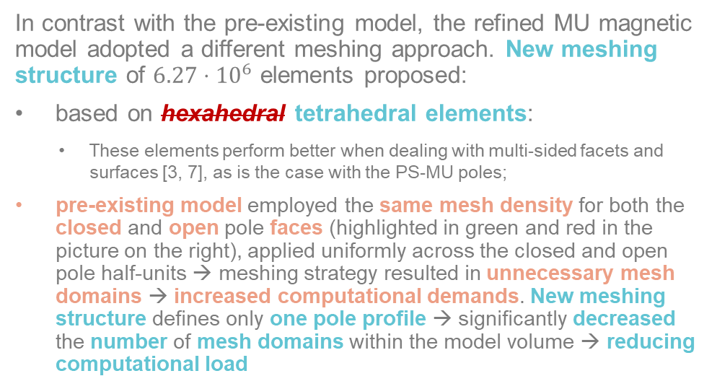
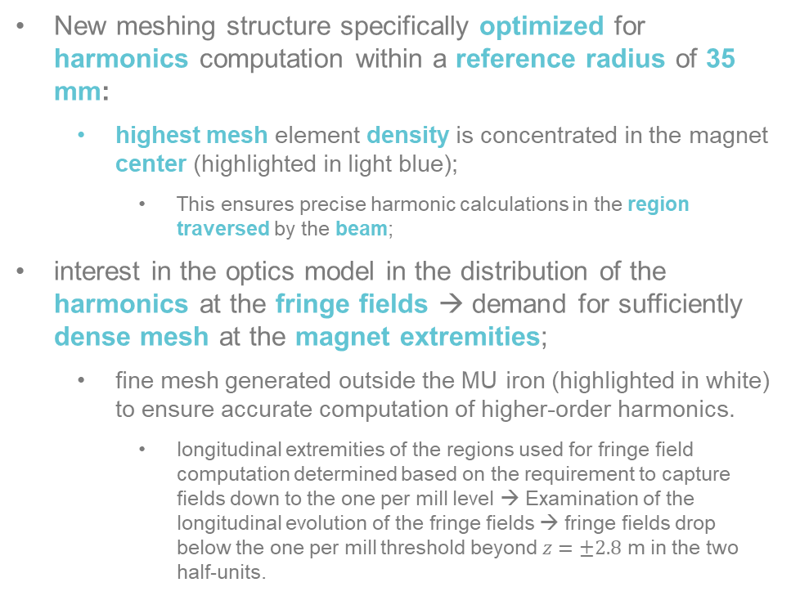
Refined MU magnetic model: new meshing approach
In contrast with the pre-existing model, the refined MU magnetic model adopted a different meshing approach. New meshing structure of $6.27⋅10^{6}$ elements proposed:
based on hexahedral tetrahedral elements:
  These elements perform better when dealing with multi-sided facets and surfaces [3, 7], as is the case with the PS-MU poles;
pre-existing model employed the same mesh density for both the closed and open pole faces (highlighted in green and red in the picture on the right), applied uniformly across the closed and open pole half-units → meshing strategy resulted in unnecessary mesh domains → increased computational demands. New meshing structure defines only one pole profile → significantly decreased the number of mesh domains within the model volume → reducing computational load
New meshing structure specifically optimized for harmonics computation within a reference radius of 35 mm:
  highest mesh element density is concentrated in the magnet center (highlighted in light blue);
    This ensures precise harmonic calculations in the region traversed by the beam;
interest in the optics model in the distribution of the harmonics at the fringe fields → demand for sufficiently dense mesh at the magnet extremities;
  fine mesh generated outside the MU iron (highlighted in white) to ensure accurate computation of higher-order harmonics.
    longitudinal extremities of the regions used for fringe field computation determined based on the requirement to capture fields down to the one per mill level → Examination of the longitudinal evolution of the fringe fields → fringe fields drop below the one per mill threshold beyond $z=±2.8$ m in the two half-units.
26 March 2025

Slide 13
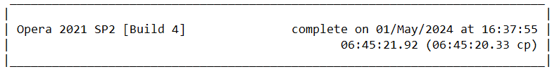
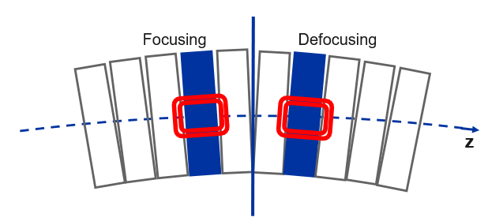
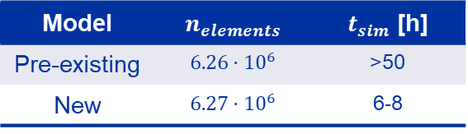
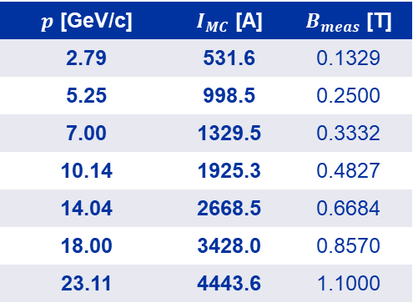
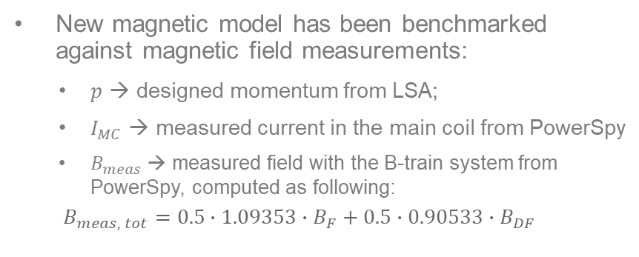
Refined MU magnetic model: performance/validation
Refined MU magnetic model revealed to be much lighter, manageable and resource-efficient;
Computation times reduced to 6-8 hours in contrast to the ~50 needed by the previous model, depending on the current level (using same current level and machine for the simulation);
How was this achieved?
Significant gain in computational efficiency was not achieved by drastically reducing the number of mesh elements. Rather, it was driven by the strategic selection of tetrahedral mesh elements and the careful placement of high-density domains only where necessary throughout the model.
This approach ensured that the model maintains a high level of detail and accuracy, while significantly reducing the computational load.
Model | $$n_{elements}$$ | $t_{sim}$ [h]
Pre-existing | $$6.26⋅10^{6}$$ | >50
New | $$6.27⋅10^{6}$$ | 6-8
New magnetic model has been benchmarked against magnetic field measurements:
  $p$ → designed momentum from LSA;
  $I_{MC}$ → measured current in the main coil from PowerSpy
  $B_{meas}$ → measured field with the B-train system from PowerSpy, computed as following:
  $$B_{meas, tot}=0.5∙1.09353∙B_{F}+0.5∙0.90533∙B_{DF}$$
$p$ [GeV/c] | $I_{MC}$ [A] | $B_{meas}$ [T]
2.79 | 531.6 | 0.1329
5.25 | 998.5 | 0.2500
7.00 | 1329.5 | 0.3332
10.14 | 1925.3 | 0.4827
14.04 | 2668.5 | 0.6684
18.00 | 3428.0 | 0.8570
23.11 | 4443.6 | 1.1000
26 March 2025

Slide 14
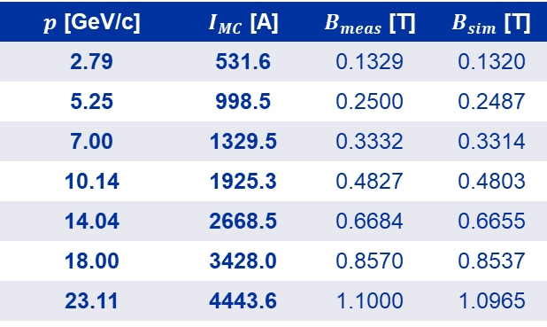
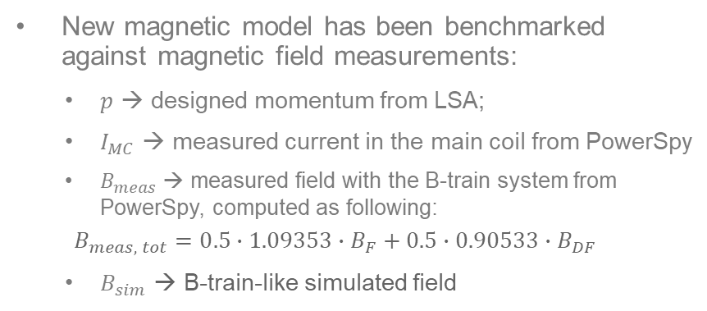
Refined MU magnetic model: performance/validation
Refined MU magnetic model revealed to be much lighter, manageable and resource-efficient;
Computation times reduced to 6-8 hours in contrast to the ~50 needed by the previous model, depending on the current level (using same current level and machine for the simulation);
How was this achieved?
Significant gain in computational efficiency was not achieved by drastically reducing the number of mesh elements. Rather, it was driven by the strategic selection of tetrahedral mesh elements and the careful placement of high-density domains only where necessary throughout the model.
This approach ensured that the model maintains a high level of detail and accuracy, while significantly reducing the computational load.
Model | $$n_{elements}$$ | $t_{sim}$ [h]
Pre-existing | $$6.26⋅10^{6}$$ | >50
New | $$6.27⋅10^{6}$$ | 6-8
New magnetic model has been benchmarked against magnetic field measurements:
  $p$ → designed momentum from LSA;
  $I_{MC}$ → measured current in the main coil from PowerSpy
  $B_{meas}$ → measured field with the B-train system from PowerSpy, computed as following:
  $$B_{meas, tot}=0.5∙1.09353∙B_{F}+0.5∙0.90533∙B_{DF}$$
  $B_{sim}$ → B-train-like simulated field
$p$ [GeV/c] | $I_{MC}$ [A] | $B_{meas}$ [T] | $B_{sim}$ [T]
2.79 | 531.6 | 0.1329 | 0.1320
5.25 | 998.5 | 0.2500 | 0.2487
7.00 | 1329.5 | 0.3332 | 0.3314
10.14 | 1925.3 | 0.4827 | 0.4803
14.04 | 2668.5 | 0.6684 | 0.6655
18.00 | 3428.0 | 0.8570 | 0.8537
23.11 | 4443.6 | 1.1000 | 1.0965
26 March 2025

Slide 15
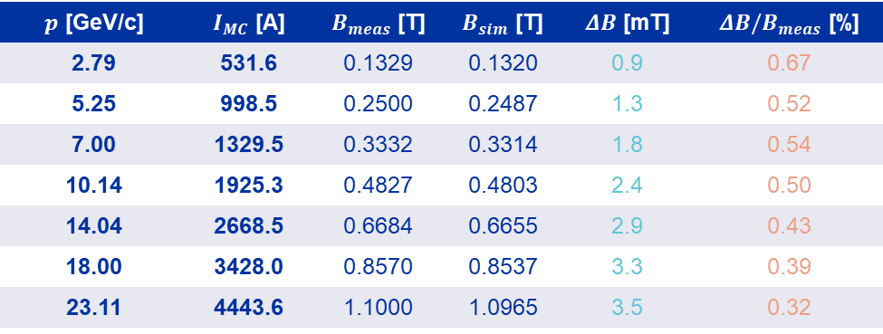
Refined MU magnetic model: performance/validation
Refined MU magnetic model revealed to be much lighter, manageable and resource-efficient;
Computation times reduced to 6-8 hours in contrast to the ~50 needed by the previous model, depending on the current level (using same current level and machine for the simulation);
How was this achieved?
Significant gain in computational efficiency was not achieved by drastically reducing the number of mesh elements. Rather, it was driven by the strategic selection of tetrahedral mesh elements and the careful placement of high-density domains only where necessary throughout the model.
This approach ensured that the model maintains a high level of detail and accuracy, while significantly reducing the computational load.
Model | $$n_{elements}$$ | $t_{sim}$ [h]
Pre-existing | $$6.26⋅10^{6}$$ | >50
New | $$6.27⋅10^{6}$$ | 6-8
New magnetic model has been benchmarked against magnetic field measurements:
  $p$ → designed momentum from LSA;
  $I_{MC}$ → measured current in the main coil from PowerSpy
  $B_{meas}$ → measured field with the B-train system from PowerSpy, computed as following:
  $$B_{meas, tot}=0.5∙1.09353∙B_{F}+0.5∙0.90533∙B_{DF}$$
  $B_{sim}$ → B-train-like simulated field
$p$ [GeV/c] | $I_{MC}$ [A] | $B_{meas}$ [T] | $B_{sim}$ [T] | $ΔB$ [mT] | $ΔB/B_{meas}$ [%]
2.79 | 531.6 | 0.1329 | 0.1320 | 0.9 | 0.67
5.25 | 998.5 | 0.2500 | 0.2487 | 1.3 | 0.52
7.00 | 1329.5 | 0.3332 | 0.3314 | 1.8 | 0.54
10.14 | 1925.3 | 0.4827 | 0.4803 | 2.4 | 0.50
14.04 | 2668.5 | 0.6684 | 0.6655 | 2.9 | 0.43
18.00 | 3428.0 | 0.8570 | 0.8537 | 3.3 | 0.39
23.11 | 4443.6 | 1.1000 | 1.0965 | 3.5 | 0.32
26 March 2025

Slide 16
Contents
  Introduction: context and scope
  CERN Proton Synchrotron and its main magnetic units: overview
  PS-MU magnetic modelling
  PS-MU optics modelling
  Beam-based measurements and models validation
  Conclusion and next steps
PS-MU:
Magnetic modelling
PS-MU:
optics modelling
Optics
measurements
26 March 2025

Slide 17
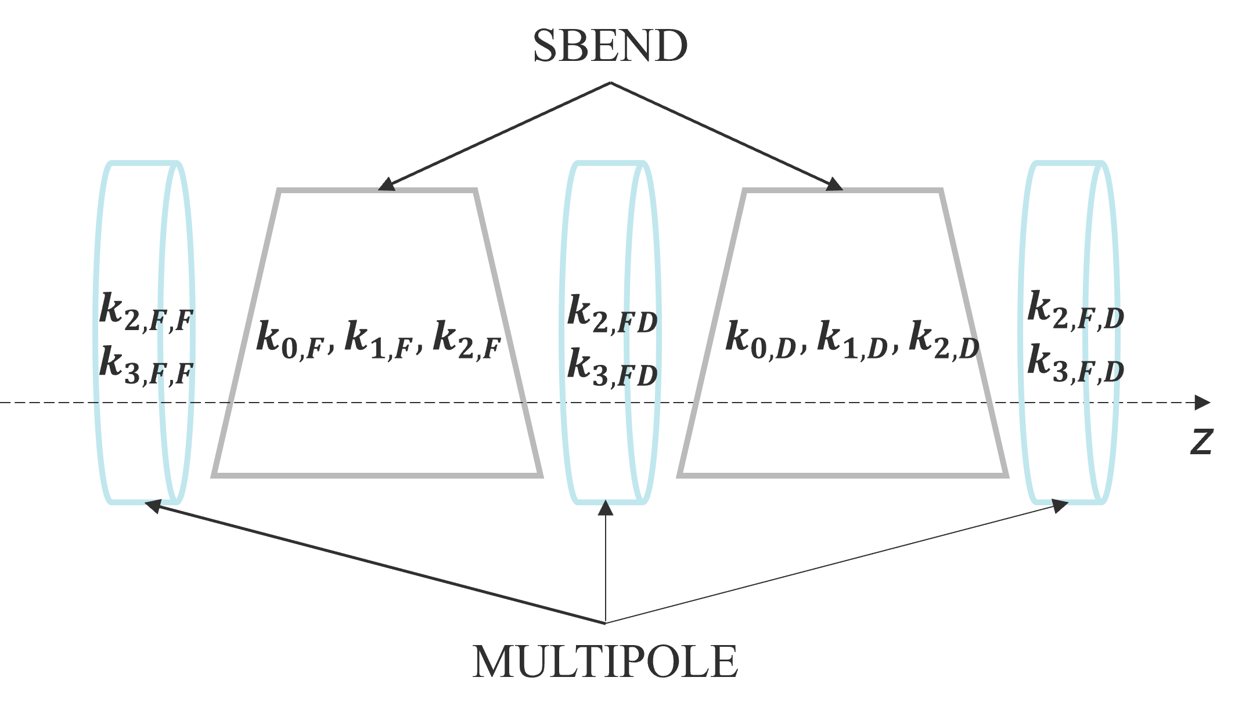
MU pre-existing optics model
PS-MU pre-existing optics model represent an effective or matched model:
magnet strengths are not defined according to true settings applied in the machine, but rather are tuned to replicate beam-based measurements or desired beam-parameters;
  quadrupolar and sextupolar components of the SBENDs were matched via the MAD-X matching module to replicate measured tunes and chromaticities at injection in the bare machine;
    no account for the magnetic saturation of the MU is made;
  models for different working points or use cases generated by replacing the desired beam parameters and using the matching module on the SBEND's quadrupolar and sextupolar strengths.
  empirical approach renders the pre-existing optics model an effective model → lack of predictive power, limiting its application for making operational decisions → This limitation highlighted the necessity for a new optics model that adopts a different approach compared to the pre-existing matched optics model of the MU;
26 March 2025

Slide 18
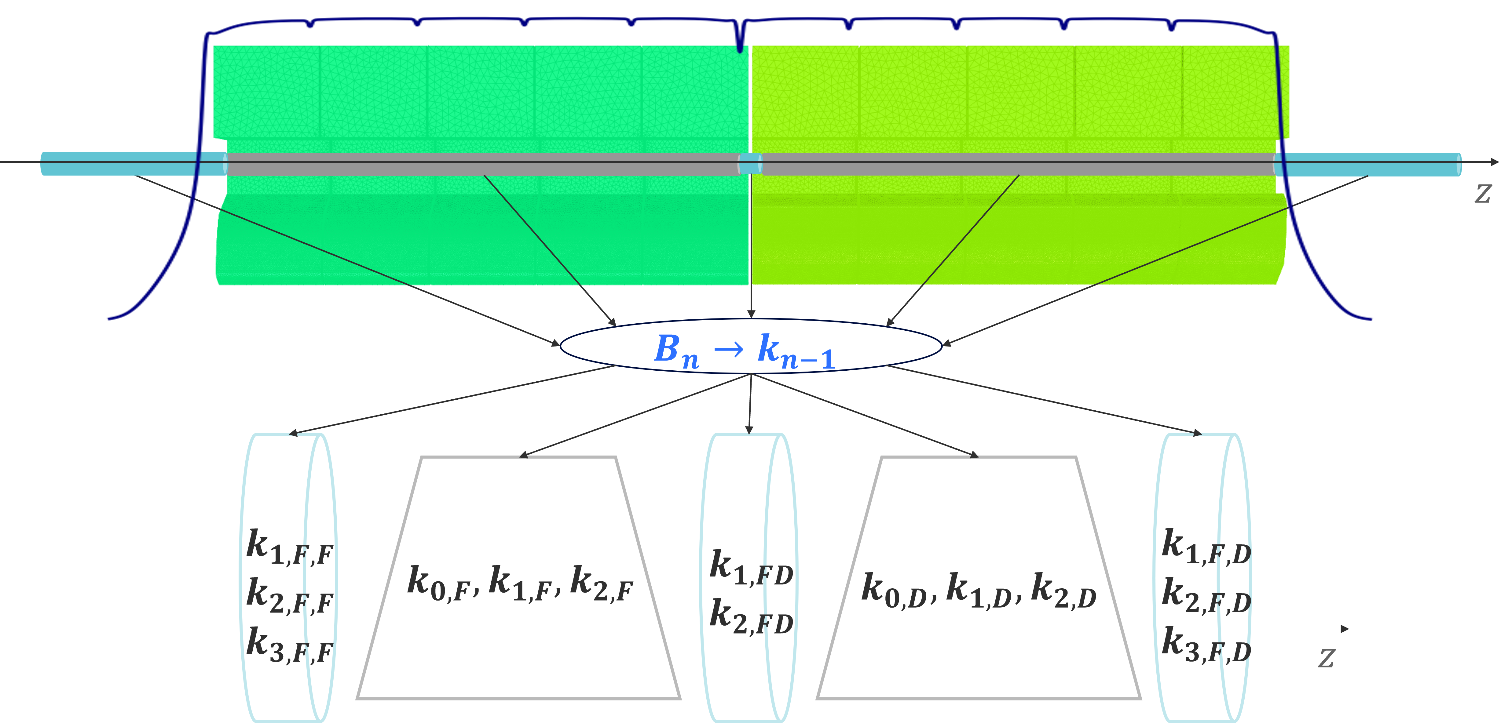
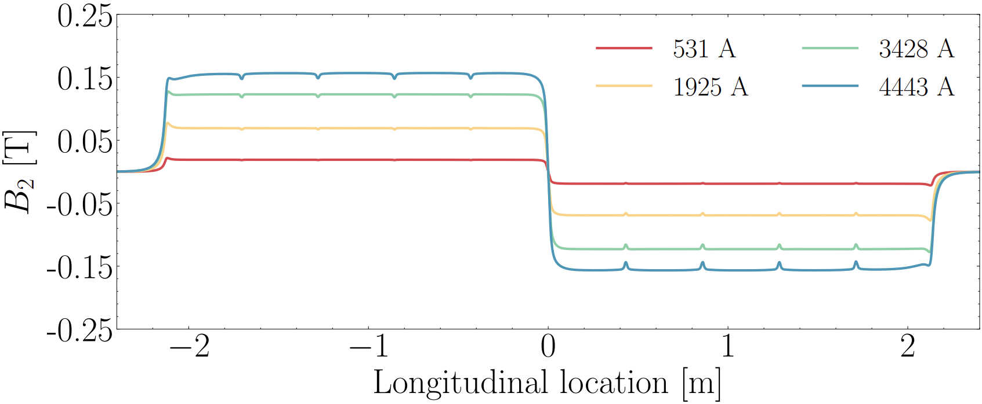
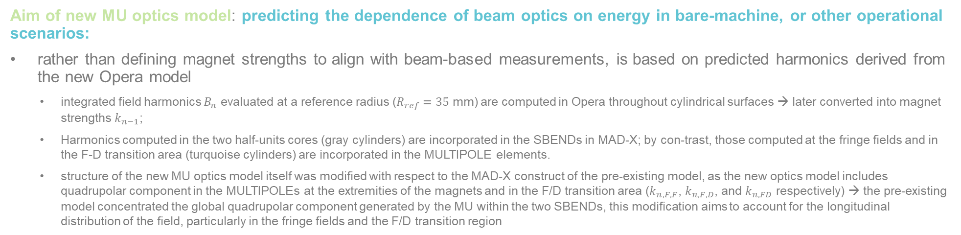
New MU optics model
Aim of new MU optics model: predicting the dependence of beam optics on energy in bare-machine, or other operational scenarios:
rather than defining magnet strengths to align with beam-based measurements, is based on predicted harmonics derived from the new Opera model
  integrated field harmonics $B_{n}$ evaluated at a reference radius ($R_{ref}=35$ mm) are computed in Opera throughout cylindrical surfaces → later converted into magnet strengths $k_{n−1}$;
  Harmonics computed in the two half-units cores (gray cylinders) are incorporated in the SBENDs in MAD-X; by con-trast, those computed at the fringe fields and in the F-D transition area (turquoise cylinders) are incorporated in the MULTIPOLE elements.
  structure of the new MU optics model itself was modified with respect to the MAD-X construct of the pre-existing model, as the new optics model includes quadrupolar component in the MULTIPOLEs at the extremities of the magnets and in the F/D transition area ($k_{n, F,F}$, $k_{n, F,D}$, and $k_{n, FD}$ respectively) → the pre-existing model concentrated the global quadrupolar component generated by the MU within the two SBENDs, this modification aims to account for the longitudinal distribution of the field, particularly in the fringe fields and the F/D transition region
26 March 2025

Slide 19
Contents
  Introduction: context and scope
  CERN Proton Synchrotron and its main magnetic units: overview
  PS-MU magnetic modelling
  PS-MU optics modelling
  Beam-based measurements and models validation
  Conclusion and next steps
PS-MU:
Magnetic modelling
PS-MU:
optics modelling
Optics
measurements
26 March 2025

Slide 20
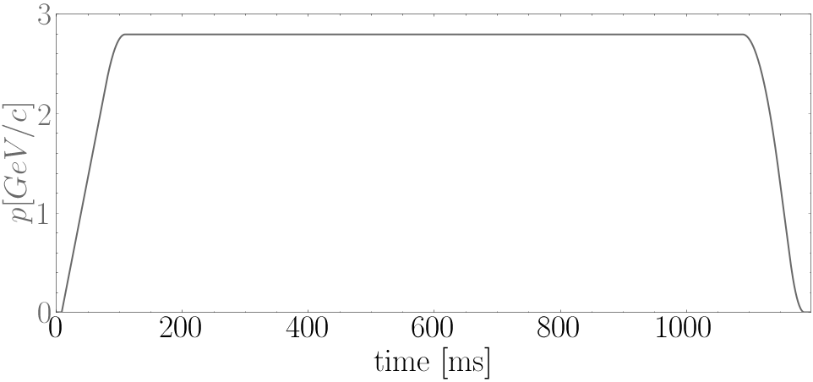
Beam-based measurements: aim and setup
Aim: provide a consistent dataset of experimental data that can be utilized for the validation of the MU models
Machine configuration: bare-machine, to isolate, as much as possible, the effect of the MU on the machine optics, enabling an effective benchmarking of the MU models:
  F8L and PFW circuits deactivated;
  all additional corrector magnets around the ring were deactivated during the beam-based measurements → preventing any interference from these additional magnets, which could otherwise affect the measurements → circulating beam was influenced exclusively by the MU → models’ predictions could be accurately assessed without the confounding effects of other magnets present in the ring.
Machine powering: to study optics dependence on energy and the effects of saturation on the machine optics, dedicated bare-machine power cycles were created;
  Thanks to Denis Gerard Cotte for setting up the power cycles and all the OP-PS/PSB operators for the support during the measurements;
  Magnetic and optics model are static and do not include for eddy-currents → need of static powering conditions:
26 March 2025

Slide 21
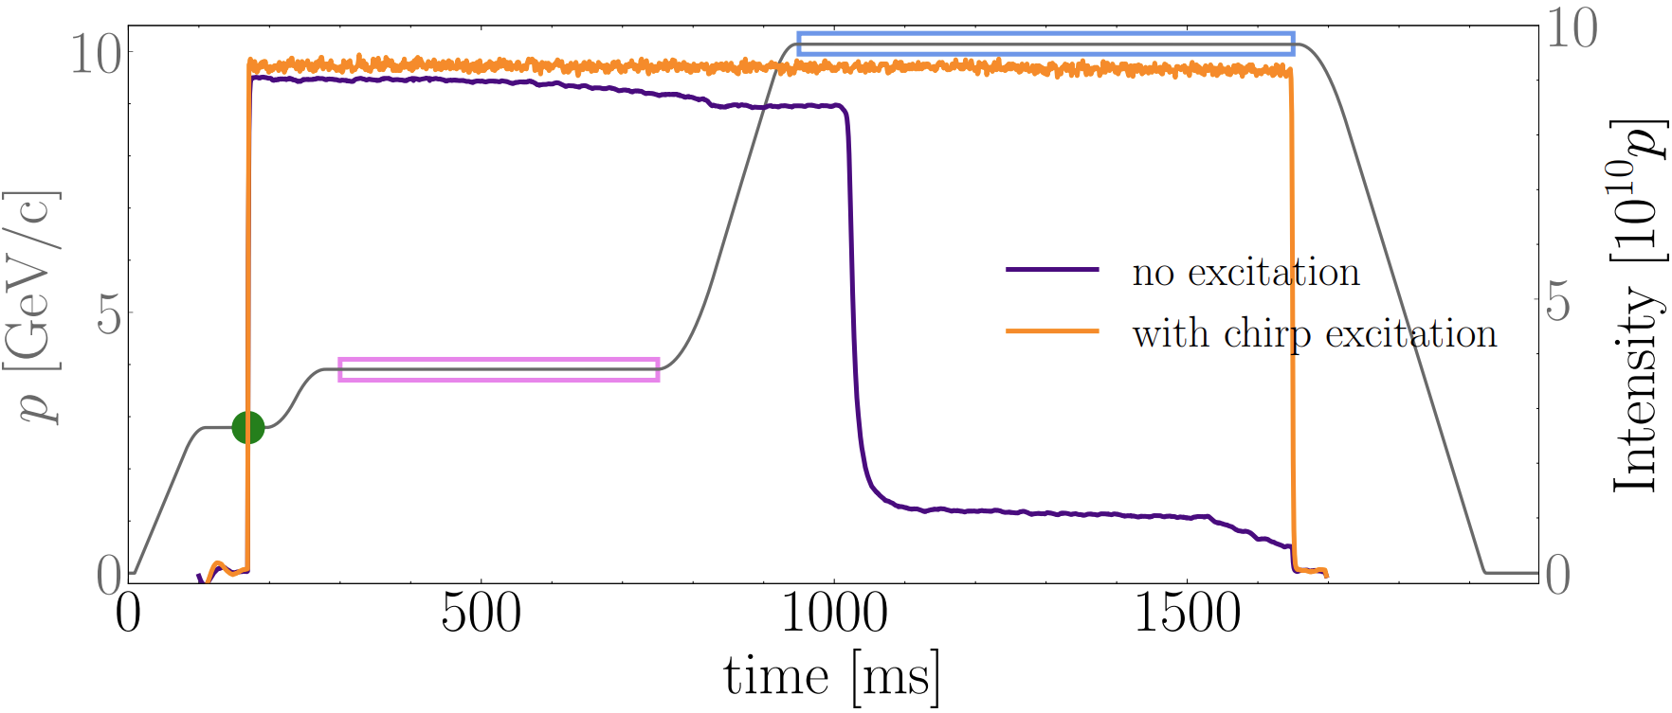
Beam-based measurements: addressing challenges
At the outset of this work, it was unclear whether the harmonic distortions caused by eddy currents were critical for beam-based measurements.
Magnet hysteresis is a crucial factor in beam dynamics across the entire energy range:
At low energies, remanent fields can influence the main field within the magnet aperture;
at higher energies, iron saturation may introduce non-linear effects → hysteresis-driven variations highlight the need for careful consideration of both low- and high-energy regimes.
Approaching higher energies, optics measurements in bare-machine revealed a significant issue: when considering cycles above transition-energy (at 6.12 GeV), the beam failed to survive the main ramp → possibility of performing measurements on the energy plateau thereby precluded:
Example of power cycle (grey) to the 10.14 GeV/c momentum plateau;
purple curve illustrates the evolution of the beam intensity, showing that the beam consistently experienced loss at the end of the ramp.
To address this issue, it was found that a brief excitation at low energy (prior to the ramp), either by briefly pulsing the chirp or exciting with the AC dipole, enabled the beam to survive the ramp, as demonstrated by the orange curve.
Maximum momentum plateau reached in bare-machine configuration, ensuring the beam remained circulating stably, was 23.11 GeV/c.
26 March 2025

Slide 22
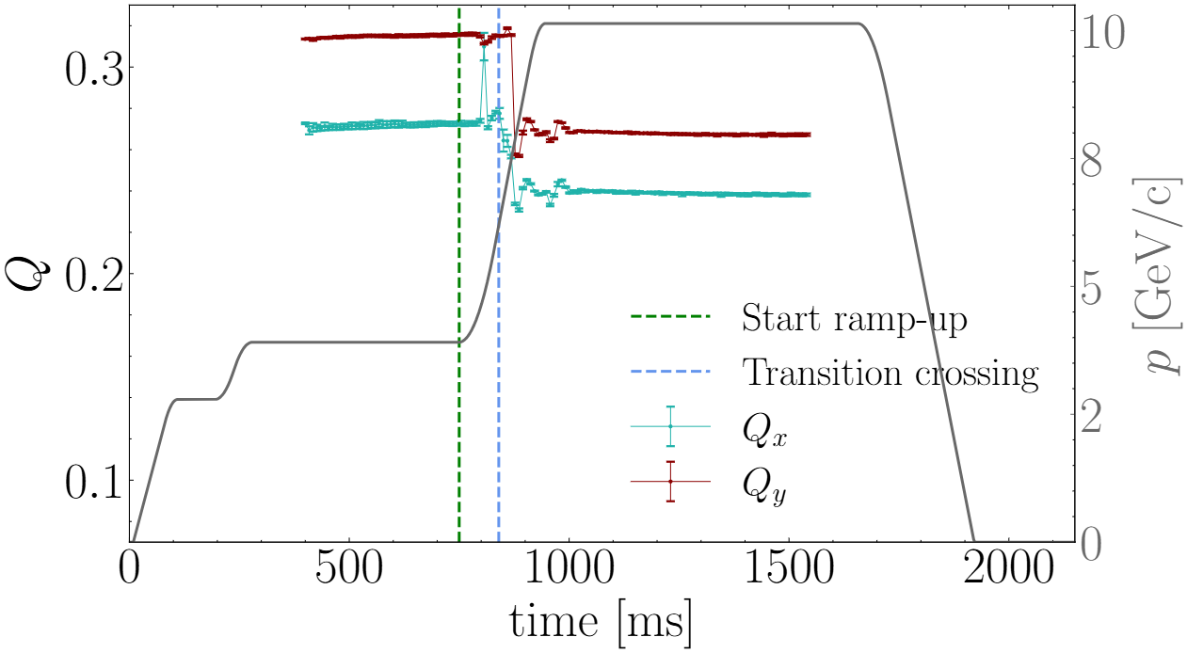
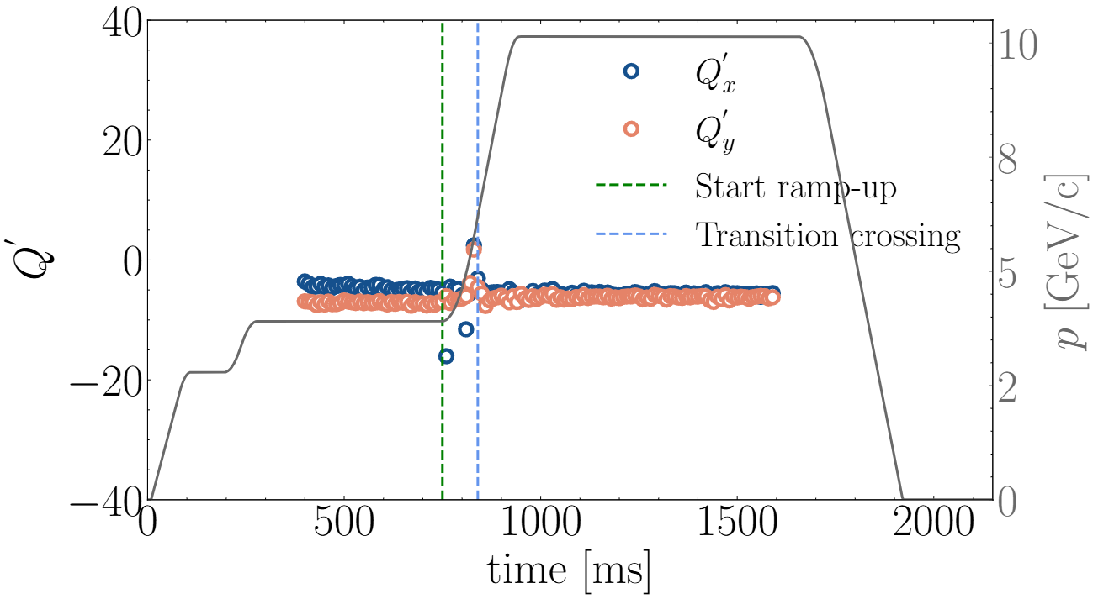
Beam-based measurements: addressing challenges
Example of measurements throughout the power cycle to the 10.14 GeV/c plateau:
Strong tune-shifts observed in both tunes when transition is crossed and at the extremities of the ramp. Tunes maintain stable on the momentum plateau;
Same applies to chromaticity;
26 March 2025

Slide 23
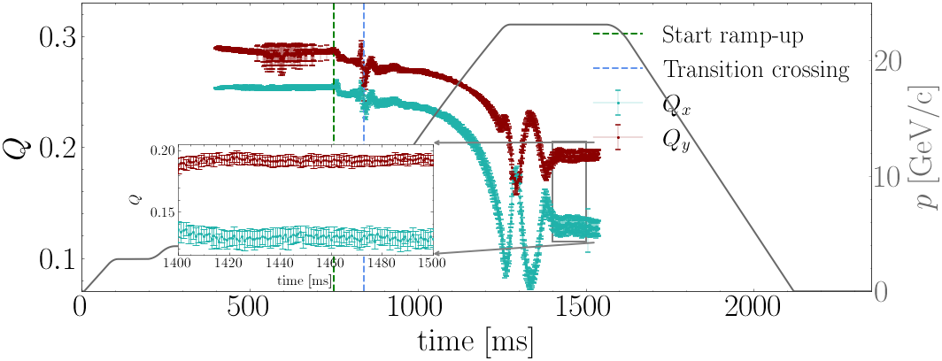
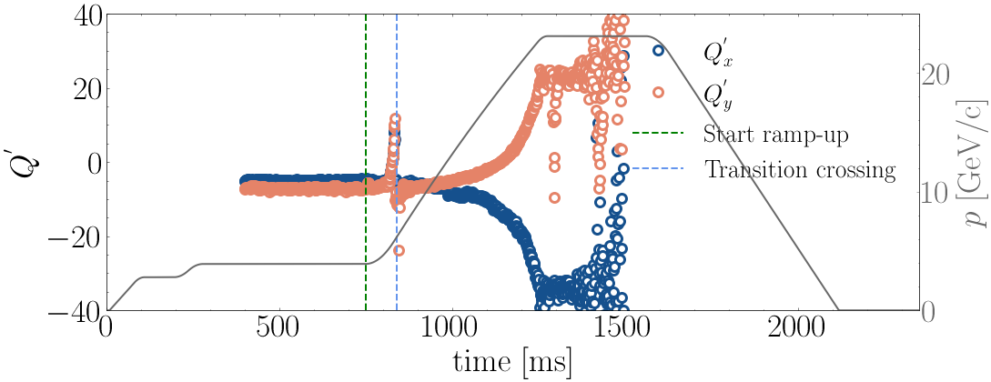
Beam-based measurements: addressing challenges
Example of measurements throughout the power cycle to the 23.11 GeV/c plateau :
Evident tune decrease throughout the tamp. Tunes quite stable on the momentum plateau.
Same for the chromaticity;
Open question: since eddy-currents effects not included in the models, do the MU models have a predictive power throughout the main body of the ramp?
Measurements carried out on the individual plateaus (static powering), were compared to those recorded continuously throughout the ramp to the 23.11 GeV/c plateau (dynamic powering).
26 March 2025

Slide 24
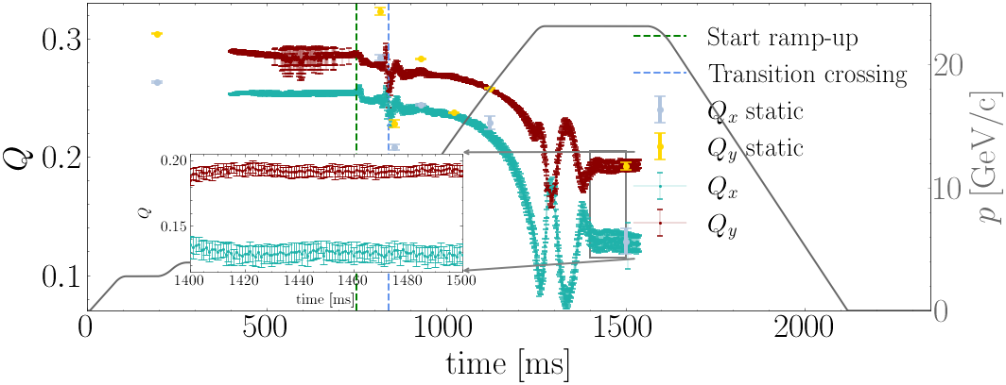
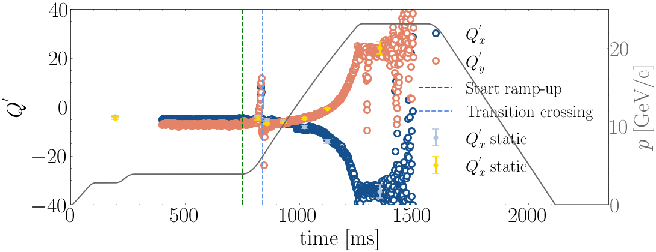
Beam-based measurements: addressing challenges
Example of measurements throughout the power cycle to the 23.11 GeV/c plateau:
Evident tune decrease throughout the tamp. Tunes quite stable on the momentum plateau.
Same for the chromaticity;
Open question: since eddy-currents effects not included in the models, do the MU models have a predictive power throughout the main body of the ramp?
Measurements carried out on the individual plateaus (static powering), were compared to those recorded continuously throughout the ramp to the 23.11 GeV/c plateau (dynamic powering).
In addition to the continuous tune measurements throughout the cycle to the 23.11 GeV/c plateau, measured tune and chromaticity from the individual lower energy plateaus are also reported → comparison of static and dynamic tune measurements at the same momentum revealed a generally poor agreement.
In contrast, a very good agreement was found between dynamic and static chromaticity measurements. This result suggests, in principle, a weak impact of dynamic effects on the chromaticity measurements.
Can harmonics distortion from eddy-currents explain discrepancy between static and dynamic measurements? Eddy-currents expected to generate dipolar and sextupolar field components [8] → expected effect on chromaticity (and tunes via feed-down) → agreement seen by comparing static and dynamic chromaticity measurements suggests eddy-currents were not a significant contribution to explain the discrepancy observed in the tunes in the main body of the ramp.
26 March 2025

Slide 25
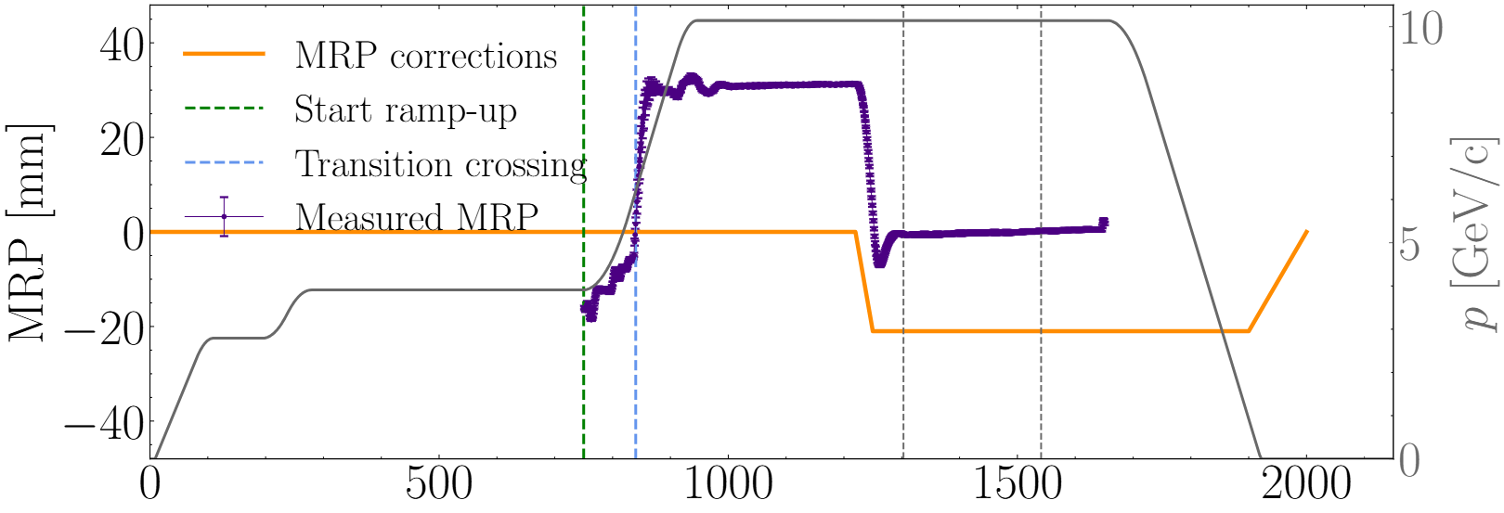
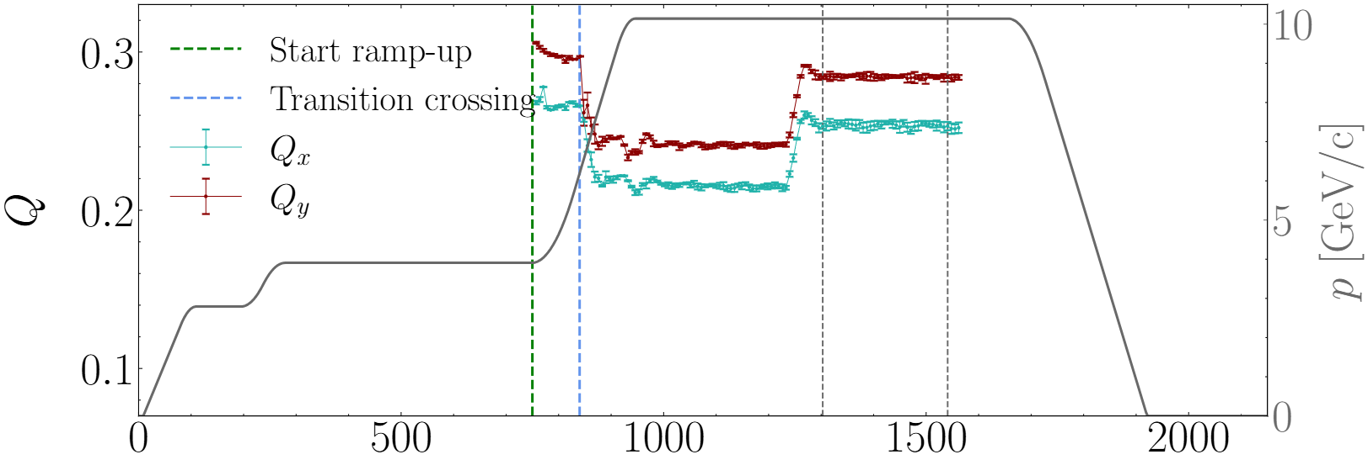
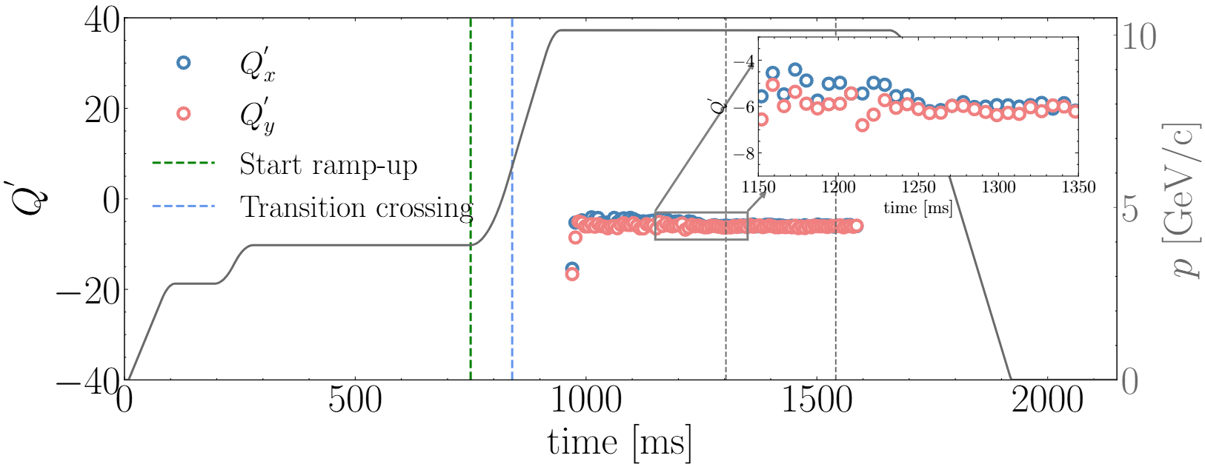
Beam-based measurements: MRP corrections (1/2)
Warning: tune evolution, across the same power cycle, exhibited poor reproducibility over timescales exceeding one day.
Investigation: Pronounced sensitivity of the beam MRP of the bare-machine cycles on the PS supercycle composition
changes in the supercycle regularly resulted in MRP shifts of ~20 mm
supercycle dependence of the MRP was identified as the cause of the tune variability
particularly marked at high energy due to chromaticity (sextupolar field) becoming very large (affecting tunes due to feed-down).
Outcome: uncontrolled supercycle-dependent MRP variations cause tune to shift (larger MRP resulting in stronger feed-down forces acting on the beam)
inconsistency in models’ benchmarking as reference orbit in MAD-X is aligned with the center of the magnets
MRP in simulation assumed to be zero (feed-down effects are not accounted for in the optics simulations).
On the ramp, pronounced MRP increase from −20 mm to approximately 30 mm. At the end of the ramp, MRP stabilizes around 30 mm. MRP corrections were applied on the plateau → corresponded with a decrease of both tunes of ~$4⋅{10}^{−2}$ (1 mm MRP change of corresponded to a tune-shift of ~ $1.3⋅{10}^{−3}$. MRP corrections caused slight change in the chromaticity evolution in both planes.
26 March 2025

Slide 26
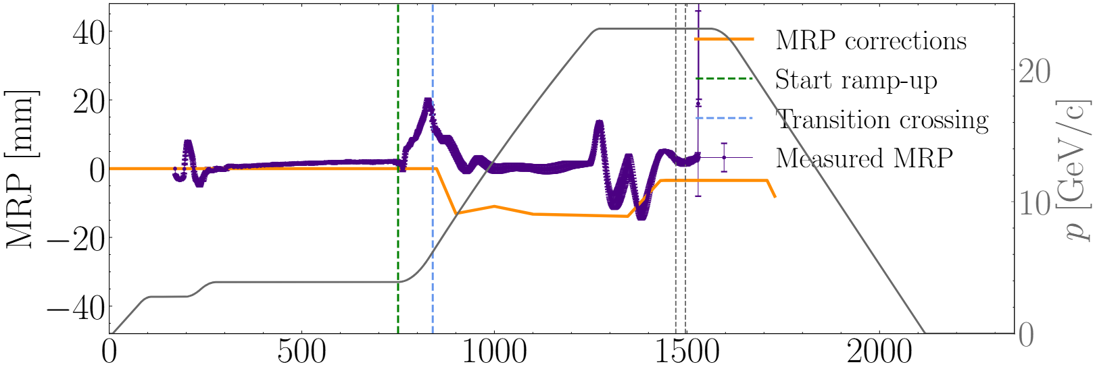
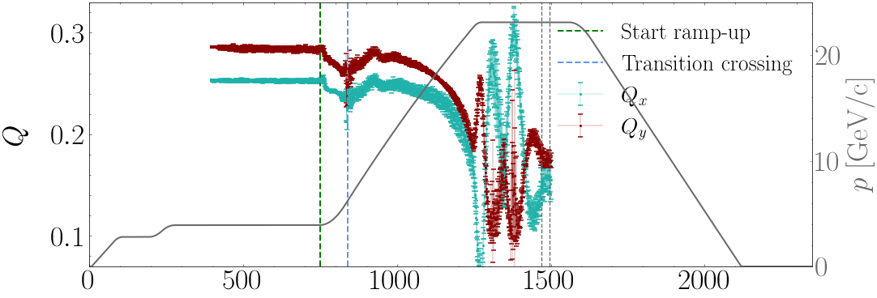
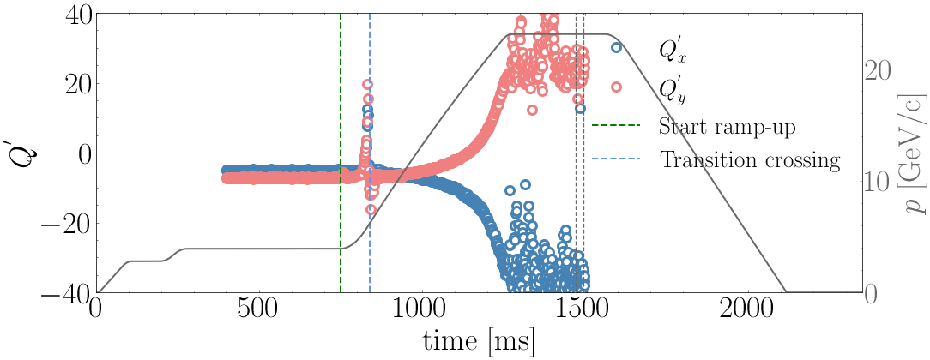
Beam-based measurements: MRP corrections (2/2)
MRP corrected on the ramp and in a small portion of the plateau.
MRP and tunes experienced significant oscillations at the end of the ramp.
With applied MRP corrections, how do the static and dynamic measurements compare?
26 March 2025

Slide 27
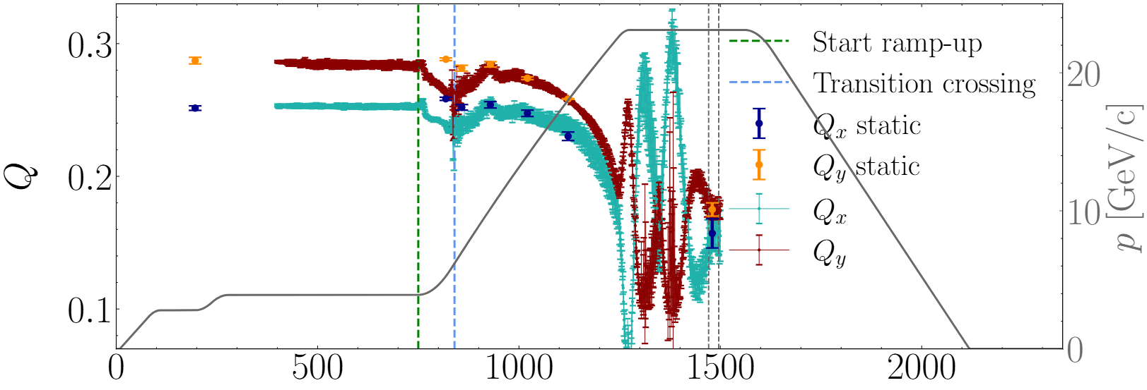
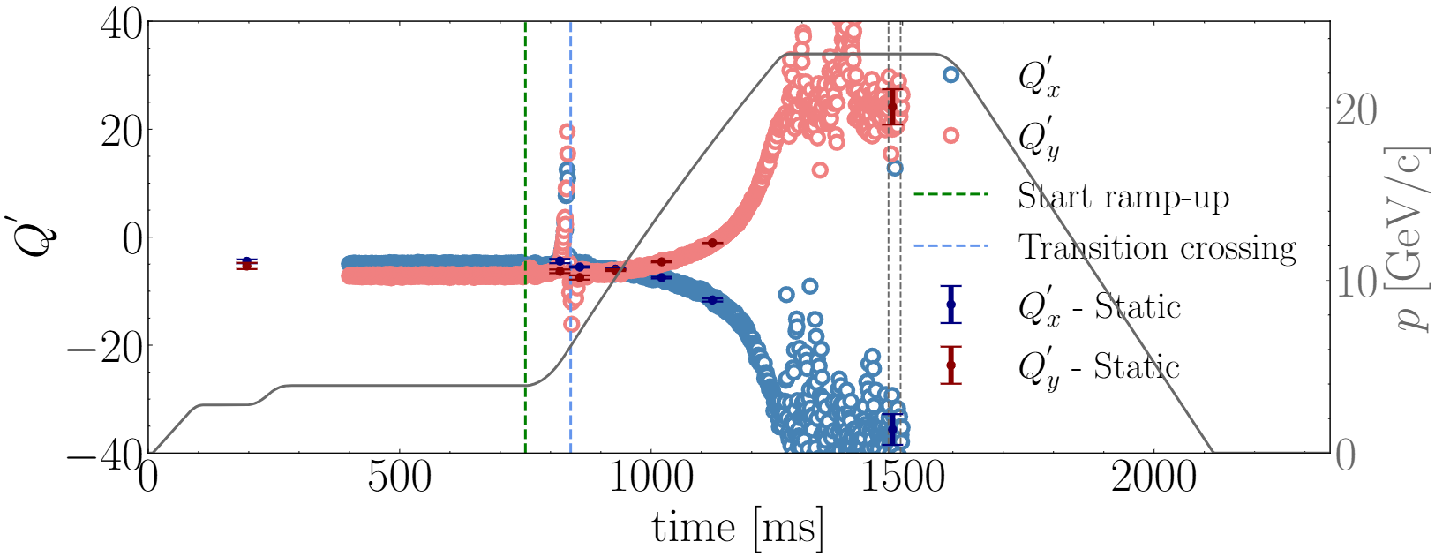
Beam-based measurements: MRP corrections (2/2)
MRP corrected on the ramp and in a small portion of the plateau.
MRP and tunes experienced significant oscillations at the end of the ramp.
With applied MRP corrections, how do the static and dynamic measurements compare?
The strategy of correcting the MRP on the individual bare-machine cycle’s plateaus and on the ramp to 23.11 GeV/c resulted in excellent alignment between static and dynamic tune measurements.
Similar to the tune measurements, the two sets of chromaticity measurements exhibited excellent agreement.
Bare-machine study conclusion: beam-based measurements proved that:
without corrections, MRP exhibited large values on the various energy plateaus;
introduction of MRP corrections → significant shifts in the tune evolution across the different cycles, highlighting necessity of these corrections for accurate model benchmarking;
excellent agreement between static and dynamic measurements → both sets of measurements are equivalent for model validation → continuous measurements taken on the ramp to 23.11 GeV/c plateau can be reliably used for benchmarking at various energies → no need to establish new bare-machine cycle each time with a specific energy plateau
  this agreement demonstrates that, aside from the transient phases (start and end of the ramp and during transition), tune measurements are not significantly affected by dynamic or eddy-current effects throughout the main portion of the ramp
  this validates the use of static Opera and MAD-X models to predict tune evolution during the main part of the ramp, despite the absence of dynamic effects in these models.
26 March 2025

Slide 28
Contents
  Introduction: context and scope
  CERN Proton Synchrotron and its main magnetic units: overview
  PS-MU magnetic modelling
  PS-MU optics modelling
  Beam-based measurements and models validation
  Models’ benchmarking
  Conclusion and next steps
PS-MU:
Magnetic modelling
PS-MU:
optics modelling
Optics
measurements
26 March 2025

Slide 29
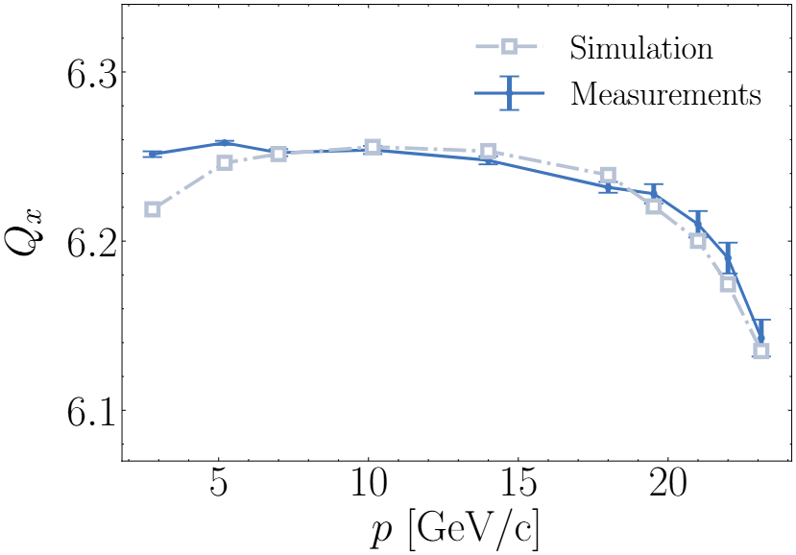
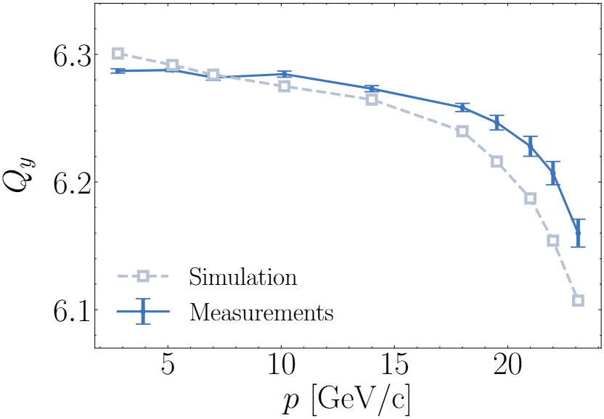


Models’ benchmarking: bare-machine (1/2)
Comparison between simulated and measured tunes: simulations closely align with the experimental data over the whole range of energy.
Models correctly predict the integer part of the tunes (6);
Measurements revealed rapid decrease at higher energies on both planes → captured by the new combined magnetic/optics models;
  within the error bars for the horizontal tunes, slightly more pronounced saturation on the vertical plane;
At injection energy, discrepancy between simulations and measurements due to remanent field, not included in the model;
  Above 2.79 GeV/c the remanent field effect diminishes and becomes negligible → quality of agreement progressively improves. Between 5.25 GeV/c and 14.04 GeV/c, remanent field effects are negligible, and saturation is not significant → excellent agreement with discrepancy on the level of 10−3.
Tunes relative errors below 1 %, maximum error at injection for the horizontal tunes of 0.5% and of 0.85% at high energy for the vertical;
$$ε_{q}=\frac{Q_{meas}−Q_{sim}}{Q_{meas}}$$
26 March 2025

Slide 30

Models’ benchmarking: bare-machine (2/2)
Comparison between simulated and measured chromaticity: simulations closely align with the experimental data over the whole range of energy.
Very good agreement was observed over the entire energy range:
slight discrepancies at low energies attributed to the effects of remanent fields;
predicted chromaticities remained relatively constant up to 10.14 GeV, aligning with the experimental observations.
Beyond 10 GeV, the model accurately captured the saturation of the horizontal and vertical chromaticities, which shift in opposite directions, consistent with the measured data
  simulated values exhibited a slightly faster variation compared to the experimental data (within the error-bars up to 22 GeV/c),
This demonstrates the model’s capability to predict chromaticity evolution even in the presence of non-linear effects such as iron saturation. Models provide a predictive tool to be useful for operation predictions on chromaticity.
26 March 2025

Slide 31




Tune decrease: investigation
Are we able to explain the rapid tune decrease approaching high energies? Tune decrease suggested a more rapid saturation of the quadrupolar component generated by the MU with respect to the saturation of thedipolar component
Simulated quadrupolar strengths of the SBENDs in the focusing and defocusing half-unit derived from Opera, which served as input for the optics simulations
  10.14 GeV
18.00 GeV
Model revelation: quadrupole generated within the main body of the half-units exhibits pattern of rapid saturation → as the tunes at high energies → consistent with the measured tune drop
2D field maps at 10.14 GeV and 18.00 GeV: hyperbolic pole, characteristic of an ideal quadrupole, begins to saturate at its edges as energy increases.
Such localized saturation reduces the effectiveness of the quadrupole field generation relative to the dipole field:
  at increasing energies, increase in quadrupole strength does not scale proportionally with increase in dipole strength;
  this imbalance leads to observed reductions in tune, highlighting the significant role of iron saturation in shaping the beam dynamics at higher energies.
$B_{2}/B_{1}$ ratio along the MU at different energies: Diminishing influence of $B_{2}$ component relative to the dipole field occurs at lower energies primary at the magnet extremities, pronounced in the half-unit cores at increasing energy
26 March 2025

Slide 32

Dipole field saturation 1/2
Tune comparison between models’ predictions and beam-based measurements revealed an agreement within the error-bars on the horizontal plane in the saturation region, while a larger discrepancy was observed on the vertical plane.
If true, saturation is modelled more precisely in one half-unit with respect to the other??
Guess: implausible as they are characterized by the same material construction, hence described by same hysteresis curve in the magnetic model. Also, comparison between predicted field and the B-train measurements highlighted the convergence of the model predictions to the B-train.
$p$ [GeV/c] | $ΔB$ [mT] | $ΔB/B_{meas}$ [%]
2.79 | 0.9 | 0.67
5.25 | 1.3 | 0.52
7.00 | 1.8 | 0.54
10.14 | 2.4 | 0.50
14.04 | 2.9 | 0.43
18.00 | 3.3 | 0.39
23.11 | 3.5 | 0.32
Is this pointing to something missing in the models, not captured by the B-train comparison due to their location in the MU?
26 March 2025

Slide 33


Dipole field saturation 2/2
Saturation-driven effects in the fringe fields, not captured by the B-train due to their position in the MU could be an explanation for the different discrepancy observed between the horizontal and vertical tunes.
Dipole field from the model at four different energies: more rapid saturation of the dipole field at the fringe fields at higher energies, visible in the blue curve.
B-train coils do not capture the more rapid saturation of the iron at the magnet extremities compared to the main body of the half-units → OMG: is the magnetic model not valid anymore? Magnetic measurements of the integrated field across the entire MU were performed by specialized a team at CERN [9], using the Single Stretched Wire (SSW) method.
Measured transfer function (TF) obtained using the SSW system (red) shows clearly that the B-train measurements (green) is not able to fully capture the dipole saturation. The simulated transfer function (black) follows very well the SSW measurements.
strong agreement between the two magnetic measurements and model at medium to high currents, where the saturation of the iron is strong.
26 March 2025

Slide 34





Model improvement: magnetic length saturation
$$L_{M}=\frac{\int_{−∞}^{∞}{B\left(z\right)dz}}{B_{0}}$$
$B_{0}$ field in the magnet longitudinal center; integral computed between $±$ 2.8m (where the field drops below the 1 per mill of its value within the MU)
In light of this observation, it was decided to assess the magnetic length predicted by the model.
$$L_{m}=\frac{C −n_{\begin{aligned}str \\ sec\end{aligned}}L_{\begin{aligned}str \\ sec\end{aligned}}−n_{\begin{aligned}sh str \\ sec\end{aligned}}L_{\begin{aligned}sh str \\ sec\end{aligned}}}{N_{MU}}=\frac{2π100−20∙3−80∙1.6}{100}=4.403 m$$
At injection, the simulated magnetic length closely matches the theoretical value, with an error below the per-mill level, but it decreases with increasing energy due to iron saturation.
By 23.11 GeV/c, the magnetic length is reduced by approximately 0.8 % compared to its value at injection.
Bottleneck: optics simulations rely on the estimate of the beam momentum to convert the field harmonics computed in Opera ($B_{n}$) into magnet strengths ($k_{n−1}$).
$$k_{n−1} \left[m^{−n}\right]=\frac{1}{3.3356 p}\left(n−1\right)!\frac{B_{n}}{R_{ref}^{n−1}} Bρ=3.3356 p$$
For this computation, beam momentum from LSA was used → derived from the magnetic rigidity. This designed momentum is regulated based on the B-train measurements, which ensure that the designed and the actual field in the machine matches.
In the design of PS cycles a constant magnetic length across the entire energy range is assumed equal to the theoretical nominal magnetic length of the machine → the effect of magnetic length saturation is not accounted for in the programmed beam momentum evaluation → $p$ used for computing $k_{n−1}$ might be affected by uncertainty
What happens now to previous tune results/comparison? Can we correct the momentum computation
26 March 2025

Slide 35




Model improvement: corrected momenta
Two distinct approaches followed to correct for the magnetic length saturation:
Physics driven approach → Corrected momenta computation by flattening $k_{0}L$ with the value it has at 10.14 GeV/c (no remanent field nor saturation effect):
$$k_{0}\left(p\right)=\frac{1}{3.3356 p}B_{1,i}\left(p\right) →p_{corr}=\frac{B_{1,i}(p)}{3.3356 k_{0}\left(10.14\frac{GeV}{c}\right)}$$
Corrected momentum computation via magnetic length predictions from the model:
$$L_{m}=\frac{2πρ}{N_{MU}}→ρ=\frac{NL_{m}}{2π}$$
$$Bρ=B\frac{N_{MU}L_{m}}{2π}=3.3356 p →p=\frac{1}{2π}\frac{1}{3.3356}BN_{MU}L_{m}$$
With corrected momenta, magnet strengths were computed again and new optics simulations repeated:
26 March 2025

Slide 36




Model improvement: corrected momenta
Two distinct approaches followed to correct for the magnetic length saturation:
Physics driven approach → Corrected momenta computation by flattening $k_{0}L$ with the value it has at 10.14 GeV/c (no remanent field nor saturation effect):
$$k_{0}\left(p\right)=\frac{1}{3.3356 p}B_{1,i}\left(p\right) →p_{corr}=\frac{B_{1,i}(p)}{3.3356 k_{0}\left(10.14\frac{GeV}{c}\right)}$$
Corrected momentum computation via magnetic length predictions from the model:
$$L_{m}=\frac{2πρ}{N_{MU}}→ρ=\frac{NL_{m}}{2π}$$
$$Bρ=B\frac{N_{MU}L_{m}}{2π}=3.3356 p →p=\frac{1}{2π}\frac{1}{3.3356}BN_{MU}L_{m}$$
With corrected momenta, magnet strengths were computed again and new optics simulations repeated:
  Two corrections methods are consistent;
  Saturation rate on the horizontal and vertical planes comparable;
  Horizontal simulated tune exhibited slight over-correction, but still within the measured standard deviation, while vertical predicted tunes fall within the measurement error bars across the entire energy range. Now, model showed a good predictive power for the tunes, with agreement with experimental data of the level below $1⋅{10}^{−3}$
26 March 2025

Slide 37
Contents
  CERN Proton Synchrotron: overview
  Magnetic and optics modelling of the PS-MU and beam-based measurements: project introduction
  PS-MU magnetic model: old model
  PS-MU magnetic model: new meshing structure
  Model validation via magnetic measurements
  Conclusion and next steps
PS-MU:
Magnetic modelling
PS-MU:
optics modelling
Optics
measurements
26 March 2025

Slide 38
Conclusions
The aim is to develop a predictive tool to support PS operation based on the predictions from a combined magnetic and optics model of the MU. The models are validated via-beam based measurements.
Limitations from the pre-existing PS-MU magnetic model identified. A new magnetic model designed with optimized mesh → significantly reduced simulation times (6-8h) → model compatible to timescales to support operation.
Pre-existing PS-MU optics model consisted in an effective (matched) model. Tune and chromaticity measurements (or a desired working point) could be replicate via the MAD-X matching tool using quadrupolar and sextupolar components in the SBDENs. A new optics model was created including a quadrupolar component in the MULTIPOLEs to account for the longitudinal evolution of the field at the fringe fields and in the F/D transition area.
Beam-based measurements in bare-machine revealed a strong dependence of the MRP on the PS supercycle composition and sudden changes within it. This asked for monitoring, measurements and correction of the MRP. Tune and chromaticity measurements from individual momentum plateaus (static) showed a good agreement with continuous measurements acquired throughout the ramp to the 23.11 GeV/c momentum plateau. Continuous measurements taken on the ramp to 23.11 GeV/c plateau can be reliably used for benchmarking at various energies. Tune measurements are not significantly affected by dynamic or eddy-current effects throughout the main portion of the ramp, enabling the use of static Opera and MAD-X models to predict tune evolution during the main part of the ramp, despite the absence of dynamic effects in these models.
Operational outcome: understanding achieved by the improved models with respect to the sextupole saturation has motivated the re-design of EAST-T9 and T10 cycles → slow extraction on these cycles was changed to 15 GeV/c based on the models’ predictions in order to allow the PFW to be deactivated during slow-extraction.
Models’ benchmarking showed a good agreement between measured and simulated tunes, with minor discrepancies at injection and 23.11 GeV/c. Comparison of the experimental and predicted chromaticity data showed agreement within the error bar at medium-high energies
Magnetic length from the model undergoes a strong saturation. In operation, it is assumed to be constant equal to the theoretical value for the PS, and it is used for the computation of the beam momentum, which is used in the model to convert field harmonics to strengths. Momentum was corrected and benchmarking improved:
Operational outcome: predicted magnetic length saturation from the model inserted in LSA for momentum computation
26 March 2025

Slide 39
References
J. Renedo. A reference magnetic model of the proton synchrotron main units, 2019. Technical Note 2019-08, report number:2140704, https://edms.cern.ch/ui/#!master/navigator/document?D:100416838:100416838:subDocs.
Dessault Systems. Opera. https://www.3ds.com/products/simulia/opera.
Opera - 3D Reference Manual. https://www.rcnp.osaka-u.ac.jp/~sakemi/OPERA/ref-3d.pdf.
P. A. Thonet. Design and manufacturing of two high gradient quadrupoles based on permanent magnets for the CERN antiproton decelerator. IEEE Transactions on Applied Superconductivity, 32(6):1–5, 2022.
Eliott Johnson, Ewa Oponowicz, Matthew Fraser, Miroslav Atanasov, and Yann Dutheil. Beam optics modelling through fringe fields during injection and extraction at the CERN proton synchrotron. JACoW IPAC, 2022:511–514, 2022.
Trygve Helseth, Thomas Kramer, Matthew A Fraser, Laurent Ducimetière, Bruno Balhan, Miroslav G Atanasov, and Jan Borburgh. Jacow: Feasibility study for the novel CERN PS fast extraction septum. JACoW IPAC,2021:2363–2366, 2021.
Jason Shepherd and Chris Johnson. Hexahedral mesh generation con-straints. Eng. Comput. (Lond.), 24:195–213, 09 2008.
N S Sereno and S H Kim. Eddy-current-induced multipole field calculations. Technical report, Argonne National Lab., IL (US), 10 2003.
V. Di Capua, M. Buzio, M. Pentella, and C. Petrone. Magnetic mea-surements of the injection correction quads and ps mu. PS Coordinationmeeting 114, https://indico.cern.ch/event/1352277.
26 March 2025

Slide 40
Thank you all for your attention

Slide 41
Backup Slides

Slide 42



MU pre-existing magnetic model: some features
BH curve used in the model comes from magnetic measurements carried out in 2008:
  EDMS 593272;
Packing factor of 93.53%:
  Computed by M. Juchno in 2013 in his PhD thesis;
air gaps length assumed to be equal within each half-unit:
  9.75 mm in the open blocks (defocusing);
  7.75 mm in the closed blocks (focusing);
Main air gap in the F/D transition area 20 mm long;
Model enclosed within a larger domain of air, normally referred to as the far-field area, to assign boundary conditions:
  Chosen to have no impact on the field in the aperture;
  Tangential and normal field conditions on the $γ_{t}$ and $γ_{n}$, respectively.
On the y = 0 plane, a symmetry condition is also applied:
  This allows the modelling of only one half of the magnet (one pole), with the FE software solving also for the other half based on the imposed conditions. This approach significantly reduces computational complexity while main-taining accurate field predictions.
This model, developed between 2010 and 2020, was maintained at CERN over the years, but not largely used for operational studies. Why?
26 March 2025

Slide 43







Mesh sensitivity analysis
Standard mesh $k_{mesh}=1$:
  Number of mesh domains in the volume: ~ 6.3 M
  Simulation time: 6h 45min
  Field (as measured with B-train): 0.4803 T
$k_{mesh}=1.1$
  Number of mesh domains in the volume: ~ 4.98 M
  Simulation time: 5h 31min
  Field (as computed by B-train): 0.4803 T
 | $$k_{mesh}=1$$ | $$k_{mesh}=1.1$$ | $ΔB_{2}/B_{2, k_{mesh}=1}$ [%]
$B_{2,F_{BODY}}$ [T] | 690.40 | 690.41 | 0.0014
$B_{2, DF_{BODY}}$ [T] | -690.60 | -690.61 | 0.0014
$B_{2, F_{FRINGE}}$ [T] | 28.185 | 28.158 | 0.096
$B_{2, {DF}_{FRINGE}}$ [T] | -29.083 | -29.151 | -0.23
26 March 2025

Slide 44




Mesh sensitivity analysis
Standard mesh $k_{mesh}=1$:
  Number of mesh domains in the volume: ~ 6.3 M
  Simulation time: 6h 45min
  Field (as measured with B-train): 0.4803 T
$k_{mesh}=1.2$
  Number of mesh domains in the volume: ~ 4.0 M
  Simulation time: 3h 15min
  Field (as computed by B-train): 0.4803 T
 | $$k_{mesh}=1$$ | $$k_{mesh}=1.2$$ | $ΔB_{2}/B_{2, k_{mesh}=1}$ [%]
$B_{2,F_{BODY}}$ [T] | 690.40 | 690.37 | 0.0043
$B_{2, DF_{BODY}}$ [T] | -690.60 | -690.68 | 0.011
$B_{2, F_{FRINGE}}$ [T] | 28.185 | 28.219 | 0.12
$B_{2, {DF}_{FRINGE}}$ [T] | -29.083 | -29.072 | 0.038
Such small differences in the harmonics computation, do not affect the optics simulation at the level of interest (e.g., 3rd digit in tune prediction)
26 March 2025

