Slide 1

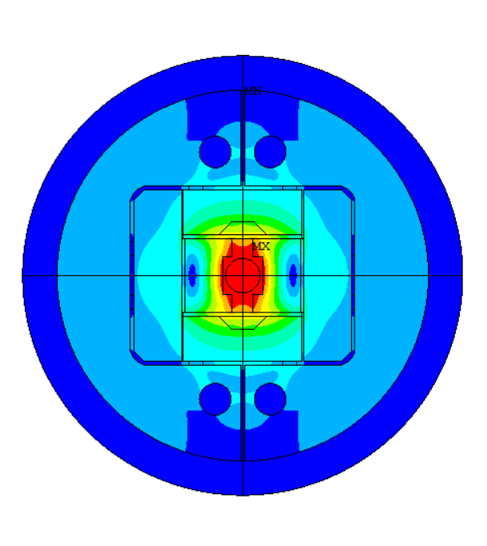
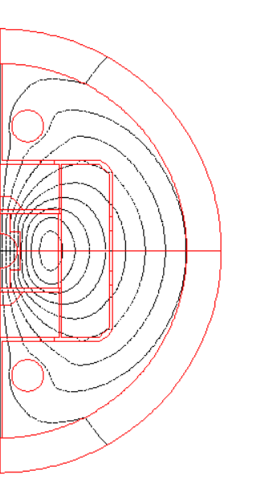
5-m long block
Update on design
J. Ferradas Troitino & S. Izquierdo Bermudez,
TE-MSC-LMF
March 2025

Slide 2
Outline
Introduction
Updates and model checks
Rods design
2D Magnetic results
2D Mechanical results
2D Mechanical results – Bladders
2D Mechanical results – Str. limit
3D Mechanical results
Next steps

Slide 3
Outline
Introduction
Updates and model checks
Rods design
2D Magnetic results
2D Mechanical results
2D Mechanical results – Bladders
2D Mechanical results – Str. limit
3D Mechanical results
Next steps

Slide 4
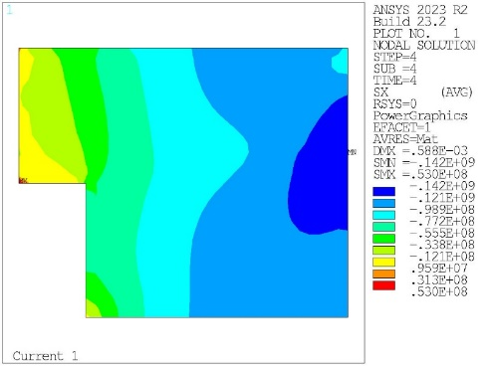
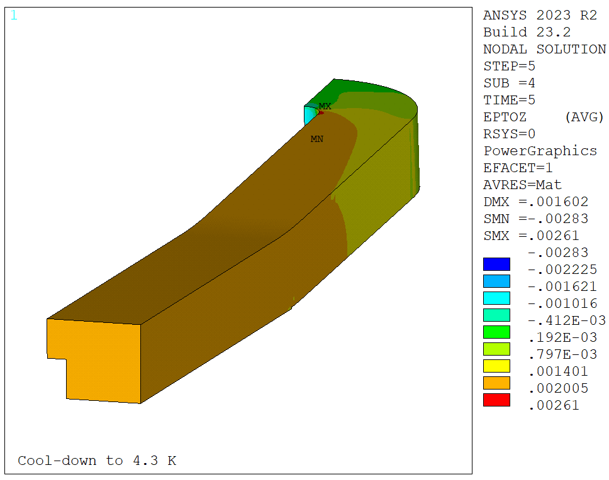
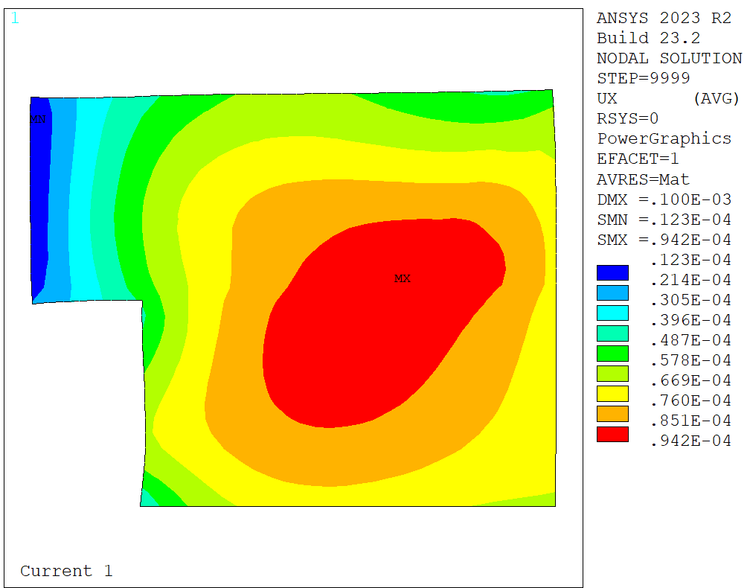
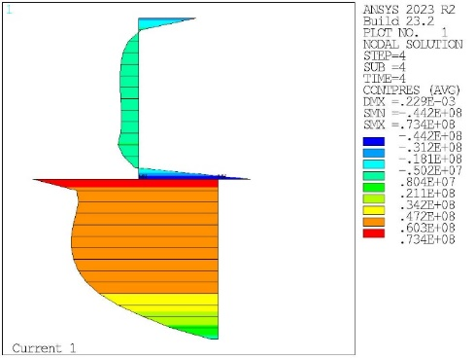
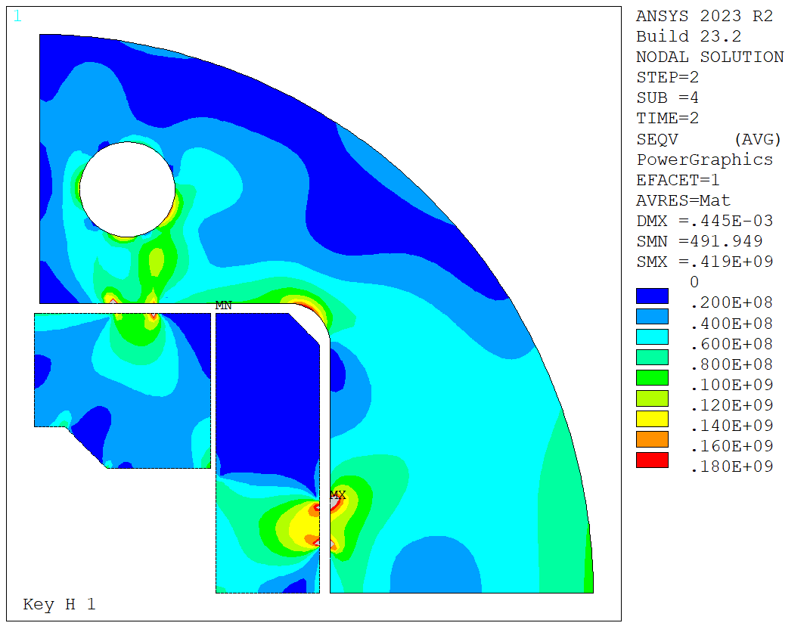
Intro - Mechanical analysis
Figures of merit
Coil stresses
Coil strain
Coil displacements
Coil contact pressure
Stress limits in the structure
Roughly:
Roughly:
Check the coil displacements during powering
Try to maintain an average contact pressure > 5 MPa while respecting the stress limits
All components below yield limits. We check S1 for brittle materials in first order
σ_{VM} < 120 MPa at RT
ε_{z} < 2000 µstr
σ_{VM} < 150 MPa at cold

Slide 5

14 T Magnet design
Conductor parameters
40 strands x 0.85 mm – 5 mm smaller in width than BOND
14 T Conductor
Conductor parameters |  | L-BOND | BOND
Strand diameter | (mm) | 0.85 | 1.10
Layout |  | RRP 108/127 | RRP 162/169
Effective filament diameter | (µm) | 55 | 64
Jc at 4.2 K and 15 T , no self-field | (A/mm^2) | > 1280 | 1200
Cu/NonCu ratio |  | 1.2 | 0.9
No. of strands in cable |  | 40 | 40
Bare cable thickness | (mm) | 1.525 | 1.98
Bare cable width | (mm) | 18.150 | 23.045
Bare cable thickness (reacted - 4.5%) | (mm) | 1.594 | 2.06
Bare cable width (reacted - 1.2%) | (mm) | 18.363 | 23.275
Insulation thickness | (mm) | 0.15 | 0.15
Insulated cable width (reacted) | (mm) | 18.663 | 23.575
Insulated cable thickness (reacted) | (mm) | 1.894 | 2.36
Astrand | (mm²) | 0.567 | 0.950
Asc | (mm²) | 0.258 | 0.500
Acu | (mm²) | 0.310 | 0.450
Check | (mm²) | 0.567 | 0.950
ACTION ITEM: As soon as conceptual design is fixed, contact SCD for the cable (RMC-QXF)

Slide 6
14 T Magnet design
Name |  | 5m NO IRON | 5m | Bond_14T Single
 |  |  | OR = 225 | Baseline
Aperture | (mm) | 35 | 35 | 50
Field | (T) | 0.02 | 12.02 | 14.00
Field integral | (T m) |  |  | 15.10
Magnetic length | (m) |  | 0.00 | 1.08
Coil length | (m) |  |  | 1.31
Number of apertures | (adim) |  | 1 | 1
Distance between apertures | (mm) |  | - | -
Yoke outer diameter | (mm) |  | 450 | 540
Shell outer diameter | (mm) |  |  | 640
Cable data
Material |  | Nb3Sn | Nb3Sn | Nb3Sn
Process |  | RRP | RRP | RRP
No. strands | (adim) | 40 | 40 | 40
Strand diameter | (mm) | 0.850 | 0.850 | 1.100
Cu/NonCu | (adim) | 1.2 | 1.2 | 0.9
RRR | (adim) | 150 | 150 | 150
Bare cable thickness (R) | (mm) | 1.59 | 1.59 | 2.06
Bare cable width (R) | (mm) | 18.363 | 18.363 | 23.275
Insulation thick radial (5 Mpa) | (mm) | 0.150 | 0.150 | 0.150
Insulated cable surface | (mm²) | 35.35 | 35.35 | 55.64
Filling factor | (adim) | 0.292 | 0.292 | 0.360
Coil design
Insulated cable surface (one aperture) | (mm²) | 5514 | 5514 | 11572
Equivalent coil width | (mm) | 36.7 | 36.7 | 53.4
Coil efficiency | (T mm / A) | 0.00060 | 0.00073 | 0.00073
N. layers | (adim) | 2 | 2 | 2
N. turns/pole | (adim) | 39 | 39 | 52
Cable length/pole | (m) |  |  | 136
Operational parameters
Current (Inom) | (kA) | 0.035 | 15.800 | 20.005
Peak Field | (T) |  | 12.82 | 14.85
Bp/B0 |  |  | 1.067 | 1.061
Short sample current @ 1.9 K | (kA) |  | 19.627 | 24.199
Short sample current @ 4.5 K | (kA) |  | 17.496 | 21.602
Short sample field @ 1.9 K, Bp | (T) |  | 15.44 | 17.55
Short sample field @ 4.5 K, Bp | (T) |  | 13.98 | 15.93
j overall⁷ | (A/mm²) | 1 | 447 | 360
j strand | (A/mm²) |  | 696 | 526
j superconductor | (A/mm²) |  | 1531 | 1000
Loadline fraction @1.9 K | (%) |  | 80.50 | 82.7
Loadline fraction @4.5 K | (%) |  | 90.3 | 92.6
Stored energy/m | (MJ/m) |  | 0.382 | 1.031
Inductance/m | (mH/m) |  | 2.64 | 4.72
Stored energy | (MJ) |  | 0.00 | 1.35
 |  |  | Rref | Rref
Field quality |  |  | 11.67 | 16.67
Harmonic b2 @ Inom | (10-4) |  | 0.00 | 0.00
Harmonic b3 @ Inom | (10⁻⁴) |  | -0.18 | -3.49
Harmonic b4 @ Inom | (10⁻⁴) |  | 0.00 | 0.00
Harmonic b5 @ Inom | (10⁻⁴) |  | -0.45 | 2.78
Harmonic b7 @ Inom | (10-4) |  | 0.76 | 0.88
Protection
Coil energy density | (J/mm³) |  | 0.0692 | 0.0891
j copper | (A/mm²) |  | 1276 | 1111
Mechanics
Forces x | (MN/m) |  | 3.295 | 5.937
Forces y | (MN/m) |  | -1.362 | -2.680
Force z | (MN) |  | 0.382 | 0.958
Fx/2*Wcable | (MPa) |  | 88.3 | 125.9
Magnet ID card

Slide 7
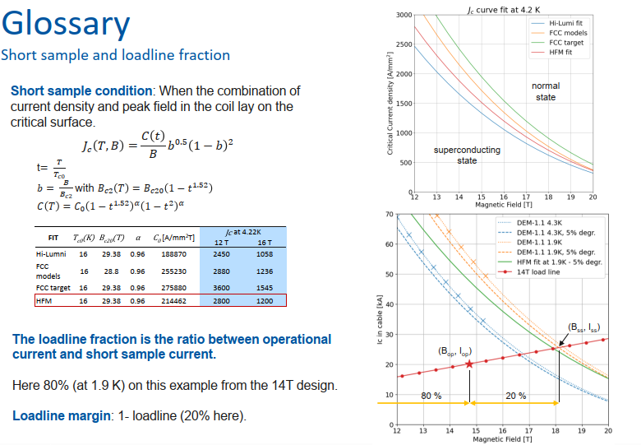
Slide from Ariel

Slide 8
Outline
Introduction
Updates and model checks
Rods design
2D Magnetic results
2D Mechanical results
2D Mechanical results – Bladders
2D Mechanical results – Str. limit
3D Mechanical results
Next steps

Slide 9
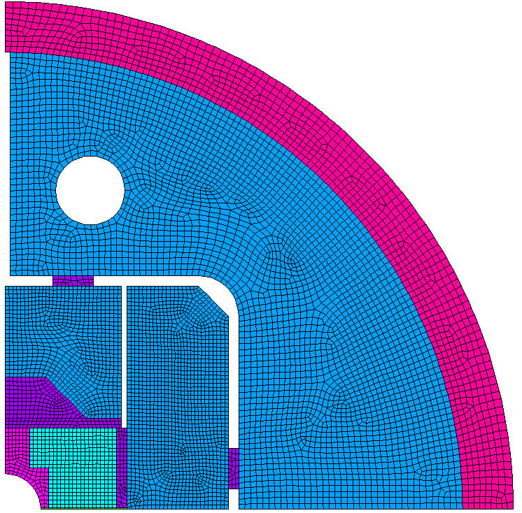
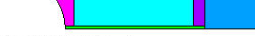
2D Models
New version with the 40 strands MQXF cable
Based on the 14 T BOND model
Log (05/03/2025)
  Yoke outer radius chosen based on the bore field loss
  Vpad height sized to accommodate the flared end:
    75 mm from Y=0 to end of coil (preliminary) + 5 mm Vfiller + 25 mm margin (ESC leads, tooling holes, etc) = 106 mm → 110 mm
110 mm
225 mm
Zoom at midplane shim

Slide 10
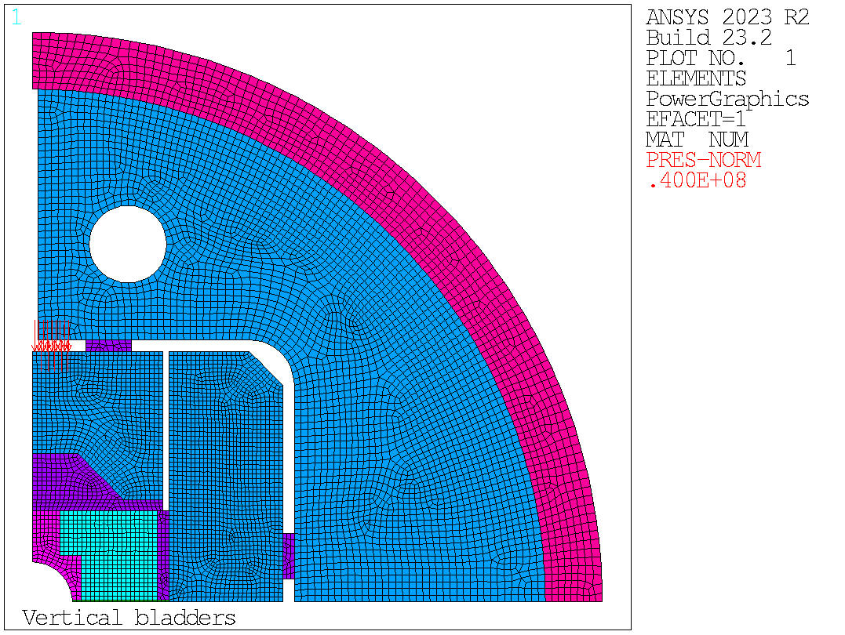
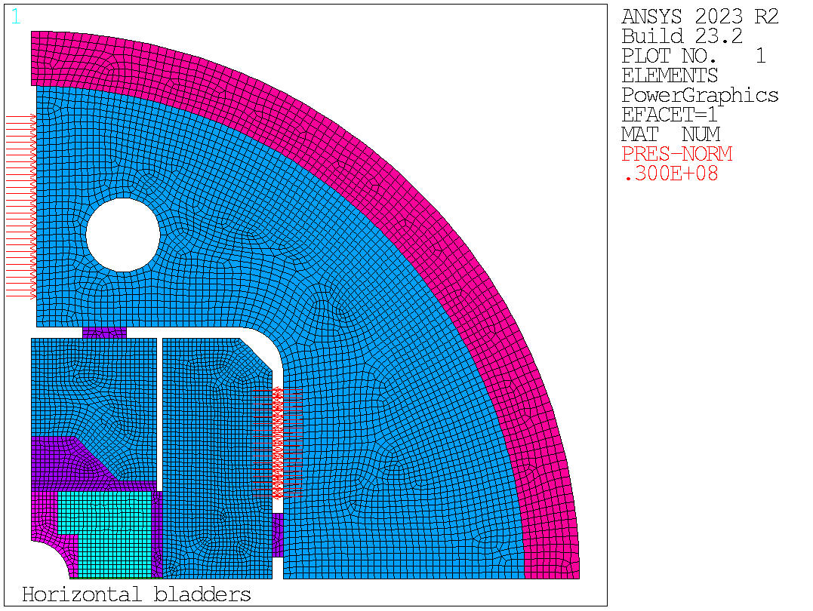
2D Models
1 short vertical bladder
1x long vertical bladder + 1x short vertical bladder in the yoke
1 x long vertical bladder in Hpad

Slide 11
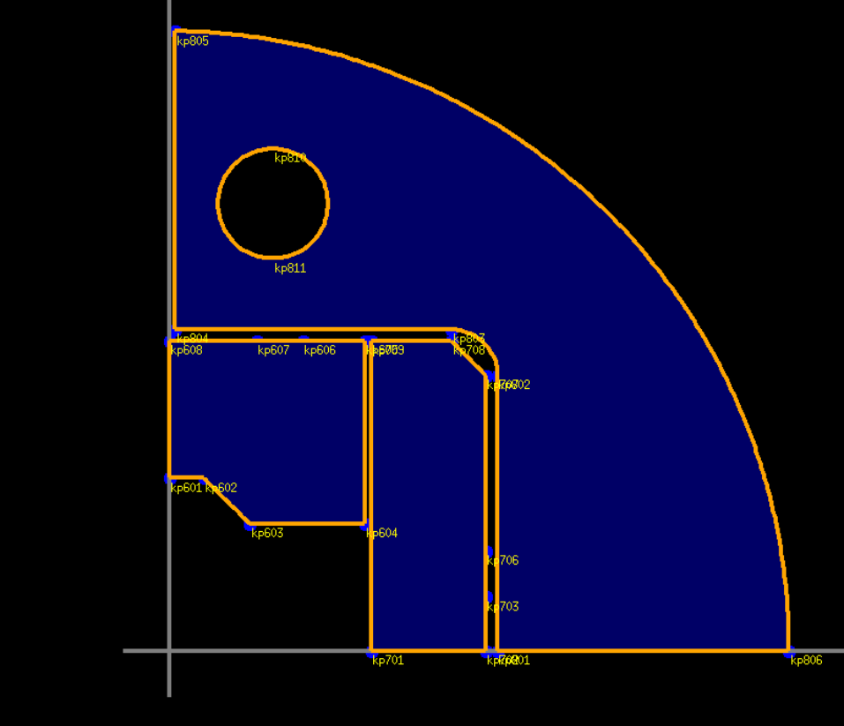
2D Roxie magnetic model
R=17
X0: 42
Y0: 50.5
R=225
R=20
57.323
20
20
115
110
20
95
44.976
50
59.948
104.948

Slide 12

2D Models
42.668 mm
19.738 mm
39.351 mm
19. 613 mm
33.198 mm

Slide 13
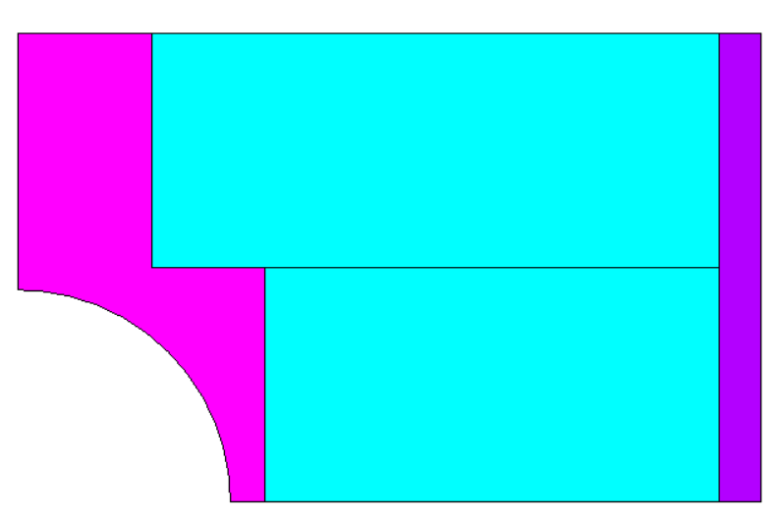
2D Models
12.03 mm
Ground insulation attributed to coil top and bottom.
Ground insulation around the shoe not modelled / included in the shoe (0.25 mm)
39.351 mm
17.5 mm
4 mm
5.25 mm
59.948 mm

Slide 14
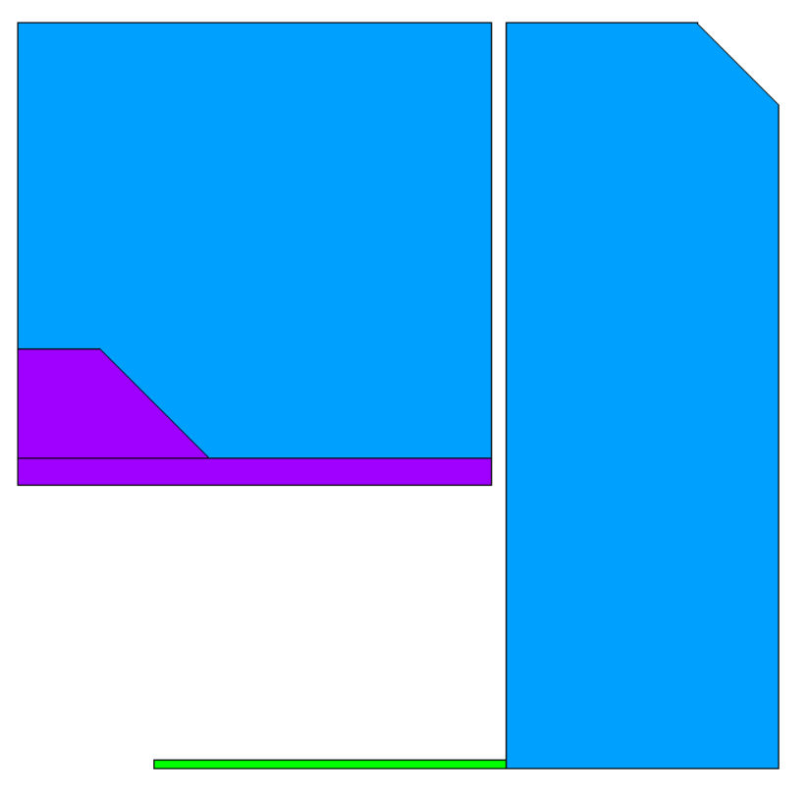
2D Models
57.323 mm
45.024 mm
65.024 mm
20 mm
95 mm
110 mm
Vertical SS filler = 5 mm
44.976 mm
Th = 0.625 mm
59.948 mm
50 mm

Slide 15
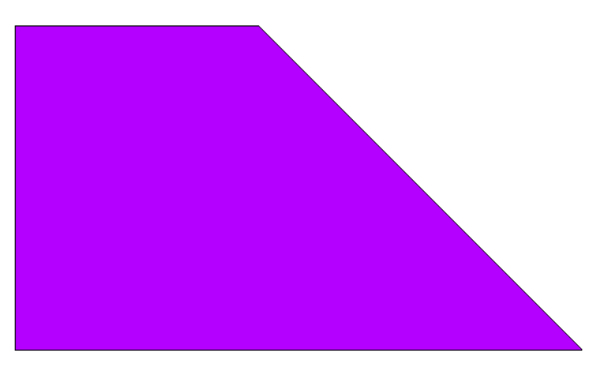
2D Models
20 mm
20 mm
40 mm

Slide 16

2D Models
25 mm
Key th. = 5 mm
Key width = 20 mm
Vkey: X0 = 23.5 mm
Hkey: Y0 = 10 mm
Min Vkey X0 = 37mmm/2 (bladder physical length) + 1 mm assy. gap + 3 mm groove width + 1 mm gap = 23.5 mm
Min Hkey Y0 = 0 mm
No space for bladder at midplane due to coil size
110 mm
Yoke gap = 2.5 mm
D = 34 mm
X0 = 42 mm
Y0 = 157 mm
20 mm
115 mm
114.948 mm
225 mm

Slide 17
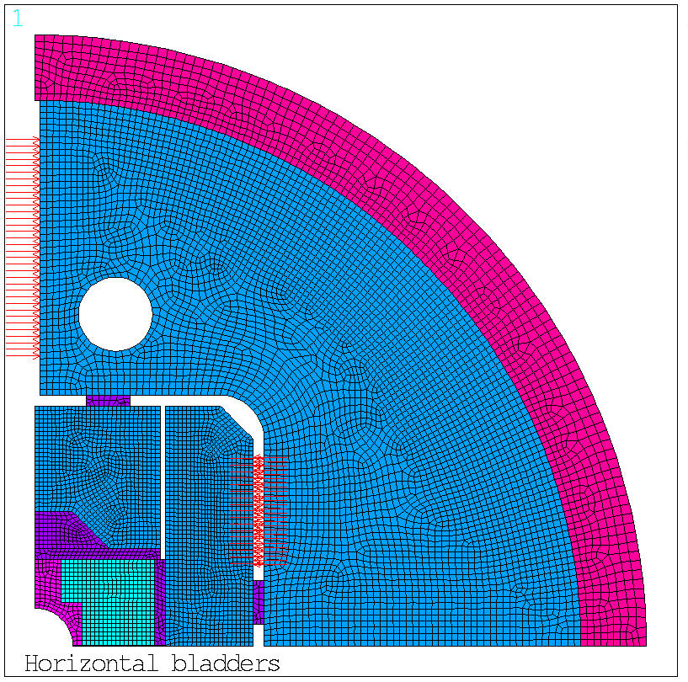
2D Models
3 mm thick bladder (nominal, to be verified) -> groove depth ~ 2 mm, groove indent width ~ 3 mm
Yoke L = 110 mm
3 mm
2 mm
3 short bladders:
3 x 39 mm (with 2 mm gap) + 4 x 3 mm (groove) = 129 mm
2 long bladders:
2 x 56 mm (with 2 mm gap) + 3 x 3 mm (groove) = 121 mm
2 short bladders:
2 x 39 mm (with 2 mm gap) + 3 x 3 mm (groove) = 87 mm
1 short +1 long bladders:
1 x 39 mm (with 2 mm gap) + 1 x 56 mm (with 2 mm gap)+ 3 x 3 mm (groove) = 104 mm
Short bladders = 37 mm (34 mm active)
Long bladders = 54 mm (51 mm active)
1 long bladder:
56 mm (with 2 mm gap) + 4 x 3 mm (groove) = 68 mm
Adding the key with 1 mm per side = 90 mm
We have 5 mm available space
95 mm
For OR = 225 mm we can only put 2 short bladders (or 1 long+1short)

Slide 18
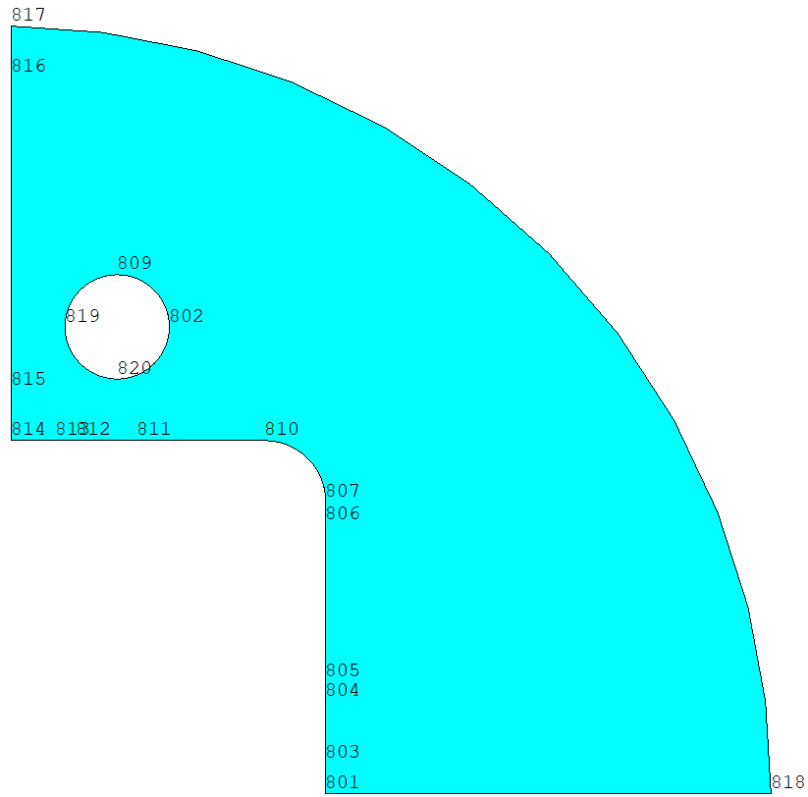
2D Models
Bladder options
6. 5 mm from end of active bladder to key. We need 6.5 mm, so we have 0 mm margin.
17 mm
½ short active bladder
7.5 mm
51 mm long active bladder
6.5 mm = 1.5 mm bladder physical + 1 mm gap + 3 mm groove width + 1 mm key gap
10 mm

Slide 19
2D Mechanical analysis – Mat. Props.
MQXF Model
Coil |  |  |  | Stainless Steel |  |  |  | AlBr |  |  |  | Iron |  |  |  | Aluminum |  |  |  | G10 |  |  |  | Nitronic |  |  |  | Ti |  |  |  | HiMn Steel
 | 4.3 | 293 |  |  | 4.3 | 293 |  |  | 4.3 | 293 |  |  | 4.3 | 293 |  |  | 4.3 | 293 |  |  | 4.3 | 293 |  |  | 4.3 | 293 |  |  | 4.3 | 293 |  |  | 4.3 | 293
Ex | 20 | 20 |  | Ex | 210 | 193 |  | Ex | 120 | 110 |  | Ex | 224 | 213 |  | Ex | 79 | 70 |  | Ex | 30 | 30 |  | Ex | 225 | 210 |  | Ex | 130 | 130 |  | Ex | 210 | 193
Pr | 0.3 | 0.3 |  | Pr | 0.28 | 0.28 |  | Pr | 0.3 | 0.3 |  | Pr | 0.28 | 0.28 |  | Pr | 0.34 | 0.34 |  | Pr | 0.3 | 0.3 |  | Pr | 0.28 | 0.28 |  | Pr | 0.3 | 0.3 |  | Pr | 0.28 | 0.28
Alpx | 1.35E-05 |  |  | Alpx | 9.83E-06 |  |  | Alpx | 1.08E-05 |  |  | Alpx | 6.82E-06 |  |  | Alpx | 1.45E-05 |  |  | Alpx | 2.44E-05 |  |  | Alpx | 9.00E-06 |  |  | Alpx | 6.03E-06 |  |  | Alpx | 5.55E-06
Th. Strain | 3.89E-03 |  |  | Th. Strain | 2.84E-03 |  |  | Th. Strain | 3.12E-03 |  |  | Th. Strain | 1.97E-03 |  |  | Th. Strain | 4.18E-03 |  |  | Alpy | 2.44E-05 |  |  | Th. Strain | 2.60E-03 |  |  | Th. Strain | 1.74E-03 |  |  | Th. Strain | 1.60E-03
 |  |  |  |  |  |  |  |  |  |  |  |  |  |  |  |  |  |  |  | Alpz | 8.34E-06
 |  |  |  |  |  |  |  |  |  |  |  |  |  |  |  |  |  |  |  | Th. Strain | 7.04E-03
 |  |  |  |  |  |  |  |  |  |  |  |  |  |  |  |  |  |  |  | Th. Strain | 7.04E-03
 |  |  |  |  |  |  |  |  |  |  |  |  |  |  |  |  |  |  |  | Th. Strain | 2.41E-03

Slide 20
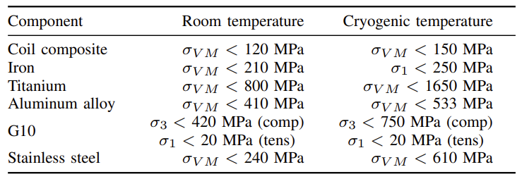
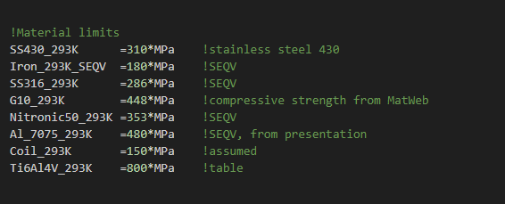
2D Mechanical analysis – Stress criteria
RMM

Slide 21
Outline
Introduction
Updates and model checks
Rods design
2D Magnetic results
2D Mechanical results
2D Mechanical results – Bladders
2D Mechanical results – Str. limit
3D Mechanical results
Next steps

Slide 22
2D Mechanical analysis
Tie rods dimensioning:
Recall:
Aluminum |  |  |  |  |  | Stainless steel
Cryogenic temp. |  |  |  |  |  | Cryogenic temp.
σ_{yield} Al | 533 | MPa |  |  |  | σ_{yield} Al | 610 | MPa
Fz | 0.38 | MN | Per magnet end |  |  | Fz | 0.38 | MN | Per magnet end
Fz per rod | 0.19 | MN | Fz /4 |  |  | Fz per rod | 0.19 | MN | Fz /4
0.7*σ_{yield} Al | 373.1 | MPa |  |  |  | 0.7*σ_{yield} Al | 427 | MPa
Aneeded | 511.659 | mm2 |  |  |  | Aneeded | 447.073 | mm2
Rrod | 13 | mm |  |  |  | Rrod | 12 | mm
ADD 3D ROXIE FORCES
12 T = 4* D = 30 mm rods
Stored energy/m | (MJ/m) | 0.38

Slide 23
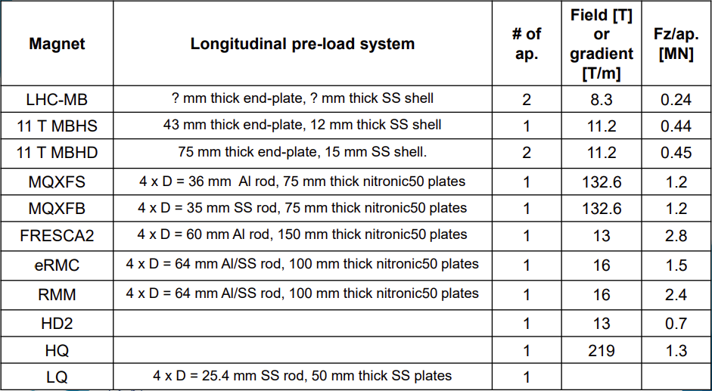
2D Mechanical analysis
4* D = 37 mm rods

Slide 24
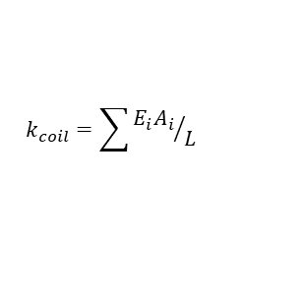
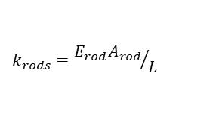
2D Models
Main Parameters Governing the Longitudinal Motions
Two type of axial displacements:
Relative movement of the coil with respect to the structure. It depends on the overall stiffness of the structure, i.e., independent of the level of axial pre-load in the ends.
Relative movement of the coil ends with respect to the pole. It depends on the level of pre-load.
TO BE UPDTED
Parameter | Unit | BOND | L-BOND
e.m. Force Nominal Current | MN | 1.031 | 1.031
Coil Stiffness | MN/mm | 0.393 | 0.118
Rod radius | mm | 20 | 20
Rod area | mm² | 1257 | 1257
Number of rods |  | 4 | 4
Al. Rod Stiffness | MN/mm | 0.20 | 0.07
SS. Rod Stiffness | MN/mm | 0.53 | 0.19
Coil Length | m | 1.50 | 5
Magnet Length | m | 2 | 5.5
Coil Elongation
No friction, no rods | mm | 2.627 | 8.755
No friction, Al. rods | mm | 1.744 | 5.428
No friction, SS. rods | mm | 1.120 | 3.329
Friction, Al. rods | mm | 0.087 | 0.271
Friction, SS. rods | mm | 0.056 | 0.166
Recall – For an element in tension/compression, stiffness (extensive property) decreases with the length.
  Keeping the same diameter, the rod stiffness is almost the same for (i) BOND in Al and (ii) L-BOND in SS.
  (E_{ss}/E_{Al} ~ 2.7 , L_{long}/L_{short} = 5.5/2 ~ 2.75)
In the table, coil elongation with friction assumes only 5% of the total force acting.
In BOND (Al-rods, no friction) the rods carry 34% of the e.m. forces
$$k_{rods}={E_{rod}A_{rod}}/L$$
$$k_{coil}=\sum{{E_{i}A_{i}}/L}$$
*Coil stiffness includes the coil block and Ti-pole (no wedge)
G. Vallone, et. al., Mechanical Design Analysis of MQXFB, the 7.2 m long-β quadrupole for the High-Luminosity LHC Upgrade, IEEE Trans. Appl. Supercond., vol. 26, no. 4, 2016.

Slide 25
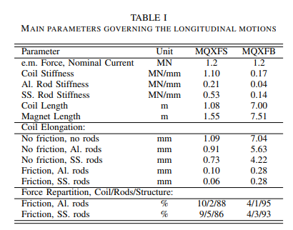
2D Models
Just for reference, MQXF values
G. Vallone, et. al., Mechanical Design Analysis of MQXFB, the 7.2 m long-β quadrupole for the High-Luminosity LHC Upgrade, IEEE Trans. Appl. Supercond., vol. 26, no. 4, 2016.

Slide 26
Outline
Introduction
Updates and model checks
Rods design
2D Magnetic results
2D Mechanical results
2D Mechanical results – Bladders
2D Mechanical results – Str. limit
3D Mechanical results
Next steps

Slide 27
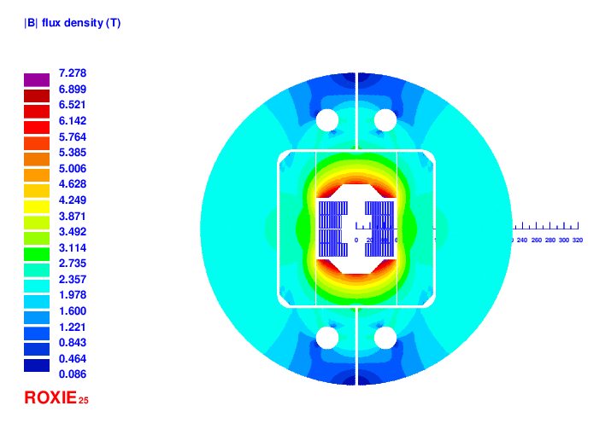
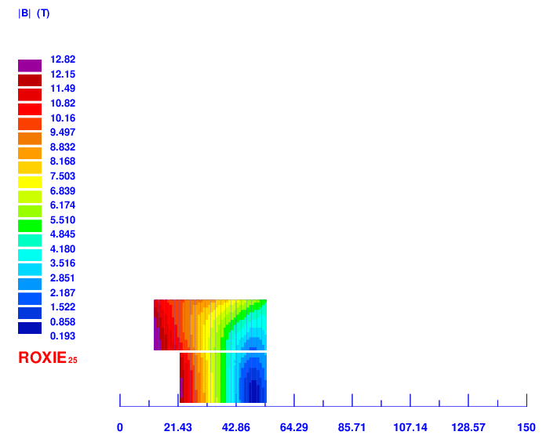
New 2D Magnetic results
Magnet |  | ROXIE | ANSYS
Current | [kA] | 15.8 | 15.8
Bpeak | [T] | 12.82 | 12.63
Bap | [T] | 12 | 12
Fx (quadrant) | [MN/m] | 3.295 | 3.24
Fy (quadrant) | [MN/m] | -1.362 | -1.353
Fx/CableW | [MPa] | 88 | 87
*ROXIE computation including self-field

Slide 28
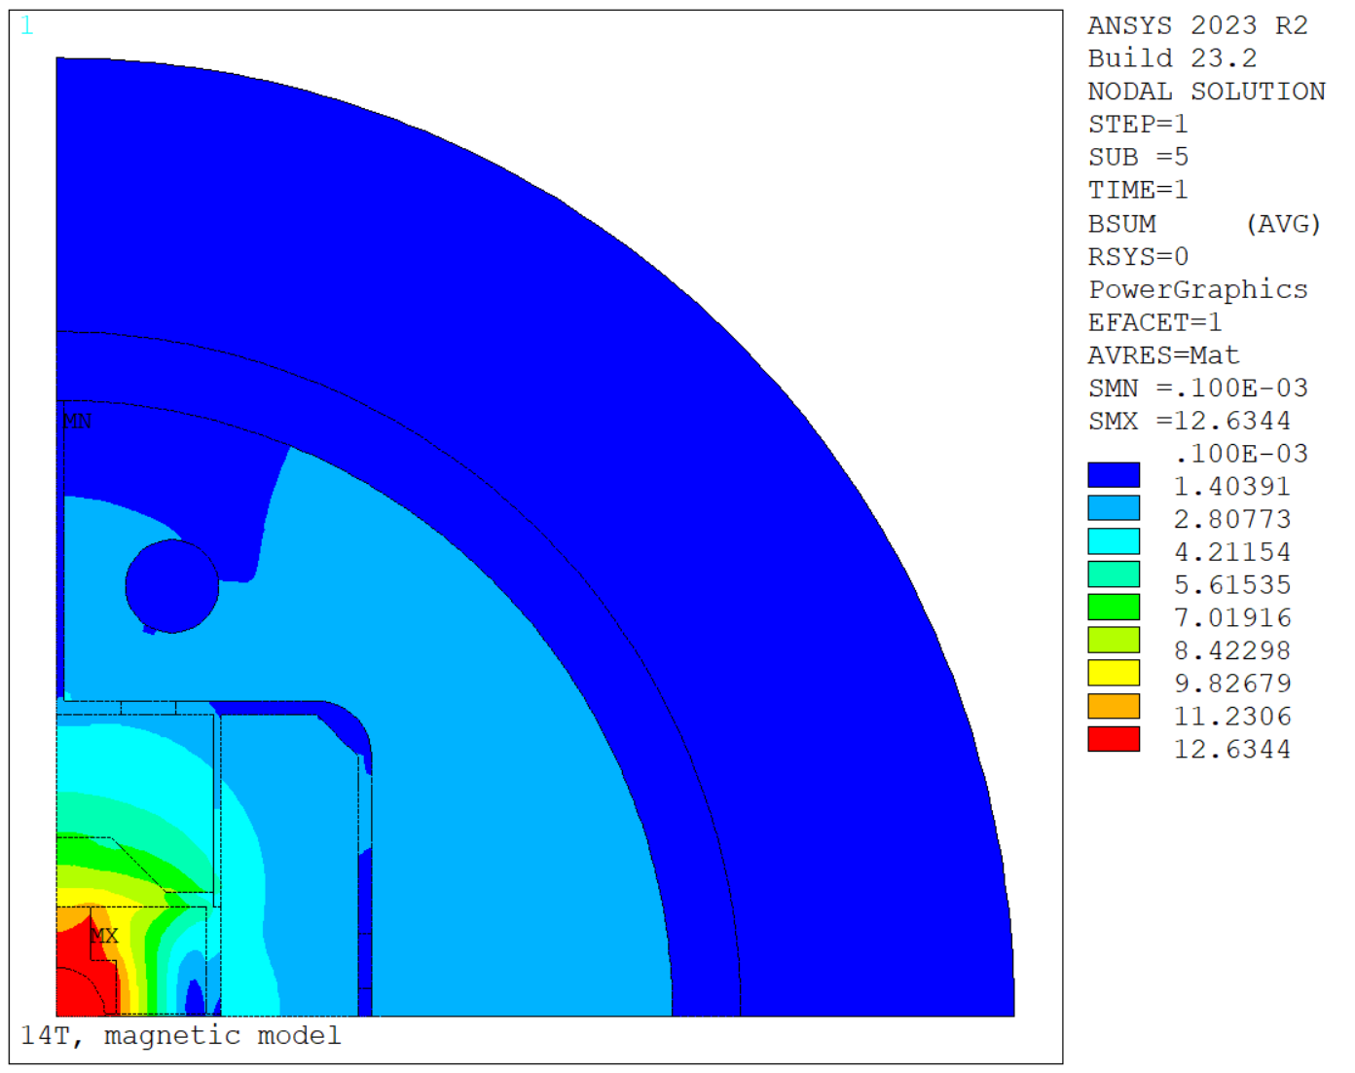
2D Magnetic results

Slide 29
Outline
Introduction
Updates and model checks
Rods design
2D Magnetic results
2D Mechanical results
2D Mechanical results – Bladders
2D Mechanical results – Str. limit
3D Mechanical results
Next steps

Slide 30
2D Mechanical analysis
Bonded coil components
Frictional contacts anywhere else (µ = 0.2)
  Including in between the midplane shim and the coil-pole-rail
Isotropic material properties (Annex)
Criteria
Use same modelling assumptions as MQXF, which we know well
Target similar coil peak stress limits at warm/cold as MQXF:
  RT below 110 - 120 MPa
  CD below 150 MPa
For reference, our MQXF reference preload gives in the model:
  RT peak azimuthal stress = 80 MPa
  CD peak azimuthal stress = 110 MPa
Gap = 100 µm
Merged areas: the two poles together and the two coil layers (removes contacts)
Side note – If instead of gluing the coil areas we put a contact, some sliding is allowed (based on contact stiffness) even if the contact is bonded. For last case, the upper layer can slightly slide and could be a bit more preloaded. Contact pressure at 12 T improves.

Slide 31
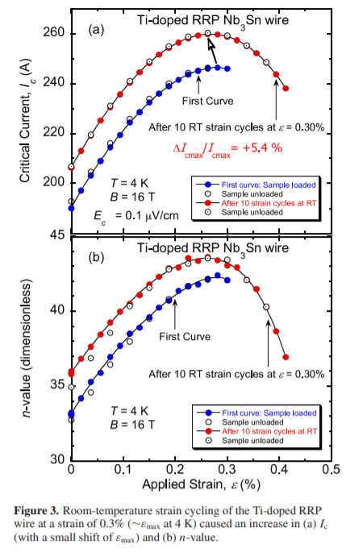
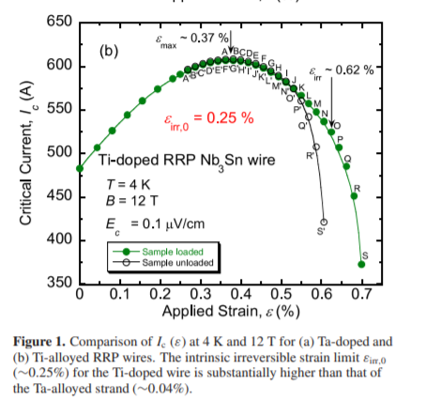
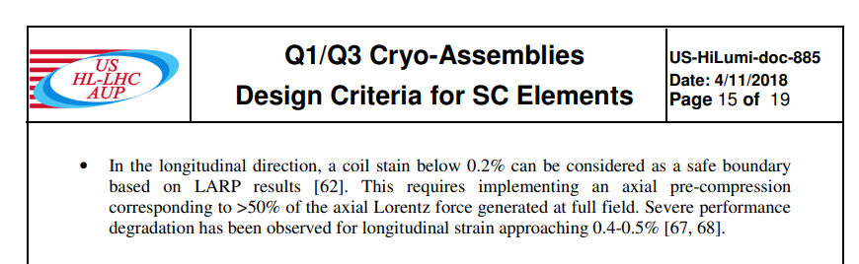
2D Mechanical analysis
Coil H&S Requirement #1: The conductor strain shall never exceed 500 microstrain (0.05%) in any part of the coils during any handling or shipping operation.
This requirement is based on the assumption that permanent degradation may occur above 2000 microstrain (0.2%) of applied tension at room temperature [1] and uses a safety margin of 4.

Slide 32
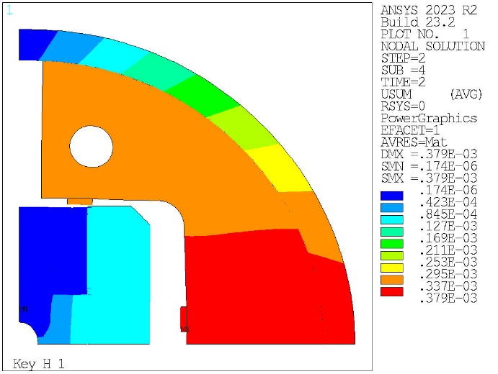
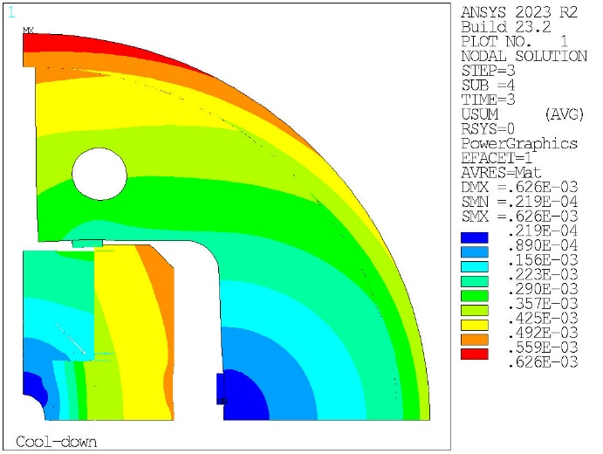
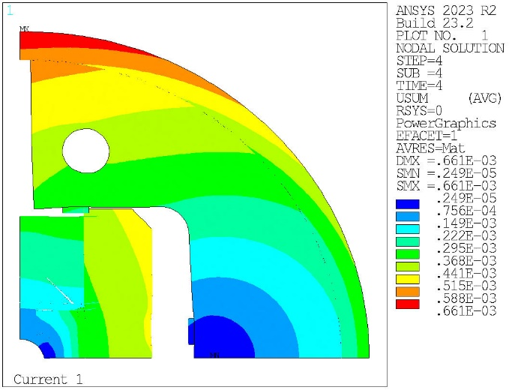
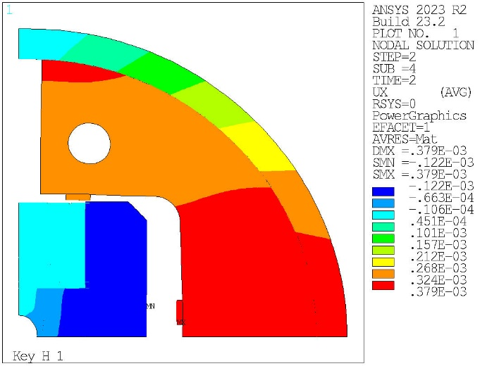
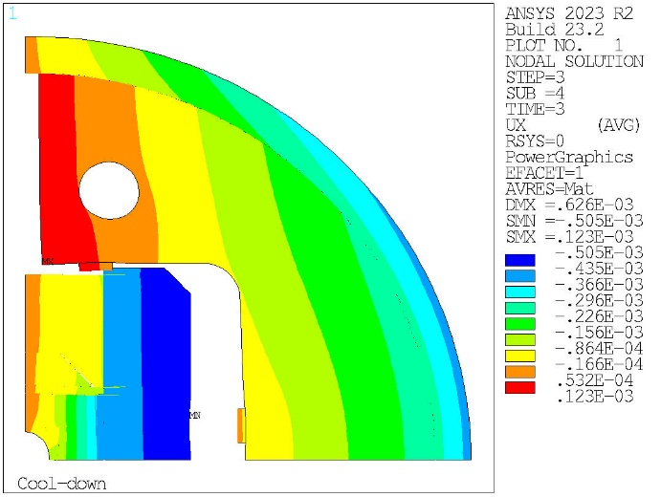
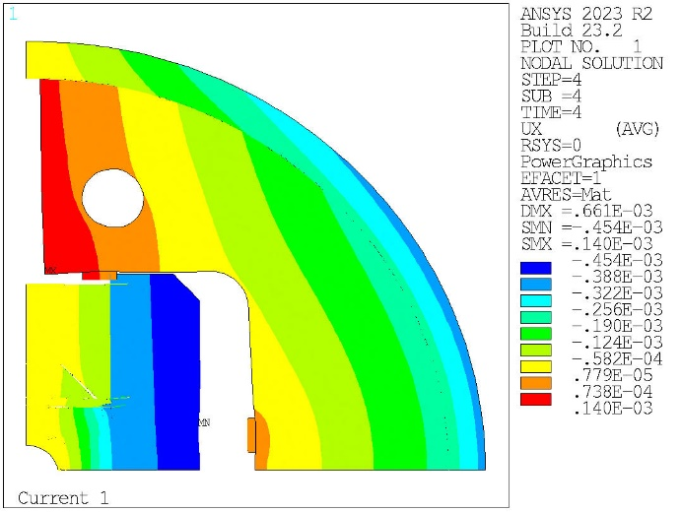
2D Mechanical analysis
Displacement sum
Horizontal displacement

Slide 33
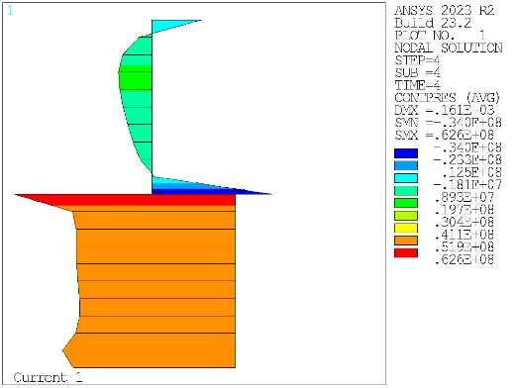
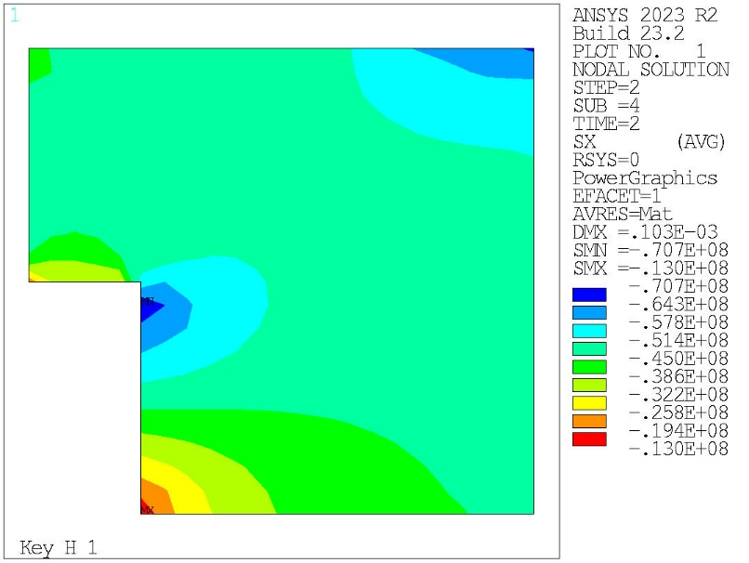
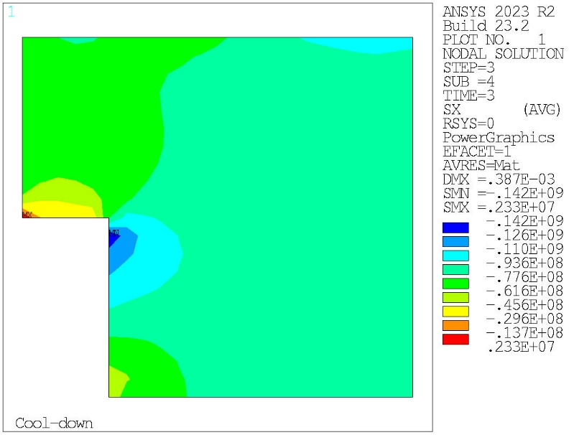
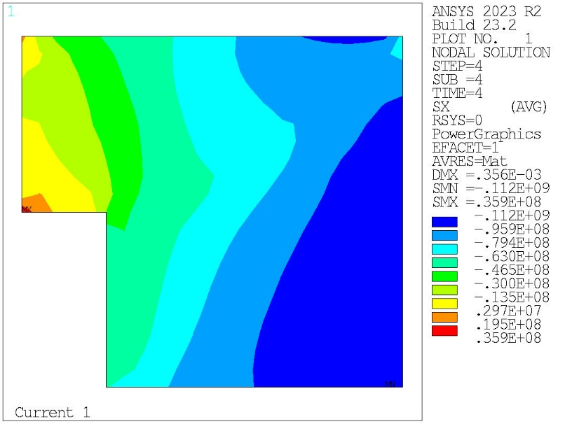
2D Mechanical analysis
Contact pressure at 12 T
Transverse stress (Horizontal)
Peak at RT = 70 MPa
Peak at CD = 142 MPa
Peak at 14 T = 112 MPa

Slide 34
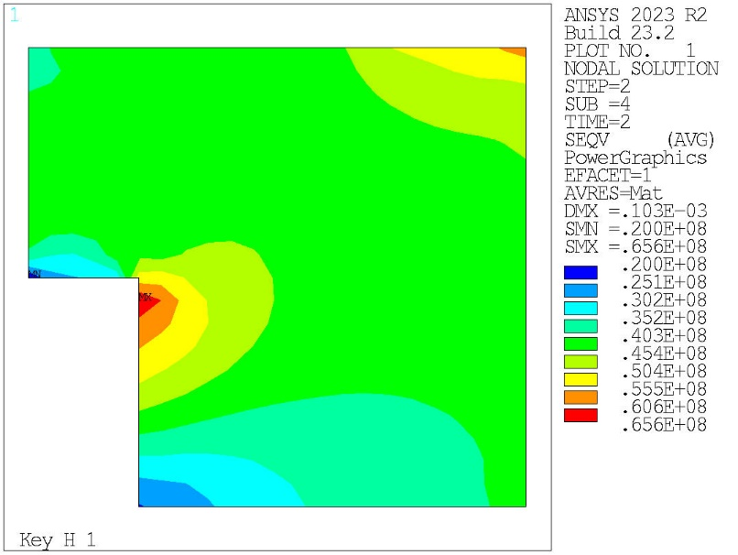
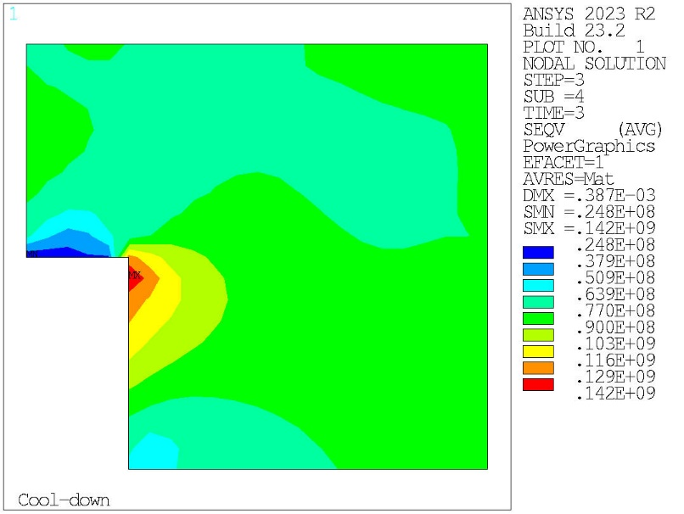
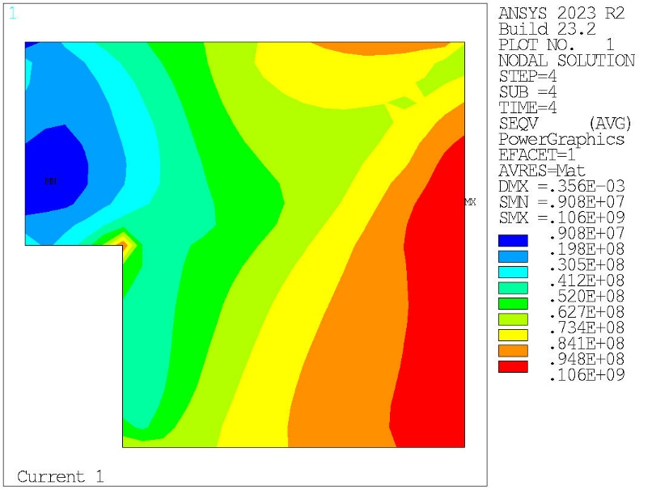
2D Mechanical analysis
Contact pressure at 12 T
VM Equivalent stress
Peak at RT = 65 MPa
Peak at CD = 142 MPa
Peak at 14 T = 106 MPa

Slide 35
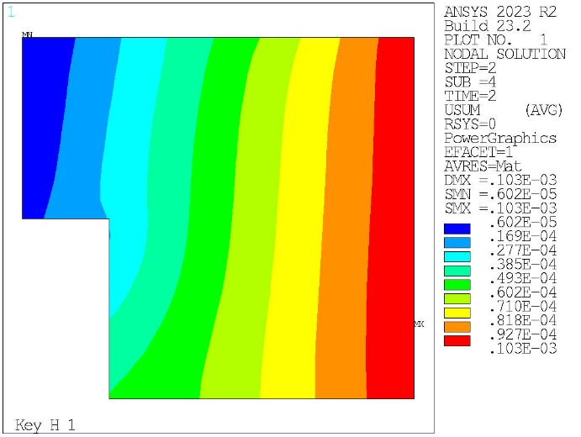
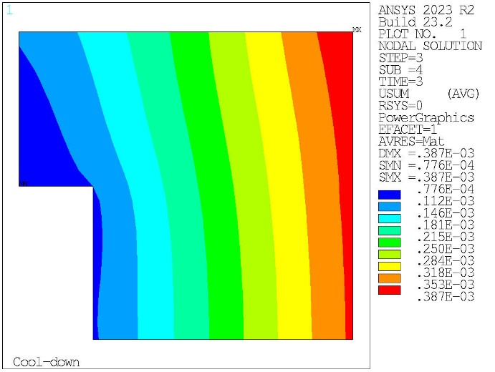
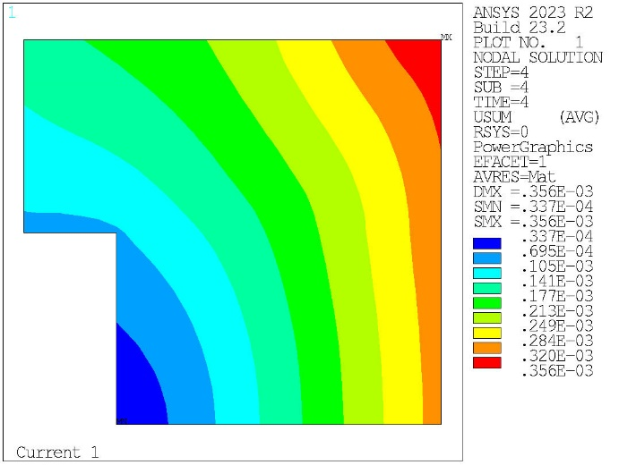
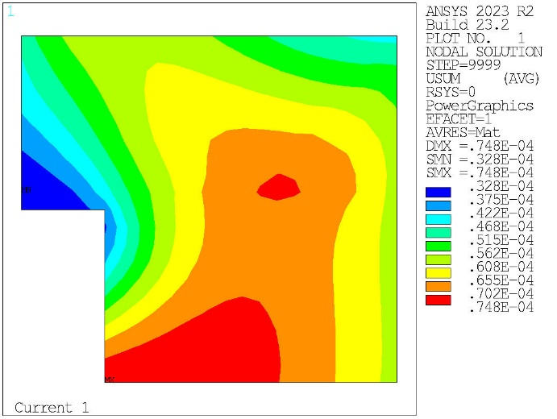
2D Mechanical analysis
Total displacement
33 µm
Difference in Usum (Powering – CD)
75 µm

Slide 36
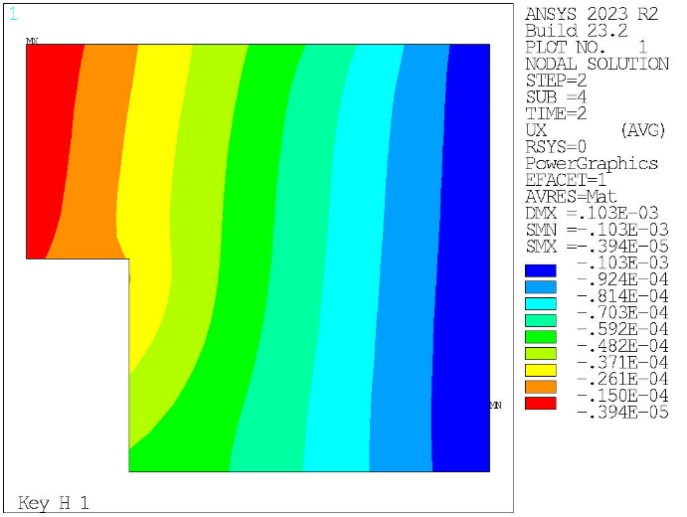
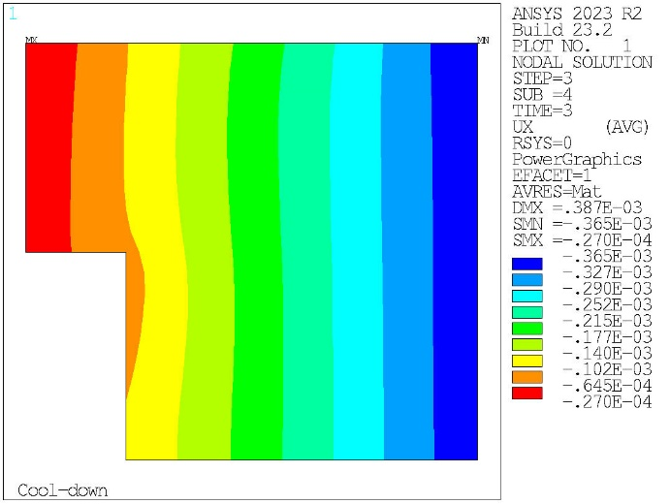
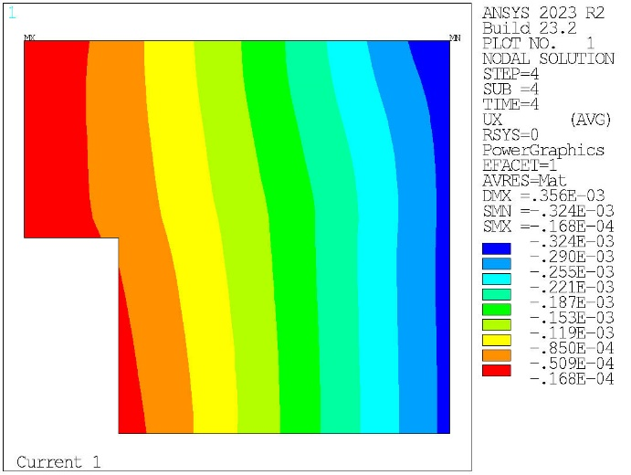

2D Mechanical analysis
Horizontal displacement
8 µm
Difference in Ux (Powering – CD)
+ UX
75 µm

Slide 37




2D Mechanical analysis
VM Equivalent stress
Peak at RT = 112 MPa
Peak at CD = 225 MPa

Slide 38



2D Mechanical analysis
VM Equivalent stress

Slide 39






2D Mechanical analysis
VM Equivalent stress

Slide 40



2D Mechanical analysis
VM Equivalent stress

Slide 41
2D Mechanical analysis
Mechanical structure behavior
 |  | 0 Deg | Avg.
Shell az. stress at RT 0 Deg | [MPa] | 56.3 | 23.5
Shell strain at RT 0 Deg | [µstr] | 804.9
Shell az. stress at cold 0 Deg | [MPa] | 199.9 | 69.1
Shell strain at cold 0 Deg | [µstr] | 2530.6
Step | σ_θ,shell 0° [Mpa] | σ_θ,shell 90° [Mpa] | σ_θ,shell 45° [Mpa] | Avg. σ_hor.,coil [Mpa] | Avg. σ_θ,shell [Mpa] | Coil Max Seqv [Mpa] | Coil Min Sx [Mpa] | F_hor.,pole [kN/m] | F_θ,shell [kN/m] | F_pole/F_e.m. [%]
After RT pre-load | 56 | 34 | 56 | -48 | 24 | 66 | -71 | 1848 | 1766 | 0.55
At 1.9 K | 200 | 130 | 169 | -82 | 69 | 142 | -142 | 3342 | 3891 | 1.20

Slide 42
Outline
Introduction
Updates and model checks
Rods design
2D Magnetic results
2D Mechanical results
2D Mechanical results – Bladders
2D Mechanical results – Str. limit
3D Mechanical results
Next steps

Slide 43


2D Mechanical analysis
Same model, but now we simulate the bladder pumping.
We show results for the last horizontal bladder operation.
Bladder positioning:
  1 long + 1 short bladders in the split yoke (horizontally)
  One long bladder in the Hpad (per quadrant)
  Half short bladder in the vertical pad
Bladder pressure and opening:
  Vertically: 400Bar – 150 µm opening – 50 µm interference
    Clearance = 100 µm
  Horizontally: 300 Bar – 800 µm opening – 500 µm interference
    Clearance = 300 µm
Short bladders = 37 mm (34 mm active)
Long bladders = 54 mm (51 mm active)

Slide 44








2D Mechanical analysis
Displacement sum
Horizontal displacement

Slide 45
2D Mechanical analysis
Displacement sum (with bladders) – After loading
Displacement sum (without bladders) – After loading

Slide 46




2D Mechanical analysis
Contact pressure at 12 T
Transverse stress (Horizontal)
Peak at RT = 46 (70 prev.) MPa
Peak at CD = 142 MPa
Peak at 14 T = 112 MPa

Slide 47




2D Mechanical analysis
Contact pressure at 12 T
VM Equivalent stress
Peak at RT = 42 (65 prev.) MPa
Peak at CD = 142 MPa
Peak at 14 T = 105 MPa

Slide 48




2D Mechanical analysis
VM Equivalent stress
Peak at RT = 257 MPa
Peak at CD = 235 MPa

Slide 49


2D Mechanical analysis
VM Equivalent stress

Slide 50






2D Mechanical analysis
VM Equivalent stress

Slide 51


2D Mechanical analysis
VM Equivalent stress

Slide 52
2D Mechanical analysis
Mechanical structure behavior

Slide 53
2D Mechanical analysis
No bladder simulation
With bladder simulation
 |  | 0 Deg | Avg.
Shell az. stress at RT 0 Deg | [MPa] | 56.3 | 23.5
Shell strain at RT 0 Deg | [µstr] | 804.9
Shell az. stress at cold 0 Deg | [MPa] | 199.9 | 69.1
Shell strain at cold 0 Deg | [µstr] | 2530.6
 |  | 0 Deg | Avg.
Shell az. stress at RT | [MPa] | 84.5 | 27.9
Shell strain at RT | [µstr] | 1207.2
Shell az. stress at cold | [MPa] | 200.5 | 69
Shell strain at cold | [µstr] | 2537.4
Trivially, a frictionless bladder simulation gives the same result as the no bladder one (frictionless as well)

Slide 54
Outline
Introduction
Updates and model checks
Rods design
2D Magnetic results
2D Mechanical results
2D Mechanical results – Bladders
2D Mechanical results – Str. limit
3D Mechanical results
Next steps

Slide 55




2D Mechanical analysis
Contact pressure at 19.6 kA
Transverse stress (Horizontal)
We check the structure limit– focus on coil, brittle iron and shell (the other components have margin)
19.6 kA (14.4 T), 0.9 mm interference (0.6 previously), 500 Bar vertically, 450 bar horizontally
Peak at RT = 125 MPa
Peak at CD = 184 MPa
Peak at 19.6 kA= 155 MPa

Slide 56



2D Mechanical analysis
Contact pressure at 19.6 kA
VM Equivalent stress
We check the structure limit– focus on coil, brittle iron and shell (the other components have margin)
19.6 kA (14.4 T), 0.9 mm interference (0.6 previously), 500 Bar vertically, 450 bar horizontally
Peak at RT = 120 MPa
Peak at CD = 182 MPa
Peak at 19.6 kA = 144 MPa

Slide 57





2D Mechanical analysis
VM Equivalent stress

Slide 58




2D Mechanical analysis
VM Equivalent stress

Slide 59


2D Mechanical analysis
VM Equivalent stress

Slide 61


Slide 62

Thank you very much for your attention!

Slide 63


Slide 64


Slide 65
MQXF Criteria
Pole-coil contact in pole-turns midpoint
p_{cont} ≥ 2 MPa
Max bladder pressure
< 50 MPa
Bladder should open the interf=interf_{nom} + 100μm
σ_{eq coil max} ≤ 150-200 MPa at
4.3K and 155 T/m
  ≤ 100 MPa at 293K
All components σ ≤ R_{p 0.2}
For iron at 4.3K (brittle)
σ_{I} ≤ ~200 MPa
Material | R_{p 0.2} [MPa]
 | 293 K | 4.3 K
Al 7075 | 480 | 690
SS 316 LN | 286 | 930
NITRONIC 40 | 353 | 1240
MAGNETIL | 180 | 723
Ti 6Al 4V | 827 | 1654

Slide 66


Material options for the pole
Material | 0.2 % YS RT (MPa) | Saturation (T) | Comments
430 Stainless Steel | 310 | 1.47 | * Structural steel, easy to find in the market
Magnetil | 180 | 2.18 | * LHC production
Armco | 180 | 2.15 | * HiLumi production
Co-Alloys |  |  | *Issue for radio protection
Fe-Ni alloy > 50
Permalloy 45 |  |  | * The addition of Nickle improves the strength but decreases ductibility
AISIS 1010 Carbon Steel | 220-350 (305) | 2.05 | * Used in LHC experiments
Mumetal | 280
Most promising options:
armco
ST430
Ti
armco
Ti

Slide 67


2D Mechanical analysis – Stress criteria

