Slide 1
Changes on the LHC BLM system during YETS
B.Salvachua, S.Morales, E.Effinger for the BLM team
BLMTWG 25 March 2025

Slide 2
BLM system layout modifications
TWOCRYST in IR3
Beam Gas Curtain (BGC) in IR4
RF cryo module in IR4
TDIS in 4L2
Short a list of temporal removal and re-installation of BLMs

Slide 3
New BLMs for TWOCRYST in IR3
In the scope of Physics Beyond Collider. There was an installation of a proof-of-principle of an LHC experiment based on double-crystal to study the magnetic and electric dipole moment of short-lived baryons.
ECR for the TWOCRYST installation: LHC-LJ-EC-0054
The installation on Beam 2 involved:
  Bend crystal for Splitting (4mm – 50 urad max deflection): TCCS goniometer in A5R3
  Long Bend Cyrstal for Precession (70mm – 7 mrad max deflection): TCCP goniometer in A4L3
    With a Tungsten target (200um) in A4L3
  Two Roman Pot Stations to detect particles channelled by both cyrstals (TCCS and TCCP) recovered from ATLAS-ALFA
  Two BLMs: 1 downstream the TCCS and 1 on the TCCP/XRP – Integration study EDMS 3129362

Slide 4
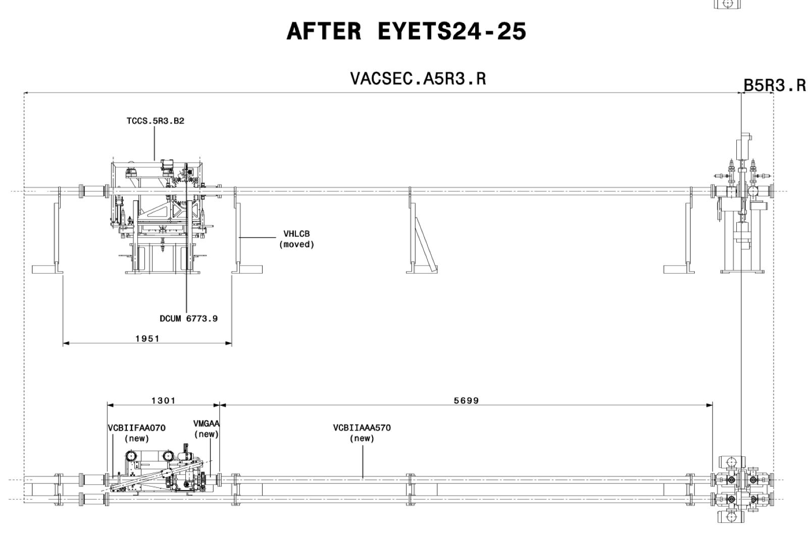
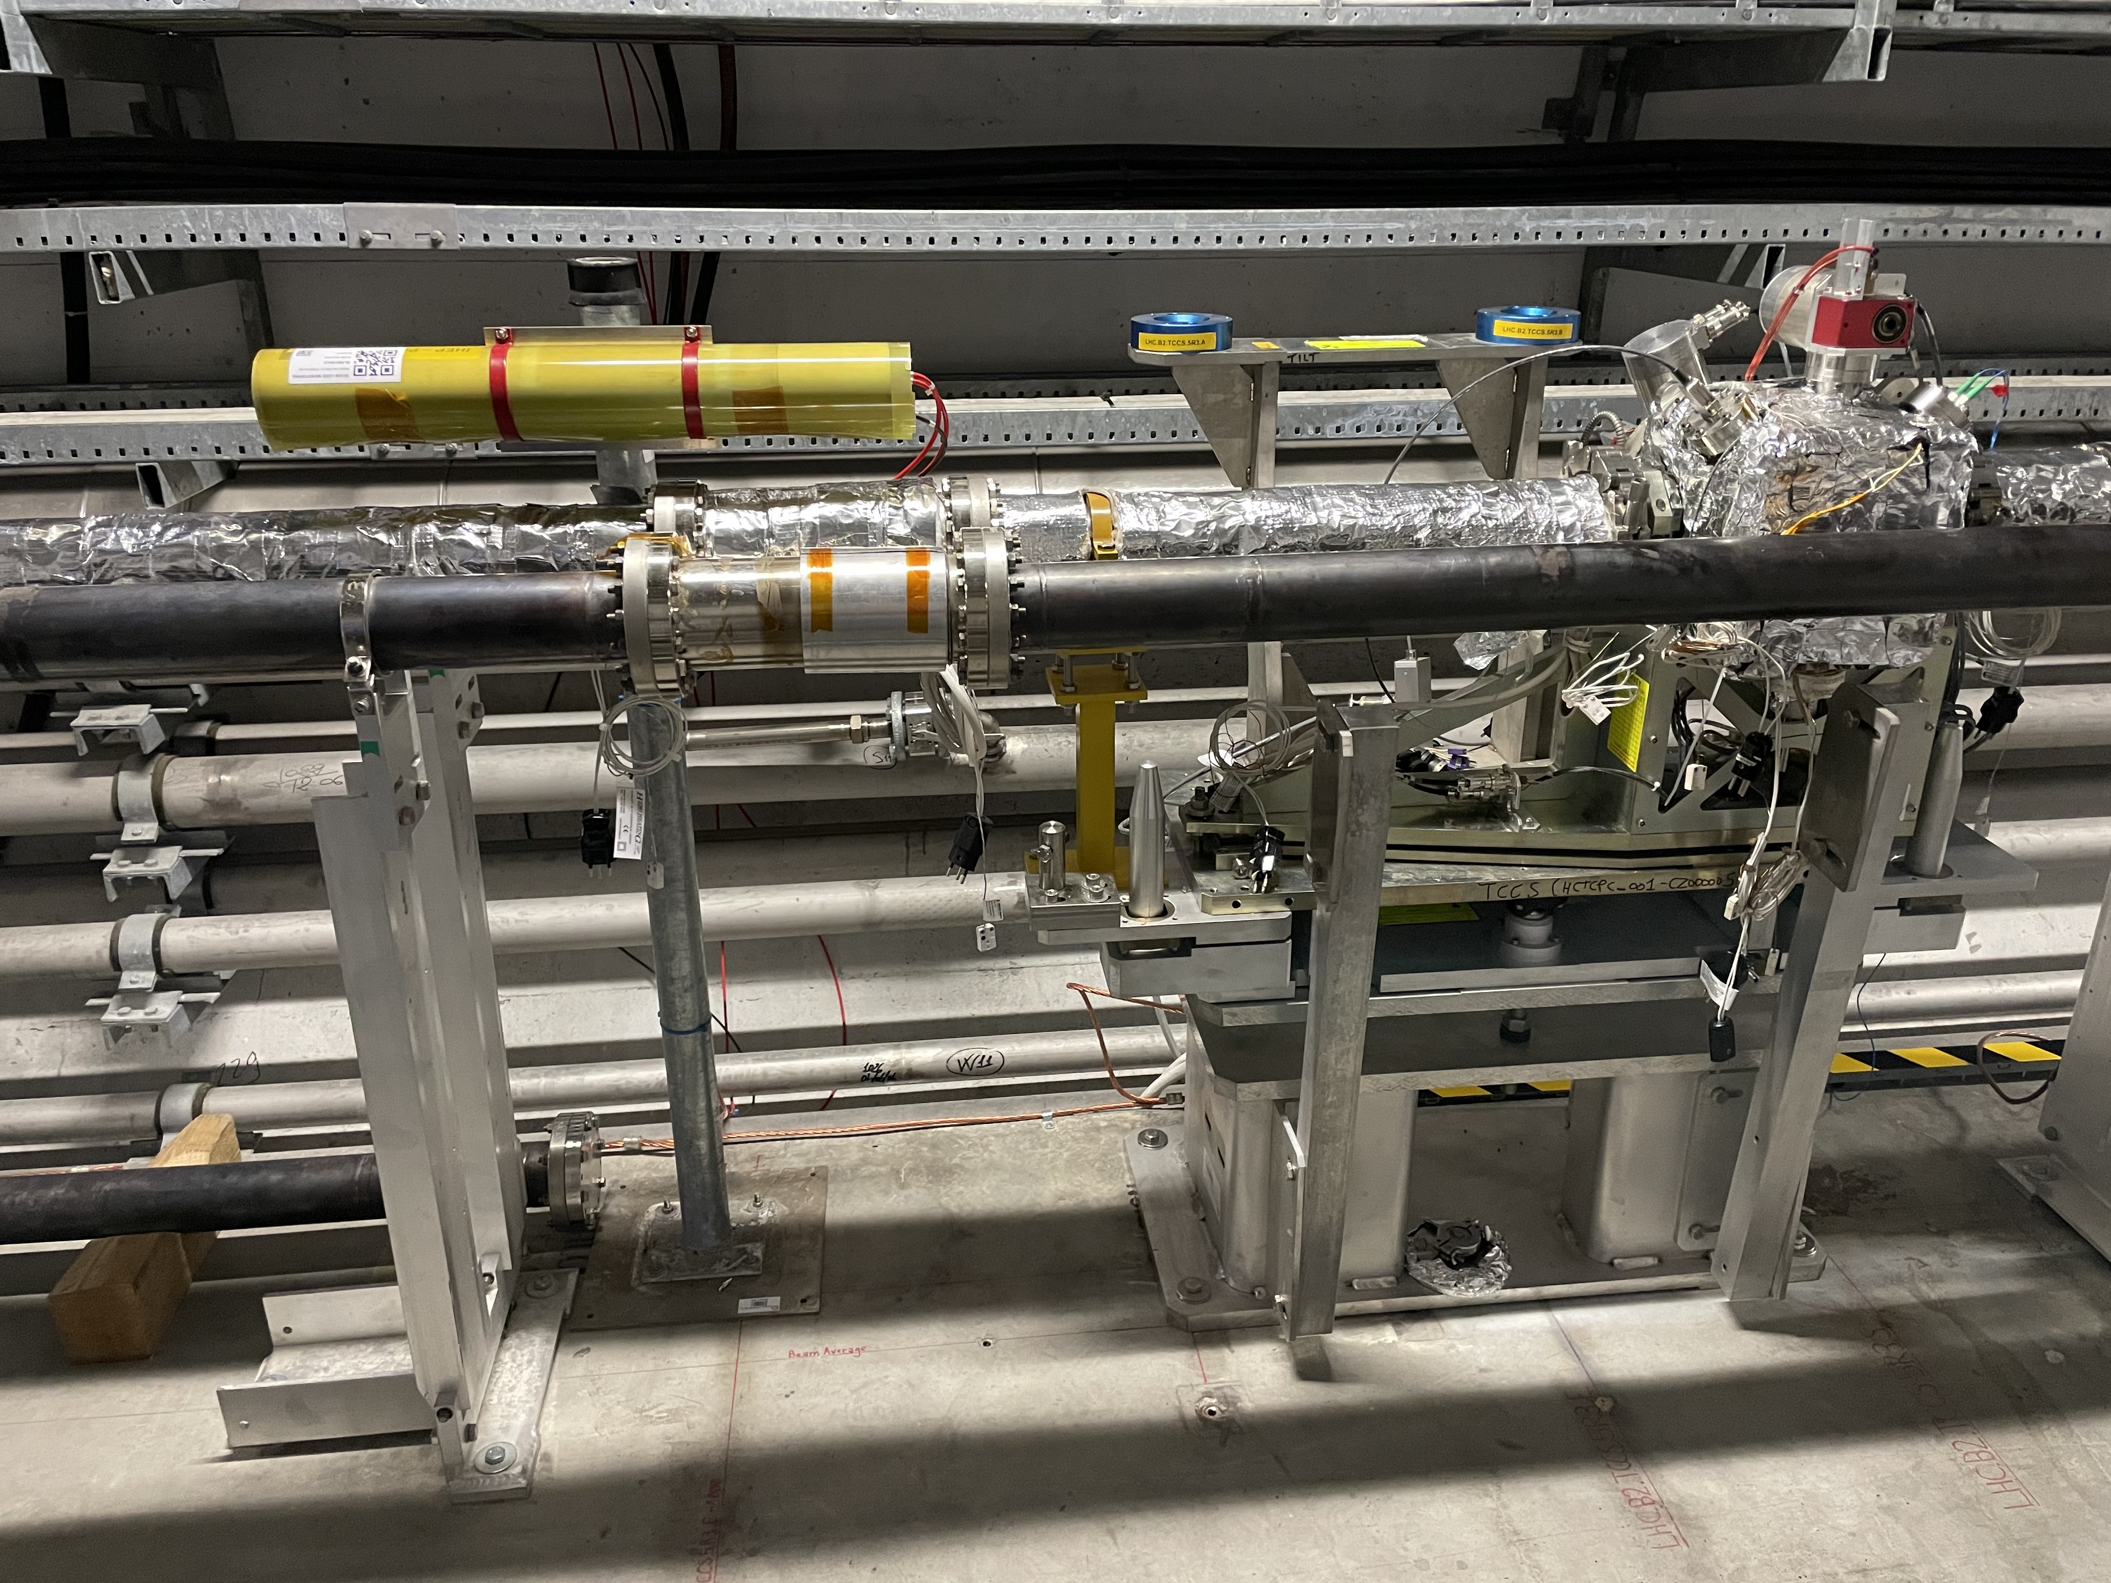
New BLMs for TWOCRYST in 5R3
One BLM installed after the TCCS.5R3.B2:
New BLM:
BLMTI.05R3.B2E10_TCCS.5R3.B2
Installed parallel to the Beam pipe (horizontal) on a movable support.
Beam 2
BLM
BLECF_SERIAL_NUMBER 602.0 BLETC_CRATE_CARD_IDX 9 BLETC_CRATE_CARD_CHAN_IDX 15
For the moment NOT interlocked.

Slide 5
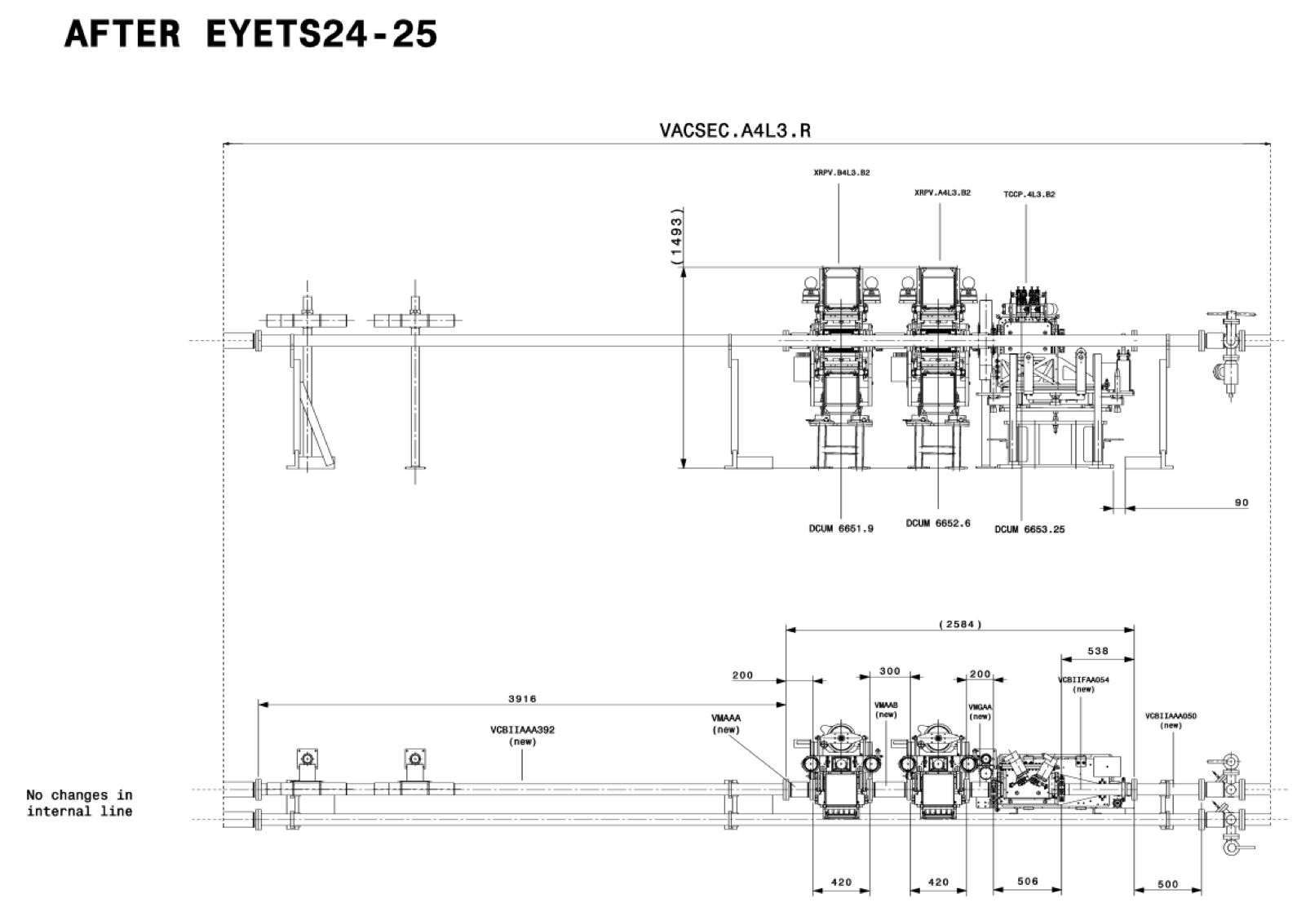
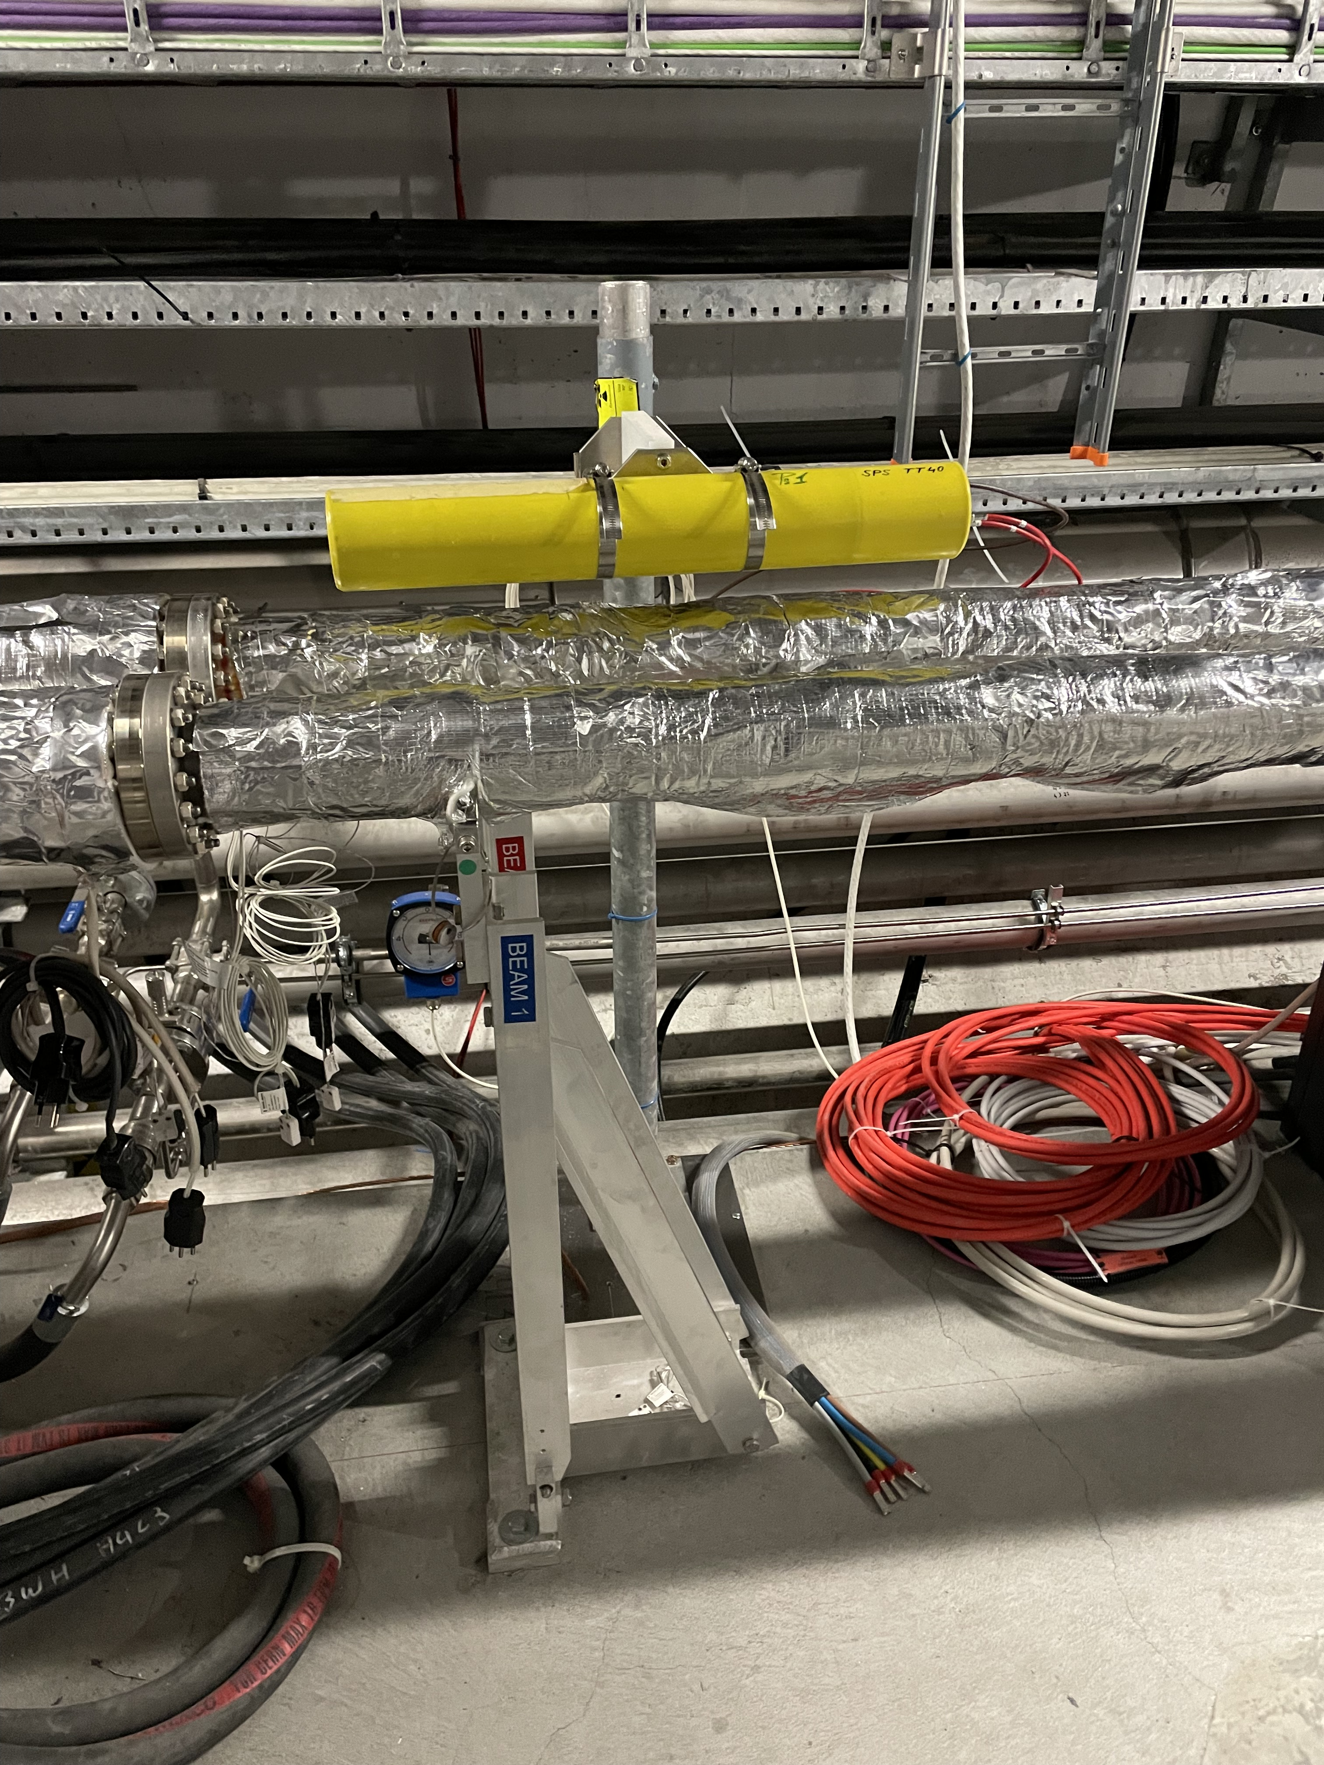
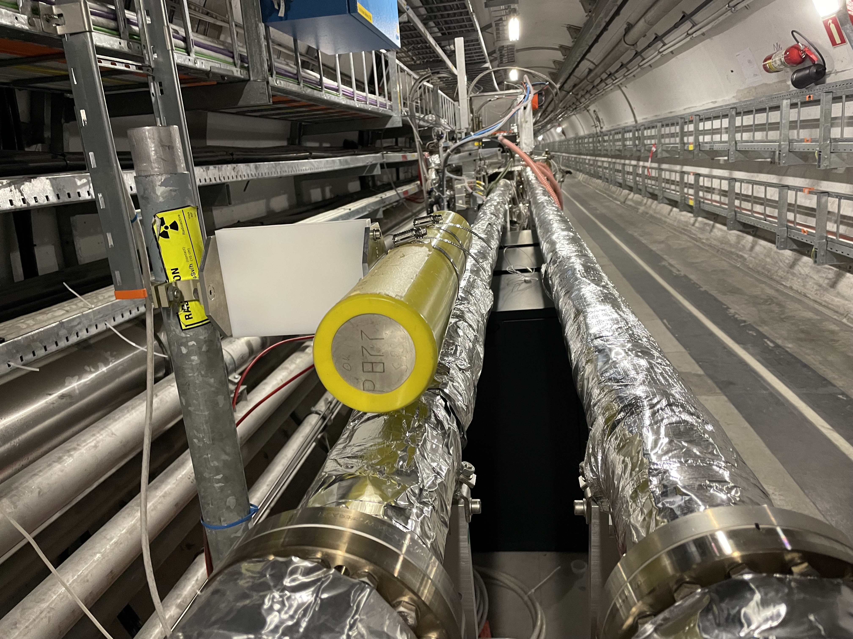
New BLMs for TWOCRYST in 4L3
Only one 1 BLM installed in 4L3.
Since no empty BLM channels were available in 4L3 (only 2 in 5L3 BJBAP.A5L3 )
We reused the BLM detector and the connexion of :
BLMEI.04L3.B2E10_TCSM.4L3.B2 (after EYETS this BLM does not exist)
New BLM: BLMTI.04L3.B2E10_TCCP_XRPV
Beam 2
BLM
BLECF_SERIAL_NUMBER 543.0 BLETC_CRATE_CARD_IDX 1 BLETC_CRATE_CARD_CHAN_IDX 7
For the moment NOT interlocked.

Slide 6
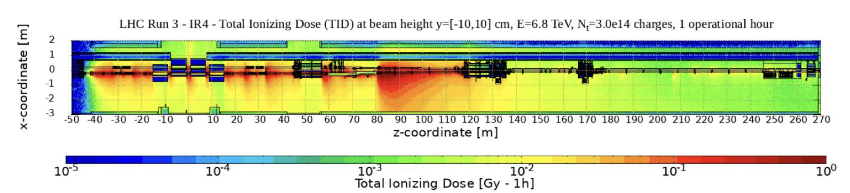
Beam Gas Curtain (BGC) in IR4
We would like to investigate the use of the BGC as a device to measure transverse beam profile, by scanning the beam with a gas curtain.
Installation of 2 BLMs to monitor the beam losses created by the Beam Gas Curtain for beam diagnostics purposes (not machine protection). Installation done on Beam 1 only.
ECR LHC-BLM-EC-0021
1 BLM very close to the BGC
1 BLM at the hottest spot

Slide 7
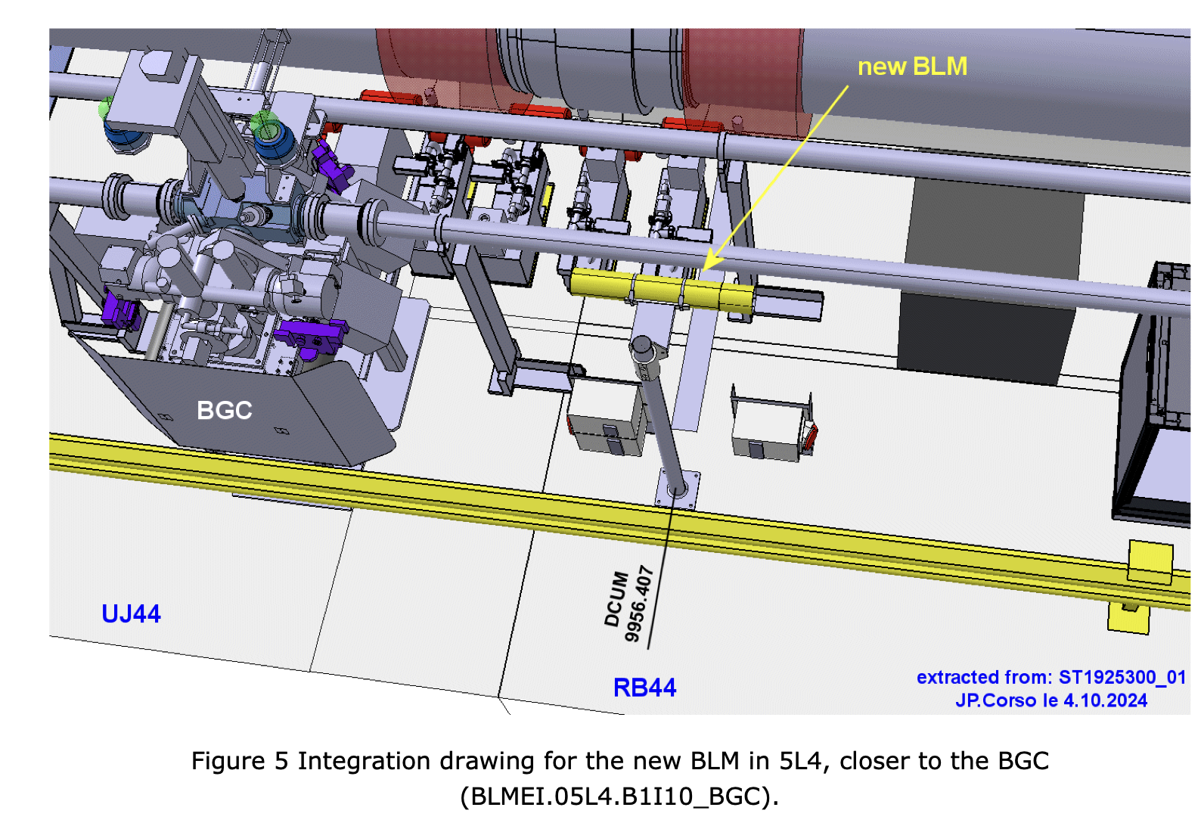
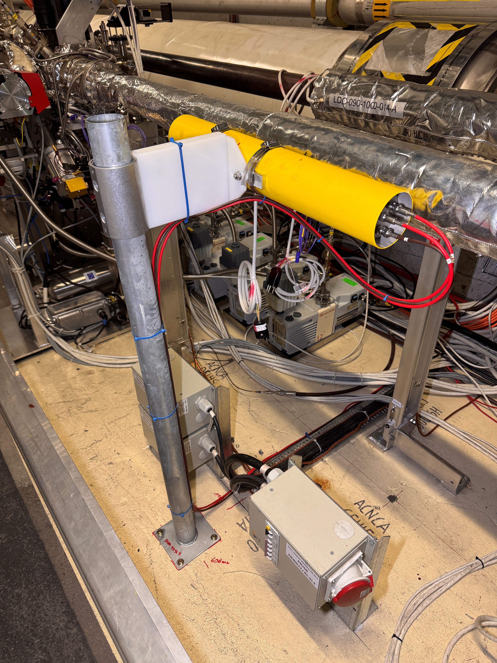
Beam Gas Curtain (BGC) in 5L4
BLECF_SERIAL_NUMBER 624.0 BLETC_CRATE_CARD_IDX 1 BLETC_CRATE_CARD_CHAN_IDX 5
Not interlocked
New Name: BLMEI.05L4.B1I10_BGC

Slide 8
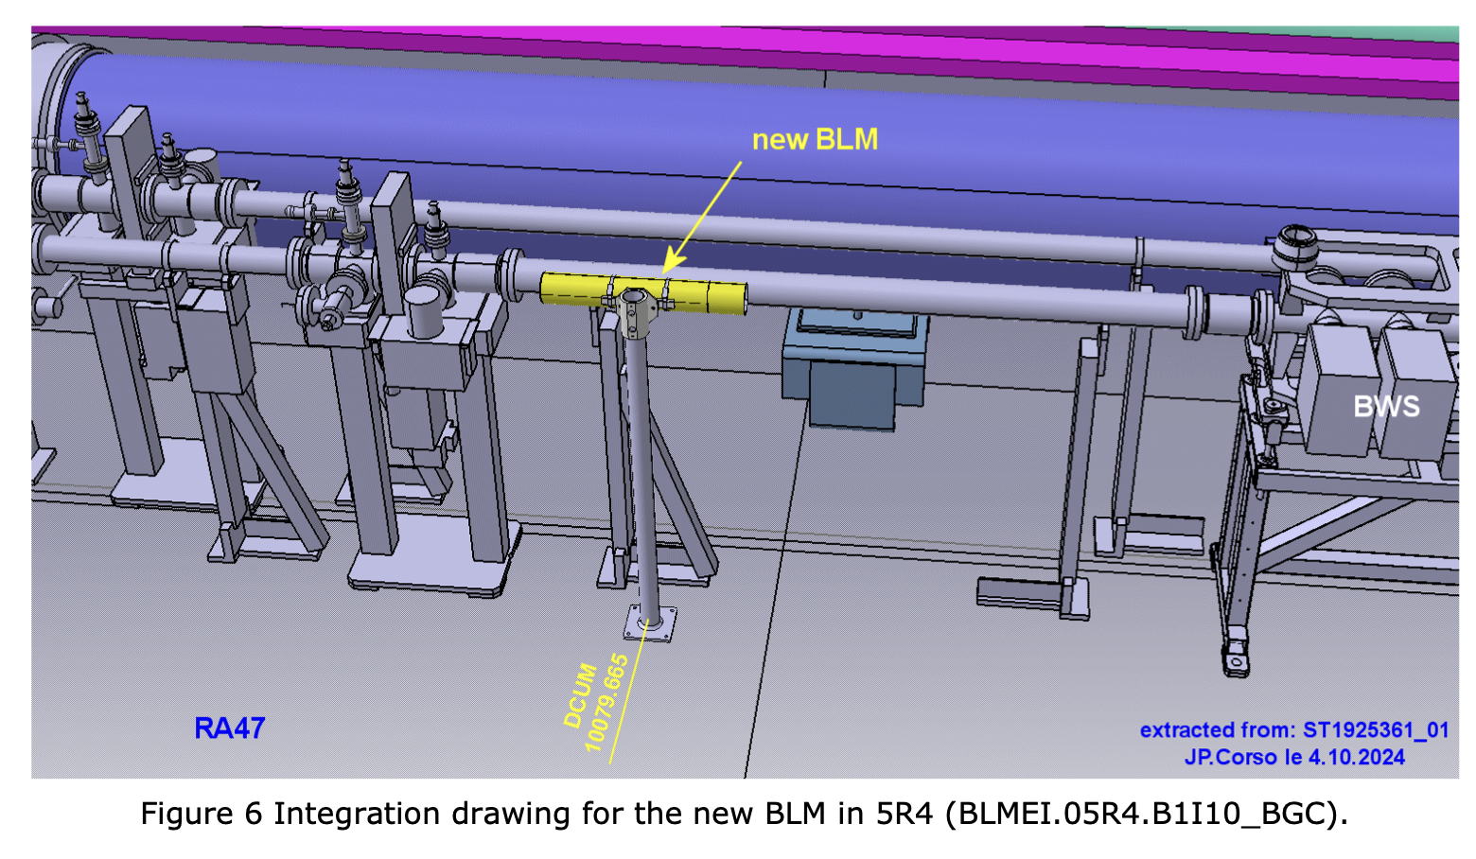
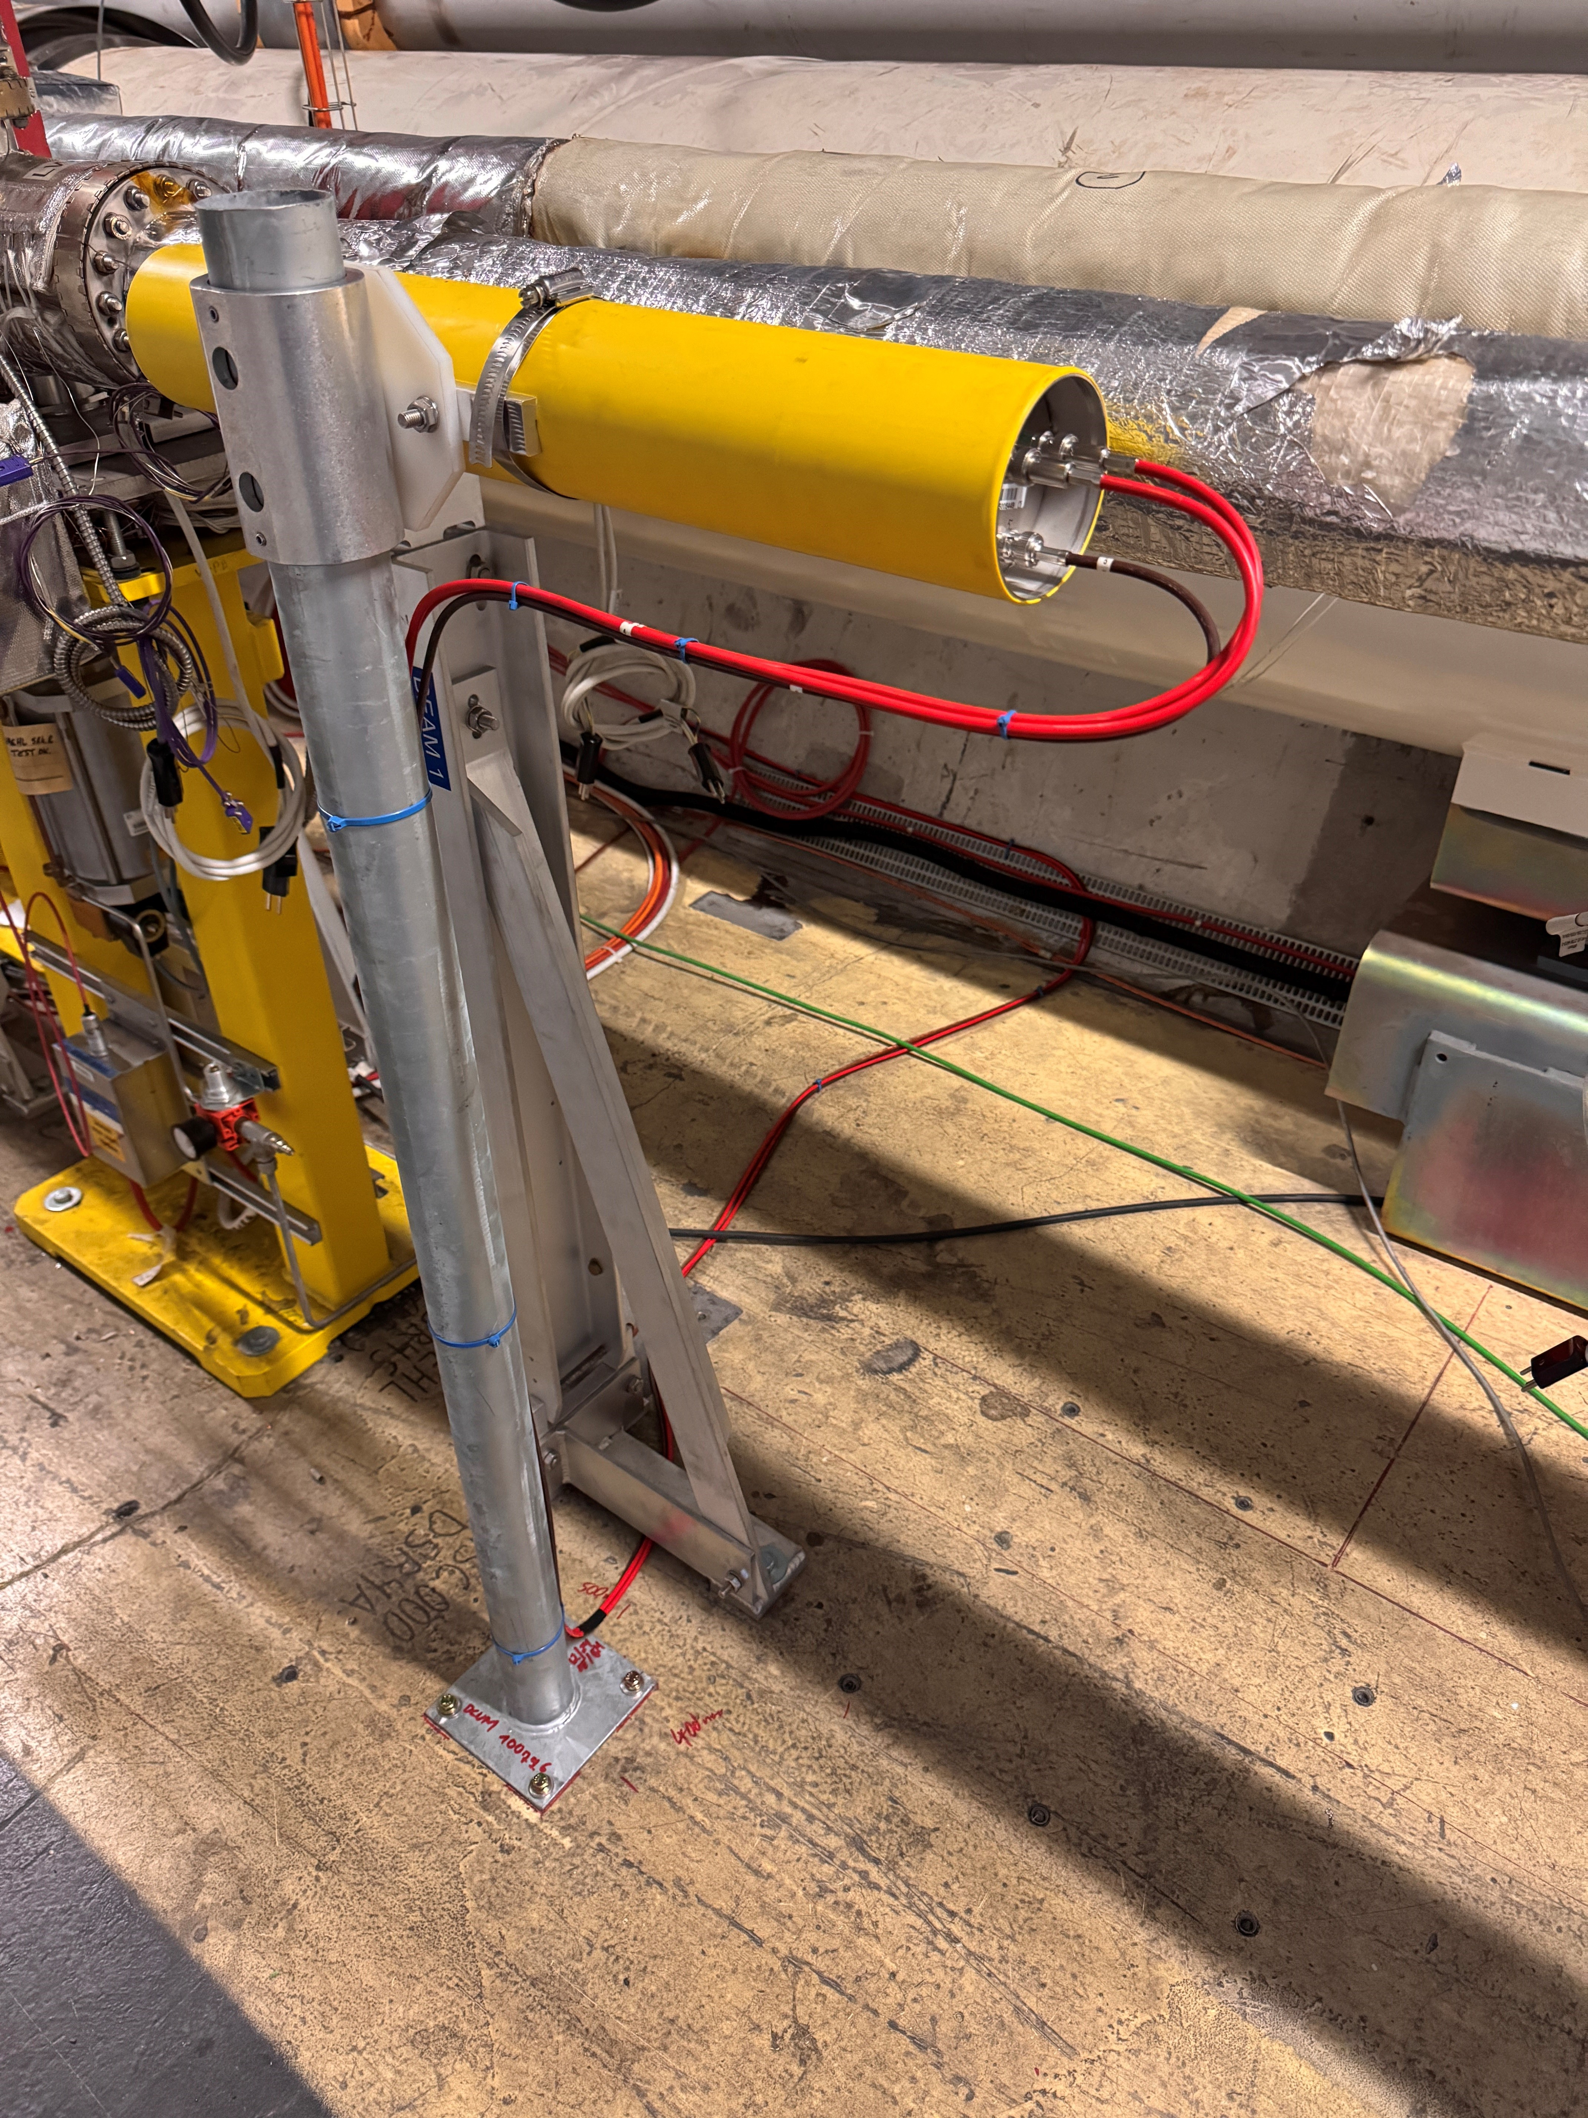
Beam Gas Curtain (BGC) in 5R4
New name: BLMEI.05R4.B1I10_BGC
BLECF_SERIAL_NUMBER 8.0 BLETC_CRATE_CARD_IDX 9 BLETC_CRATE_CARD_CHAN_IDX 5
Not interlocked

Slide 9
RF cryo module in IR4
The RF team (K.Turaj and A.Butterworth) requested to relocate the 3 existing BLMs in the RF zone around the cryo-module 1 - Beam 2.
The reason is the observation of HOM heating and quenches of the cavity ACS3.B2 during 2024.
It is not clear if the issue comes from the beam or from the cavity. RP monitors have been also installed around that cryo module.
ECR is under preparation but request was presented and approved at the LMC
The BLMs were not interlocked and will not be now either.
The cables are routed on the protection from transport area to reduce the noise.

Slide 10
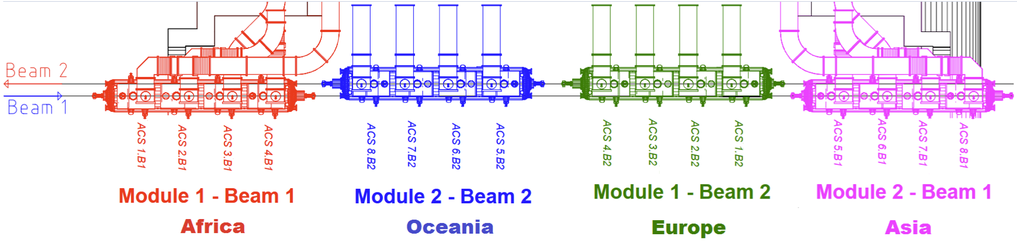
Relocation and addition of BLMs in RF zone
Before EYETS
Installation close to the floor
After EYETS
Installation close to beam line

Slide 11
Relocation and addition of BLMs in RF zone
Beam 2
BLMEI.05R4.B2E23_ACSGA.5R4.B2
BLMEI.05R4.B2E21_ACSGA.5R4.B2
BLMEI.05R4.B2C30_ACSGA.5R4.B2
BLMEI.05R4.B2C10_ACSGA.5R4.B2
BLMEI.05R4.B2I22_ACSGA.5R4.B2

Slide 12
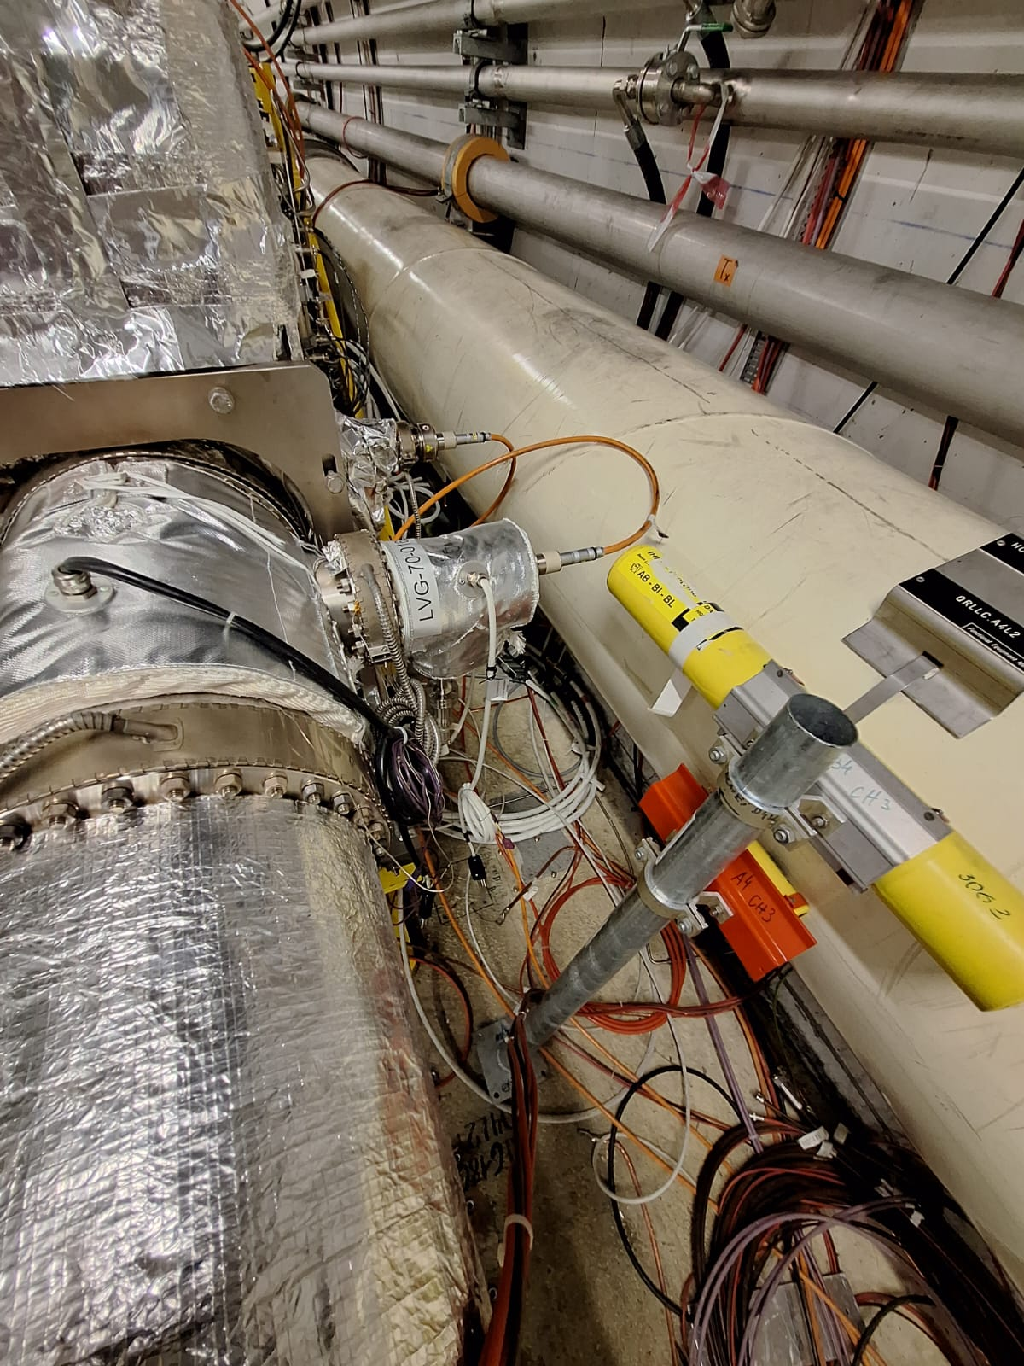
TDIS 4L2
During the consolidation of the ID212 warm modules (see LHC-VM-EC-0002). The VSC team had to modify the machine layout. This conflicts with the original location of 1.
The BLM BLMTI.04L2.B1E20_TDIS.4L2.B1
had to be displaced by 66 cm.
The BLM was re-installed and renamed to:
BLMTI.04L2.B1E21_TDIS.4L2.B1
No modification of thresholds, only the expert name and DCUM.
In addition, due to the replacement of the TDIS IP2/IP8 the TDIS BLMs were temporally removed and re-installed.

Slide 13
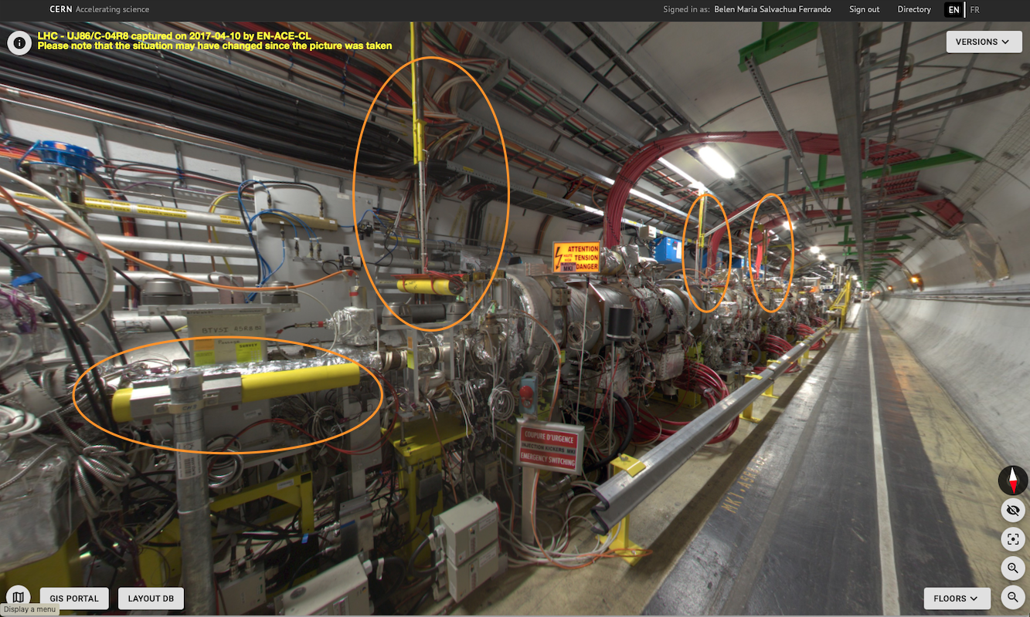
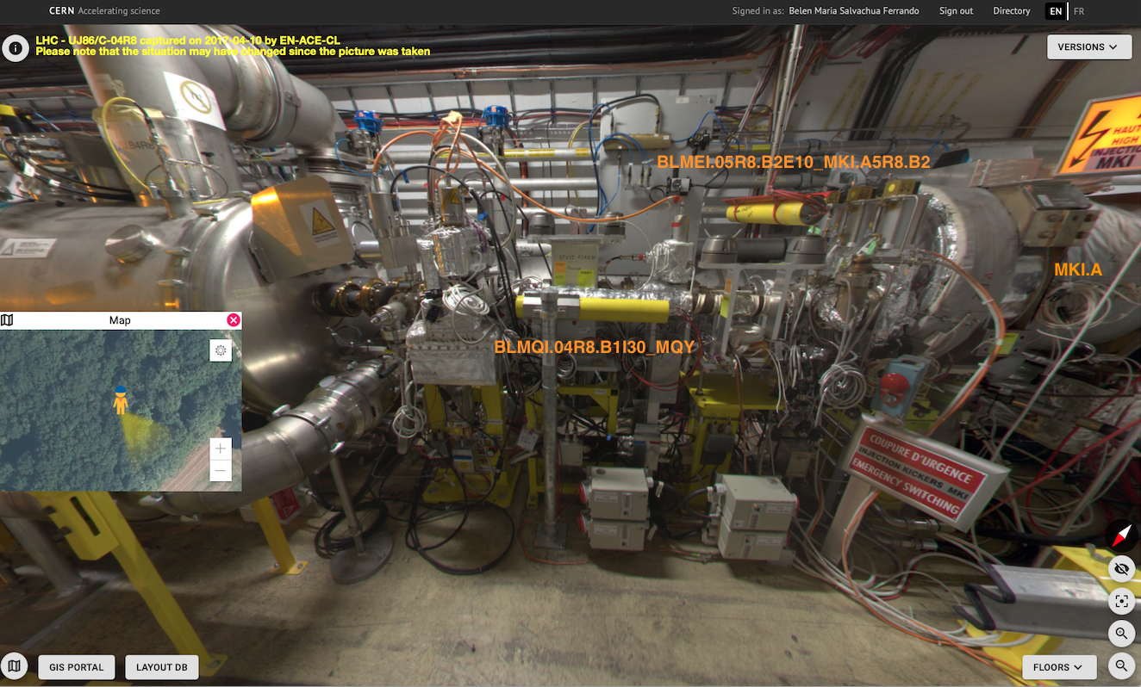
Exchange of MKIA MKI8B
Temporal removal and re-installation of 4 BLMs:
  BLMQI.04R8.B2E10_MQY
  BLMEI.05R8.B2E10_MKI.A5R8.B2
  BLMEI.05R8.B2E10_MKI.B5R8.B2
  BLMEI.05R8.B2E20_MKI.C5R8.B2

Slide 14
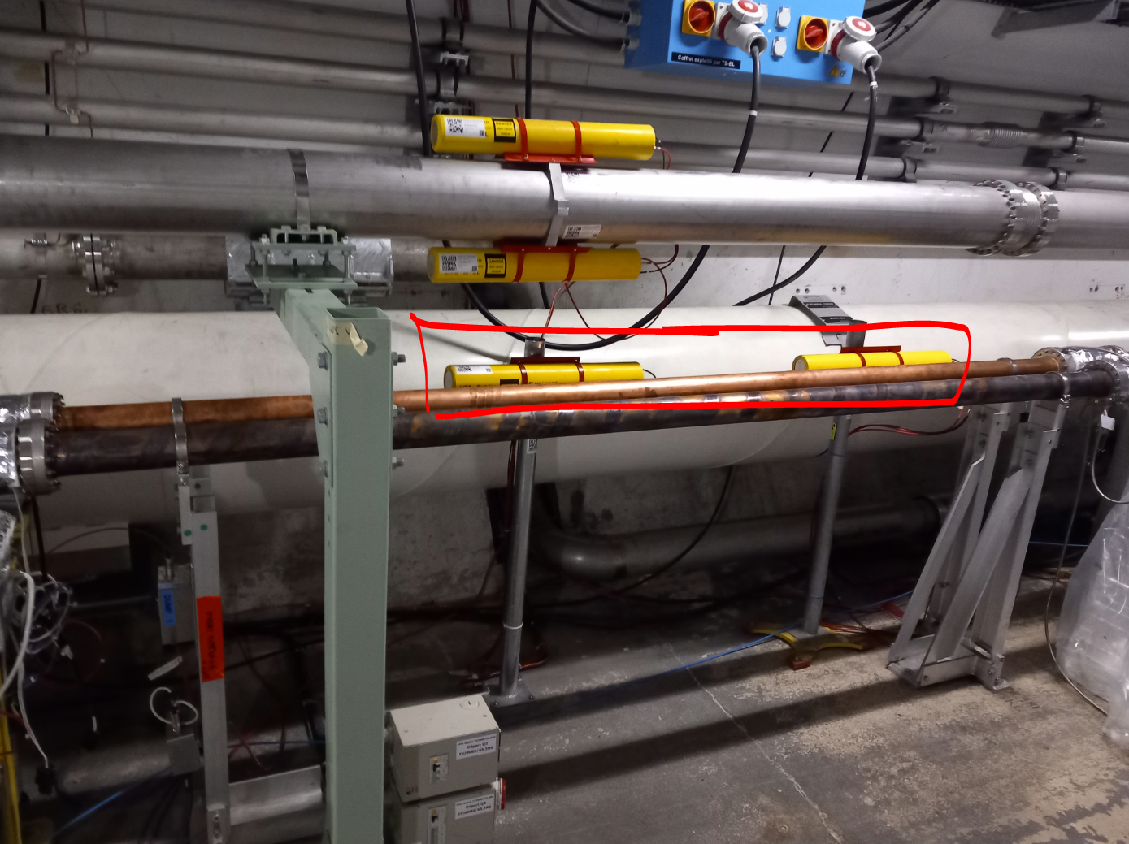
LESS solenoid installation
For the bake-out and solenoide installation in the LESS demonstrator chamber, two BLMs had to be removed and re-installed.
In addition, the vacuum team had requested to temporally removed and re-installed BLMs along the machine. No conflict with the re-installation (except the case of the TDIS IP2 described earlier)

Slide 15
Summary and Conclusions
New layout BLM BLM_EXPERT_NAME
BLMTI.04L2.B1E21_TDIS.4L2.B1
BLMTI.04L3.B2E10_TCCP_XRPV
BLMTI.05R3.B2E10_TCCS.5R3.B2
BLMEI.05L4.B1I10_BGC
BLMEI.05R4.B2C30_ACSGA.5R4.B2
BLMEI.05R4.B2E23_ACSGA.5R4.B2
BLMEI.05R4.B2I22_ACSGA.5R4.B2
BLMEI.05R4.B2E21_ACSGA.5R4.B2
BLMEI.05R4.B2C10_ACSGA.5R4.B2
BLMEI.05R4.B1I10_BGC
Old/LSA BLM BLM_EXPERT_NAME not in the new
BLMTI.04L2.B1E20_TDIS.4L2.B1
BLMEI.04L3.B2E10_TCSM.4L3.B2
BLMEI.05L4.B1I10_ACSGA.5L4.B1
BLMEI.05L4.B1I20_ACSGA.5L4.B1
BLMEI.05R4.B1I20_ACSGA.5R4.B1
Most of the BLM changes were temporal removal and re-installations.
Before EYETS: 3939 monitors (IC,SEM,LIC)
After EYETS: 3944 monitors (IC, SEM, LIC)
The changes were inserted into LSA on Monday 23th March 2025.

