Slide 1
LHC BLM system readiness for 2025 first beam
S.Morales, B.Salvachua, E.Effinger on behalf of the BLM team – SY-BI-BL
25/03/2025 – 103rd BLMTWG meeting

Slide 2
LHC BLM system commissioning
During the commissioning phase, the LHC BLM system must pass a list of tests divided in three groups, normally performed in this order:
1. Hardware commissioning
2. Machine checkout
3. Tests with beam
Detailed info on LHC-OP-MPS-0009

Slide 3
LHC BLM system commissioning
1. Hardware commissioning:
  11 tests, for example, high voltage modulation test
  BLM team targets different octants to pass the tests -> Going through the last checks until tomorrow
  Info regarding all new installations presented by Belen uploaded to LAYOUT DB
    Info synchronized to LSA DB
    LSA BLM settings generated and driven to crates -> OK
  100Hz data logging -> Will be done by the section from now on
    Provided crate by crate at the moment

Slide 4
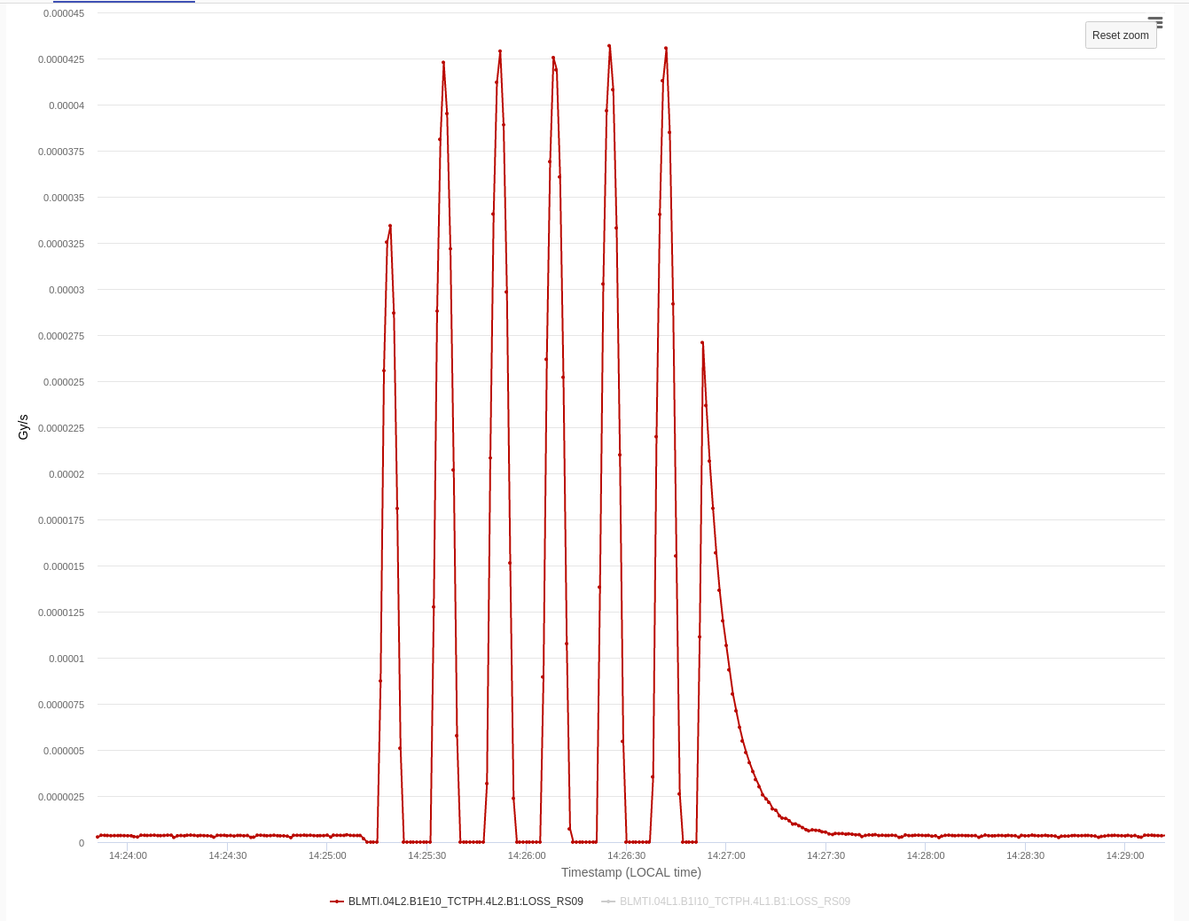
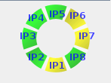
Hardware checkout
High voltage modulation test:
Ensure the integrity of the cabling and system components
Harmonic modulation added on the HV supply -> Signal modulation on the detectors
Amplitude and phase compared to predetermined limits
All detectors OK and modulating
within limits!
Limits on the new detectors updated
yesterday

Slide 5
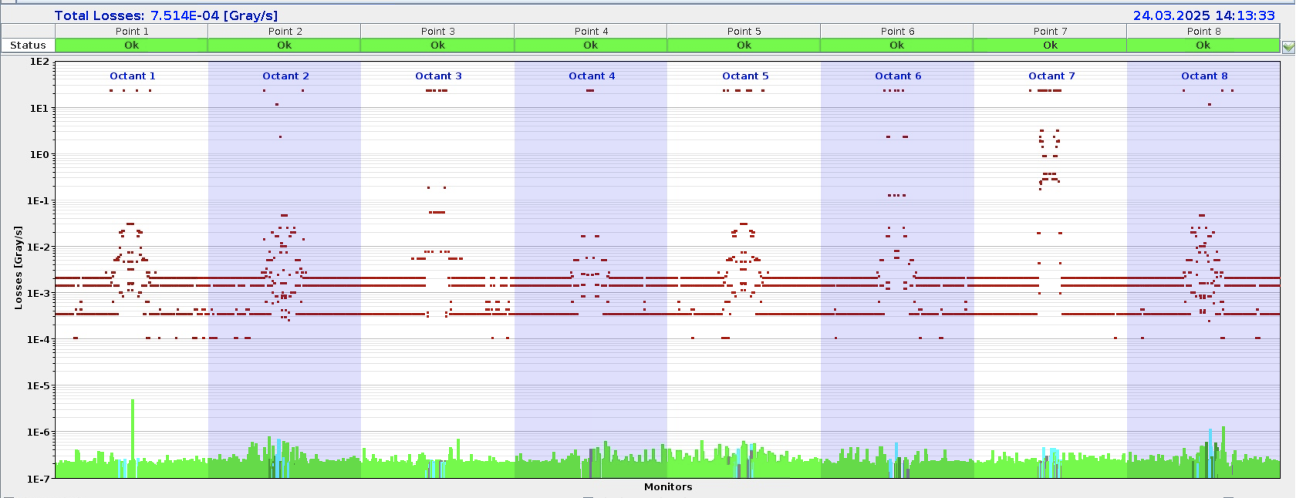
Hardware checkout
Continuous monitoring of the status of the system:
LHC BLM Fixed Display

Slide 6
Hardware checkout
Continuous monitoring of the status of the system:
To be checked today in tunnel
Detector or CFC card?
Interventions in tunnel today and tomorrow to fix broken optical links and perform some DAC resets manually
LHC BLM Fixed Display – DAC reset on all cards, lower offset levels -> Will perform noise analysis

Slide 7
LHC BLM system commissioning
2. Machine checkout:
  3 tests run from the CCC without beam needing around 1 hour
  User permit transmission test
  Threshold values change with energy test
  Missing HV detection and propagation to the SIS test
  To be completed later on during the machine checkout
3. Tests with beam:
  Latency tests
  Blinding functionality test -> Procedure to be discussed with ABT
  Scraping for BLM calibration at injection and top energy, IR3 and IR7 -> With final collimation and optics in place -> Early May shift during LHC commissioning

Slide 8
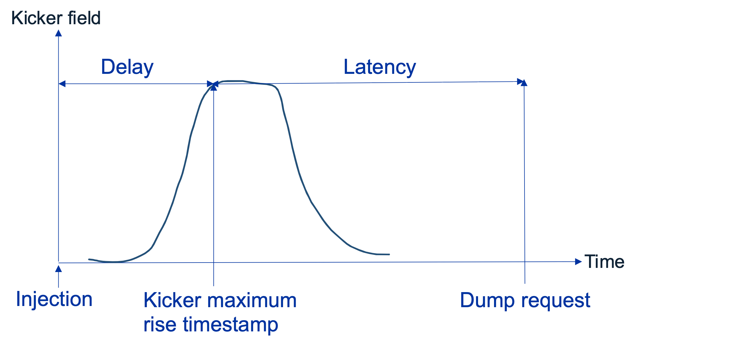

Latency tests
Two tests performed in paralell, by OP in the last years, following LHC-BLM-NOT-0008
Test 1: Interlock request functionality of the BLM crates
  Aim to trigger all possible BLM crates
  Collimators closed initially and opened using threading sequence by D.Mirarchi
  Injection of pilot bunch
Test 2: Interlock request system latency
Possible to perform both tests in paralell -> Latency calculated for each triggered crate
Latency has to be below 3 LHC turns (89 $μ$s each)

Slide 9
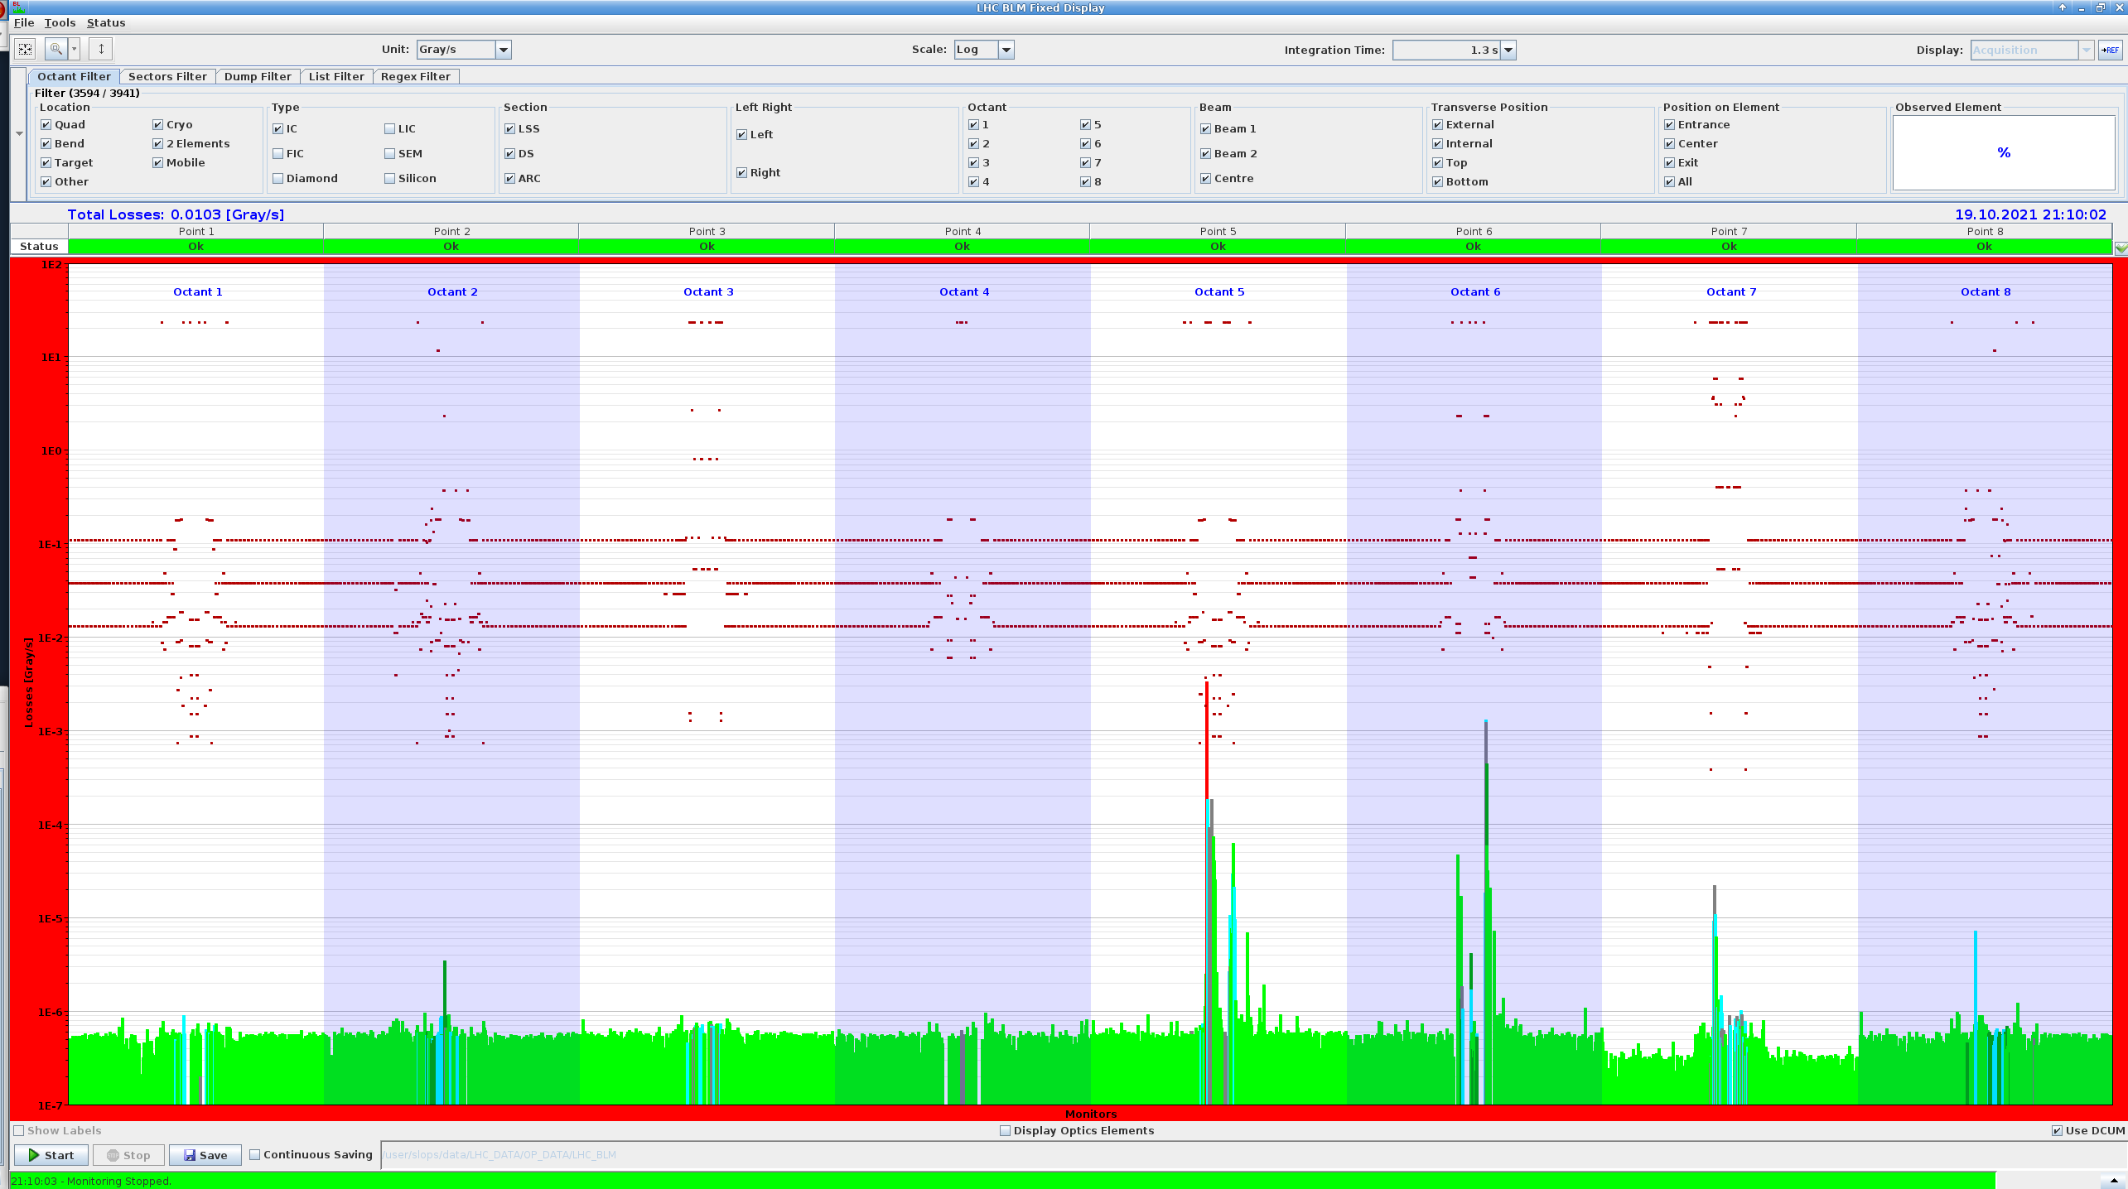
Latency tests
Selection of collimator orientation arbitrary
Same collimator type per point for B1 and B2
Most dumps from central crate, maskable channels
Triggering beam dump in IP5 with B1 in 2021

Slide 10
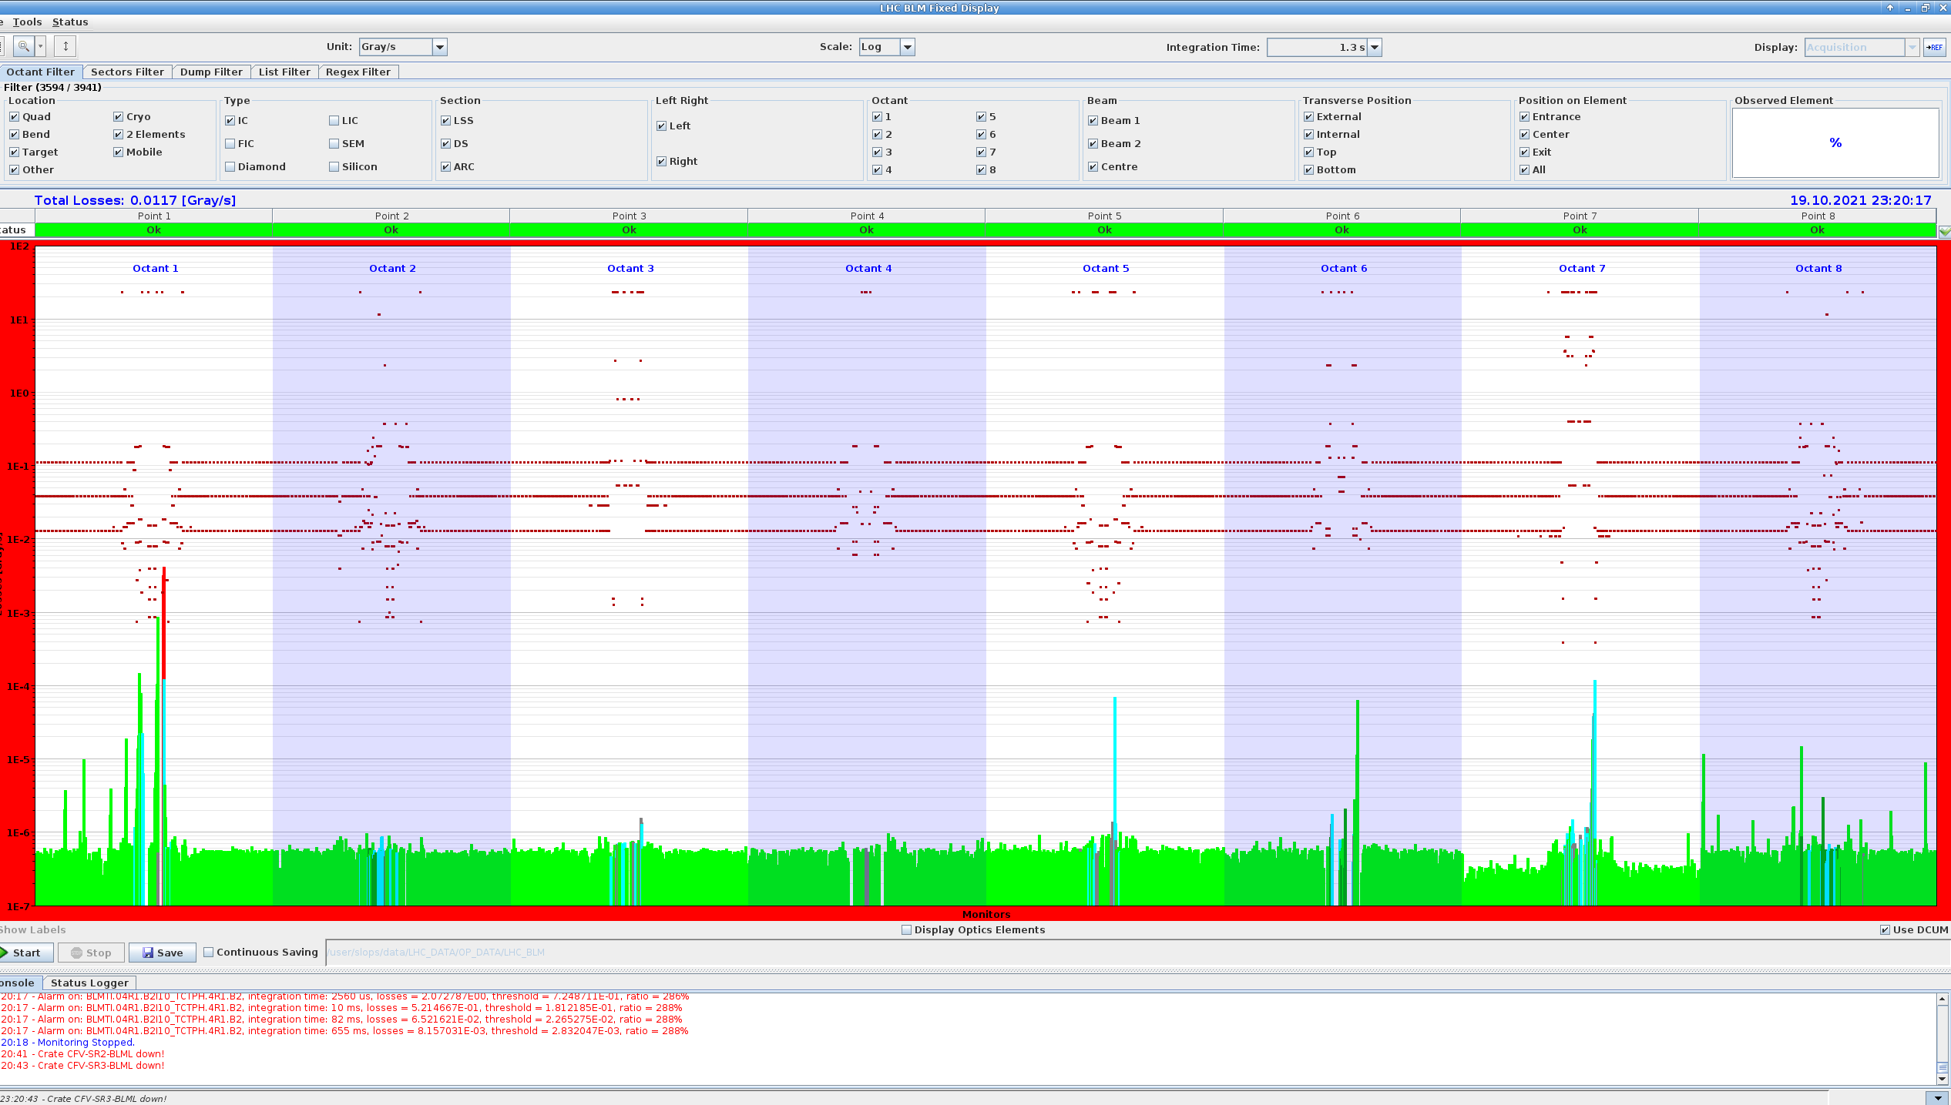
Latency tests
Selection of collimator orientation arbitrary
Same collimator type per point for B1 and B2
Most dumps from central crate, maskable channels
Triggering beam dump in IP1 with B2 in 2021

Slide 11
Summary
During the commissioning phase, the LHC BLM system must pass a list of tests divided in three groups, normally performed in this order:
Hardware commissioning
  Info of new installations on LAYOUT and LSA DB, driven to BLM crates
  BLM team doing last checks until tomorrow, everything looks OK, no blocking issues
2. Machine checkout
  3 tests without beam to be done in the CCC -> Needing ~1 hour
3. Tests with beam
  Latency tests to be run during commissioning, normally by OP
  Blinding functionality test procedure to be agreed with ABT and scheduled
  Scraping for BLM calibration scheduled for early May

