Slide 1

Awake CSCP Meeting #14 Simplified Layout and Integration
Frédéric Galleazzi EN/ACE/INT
02/07/2025

Slide 2
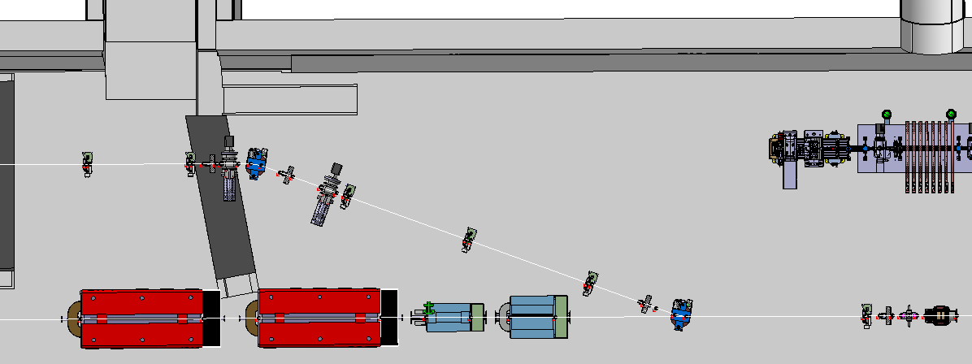
Awake Run 2C – New Beam Lines
Proton Beam Line : TT41
REMINDER
TSG42
TT450 – 450000-450100
e- Source 2
TT450
e- Beam Line
TT450 – 450100-412349
Nicolas is working on the Modification
TT41
Proton Beam Line
TT41
Proton Beam Line

Slide 3
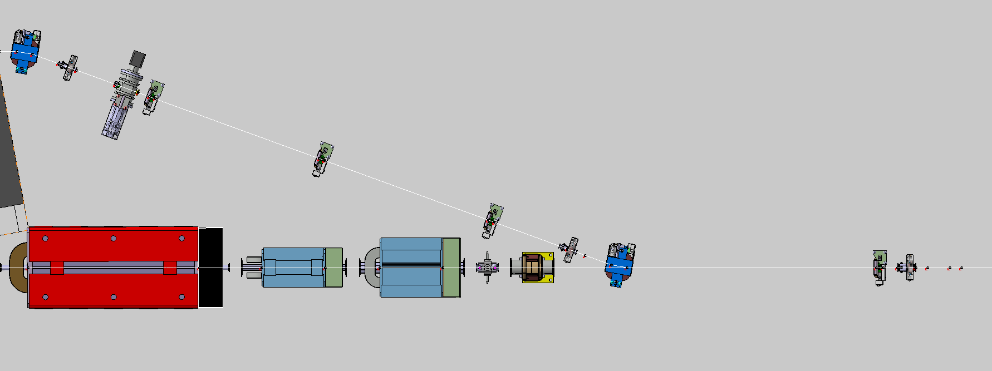
Awake Run 2C – New Beam Lines
Proton Beam Line - Electron Beam Line 18 MeV : TT41 – TT450
TT450 – 450100-412349
TT450
e- Beam Line
TT41
Proton Beam Line
TT41
Proton Beam Line
BPM and BCTF
New Positions

Slide 4
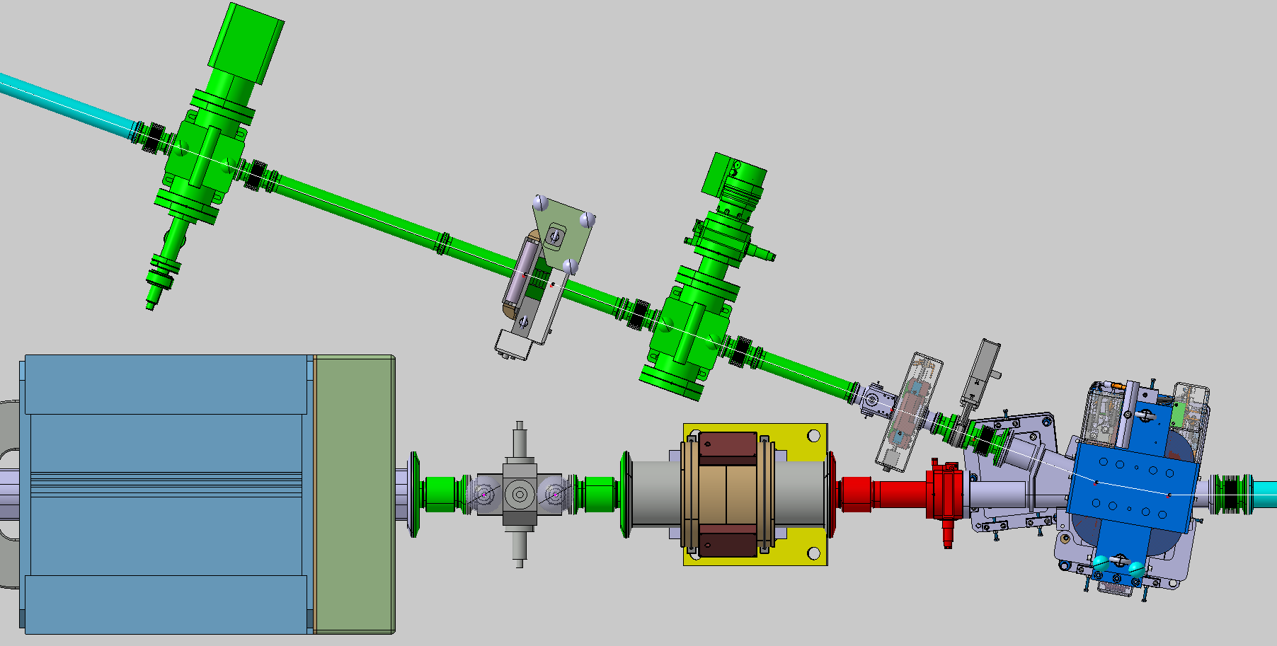
Awake Run 2C – New Beam Lines
Proton Beam Line - Electron Beam Line 18 MeV : TT41 – TT450 (with Vacuum Layout)
TT450
MQAWF 450155
BPM 450164
MCAWA 450165
TT41
MDSH 412344
BPM 412347
BCTF 412348
MBAWH 412349

Slide 5
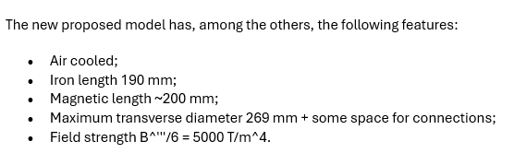
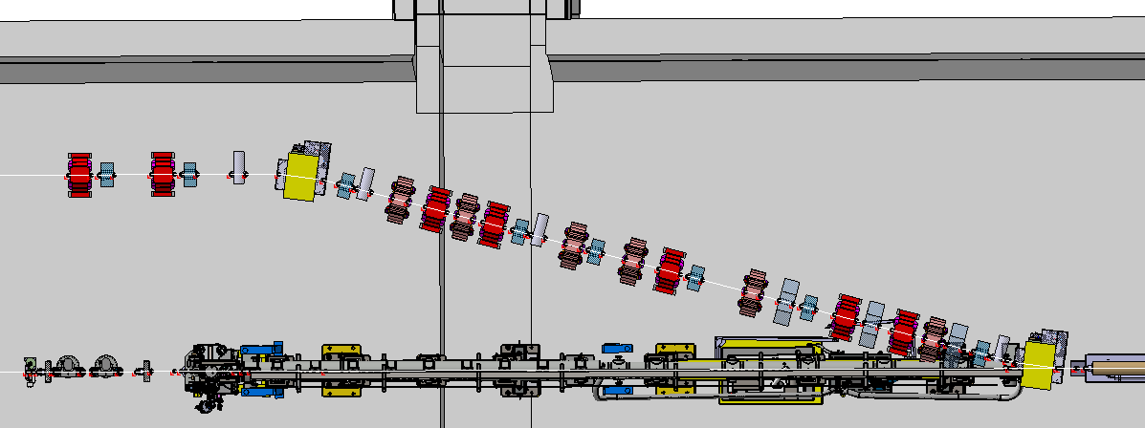
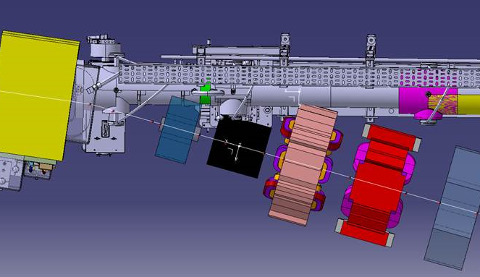
Awake Run 2C – New Beam Lines
Proton Beam Line - Electron Beam Line 150 MeV : TT41 – TT451
REMINDER
TSG43
TT451 – Part 1
I need to work on the beam line
3D Model to be updated – Last news
TT451 – Part 2
TT451
e- Beam Line
TT41
Proton Beam Line
Plasma-Cell 1
Plasma-Cell 2

Slide 6
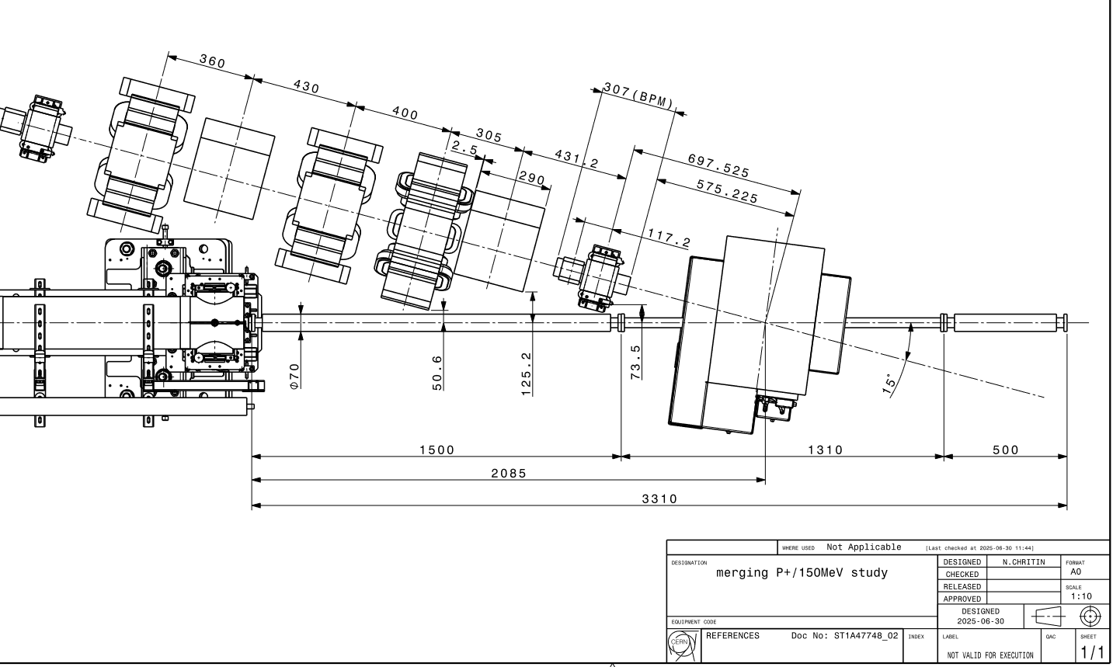
Awake Run 2C – New Beam Lines
Proton Beam Line - Electron Beam Line 150 MeV : TT41 – TT451
Meeting last Friday
New Proposition for this Area
Study on going…

Slide 7
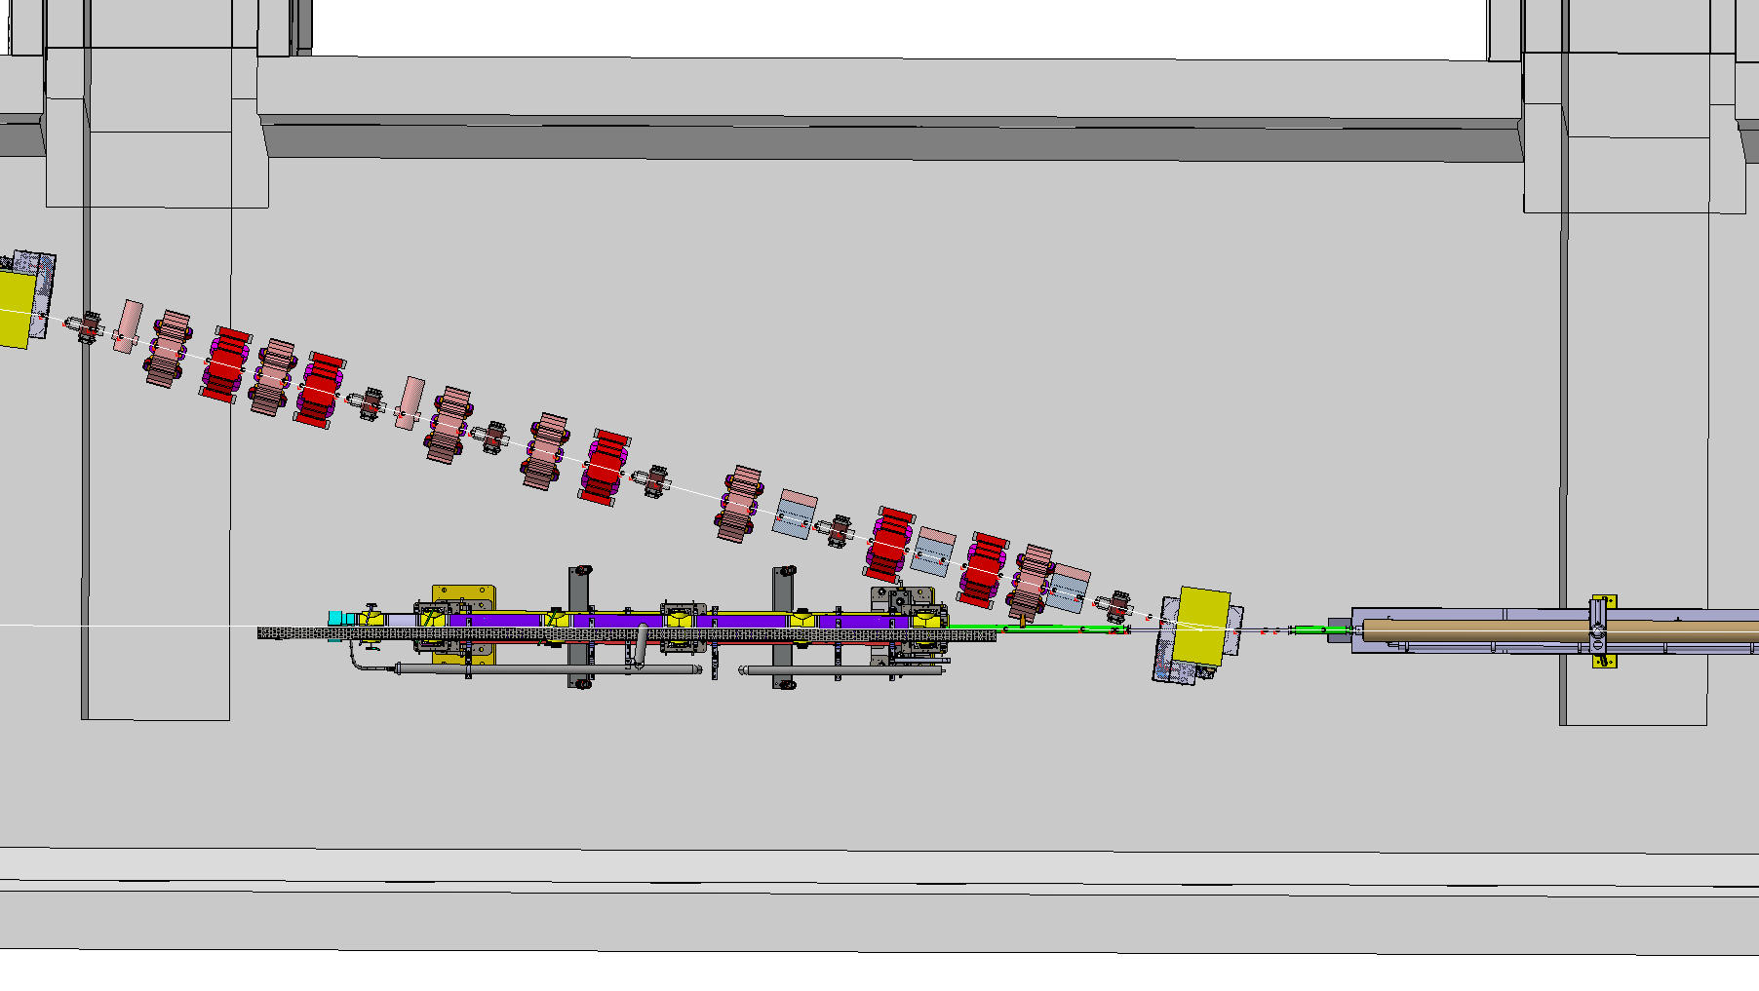
Awake Run 2C – New Beam Lines
Proton Beam Line - Electron Beam Line 150 MeV : TT41 – TT451
TT451 – Part 2
TT451
e- Beam Line
TT41
Proton Beam Line
Plasma-Cell 1
Plasma-Cell 2

Slide 8
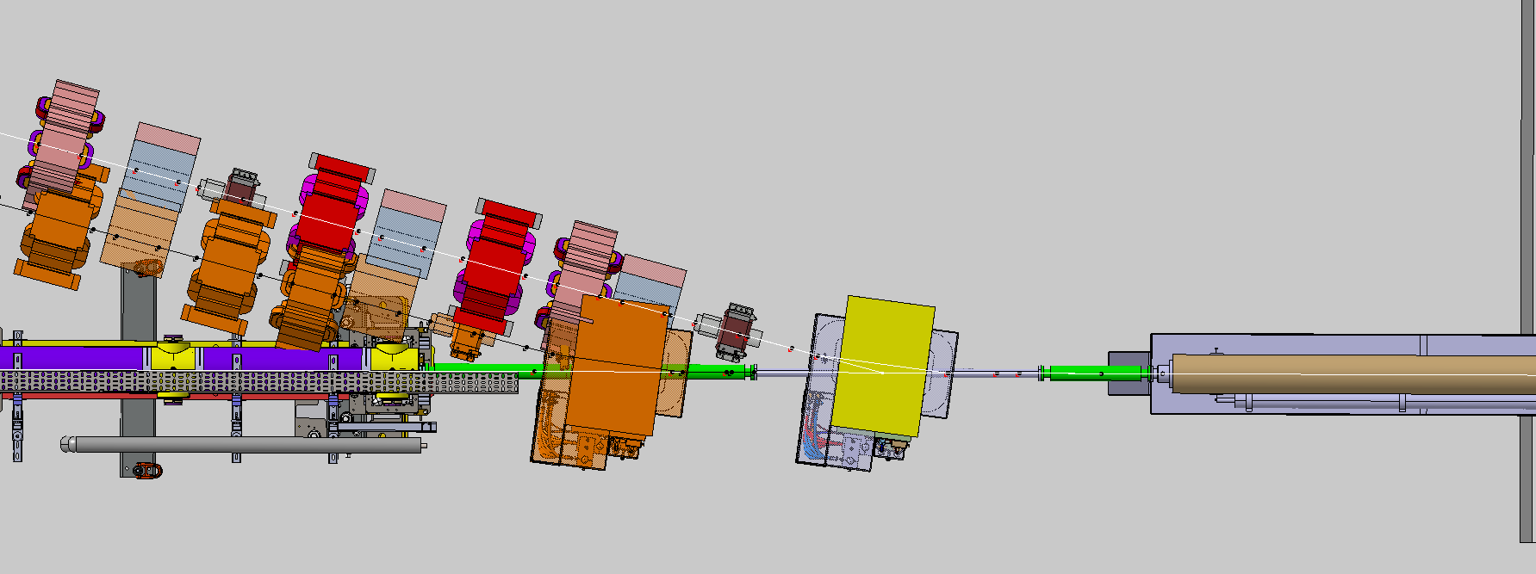
Awake Run 2C – New Beam Lines
Proton Beam Line - Electron Beam Line 150 MeV : TT41 – TT451
TT451
e- Beam Line
New Position
(proposition)
Current Position
(orange)
Plasma-Cell 2
TT41
Proton Beam Line
Plasma-Cell 1
TT451
Shifted by 1210 mm

Slide 9
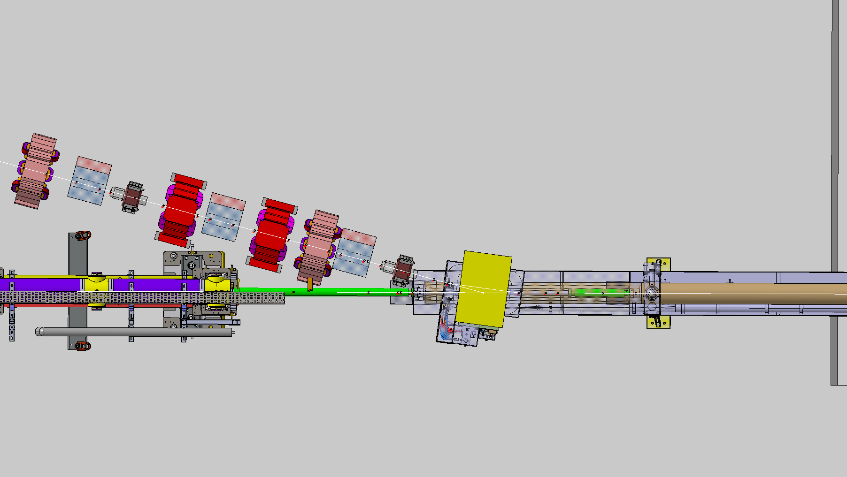
Awake Run 2C – New Beam Lines
Proton Beam Line - Electron Beam Line 150 MeV : TT41 – TT451
Plasma-Cell 2
TT451
e- Beam Line
Current Position
(start point)
New Position
(start point)
TT41
Proton Beam Line
Plasma-Cell 1
Plasma Cell 2
Shifted by 1810 mm

Slide 10
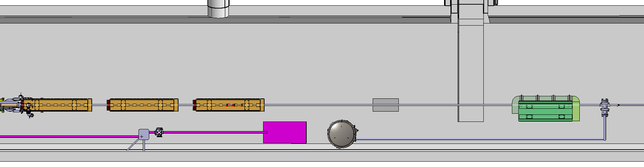
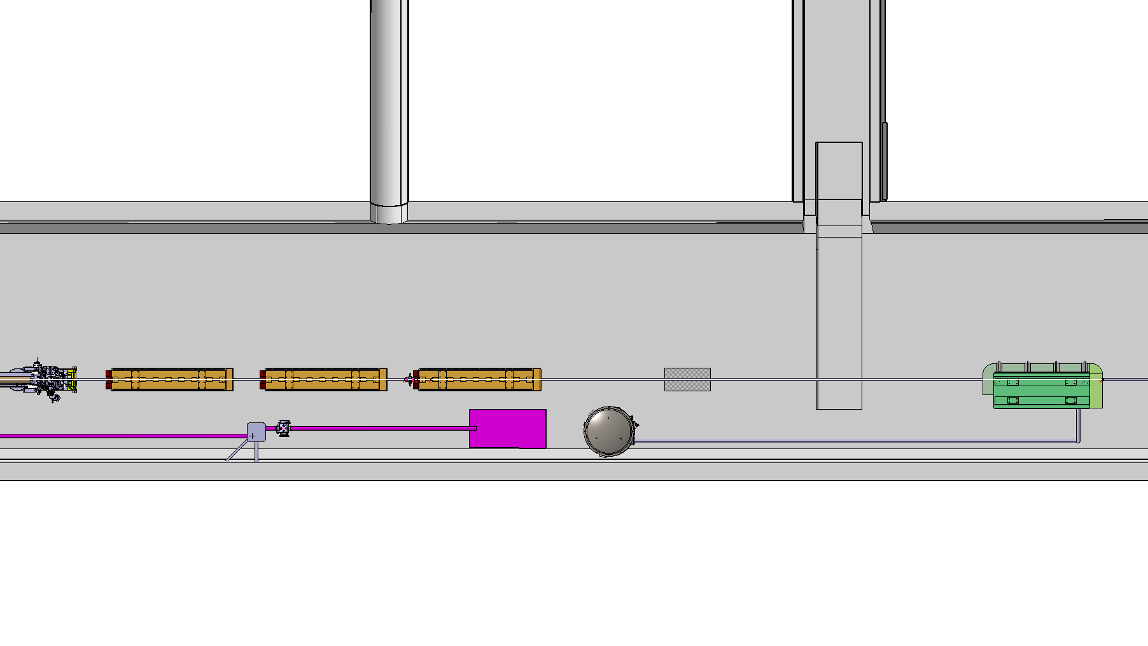
Awake Run 2C – New Beam Lines
Proton Beam Line - Electron Beam Line 150 MeV : TT41 – TT451
Experimental Area : Current Position
TSG 45
TT41
Proton Beam Line
Laser Beam Line
Experimental Area : New Position
TT41
Proton Beam Line
Shifted by 1810 mm
Laser Beam Line

Slide 11
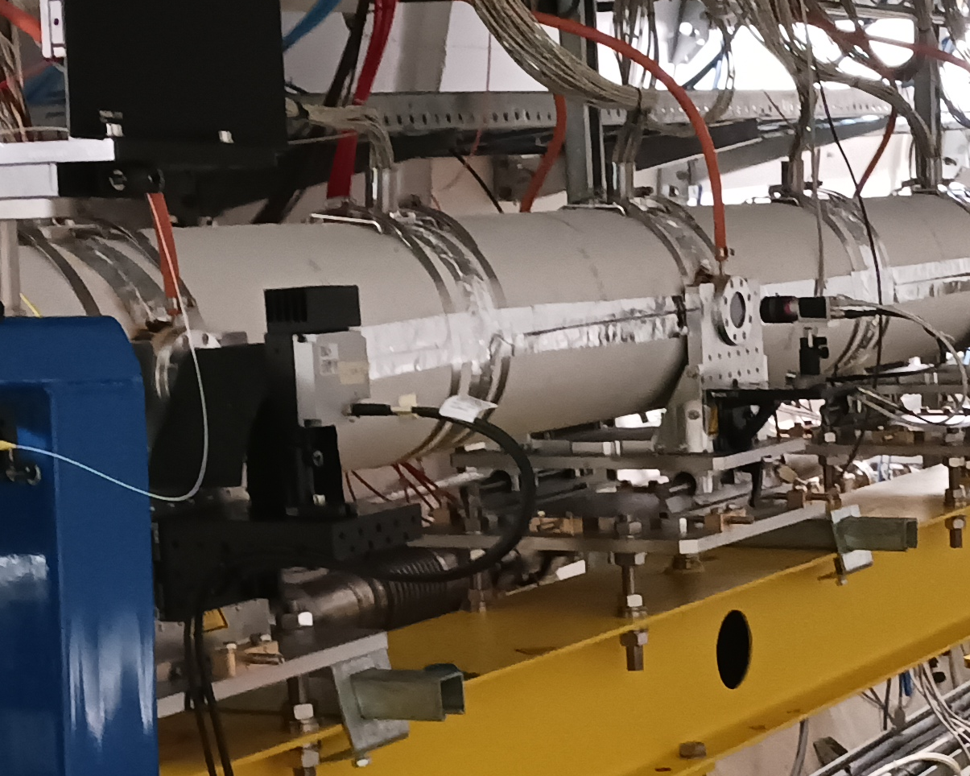
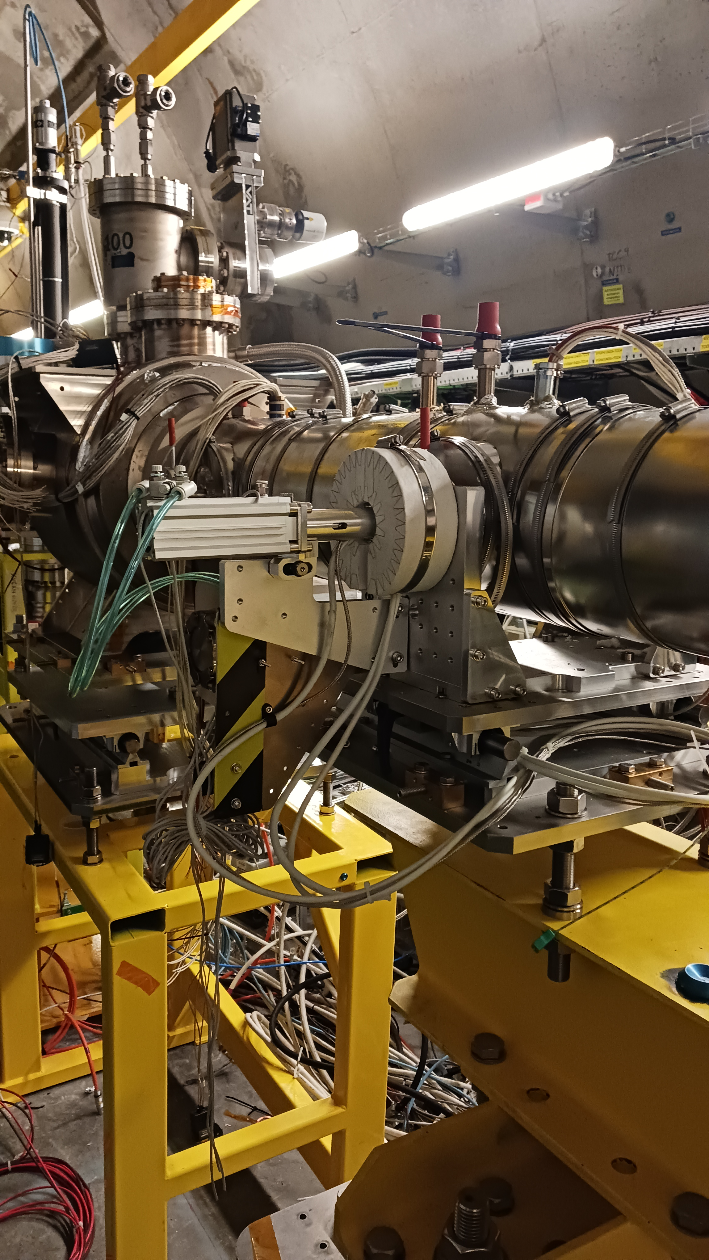
Awake Run 2C – New Beam Lines
Proton Beam Line - Electron Beam Line 150 MeV : TT41 – TT451
TT451
e- Beam Line
Plasma-Cell 2
Plasma-Cell 1
TT41 Proton Beam Line
Equipment fixed on Plasma Cell ?

Slide 12
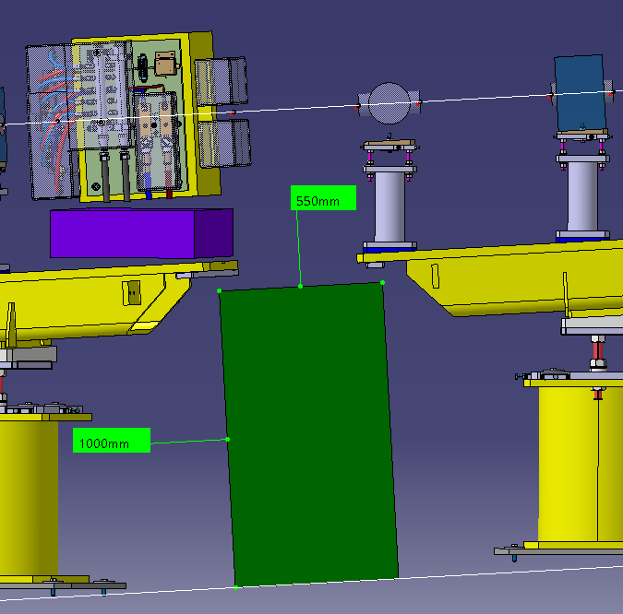
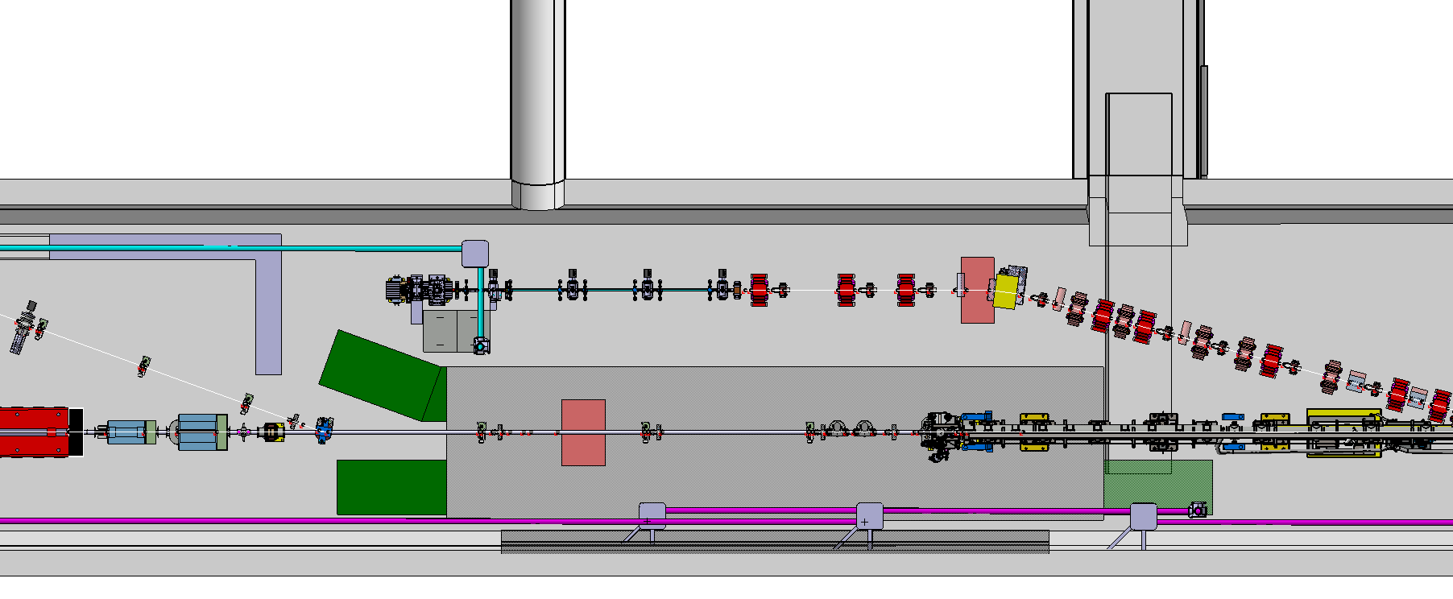
Awake Run 2C – Shielding in TCC4
TCC4 – New Shielding and Access :
500
Free Passage for Small Trolley (below e- beam line)
TSG43
1000
TCC4
TCC4
Access Ramp Lev. +200
e- 18 MeV Beam Line
e- 150 MeV Beam Line (15 °)
Shielding on Ground
(Level +200)
TT41 Proton Beam Line
2nd Access Ramp Lev. +200
Free Passage for Trolley (below e- beam line)
3rd Access Ramp
Lev. +200 (if necessary)

Slide 13
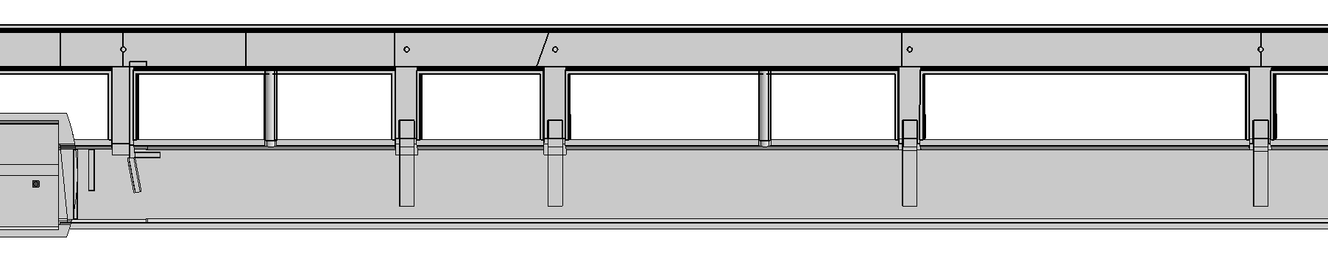
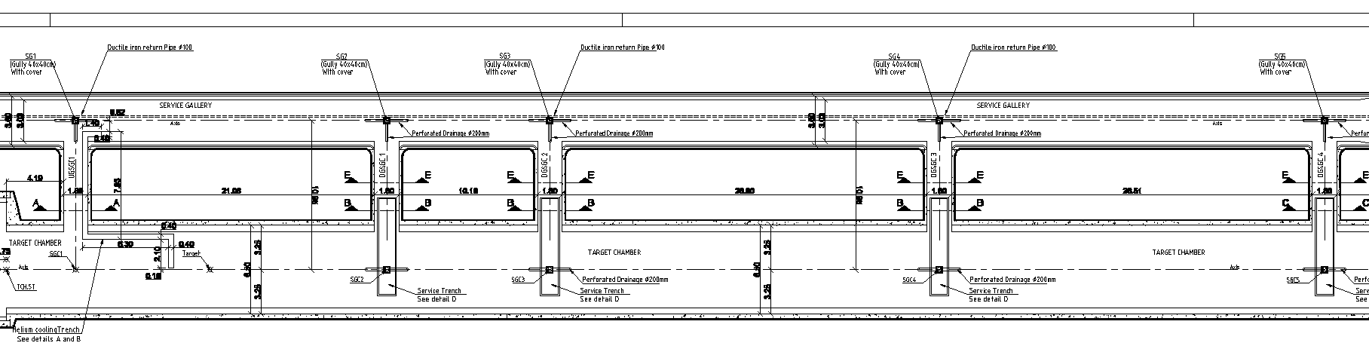
Awake Run 2C – TCC4
TCC4 Cavern : Civil Engineering 3D Model and Drawings

Slide 14
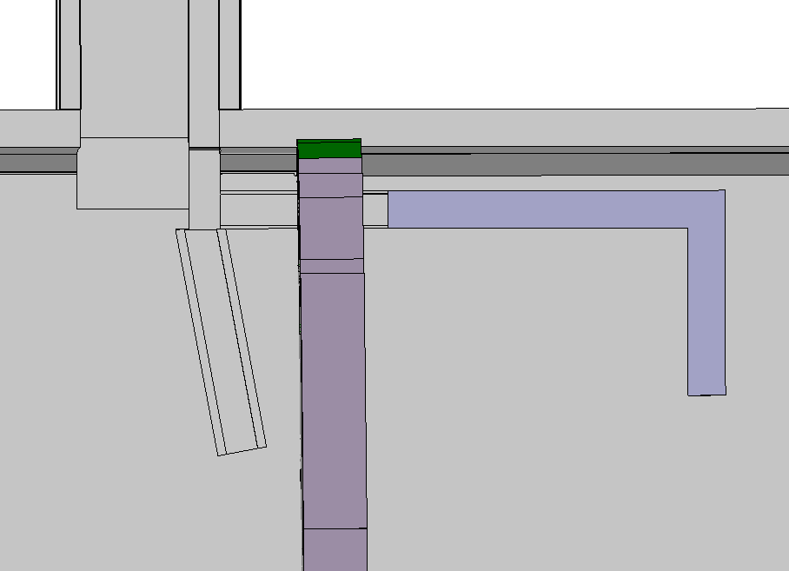
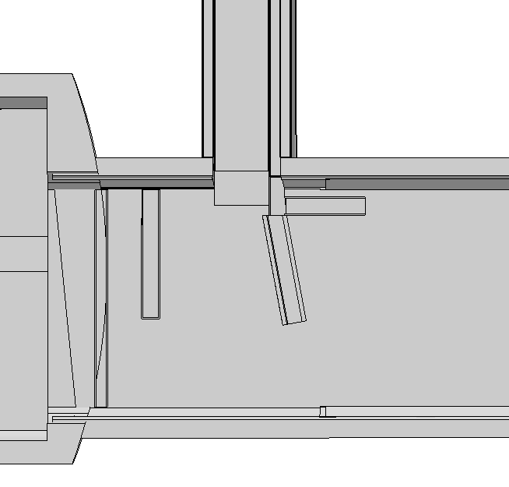
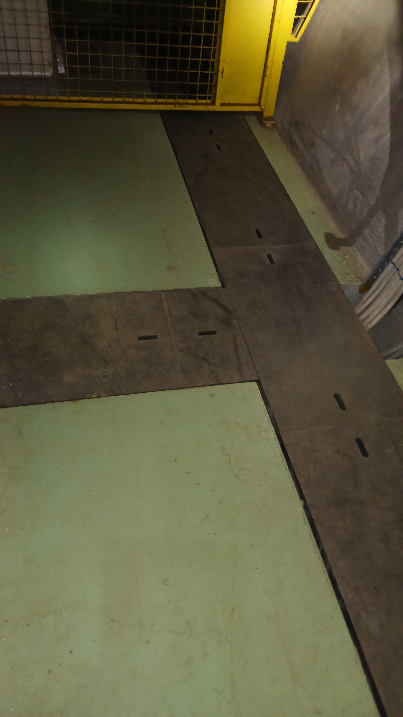
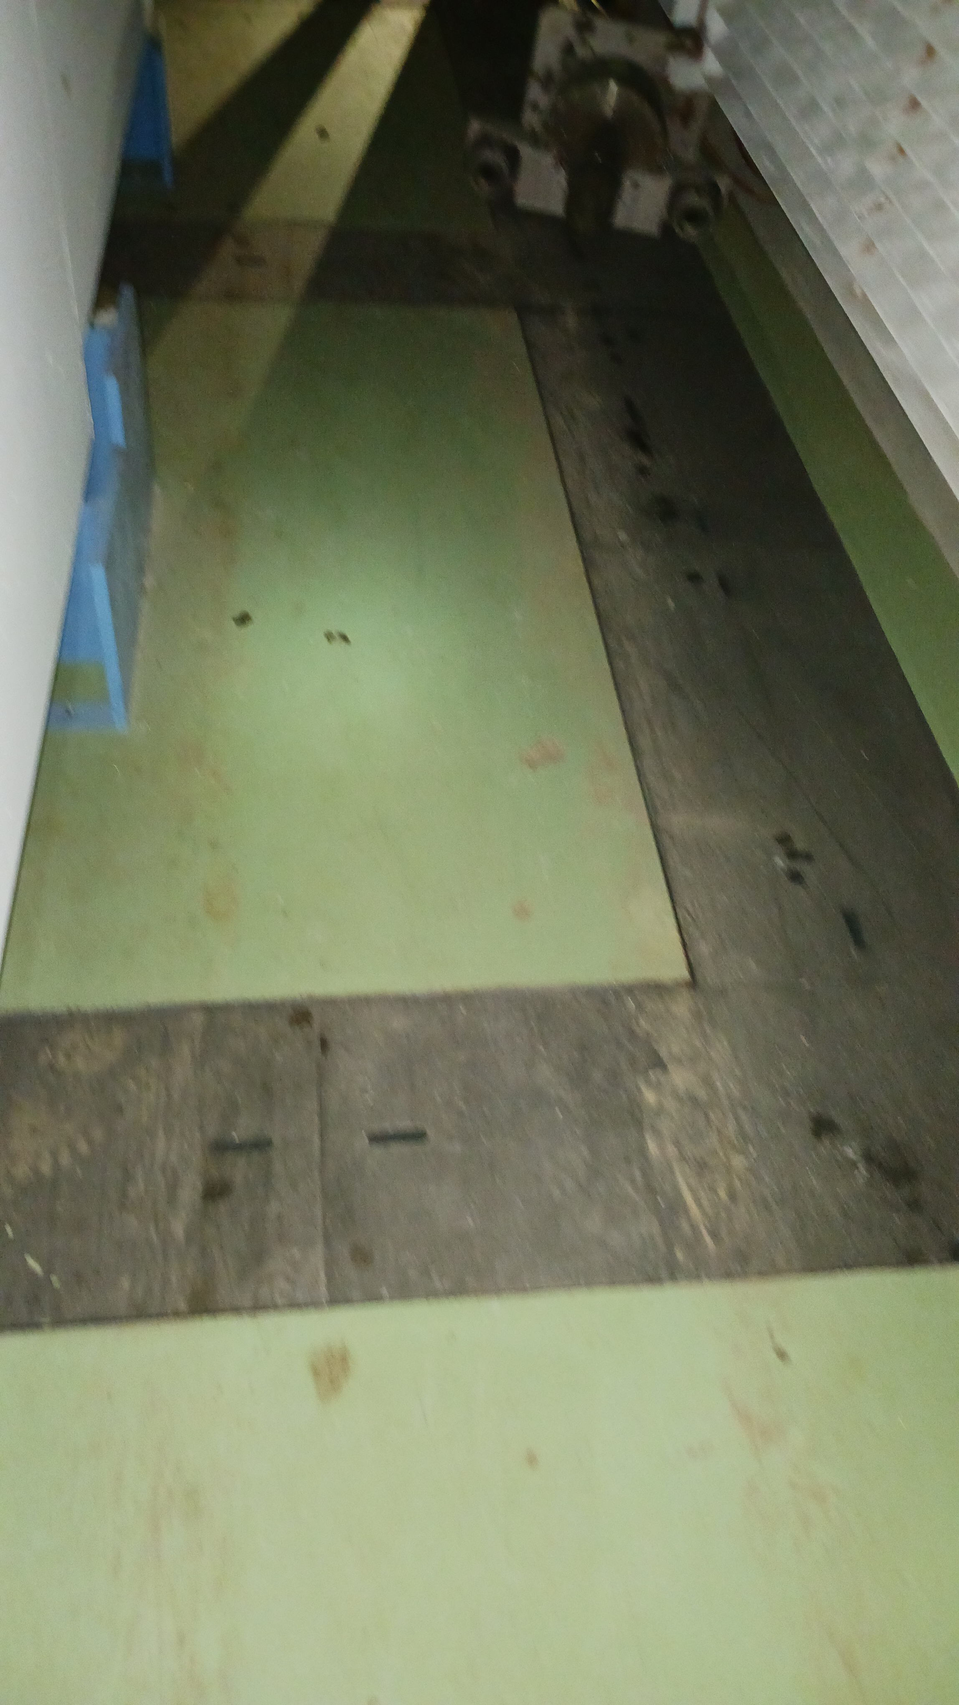
Awake Run 2C – TCC4
TCC4 Cavern : Civil Engineering 3D Model and Drawings
Missing Part
in the model
In the cavern…

Slide 15
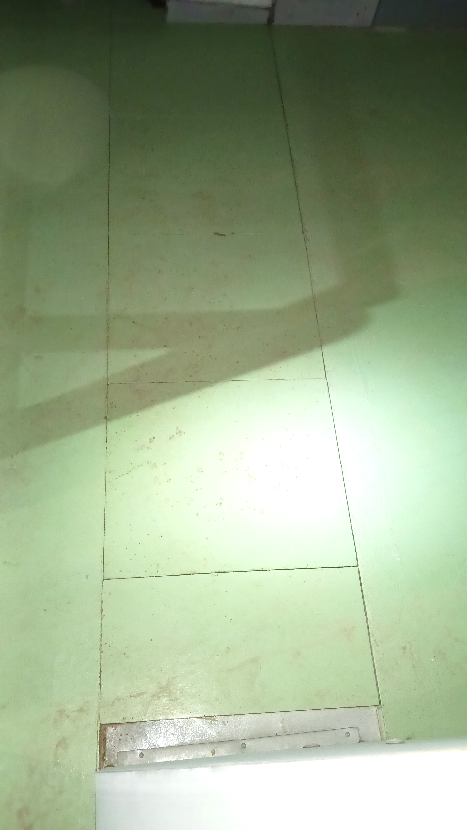
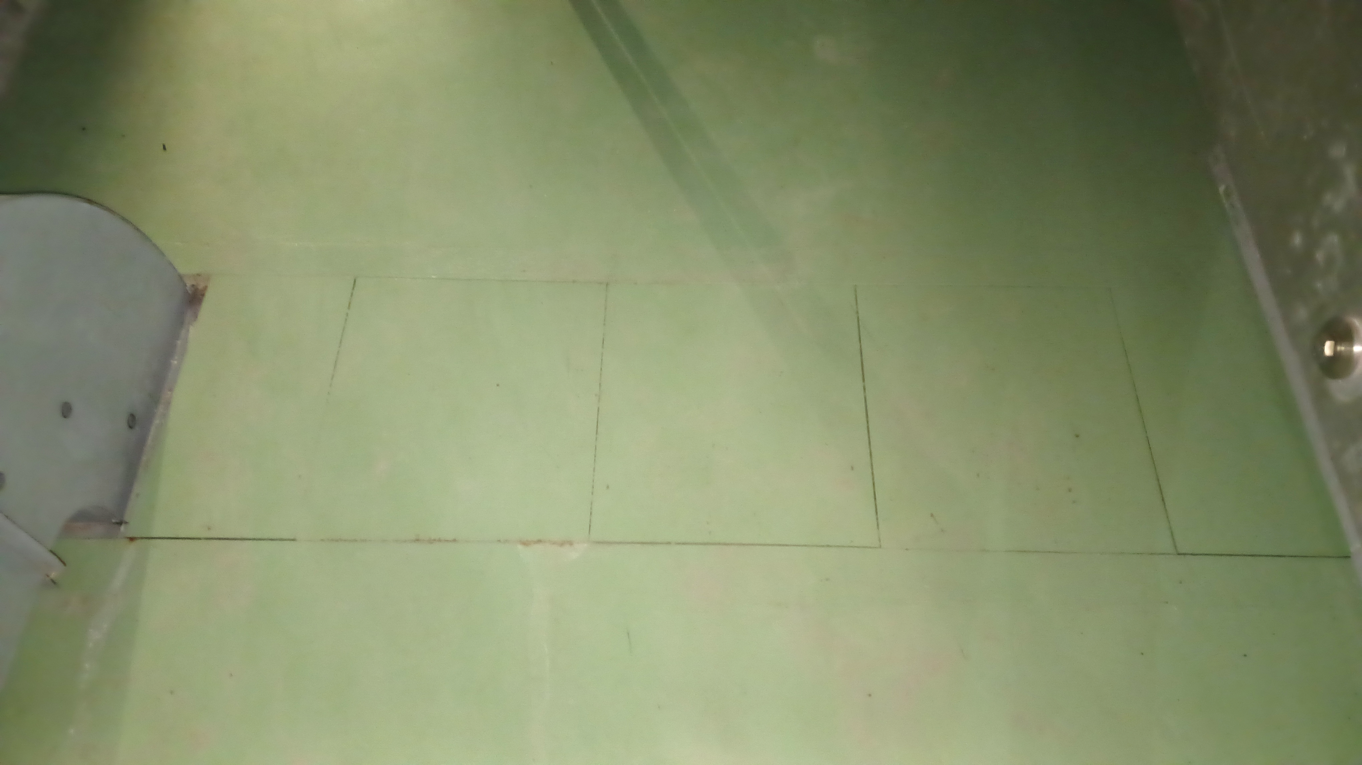
Awake Run 2C – TCC4
TCC4 Cavern : Civil Engineering 3D Model and Drawings
In the cavern…
TSG 43
TSG 44

Slide 16
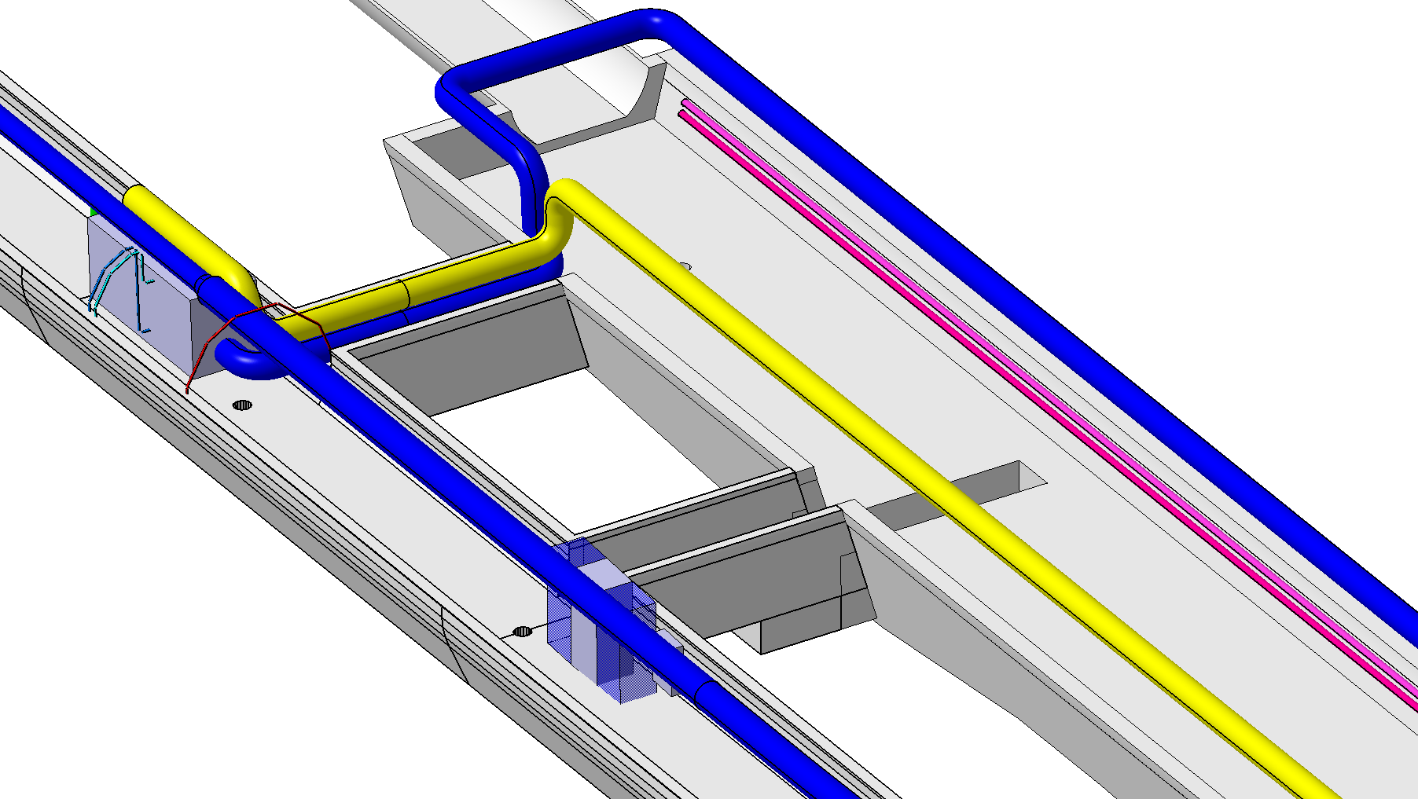
Awake Run 2C – EN-CV 3D Models
TSG4 :
References of EN-CV 3D Models :
TCV4 : ST1A49200_01
TCC4 : ST1A49286_01
TSG4 : ST1A51510_01

Slide 17
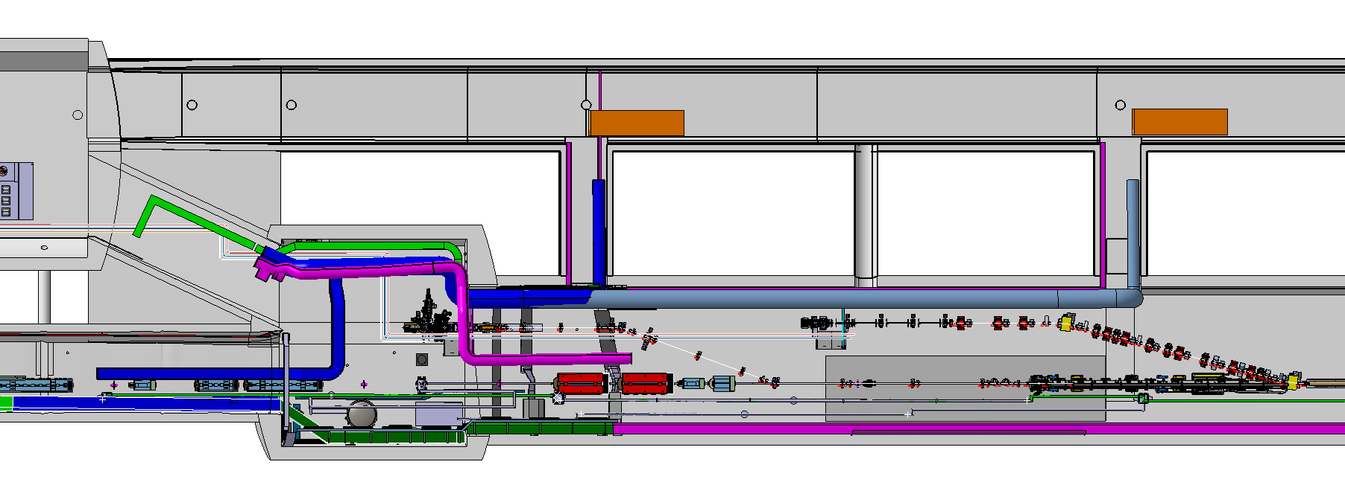
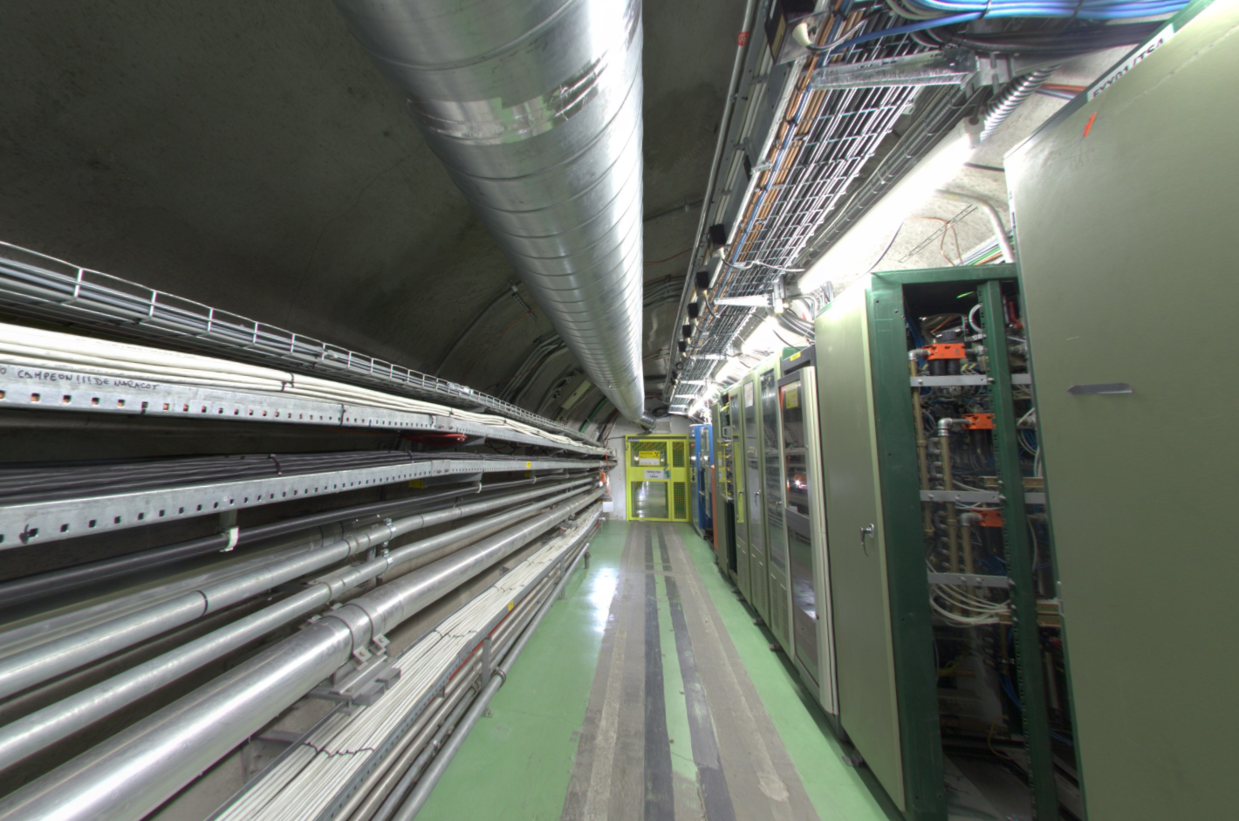
Awake Run 2C – Ventilation
TCC4-TSG4 : Ventilation
REMINDER
New Routing ?
TSG4
TSG42
TSG43
TCC4
Existing Ventilation Duct
Modification requested
No Space for Additional Ventilation Duct…

Slide 18
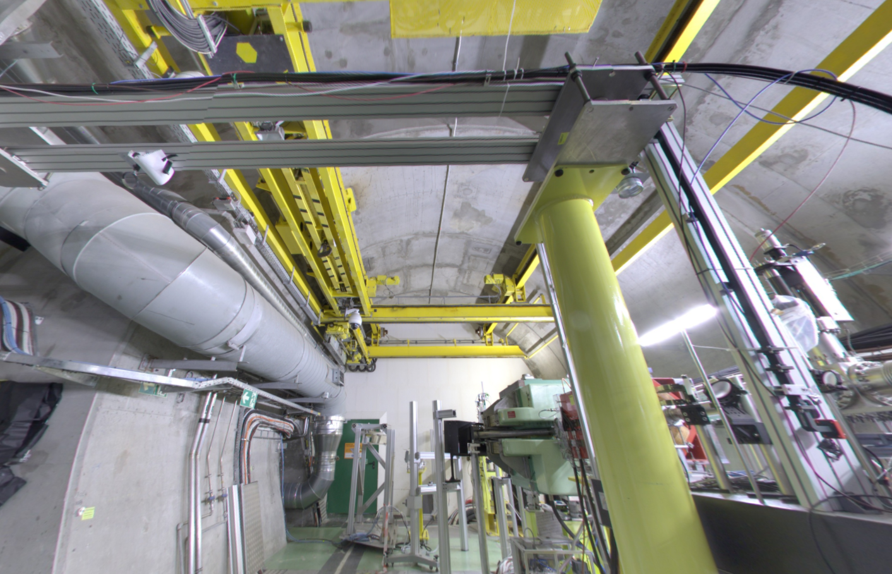
Awake Run 2C – Ventilation
TCC4-TSG4 : Ventilation
TSG4
TSG42
TSG43
TCC4
Existing Ventilation Duct
Modification requested
New Routing ?

