Slide 1


H8 users meeting
M. van Dijk, L. Nevay
Date: 02.04.2025

Slide 2
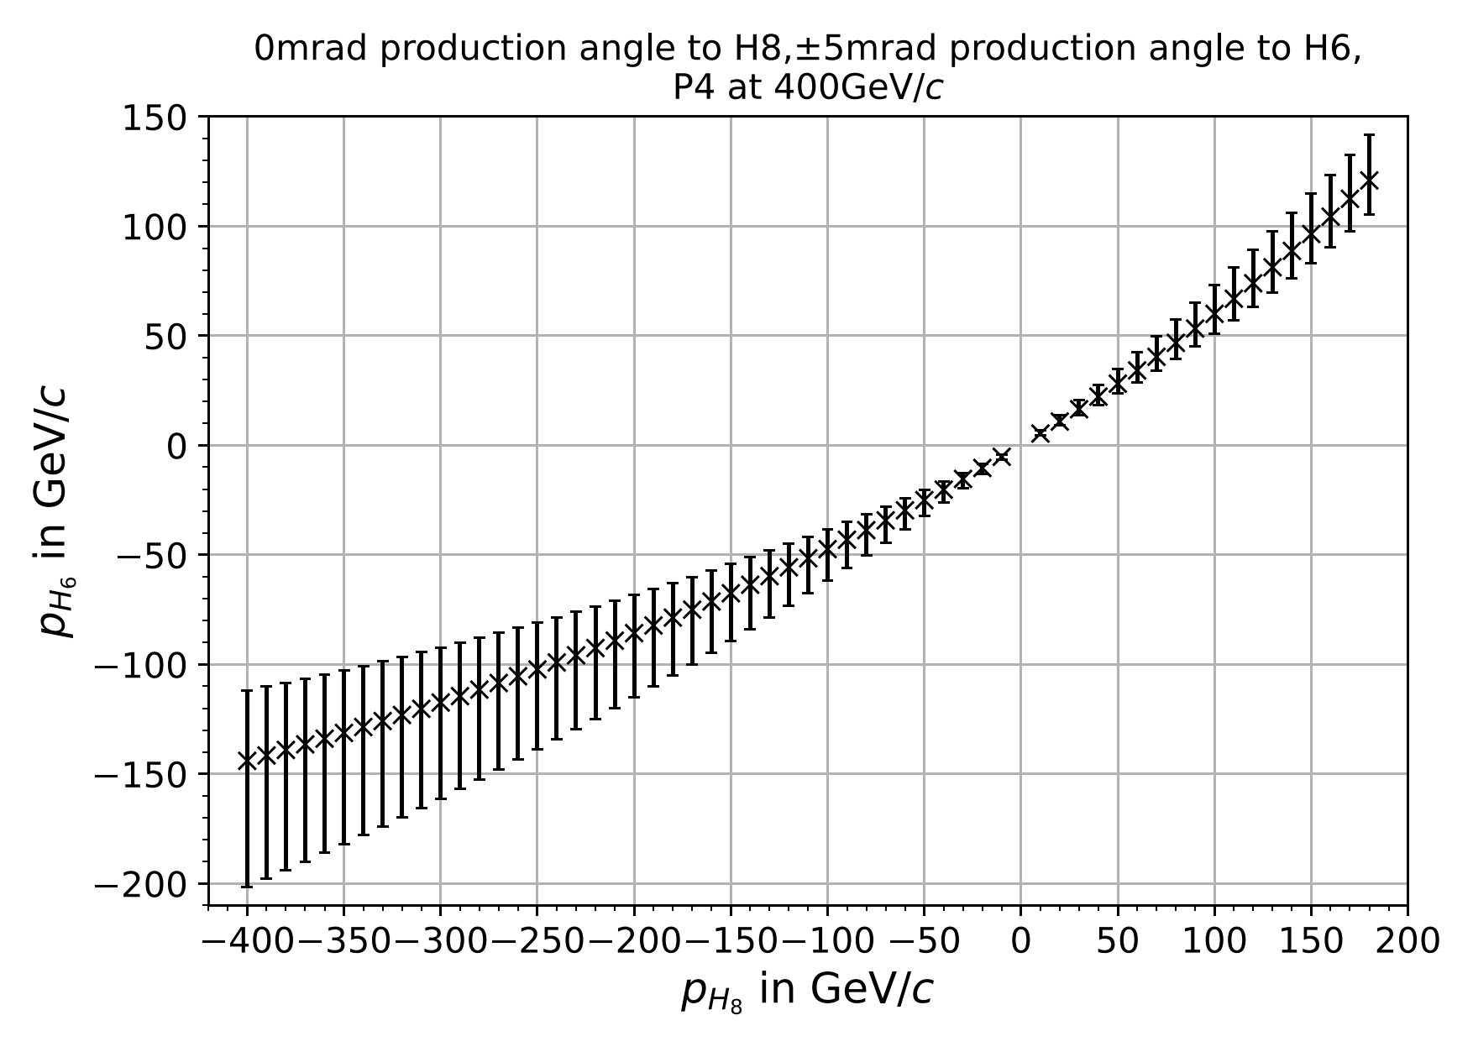
H8 beam: the wobbling configuration
  SPS protons hit the T4 target; most protons go through to NA62
  A dipole magnet after the target separates out secondary particles
  H6 and H8 are strongly correlated in momentum
    Width of line in H6 not an error bar but flexibility of H6
“TAX”
absorber
Dipole
Magnet
(“Wobbling”)
H6
Target
H8
400 GeV/c
protons
P42 ➞ NA62

Slide 3
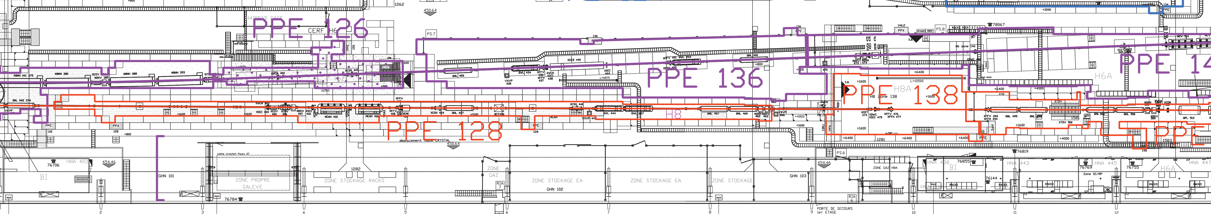
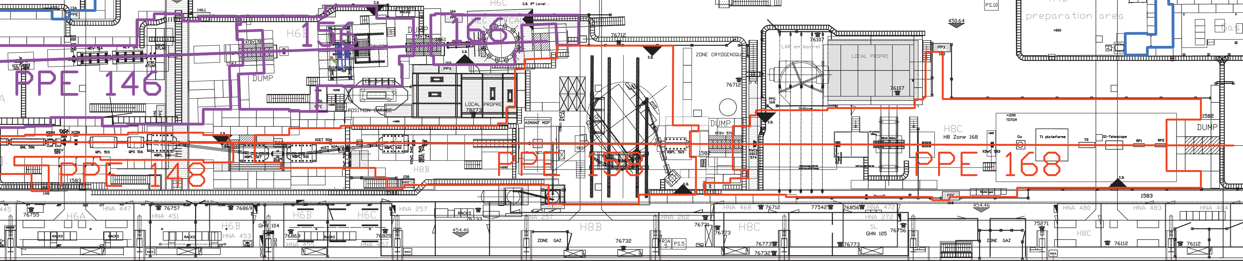
Layout of the areas
H8Z
H8A
H8B
H8C

Slide 4
H8 General Information
Beam originates from the T4 target, shared with the H6 and P42 beamlines
  Magnetic spectrometers with maximum δp/p : 0.1 - 1.5% (not for muons)
    Momentum selection, not particle species selection
Normal beam for H8 is +180 GeV/c hadrons, secondary beam derived from T4
  In case your request requires a special wobbling: No wobbling change on the weekend, not too often!
  Beam made to fit reasonably to all users (focusing on main, then parallel, and parasitic if somewhat possible)
  Available momenta in secondary beam range from -350 to +180 GeV/c
      Rates at detector are adjustable, from ~hundreds up to ~5 10⁶ per spill (RP and other limitations will apply)
      Any lower energy accessible as “tertiary” beam (few 10³ up to a few 10⁴) using another target further downstream
      Configurable for electrons (positrons, usually) and hadrons
  Tertiary muons (low rate) – available as dedicated beam (160 GeV/c) or behind one of the beam stoppers
  400 GeV/c protons only available under very special conditions (no beam possible for NA62)
Spill duration: flat-top ~4.8s, 1-2 spills / supercycle (~1000-3000/day at full availability)

Slide 5
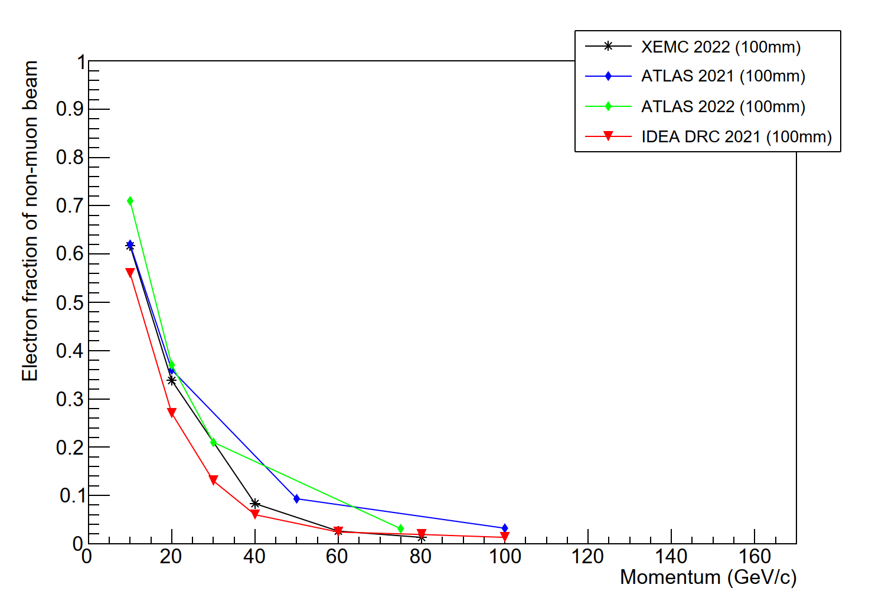
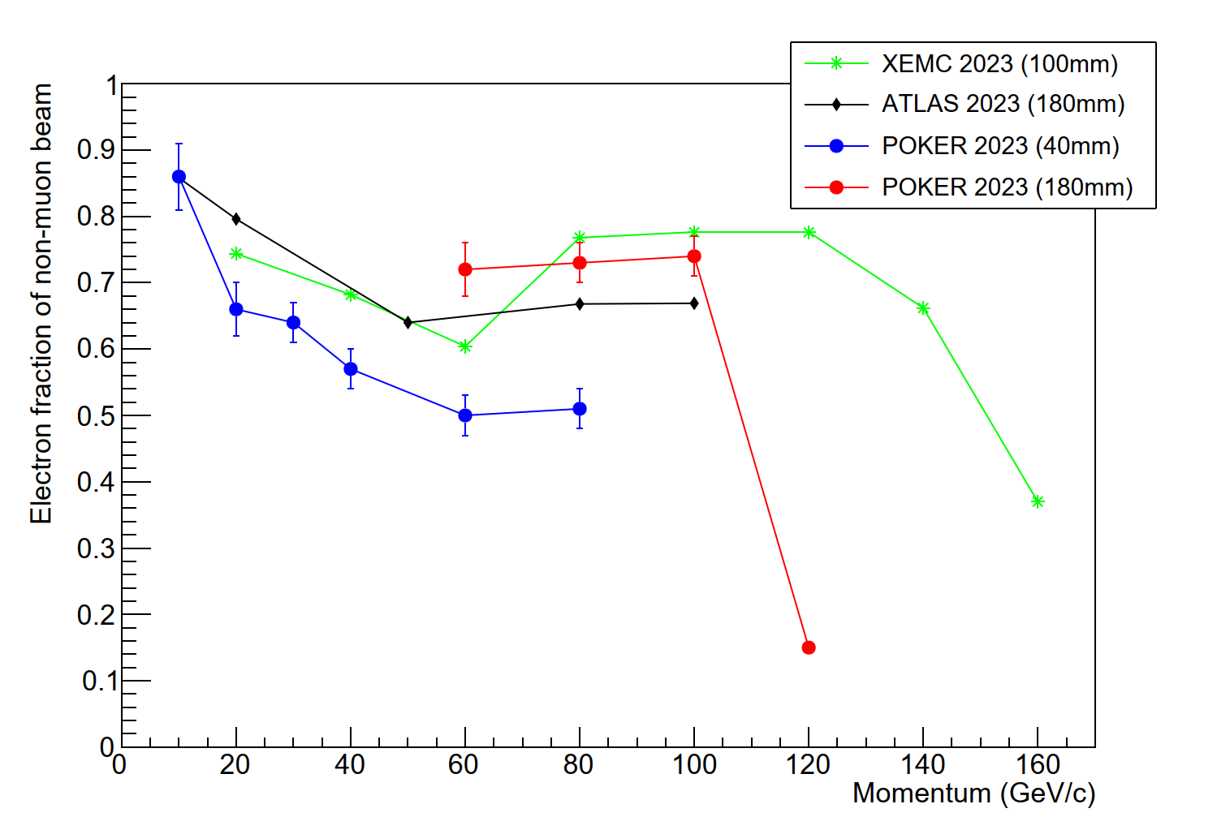
H8 positive electron beams
Many more relevant details here, but: electron beams have been restored to H8 following an issue with an upstream vacuum chamber
  Shown by a number of users (many present today), thank you again!!
  Beams shown here all derived from +180 GeV/c secondary beam
Notable feature: muons are an important part of the electron beam!
  Decays of upstream pions lead to muons, due to decay kinematics these start around 57% of the energy of the secondary beam
  If you would like to have electrons above 100 GeV/c, consider strongly to bring a muon veto!

Slide 6
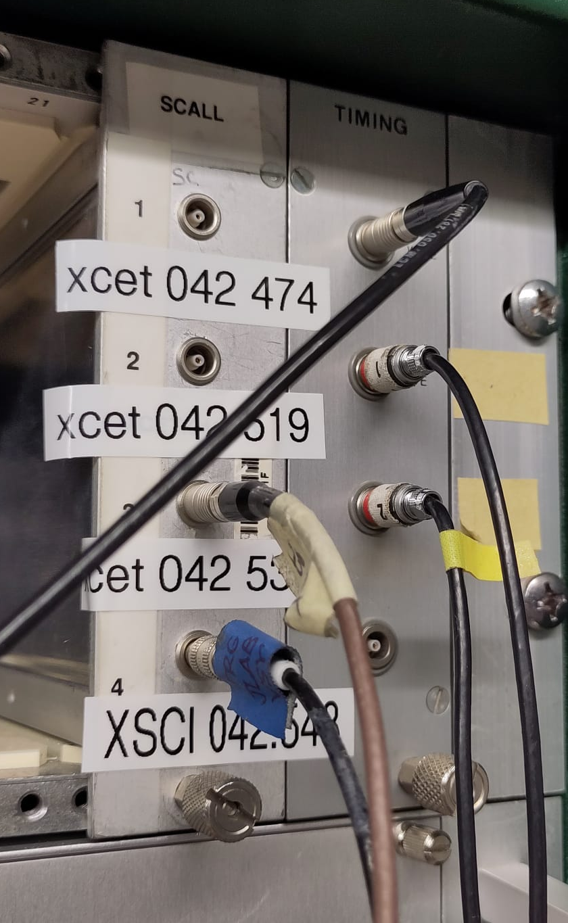
Signals and stuff
Scalers
(ignore labels!)
Beam warnings
Users can provide a NIM-standard signal of 20-30ns (or so)
  Usually a scintillator trigger at front of setup
  Detected, recorded and displayed in CESAR, so-called scalers
  Providing such a signal in particular for small detectors
  makes finding your setup a LOT easier
Beam detector signals can also be made available to users (direct analog or digitized with delay) – request in advance!
Beam warning signals available in most control rooms
  2 μs TTL signals, adjusted to SPS supercycle timing
  WWE (warning warning extraction): typically ~1s before particles arrive
  WE (warning extraction): typically few 10 ms before particles arrive
  EE (extraction end): at the end of extraction

Slide 7

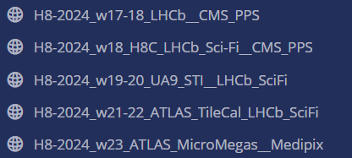
Communication & Mattermost
Please let us know your beam requirements: preferred particle type, rate, beam size, etc
  We cannot circumvent physics (though we may try) – for example we cannot make a beam tiny and perfectly parallel
  Your beam request will be taken together with that of all other simultaneous users, meetings will be made as needed
For most weeks, I will make a dedicated Mattermost channel to communicate with you
  For me (personally) it is my preferred method of communication
  Also serves as a cross-user communication channel: many problems are joint!
Click here to join sps-h8-users

Slide 8
Contact persons for H8
Beamline physicists
    Main Maarten van Dijk 166972 maarten.van.dijk@cern.ch
    Deputy Laurie Nevay 167401 laurie.nevay@cern.ch
General beamline support (see also later presentation)
    Bastien Rae 167388 bastien.rae@cern.ch
      CESAR training, patrol rights training, beam control, file loading, beam tuning …..
In case we are all away: Dipanwita Banerjee, Nikolaos Charitonidis
Technical support (see also later presentation)
    Michael Lazzaroni 162407 michael.lazzaroni@cern.ch
      “I want help with transport”, “I need a special (moving) table”, “my zone has less blocks than last year and I need them”, “something is broken in the zone” …..

Slide 9

After-hours support
During work hours, contact your beamline physicist (Maarten, Laurie)
At weekends and out of hours, we have now an on-call piquet service where one of the beam physicists of our team is on call
  Can help with specialized questions
CCC SPS island is also available (24/7 shifts) 77500
  Equipment/magnetic element failure, beam got switched OFF due to RP alarms, access to the zone, …
  The operators can help you solve most issues, and can help you with some parts of the beam
Mattermost is available
  General channels on sps-h8-users (invite link)
  A separate subchannel can be made for your testbeam
  Also available for private messages (@mvandijk)
67500

Slide 10
H8 access rights & control rooms
Before coming, request rights for
relevant control room
  Use room # from table on adams.web.cern.ch
Patrol rights needed to turn on the beam
  Not needed for access to the building / zone
  Granted only after patrol training
  Coordinate this with Bastien (bastien.rae@cern.ch)
  (more than 1 week in advance!!)
For access to the building and the zone you only need a personal dosimeter and PPE
  Helmet, safety shoes, get personal dosimeter from dosimetry service
  Training needed, provided online at lms.cern.ch
    10010 (Safety at CERN)
    10350 (Radiation Protection - Supervised Area)
 | Barracks | Room # | Phone #
H8Z | HNA-451 | 0887-1-Q49 | 76757
H8A | HNA-443 | 0887-1-Q43 | 79340
H8B | HNA-257 / 262 | 0887-R-Q60 | 63145
H8C-1 | HNA-468 | 0887-1-Q70 | 76773
H8C-2 | HNA-480 / 483 / 484 | 0887-1-Q80 | 76112

Slide 11
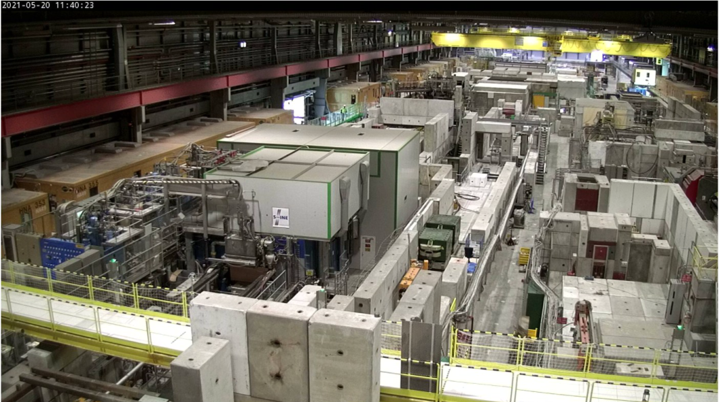
Summary
We look forward to welcoming you in H8!
Communicate with us as early as possible your worries, issues, details so that we can identify and mitigate showstoppers if any

Slide 12
Backup slides

Slide 13
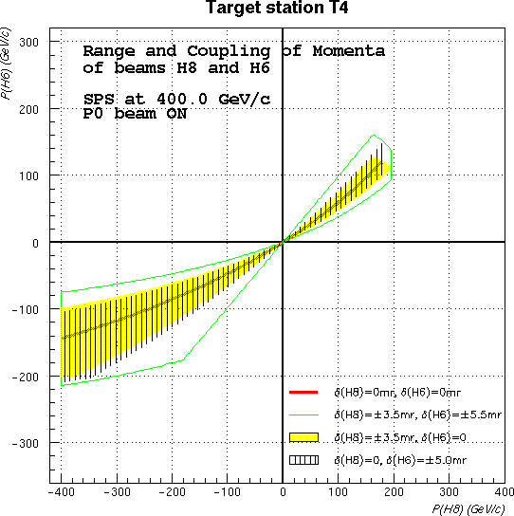
Wobbling configuration
Assumed precondition: 400 GeV/c primary beam
sent to P42 (currently housing NA62)
Table with some possible settings

Slide 14
Beam line & machine limitations
H6, H8 and P42 share the same target
    In general strong coupling between the momenta of H6 and H8
    Standard setting: +180 GeV/c in H8 and +120 GeV/c in H6.
    This is the reason we need to know in advance your schedule and discuss !
    → Not everything will be known in detail today – please get in touch 2-3 weeks before your beamtime!
Moreover :
  SPS machine has its own limitations, MD’s, Q-ripples etc → May have some impact on your beam quality
    Especially for primary beams.
  Proton content and spot size in low momenta (<30 GeV) beams is small (15%) and big (10 cm ) in both planes
    Not many things to be done (physics boundaries).
However : Many times many workarounds can be found, and many possibilities exist. Keep us involved and informed in your experiment !

