Slide 1
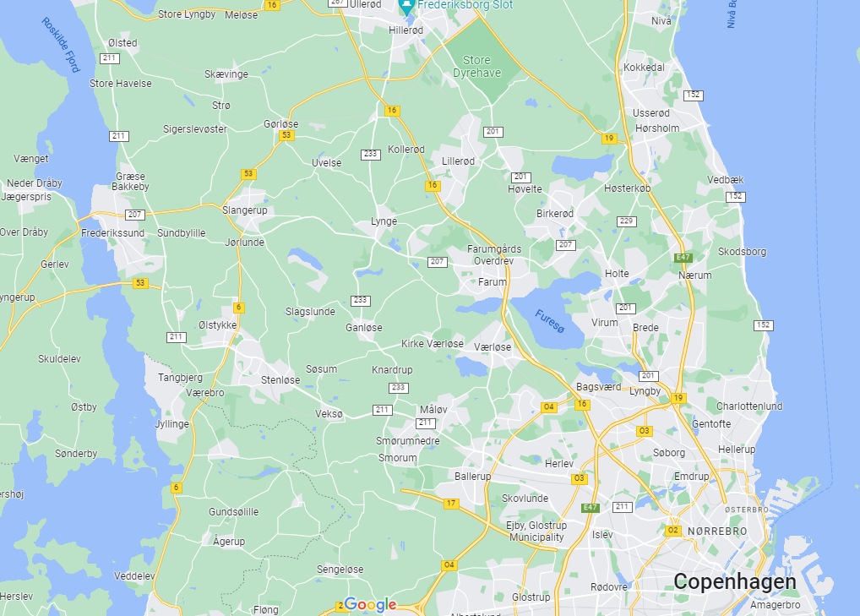


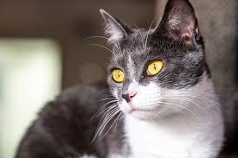

Background
Married, 2 Children
2 Cats
And a horse

Slide 2

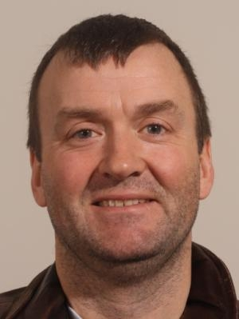



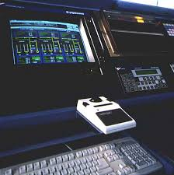
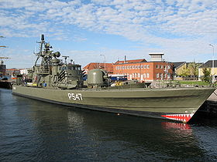
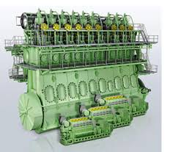
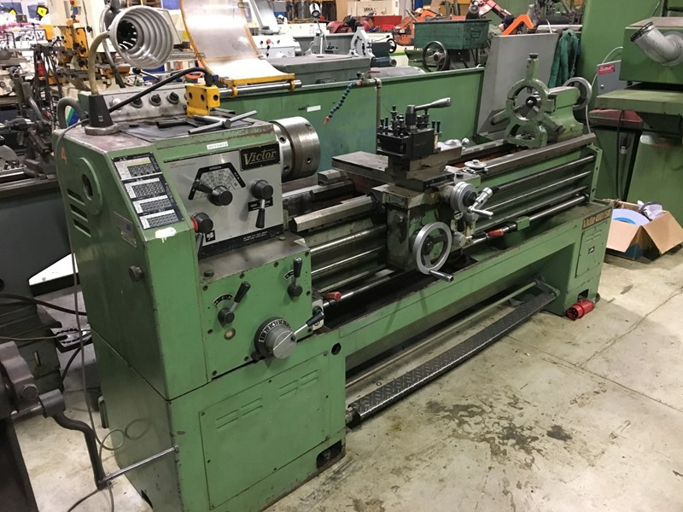
Erhvervs grunduddannelse (EFG)
Maskinmester Skole
Lyngsø Marine
CERN
Søværnet (Maskinarbejder)
Henrik
Nissen
Image credit: Henrik Nissen
Folkeskole10 Klasse

Slide 3
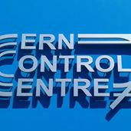
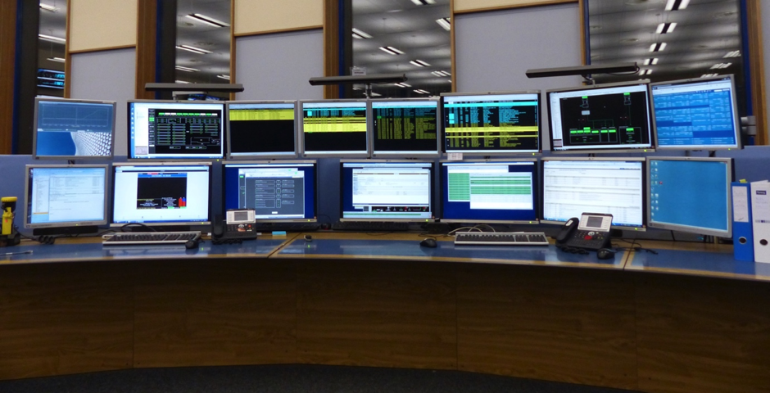

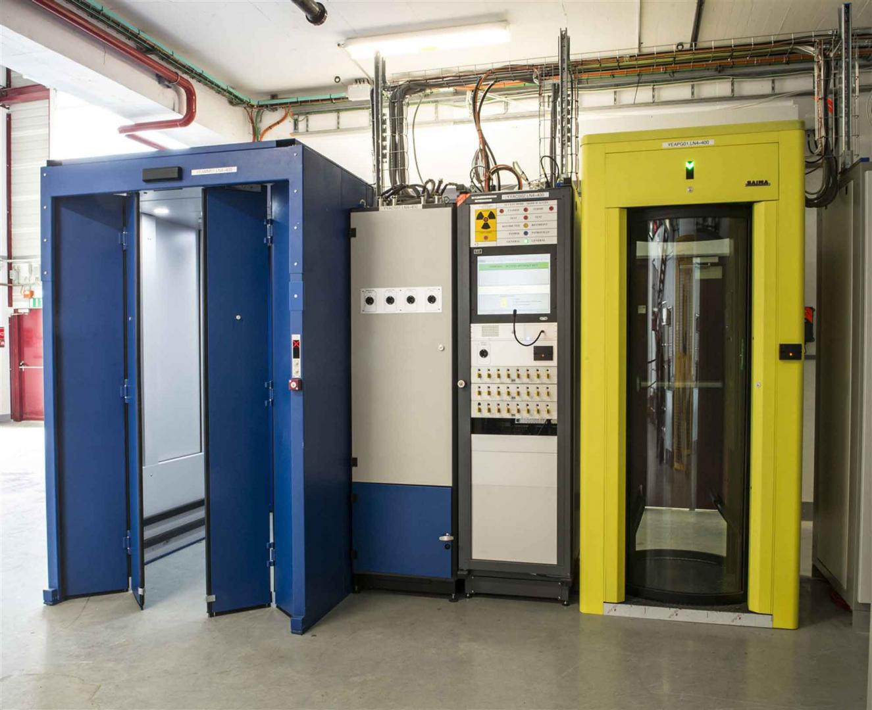
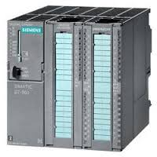
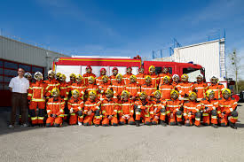
1997 Started working in the technical control room
Henrik
Nissen
2002 Technical support for maintenance database and tools
2004 PLC programming for access
system for radioactive zones
2005 Technical responsible for CERN
Safety Alarm monitoring
Image credit: Henrik Nisse

Slide 4
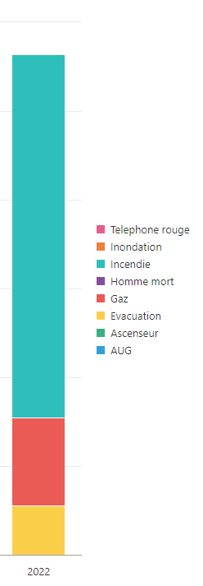
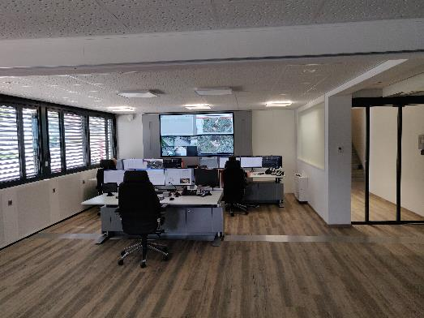
CERN Safety Alarm Monitoring
30000 safety alarms at CERN

Slide 5

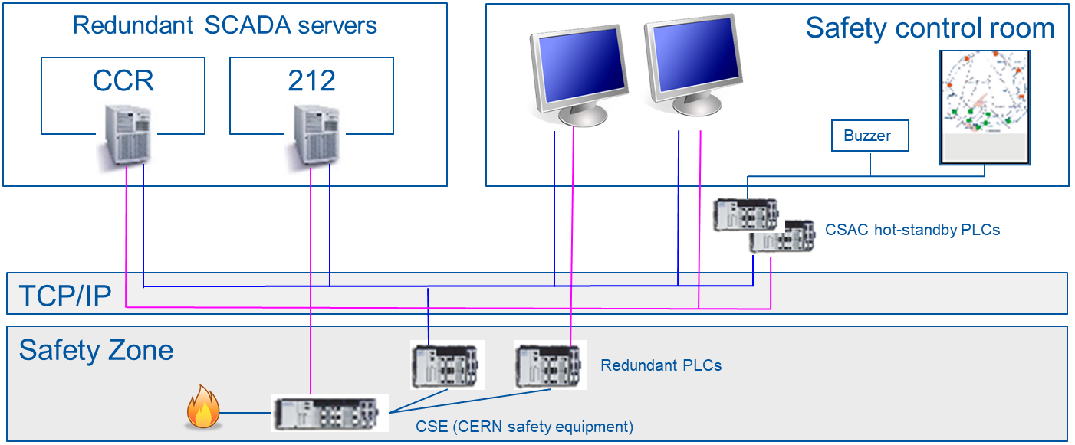
CERN Safety Alarm Monitoring
30000 Alarms, Redundant network, Operational 365 days, 64 PLC, 4 physical servers, 6 virtual servers, 7 Operator stations
Large number of technologies and processes:
Hardware: PLC, servers, optical fiber, networks, virtual machines
Automation: (PLC), SCADA, databases,,
Software: Oracle, development methodologies, JAVA
I am responsible for the maintenance, operation and evolutions of CSAM.
Broad knowledge required to integrate the different technologies used and in many arears specialized knowledge required

Slide 6
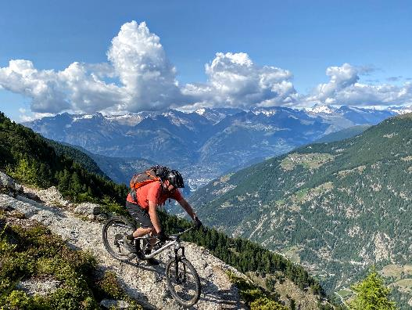
Outside of work
Cycling ! A bit more varied than DK
Skiing
Reading
DIY

