Slide 1


BTL Progress Update @ CMS
3.25.2025
Zhihao Cheng

Slide 2
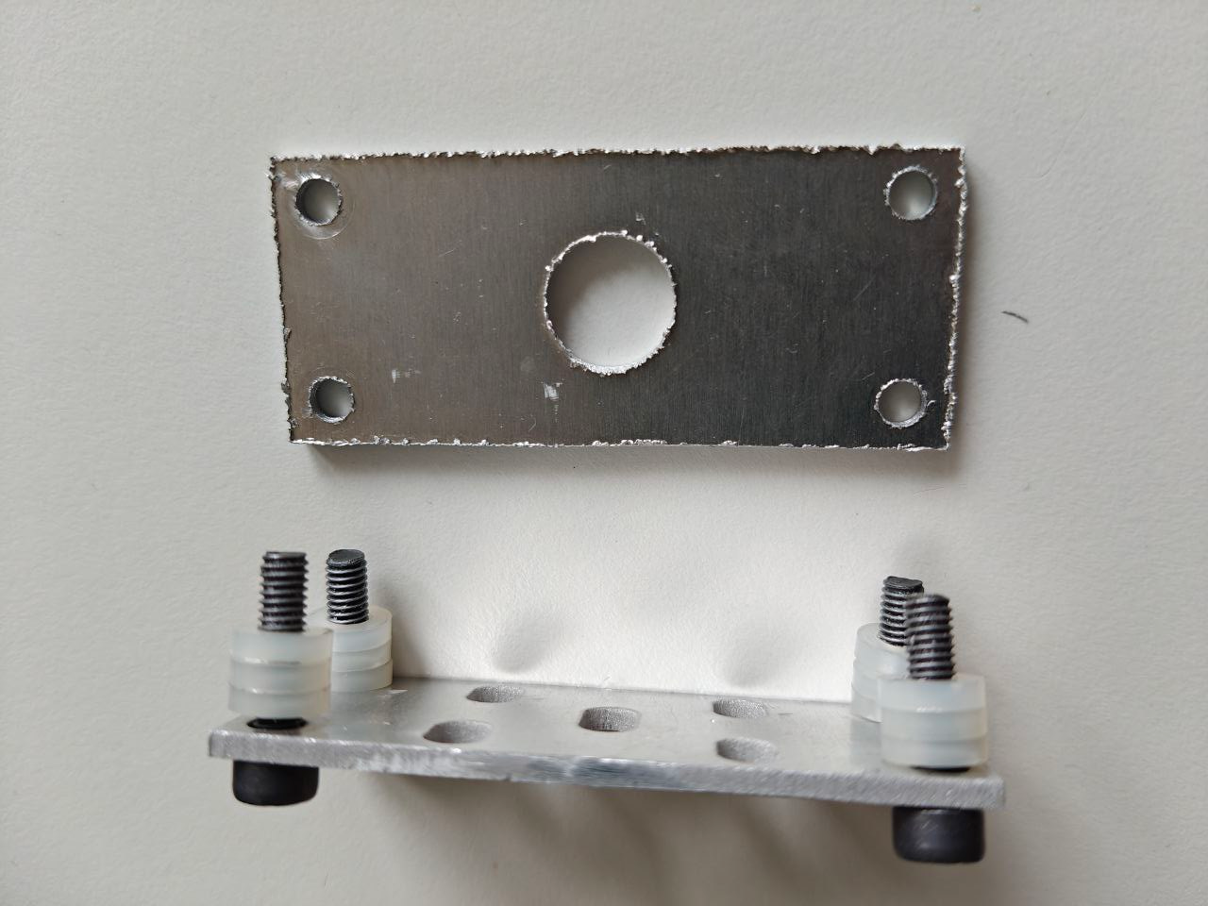
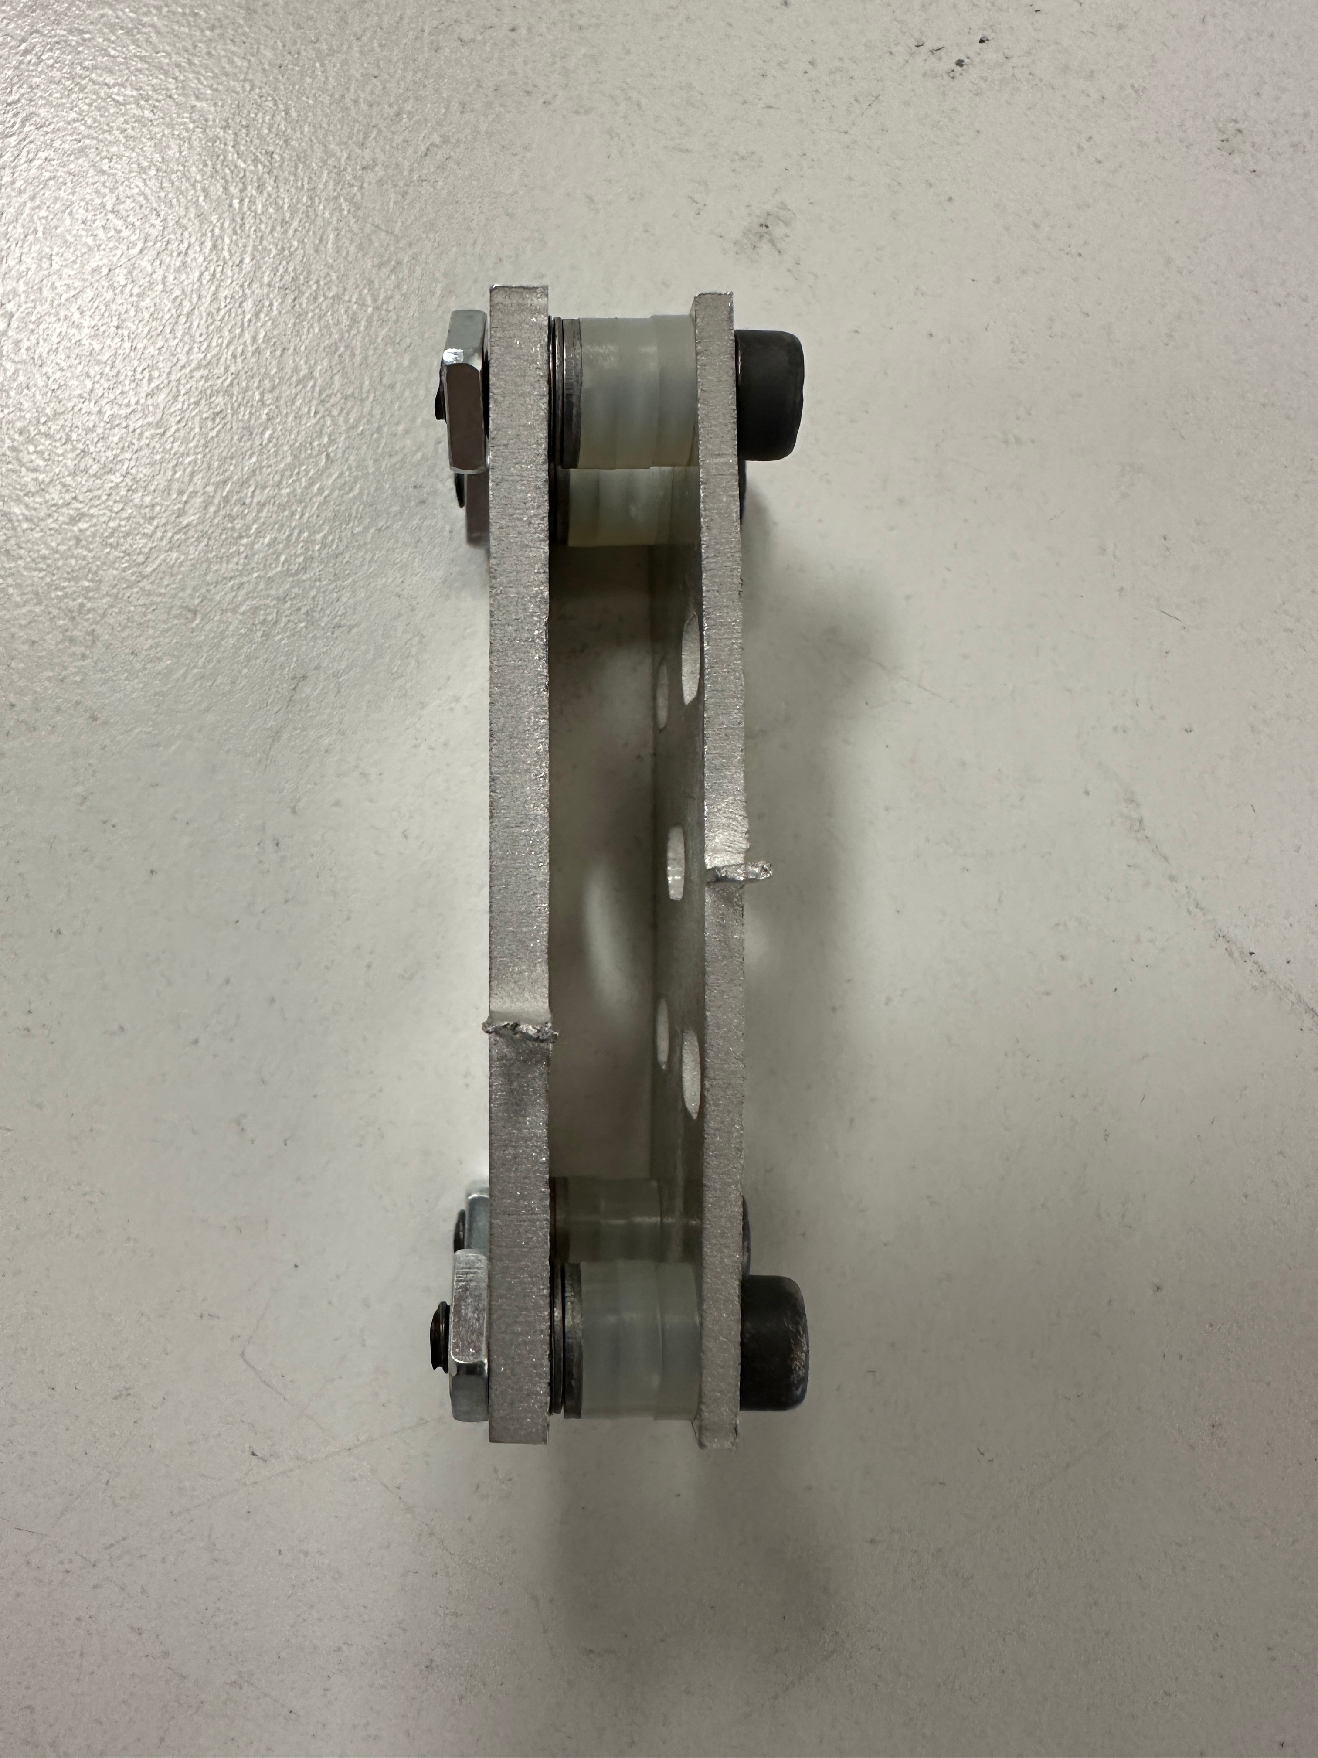
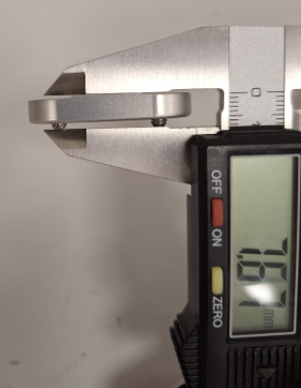
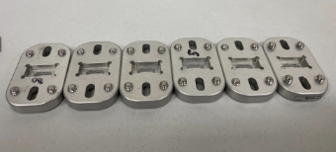

Beam Assembly Update
Beam assembly delayed until further notice (possibly mid to late April) due to some BTST problems
Feet calibration tool random errors:
Spacers has different thickness
Spacer plates are aluminum (malleable) -> bending & over-pressing affects precision
Caliper measurements
Need spacers on each corner $±0.05 mm$ tolerance

Slide 3
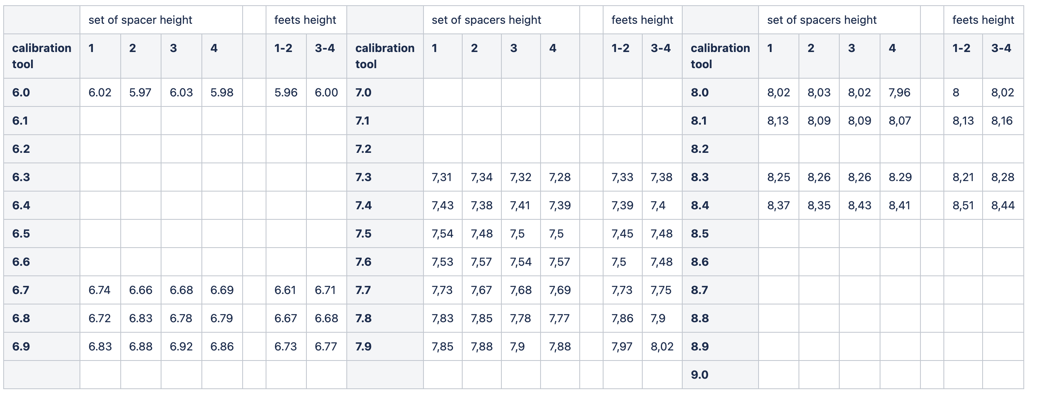
Calibration Table.
Calibration tool 6 to 9 mm based on Purdue data
Spacer & feet height measurements at least 3 times to avoid the ambiguity

Slide 4
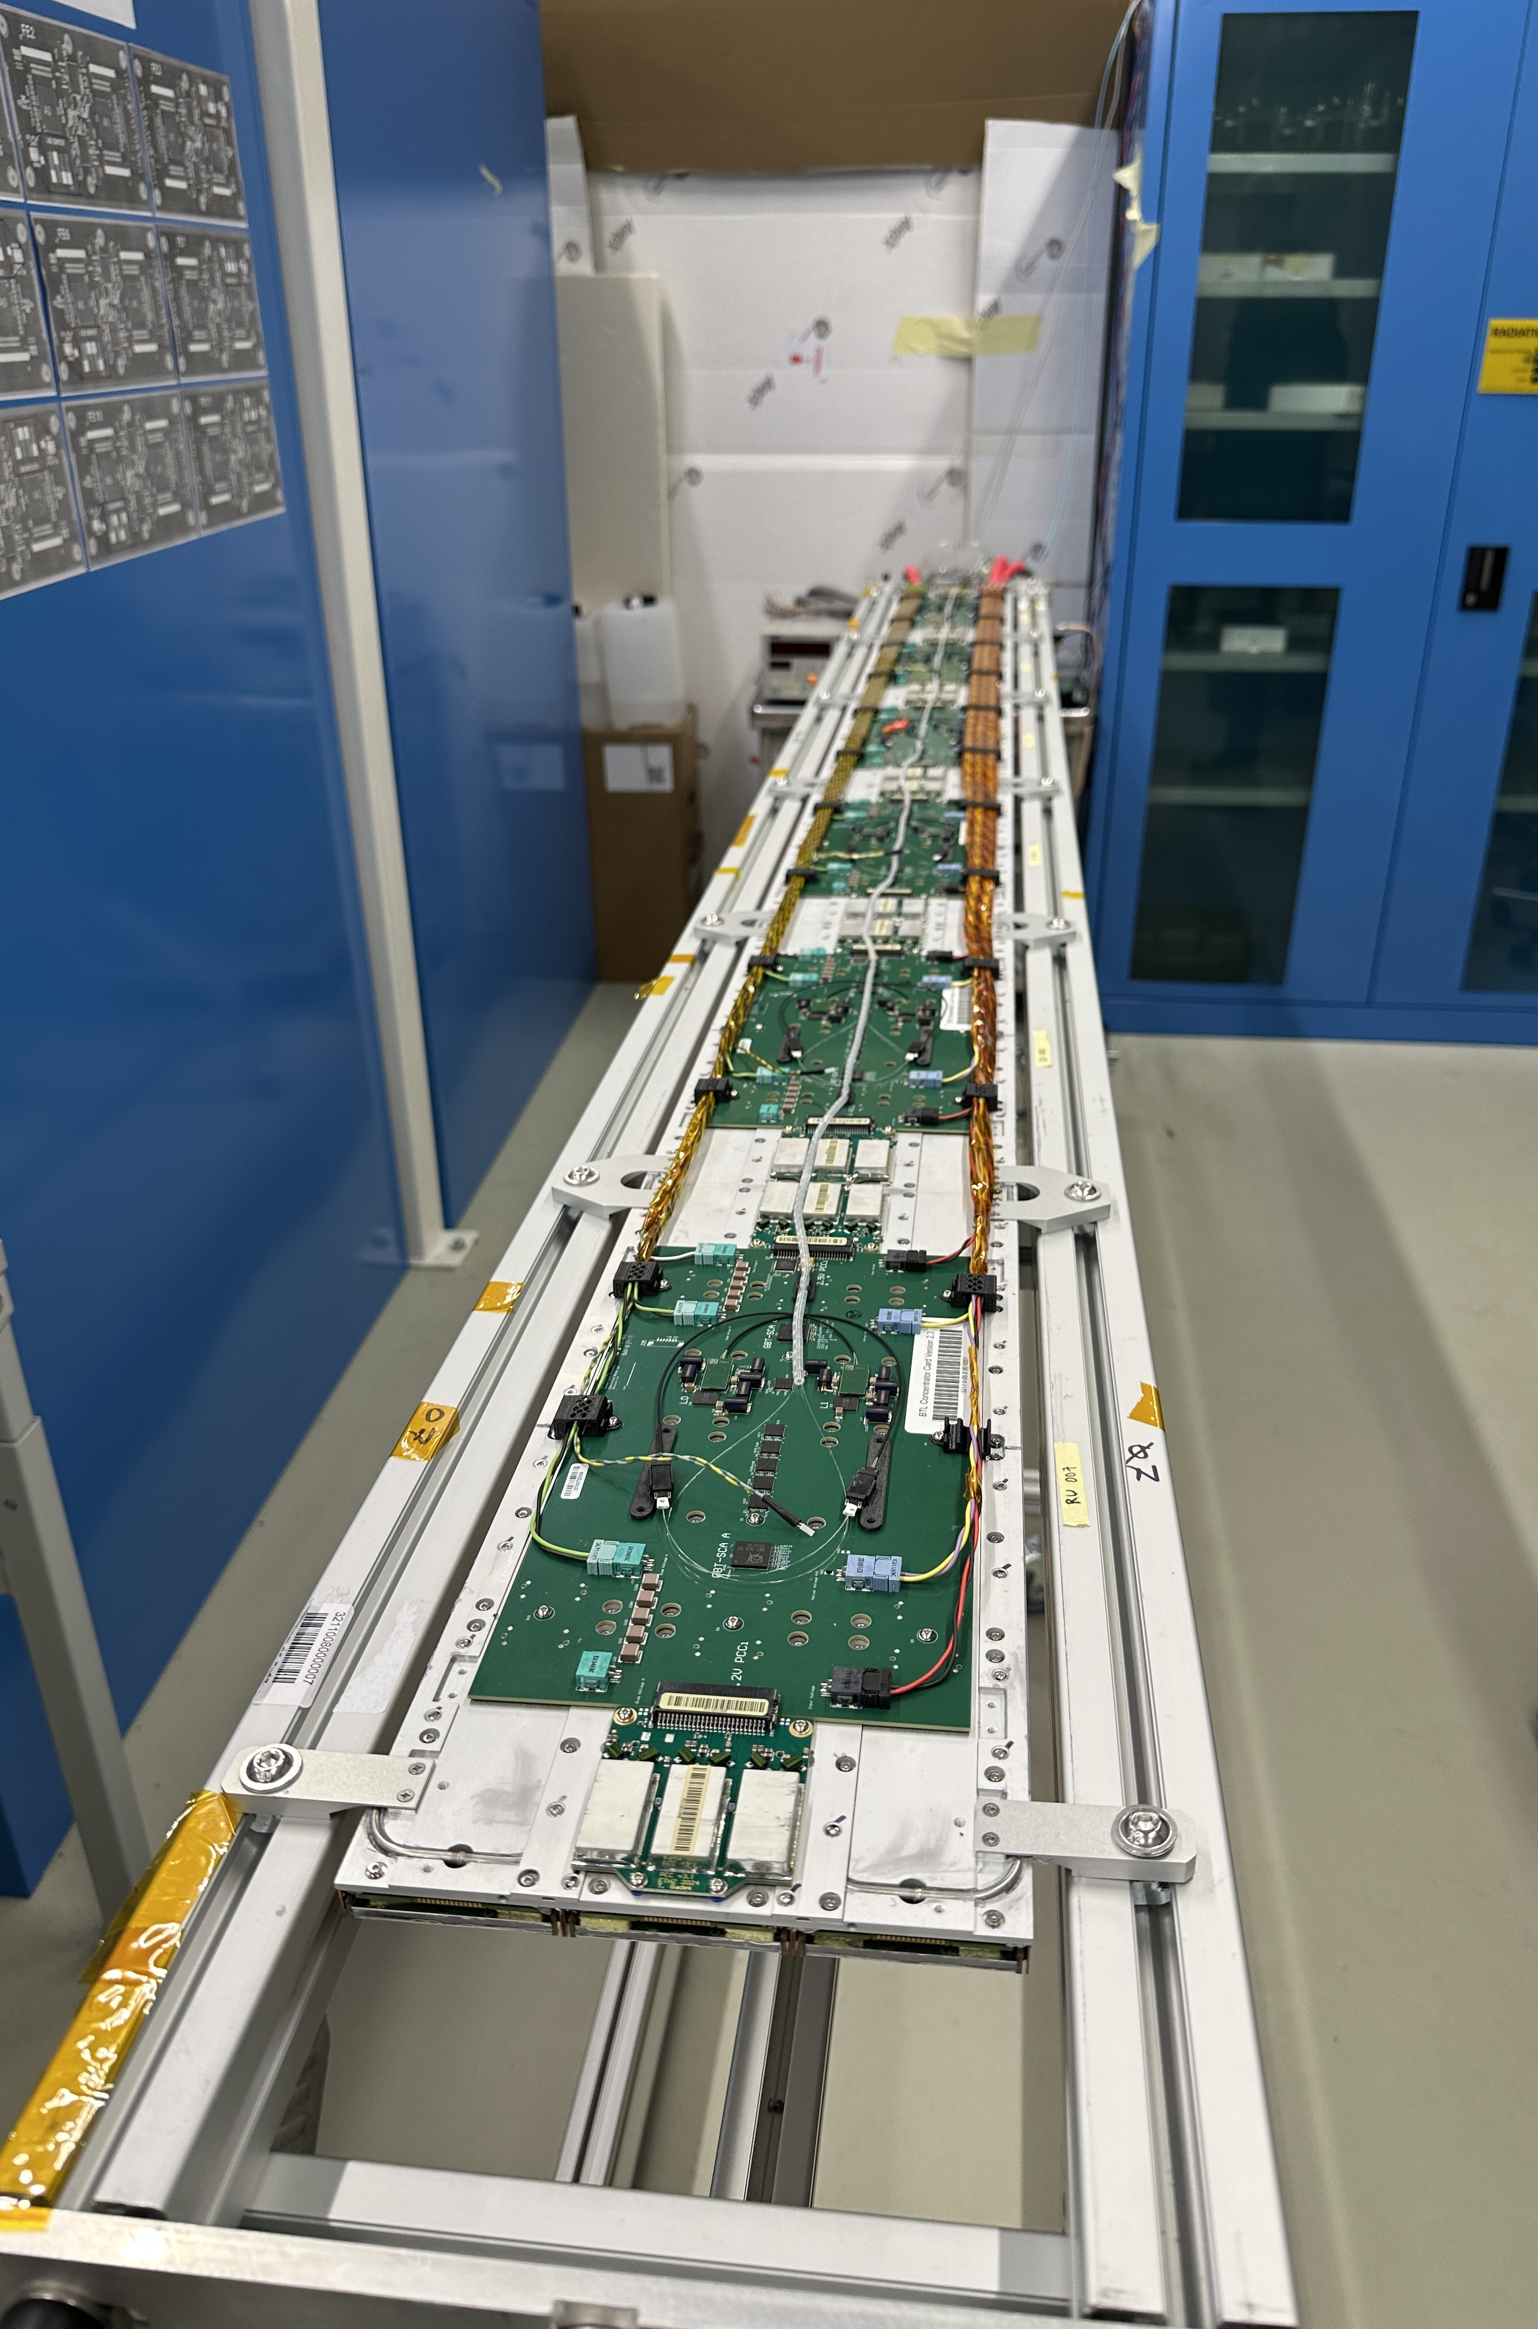
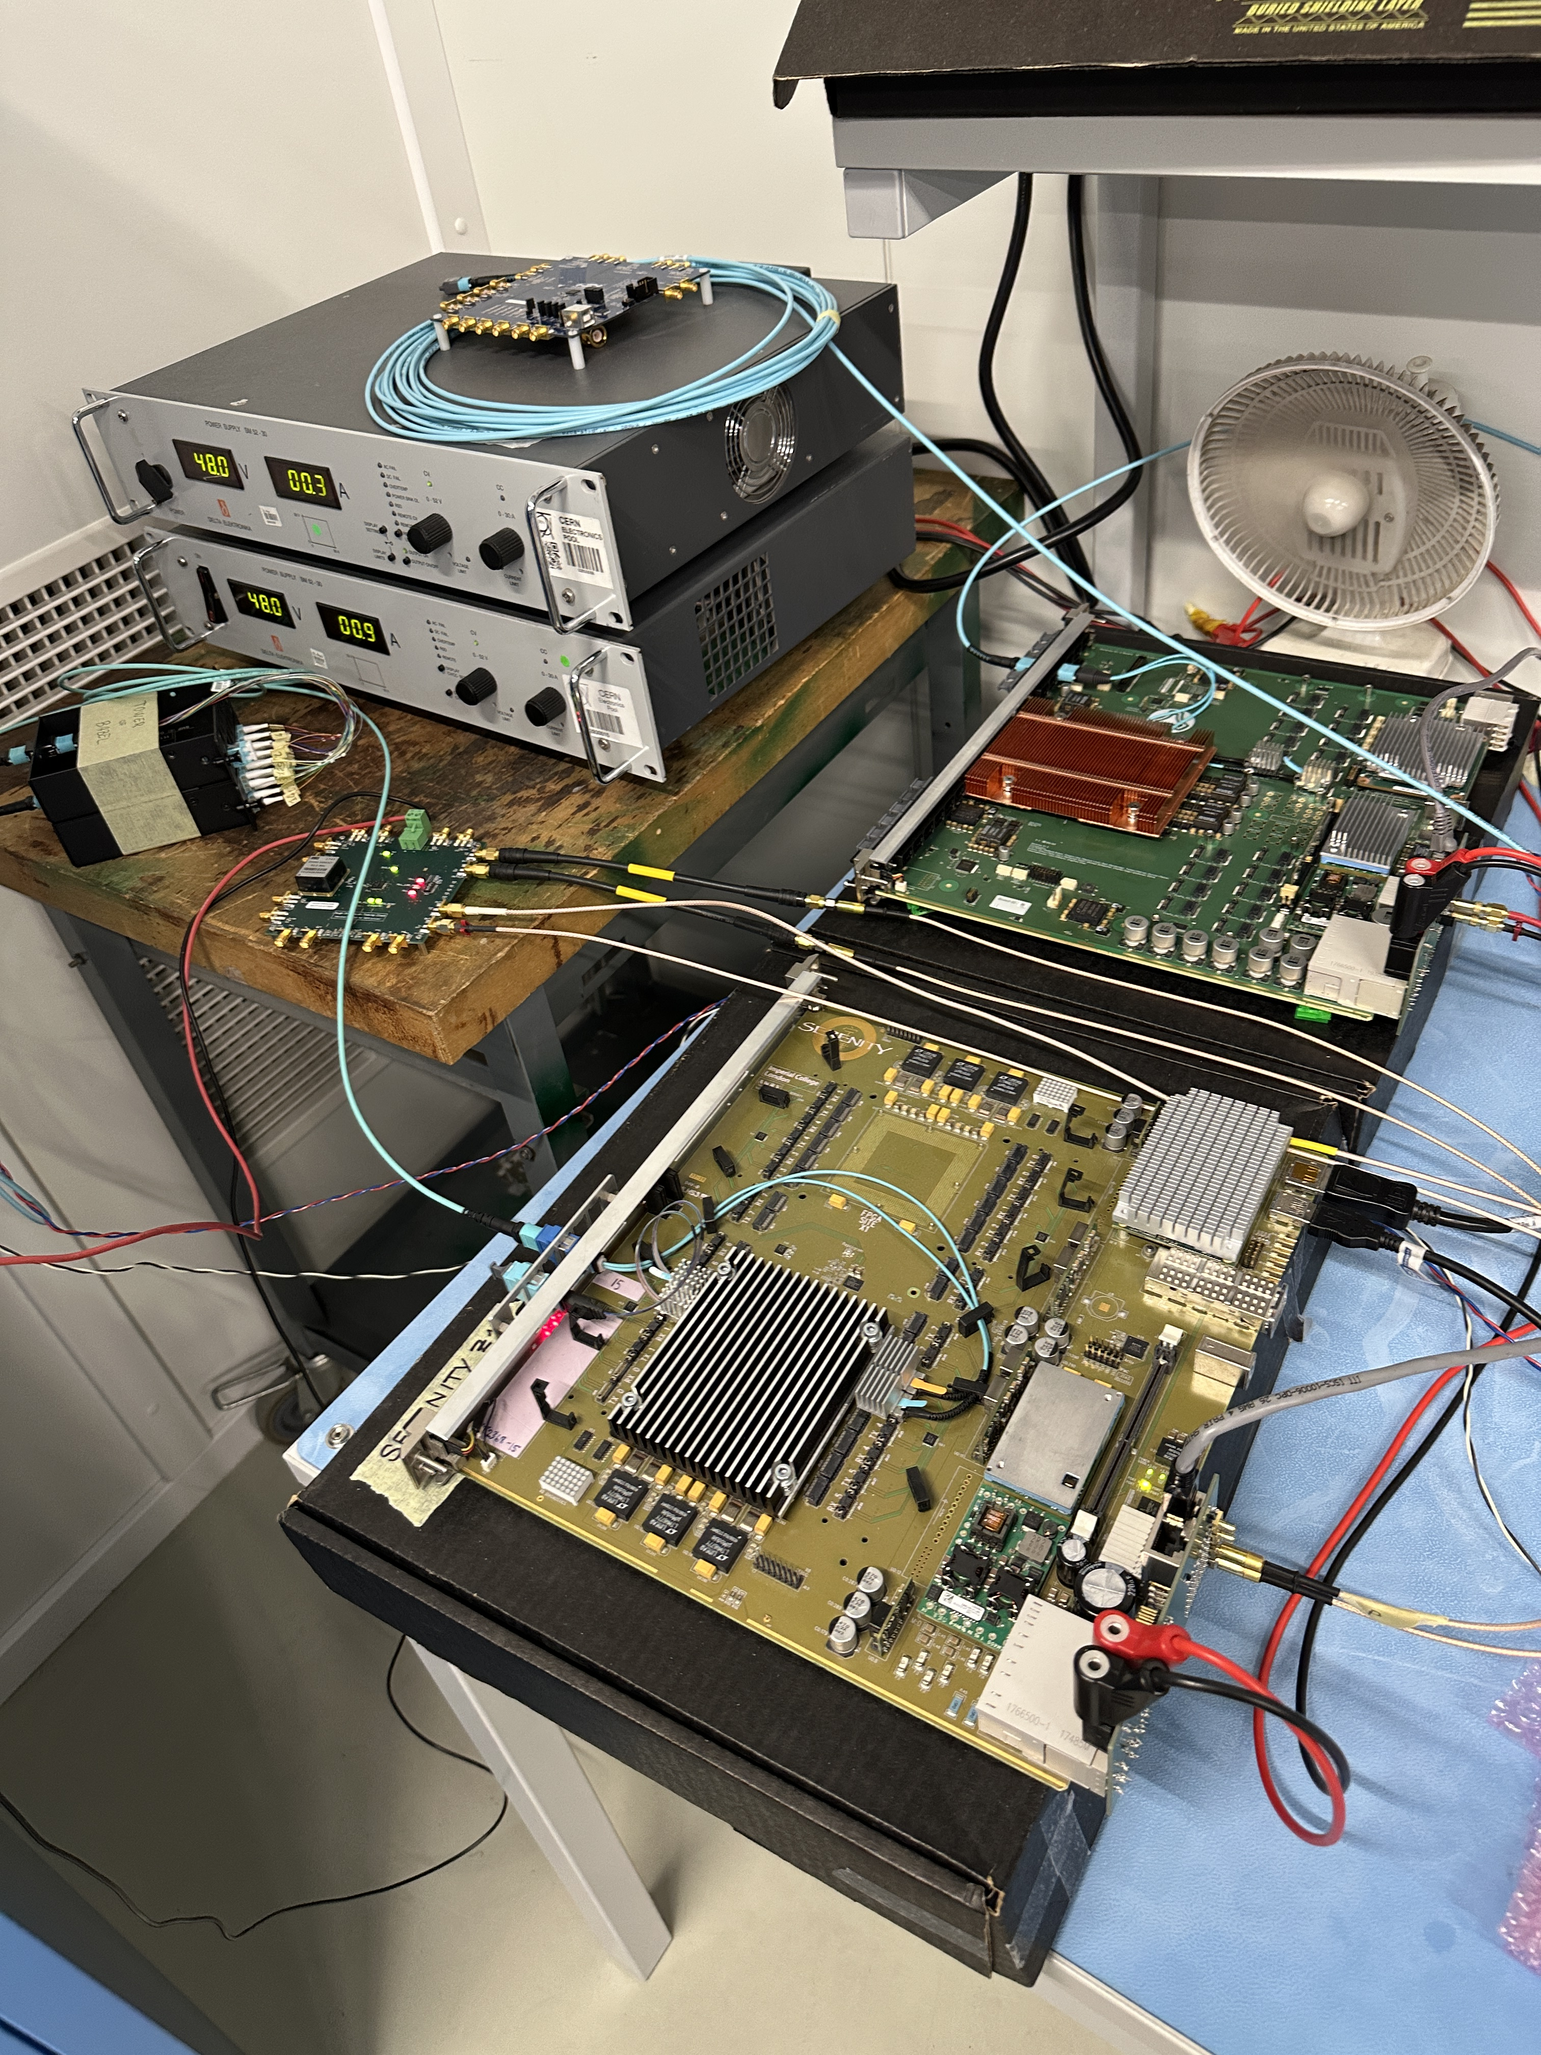
Tray Assembly/Testing Update
Tray Assembly workshop week 3.10-14
One tray consists of 6 readout units (RU), supporting 4608 SiPMs
Data readout testing through the backend machine, connected to the power supply tray distribution board (PSTDB) & Serenity card
Each readout unit’s components: the back-end concentrator card (CC) along with power-converter card (PCC), the detector module (DM), and the front-end board

Slide 5
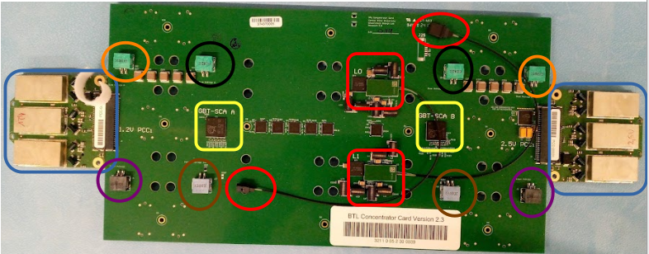
CC & PCC
Versatile Link Plus (VTRx+) – Low Power Giga Bit Transreceivers (LpGBT) Unit
Giga Bit Transreceivers Slow Control Adapters (GBT-SCAs)
PCCs: 1.2 V (left) & 2.5 V (right)
Connectors to thermo-electric coolers (TECs)

Slide 6
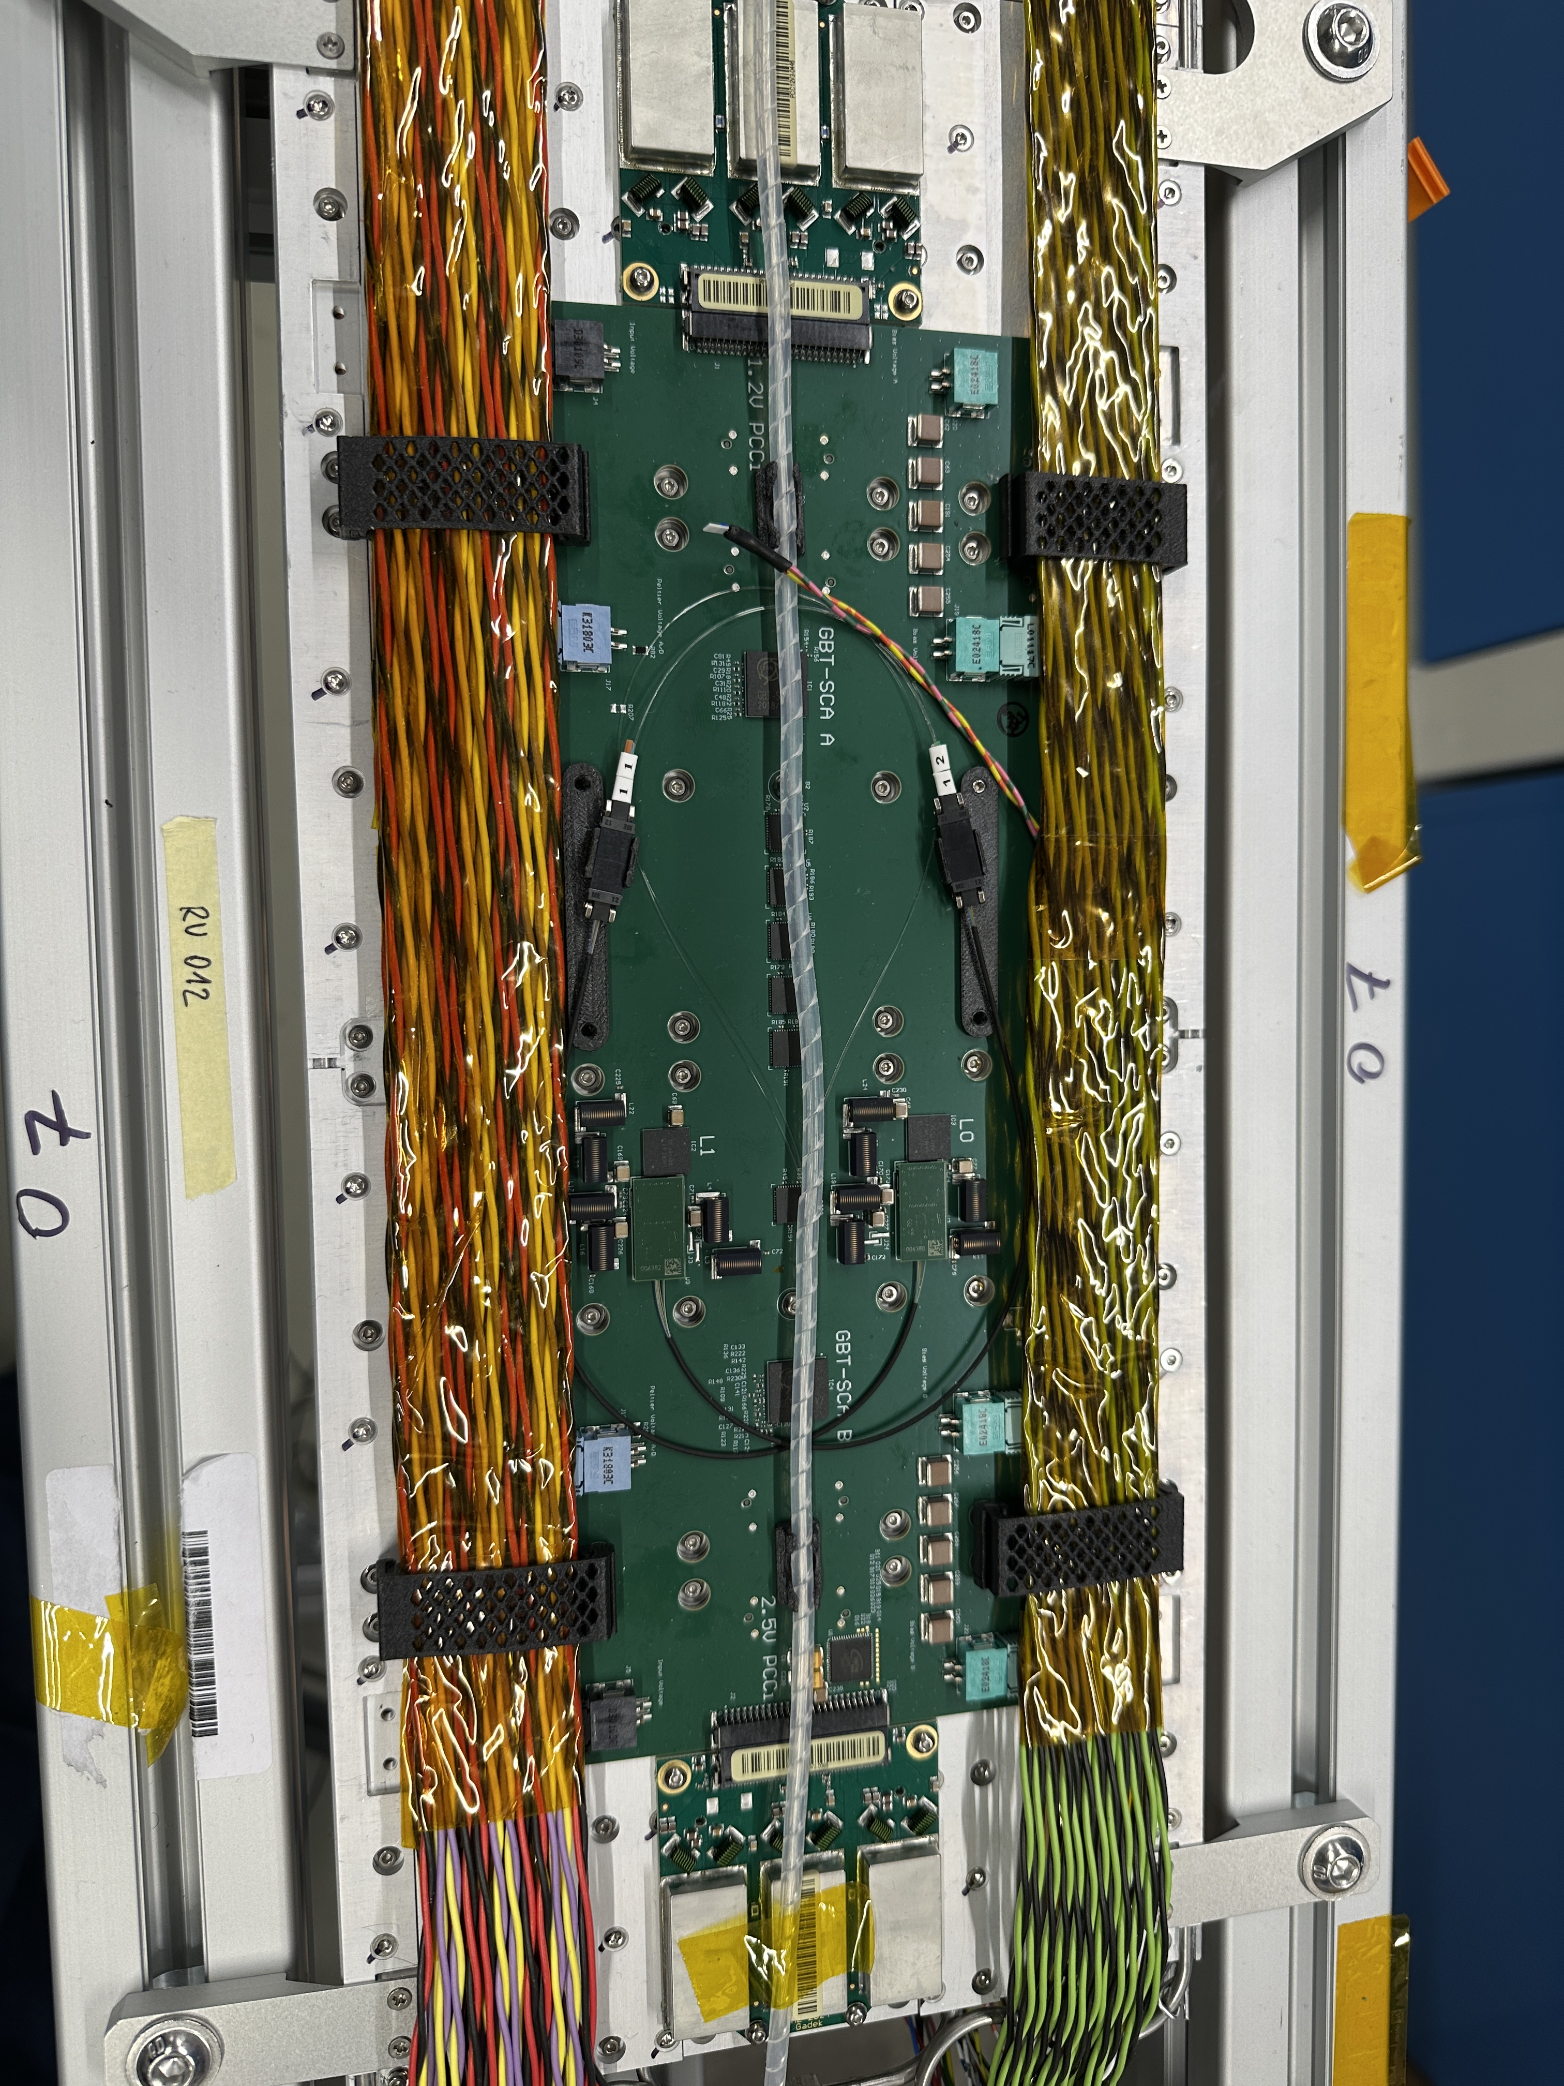
CC& & PCC Cont.
Used optic fibres to connect the VTRx+ - LpGBT unit to the PTSD
Padded PCC& CC attached to the cold plate (TIF Tray Operation)
Red & black cables connect to the low voltage, while the green & black cables go to the high voltage

Slide 7
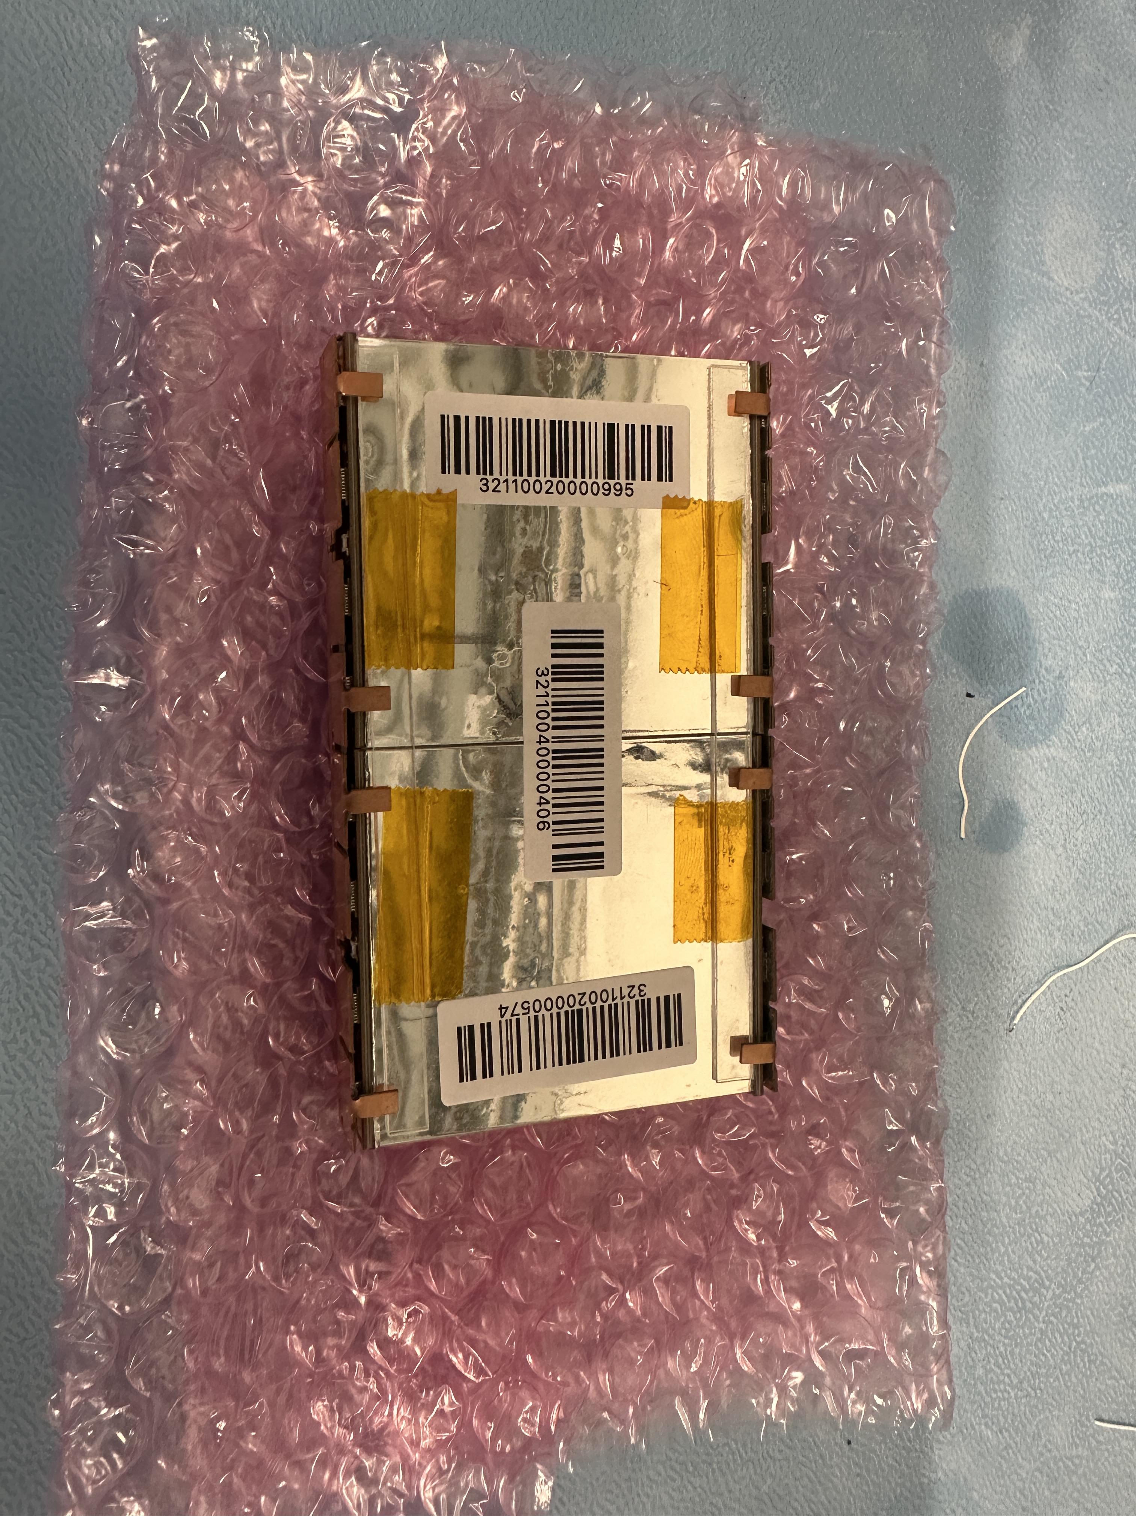
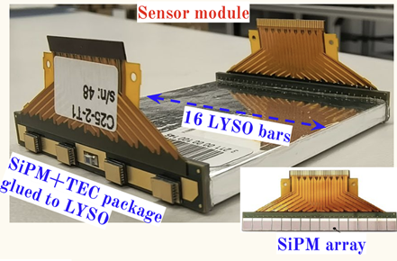
DMs
Each RU: 12 DMs; each DM 2 sensor modules: 16 LYSO crystal bars with 32 SiPMs (both sides)
Photoelectric effects – particles passing through the SiPM arrays, sending electric signals to the front-end board
TECs cool down SiPMs + reverse radiation damage done to the LYSO bars
SiPM + TEC package glued to LYSO & connected to the front-end board

Slide 8
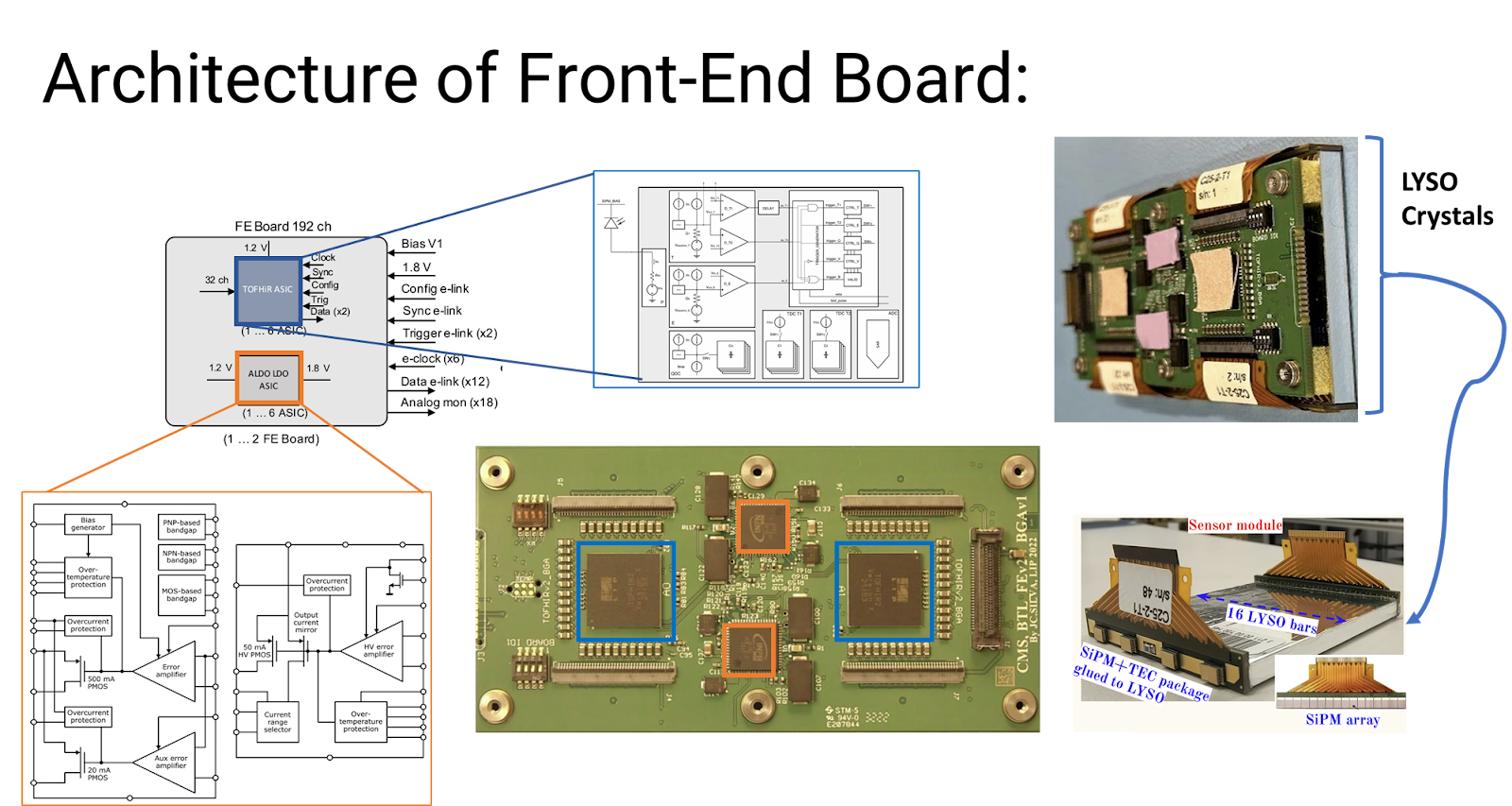
Front-end Board
Time of Flight High Rate (TOFHIR) chips
Aldo chips
TOFHIR chips read out signals from LYSO bars and provide accurate measurements and data acquisitions (timing, energy, charge, etc.)
ALDO chips regulate the voltage (and provide a low-noise environment?)

Slide 9
Tray Testing Current Progress
Making sure every component of the entire BTL tray is working properly (aim of the workshop)
IV scans: testing the breakdown voltages, see at above how many volts the currents start becoming “saturated” ; LYSO crystal testing
Disc scans: testing discriminators, see above what threshold/baseline currents the electric signals disappear; TOFHIR chip testing
Both scans already tested in Lisbon, now checking how strongly correlated 2 measurements are

Slide 10
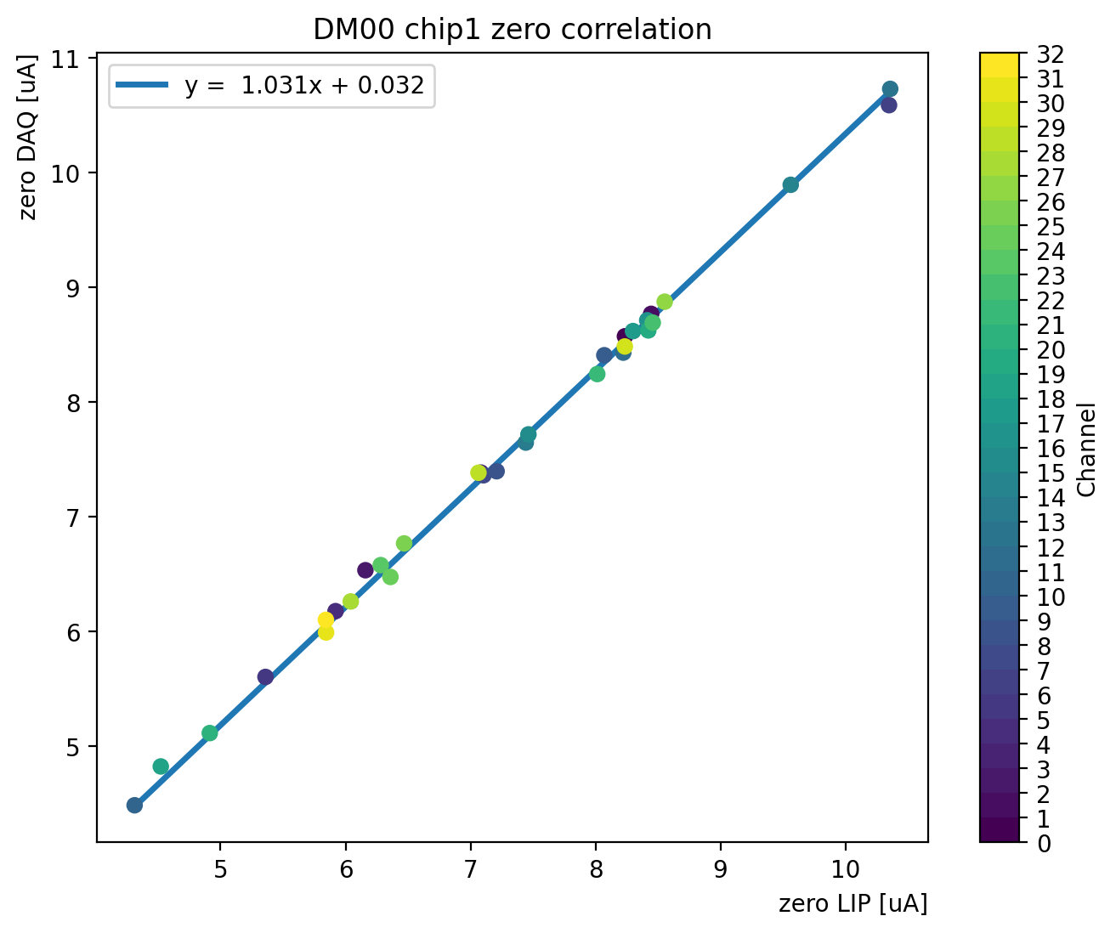
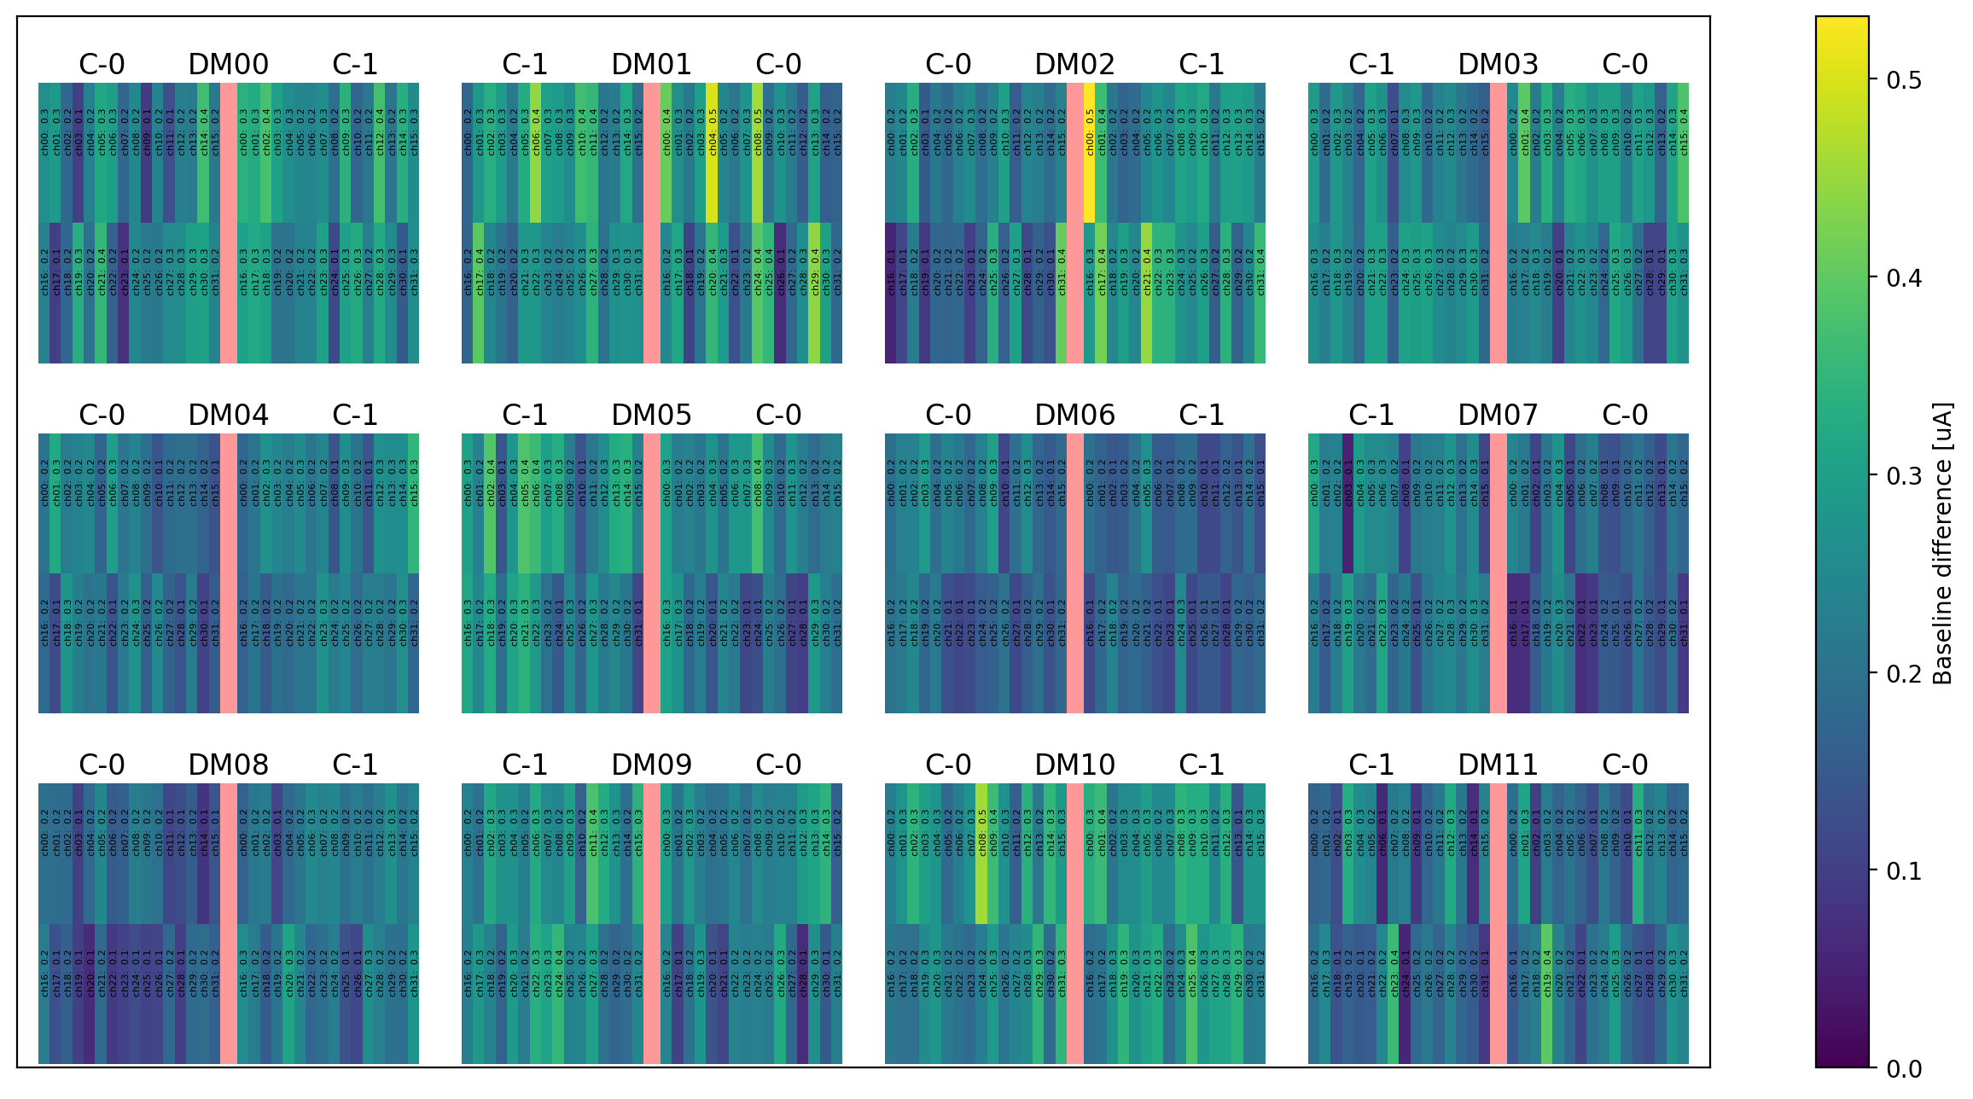
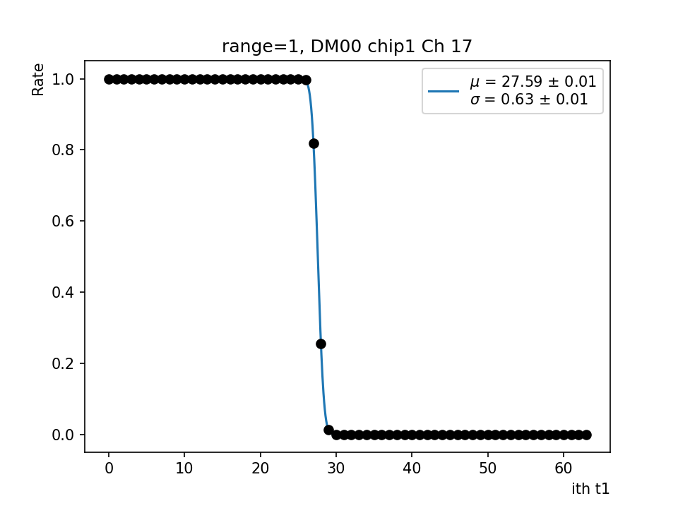
Disc Scan
12 DMs, each 2 TOFHIR chips (32 channels)
Sigmoid fit, simulated pulses from TOFHIRs
Zero indicates the baseline current above which signal filtered

Slide 11
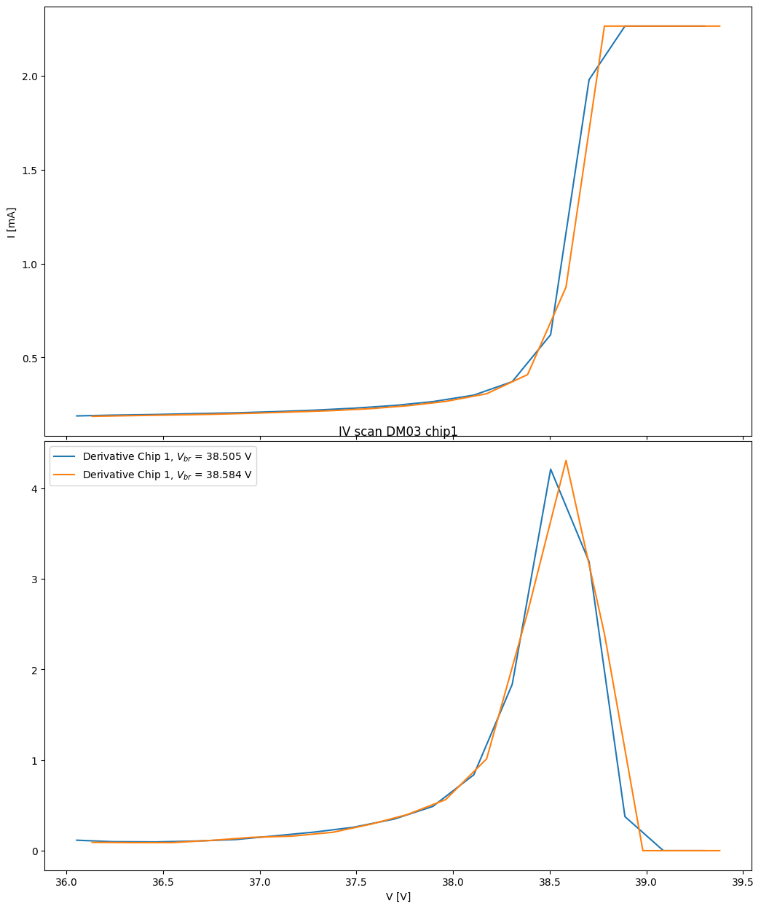
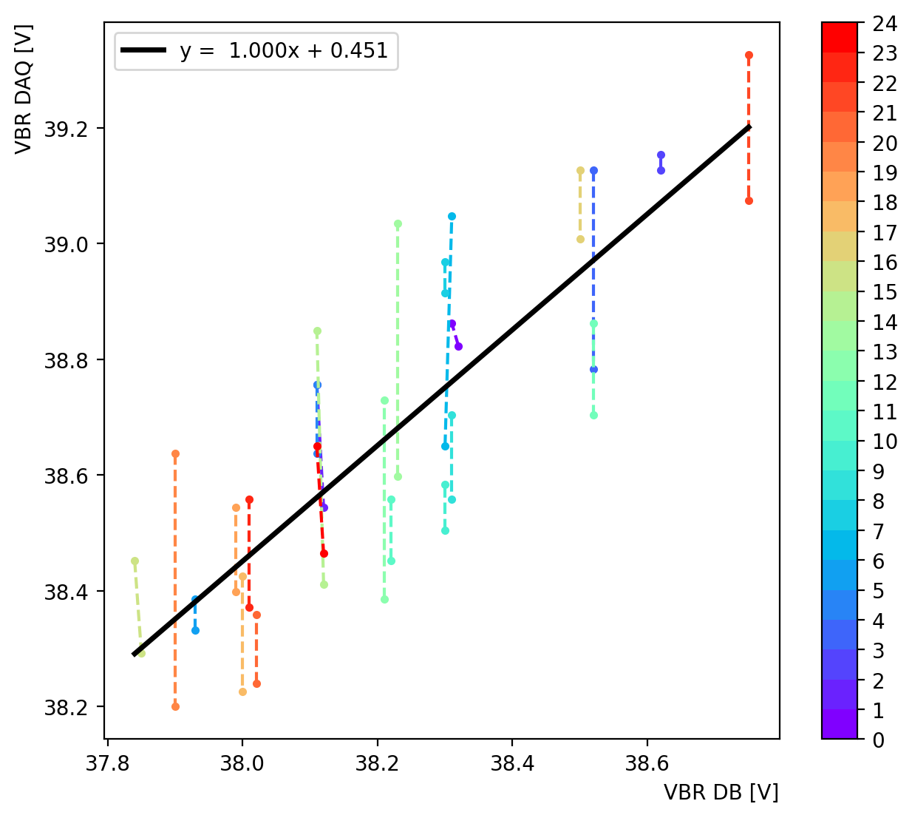
IV Scan
12 DMs, each 2 sensor modules, 2 sides of SiPM arrays
Sharp increase (spike) – breakdown voltage
Applied cuts for better efficiency
DM03 chip 1

Slide 12
Next Step
Continue refining the beam assembly steps and improving our manual
First finish the assembly of all feet calibration tools, and then test all of them to ensure nothing goes wrong
Need more discussions with members in the BTL lab & learn more about data readout systems & testing procedures
In the next 1 or 2 months more trays will come in from assembly centers; multi-tray testing?

Slide 13
Reference
https://cmsonline.cern.ch/webcenter/portal/cmsonline/Common/Elog?__adfpwp_action_portlet=683379043&__adfpwp_backurl=https://cmsonline.cern.ch:443/webcenter/portal/cmsonline/Common/Elog?__adfpwp_mode.683379043=1&_piref683379043.strutsAction=//viewSubcatMessages.do?catId=1491&subId=1751&page=1&fetch=1&mode=expanded
https://confluence.cern.ch/pages/viewpage.action?spaceKey=BTLTRAY&title=TIF+Operation
https://docs.google.com/document/d/1fuv4RAWvxy2H3MfrxHiL1igFq67MoqwF6Mutf2Tf2fk/edit?tab=t.0
https://indico.cern.ch/event/918746/contributions/3889710/attachments/2052902/3441455/OS_talkHPTD_080620.pdf

