Slide 1
LHC linear wire scanner CONS
Project meeting mechanics update
24th March 2025
Harry Sullivan
Notes:
Harry

Slide 2
Overview
Test rig update
Instrument design update
Impedance update
Items for disucssion

Slide 3
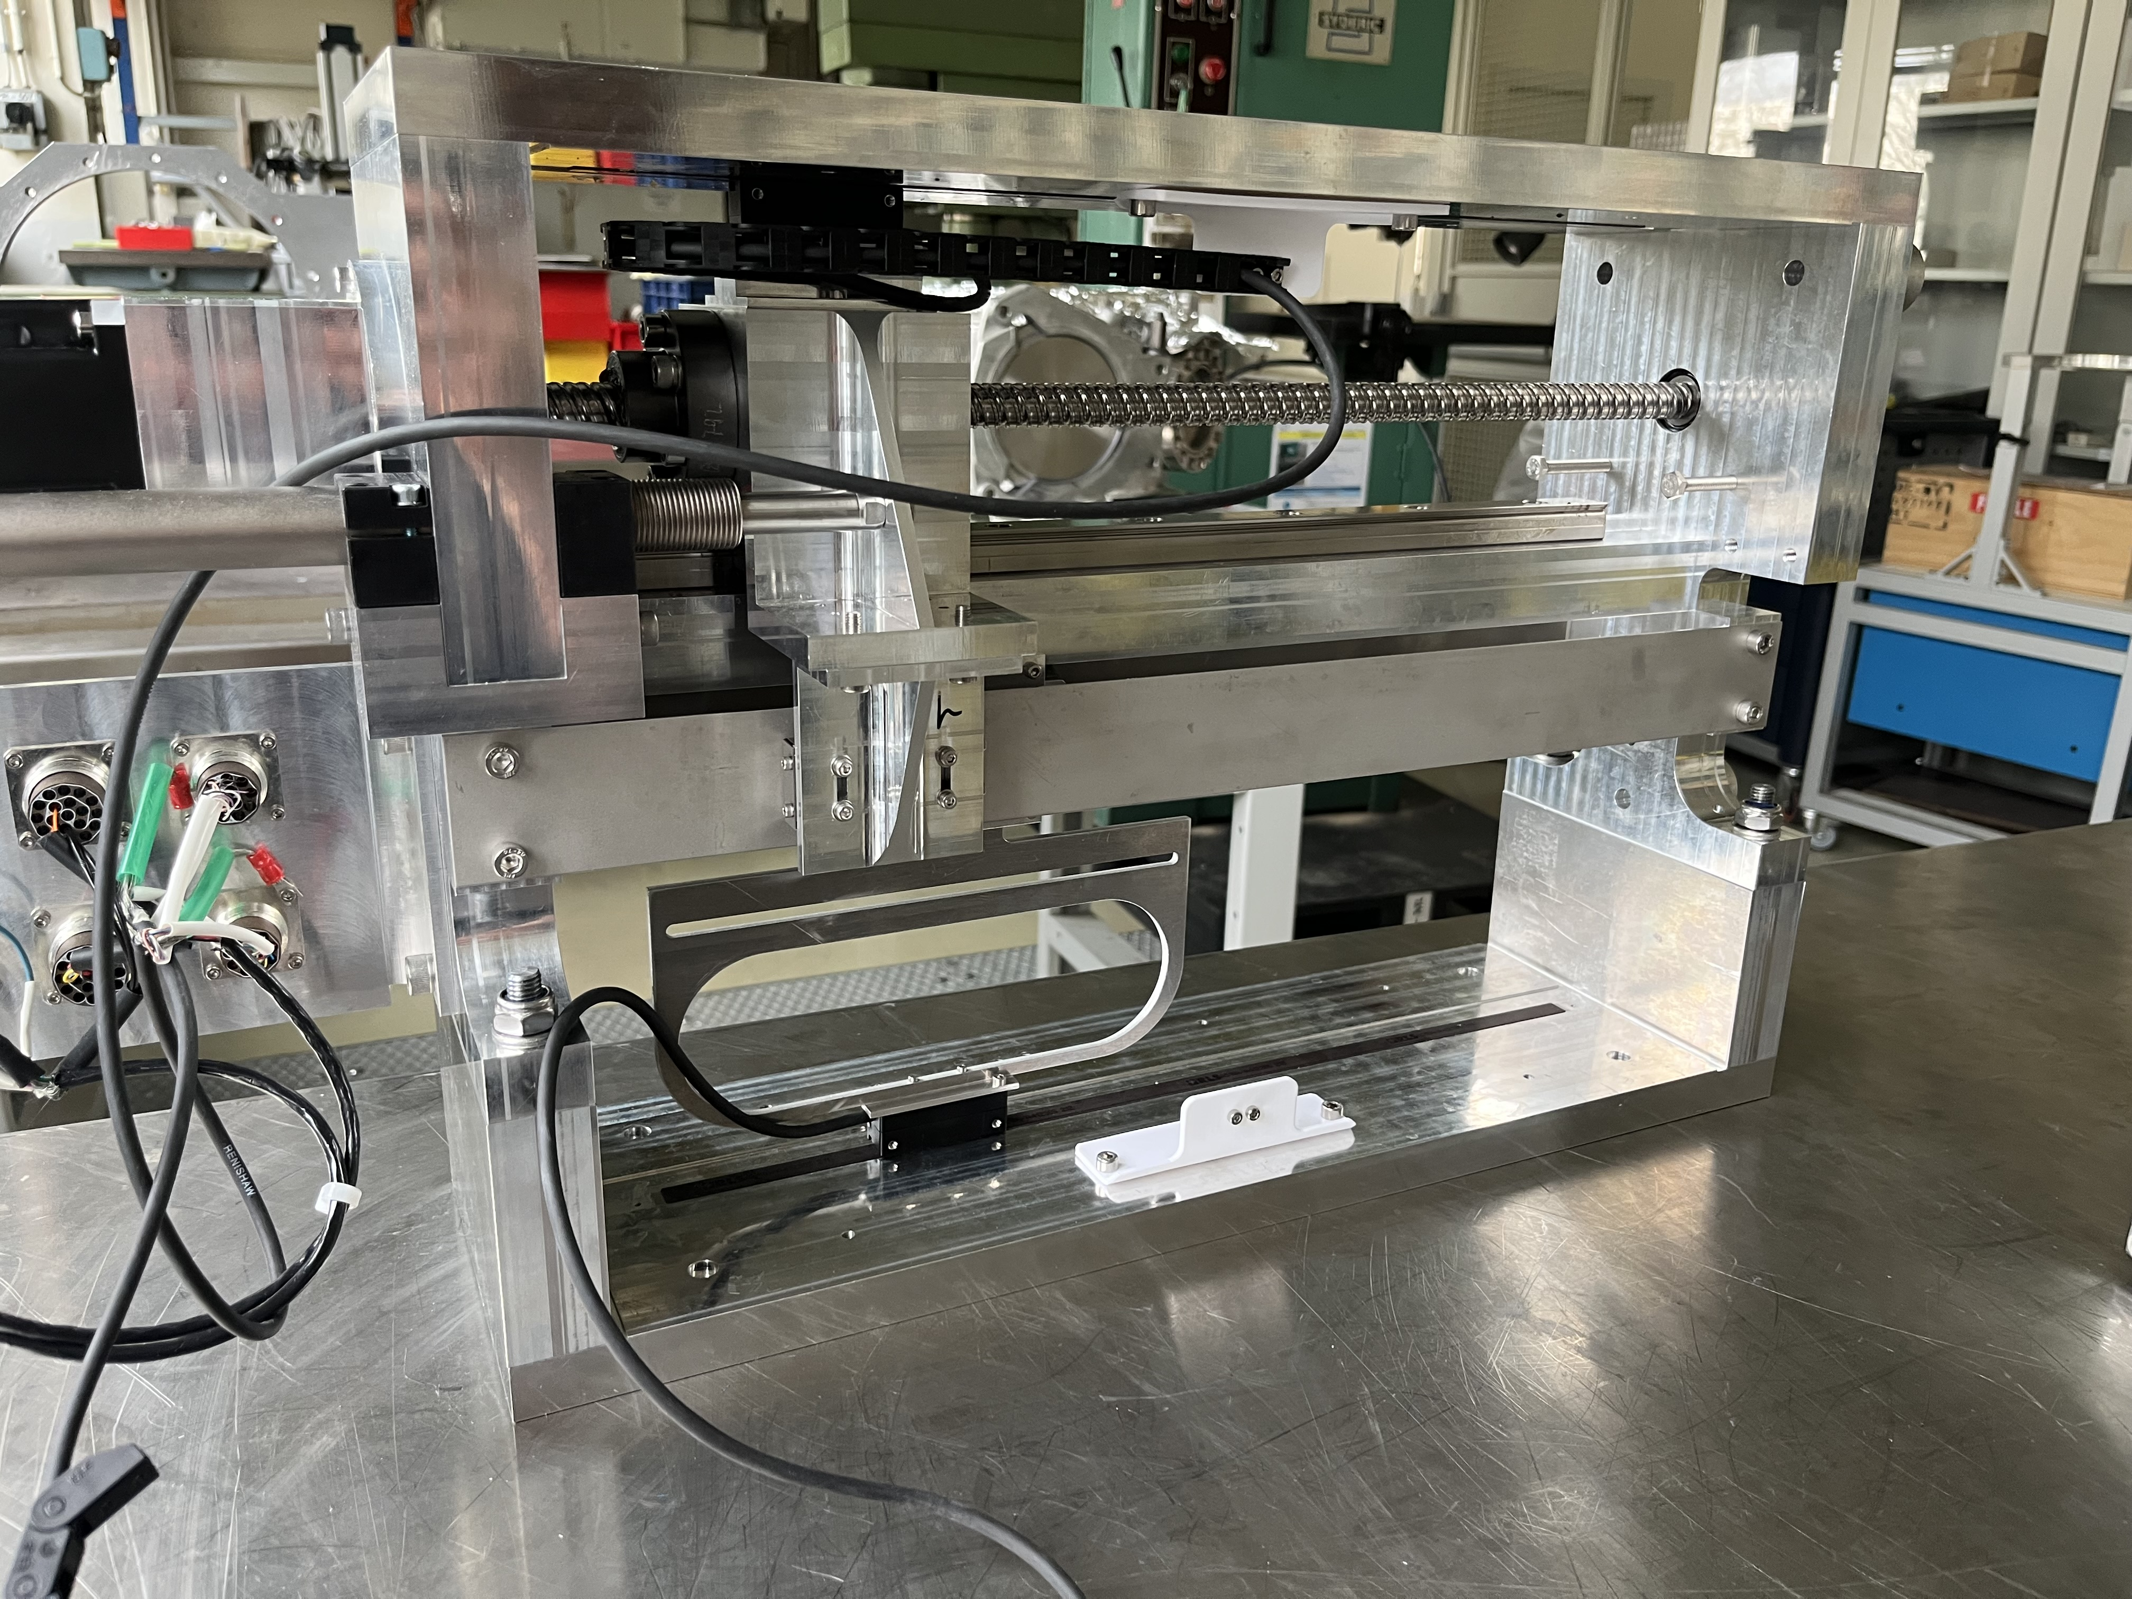
Test rig update
2nd phase testing changes complete
  Dummy card installed
  New bearings installed
  New bearings torqued to 2Ncm
    ~12.5N compression force on each bearing
Phase 1 testing shared with Ceratec
  Conclusion that guide concept successful
  Can progress to next iteration
    We will design and they will produce
    Waiting for feedback on model and quote

Slide 4
Instrument design update
Tank design complete
  Part drawings by tomorrow
  To be sent to vacuum group for review with assembly model
    VDAM to be organised asap to get sign off from vacuum
  Assembly drawings expected later this week
  Material for tanks on order
  Delivery promised end of Sept 25

Slide 5
Instrument design update
Design in progress
  Interior
    Sliding electrical contact details
      Included for LHC impedance prototype – worst case
      Different solution(s) can be tested on lab test prototype
        Measurement only in parking position
        Flying wires
        Kapton flex
    Electrical routing for card
  External
    Tank support
    Motion system
      Plan to use same system as Hybrid+ for first prototypes
    Beamline integration (tapers & bellows)
Simplified version
  Design to change all conflat flanges to O-ring
  Lower grade stainless steel to be used

Slide 6
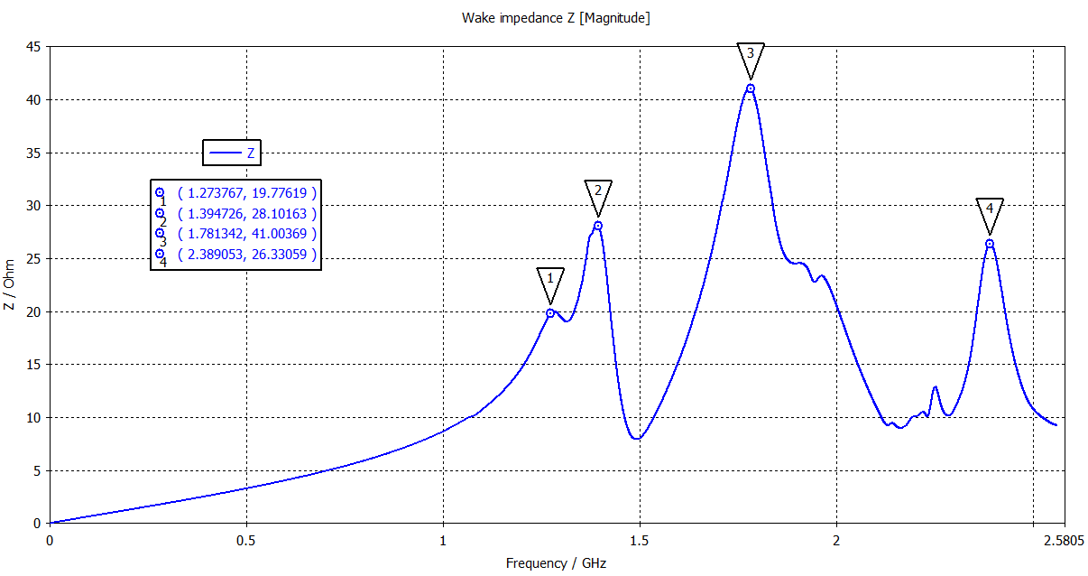
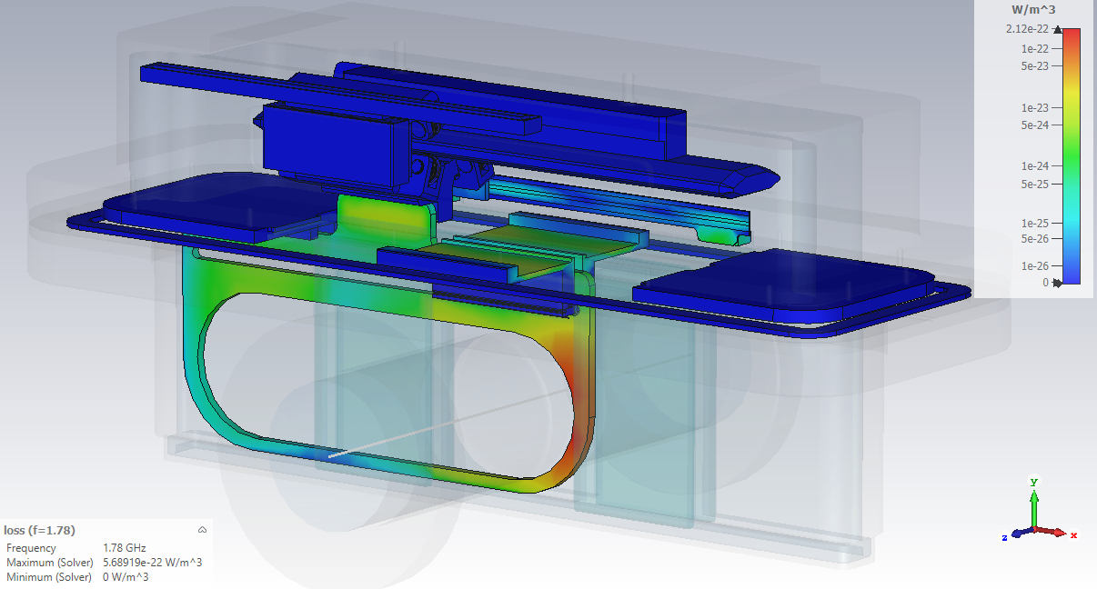
Impedance update
Latest updates and design details shown to have negligible effect on the impedance
Power deposition map under investigation
  Initial estimates show no deposition on the wire
  CST power loss map in CST to be input to ANSYS to determine heating of other chamber components
Port hole for measurement coupler added to tank design

Slide 7
Next steps
Ruler order
  Decision ready for Selba pattern?
Ceramic guide order
Simplified tank design
External component design with MME
ECR

Slide 8
