Slide 1
BWS LHC CONS
Status and planning update
BWS LHC CONS #26
J. Emery
23.03.2025

Slide 2
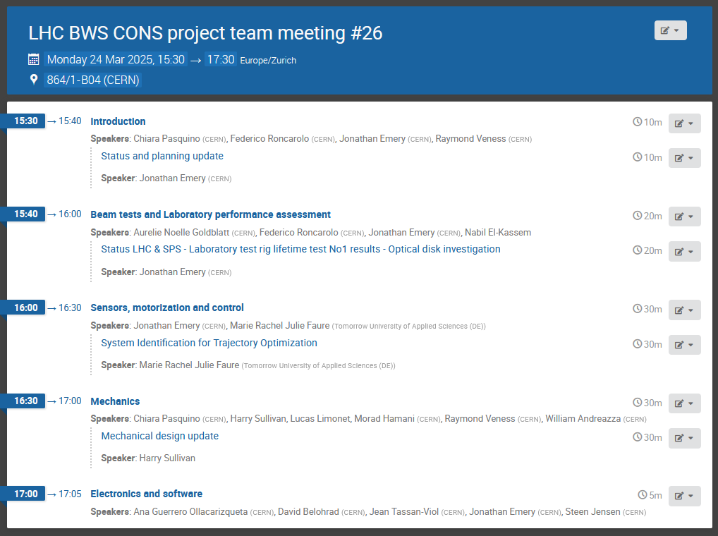

Slide 3
February 2025
10.02.2025 - February BWS LHC CONS meeting #25
https://indico.cern.ch/event/1514016/
18.02.2025 - 96th Impedance Working Group meeting
Studies on BWSs for HL-LHC (Hikmet Bursali)
https://indico.cern.ch/event/1486663/

Slide 4
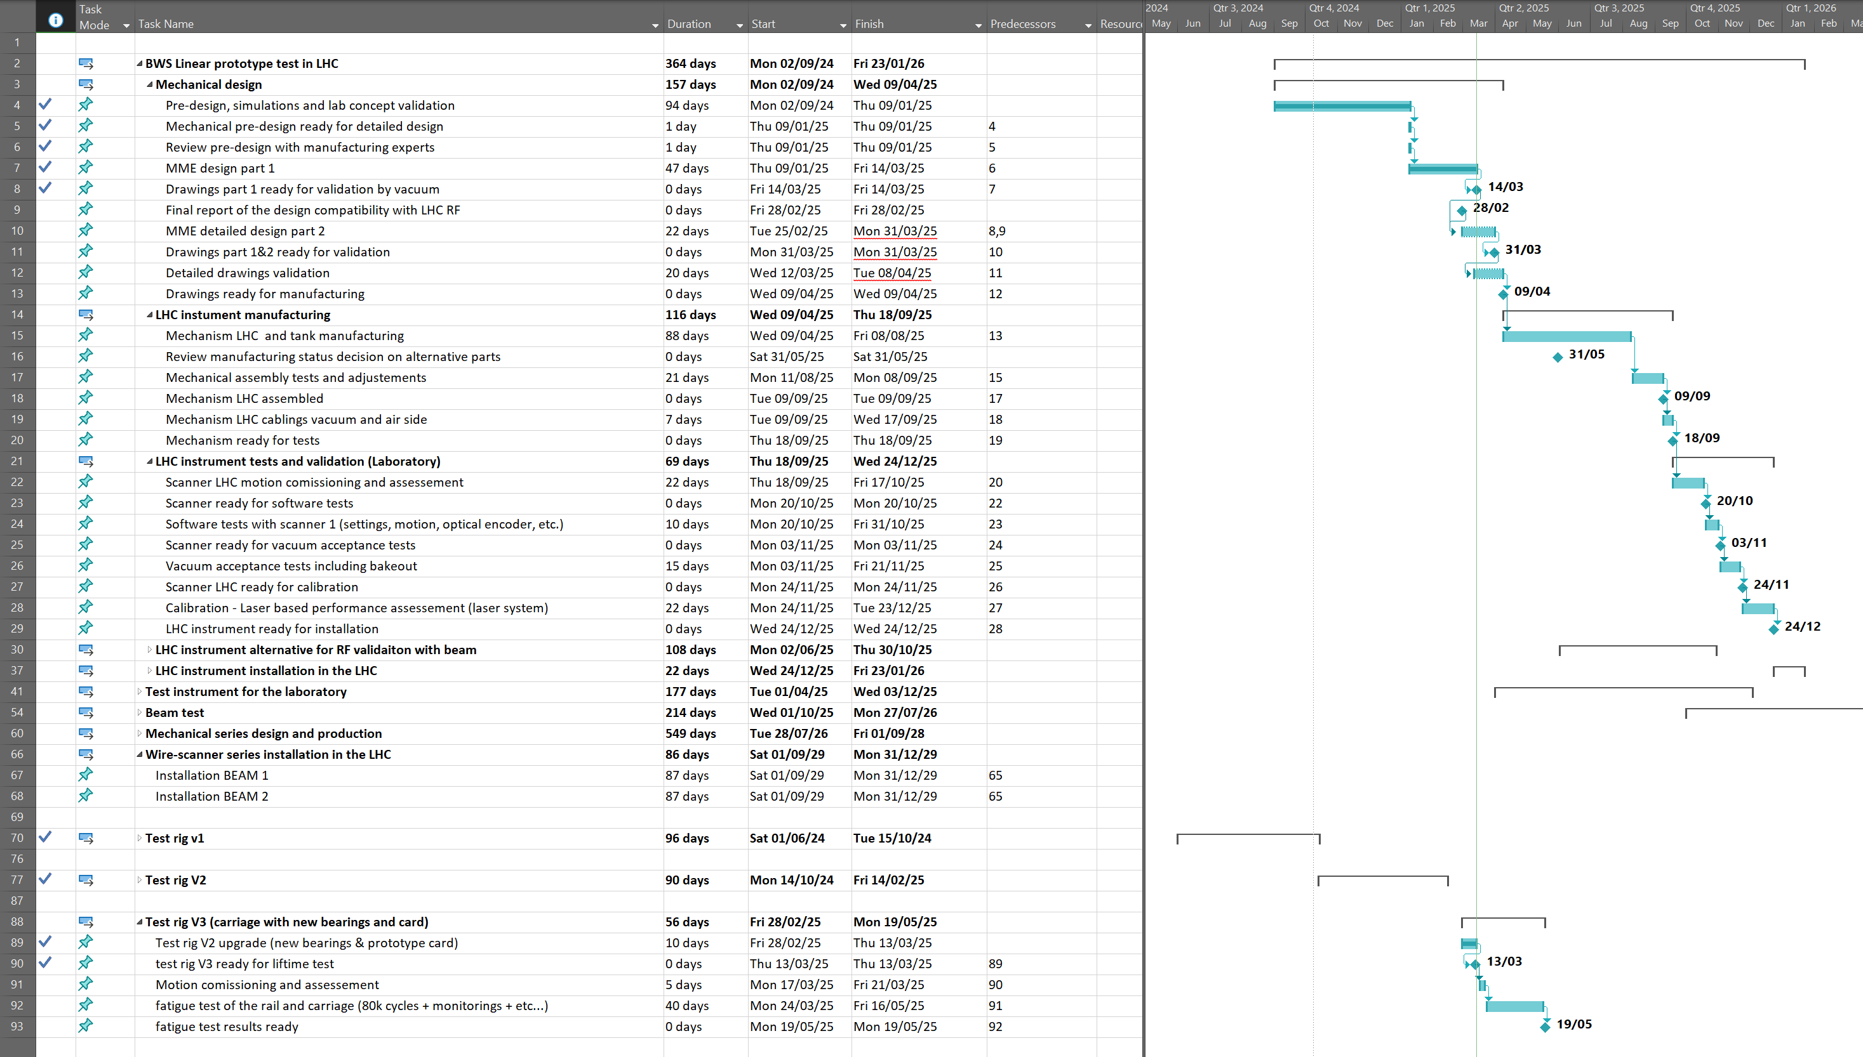
Waiting
final OK
04.03.2025 (Chiara) : Transverse simulations are done and impact on the transverse impedance is low ( 0.2%). Still, I asked for an official confirmation [from the IWG]

Slide 5
2025 Milestones
End of April 2025: Mechanical design of the tank and scanner ready without driving system
?--May 2025-- Documentations for the installation, ECR?
Mid 2025:
- Laboratory scanner ready for dynamic testing (motion, calibration, etc..)
with the aim to design optimal motion and validate it with the laser calibration bench (Bld. 867)
- Update detailed budget based on R&D advances
September 2025: Tank and scanner (external driving system optional if time) ready for laboratory tests (Vacuum, RF, --?Motion, --?Calibration)
-equipped with inner part identical to the final system to measure RF coupling and carbon wire heating in the LHC during the run2026.
End of 2025: Ready to install wire-scanner prototype in the LHC.

Slide 6
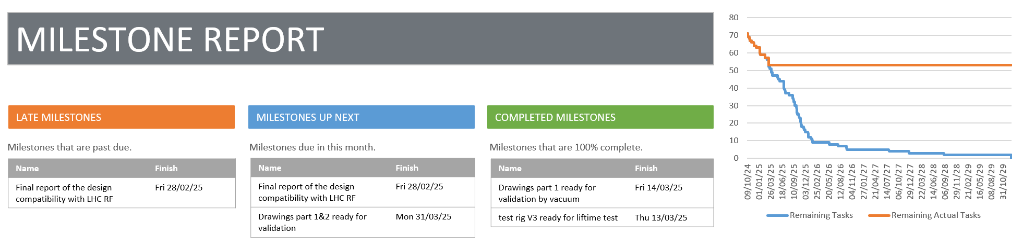
BWS LHC CONS – MS Project reporting
(as good as what we file in it…)

Slide 7
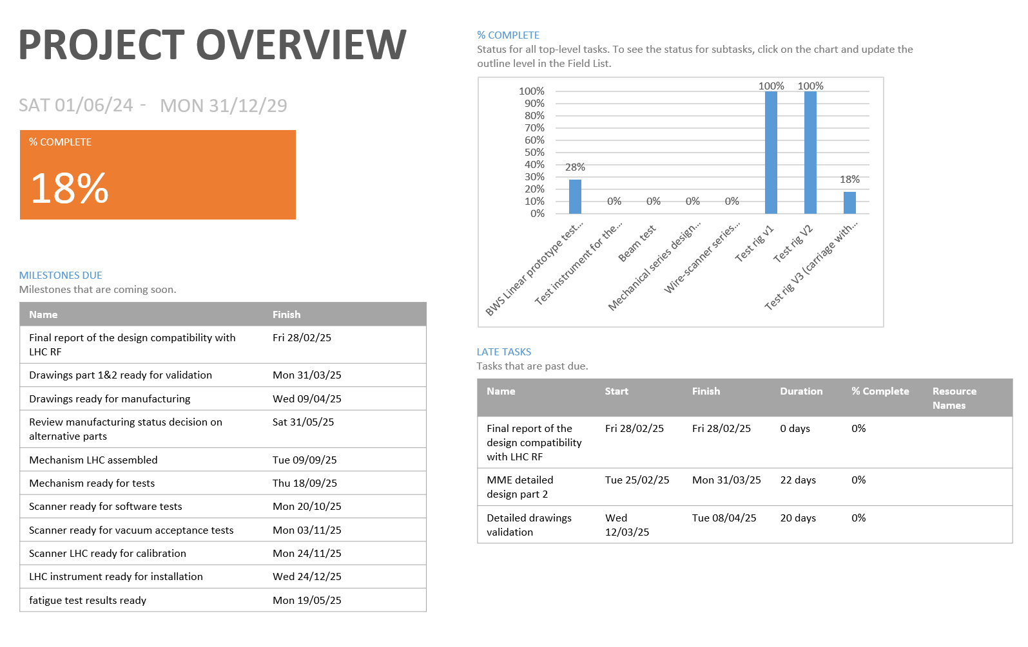

Slide 9
January 2025 recorded activities
09.01.2025 - Kick off detailed linear design SY-BI / EN-MME
=> status update today (Harry)
14.01.2025 - January BWS LHC CONS meeting
https://indico.cern.ch/event/1503356/
21.01.2025 - Magnet system for LHC BWS - final design
https://indico.cern.ch/event/1504619/
=> Magnet team waiting for simulation inputs (Jonathan/Harry)
23.01.2025 - BI consolidation activities review
https://indico.cern.ch/event/1478672/
28.01.2025 - Optical ruler design discussion
=> missing info on the markings (Jonathan)

Slide 10
Proposed project structure (presented BI cons day 23.01.2025)
Milestones and Deliverables
WU 1 | Next activities/ milestones/deliverables | Date Expected
WU 1 | Design/production/test of a prototype in the LHC | By 09.2026
WU 1.1 | Detailed design with MME | By 05.2025
WU 1.2 | Production of the protype LHC (mechanical, electrical) | By 10.2025
WU 1.3 | Laboratory test of the prototype (vacuum, RF, motion?) | By 12.2025
WU 1.4 | LHC Beam test and analysis | By 07.2026
WU 2 | Next activities/ milestones/deliverables | Date Expected
WU 2 | Design/production/test of dynamic proto in the Laboratory | By 05.2026
WU 2.1 | Detailed design with MME | By 05.2025
WU 2.2 | Production (mechanical, electrical, c-wire technology) | By 10.2025
WU 2.3 | Laboratory test of the prototype (motion, calibration with laser) | By 05.2026
WU 3 | Next activities/ milestones/deliverables | Date Expected
WU 3 | Design/production/validation of the series for the LHC | By 2029
WU 3.1 | Final detailed design with MME (after results machine & lab tests) | By 04.2027
WU 3.2 | Production of the series (mechanical, electrical, PMT, etc…) | By 06.2028
WU 3.3 | Calibration of the instruments in the Laboratory | By 12.2028
WU 4 | Next activities/ milestones/deliverables | Date Expected
WU 4 | Installation 4 new linear scanners + validation with beam | By end 2031
WU 4.1 | Installation of the 4 scanners in the LHC | By 12.2029
WU 4.2 | Validation with beam, comparison against OP systems | By end 2031
WU 5 | Next activities/ milestones/deliverables | Date Expected
WU 5 | Installation and validation 4 spares linear scanners in LHC | By end 2032
WU 5.1 | Decommissioning Hybrid+ and installation 4 last scanners | By end 2031
WU 5.2 | Validation with beam, comparison against OP scanners | By end 2032

Slide 11
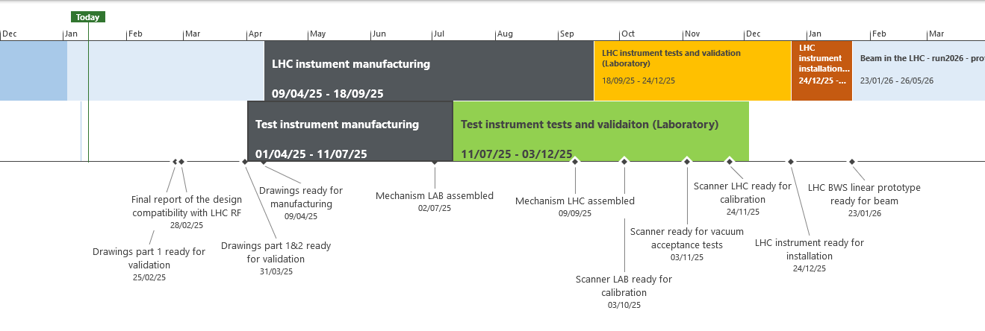
Planning
Today
Jul '24
Oct '24
Jan '25
Apr '25
Jul '25
Oct '25
Jan '26
Apr '26
Jul '26
Oct '26
Jan '27
Apr '27
Jul '27
Start
01/06/24
Mechanical design
02/09/24 - 09/04/25
LHC instument manufacturing
09/04/25 - 18/09/25
LHC instrument tests and validation (Laboratory)
18/09/25 - 24/12/25
LHC instrument installation in the LHC
24/12/25 - 23/01/26
Beam in the LHC - run2026 - prototype test with beam
23/01/26 - 26/05/26
Mechanical series design and production
28/07/26 - 28/07/27
Wire-scanner series installation in the LHC
29/07/27 - 27/08/27
Finish
27/08/27
✔Mechanical pre-design ready for detailed design
09/01/25
Test instrument manufacturing
01/04/25 - 11/07/25
Test instrument tests and validaiton (Laboratory)
11/07/25 - 03/12/25

Slide 12
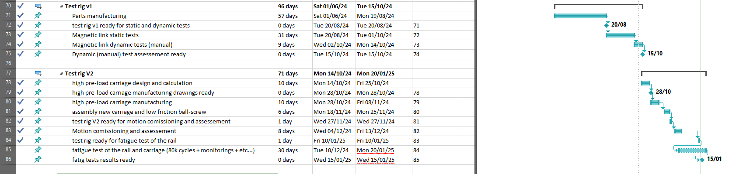
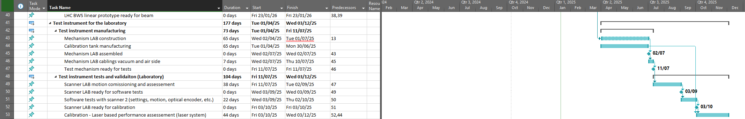
Laboratory test instruments

Slide 13
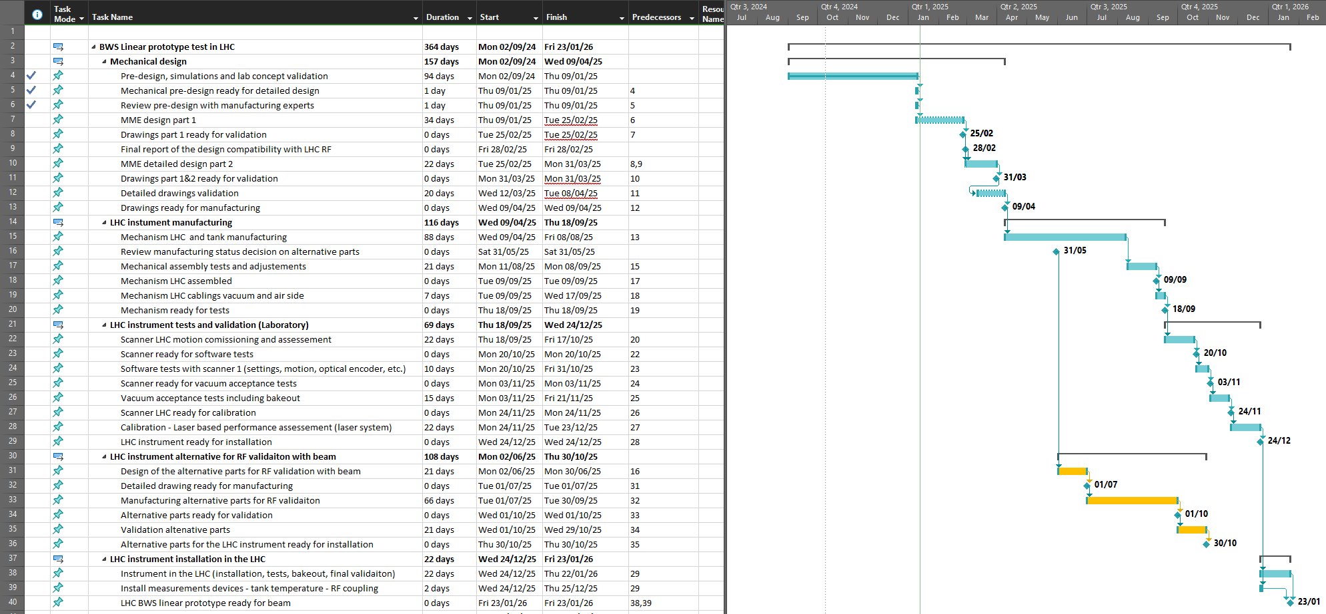
LHC test instrument

Slide 14
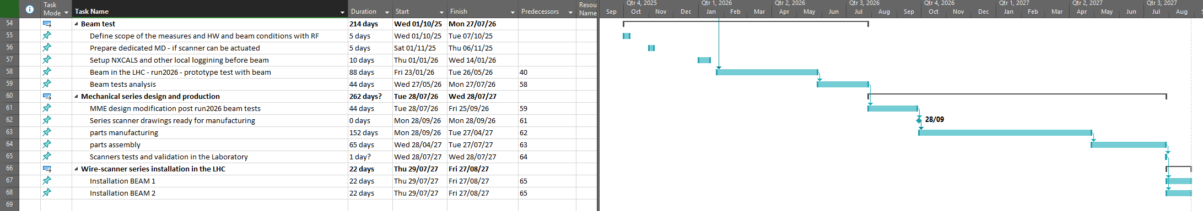
New entries:
LHC test instrument validation and series production

