Slide 1

System Identification for Trajectory Optimization
SY
Accelerator System
Marie Faure (SY-BI-PM)
14/03/2025

Slide 2
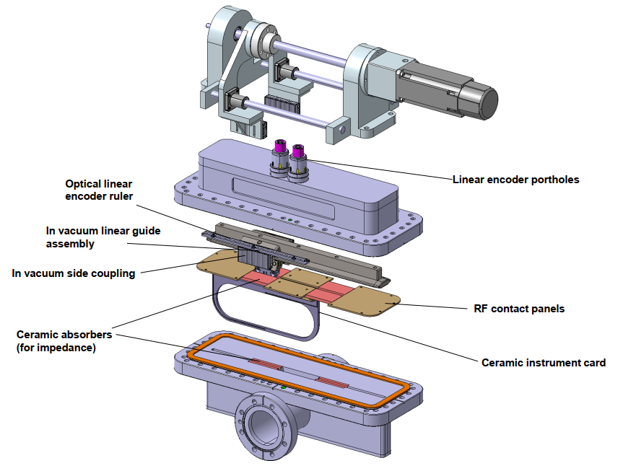
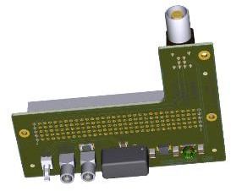
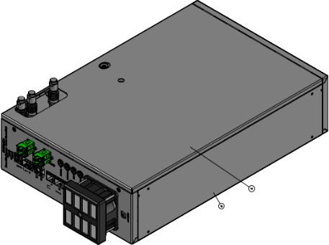
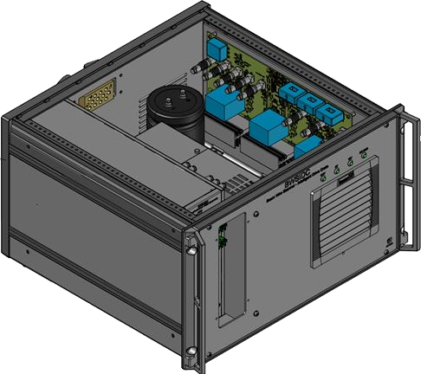
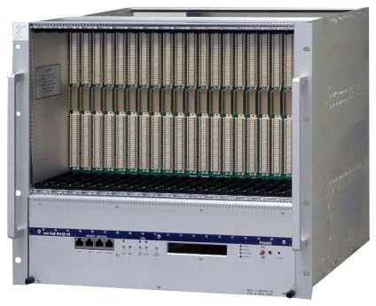
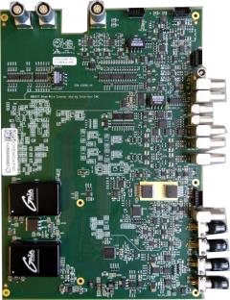
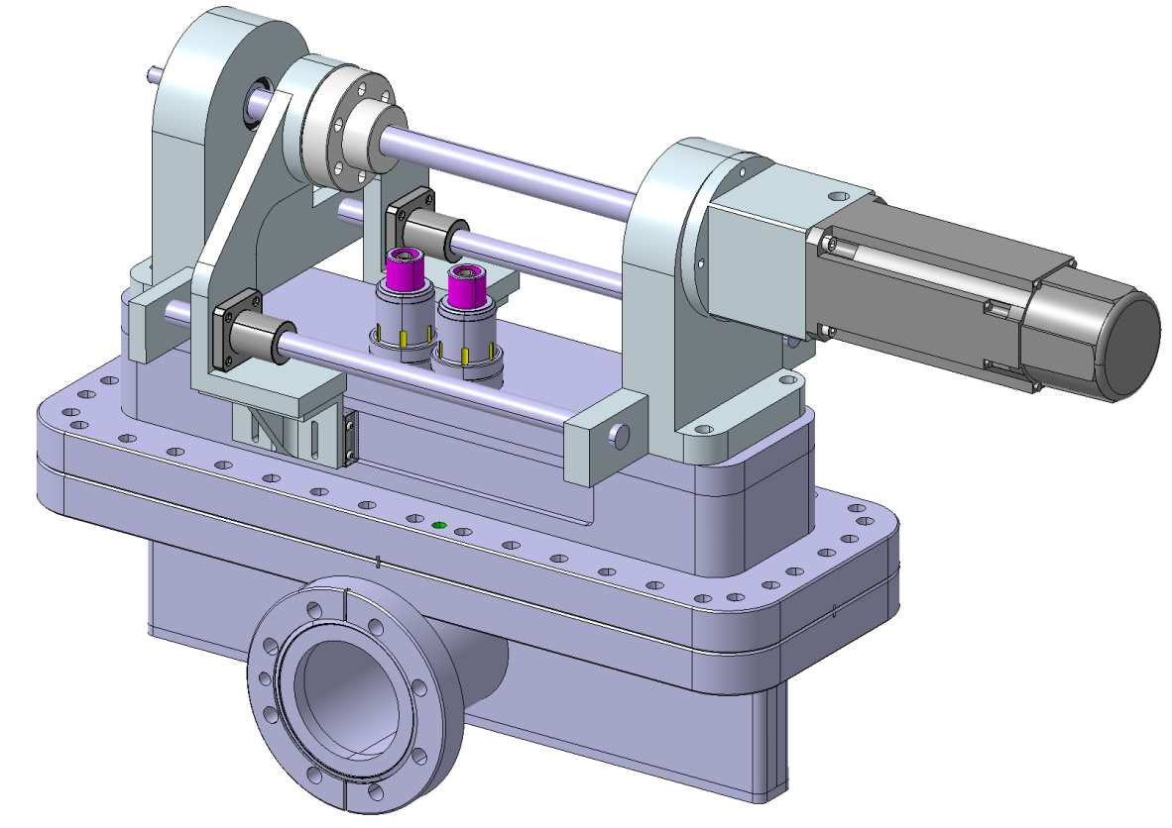




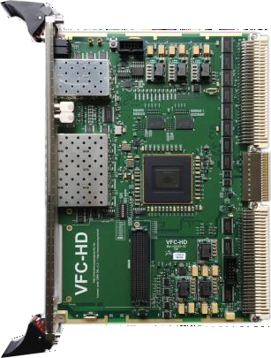

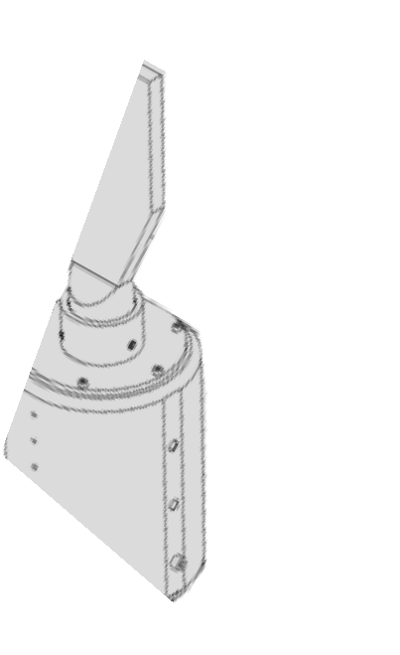

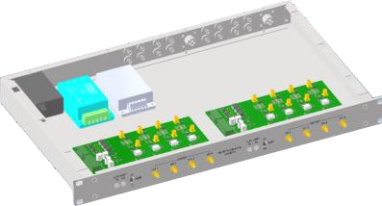
Project Description
System definition:
1 magnet actuated by the PMSM through a ball screw
  Air side
1 magnet following the 1st one along the rail
  Vacuum side separated by a membrane
Brake locking power
MCU
IDC
Acquisition & Supervision crate
LIN POT
Wire, ESN, brake
Position (Resolver)
Power
Ethernet
Analog Interface FMC
SY
Accelerator System

Slide 3
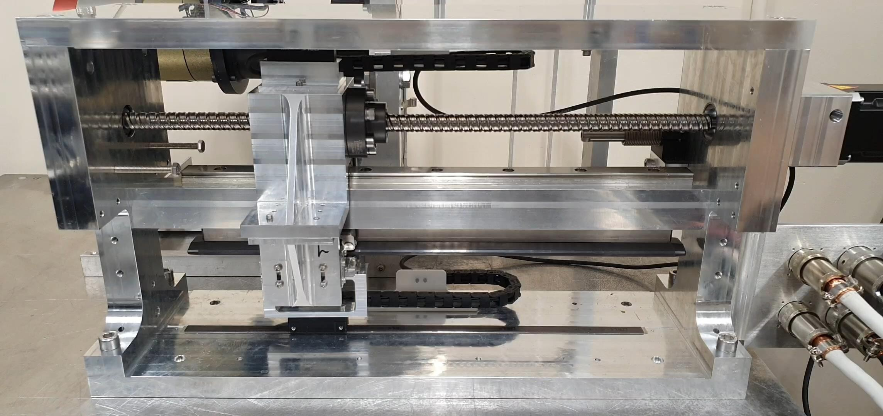
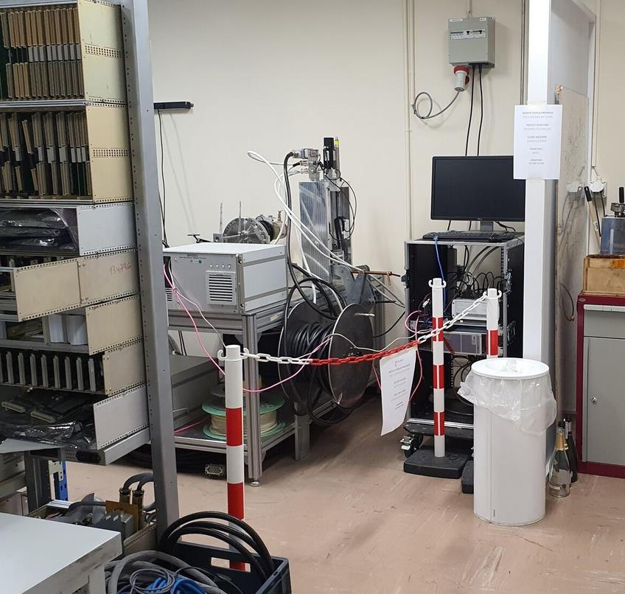
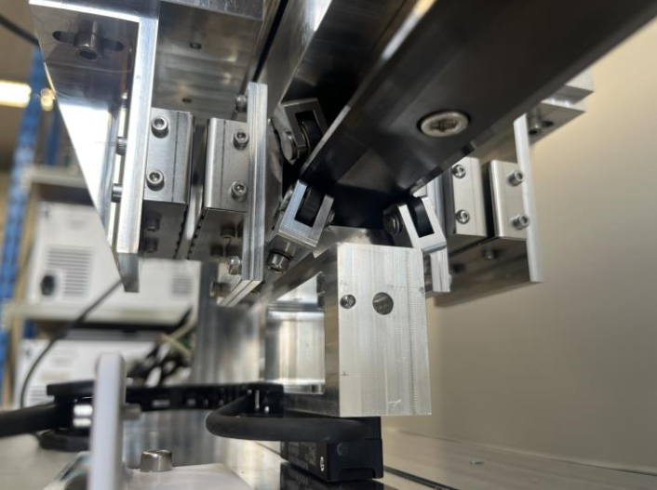
Project Description
Testbench
PMSM
Acquisition & Supervision
IDC
Vacuum side
Air side
Wire support
SY
Accelerator System

Slide 4
Goal of system modeling
System definition:
1 magnet actuated by the PMSM through a ball screw
  Air side
1 magnet following the 1st one along the rail
  Vacuum side separated by a membrane
Issue:
The magnet following has tendencies to oscillate which leads to an imprecision of the wire position
Goal:
Create an optimal trajectory for the following magnet to avoid oscillations
Creation of a model of the physical elements to understand the dynamics between the 2 parts
SY
Accelerator System
Notes:
Identify a System Model from Real Data:
In my work, I developed a script identifying a model that captures the dynamics of the system based on multiple datasets called experiments. This script allows me to input multiple datasets collected from different amplitudes and inputs. It explores various model orders, including different numbers of poles, zeros, and delays, to find the combination that best fits my measured data.
In simpler terms: I am trying to answer the question: “Which transfer function best represents how Magnet 2 moves when Magnet 1 is driven by certain inputs?” This model points any resonant frequencies, which are crucial to avoid exciting during motion.
For the trajectory generation based on the work done on the previous system: I used S-curve trajectory optimization (based on cascaded rectangular smoothers) and a Matlab tool created by the writers of the paper called the “BuildTrajectoryGenerator.” This time-optimized trajectory generator incorporates built-in constraints on velocity, acceleration, jerk, and frequency content. If my identified model indicates a resonance around 35 to 40 Hz, this script helps me plan paths or velocity profiles that effectively avoid introducing energy in that frequency range. But this part is still to be improved.
Once you know where the system resonates, you use this trajectory generator to shape the motion commands so you don’t shake or excite that resonance. The script ensures the motion respects physical limits (max velocity, acceleration, jerk) and the system’s sensitivity at certain frequencies

Slide 5
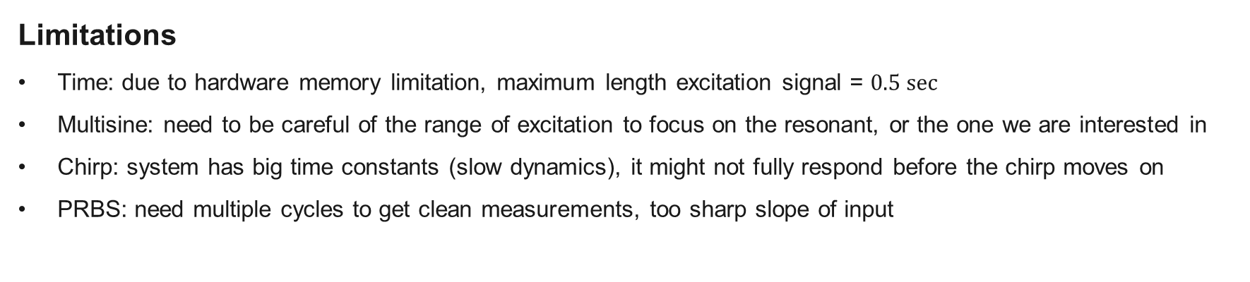
How to identify the system
Multifrequency excitation
Multisine: addition of a range of sinusoidal signal
Chirp: increasing the frequency of a signal in a given range
PRBS: random binary signals
Limitations
Time: due to hardware memory limitation, maximum length excitation signal = $0.5 sec⁡$
Multisine: need to be careful of the range of excitation to focus on the resonant, or the one we are interested in
Chirp: system has big time constants (slow dynamics), it might not fully respond before the chirp moves on
PRBS: need multiple cycles to get clean measurements, too sharp slope of input
SY
Accelerator System
Notes:
About system identification, one common approach is to excite the system with known signals (like multisine, chirp, or PRBS) and measure how it responds. This helps us extract frequency-response data
However, we have some practical limitations: we can only capture about half a second of data due to hardware memory limits, so we must choose our excitation signals carefully. If we don’t stay within a meaningful frequency band or if the system can’t fully respond in the given time, our data might not accurately capture the dynamics

Slide 6
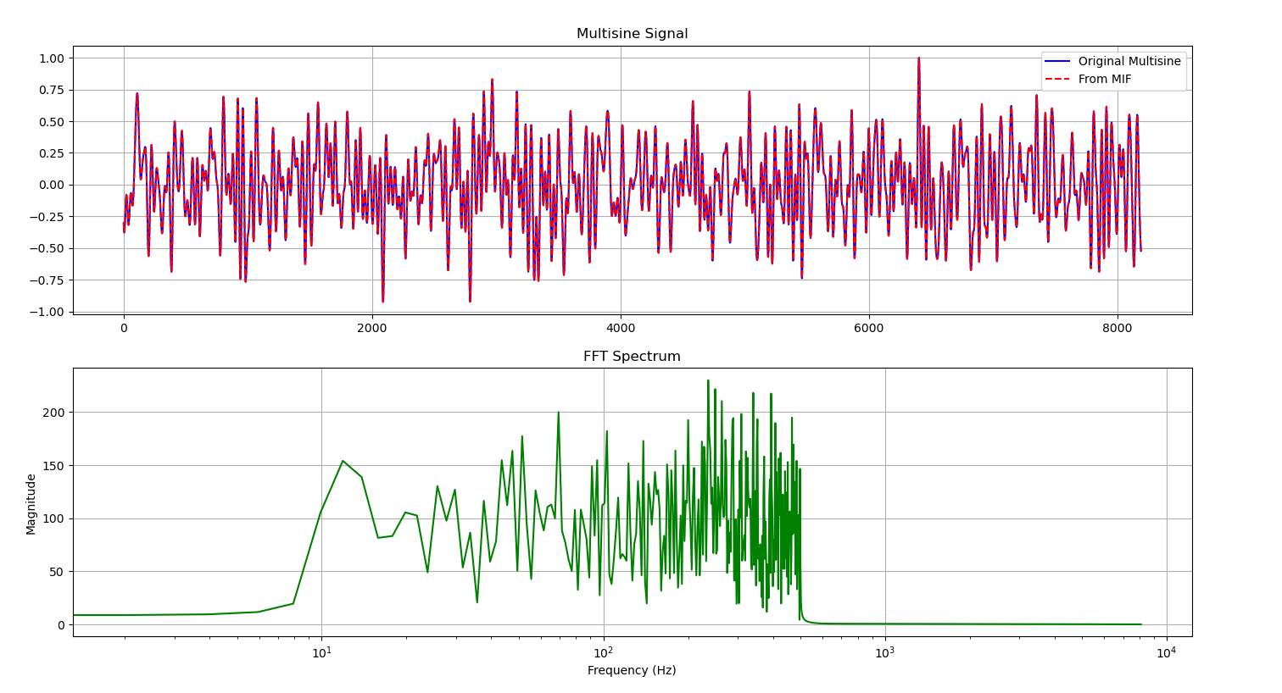
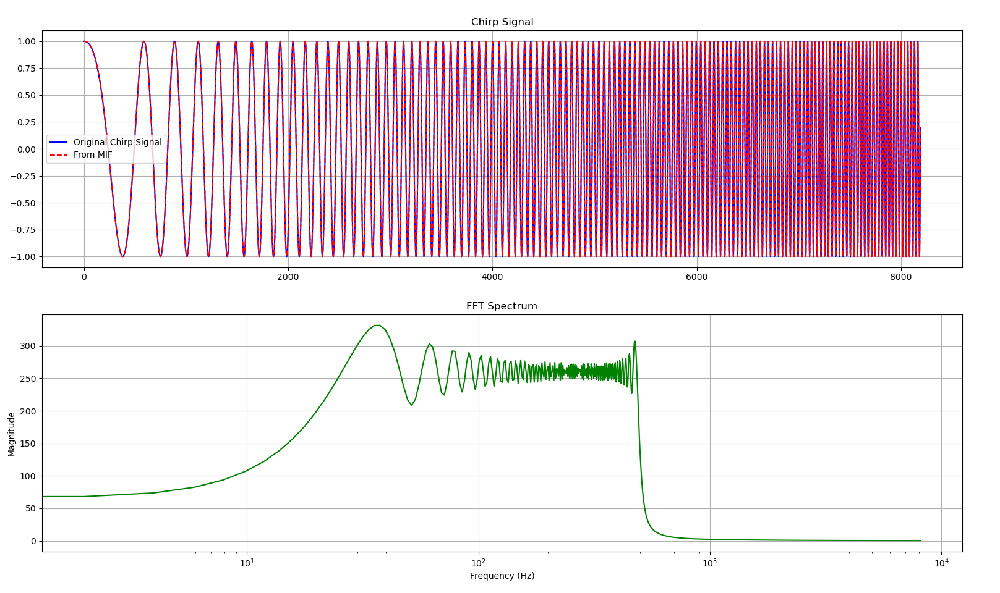
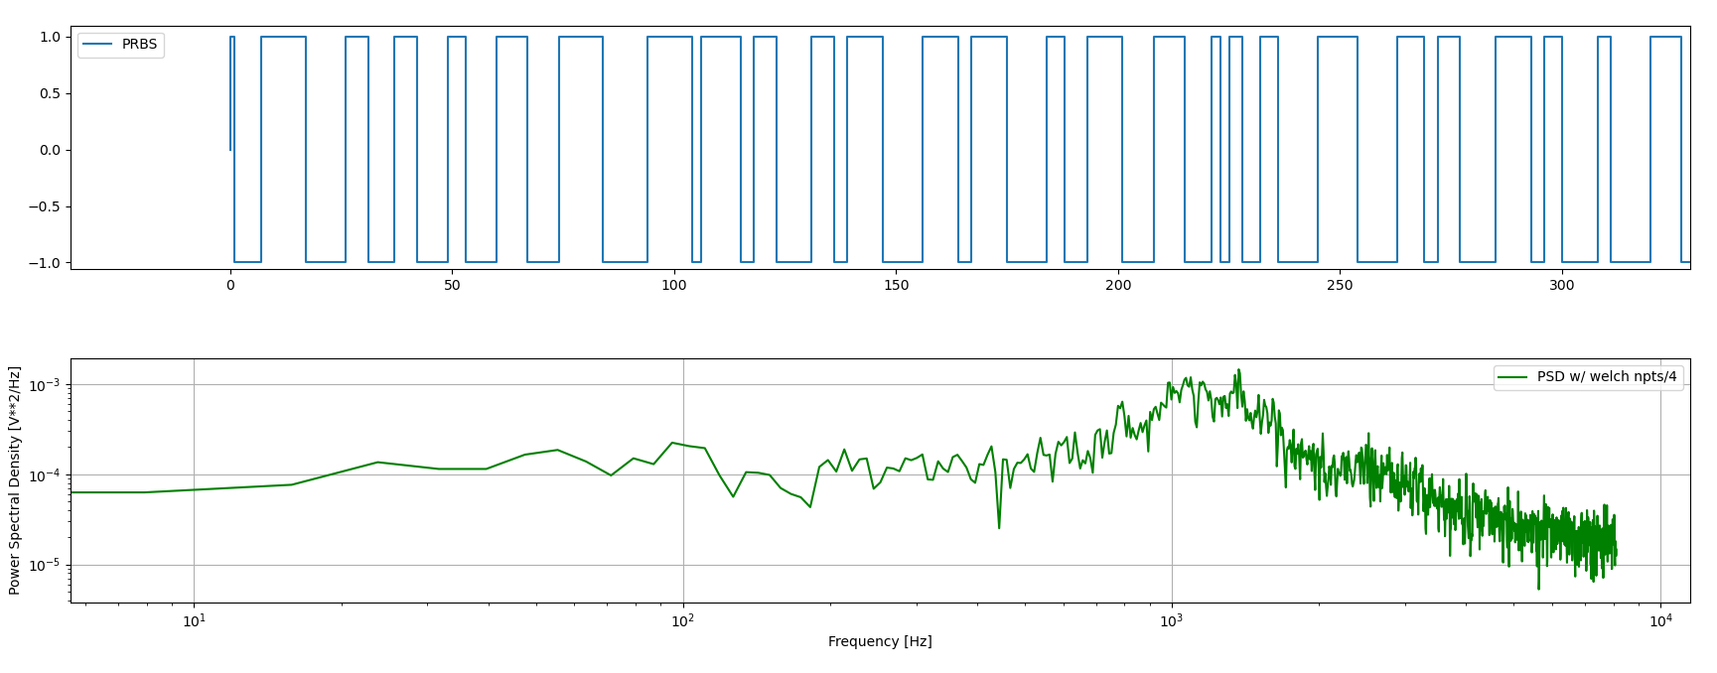
How to identify the system
Chirp
Multisine
PRBS
SY
Accelerator System
Notes:
Here, you can see the schematic representations of the three signals used. With multisine, we combine different sinusoids at selected frequencies to excite the system. The chirp signal sweeps from low to high frequency, and the PRBS is a pseudo-random binary sequence. Each has trade-offs, especially given our hardware constraints and the slow dynamics of the magnet coupling.

Slide 7
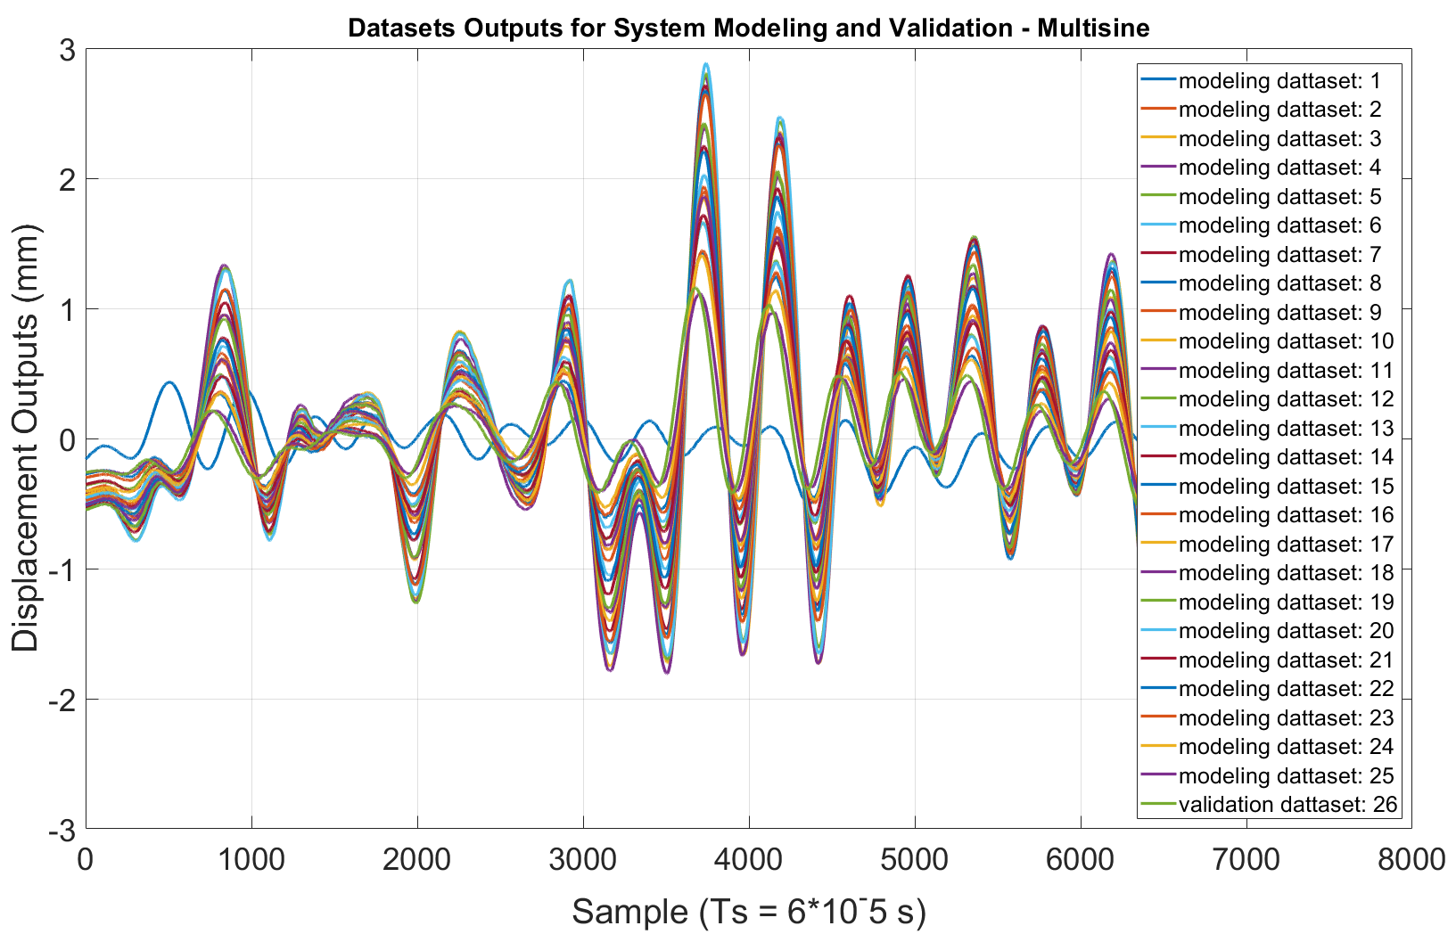
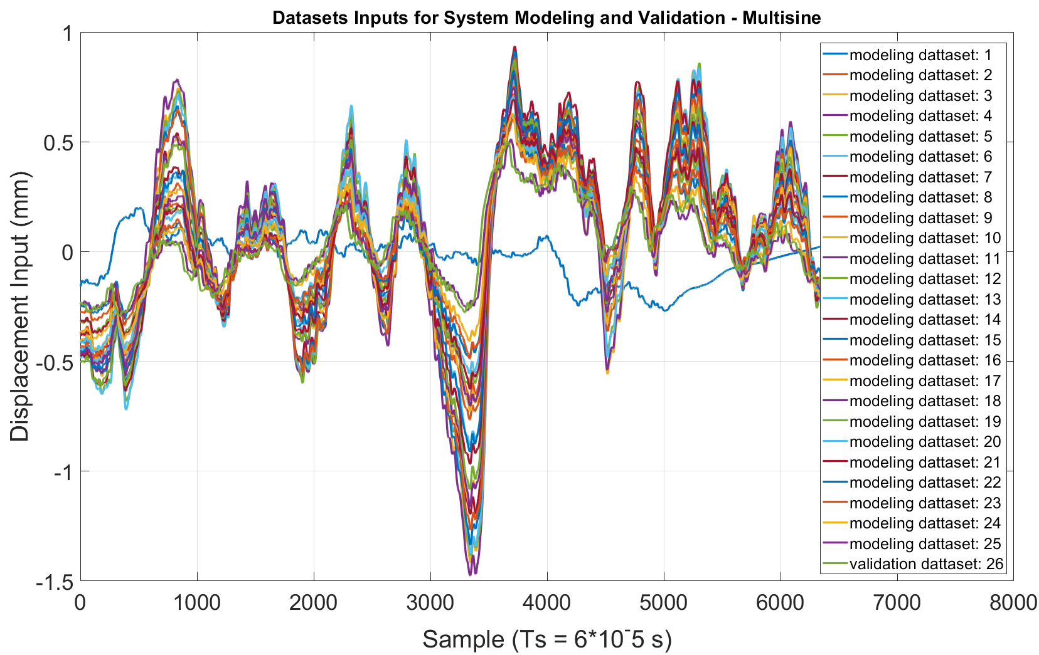
How to identify the system
Data Collection
Changing the amplitude of the input signal to get different outputs from the system
Multisine 8192 set points values, different amplitudes
25 datasets for modelling, 1 for validation
SY
Accelerator System
Notes:
To identify the system properly, we repeated the multisine excitation with different amplitudes.
By amplitude I mean that on the Acquisition and supervison post, the set point table (hardcoded in the FPGA memory) is from 0 to 1 and with an offset and a gain we can control the amplitude of the signal (current). What we excite is not straightly the position it is the current that leads to the excitation of the physical parts we are interested in.
A specific datasets for model is designated training and others for validation, following standard practice in system identification to avoid overfitting.

Slide 8
How to identify the system
Modelling based on data
Goal is to have a transfer function that could be used for modeling the system entirely in the future
Goal is to have the least number of parameters with the highest accuracy of the system
Method
Using the transfer function estimator function on MATLAB, trying to fit the frequency response of the real system
Trying with different parameters (poles and zeros)
Trying with Multisine and chirp datasets
Modeling steps
1 Processing the data (cutting the useless data (0) and detrending due to the gravity compensation)
Gathering datasets into 2 sets: training data for the model and validation data for verification of the designed model
Variating parameters of the transfer function
Finding the transfer function coefficients
Simulate outputs from the validation datasets input and compare the predicted output to the real output
Analyse the model responses
SY
Accelerator System
Notes:
Here, I’m focusing on how the models of our system from the data we’ve collected were built.
1)
Before modeling, we remove any “dead” intervals in the data where there is no meaningful motion (e.g., zero input and zero output). This ensures our analysis focuses on the segments where the system is actively responding
We also detrend the data to account for gravity compensation. In other words, we subtract any constant offset caused by holding the magnet against gravity, so the model sees only the dynamic part of the motion rather than a static shift
2)
We merge several experiments into one comprehensive dataset, then split it into two subsets: A training set to estimate or “fit” the transfer function parameters (poles, zeros, delays, etc.).
A validation set to test how well the fitted model predicts new, unseen data. This step guards against overfitting and tells us how robust the model is.
3)
We try different model structures: for example, 1-pole vs. 2-pole vs. 3-pole systems, with different numbers of zeros and possible input-output delays.
Each candidate model is evaluated, and we keep track of performance metrics like mean-squared error (MSE) and fit percentage.
4)
After identifying the most promising structure, we solve for the actual numerical coefficients (pole and zero locations, gain, and delay). These coefficients define how the system’s output responds to a given input.
5)
With the chosen model, we use the validation data’s inputs—which the model has never “seen” during training—and simulate the output.
We then compare the simulated output with the real measurement to check how closely the model replicates reality. A good match means the model is capturing the essential dynamics.
6)
Finally, we evaluate residuals (the difference between measured and simulated outputs), look for patterns in the error (e.g., correlated noise), and confirm whether the resonant frequency region is correctly identified.
This analysis helps us confirm that the model is reliable enough for subsequent tasks, like trajectory optimization to avoid exciting unwanted oscillations.

Slide 9
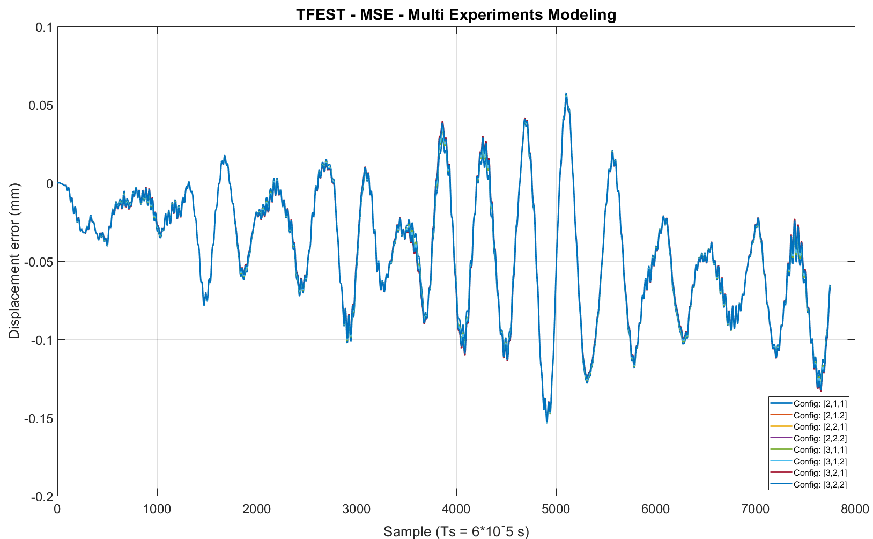
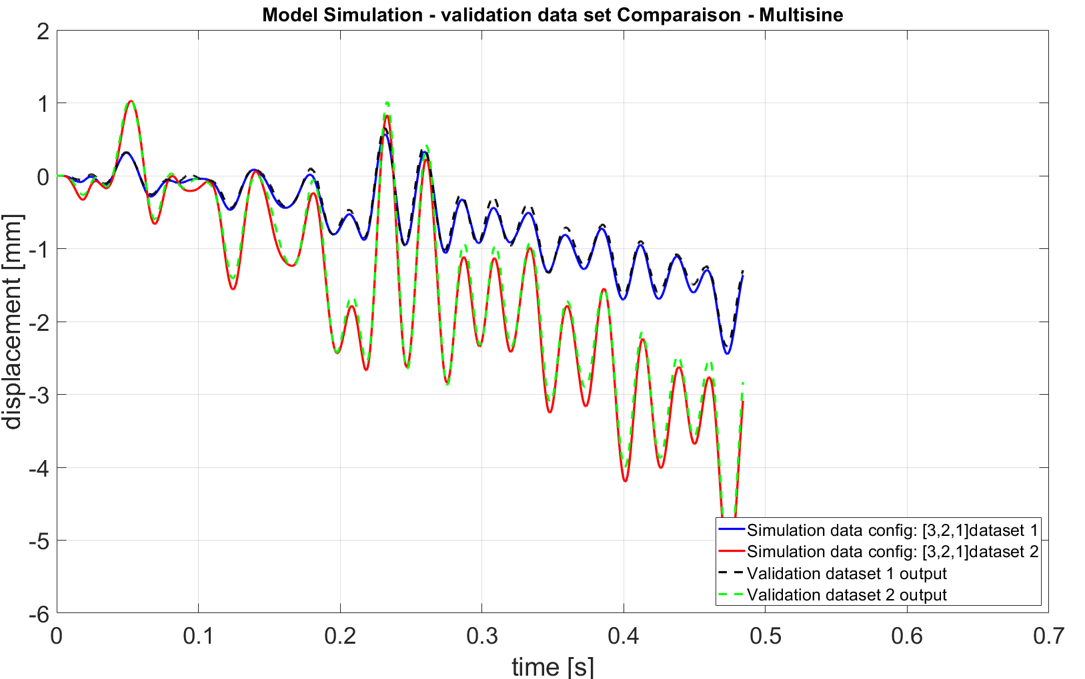
Results - Multisine
Model Validation: simulation of the output based on validation input and comparison
Similar residuals for models with poles>1
SY
Accelerator System
Notes:
This plot compares the real system output with the model’s simulated output for a validation dataset. We can see the residuals remain relatively small, indicating that the model captures the primary dynamics when the excitation type is similar (i.e., multisine). Models with more than one pole show better fit.

Slide 10
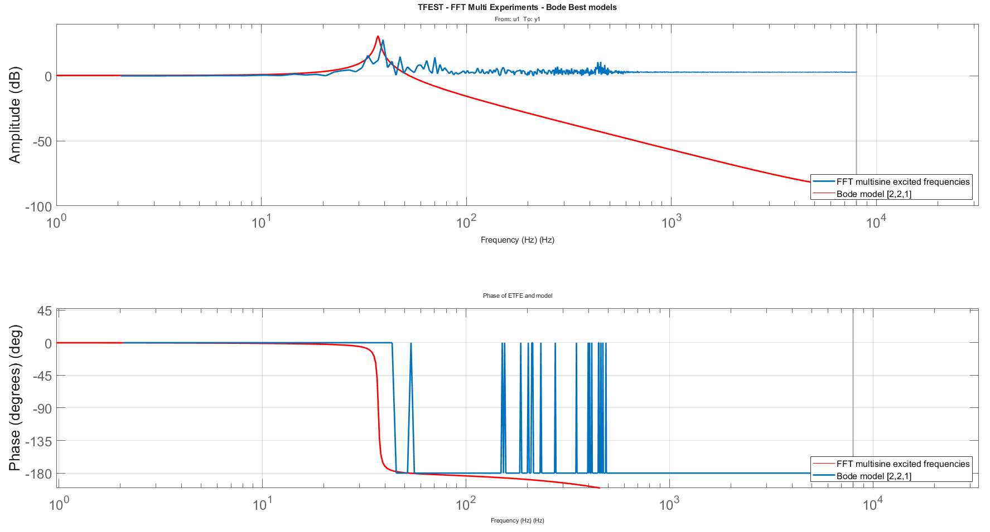
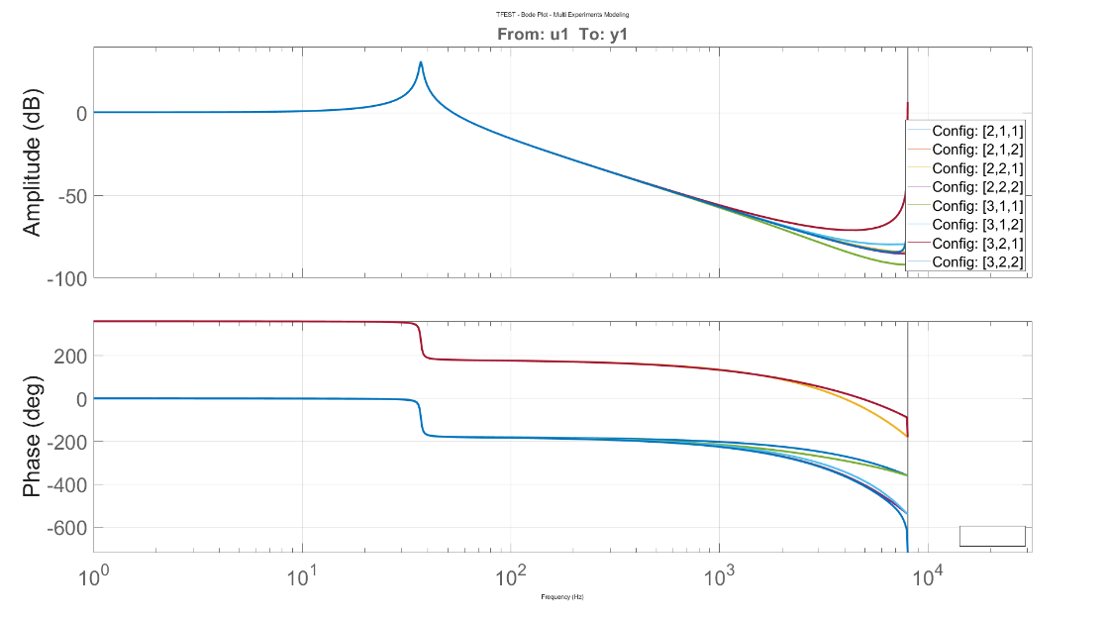

Results - Multisine
Model Frequency response
Resonant frequency identification
High frequency noisy -> amplitude to 1 (out/in), Multisine didn’t excite these frequencies
$$f_{model}=37 Hz$$
$$f_{ETFE}=39 Hz$$
SY
Accelerator System
Notes:
From the frequency response, we identified a resonant frequency around 37–39 Hz using both the model and the Empirical Transfer Function Estimate (ETFE). Notice how amplitude spikes near resonance. Above this frequency, the system is noisy, partly because the multisine did not sufficiently excite those higher band

Slide 11
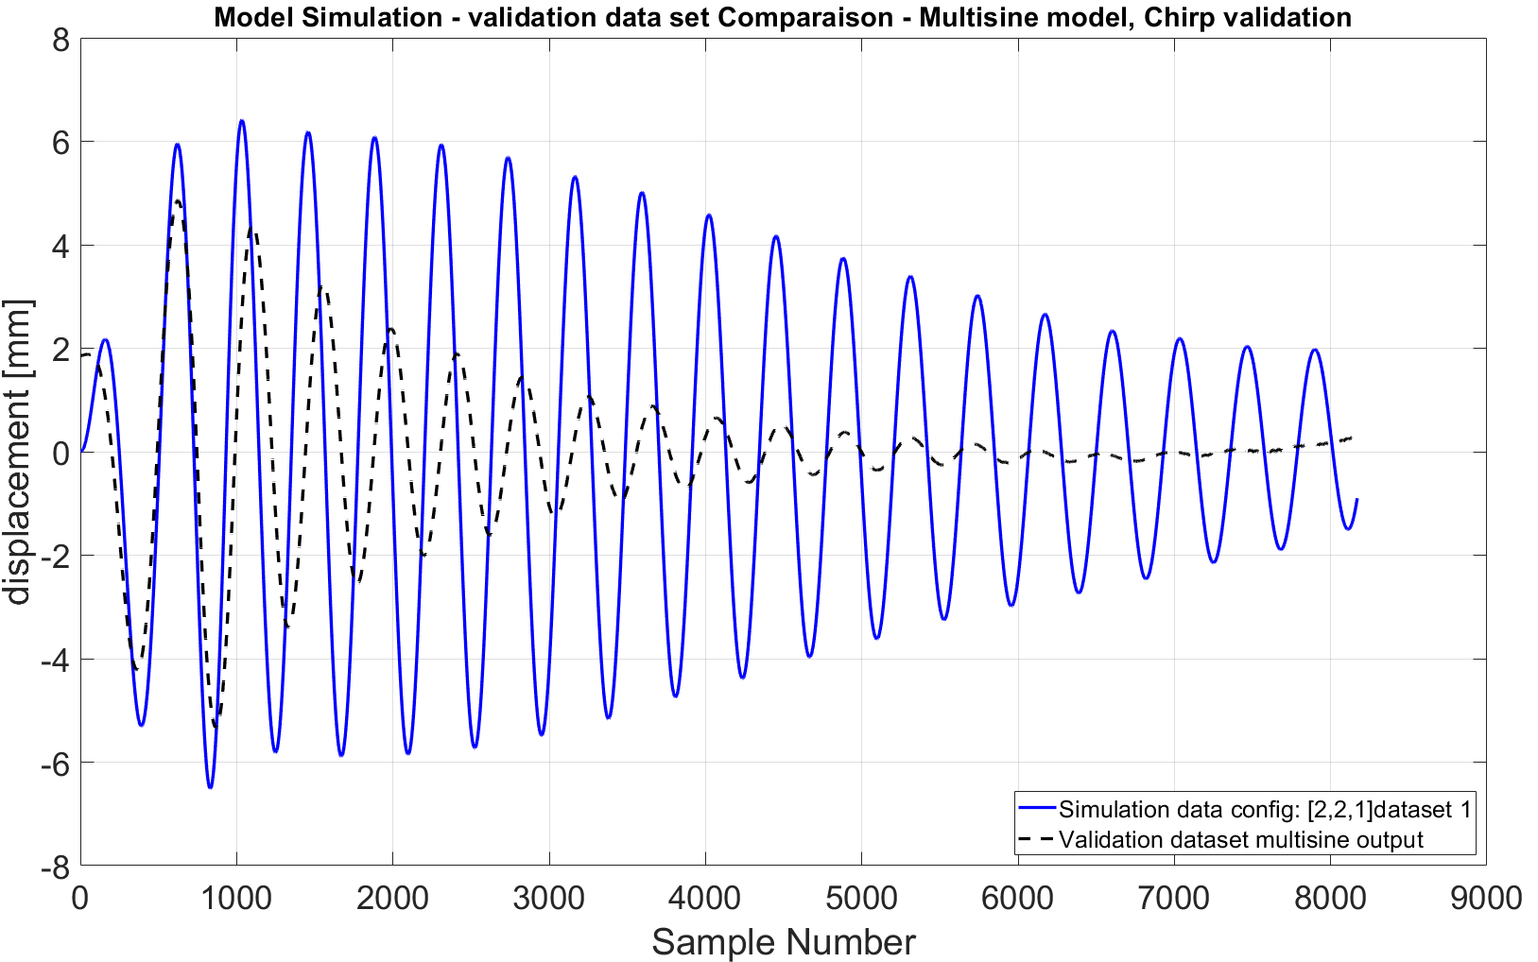
Results - Multisine
Model Cross Validation: validation dataset: chirp, modeling: multisine
Bad behavior when unknown validation dataset -> multisine limits
chirp
SY
Accelerator System
Notes:
When we used the multisine-based model to predict system output for chirp data, we saw a drop in performance. This suggests that the model is specialized to signals similar to what it was trained on. The chirp input highlights non-uniform dynamics that the model hasn’t fully captured

Slide 12
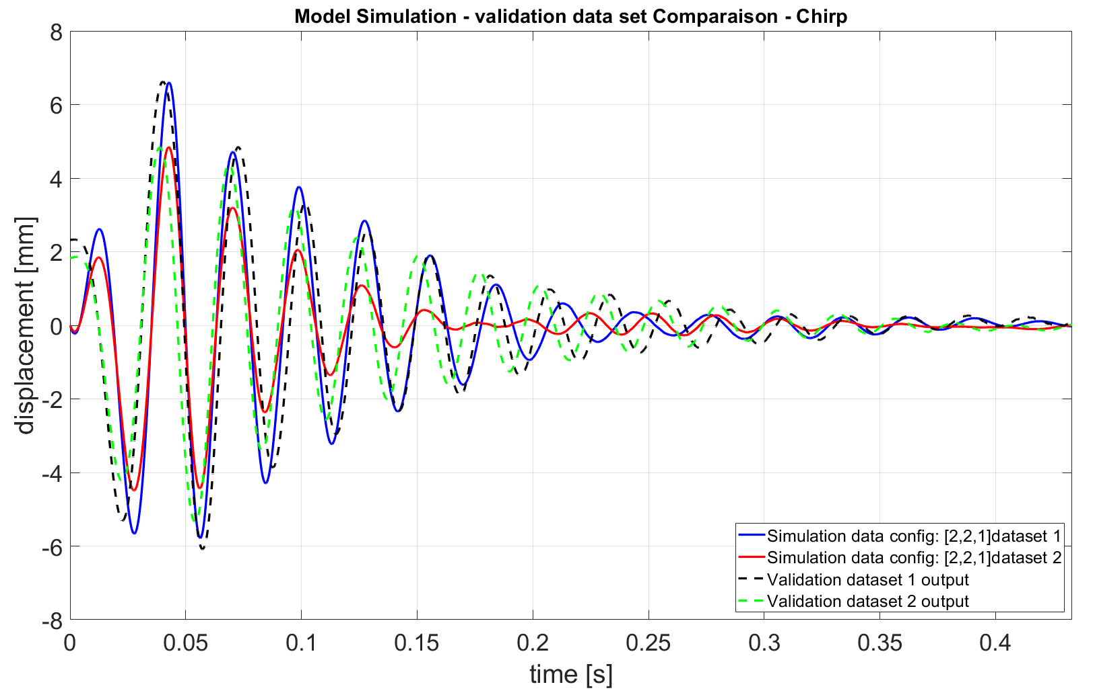
Results - Chirp
Model Validation: simulation of the output based on validation input and comparison
delay seems to vary along the sequence, the dynamic of the system slowly changes due to increasing frequency linearly and not randomly unlike Multisine
In any case, we need the model of the system to design a trajectory optimization, so what matters the most is the dynamic of the system and how the model represents it.
SY
Accelerator System
Notes:
For the chirp-based modeling, the delay appears to vary over time because the frequency content changes continuously. This can reveal mild nonlinearities or variable dynamics. Even though the chirp data produce somewhat larger residuals, we still capture the main system behavior—especially around the resonance range, which is critical for trajectory design.

Slide 13
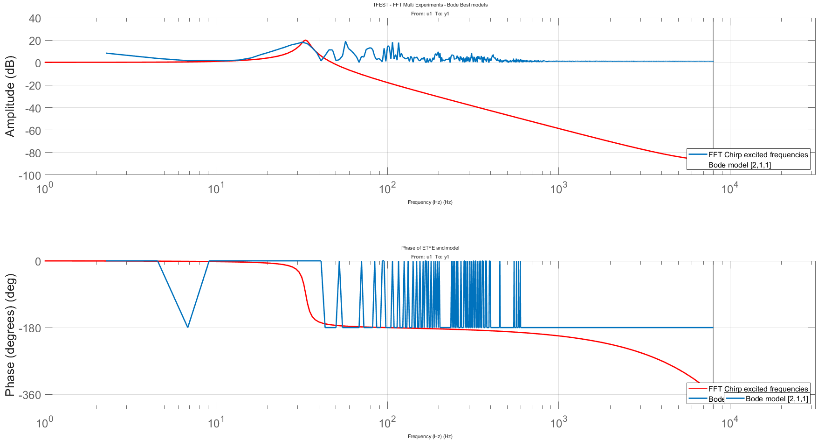
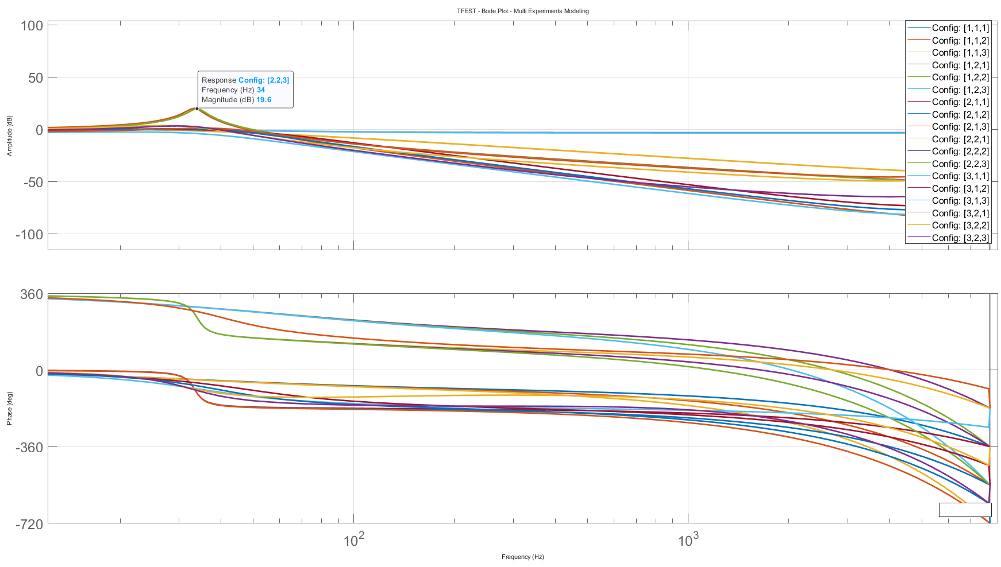

Results – Chirp
Model Frequency response
Resonant frequency identification
Different excitation response with chirp
High frequency noisy -> amplitude to 1 (out/in), multisine didn’t excite these frequencies
$$f_{model}=33 Hz$$
$$f_{ETFE}=32.5 Hz$$
Poles = 1 to be discarded like for Multisine
(doesn’t see the main frequency response)
SY
Accelerator System
Notes:
Here, the chirp-based frequency response also reveals a resonant peak, around 32.5–33 Hz, which is close to what we saw with the multisine. High-frequency noise is more visible in the chirp data because we continuously sweep through those frequencies. Again, low-order models (e.g., single-pole) ignore the main resonance, so a second-order model is more appropriate.

Slide 14
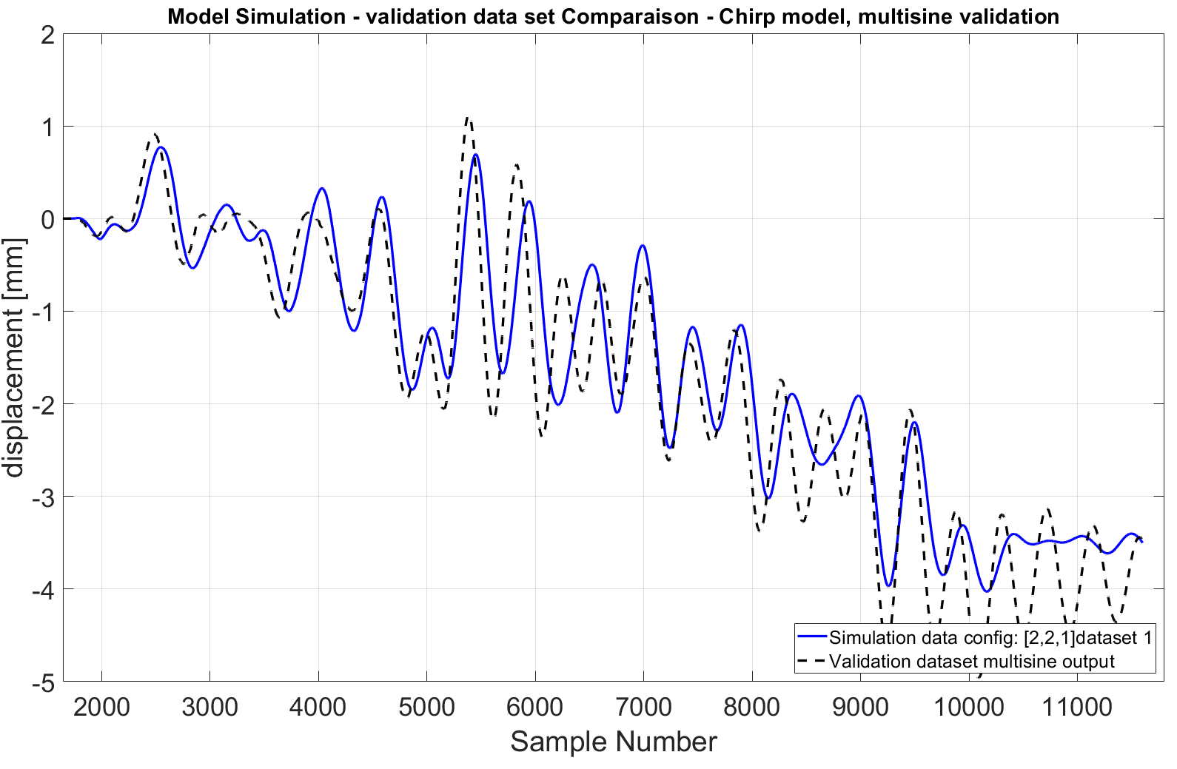
Results - Chirp
Model Cross Validation: validation dataset: multisine, modeling: chirp
Time shift due to non-linearities but good simulation for another type of validation dataset
SY
Accelerator System
Notes:
This time, the chirp-based model does a better job on multisine data than the multisine model did on chirp, suggesting that the chirp-based model has somewhat broader generalization. However, we still see time shifts at certain frequencies, indicating mild nonlinear effects and possibly some parameter drift

Slide 15
Results – Model Selection
Selection Criterion
  MSE but to be criticized
  Fitting rate and fit ration
  Noise distribution
  Ratio: number of parameters, fitting rate
SY
Accelerator System

Slide 16
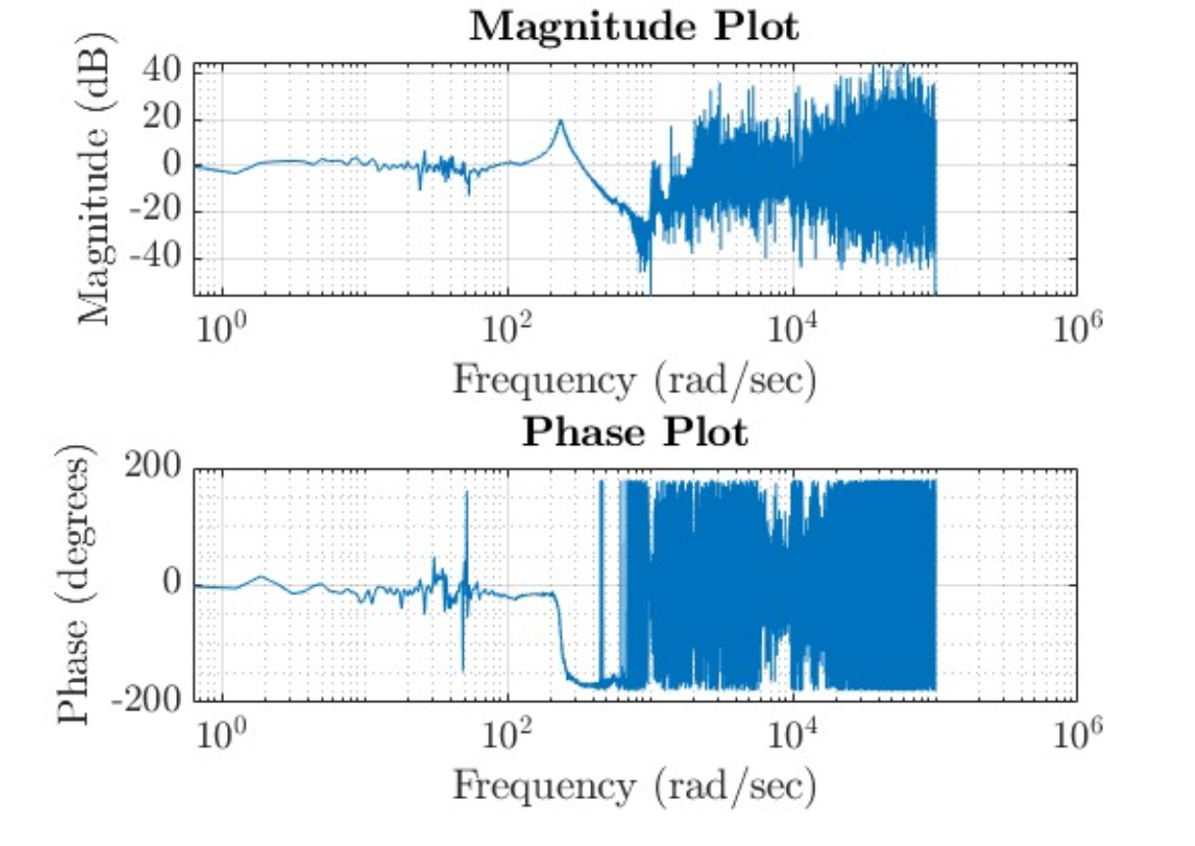
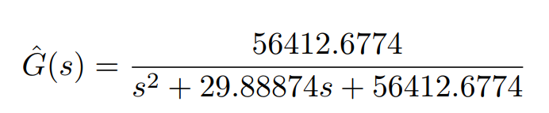
Conclusion
Bode plot for both types of dataset similar (2nd order dynamic)
Residuals more important for chirp but due to non-even excitation
Chirp model passes the cross-validation
Hardware limits (length of identification dataset) are strict and don’t allow to excite multiple cycles on the same dataset which limits the modeling of all frequencies
  What can be done to limit the range of frequency around resonant frequency
Vishnu comparison (old system)
Designed models
Multisine: [2,2,1]
-1.037e-05 z + 0.0002307
------------------------
z^2 - 1.999 z + 0.9996
Chirp: [2,2,1]
-0.005569 z + 0.005736
----------------------
z^2 - 1.998 z + 0.9986
$$fr= 37.56 Hz$$
One zero more
SY
Accelerator System
Notes:
both the multisine and chirp excitations reveal a second-order resonance in the 30–40 Hz range. Because of the hardware limit of 0.5-second data, we can’t fully excite multiple cycles at each frequency, so we have to compromise on frequency resolution and signal type. Nonetheless, we get enough accuracy around the resonance to proceed with trajectory design. Ultimately, we identified second-order dynamics that we can incorporate into an optimal trajectory planning algorithm, which will minimize magnet oscillations and improve positioning precision
One zero =~ 1=> suppress dc noise (low frequencies)

Slide 17
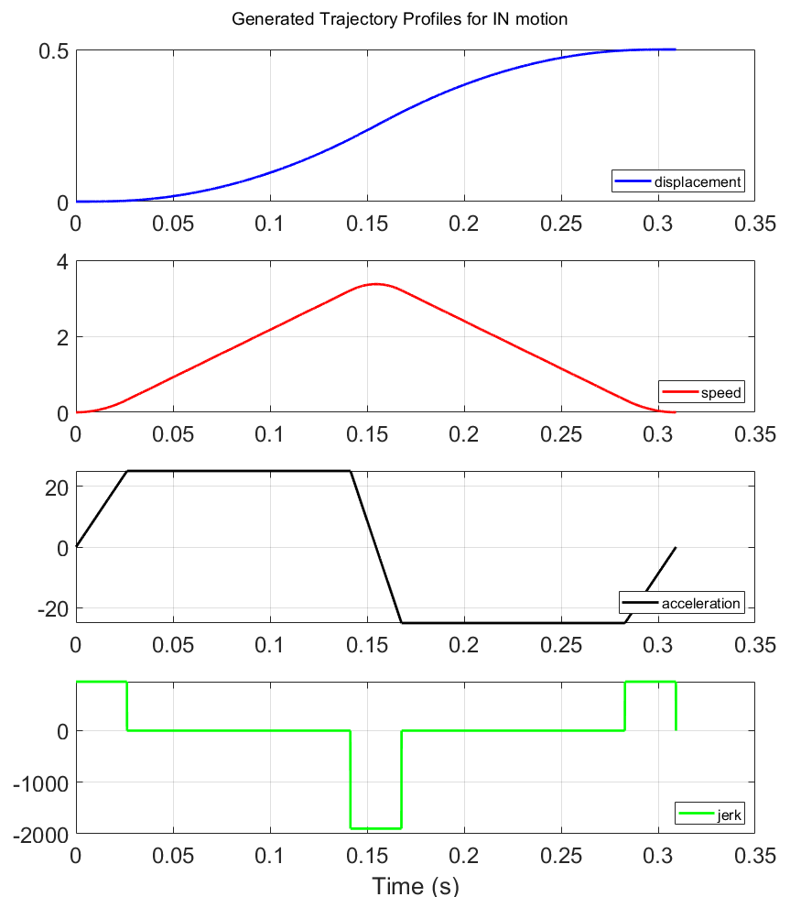
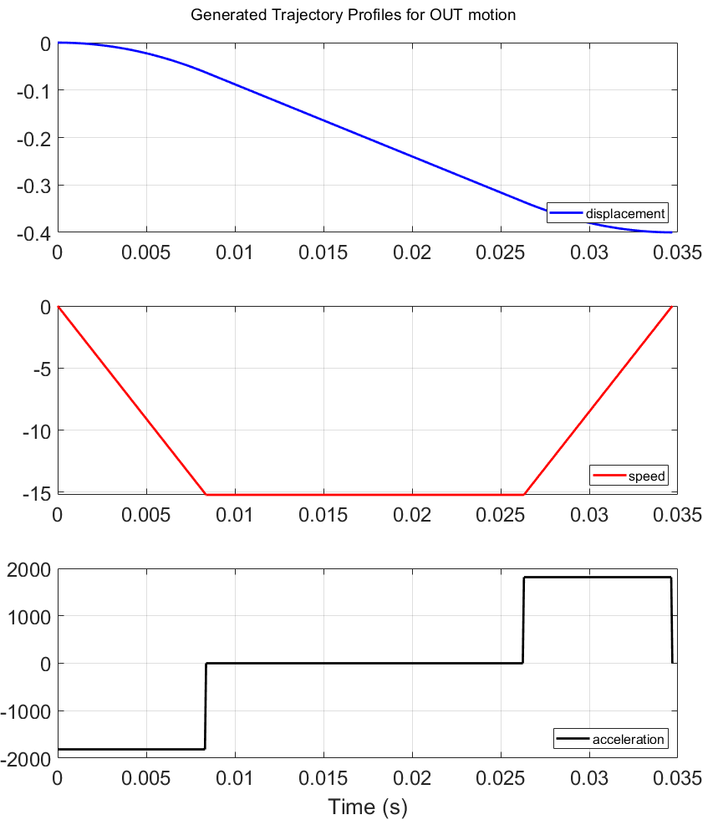
Future work
Set up the testbench with the development hardware (Control desk) for further modeling and trajectory optimization
Using the model to establish an optimal trajectory of the magnet
Example of generated trajectories (kinematics constraints to be finely defined)
SY
Accelerator System

