Slide 1

Science in School
Dr. Nathalie Wössner
Executive Editor

Slide 2
Supporting STEM teachers in inspiring their students and fostering positive attitudes towards the science that shapes our lives.

Slide 3








EIROForum
European Intergovernmental Research Organisation forum
Facilitating interactions with EU organs, national governments, industry
Stimulating transfer of technology
cooperating on large-scale outreach activities to a wide audience
promoting inspiring science teaching

Slide 4
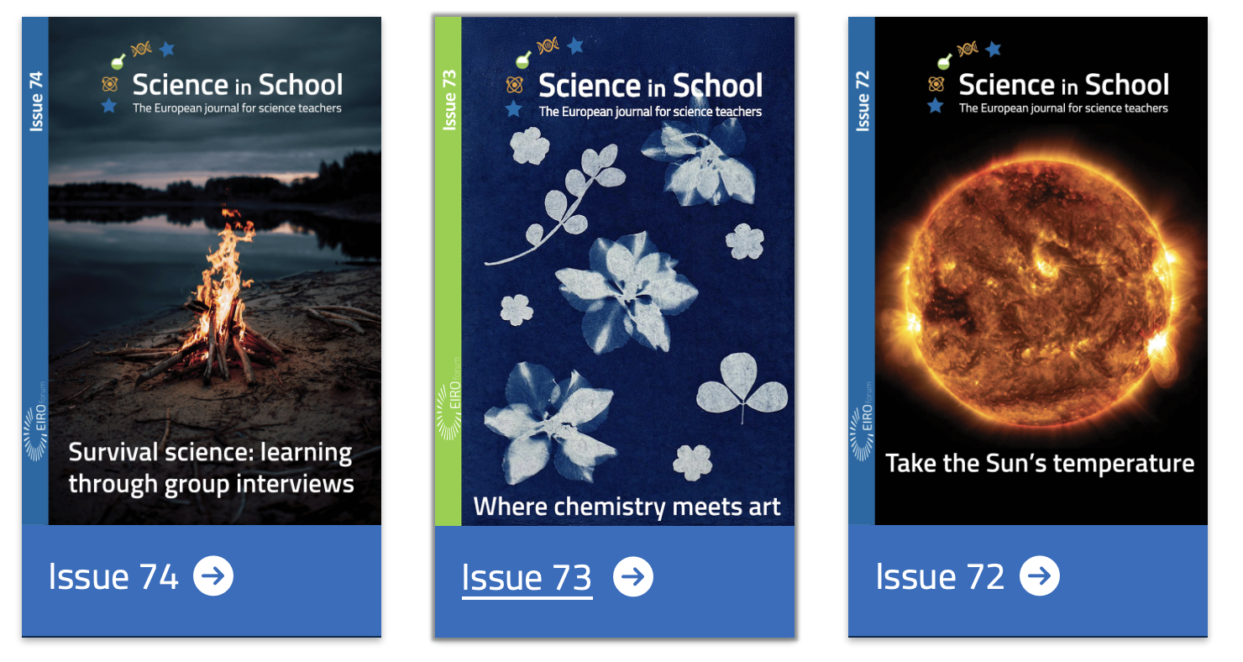
Free & Accessible
Publication online
5 Issues per year
Ca. 1000 articles
32 languages
Across disciplines
Astronomy, Biology, Careers in STEM, Chemistry, Coding, Engineering, Health, Mathematics, Physics, Science and society, Sustainability…

Slide 5
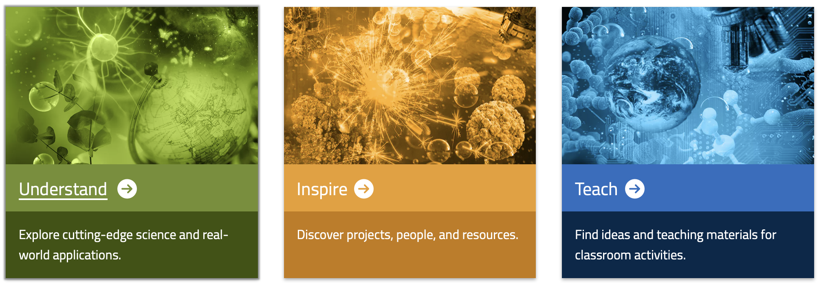
What’s featured?

Slide 6
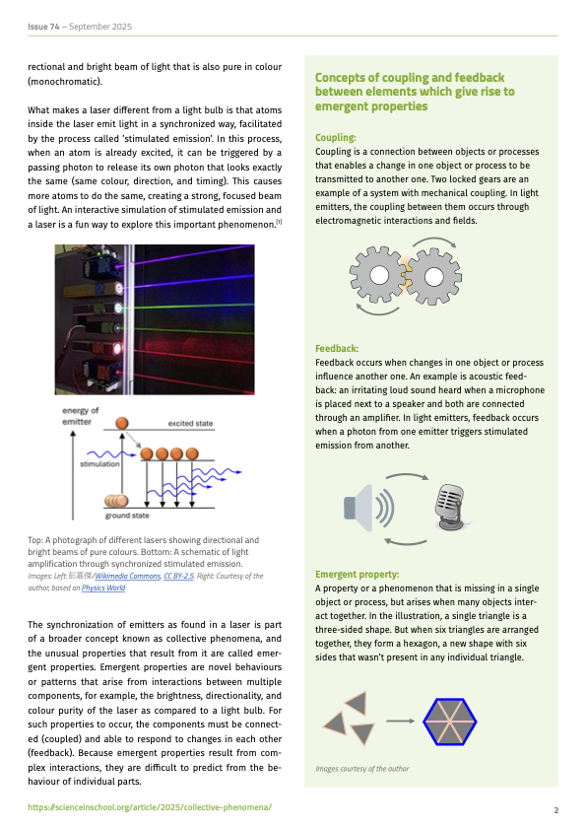
UNDERSTAND
340 articles
Current research
Underlying principles
New technologies
Real-life applications

Slide 7
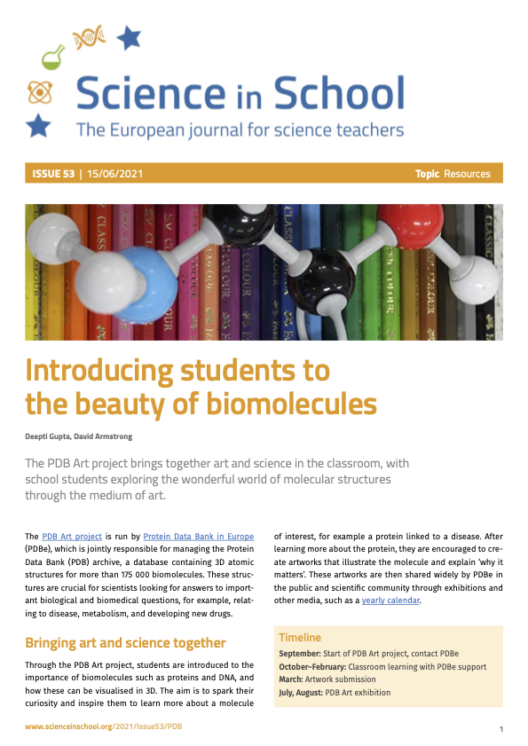
INSPIRE
306 articles
Inspiring methods
High-impact news
Programs for schools
People in science
Diversity in Science

Slide 8
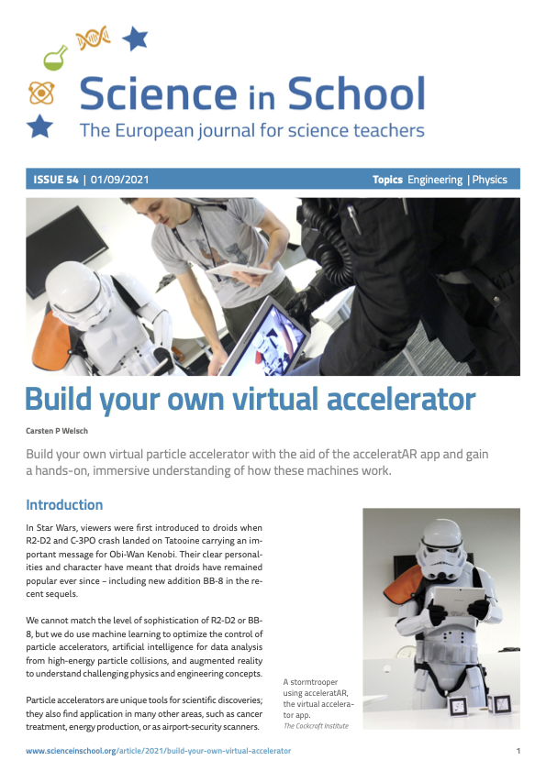
TEACH
314 articles
Concrete activities for the classroom
Ready to use incl. list of materials, procedures worksheets, etc.

Slide 9
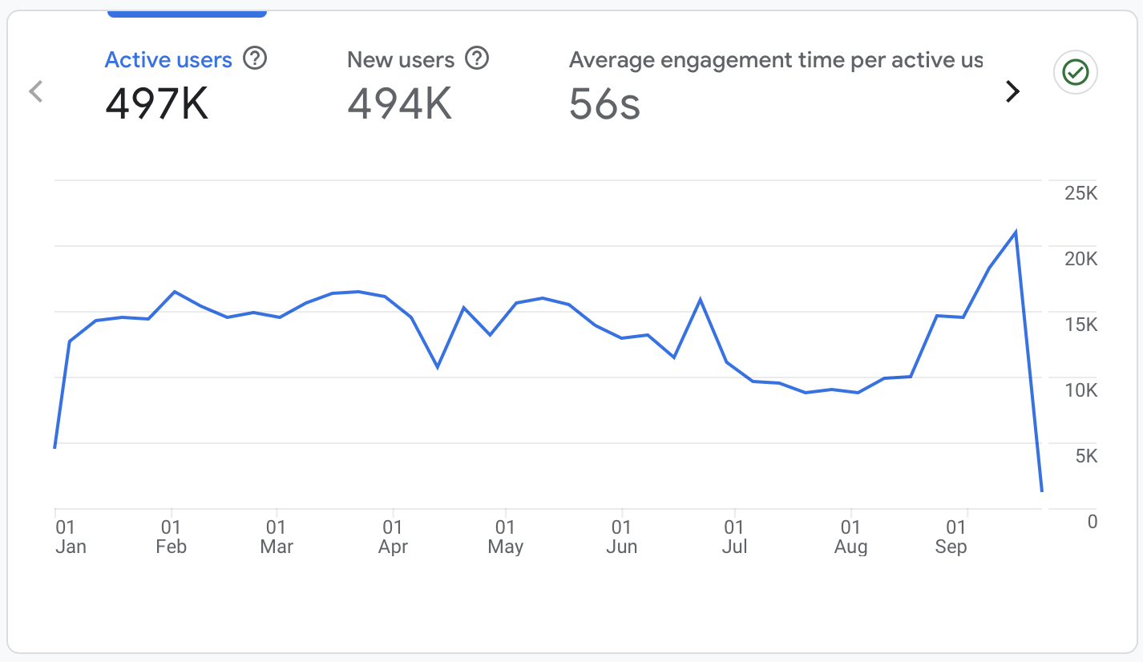
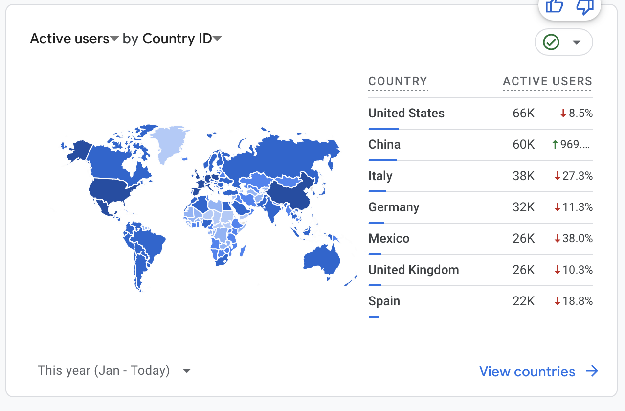
Who do we reach?
Up to 30’000 views for the most popular articles in 2025
Colour, chlorophyll and chromatography Build your own particle accelerator
Quick quantitative chemistry – the microscale way

Slide 10



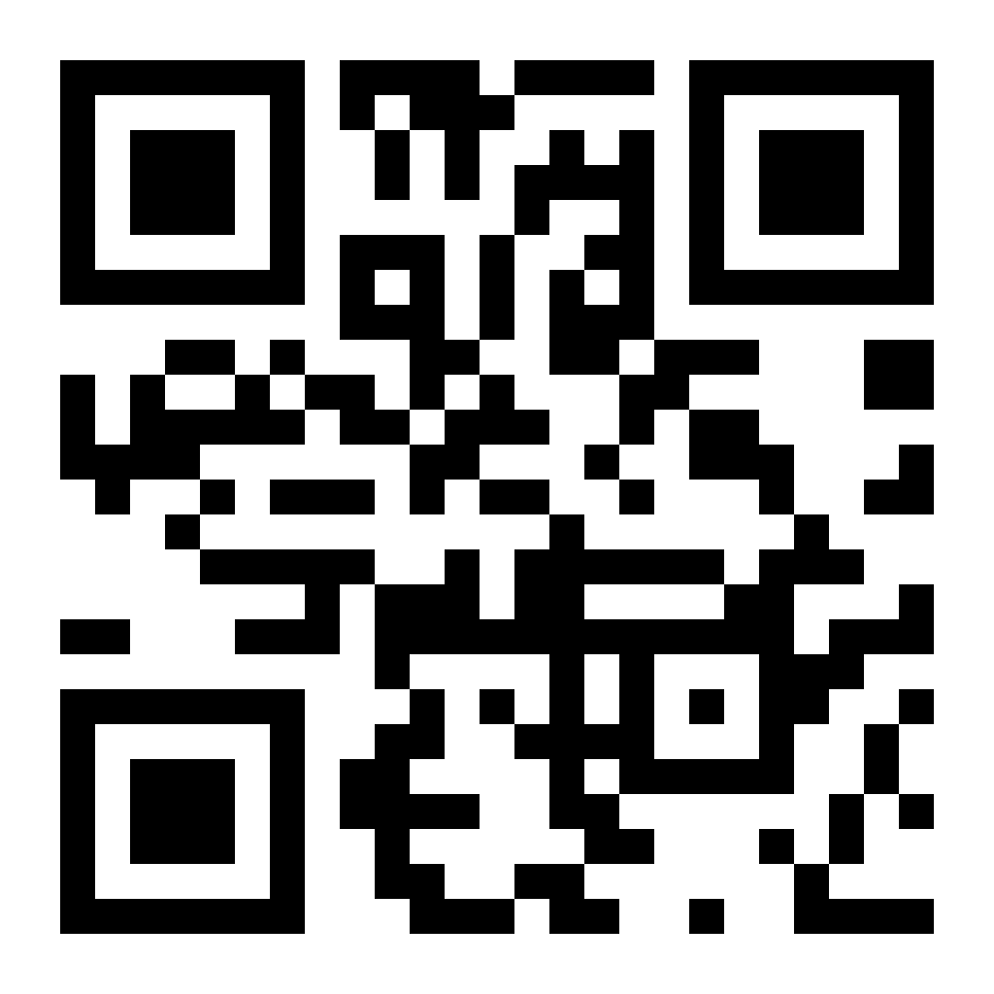
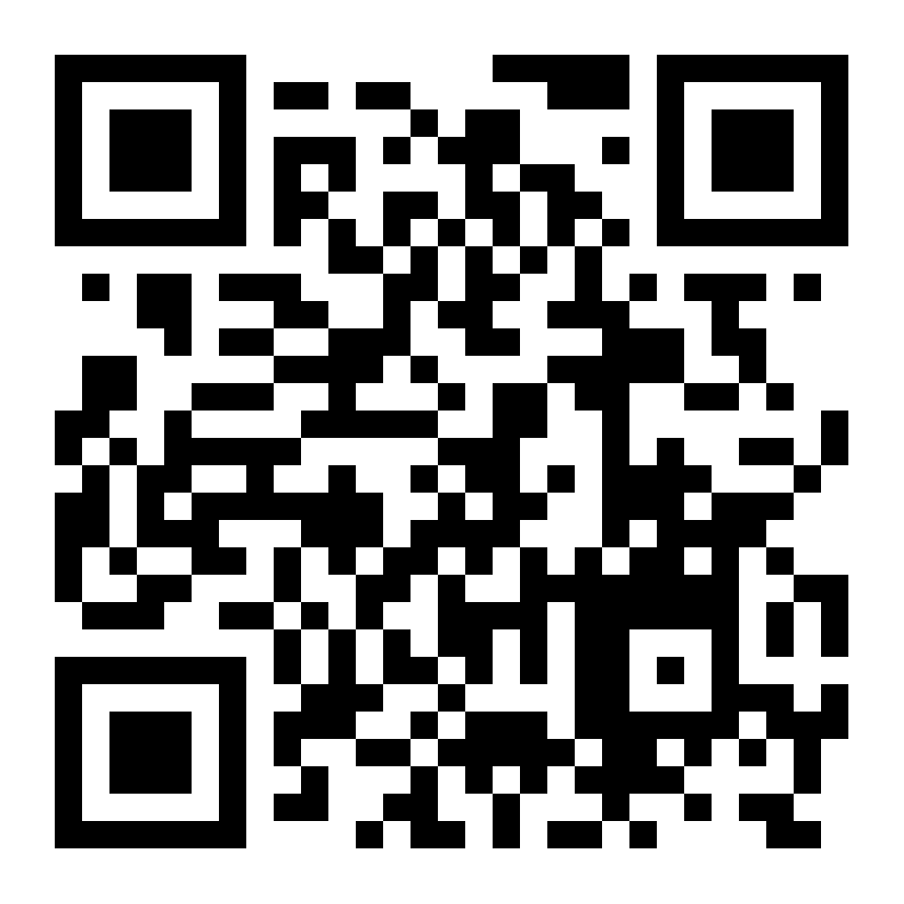
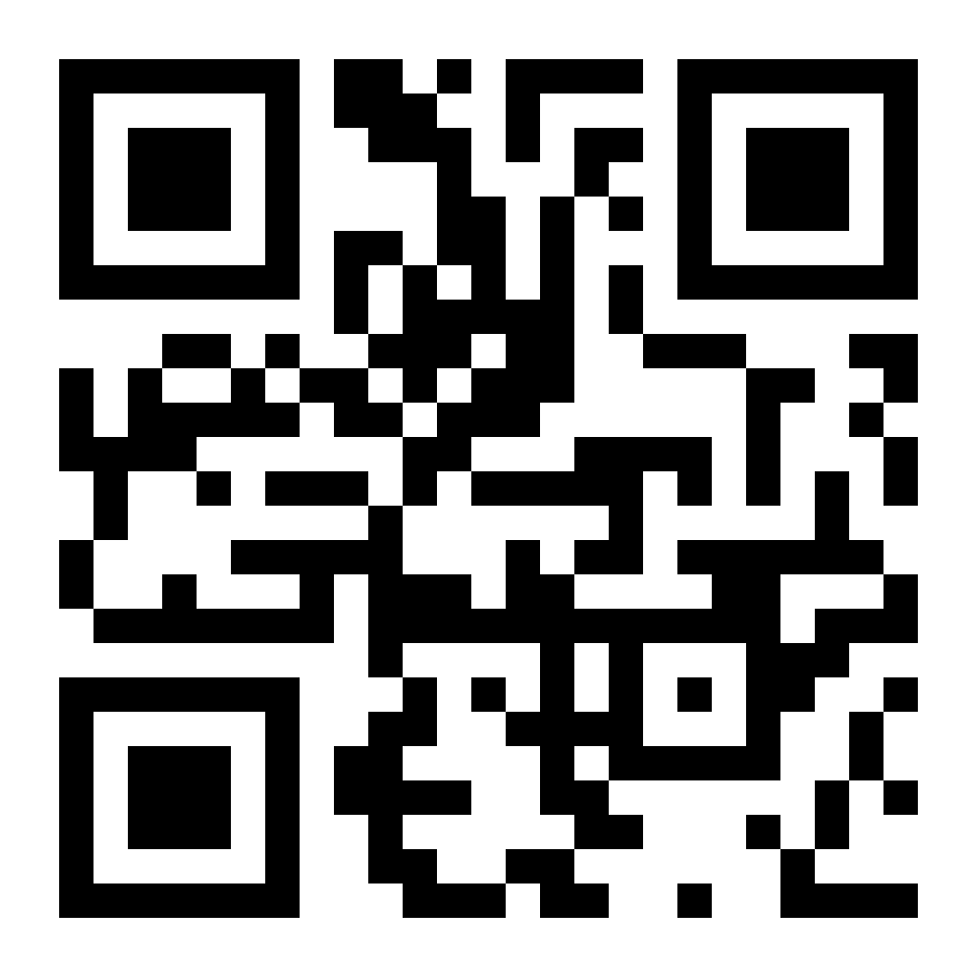
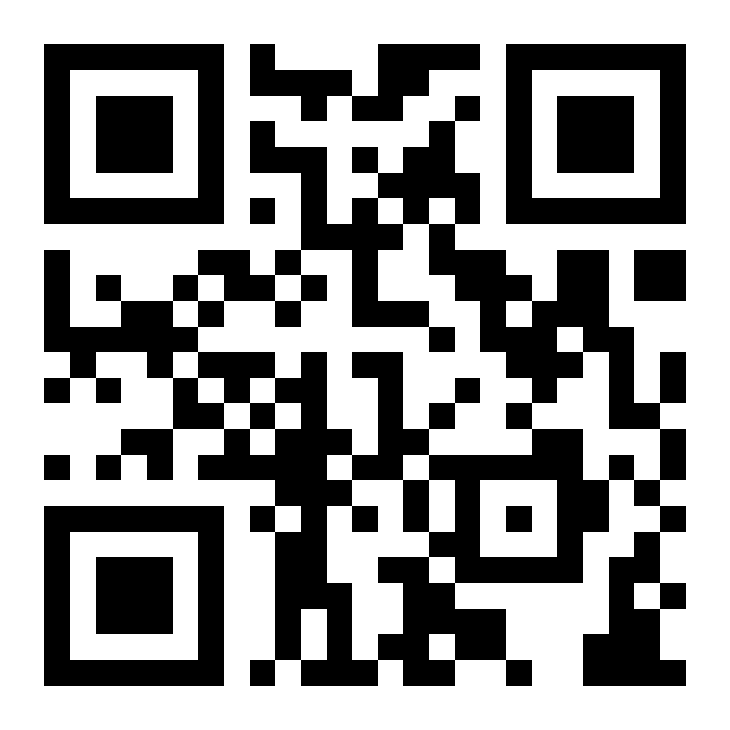
Who do we reach?
Newsletter
9’000
5 per year
3’800
3-4 posts per week
10’000
3-4 posts per week
3’650
2 posts per week
August 2025

Slide 11
What’s in the future?
Involve national/regional organisations promoting STEAM education
Increase our reach
Get more articles translated

Slide 12
How can you contribute?
Encourage contributions from your country
Encourage article reviews
Help translating articles
Introduce local teachers to Science in School
Talk about us!

Slide 13
Thanks for your attention!

