Slide 1
Collimators discussion points
Richard Cowan
5th May 2025

Slide 2
Aperture and bellows movement
Nominal aperture shape and Ø (30mm)? Ø constant? Wings in straight section?
What is the free aperture we need in any part of the life cycle?
  … do we need to fully retract the jaws, at any point? (length of stroke will be long for required accuracy)
What are the required jaw motions for each part of life cycle? (for fatigue considerations):
  Beam-on? parking/beam-off? MD? testing? … also assembly, jaw swap
or

Slide 3
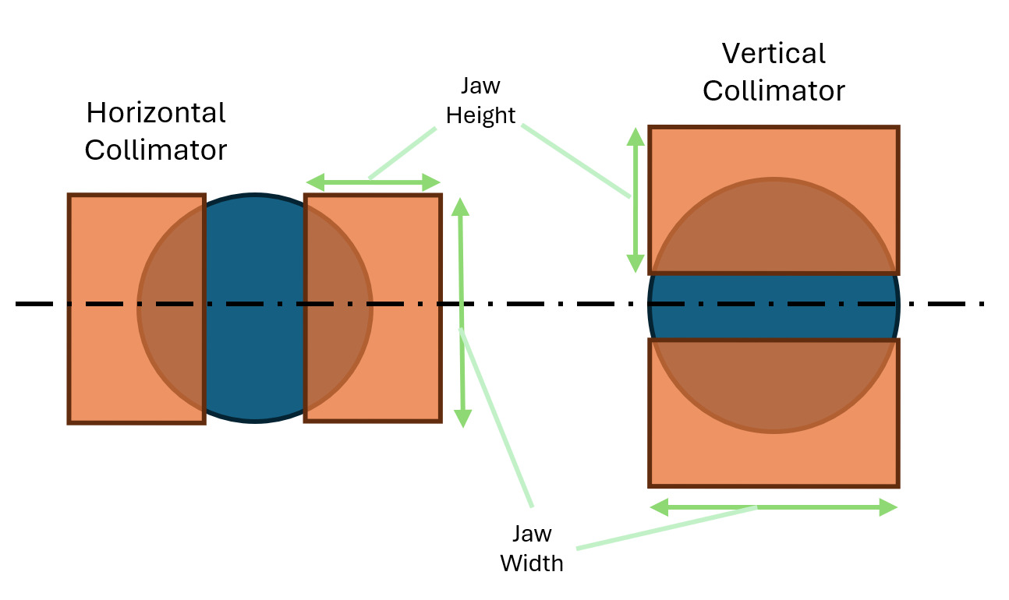
Beam and position
Orbit variation in Vertical plane and in horizontal plane? V ±5mm H ±5mm ?
Beam size on primaries? secondaries? absorbers? tertiaries?
These both feed into the base question of Jaw / Absorber block size?
Simply cover the beam pipe?
  3cm height, 6cm width
Or smaller? (less impedance maybe?)

Slide 4
Tolerance and Angular tilt
Do we need this? The design is much simpler with only one actuator rather than 2, hence will have higher reliability etc, as well as reduced cost.
If so, is it needed on all collimators? (Could it be just primary vertical - tcp.v.b1 + tcp.v.b2)
Can angular tilt can be fixed for each run or does it need to be adjusted during/mid run?
Does the angular tilt tolerance requirement change if adjustable or not?
First draft Tolerances – do these make sense/need to be tighter …
Stepper motors without gearbox (preferred) can drive to ~5µm precision, so 10urad doable over 500mm engagement length
Gap | Flatness | Ra | Angular tilt
±20µm | ±20µm | 1.6 (µm) | Nominal 130µrad? perhaps ±10%?

Slide 6
Backups

Slide 7
Collimator numbers
  Point F Halo collimation:
  3 horizontal (betatron), 3 vertical (betatron), 3 momentum
  Primary 25cm MoGr, Secondary 30cm TZM
  Plus 4-6 shower absorbers - 2 betatron and 2-4 momentum? - Shower absorbers are probably 30cm TZM too
  So 13-15 collimators per beam
  = 26-30 total? (1:2 V:H)
  SR collimation:
  6 collimators and 2 masks upstream of each point (G Broggi FCC week 2024)
  SR Collimators - 10cm Tungsten, SR Masks - 2cm Tungsten
  for 2 beams * 4 IPs
  = 48 collimators (1:2 V:H) + 16 masks!

Slide 8
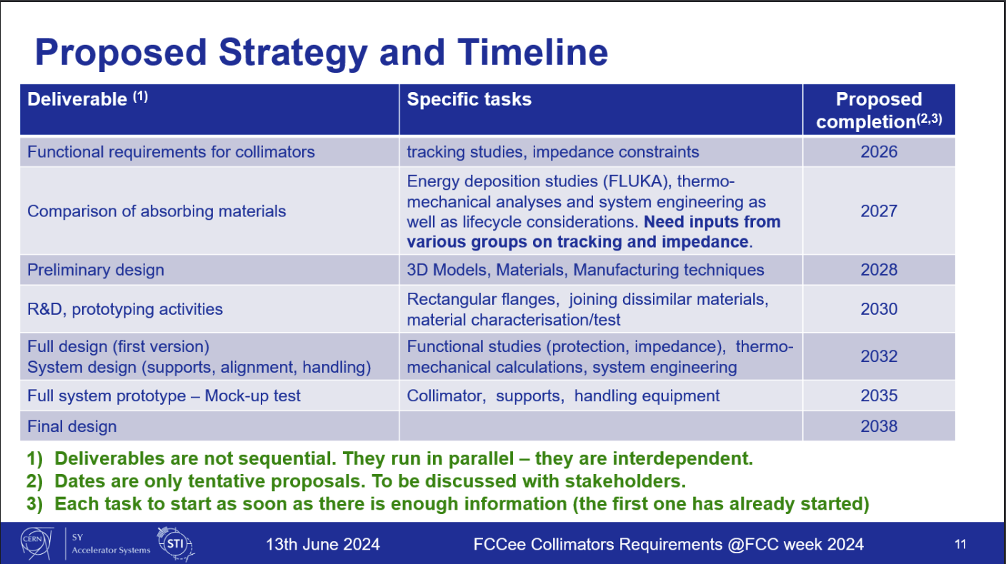

Slide 9
