Slide 1
Reflection
What have we experienced, achieved and learned?

Slide 2
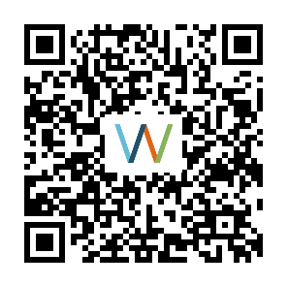
Weekly creativity reflection
I liked I wished I learned
https://link.webropolsurveys.com/S/6603C802D4ADA0BE

Slide 3
Final exercise 1
Creativity essay (max. 2 pages)
Research your creativity by answering these questions. The writing style should be reflective, even narrative. Please be honest in your answers and remember, there are no right or wrong answers.
What does creativity mean to you?
How creative do you consider yourself? Why?
Do you feel that you can influence your creativity? Why? Why not?
How did you experience the process of developing your individual creative strategies next to your innovation challenge?
How would you evaluate the process of developing your individual creative strategies?
Are there any other thoughts or experiences you would like to reflect on?

Slide 4
Final exercise 2
Based on your findings, draw an updated version of your creative alter ego. Take inspiration from your final creativity essay.
Then write under the drawing your final creative strategy.
Remember, your drawing doesn’t need to be beautiful. I encourage you to draw by hand and take a photo/scan the drawing, but you can also use a computer for drawing your alter ego. The picture should be original. Use your imagination!
Please send your essays to me by email to nina.jackson@oulu.fi by August 3rd

Slide 5
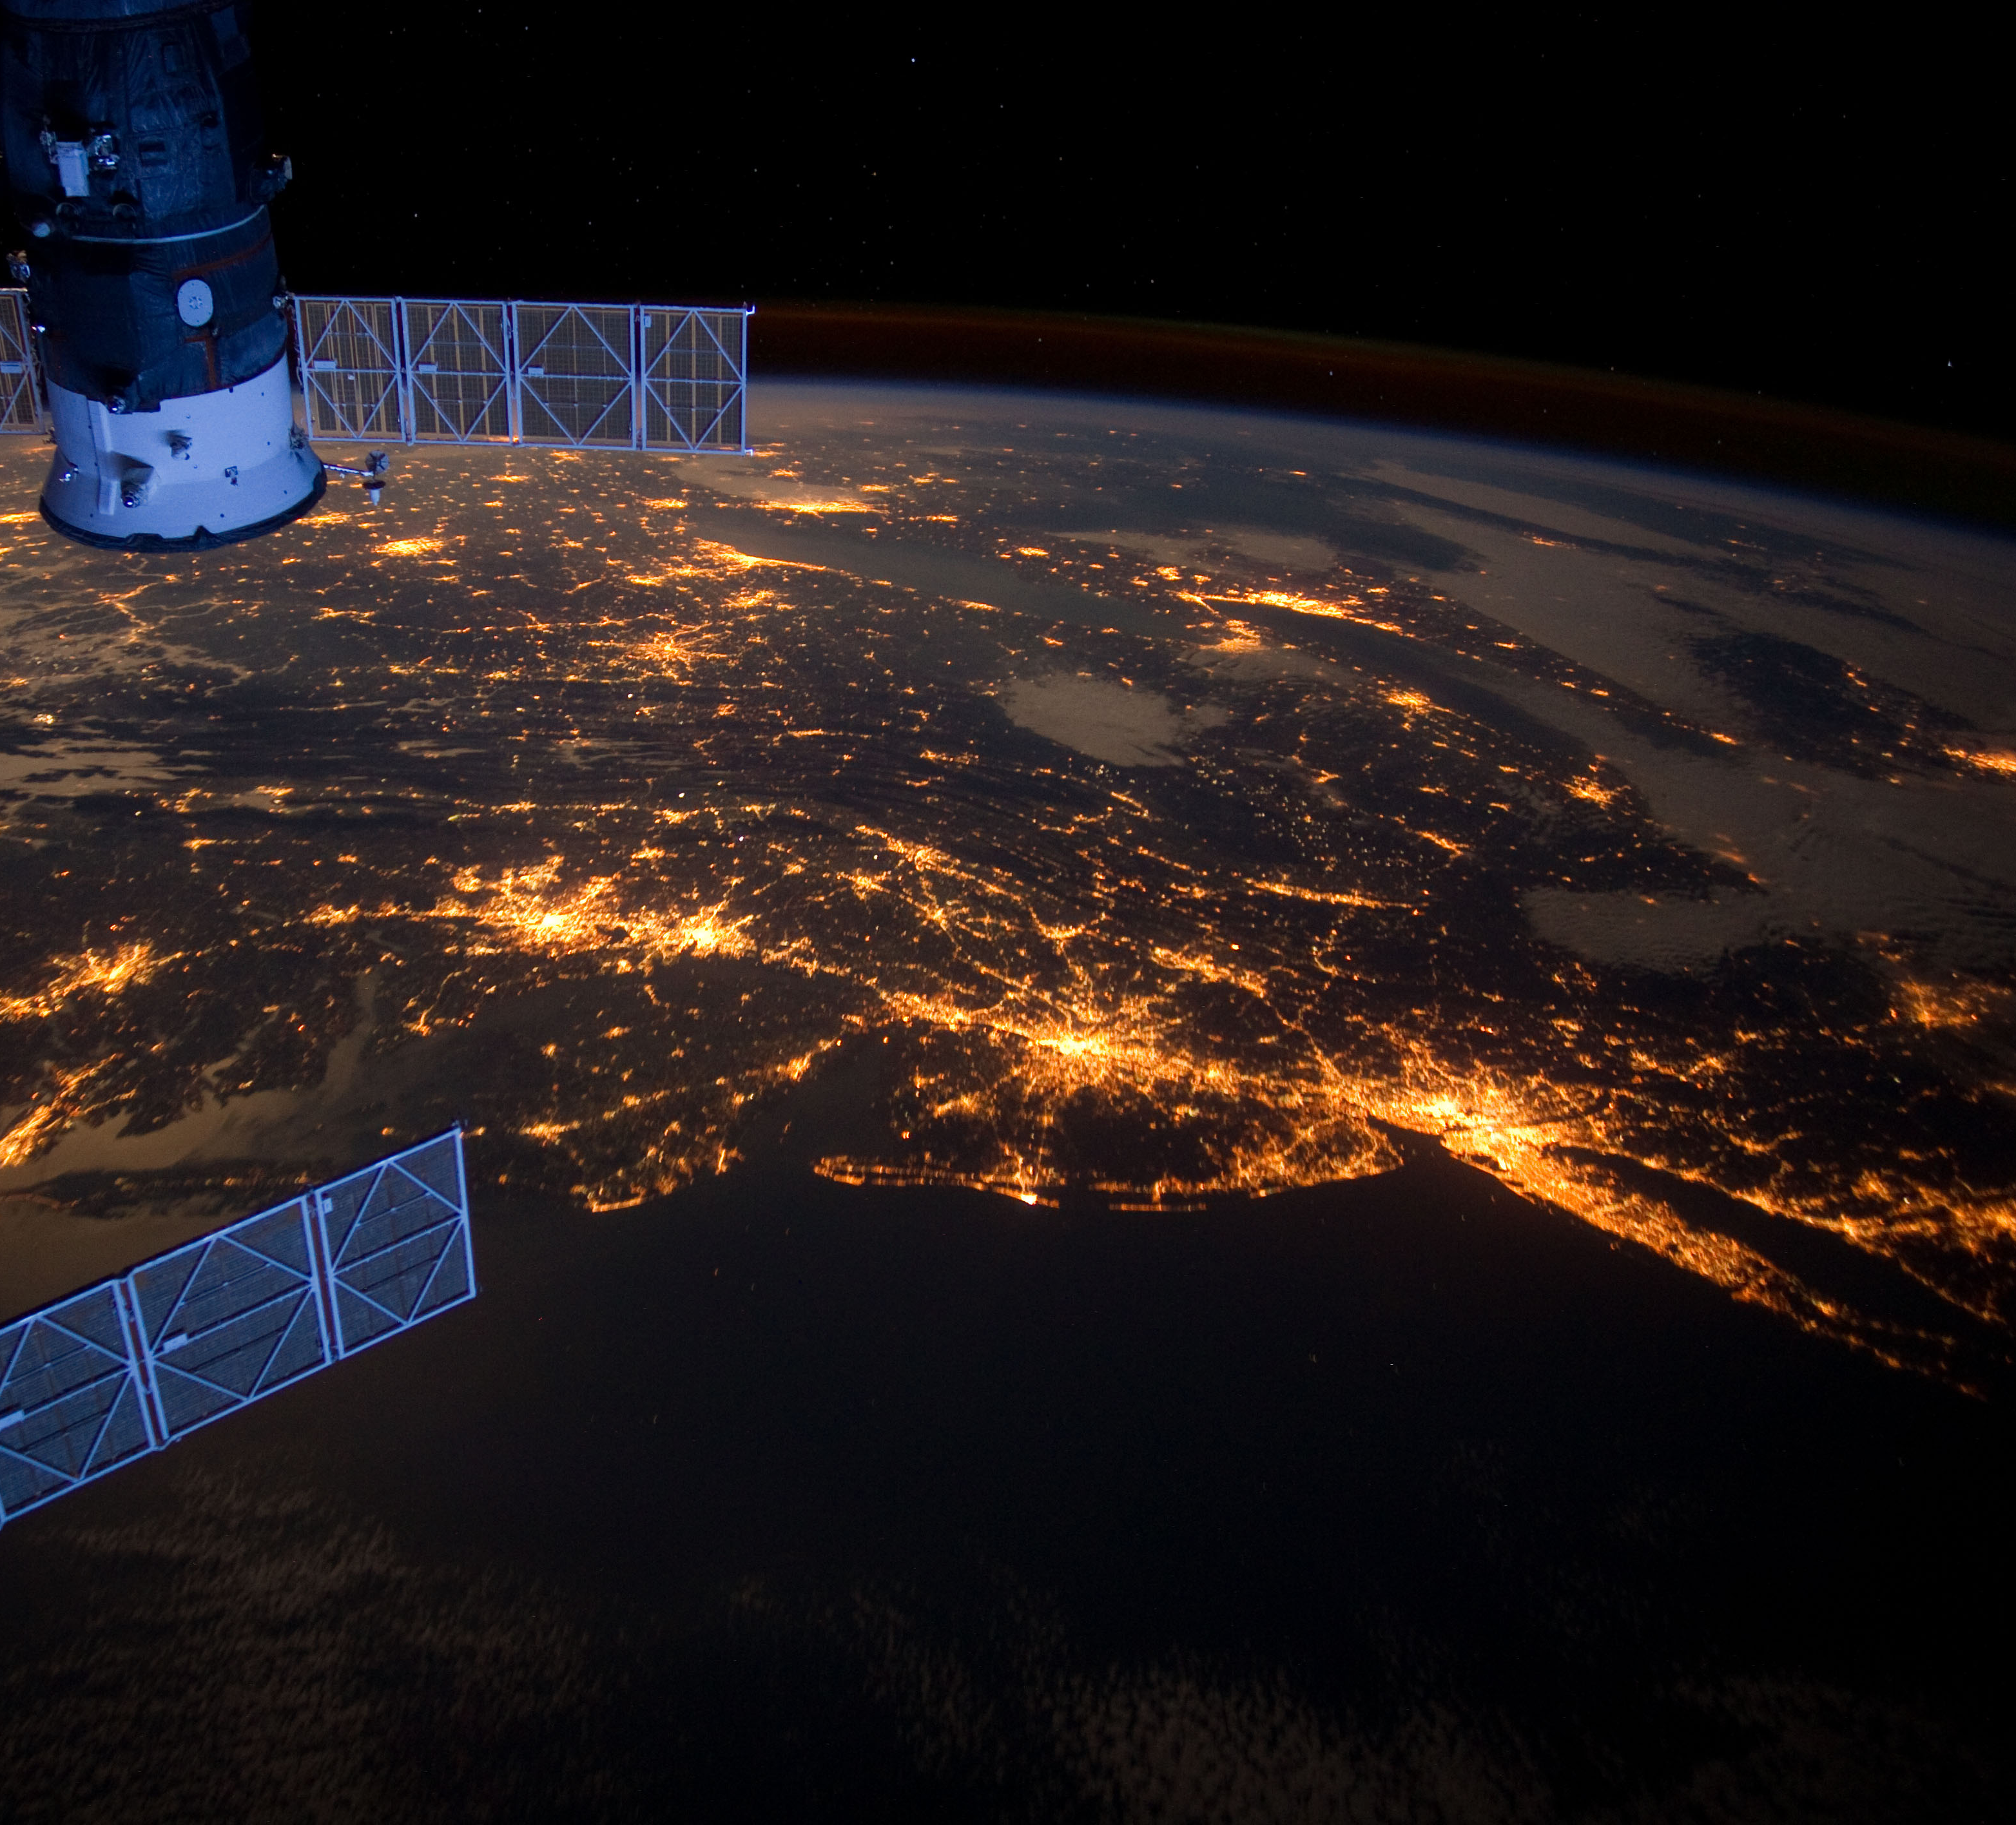
How has your week been?
What have you achieved during this week?
What do you think you have learned?

