Slide 1
Report CERN Masterclasses
13.05.2025

Slide 2
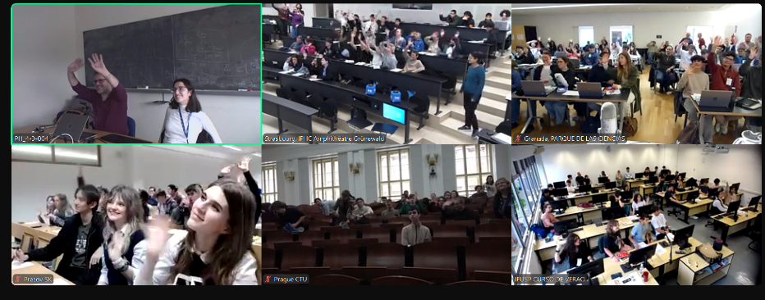
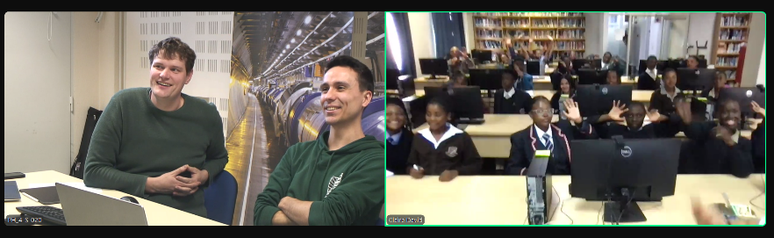
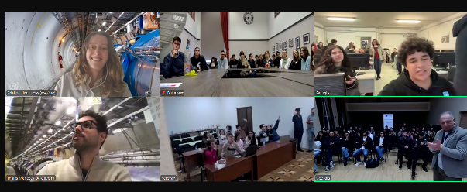
Statistics
CERN LHC Masterclasses
237 MCs with CERN VC (233)
109 ATLAS (115)
  92 ATLAS Z
  17 ATLAS W
62 CMS (67)
31 LHCb (26)
35 ALICE (36)
NEW
TRACER 3D event display used in ATLAS W path (see report from Lasha)
Revised concept for videoconference
11.05.2025
Uta Bilow, TU Dresden
2

Slide 3
Revised concept for videoconference
Majority of institutes is very positive
  “videoconference was great”
  “went exceptionally well”
  “students had a great time and I heard lots of positive feedback”
Very few negative feedback, on various points
Meeting „ review CERN videoconference“ on Nov 19, 2024
  Institutes who send negative feedback, IMC SG, WG videoconference (Ina Carli, Ana Peixoto)
Collected a list of points to be addressed
Follow-up with WG videoconference
11.05.2025
Uta Bilow, TU Dresden
3

Slide 4
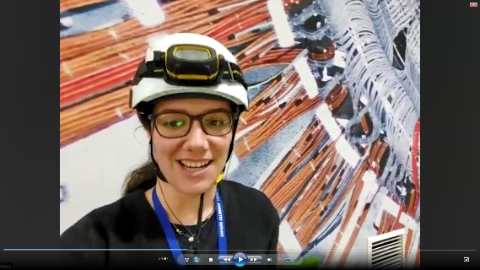
CERN video conference
General structure kept:
2 moderators
16:00-16:10 Welcome & icebreaker
16:10-16:30 Combination and discussion of results
16:30-16:50 General Q&A
16:50-17:00 Quiz & bye-bye
LHCb has a 3rd moderator, connecting from the pit
09.05.2025
Uta Bilow, TU Dresden
4

Slide 5
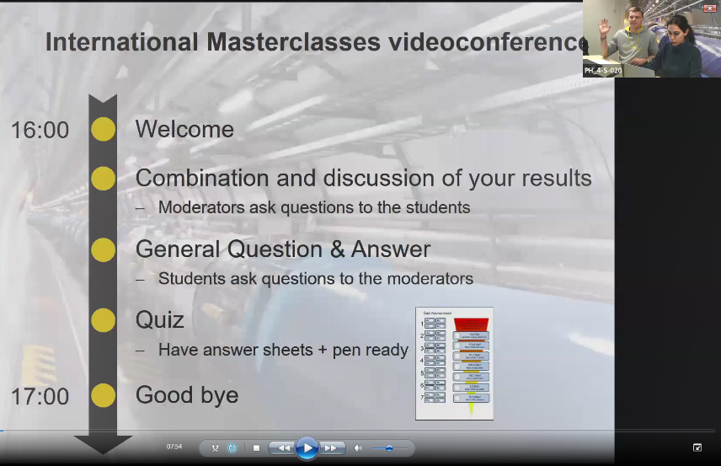
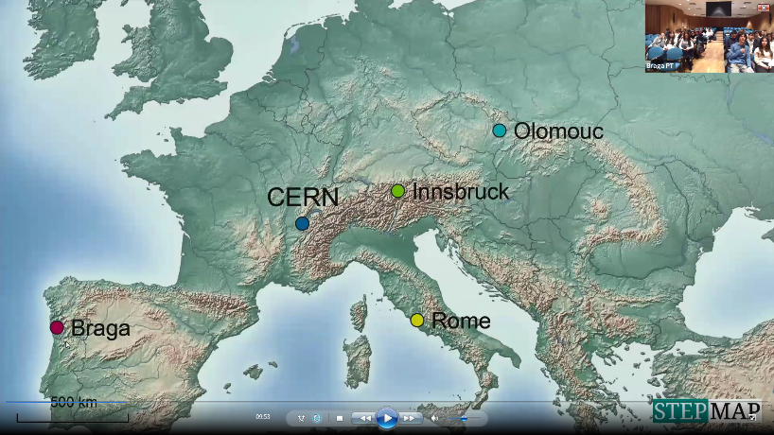
Welcome & icebreaker
Self-introduction of moderators
Presenting VC timeline (1 prepared slide)
Map is shown, with all connected sites
09.05.2025
Uta Bilow, TU Dresden
5

Slide 6
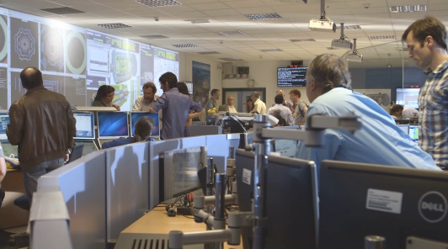
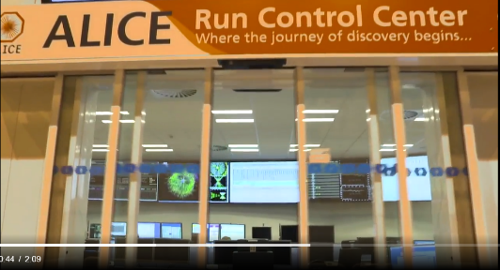
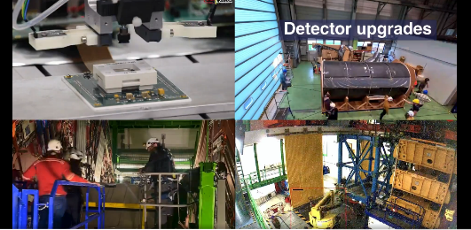
New: videos
ATLAS, CMS and ALICE short videos to give a hint of day-to-day life at the LHC experiments control rooms
  Experimental cavern
  Upgrade work at the surface
  Data analysis
  Prepared by collaborations, comm teams
ALICE: 2 min with sound and subtitles
ATLAS: 2 min, no sound
CMS: 1 min, no sound
ATLAS
Control Room
CMS

Slide 7
New: revised list of welcome questions
Questions to speakers of the group (predefined)
  How long did you have to travel to the institute today?
  How did you find out about International Masterclasses?
  Is there a building in your city comparable in size to ATLAS/CMS/ALICE/LHCb?
  Do you have a vague idea how many people are working at CERN?
  …
Questions to the whole group (answers by raising hands):
  Who from the group has had contact to a particle physicist before today?
  Who from the group has heard or read before about the LHC before today?
  Who from the group found the measurement today more difficult than normal school stuff?
  Who from the group is already convinced that they want to study physics?
  …
11.05.2025
Uta Bilow, TU Dresden
7

Slide 8
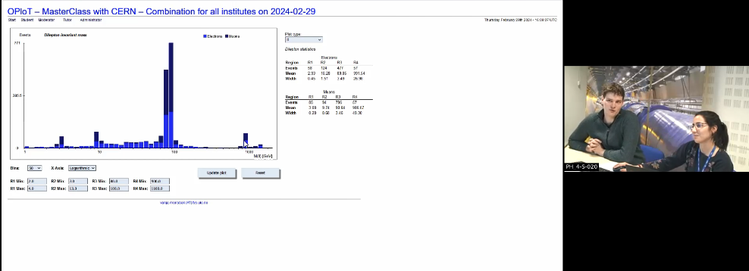
Combination and discussion of results
Moderators share combined results
Ask 1 „pre-agreed“ question to each group (published in twiki for moderators, in manual for institutes)
Summarize, comment, compare to theory
New: animations added (Higgs-> 4l, WW, ZZ, di-photon) for ATLAS and CMS in the twiki
09.05.2025
Uta Bilow, TU Dresden
8

Slide 9
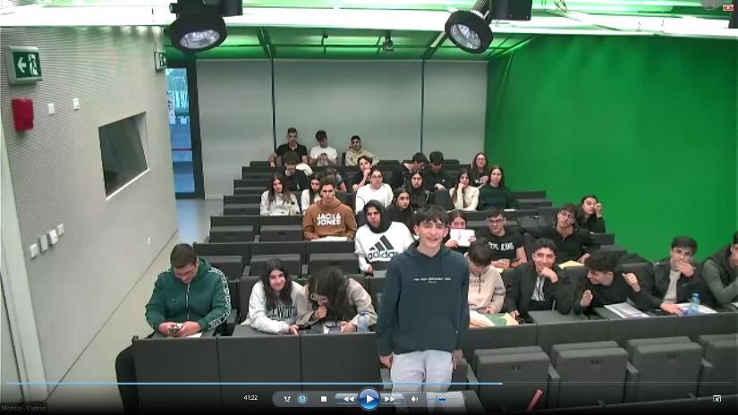
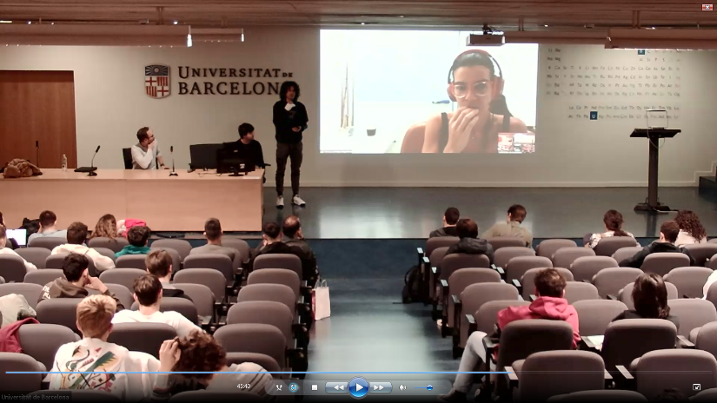
General Q&A
1 question per institute per round
On life at CERN, how to become a particle physicist, Big Bang, black holes, dark matter, future projects, …
09.05.2025
Uta Bilow, TU Dresden
9

Slide 10
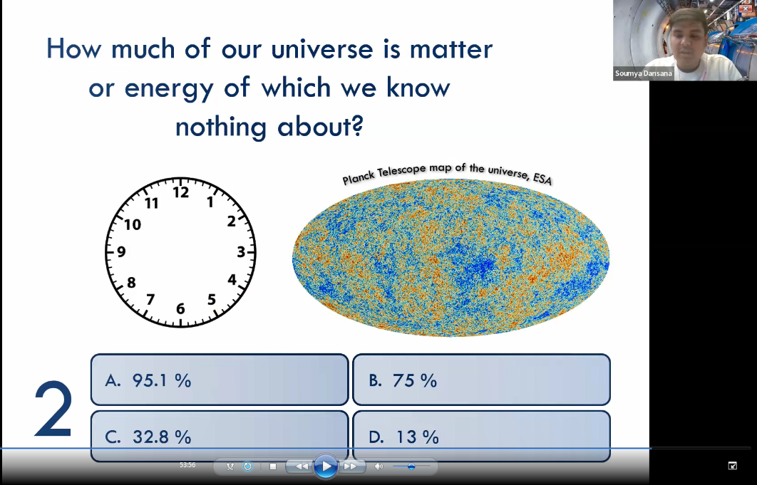
Quiz
Style „Who wants to be a millionaire“
7 multiple-choice questions
Animated ppt
Answer sheets available
09.05.2025
Uta Bilow, TU Dresden
10

Slide 11

Moderators
Call for moderators via usual channels + New: poster at CERN (library, b40, ...)
Volunteers from all experiments and theory
  New: Focus on junior moderators
~ 30% newcomers
  New: Rehearsal with all new volunteers, audio tests
2h training event held in person at CERN, shortly before IMC start
  Procedure, technical issues, conversation with groups of high school students
  being a moderator on Zoom (mute noisy participants etc.)
  Coffee/tea + croissants before the training, paid by IPPOT
Material: twiki, recordings from last year, shadowing
Room at CERN offered, decorated with roll-ups
  Moderators can also connect remotely
11.05.2025
Uta Bilow, TU Dresden
11

Slide 12
Feedback (negative) in 2025
Institute 1
audio quality of the two hosts was good and they could be clearly understood
hosts kept the time as they were supposed to
but the discussion was still not exciting for the students
one of the moderators gave a wrong physics explanation, which the students did not notice
VC does not make CERN and particle physics more attractive for the young visitors
Evaluation VC: 2.4 (on a scale from 1-5). Overall: 4.6
Institute 2
moderators, since they communicate with 16-18 years old students from around the world, they should speak clear (and somehow "slower" than usual), avoiding advanced technical terms
11.05.2025
Uta Bilow, TU Dresden
12

