Slide 1




Progress Report of the MCBRD Magnets3 () (2025.03.24)
Yingzhe Wang

Slide 2



Progress of series production
 | Nickname CERN | Manufacturer | Remarks | Status | Location
MCBRD05 |  |  |  | On the way to CERN | -
AP1 | MCBRD_CB18 | BAMA | 532A, 42 quenches | 394A (3 quenches); 422A (+6 quenches)
AP2 | MCBRD_CB19 | BAMA | 530A, 68 quenches | 394A (7 quenches); 422A (+10 quenches)
MCBRD06 |  |  |  |  | CERN
AP1 | MCBRD_CB14 | BAMA | 530 A (30+34 quenches)
AP2 | MCBRD_CB21 | BAMA | 530 A (119quenches)
MCBRD07 |  |  |  | On the way to CERN
 | MCBRD_CB20 | BAMA | 530A (68 quenches)
 | MCBRD_CB23 | BAMA | 530A (76 quenches) | 3.2KV-20.4GΩ
 | MCBRD_CB22 | BAMA | 489A (124 quenches), put in quarantine | 3.2kV-71GΩ | IHEP
MCBRD08
 | MCBRD_CB24 | BAMA | 492 A(109 quenches) | 3.2kV-35GΩ | IHEP
 | MCBRD_CB25 | BAMA | Injection: Dec. 11; Deliver to IHEP: Jan. 13 | 3.2kV-49.9GΩ | IHEP
MCBRD09
 | MCBRD_CB26 | BAMA | Injection: Jan. 7; Deliver to IHEP: Jan. 13 | 3.2kV-93.2GΩ | IHEP
 | MCBRD_CB27 |  | Injection : Mar. 17
MCBRD10 |  |  | Yoke lamination will be ready by the end of August
 | MCBRD_CB28
 | MCBRD_CB29
CB24 reached 492A after 109 quenches.
The training stopped because we have to do the acceptance test of our common-coil magnet. By the end of March, training of CB24 and CB25 will start again.

Slide 3
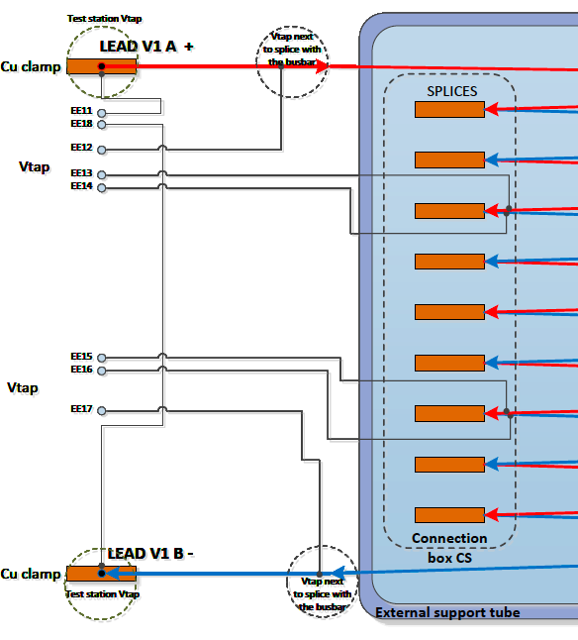
Vts labelling of MCBRD06
I’ve checked with BAMA, from MCBRD05, the Vts label is based on the diagram on the left.
Vts labelling of MCBRD06 made a mistake.

Slide 4
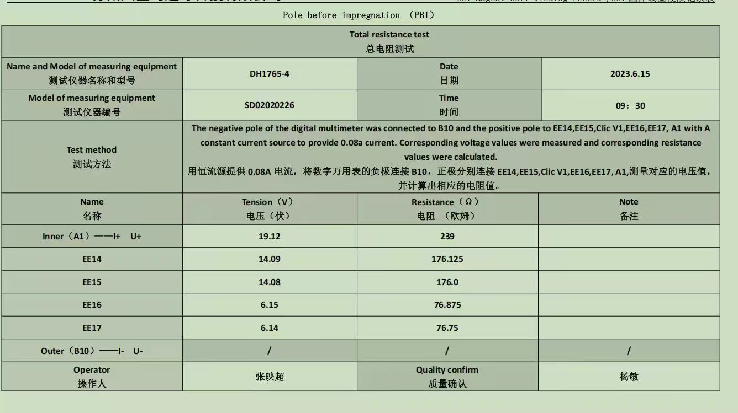
Splices resistance

Slide 5
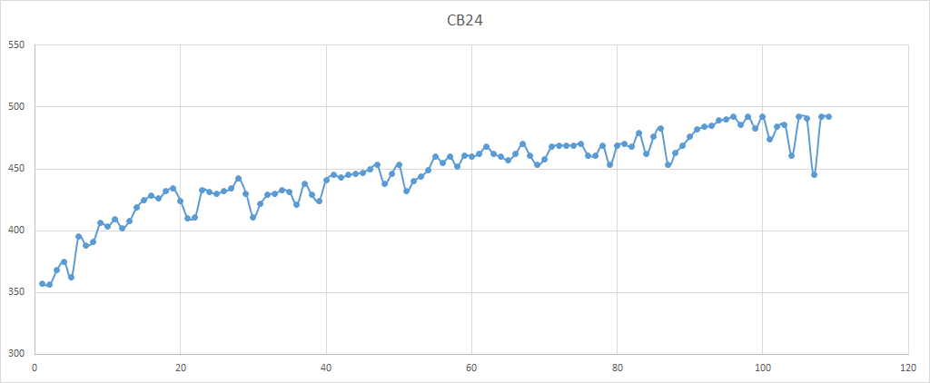
Training history of CB24

Slide 6
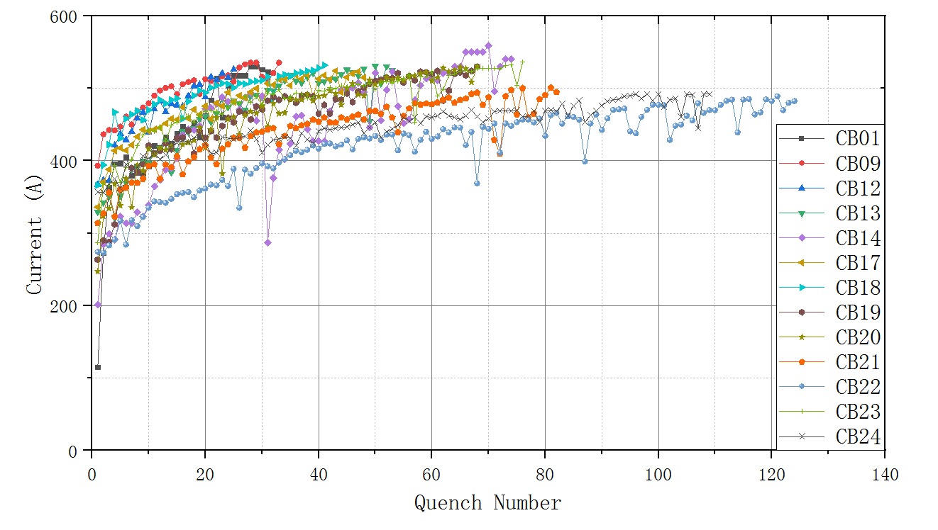
Training history of all apertures

