Slide 1
IdeaSquare Planet: Mission on Planet Y debrief
Making sense of a 5-day thought experiment
Ole Werner, Catarina Batista
25.04.2025

Slide 2
Let's look back...
What different approaches did you see in others?
  What challenged you? Where did you find yourself comfortable?
How did you experience the project over these past 4 days?
What inspired you?
What were some of the topics you learned about?
What did you learn about yourself and your unique contribution regarding your teamwork?
What do you think this experience brings to your professional life?

Slide 3
Let's look back...
What would you have liked to understand better?
  What is something you are proud of having developed?
How do you think about the life on Planet Y?
Which Earth-patterns did you challenge?
What do you wish you would have done differently?
What did you get a better understanding for being the way it is on Planet Earth?
What are some of the interventions/learnings that you want to bring to Planet Earth?

Slide 4


Slide 5

Why were we here?

Slide 6
What do me mean?
Common Innovation Courses (of course not all, but most we’ve seen)
Lecture: How to think outside the box
Assignment: Think out of the box (30 min.)
AND/OR
Here is a specific industry challenge, that multiple R&D teams are working on with 10x your resources, good luck providing a viable solution in 3 months.
Led to incremental innovation

Slide 7
How can we consider solutions without understanding the systemic nature of the problem?

Slide 8
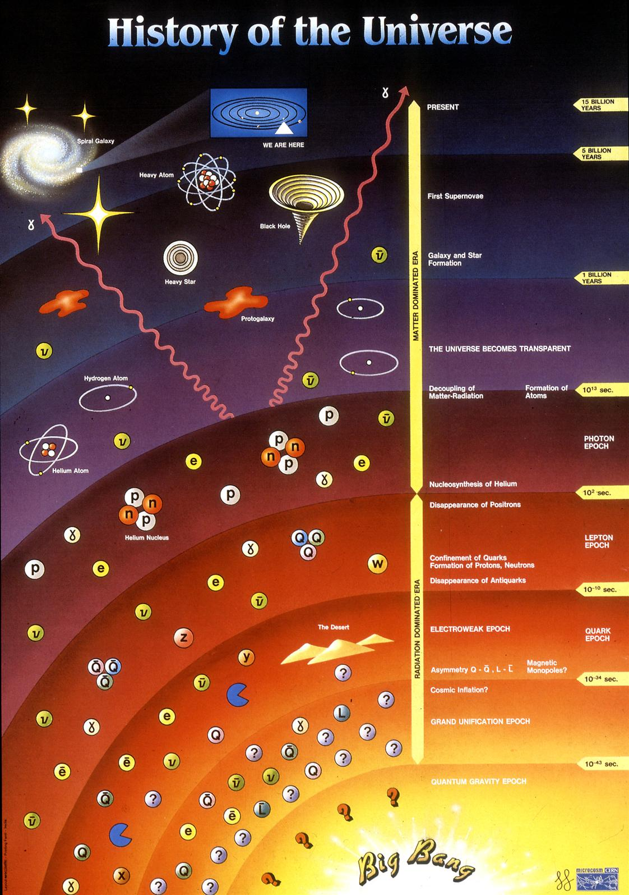
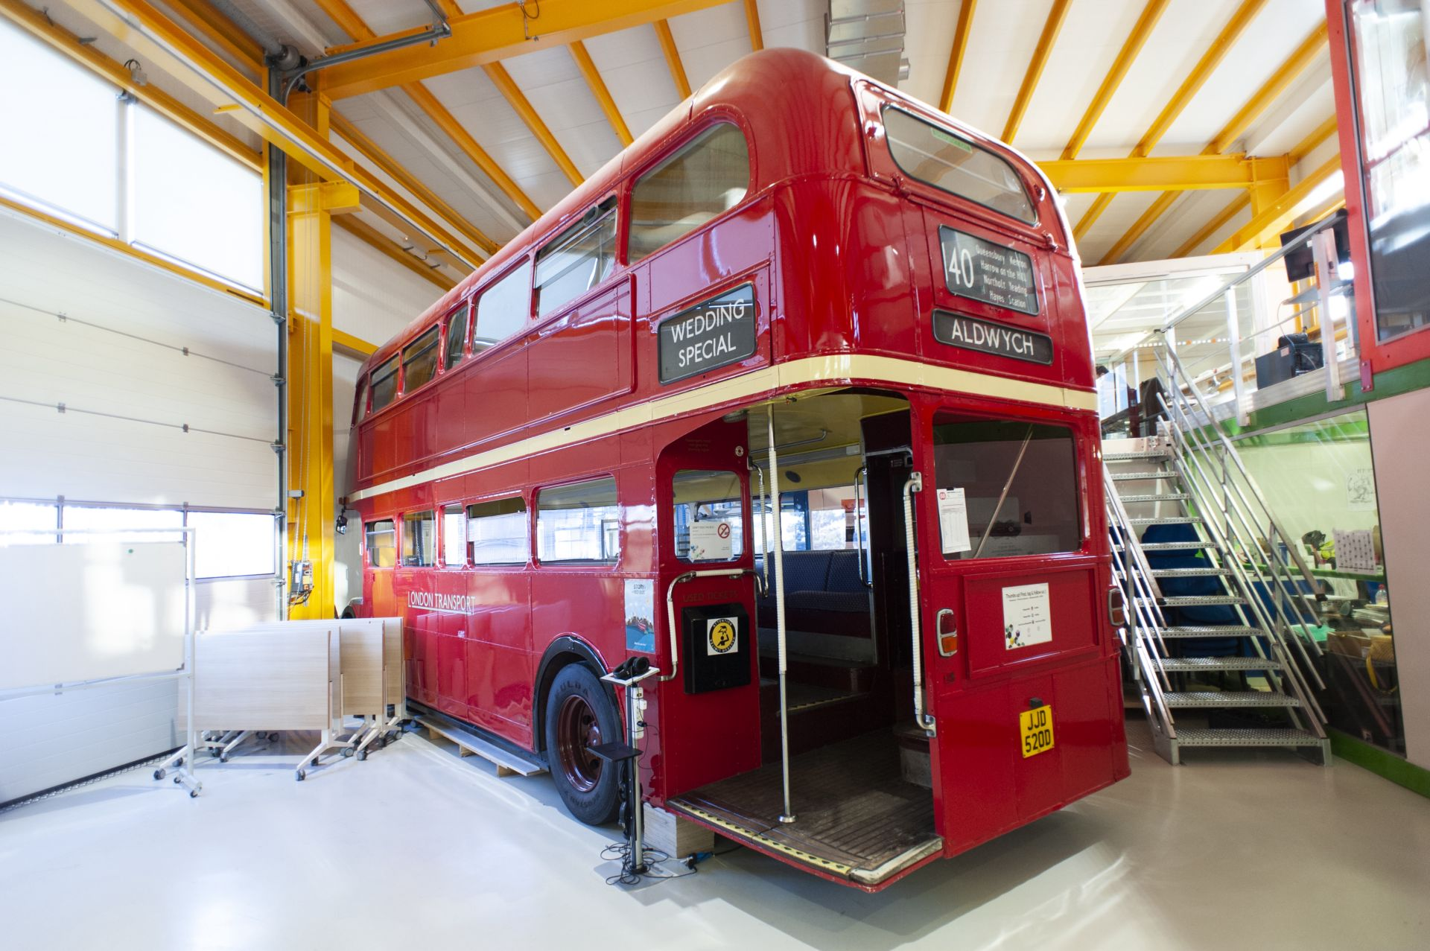
Remember this?

Slide 9

So we went back to the basics

Slide 10
Dissect the problem
What is the origin of the universe?
Theory
Experimentalists
Mathematicians
Engineers
Data Scienctists
Cafeteria (R1 open -> more papers published)
Infrastructure
Management
Human Resources

Slide 11
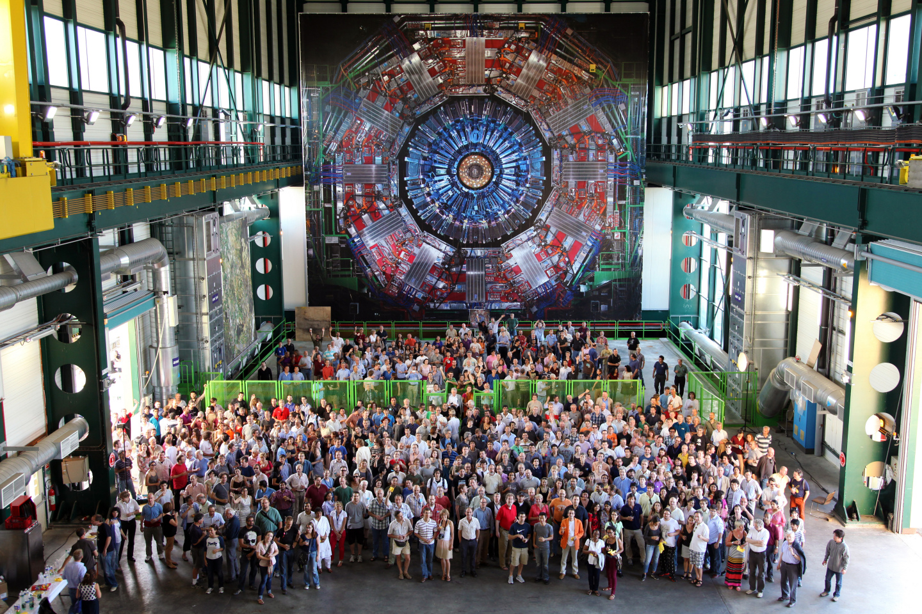
Unite different disciplines and backgrounds
Not one single person has studied “Particle-collision detector construction management”
Which is why we need Theoretical & Experimental Physicists, Engineers, Data Scientists, Economists, Lawyers, Technical workers and many more disciplines to plan, organize parts, build, manage and maintain the LHC and all connected experiments.
You need to learn to “speak the same language” and establish a common baseline by agreeing on a set of assumptions that you share. Otherwise you will struggle repeatedly throughout your project.

Slide 12
Anticipate the future
When pursuing big(ger) projects, the aspect of time becomes ever more impactful.
The LHC was conveived at a time when the Magnets that are needed to steer the protons did not exist yet at an affordable price.
But to reach superconductivity by cooling did 1) not violate the laws of physics, and considering the prices of other technologies, 2) it could be expected that they will become affordable in the quantity needed by the time the experiment was built.
Planning for 30-50 years challenges you to take a look at the world outside of your projects.

Slide 13
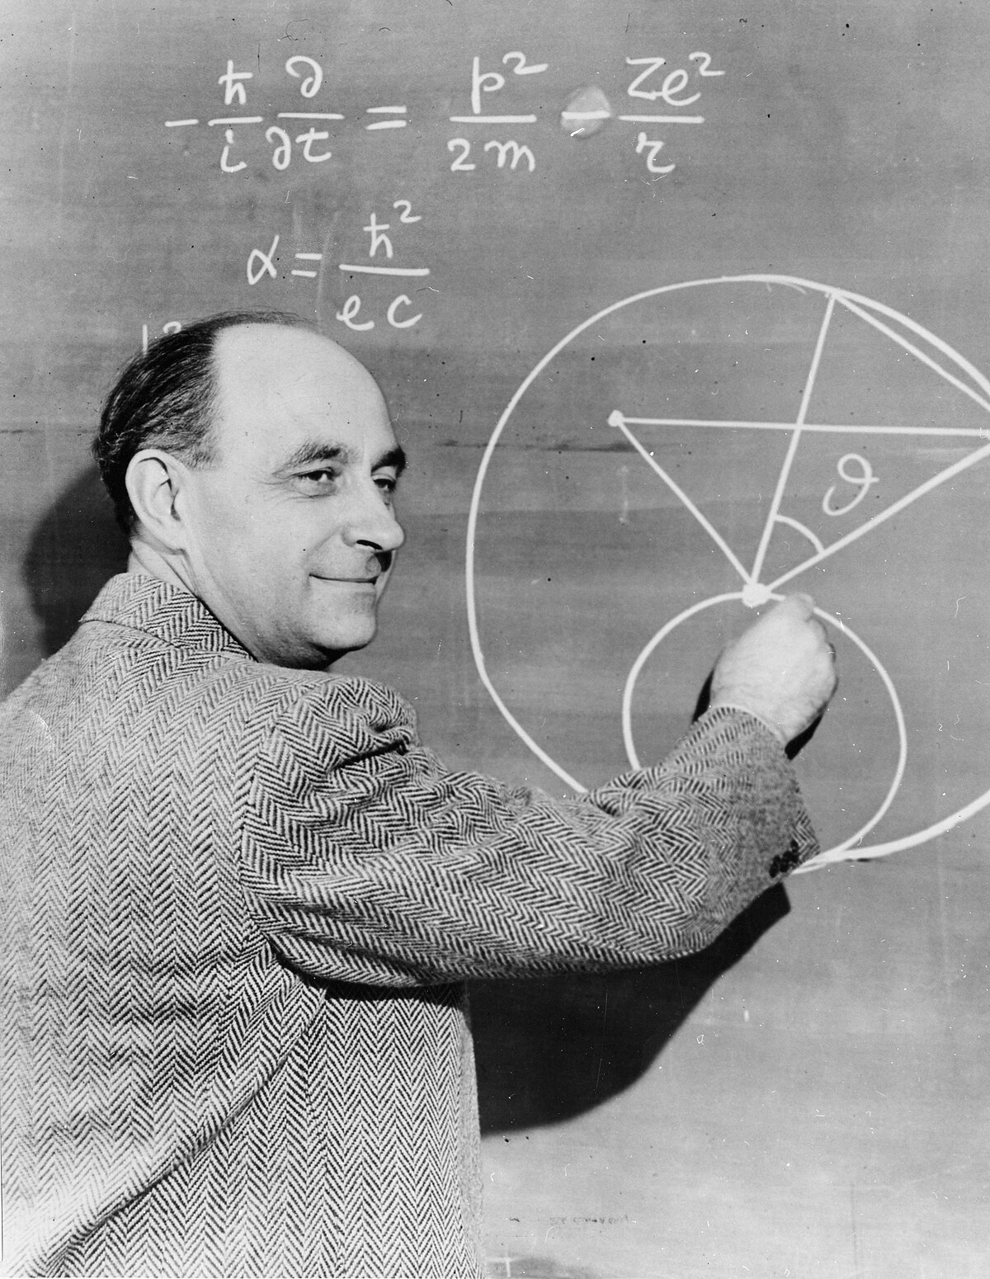
Argue Scientifically
Talking about anything without having some data on it, is a bar talk.
Using basic calculations (back on the envelope calculations) is a great way to understand the order of magnitude of a problem or a solution.
Think of Enrico Fermi and his pieces of paper. With proper estimations you can argue, without data, you cannot.

Slide 14

Challenge Paradigms
Thinking in terms of “if… then” is putting you in a reactive mode, in which it is extremely hard to archieve real change.
Thinking in terms of “what if…”, however, enables you to imagine, dream and change.
Think of Rosa Parks (and activists before and after her), challenging existing paradigms (with good reason), might end up changing the whole world.

Slide 15
Exponential innovation, a CERN recipe
Dissect the Problem
Unite different disciplines and backgrounds
Anticipate the future
Argue Scientifically
Challenge Paradigms

Slide 16
Mood-Meter
Notes:
How familiar are you with this type of working/exercise?
How did you experience the exercise?
Would you like to live in the societies you created?
How much did you feel like your opinion was heard?
Did you listen to the others in your team?

Slide 17
Open discussion
What went surprisingly well?
What went surprisingly bad?
In what moments did you feel lost/confused/on top of things/relieved?
Any comments?

