Slide 1
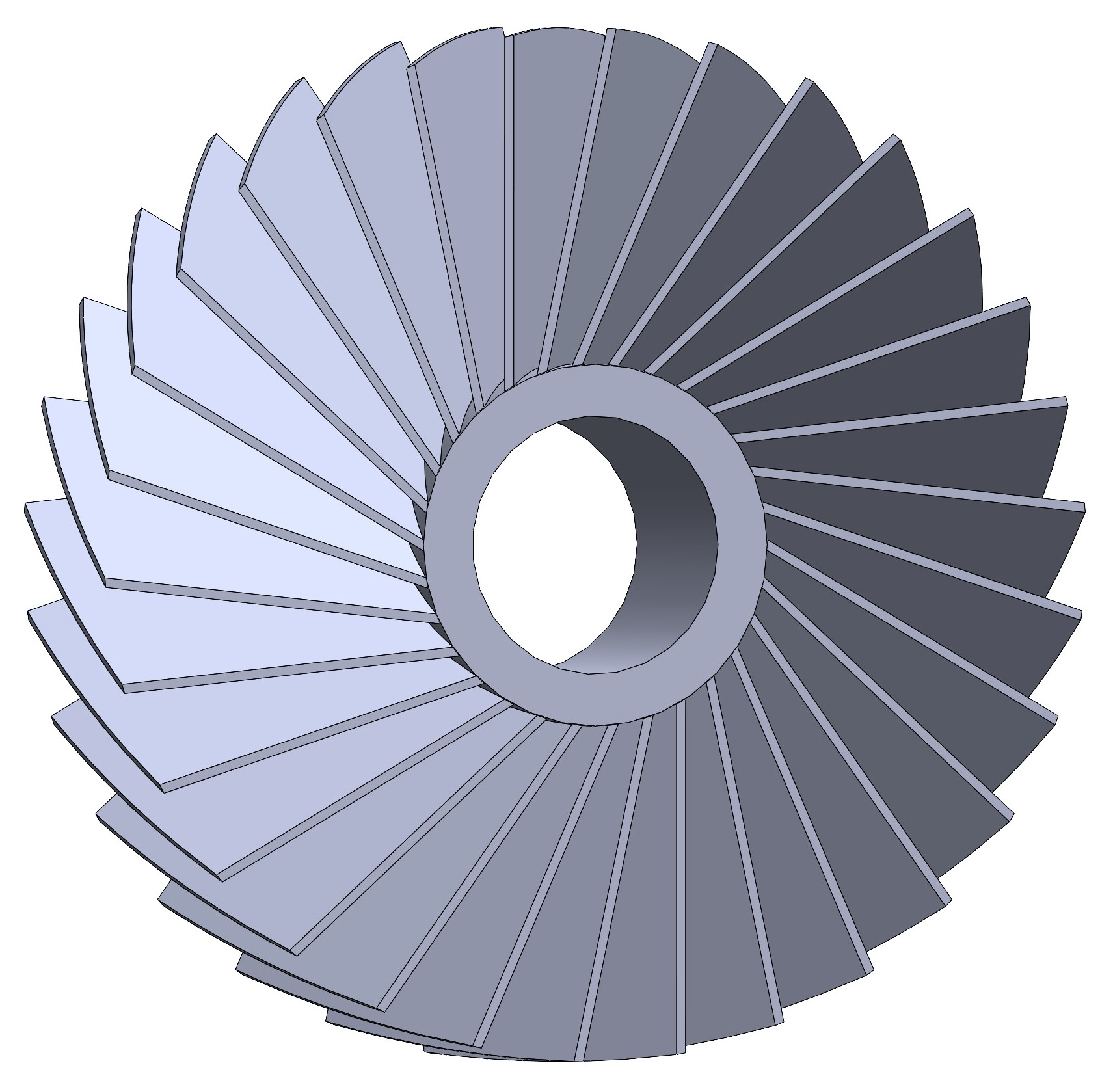
ALLEGRO Noble Liquid Ecal
Readout Board Transmission Line Impedance
J.Rutherfoord
1 April 2025
v3

Slide 2
Transmission Line Impedance
Use 2-D FEA to calculate the Electric Field
  Specify the geometry
  Use vacuum as the dielectric
  Apply D.C. potential between the signal trace and the ground trace
  The FEA reports the energy in the Electric Field
Calculate the capacitance per cable length
  Equate E-field energy with work to charge the cable
Use propagation speed (root dielectric constant) to calculate impedance

Slide 3
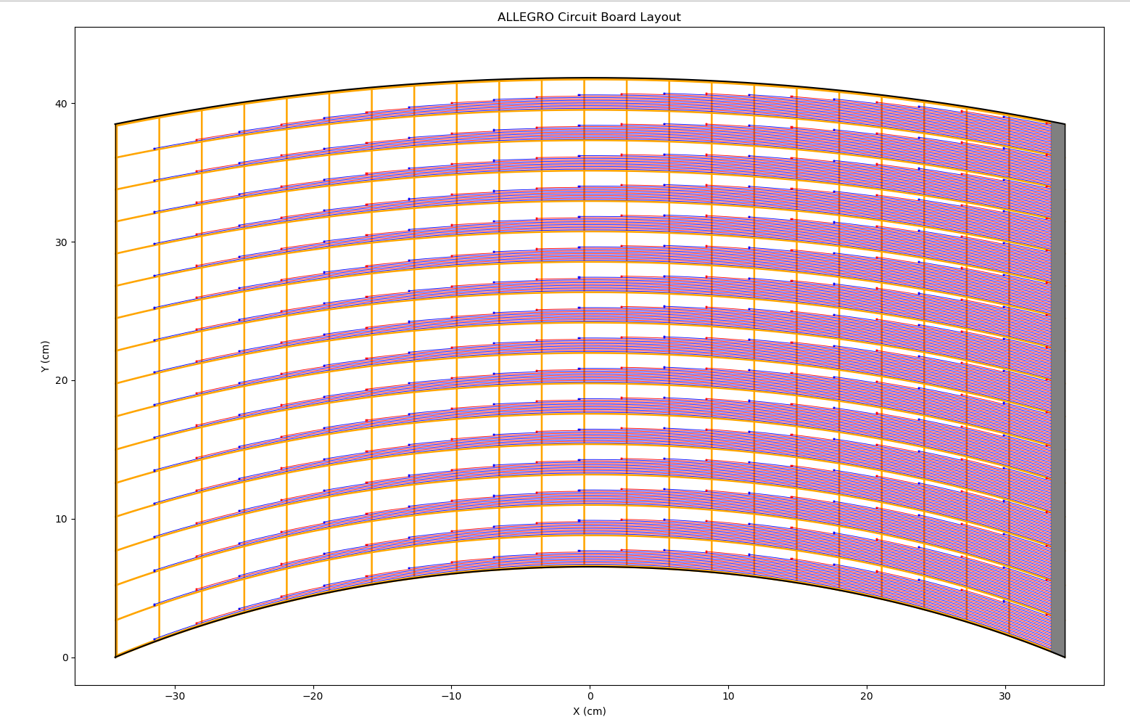
ALLEGRO Turbine Circuit Board Layout

Slide 4
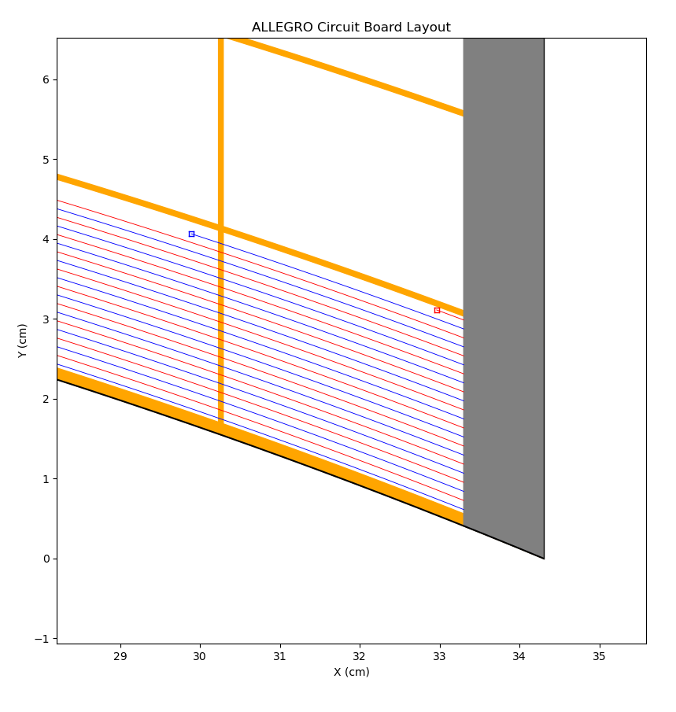
ALLEGRO Turbine Circuit Board Layout
Cross Section

Slide 5
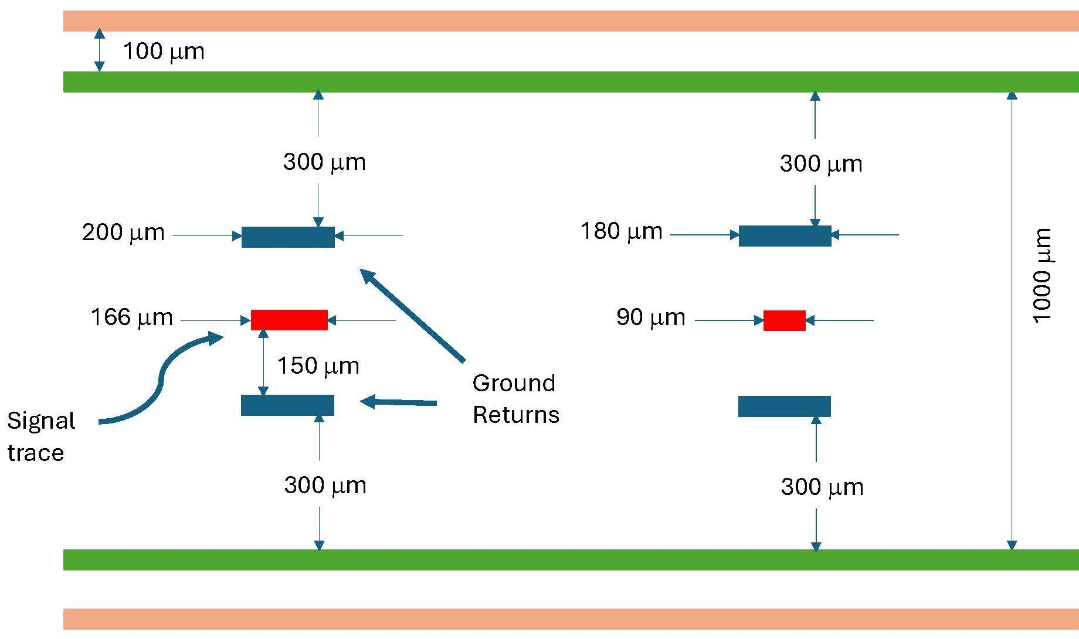
Xsection of two different embedded transmission lines

Slide 6
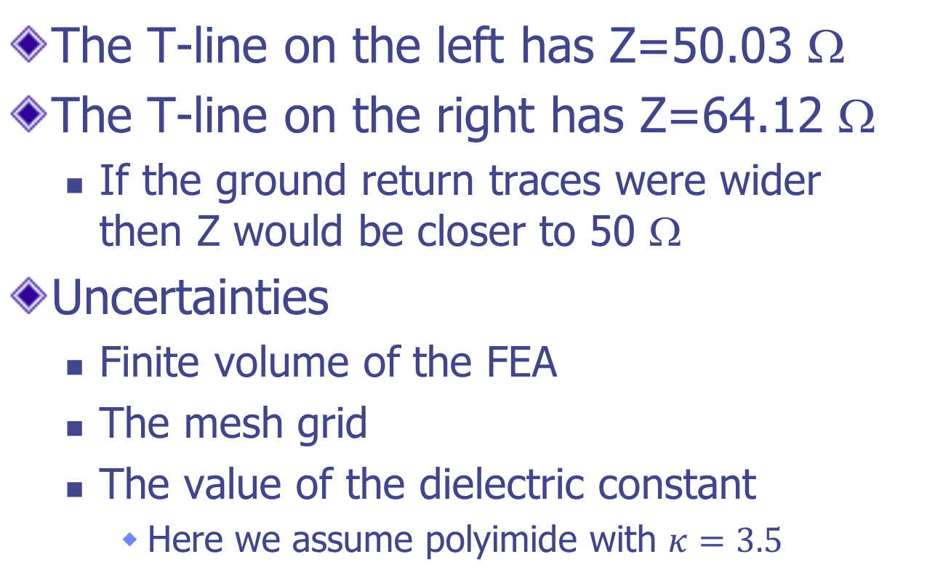
Transmission line impedance
The T-line on the left has Z=50.03 Ω
The T-line on the right has Z=64.12 Ω
  If the ground return traces were wider then Z would be closer to 50 Ω
Uncertainties
  Finite volume of the FEA
  The mesh grid
  The value of the dielectric constant
    Here we assume polyimide with $κ=3.5$

Slide 7
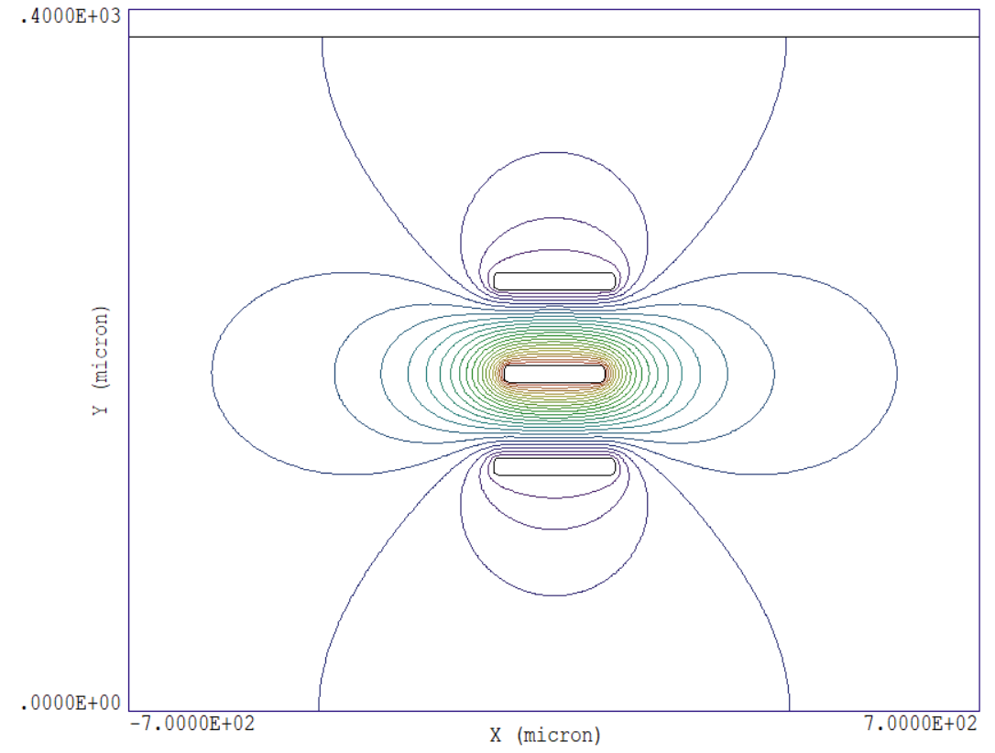
Iso-potential lines from the FEA

Slide 8
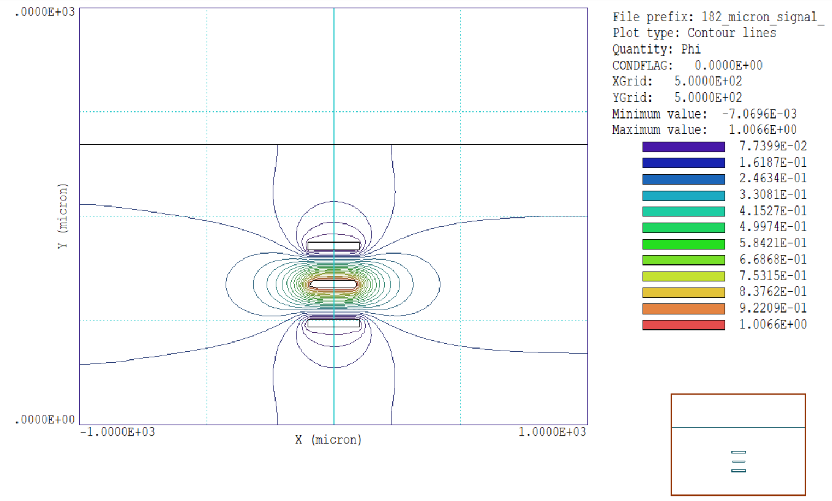

Slide 9
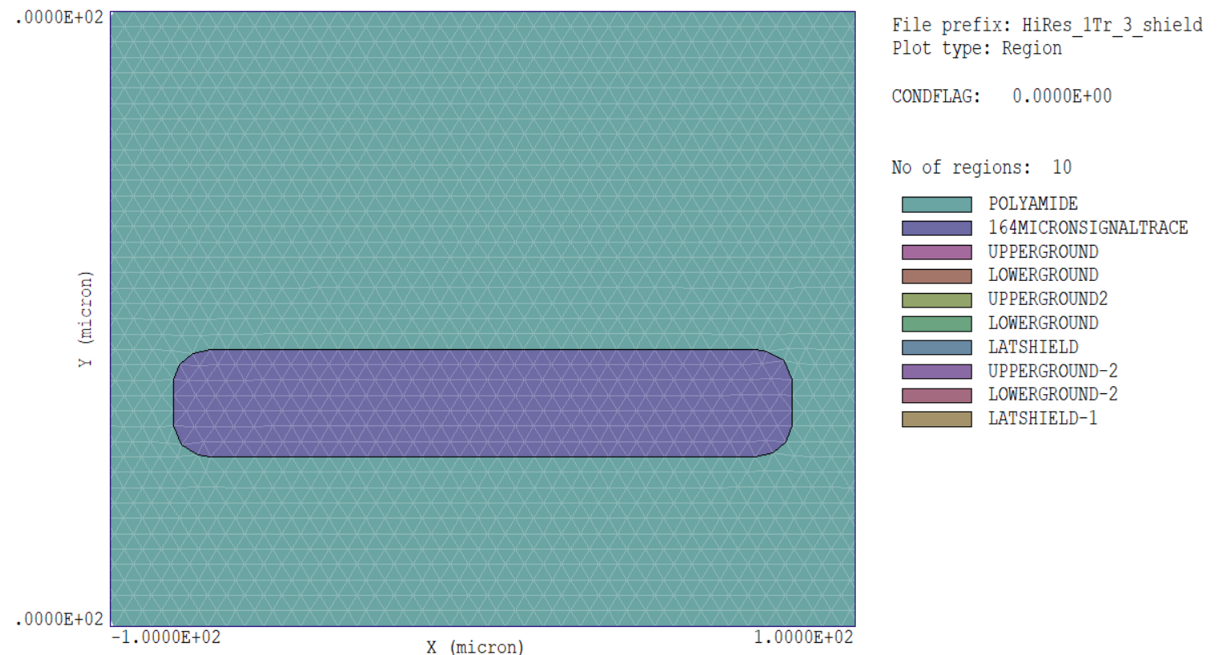
Mesh near the signal trace

Slide 10
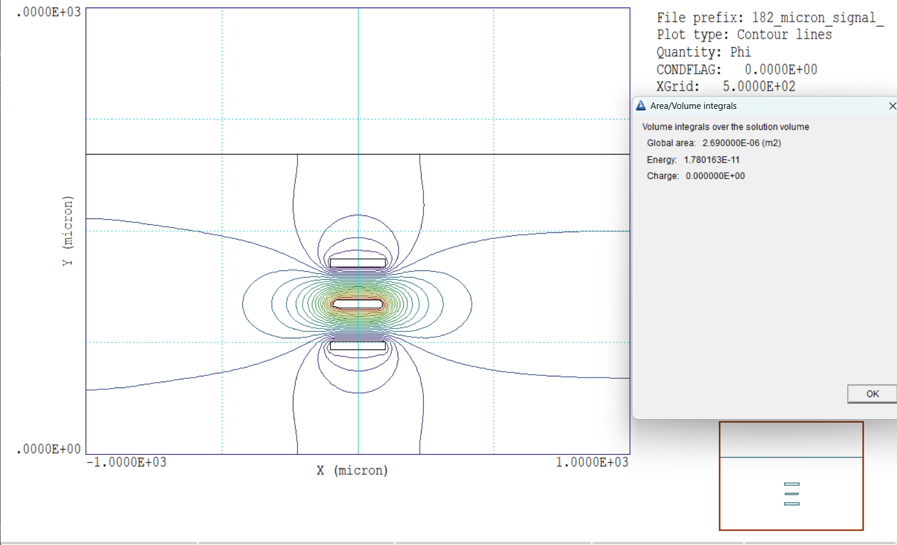
Energy in Joules/m where the depth (length along the transmission line) is assumed to be 1 meter.
Energy is directly proportional to the dielectric constant κ of the medium. Assume κ=1 and put in the correct κ later.

Slide 11
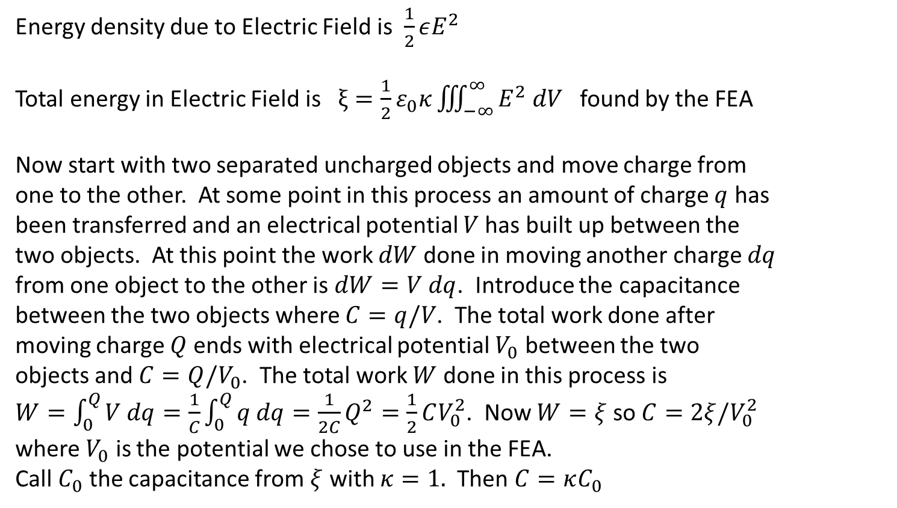
Two different energies
Energy density due to Electric Field is $\frac{1}{2}εE^{2}$
Total energy in Electric Field is $ξ=\frac{1}{2}ε_{0}κ\iiint_{−∞}^{∞}{E^{2} dV}$ found by the FEA
Now start with two separated uncharged objects and move charge from one to the other. At some point in this process an amount of charge $q$ has been transferred and an electrical potential $V$has built up between the two objects. At this point the work $dW$ done in moving another charge $dq$ from one object to the other is $dW=V dq$. Introduce the capacitance between the two objects where $C=q/V$. The total work done after moving charge $Q$ ends with electrical potential $V_{0}$ between the two objects and $C=Q/V_{0}$. The total work $W$ done in this process is $W=\int_{0}^{Q}{V dq=\frac{1}{C}}\int_{0}^{Q}{q dq}=\frac{1}{2C}Q^{2}=\frac{1}{2}CV_{0}^{2}$. Now $W=ξ$ so $C=2ξ/V_{0}^{2}$ where $V_{0}$ is the potential we chose to use in the FEA.
Call $C_{0}$ the capacitance from $ξ$ with $κ=1.$ Then $C=κC_{0}$

Slide 12
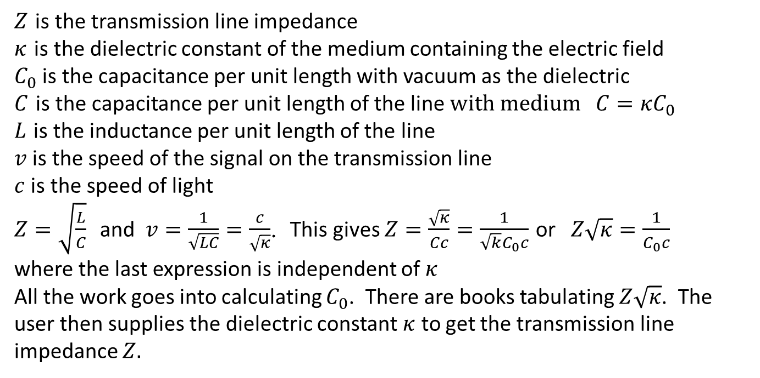
Transmission Line Impedance
$Z$ is the transmission line impedance
$κ$ is the dielectric constant of the medium containing the electric field
$C_{0}$ is the capacitance per unit length with vacuum as the dielectric
$C$ is the capacitance per unit length of the line $with medium C=κC_{0}$
$L$ is the inductance per unit length of the line
$v$ is the speed of the signal on the transmission line
$c$ is the speed of light
$Z=\sqrt{\frac{L}{C}}$ and $v=\frac{1}{\sqrt{LC}}=\frac{c}{\sqrt{κ}}$. This gives $Z=\frac{\sqrt{κ}}{Cc}=\frac{1}{\sqrt{k}C_{0}c}$ or $Z\sqrt{κ}=\frac{1}{C_{0}c}$
where the last expression is independent of $κ$
All the work goes into calculating $C_{0}$. There are books tabulating $Z\sqrt{κ}$. The user then supplies the dielectric constant $κ$ to get the transmission line impedance $Z.$

Slide 13
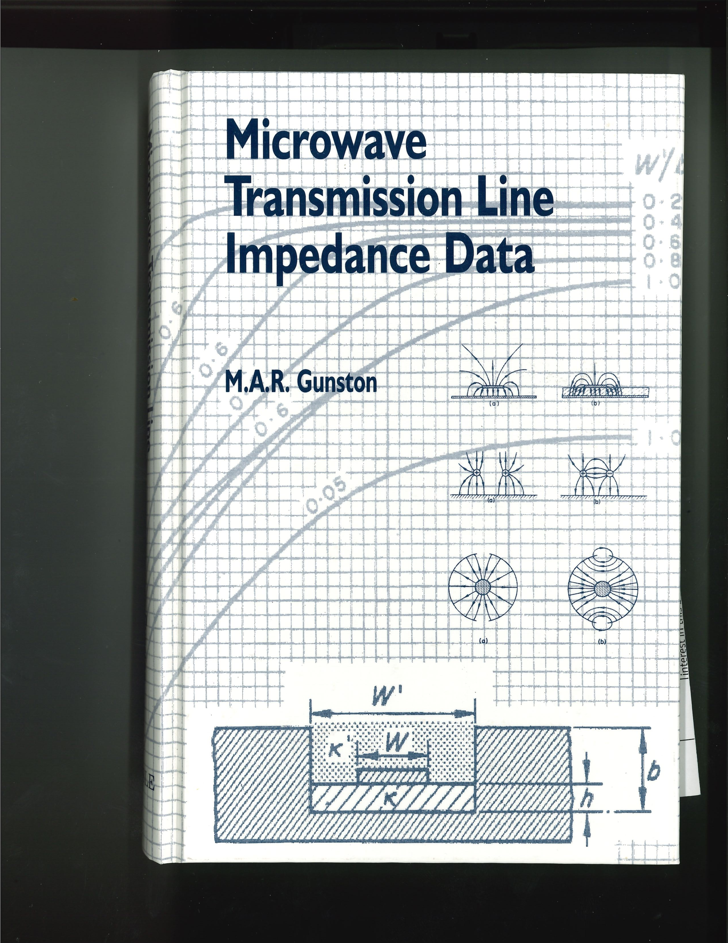

Slide 14
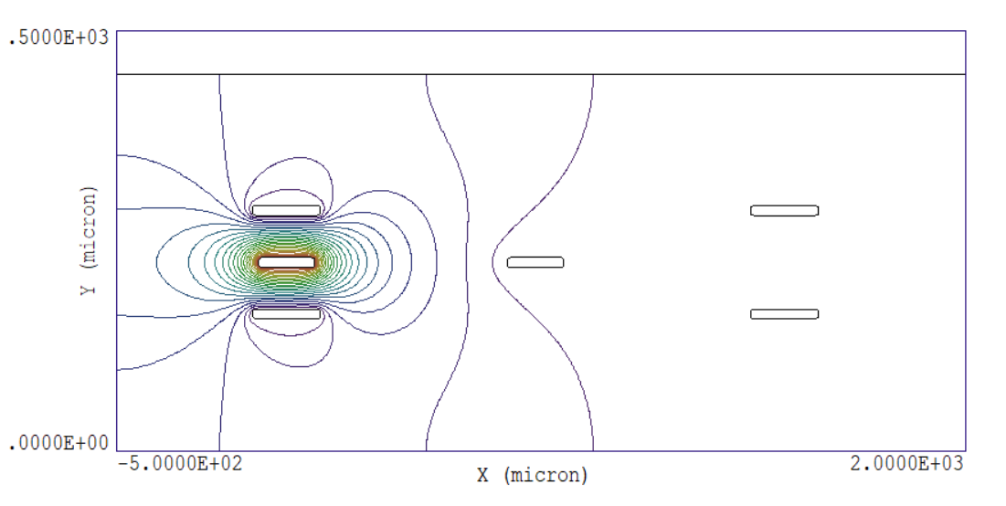
Cross-talk

Slide 15
