Slide 1
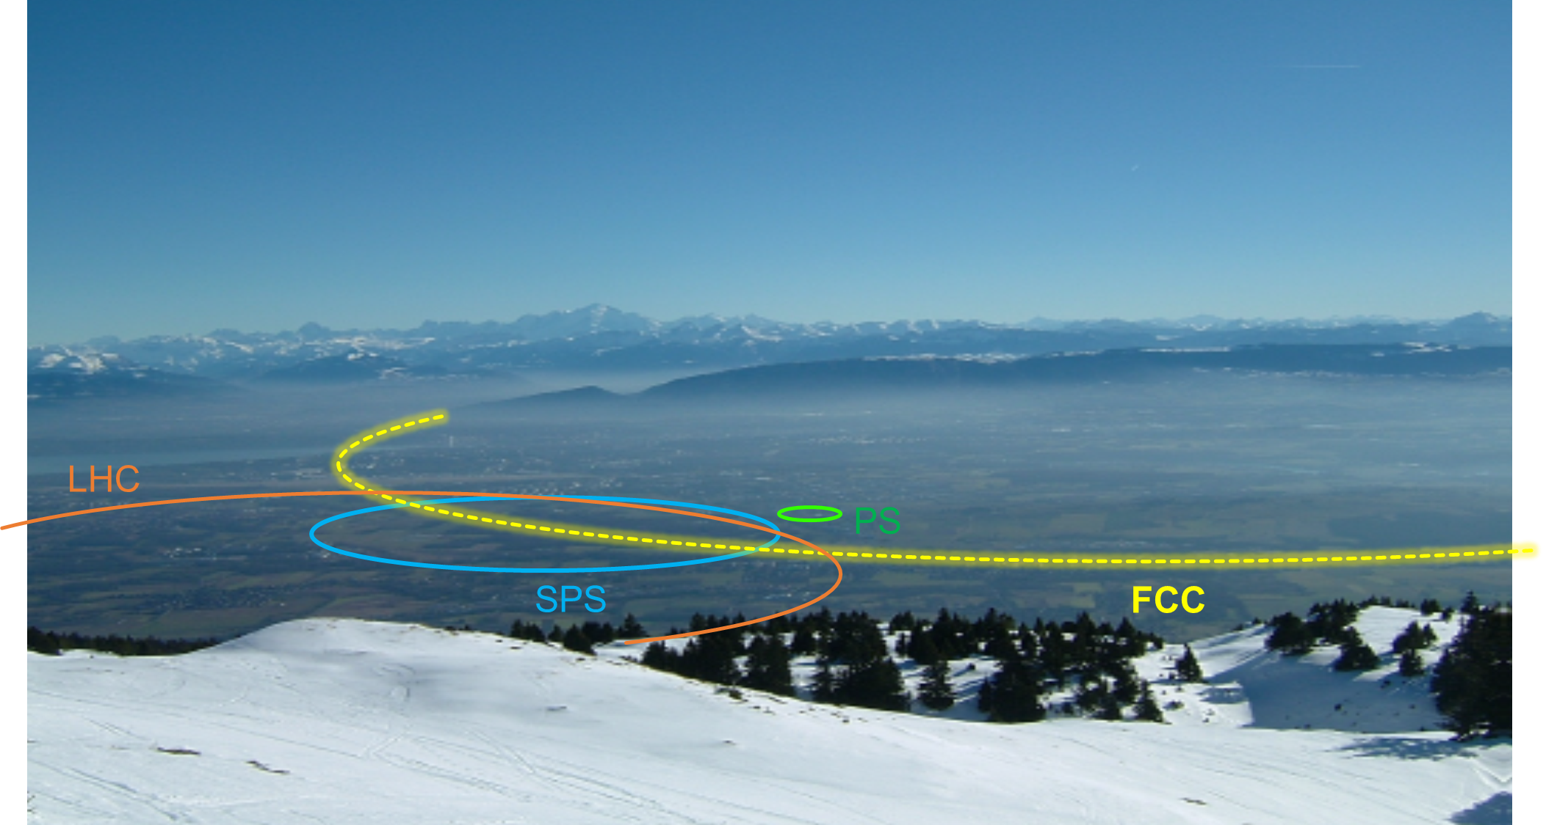
Future accelerators
Roderik Bruce

Slide 2
Outline
Introduction
  Considerations for collider design: particle type, energy, circular/linear…
  Limitations for future colliders
  European strategy for particle physics
ILC (International Linear Collider)
CLIC (Compact Linear Collider)
HL-LHC (High-Luminosity Large Hadron Collider)
FCC-hh (Future Circular collider, hadrons)
FCC-ee (Future Circular collider, e+e-)
CEPC/SppC (Chinese Electron-Positron Collider /
Super proton-proton Collider)
Muon collider
Linear
Circular

Slide 3
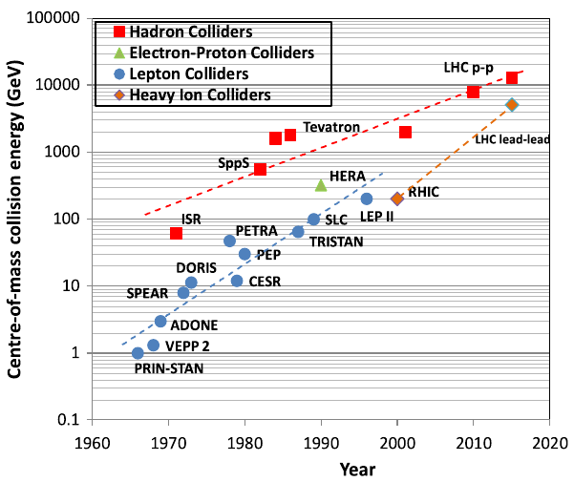
Particle colliders
Particle colliders have been instrumental for scientific discoveries in high energy physics for more than half a century
  Key for establishing the standard model in particle physics
Technological innovation made it possible to increase energy at a much faster pace than the costs
LHC has the highest energy among colliders built so far
  Circular collider, designed to collide
  7 TeV protons and heavy ions
“Livingstone plot” of collider energy vs time (source)

Slide 4
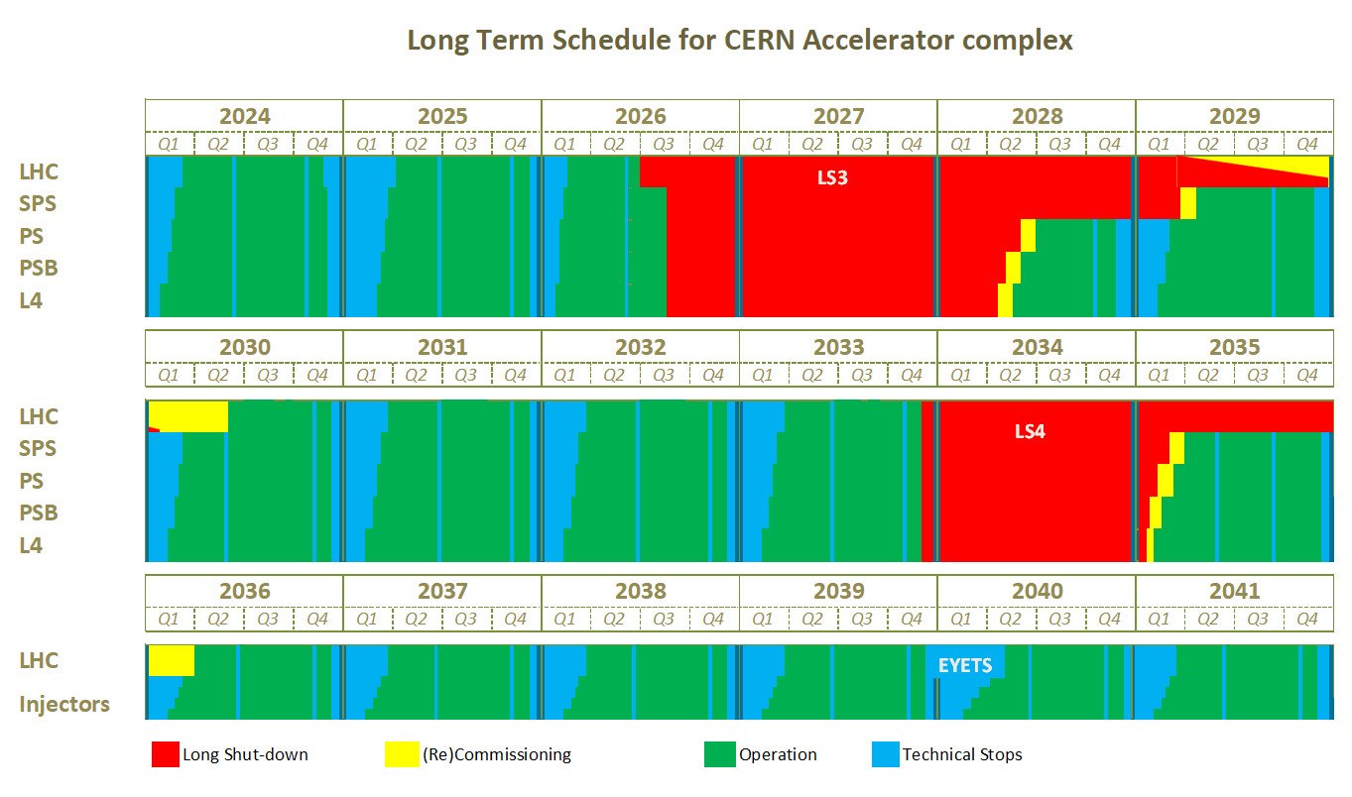
LHC timeline
Present LHC will operate for a few more years
High-Luminosity LHC (HL-LHC) upgrades foreseen for next long shutdown (LS3) for Run 4
HL-LHC planned to operate into the 2040s
What happens next?
  Nobody knows, but there are many ideas on the table
It took ~25 years to design and build the LHC, so need to start thinking now about future options
Tentative schedule, could well change
HL-LHC installation
Run 3
Run 4
Run 5
EDMS 2311633 V 4.2

Slide 5
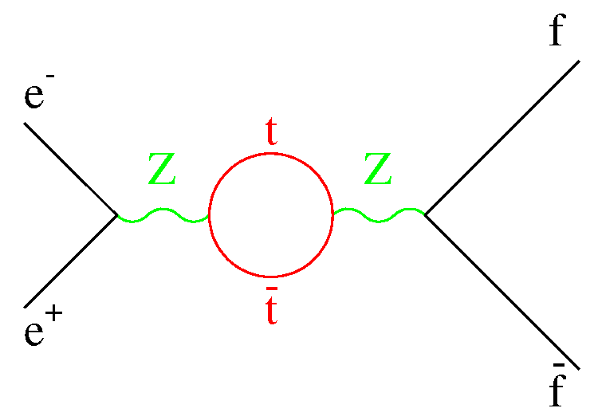
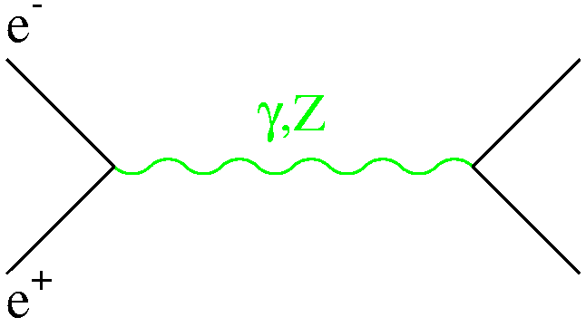
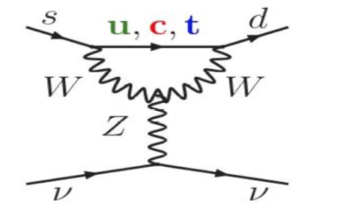
3 main complementary ways to search for (and study) new physics at accelerators
Direct
production of a given (new or known) particle
e.g.: Higgs production at future e⁺e⁻ linear/circular colliders
at √s ~ 250 GeV through the HZ process
→ need high E and high L
Indirect
precise measurements of known processes
Main focus
look for (tiny) deviations from SM expectation from quantum effects (loops, virtual particles)
sensitivities to E-scales Λ>> √s → need high E and high L
√s ~ 90 GeV
● ⁻
E.g. top mass predicted by LEP1 and SLC in 1993:
m_{top} = 177 ± 10 GeV; first direct evidence
at Tevatron in 1994: m_{top} = 174 ± 16 GeV
X*
● ⁺
Rare processes
suppressed in SM → could be enhanced by New Physics
e.g. neutrino interactions, rare decay modes → need intense beams and/or ultra-sensitive (massive)
detectors (“intensity frontier”)
E.g. K⁺ → π⁺νν decay (NA62 experiment)
Proceeds via loops → suppressed in the SM : BR~ 10⁻¹⁰
Can be enhanced by new particles running in the loop.
Theoretically very clean.
Slide from
F. Gianotti

Slide 6
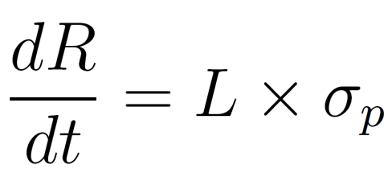
Considerations for new colliders
So, we want high energy and high luminosity
  When we say high luminosity, we implicitly mean high event rate
  Reminder: The luminosity directly determines the event rate
How do we get there? Several choices to be made:
  What to collide: lepton vs hadron
  How to collide:
    fixed target or colliding beams
    linear vs circular collider
  Acceleration technology
    DC, RF, wakefield…
  Magnet technology
    Superconducting (what conductor?), normal conducting
  Acceptable cost of construction, power consumption, site
Think about various limitations to energy and luminosity
and how to overcome them
Event rate
Cross section
(given by physics,
cannot be
influenced)
Luminosity
(determined by
and collider design:
can be influenced)
Notes:
Cross section for hadronic Higgs production is order of pico barn

Slide 7
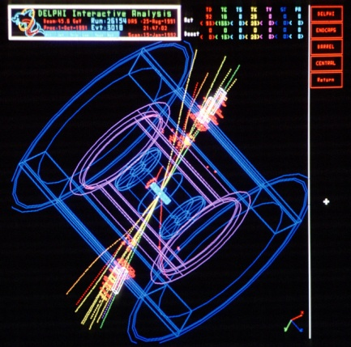
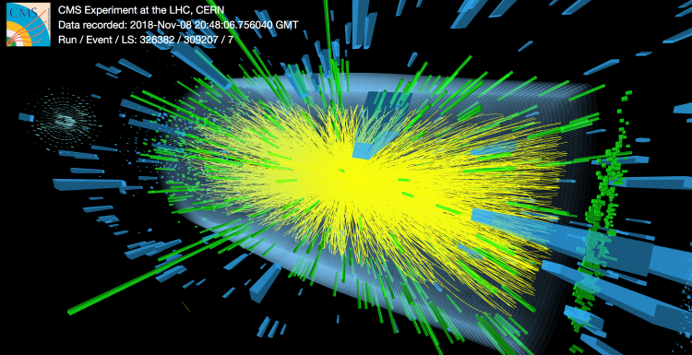
Leptons vs hadrons
Hadrons (protons or ions)
Mix of quarks, anti-quarks and gluons:
  variety of processes
  not all nucleon energy available in collision
  Energy spread between partons – spread in collision energy
  huge QCD background
Can typically achieve highest collision energy
Good for discoveries at the frontier of new physics
Leptons (electrons, positrons, maybe muons)
Elementary particles colliding - very well defined centre-of-mass energy
Low background
Good for high-precision measurements
Higher energy loss from synchrotron radiation influences accelerator design → see next slides
e+
e-
p
p
LHC Pb-Pb
collision, CMS
LEP II e+e-
collision, DELPHI

Slide 8
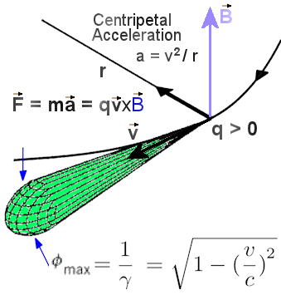
Synchrotron radiation
Classical electrodynamics: an accelerating charge radiates
  Radiation carries off energy, which is taken away from the kinetic energy
  Radiated energy needs to be replenished by accelerating RF cavities => could lead to very high power consumption
  Radiated photons impact on vacuum chamber => causes heating, maybe even damage for high power loads
Radiation in longitudinal acceleration negligible
Radiation loss for transverse acceleration (bending) can be large: depends on particle mass, energy, and bending radius:
Much stronger effect for leptons!
Emittance (beam size) shrinks when radiation carries off transverse momentum, replenished only longitudinally
Imposes limitations on
collider design
Longitudinal
acceleration
force
Transverse
acceleration
force
Notes:
Griffiths p11:16 p481 pdf,
Jackson p688 eq 14.13-14.14

Slide 9
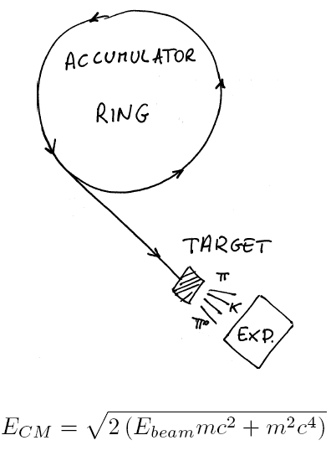
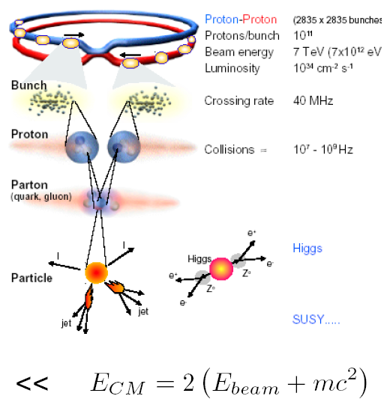
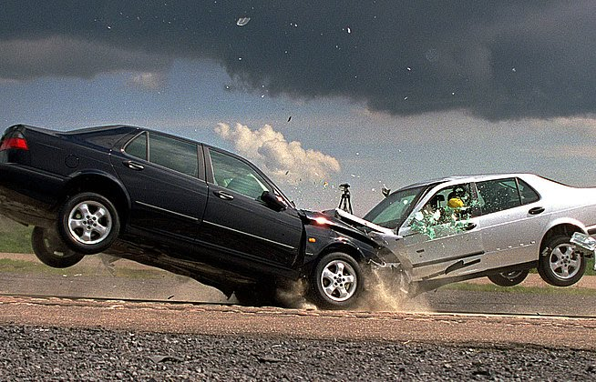
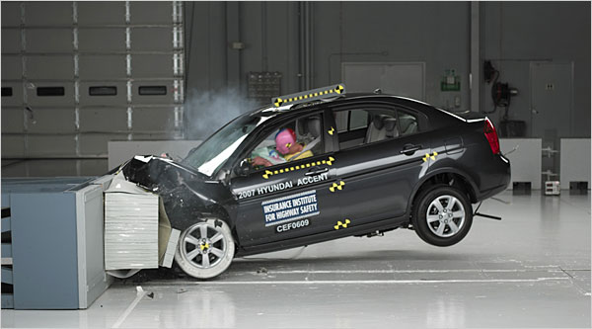
Collider vs fixed target experiments
Fixed Target
Collider
To achieve the highest possible centre-of-mass energy, need a collider

Slide 10
Circular vs linear collider
Circular Collider
multi-pass => Accelerate beam over many turns, let beam collide many times
many magnets, few accelerating cavities
Bending of beam trajectory => synchrotron radiation losses
accelerating cavities
N
N
S
S
Linear Collider
single pass => need to be very efficient
few magnets, many accelerating cavities
Not limited by synchrotron radiation – promising choice for reaching highest lepton energies
source
main linac

Slide 11
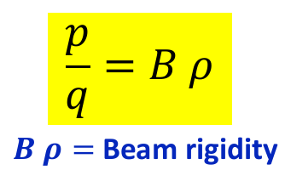
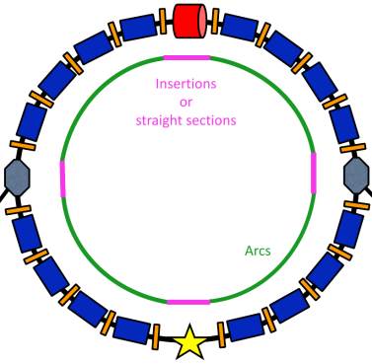
Increasing beam energy
Circular Collider
Linear Collider
Hadron beams: energy limited by ability of to keep particle on circular orbit
  Maximum achievable dipole field (superconductor technology)
  Radius of ring (cost, site)
Lepton beams: radiation losses
  RF power consumption
  Disposal of radiated power
  Radius of ring (cost, site)
Energy depends on
  Accelerating gradient (RF technology)
    Plasma wakefield acceleration promises large advancement, but not yet mature to produce required beam quality
  Length (cost, site)
E_{cm} ≈ L_{linac} G_{acc}
For protons:
To push energy boundary: improve technology (B-fields, RF gradient) or build a larger machine
Notes:
9 gev lost per turn in FCC-ee 182.5 GeV

Slide 12

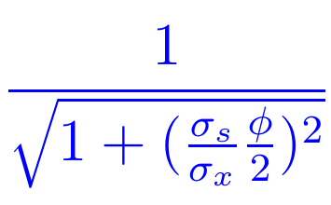
Increasing luminosity
Reminder: luminosity depends on beams and optics
Expression for round beams:
Higher intensity
Increase F: shorter bunches, smaller crossing angle
In addition:
Potential limitations on luminosity from losses and showers from the collisions
Increase number of bunches
Increase bunch intensity
Smaller β*
Smaller emittance
Smaller beam size

Slide 13

European strategy for particle physics
Common strategy worked out in Europe to guide future decision-making in field: “European strategy for particle physics”
  endorsed by the CERN council
Based on bottom-up approach:
  physics community is invited to submit proposals for near-term, mid-term and longer-term projects → community discussion in open symposium, Physics briefing book
  Based on this input, the European Strategy Group formulates the strategy
    consists of scientific delegates from CERN Member States, Associate Member States, directors of major European laboratories, representatives of various European organizations, some invitees from outside the European Community
Initiated in 2006, updated in 2013 and 2020, next update foreseen in 2026/2027
  2020 update: Key takeaway messages

Slide 14
Some recommendations in European strategy
Some points relevant to future high-energy colliders - see full document here
[about LHC] “The successful completion of the high-luminosity upgrade …. should remain the focal point of European particle physics, together with continued innovation in experimental techniques. The full physics potential of the LHC and the HL-LHC …. should be exploited. “
“An electron-positron Higgs factory is the highest-priority next collider”
“Europe, together with its international partners, should investigate the technical and financial feasibility of a future hadron collider at CERN with a centre-of-mass energy of at least 100 TeV and with an electron-positron Higgs and electroweak factory as a possible first stage. “
“The particle physics community should ramp up its R&D effort focused on advanced accelerator technologies, in particular that for high-field superconducting magnets, including high-temperature superconductors”
Notes:
Summary from DG presentation to personnel, sept 2020

Slide 15
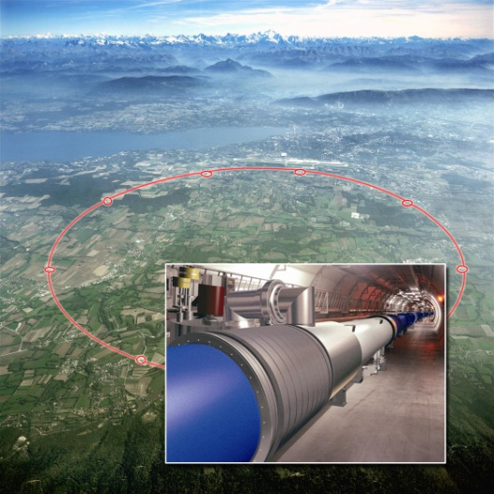
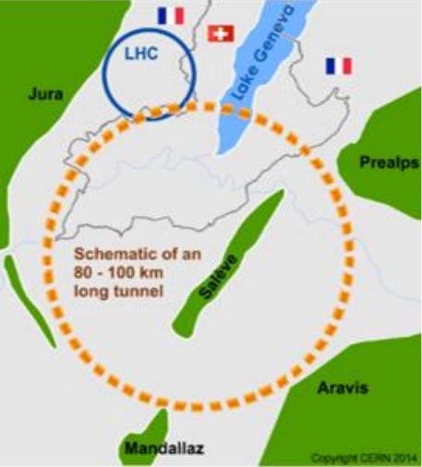
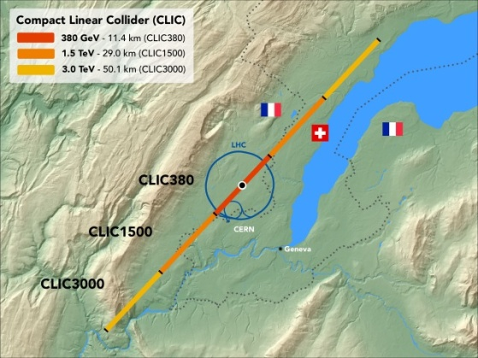
Future high-energy colliders studied at CERN
HL-LHC: luminosity upgrade of the LHC.
  Approved and financed - production and installation of upgrades already in full swing
  14TeV pp CMS and heavy ions as in LHC, 27 km
Future Circular Collider (FCC) in different stages
  Conceptual design report released
  Circular e+e- collider in 100 km tunnel, up to 365 GeV CMS: FCC-ee
  Re-use tunnel for 100 km hadron collider, 100 TeV pp CMS: FCC-hh
  2-step approach inspired by successful LEP – LHC programs at CERN
  Alternative approaches:
    energy upgrade of the LHC using stronger magnets: High-Energy LHC (HE-LHC)
    Hadron-electron collisions at the FCC: FCC-he
    Lower-field version of FCC-hh
Compact Linear Collider (CLIC)
  Linear e+e- collider, conceptual design report released
  Up to ~50 km and 3 TeV CMS energy
Muon collider
  Design study underway – many challenges
LHC
FCC
CLIC

Slide 16
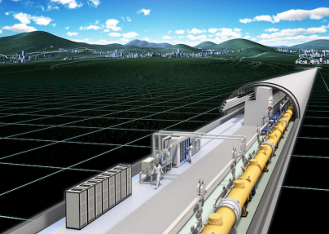
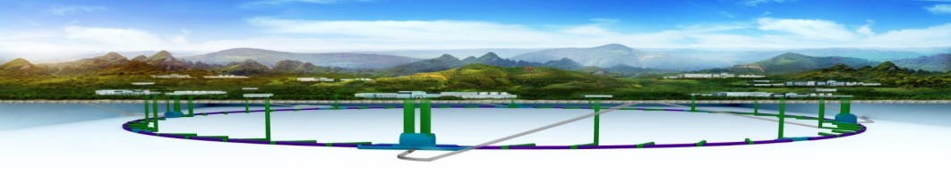
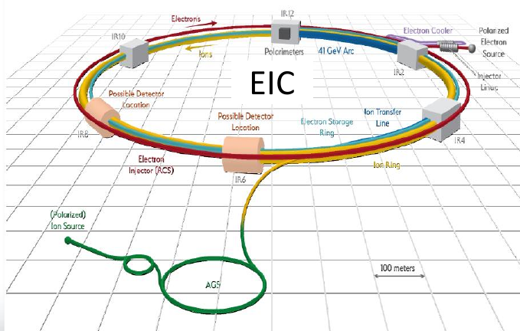
Initiatives in the rest of the world
International Linear Collider (ILC)
  Linear e+e- collider, technical design report released – mature design
  up to 500 GeV CMS, 31 km
  Potentially hosted by Japan – waiting for political decisions
Chinese initiative for circular collider
  First: e+e- collider (CEPC), up to 240 GeV CMS energy, 100 km ring
  followed by a 100 km hadron collider (SppC),
  75 TeV CMS energy (proposals for extensions to ~150 TeV)
Electron-Ion Collider (EIC) to be built at Brookhaven, US
  Circular, up to 140 GeV CMS energy, ~3.4 km
  Range of ions: p-U
  Use existing RHIC with some upgrades for ions
  New electron storage ring and injector
  Project approved, announced timeline to completion of ~10-15 years
ILC
CEPC / SppC

Slide 17

ILC

Slide 18
ILC basics
International Linear Collider: e+e- collider, aiming at 100-250 GeV beam energy (up to 500 GeV centre of mass)
  Extendable to 1 TeV (requires doubling the length)
Foreseen length at 500 GeV CMS energy of 31 km
Possibly to be built in Japan – waiting for political decisions and agreements on funding

Slide 19
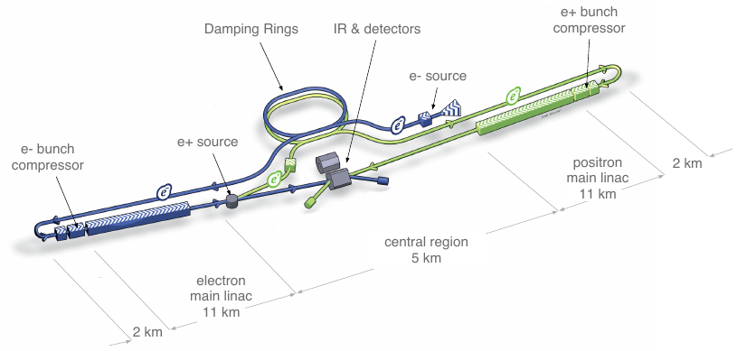
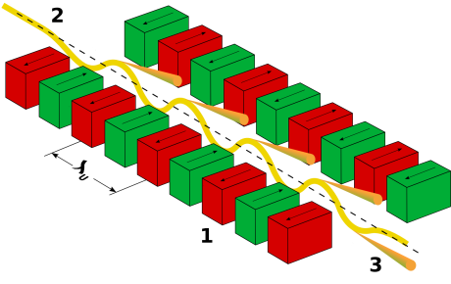
ILC layout and concept
From ILC design report
First, create e- (photocathode DC gun)
Accelerate, send to circulate in 3.2 km damping ring
  Shrinking emittance under radiation damping
e- sent to main linac, accelerate
To create e+: Electrons pass undulator – magnets with many periodic bends
  Radiated photons impact on Ti-alloy target, creating e+e- pairs.
  Capture e+, accelerate, send to damping ring
Send e+ to main linac, accelerate
Collide e+e- inside detector
Undulator
CC BY-SA 3.0, https://commons.wikimedia.org/w/index.php?curid=537945

Slide 20
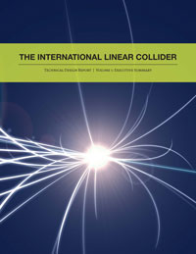
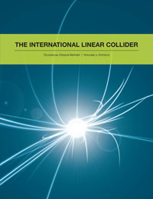

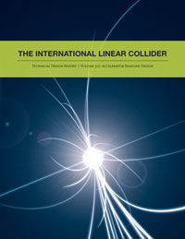
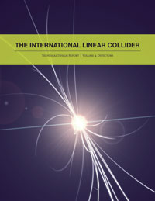
Further documentation
ILC technical design report

Slide 21
CLIC

Slide 22
CLIC basics
Linear e+e- collider, to be built in stages of increasing centre-of-mass energy:
  3 stages: 380 GeV – 3 TeV
  Length between ~11 km and ~50 km
Aiming at highest lepton energies
30 MW of beam power at 3TeV
Different acceleration technology with “drive beam”
  Fields from secondary electron beam accelerates main beam
CLIC aims at accelerating gradients of 100 MV/m
  20 times higher than the LHC
  Compare: 30 MV/m at ILC

Slide 23
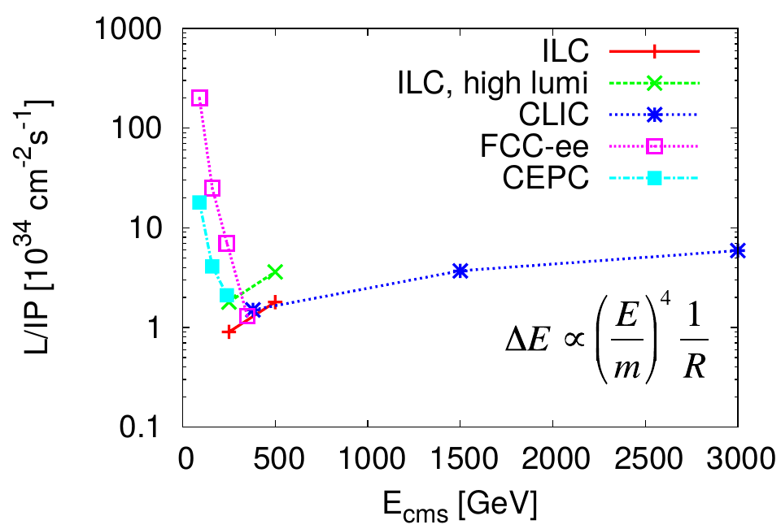
Luminosity comparison
Comparing luminosity between different future lepton colliders
  Circular and linear
At high energies, linear lepton colliders can achieve higher luminosity than circular ones
  Intensity in circular colliders limited by synchrotron raditaion

Slide 24
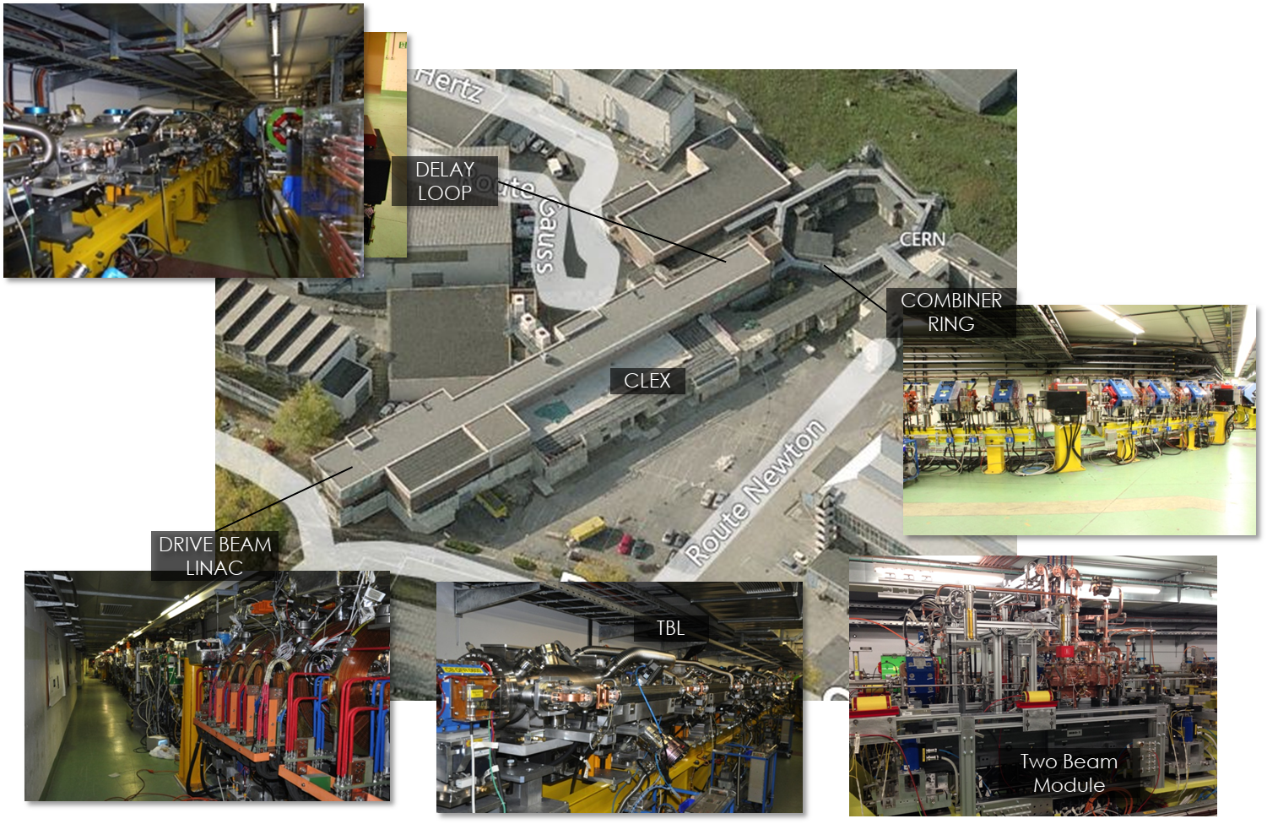
CLIC Test Facility (CTF3)
Experimental tests carried out in test facility at CERN to demonstrate drive beam concept
Accelerating gradient of >100 MV/m achieved

Slide 25
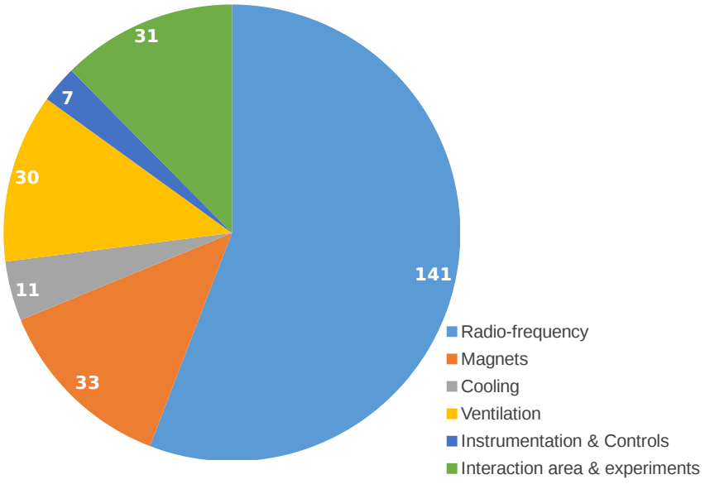
CLIC power consumption
Power and energy consumption at
380 GeV is well within the existing parameters and installations at CERN
At 1.5 TeV: power will surpass the current CERN usage (2017) by ~30%
At 3 TeV the energy consumption will be a factor two of the current CERN usage (2017)
Development work ongoing to further improve energy efficiency
Estimated power consumption of CLIC in MW at 380 GeV (total: 252 MW)
https://clic.cern

Slide 26
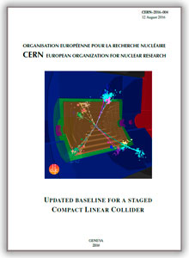
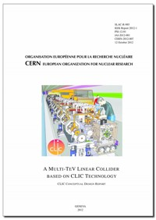
CLIC reference documents
More information:
  Conceptual design report (2012)
  Updated CLIC baseline document (2016)

Slide 27
HL-LHC

Slide 28
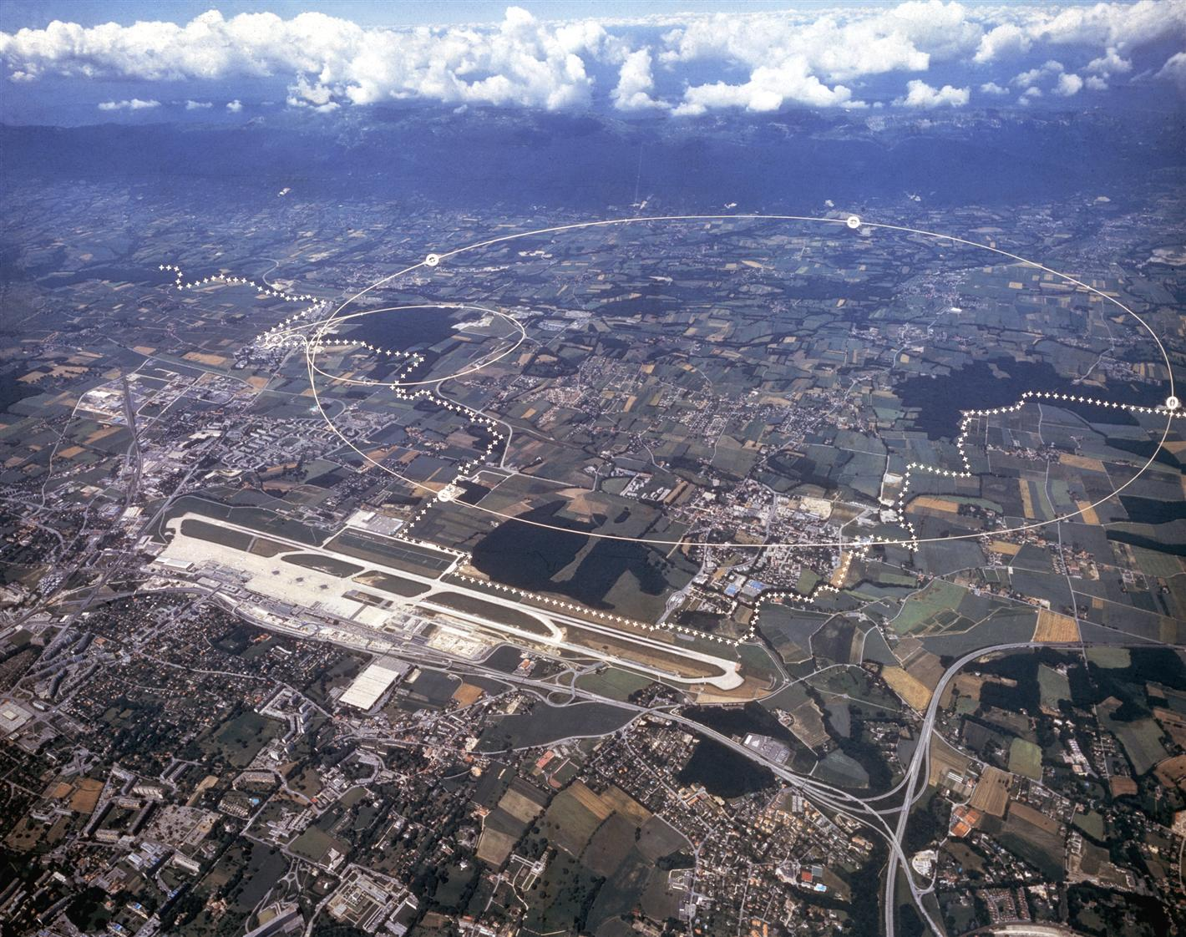
Reminder: LHC
27 km synchrotron, built to collide 7 TeV proton beams at 4 experiments
  Largest collider and highest energy to date
About 1 month per year: heavy-ion collisions
About 1200 superconducting dipole magnets (NbTi) with 8.3 T field, operating at 1.9 K
So far collected in total about 380 fb⁻¹ of integrated luminosity at the high-luminosity experiments (ATLAS, CMS)
LHC
France
ALICE
Switzerland
ATLAS
CMS
LHCb

Slide 29
HL-LHC
  High-luminosity LHC: Major upgrade of the LHC
  Main goals:
    Target an integrated luminosity of at least ~250 fb⁻¹ per year
    Achieve a total integrated luminosity of 3000 fb⁻¹ over the project lifetime
    Prepare machine for operation from 2038 and into the 2040’s
 | LHC 2018 | HL-LHC
Protons per bunch | 1.1 x 10¹¹ | 2.2 x 10¹¹
Number of bunches | 2556 | 2750
Normalized emittance | 1.8 micron | 2.5 micron
Beta* | 25-30 cm | 15 cm
Full crossing angle | 320 microrad | 500 microrad
Geometric reduction factor F | 0.6 | 0.35
“Virtual” luminosity |  | 2.4 x 10³⁵ cm⁻²s⁻¹
Levelled luminosity | 2.1 x 10³⁵ cm⁻²s⁻¹ | 5 x 10³⁴ cm⁻²s⁻¹

Slide 30
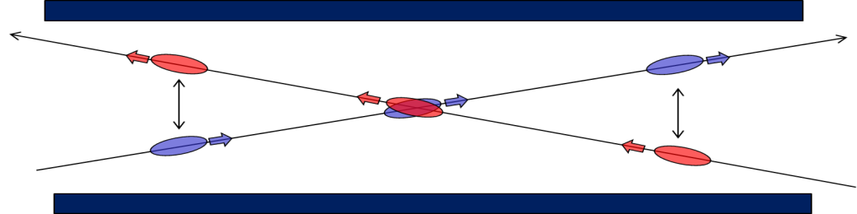
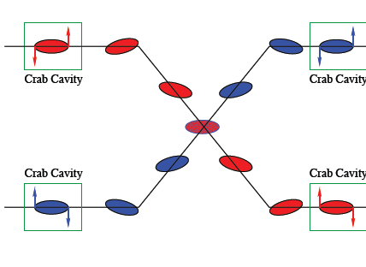
Compensation of geometric reduction factor
Bunches experience electromagnetic force from the opposing beam at the collision point (head-on beam-beam) or nearby in common beam pipe (long-range beam-beam)
  Need crossing angle, not only to avoid parasitic collisions
Crossing angle at HL-LHC must be larger than at LHC, due to higher intensity
  Would cause very large loss in luminosity: F≈0.35
To compensate: use “crab cavities” that tilt the bunches longitudinally and ensure overlap at the collision point
Long-range
Head-on

Slide 31
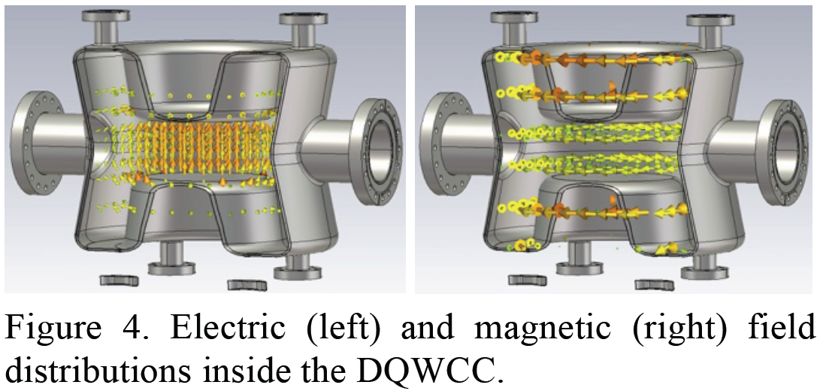
Crab cavities
Create a oscillating transverse electric field
Kick head and tail of the bunch in opposite directions

Slide 32
FCC-hh

Slide 33

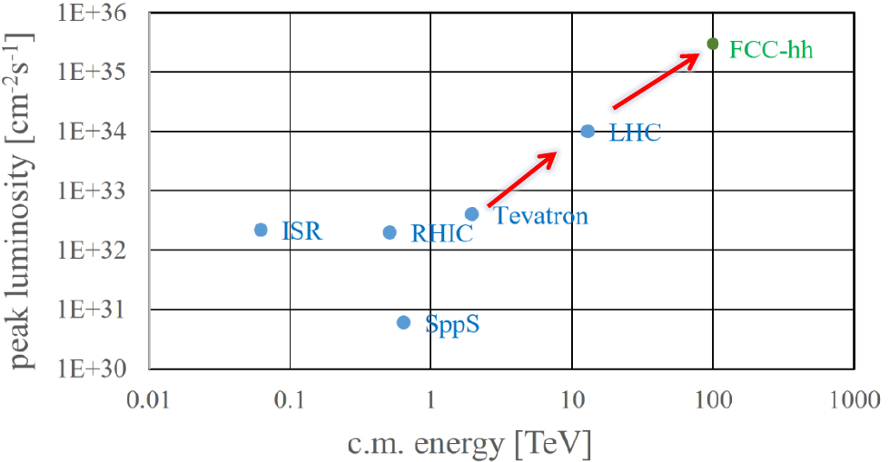
FCC-hh general goals
European strategy: “Europe, together with its international partners, should investigate the technical and financial feasibility of a future hadron collider at CERN with a centre-of-mass energy of at least 100 TeV and with an electron-positron Higgs and electroweak factory as a possible first stage. “
FCC-hh: collide 50 TeV protons (or heavy ions of equivalent magnetic rigidity) in tunnel of 90.7 km
  Factor 7 higher energy than LHC, factor ~3 longer tunnel
  International FCC collaboration (CERN as host lab)
More than an order of magnitude higher peak luminosity than LHC; factor 6 higher than HL-LHC
Goal: Achieve integrated luminosity of
20 000 fb⁻¹ per experiment collected over 25 years of operation (vs 3000 fb⁻¹ for HL-LHC)

Slide 34
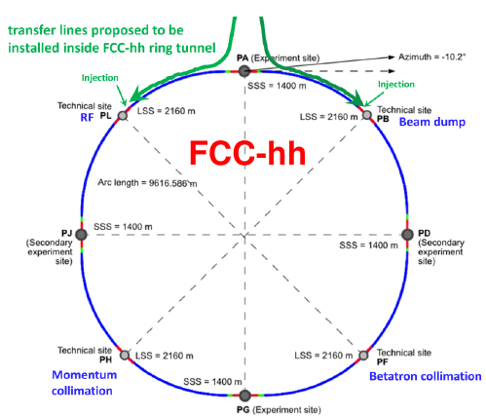
FCC-hh layout
Insertions in FCC-hh
  Two high-luminosity experiments (A and G)
  Two other experiments (D and J)
  Two collimation insertions (F and H)
  One extraction insertion (B)
  One RF insertion (L)
Insertions are 1.4-2.16 km long
Compatible with LHC or SPS as injector

Slide 35
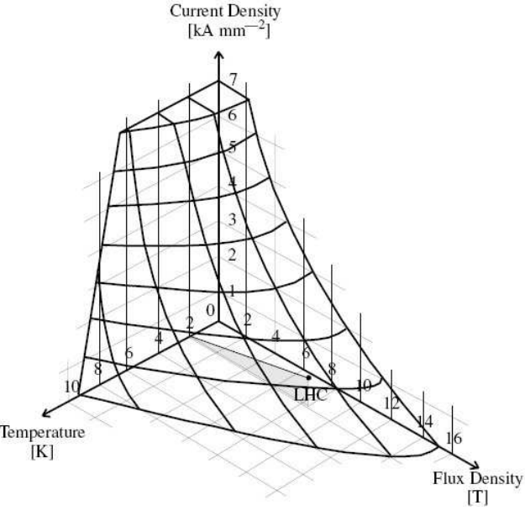
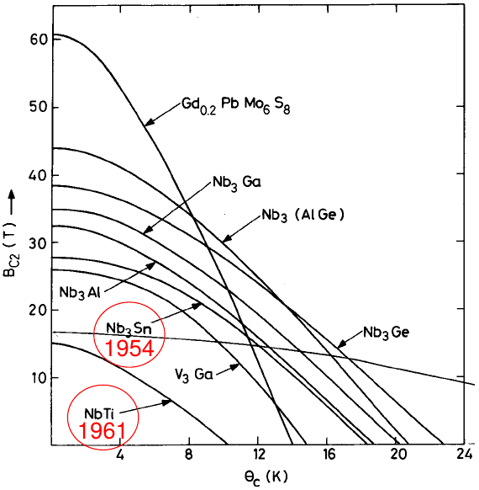
FCC-hh magnets
Need 16 T dipole magnets – not feasible with today’s technology
→ big challenge for technological development!
  In LHC, 8.3 T, with NbTi superconductors
  Cannot reach 16 T with NbTi: to be superconducting, need working point below “critical surface” in space spanned by temperature, current density and magnetic field
For 16 T, rely on future developments of Nb3Sn superconductor technology
  Alternatively, bet on high-temperature superconductors – significant technology development and cost reduction needed
Advanced research program on high-field magnets going on!
Critical surface
for NbTi

Slide 36


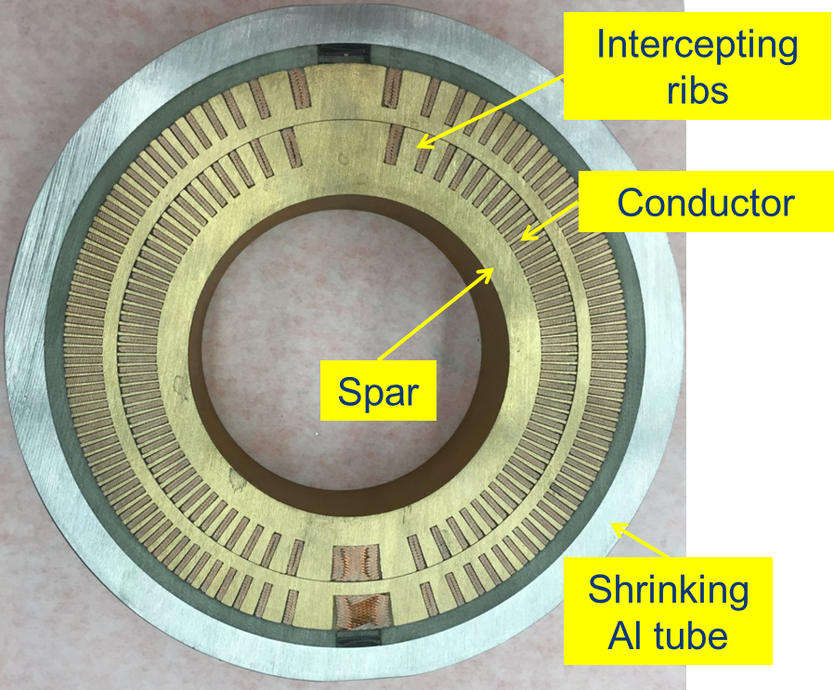
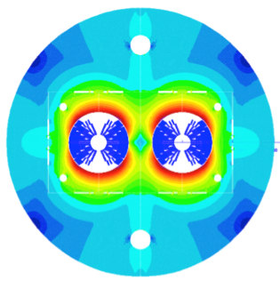
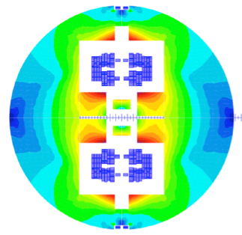
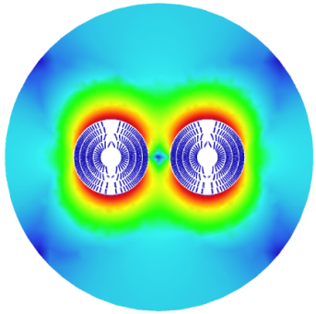
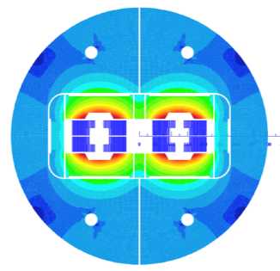
Research program on 16T Nb3Sn magnets
Swiss contribution
INFN
CIEMAT
Cos-theta
Common coils
LBNL
PSI
Canted
Cos-theta
CEA
Blocks
FNAL
Short model magnets (1.5 m lengths) will be built until ~2025

Slide 37
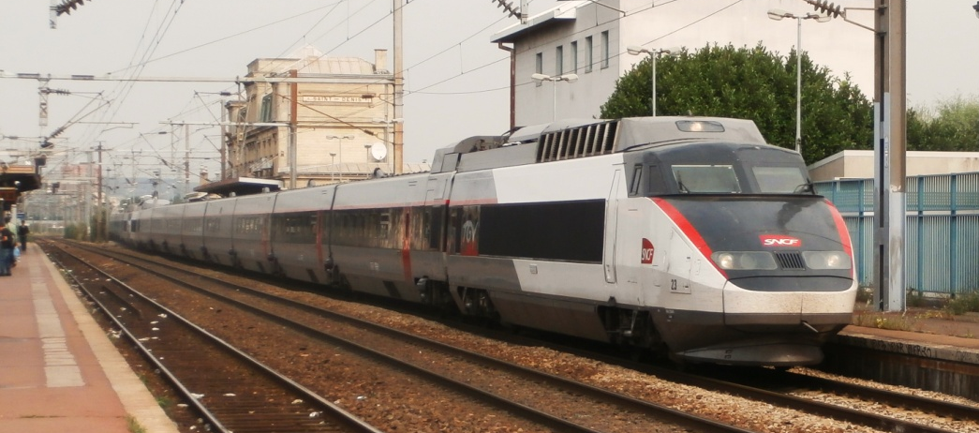

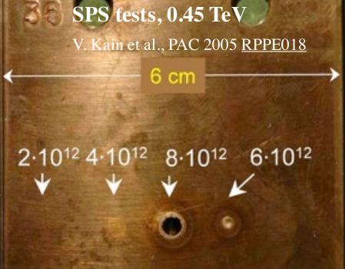
Next challenge: FCC-hh machine protection
HL-LHC: 680 MJ - kinetic energy of
TGV train cruising at 215 km/h
FCC-hh: 8.3 GJ – kinetic energy of
Airbus A380 (empty) cruising at 880 km/h
0.6 MJ

Slide 38
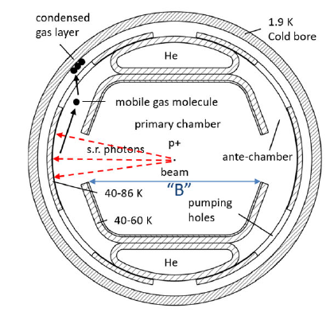

Synchrotron radiation in FCC-hh
FCC-hh first hadron collider where synchrotron radiation power has potentially limiting effects
  About 5 MW power loss per beam, lost continuously around the ring!
Need about 12 MW of RF power per beam to replenish lost energy
Need to cool away the 5MW heating power of lost photons around the ring - need much more cooling power than 5 MW (Carnot process – look back at thermodynamics)
  If beamscreen kept at 2K : 3500 MW
  If beamscreen kept at 50 K: 100 MW → choose this option!
  Special beam screen design to intercept photons in a slit
FCC-hh conceptual design report

Slide 39
FCC-ee

Slide 40




FCC-ee
European strategy: “An electron-positron Higgs factory is the highest-priority next collider”
FCC-ee is a high-luminosity, high-precision e+e- circular collider
Several different operational energies are foreseen to perform precision measurements of Z, W and H bosons and the top quark
  Goal: provide samples of 5× 10¹² Z bosons, 10⁸ W pairs, 10⁶ Higgs bosons and 10⁶ top quark pairs.
Beam energy: 45-182 GeV

Slide 41

Luminosity comparison
To reach the physics goals, need to significantly increase luminosity w.r.t. previous lepton colliders
Can reach higher luminosity than linear colliders at lower energy
  The higher the energy, the more severe limitations from synchrotron radiation

Slide 42

FCC-ee layout
Two-ring layout with two or four collision points and two RF insertions
Same footprint as FCC-hh

Slide 43

Synchrotron radiation in FCC-ee
Design choice: limit radiation power to 50 MW per beam (still huge!)
  RF cavities have a certain (in)efficiency → total RF power consumption for both beams up to about 160 MW
  Lower intensity at higher energy =>
  lower luminosity
  Not critical for cooling – normal-conducting magnets
At highest energy, 182.5 GeV, loss of
9 GeV or ~5% per turn
  particles that have lost energy are overbent by the dipoles => accumulate large transverse offsets, “saw tooth” orbit if nothing is done
  Compensate by varying magnetic strengths, “tapering”
Example horizontal orbit with radiation
B. Härer, A. Doblhammer, and B.J. Holzer, IPAC16, THPOR003

Slide 44



FCC-ee power consumption
Beam energy (GeV) | 45.6 Z | 80 W | 120 ZH | 182.5 ttbar
RF (SR = 100) | 163 | 163 | 145 | 145
Collider cryo | 1 | 9 | 14 | 46
Collider magnets | 4 | 12 | 26 | 60
Booster RF & cryo | 3 | 4 | 6 | 8
Booster magnets | 0 | 1 | 2 | 5
Pre injector | 10 | 10 | 10 | 10
Physics detector | 8 | 8 | 8 | 8
Data center | 4 | 4 | 4 | 4
Cooling & ventilation | 30 | 31 | 31 | 37
General services | 36 | 36 | 36 | 36
Total | 259 | 278 | 282 | 359
Notes:
Yearly consumption about 1.9 TWh (compare 1.2 TWh for CERN in 2016)

Slide 45

Overall FCC timeline
Foreseen FCC timeline spans several decades
Remember: it took ~25 years from the start of the LHC design to the start of operation

Slide 46



FCC design report
FCC-Conceptual Design Reports (completed in 2018):
  Vol 1 Physics, Vol 2 FCC-ee, Vol 3 FCC-hh, Vol 4 HE-LHC
  CDRs published in European Physical Journal C (Vol 1) and ST (Vol 2 – 4)
  EPJ C 79, 6 (2019) 474 , EPJ ST 228, 2 (2019) 261-623 , EPJ ST 228, 4 (2019) 755-1107 , EPJ ST 228, 5 (2019) 1109-1382
Summary documents provided to EPPSU SG
  FCC-integral, FCC-ee, FCC-hh, HE-LHC
  Accessible on http://fcc-cdr.web.cern.ch/

Slide 47
CEPC / SppC

Slide 48


CEPC (Circular Electron Positron Collider)
Chinese proposal for e⁺e⁻ collider 90-240 GeV, 100 km ring
Four operation modes: H, Z, WW, ttbar
Two collision points, two RF insertions
Limit synchrotron radiation power to 30 MW per ring, option to go to 50 MW
More details technical design report , 2023

Slide 49

SppC (Super proton-proton Collider)
100 km hadron collider to later be installed in the same tunnel as CEPC
Design report scenario:
  use 12 T high-temperature iron-based superconductors for high field dipole magnets => centre of mass energy of 75 TeV
  “ultimate” upgrade: 24T field, 150 TeV CMS energy
  Operating at 4.2 K
  Luminosity of 10³⁵ cm^{–2} s^{–1}
Baseline layout with 8 insertions for experiments, collimation, extraction, injection, RF
, following conceptual design report in 2018

Slide 50

Muon collider

Slide 51


Muon collider study
Could use heavier leptons than e+e- to minimize synchrotron radiation in a circular lepton collider
  Could reach much higher energy than with e+e- for the same radius, still with “cleaner” collisions than protons
  Or reach similar energies with a much smaller machine → cost- and energy-efficient
Use muons?
  mass = 106 MeV/c² = 207 m_{e}
  Challenge 1: Unstable, 2.2 μs mean lifetime
    Need to very quickly accelerate them to high energy – with time dilation, factor γ longer lifetime
  Challenge 2: experimental backgrounds due to e+ and e- from muon decay
  Challenge 3: abundant neutrinos from muon decay could reach surface and interact, causing radiation
Production of muons – presently considered option:
  Let high-power proton beam hit a target
  Pions are produced, which later decay into muons
  Muons have relatively large transverse momentum spread →
  need to very quickly "cool" them to achieve small beam size for
  higher luminosity
    Challenge 4: very fast cooling of muon beam
protons
target
Many particles,
including π+, π-
Notes:
At 5 TeV, gamma = 47322, mean lifetime is 95 ms
Muons should last about 1000 turns in main ring, I.e. ~30 ms. Lifetime at top energy is 95 ms for 5 TeV beams (10 TeV CMS)

Slide 52

Muon collider – schematic design

Slide 53
Summary
LHC will be upgraded to HL-LHC, and operate until 2035-2040
  Future collider projects on the table, but no decision yet
Main projects studied at CERN
  FCC-ee: circular e+e- collider
    e+e- Higgs factory is highest priority it European strategy
    conceptual design report exists; studies are ongoing to give more inputs to next European strategy
  FCC-hh: circular pp collider with ion option
    High priority by European strategy
    conceptual design report exists; studies are ongoing to give more inputs to next European strategy
  CLIC: Linear e+e- collider
    Also fulfills priority on a Higgs factory in European strategy
    Conceptual design report exists, technology and concept demonstrated
  Also: HE-LHC, FCC-eh, muon collider, LHeC
  All these machines have many interesting beam physics aspects – I could cover only a few!
Initiatives in other parts of the world
  ILC: Linear e+e- collider, possibly hosted by Japan
    Mature design with technical design report; ready to be built. Awaiting political decisions
  CEPC / SppC: circular e+e- collider followed by hadron collider, Chinese initiative
    Conceptual design report exists. China will decide
  EIC: circular electron-ion collider, to be built in the US
    Approved project with conceptual design report

Slide 54





Future colliders?
Particle collisions 50 years ago
Particle collisions today
Particle collisions in 50 years
574 TeV Pb beams colliding at ALICE, LHC
32 cm bubble chamber with liquid hydrogen, 16 GeV pion interacting with proton
https://cds.cern.ch/record/39474

Slide 55
Backup

Slide 56



Some limitations on intensity and beam size
(not exhaustive list)
Intensity
  Limitations in beam production scheme
  Collective effects and instabilities, e.g. space charge, impedance effects, beam-beam effects
  Beam-beam effects (detrimental non-linear electromagnetic field acting on opposing beam)
  In circular lepton machines, limitations on RF power (compensate synchrotron radiation losses)
  Detrimental effects of beam losses
Beam size
  β* limited by magnet focusing strength and aperture in final focus quadrupoles
  Emittance: limitations in beam production, larger risk for instabilities, blowup (intra-beam scattering); not easy to reduce emittance of existing beam, need dedicated cooling etc
    Lepton machines: equilibrium emittance determined by accelerator lattice
    Can use damping rings to shrink emittance
  Beam-beam effects
Long-range
Head-on

Slide 57



Radiated power
For full derivation, see e.g. Jackson, Classical electrodynamics, chapter 14
Very short summary
  Write down electric and magnetic fields of moving point charge (at relativistic speed)
  Power radiated is given by integral of Poynting vector over closed surface around charge, let R→∞ (only 1/R terms in fields contribute)
  Integrate …. don’t be in a hurry
Result:
  Energy loss is negligible for longitudinal acceleration, except for extreme (unphysical) gradients
  For transverse acceleration (as in circular colliders), energy loss could be significant - 4th power dependence on energy and mass
  Effect is much more limiting for light particles, such as electrons/positrons
    Electrons are 2000 times lighter than protons!
Longitudinal
acceleration
Transverse
acceleration
force
force
… meaning…

Slide 58

Radiation damping
Emitted photons along betatron trajectory – (almost) no change in angle of particle
Energy losses compensated by RF, giving purely longitudinal momentum kick
  Increases longitudinal momentum and not transverse => decrease in angle
  Smaller betatron amplitudes => smaller emittance, “radiation damping”
    Remember: emittance determines phase space area occupied by beam
On the other hand: photon emission gives small random energy (and very small angle) change => blowup, “quantum excitation”
Equilibrium between radiation damping and quantum excitation exists: equilibrium emittance
  Time needed for the beam to reach the equilibrium emittance: “Damping time”
  Equilibrium emittance is typically smaller in vertical than horizontal plane => “flat” lepton beams
M. Sands, SLAC-121 UC-28

Slide 59

Geometric reduction factor
Long-range
Head-on
Bunches must collide with an angle, ”crossing angle” – otherwise we get unwanted collisions outside interaction point
  Crossing angle need to be large enough so that bunches are not perturbed by electromagnetic field at parasitic encounters (long-range beam-beam effect)
Fewer collisions when overlap is not perfect – geometric reduction factor
  Depends on crossing angle, bunch length, and transverse size

Slide 60

ILC main parameters
From ILC design report

Slide 61
CLIC parameters
Parameter | Symbol [unit] | ILC 250 | CLIC | CLIC
Centre of mass energy | E_{cm} [GeV] | 250 | 380 | 3000
Luminosity | L [10³⁴cm⁻²s⁻¹] | 1.35 | 1.5 | 6
Luminosity in peak | L_{0.01} [10³⁴cm⁻²s⁻¹] | 1 | 0.9 | 2
Gradient | G [MV/m] | 31.5 | 72 | 100
Particles per bunch | N [10⁹] | 20 | 5.2 | 3.72
Bunch length | σ_{z} [μm] | 300 | 70 | 44
Collision beam size | σ_{x,y} [nm/nm] | 516/7.7 | 149/2.9 | 40/1
Vertical emittance | ε_{x,y} [nm] | 35 | 30 | 20*
Bunches per pulse | n_{b} | 1312 | 352 | 312
Bunch distance | Δz [mm] | 554 | 0.5 | 0.5
Repetition rate | f_{r} [Hz] | 5 | 50 | 50
D. Schulte

Slide 62



Flat beams in lepton colliders
Naturally smaller vertical beam size from radiation damping
  Often true also for linear colliders due to horizontal bending in damping rings, transfer lines etc.
Beam-beam effect
  Focusing of e+e- beams due to each others’ fields => higher luminosity
  Bending of particles => synchrotron radiation, “beamstrahlung” => unwanted energy spread in collisions
To avoid energy spread and keep luminosity high: collide “flat” beams, with much smaller beam size in one plane
M. Sands, SLAC-121 UC-28
Luminosity depends on product of beam sizes:
average number of photons per collision depends on sum of beam sizes:
M.A. Valdivia García et al.,
doi:10.18429/JACoW-IPAC2019-MOPMP035

Slide 63

CLIC cavities
D. Schulte
To reach 100 MV/m: different type of cavity from ILC
12 GHz, 23 cm long, normal conducting
  Much worse conductor than SC, but allows reaching higher fields
  Problem: power is very rapidly lost in the walls
  Need to put in very intense and short RF pulses timed to the passage of the beam
Power flow
1/3 lost in cavity walls
1/3 in filling the structure and into load
1/3 into the beam
Average RF power about 3 kW/m
About 1 kW/m into beam

Slide 64


ILC Cavities
Superconducting cavity (Ni at 2 K)
RF frequency is 1.3 GHz, 23 cm wavelength
Length is 9 cells = 4.5 wavelengths = 1 m
Standing wave structure, achieving gradients of 31.5 MV/m
Theoretical field limit around 50-60 MV/m
  In reality, reaching about 30-40 MV/m with imperfections
Need about 8000 cavities

Slide 65




CLIC Staged Scenario
3 stages foreseen:
Central complex on Prevessin site
Luminosity evolution

Slide 66
Drive beam acceleration
To produce very rapid pulses: use two-beam acceleration scheme
A very long beam pulse at 4A, 140 us produced in LINAC
Use combiner rings to decrease bunch spacing of drive beam => produce very short and intense 100 A pulse
Send to decelerating structure
Drive Beam Accelerator
efficient acceleration in fully loaded linac
Delay Loop x 2
gap creation, pulse compression & frequency multiplication
RF Transverse
Deflectors
Combiner Ring x 3
pulse compression &
frequency multiplication
Combiner Ring x 4
pulse compression &
frequency multiplication
Drive Beam Decelerator Sector
Power Extraction
R. Ruber
Drive beam time structure - initial
Drive beam time structure - final
240 ns
240 ns
5.8 µs
140 µs train length - 24 x 24 sub-pulses - 4.2 A
2.4 GeV - 60 cm between bunches
24 pulses – 100 A – 2.5 cm between bunches

Slide 67

LHC layout
8 bent sections, arcs, and 8 straight sections, “insertion regions (IRs)”
4 experiments where beams collide (ATLAS – IR1, ALICE – IR2, CMS – IR5, LHCb – IR8)
2 IRs for beam cleaning (collimation), one for RF, one for beam extraction

Slide 68

LHC main parameters
Parameter | 2018 | Design
Energy [TeV] | 6.5 | 7.0
No. of bunches | 2556 | 2808
p/bunch (typical value) [10¹¹] | 1.1 | 1.15
Max. stored energy per beam (MJ) | 312 | 362
β* [cm] | 30→25 | 55
Typical normalized emittance [μm] | ~1.8 | 3.75
Peak luminosity [10³⁴ cm⁻²s⁻¹] | 2.1 | 1.0
year
Design luminosity of 1×10³⁴ cm⁻²s⁻¹ surpassed by more than a factor 2
Collected in total about 190 fb⁻¹ of integrated luminosity at the high-luminosity experiments (ATLAS, CMS)

Slide 69




Luminosity leveling
Experiments can only cope with a certain maximum event rate before saturating
In HL-LHC, the achievable peak luminosity gives a significantly higher rate
Solution: artificially reduce luminosity to stay within limit of experiments – ”leveling”
  Can be done by changing offset between beams, β* (beam size – chosen option in HL-LHC) or crossing angle
β*-leveling
Separation
leveling

Slide 70


Collimation and machine protection
Losses from the beam are inevitable, and could cause magnet quenches or even damage
With higher intensity in the HL-LHC, need to enforce machine protection
New collimators to be installed to better protect the machine
680 MJ =
Total energy in one HL-LHC beam =
kinetic energy of TGV train at 215 km/h

Slide 71


FCC-hh collimation
The loss of even a tiny fraction of the beam could cause a magnet quench or even damage
To safely intercept any losses and protect the machine: use collimation system
  Should be the smallest aperture limitation in the ring
500 kW of continuous losses from collisions, downstream of experiments
Design requirement: must safely handle beam loss power of 11.6 MW
  For beam lifetime of 12-minute during ~10 s from instabilities, operational mistakes, orbit jitters….
  Collimators must digest these losses without breaking, while protecting the superconducting magnets
Deploying multi-stage collimation system inspired by LHC
P. Hermes
Beam lifetime:
usually defined as time needed for reduction of intensity by factor 1/e
assuming losses proportional to intensity (often true, but not always)
Beam lifetime:

Slide 72


Current working hypothesis on FCC placement
Overall layout and placement optimisation process: Many options being studied
Current baseline position based on:
  lowest risk for construction, fastest and cheapest construction
  feasible positions for large span caverns (most challenging structures)
  Total length is 97.75 km, 83 km for arcs
  12 surface sites with few ha area each

Slide 73
FCC-hh parameter comparison
parameter | FCC-hh |  | HL-LHC | LHC
collision energy cms [TeV] | 100 |  | 14 | 14
dipole field [T] | 16 |  | 8.33 | 8.33
circumference [km] | 97.75 |  | 26.7 | 26.7
beam current [A] | 0.5 |  | 1.1 | 0.58
bunch intensity [10¹¹] | 1 | 1 | 2.2 | 1.15
bunch spacing [ns] | 25 | 25 | 25 | 25
synchr. rad. power / ring [kW] | 2400 |  | 7.3 | 3.6
SR power / length [W/m/ap.] | 28.4 |  | 0.33 | 0.17
long. emit. damping time [h] | 0.54 |  | 12.9 | 12.9
beta* [m] | 1.1 | 0.3 | 0.15 (min.) | 0.55
normalized emittance [μm] | 2.2 |  | 2.5 | 3.75
peak luminosity [10³⁴ cm⁻²s⁻¹] | 5 | 30 | 5 (lev.) | 1
events/bunch crossing | 170 | 1000 | 132 | 27
stored energy/beam [GJ] | 8.4 |  | 0.7 | 0.36

Slide 74



Road to 16 T magnets
For HL-LHC:
  Three full-scale Nb3Sn quadrupoles for HL-LHC built and successfully tested (US)
  Four 11T Nb3Sn dipoles initially scheduled for installation in LS2 (2019-2022) postponed due to performance issues
Small demonstrator for 14.5 T Nb3Sn dipole at Fermilab, but still a long way to go for operational magnets and industrial production
from
LHC technology
8.3 T Nb-Ti
via
HL-LHC technology
11 T Nb₃Sn
FNAL demonstrator
14.5 T Nb₃Sn

Slide 75


Robustness studies
Use carbon-based materials for highest robustness, with hardware design based on LHC but developed further
Very important to study material response to the high loads
Typically 3-stage simulations:
  Generation of impact coordinates of lost particles
  Energy deposition studies
  Thermo-mechanical study using e.g. ANSYS of dynamic material response
    Study peak temperatures, deformations, melting, detachment of material
Very challenging engineering task to design these collimators

Slide 76



Electron cloud effects
Electrons inside vacuum chamber accelerated by field from passing bunch
Electrons hit inside of vacuum chamber, releasing more electrons, in turn accelerated => ever increasing cascasde of electrons
Causes heating, potential beam instabilities, worse vacuum...
Big challenge for LHC, even more for FCC-hh
Mitigations:
  Beam screen design, surface treatment, coatings
  If nothing else helps: increase spacing between bunches
G. Iadarola
LESS
a-C
Notes:
Laser ablation surface engineering (LASE), or laser-engineered surface structures (LESS) are techniques that can be applied to the beam-facing surfaces of the beamscreen in order to mitigate the electron cloud

Slide 77




FCC-ee baseline parameters
F. Zimmermann. M. Benedikt
parameter | Z | WW | H (ZH) | ttbar
beam energy [GeV] | 45 | 80 | 120 | 182.5
beam current [mA] | 1390 | 147 | 29 | 5.4
no. bunches/beam | 16640 | 2000 | 393 | 48
bunch intensity [10¹¹] | 1.7 | 1.5 | 1.5 | 2.3
Synchrotron radiation energy loss / turn [GeV] | 0.036 | 0.34 | 1.72 | 9.21
total RF voltage [GV] | 0.1 | 0.44 | 2.0 | 10.9
long. damping time [turns] | 1281 | 235 | 70 | 20
horizontal beta* [m] | 0.15 | 0.2 | 0.3 | 1
vertical beta* [mm] | 0.8 | 1 | 1 | 1.6
horiz. geometric emittance [nm] | 0.27 | 0.28 | 0.63 | 1.46
vert. geom. emittance [pm] | 1.0 | 1.7 | 1.3 | 2.9
bunch length with SR / BS [mm] | 3.5 / 12.1 | 3.0 / 6.0 | 3.3 / 5.3 | 2.0 / 2.5
luminosity per IP [10³⁴ cm⁻²s⁻¹] | 230 | 28 | 8.5 | 1.55
beam lifetime rad. Bhabha / Beamstrahlung [min] | 68 / >200 | 49 / >1000 | 38 / 18 | 40 / 18

Slide 78


FCC-ee vacuum and beamscreen
Need absorbers to intercept radiated photons (present design: ~6 m spacing)
  ”winglets” in the plane of the orbit to capture photons
Continuous impact of photons can cause heating, outgassing and bad vacuum
Challenging beam screen design
  Use NEG (Non Evaporable Getter) pumps next to photon absorbers – pump away emitted gas molecules
R. Kersevan

Slide 79

Top-up injection
Even with a 2-3% momentum acceptance, resulting beamstrahlung losses give ~18 minute beam lifetime at highest energy
  Remember: Beam lifetime is time needed for reduction of intensity by factor 1/e
  In addition, losses from radiative Bhaba scattering
Very short beam lifetime => use “top-up injection”
  Inject beams at collision energy, while colliding
    Compare hadron machines: inject at low energy, then accelerate to top energy, then put beams in collision
  Requires a booster ring – to be built in the same tunnel
Injector chain: source, LINAC(s), positron target, damping ring, pre-booster, booster

Slide 80

Higgs cross section:

Slide 81


CEPC parameter table
More details technical design report , 2023

Slide 82

Coffee break – some fruit?
Source: https://xkcd.com/1949/

Slide 83
Summary (2)
From 2019 – with reservation for updates
Project | Type | Energy [TeV] | Int. Lumi. [ab⁻¹] | Oper. Time [y] | Power [MW] | Cost
ILC | ee | 0.25 | 2 | 11 | 129 (upgr. 150-200) | 4.8-5.3 GILCU¹ + upgrade
 |  | 0.5 | 4 | 10 | 163 (204) | 7.8 GILCU
 |  | 1.0 |  |  | 300 | ?
CLIC | ee | 0.38 | 1 | 8 | 168 | 5.9 GCHF
 |  | 1.5 | 2.5 | 7 | (370) | +5.1 GCHF
 |  | 3 | 5 | 8 | (590) | +7.3 GCHF
CEPC | ee | 0.091+0.16 | 16+2.6 |  | 149 | 5 G$
 |  | 0.24 | 5.6 | 7 | 266
FCC-ee | ee | 0.091+0.16 | 150+10 | 4+1 | 259 | 10.5 GCHF
 |  | 0.24 | 5 | 3 | 282
 |  | 0.365 (+0.35) | 1.5 (+0.2) | 4 (+1) | 340 | +1.1 GCHF
LHeC | ep | 60 / 7000 | 1 | 12 | (+100) | 1.75 GCHF
FCC-hh | pp | 100 | 30 | 25 | 580 (550) | 17 GCHF (+7 GCHF)
HE-LHC | pp | 27 | 20 | 20 |  | 7.2 GCHF
D. Schulte, 2019
¹United States dollar as in January 2012
Notes:
FCC-hh power: 100 MW cooling to absorb 5 MW synchrotron radiation, 30 MW to cool losses from rest-gas scattering. RF power: 12 MW / beam

Slide 84

CLIC layout
Concept:
beam generation
→ pre-acceleration
→ damping rings
→ booster linac
→ main linacs →collisions
CLIC aims at gradients of 100 MV/m, 20 times higher than the LHC
  Compare 30 MV/m at ILC
Different acceleration concept in main LINAC from ILC :
  drive-beam acceleration, with RF power taken from another e- beam

Slide 85


Two-beam acceleration scheme
The high-current drive beam is decelerated in special power extraction structures (PETS)
Generated EM field can be transferred in RF waveguides to the other beam => power is used to accelerate the main beam

Slide 86


Beam dump
Need beam dump to safely extract and dispose of beam in case of any failure, or the remaining beam a the end of luminosity production
  Extract beam in separate dump channel using very fast dipole magnets
Need to dispose of 8.3 GJ!
  Enough to drill 300m long hole in copper
FCC-hh CDR

Slide 87

Beam dump
D. Schulte, W. Bartmann
Solution: as for LHC, distribute (“paint”) beam transversely, but over much larger surface than in LHC
  Beam-dump made of low-density graphite sheets, should not exceed 1500 deg C
1m
LHC pattern (same scale)

Slide 88



Tapering
  To avoid large transverse offsets due to over-bending: “Tapering scheme”
  Vary magnetic strengths along the ring, so that we always match the beam energy
No tapering (note: positive energy offset)
Tapering: adjusting magnetic field to beam energy
B. Härer, A. Doblhammer, and B.J. Holzer, IPAC16, THPOR003

Slide 89


Beamstrahlung
Particles radiate not only in magnets, but also due to electromagnetic field of opposing beam: “beamstrahlung”
FCC-ee will be the first collider where beamstrahlung plays a significant role in beam dynamics
  Collider must have sufficiently large momentum acceptance to hold a particle that loses its energy in a single photon emission due to beamstrahlung.
    A particle with 2% momentum deviation must still stay within the beampipe without touching it
Power of radiated photons reaches
almost 400 kW!
  Photons hit downstream vacuum chamber in localized spot – engineering challenge to dispose of heat without material damage
`
A. Ciarma

Slide 90

Later design
Muon collider design studies ongoing in international collaboration
A lot of advancement lately,
many challenges remain

