Slide 1
Introduction to Particle Physics
Swedish students march 2025

Slide 2
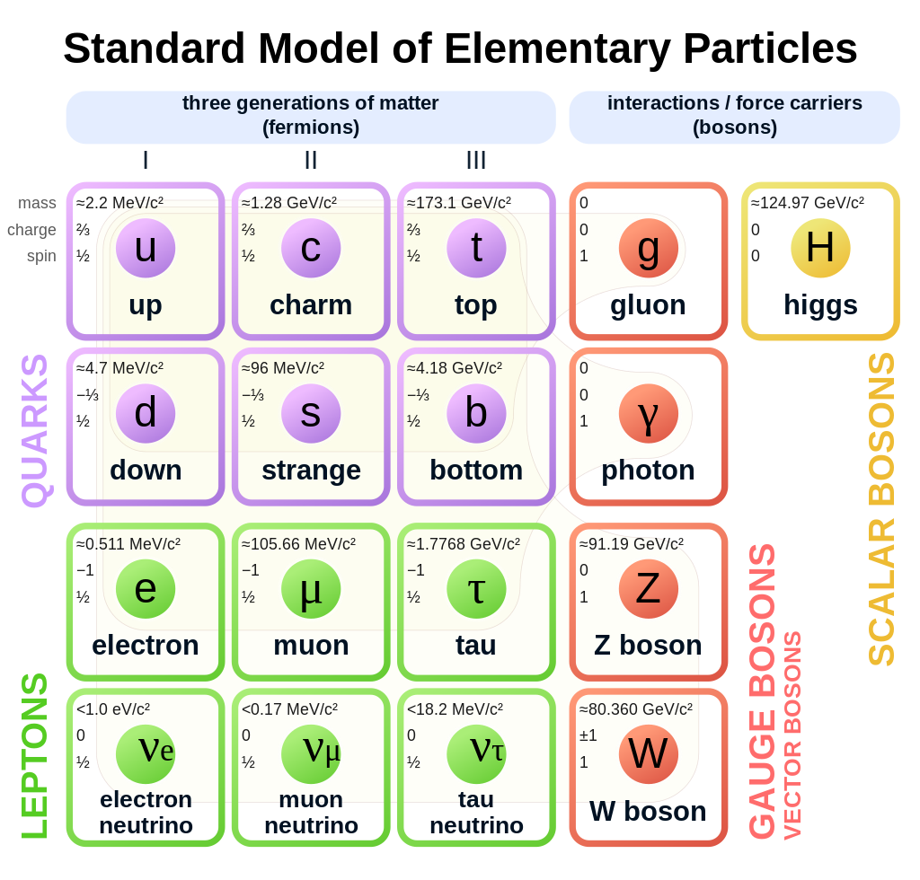

Keystones of the Standard Model

Slide 3
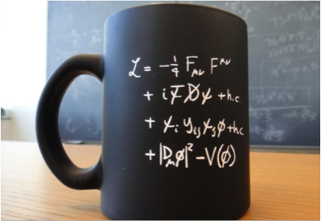

Lagrangian of the SM
Kinetic term of all gauge bosons fields
(W’s, Zº, photon and gluons)
Kinetic term of fermion fields
(quarks and leptons)
Interaction with H field giving mass to
the q’s and leptons
kinetic term for Higgs boson and H potential
!!
Notes:
kinetic term for Higgs boson and H potential that enter that minimum different from 0 that break SU(2) x(U1) in U(1)

Slide 4
Beyond the SM
Limits of the SM
Grand unified theories (GUT) (speculative)
Theories of Everything (ToE) (speculative)

Slide 5
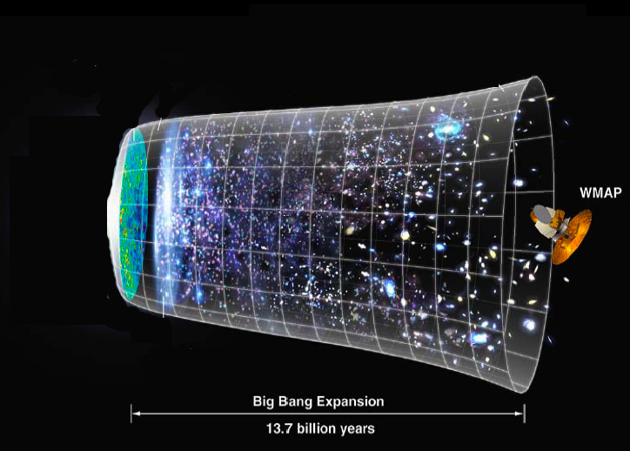
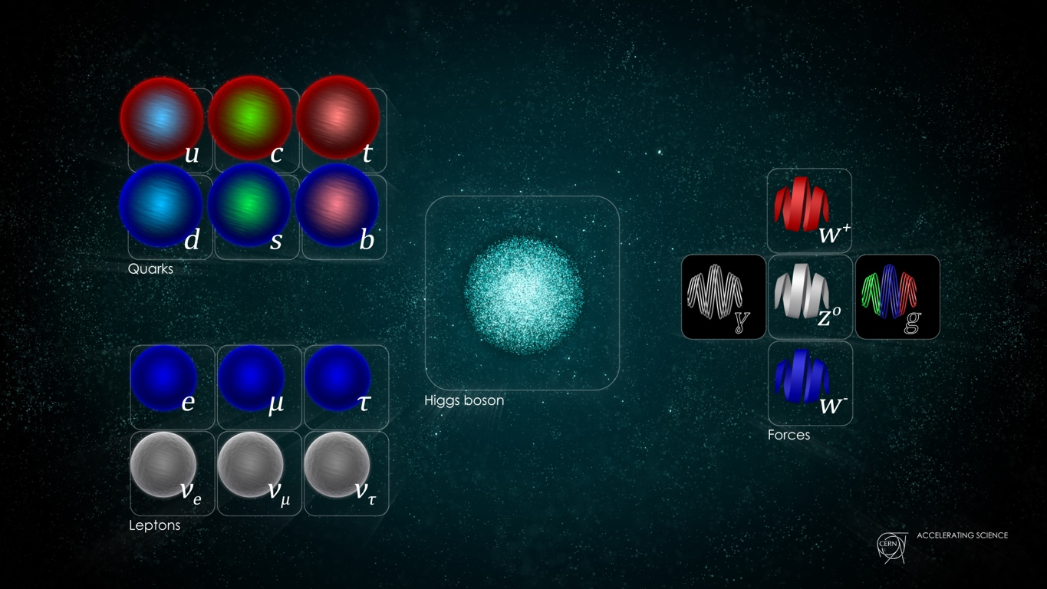
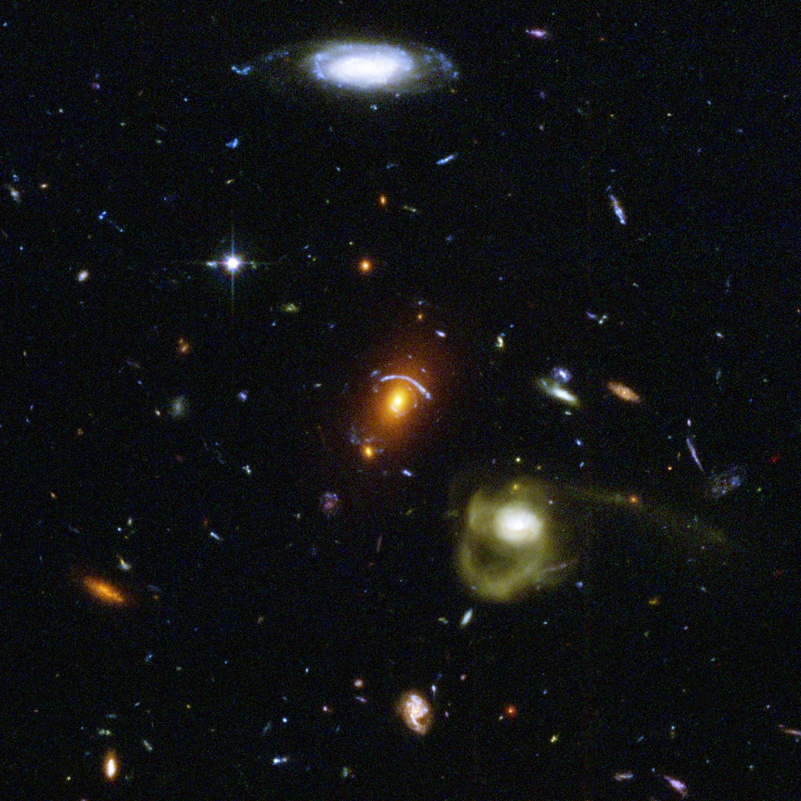
Standard Model
General Relativity
Universe ?
+
=
Wilkinson Microwave Anisotropy Probe
+
=
Actually, not yet !
- dark matter
- dark energy
Notes:
Quantum field theory depends on particle fields embedded in the flat space-time of special relativity.
General relativity models gravity as a curvature within space-time that changes as a gravitational mass moves. Historically, the most obvious way of combining the two (such as treating gravity as simply another particle field) ran quickly into what is known as the renormalization problem.

Slide 6
What the SM doesn’t explain
Dark matter: galaxy rotate too fast! It exists some extra matter not visible. It accounts for 23% of the total mass-energy. Which type of matter?
Dark energy: the universe expansion is accelerating. As a consequence, there is injection of energy. 73 % of total energy. What is its origin?
We are in the 0.4% of the observable 4% mass-energy!
SM doesn’t incorporate the neutrino oscillation (then neutrino mass);
Origin of mass (hierarchy problem);
matter-antimatter asymmetry.

Slide 7
Grand Unified Theories and
Theory of Everything
GUT (Grand Unified Theory): ElectroWeak and Strong Interaction unified in a common theory. So far, they are described within the same mathematical scheme (SM), but not in a “unified physics”. EW it is.
TOE (Theory Of Everything)= GUT + General Relativity (GR)!
So far GR is not yet a quantum theory of the interaction (QFT), it is “analytical description of space geometry” in presence of masses/(energy)
GUT and TOE, a scientific challenge …and maybe a romantic dream,
for a unified description of the Universe

Slide 8
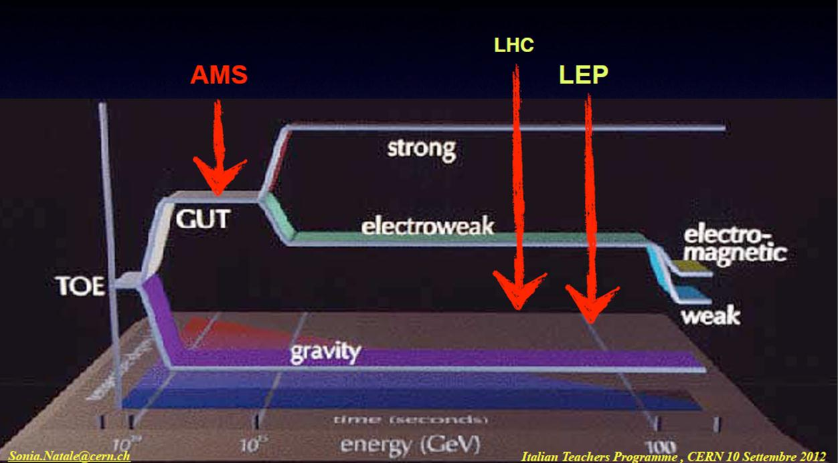
Energy scale for GUT and ToE
SM energy range
Candidates
  Supersymmetry,
  String theory,
  M-theory
  Supergavity
10¹⁹
10¹⁵
BigBang
today
t

Slide 9
Theory of Everything
Theory with the objective to unify a GUT (EW+SI) with gravity described as QFT!
Candidates:
  Composite models
  Supersymmetry (SUSY)
  Kaluza-Klein theories
  String models
  M-theories

Slide 10
(1) Composite structure
Electrons and quarks are assumed as composite structure;
So far no evidence from the cross section trend that assumes the fermions as point-like objects!!

Slide 11
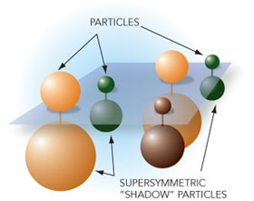
(2) SUPERSYMMETRY (SUSY)
SUSY can include the Gravity as QFT;
A connection between fermion fields (spin 1/2) and boson fields (spin 1, force carriers particles) exists;
We know that fermions (quarks and leptons) interact through the exchange of gauge bosons (gluons, photon, W± and Z°);
“SUPERSYMMETRY” predicts a complete symmetry between particles of matter and Interaction carriers :
Spin ½ (fermions) | Spin 0, Spin 1 (bosons)
electron | selectron (S=0)
quark | squark (S=0)
photino | photon (S=1)
gluino | gluon (S=1)
gaugino (Wino, Zino) | W, Z (S=1)

Slide 12
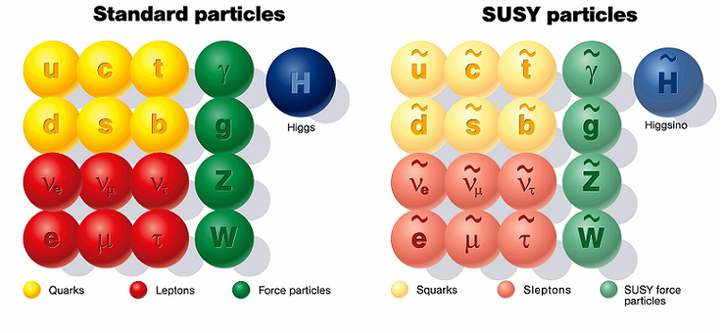
SUSY at one glance

Slide 13
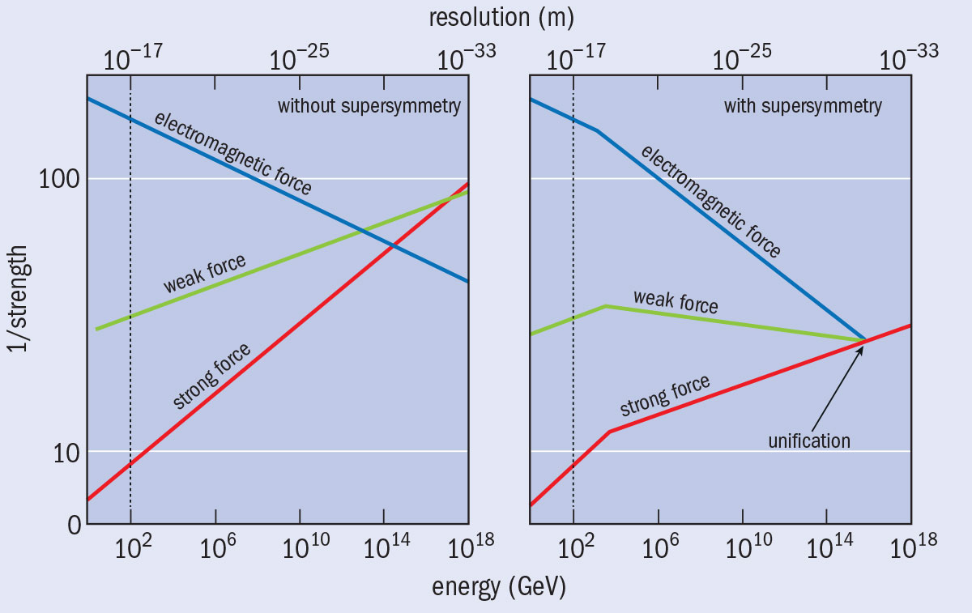
Evolution of the interactions
Forces “run” with energy ….. and don’t agree at high energy
SUSY can modify their evolution to join up → unification @ 10¹⁴ GeV
SUSY could explain the cosmological matter-antimatter asymmetry;
Lightest supersymmetric particle = dark matter ;
Unfortunately, so far, no evidence of supersymmetric particles neither in ATLAS nor in CMS search!!
Notes:
We talked about this yesterday. MYSTERY.

Slide 14
Supersymmetric BEH bosons
If the supersymmetry exist then 5 Higgs bosons should exist (three neutral and two electrically charged)
In this case the BEH boson discovered at LHC, could be one out of the three neutral;
No such SUSY partner has been observed so far. So, if they exist, they must have a mass > 1 TeV (energy explored at LHC);

Slide 15
(3) Kaluza-Klein theories
(1920-1926) The idea was to add a fifth space dimension to the space-time of the General Relativity(GR);
The fifth dimension is curled-up and has no effect on usual physics;
It is possible to define a field with components that in the four dimensions satisfy the field equation of the GR and with the other components which satisfy the Maxwell’s relations;
Electromagnetism and GR are connected but not as QFT!!
The success of the Electroweak unification has revived the interest on this theory and an integer number of dimensions have been added: work in progress.

Slide 16
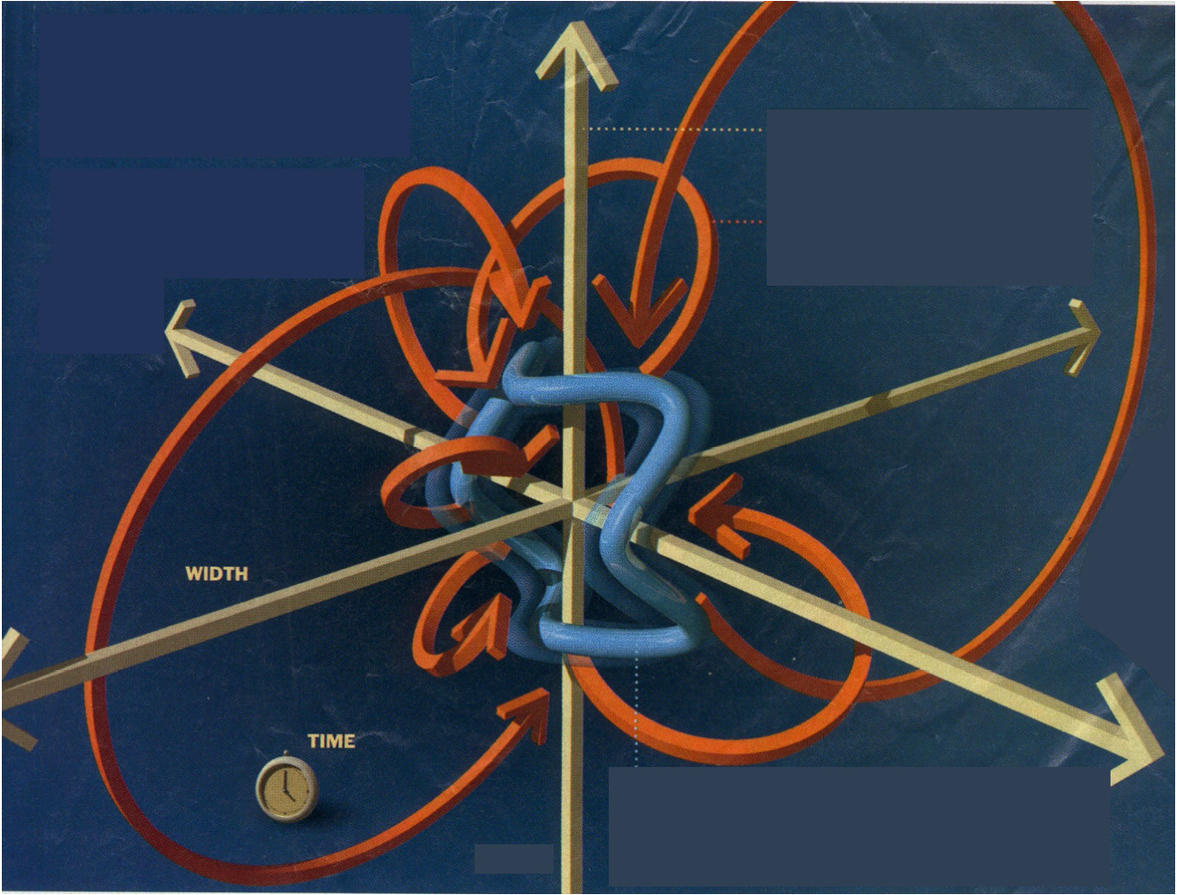
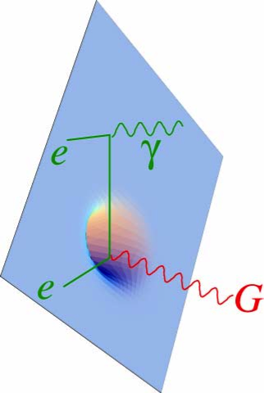
(4)String theory as ToE ?
Superstrings in 9+1 dimentional space?
The elementary entities are little strings vibrating in a 9+1 dimensional space, revealing its structure at l ~10⁻³⁵ m (Planck length );
The SM particles: would be described via different vibration modes, open/closed strings
Quantum Gravity: graviton-like particle is contained in the Superstring model
Notes:
Which string?
String theory is conceptually complex, with a fascinating but very difficult mathematical structure. This has so far prevented researchers from deriving concrete predictions from the theory for comparison with experimental results. Not only does string theory involve the complex study of the geometry of extra dimensions, but the way the structure of the dimensions are chosen appears arbitrary and can lead to different outcomes.
For instance, there seem to be many possible ways to curl up the extra dimensions, by choosing different shapes and sizes. This leads to many alternative versions of the theory. In certain cases, the sizes of the extra dimensions are very small and it will be difficult to obtain direct evidence for them. In others, the sizes are far larger and could be observed at new accelerators such as CERN’s Large Hadron Collider.
Underlying string theory is the radical idea that fundamental particles are not really like points or dots, but rather small loops of vibrating strings

Slide 17
(4)String theory as ToE ?
Superstrings in 9+1 dimentional space?
With superstring in 10 dimension, the unification of SM and Gravity (GR) is then possible!!
But, why 6 space dimensions disappeared? How did they disappear?
Is there a unique way to go from 10 to 4 dimensions where we live?
With superstrings, Axions, Magnetic monopoles, Majorana neutrinos, Dyons (MM with e charge), weakly interacting massive particles (WIMPS) can be proposed,…unfortunately, so far, no experimental observations!! ☹
Notes:
Which string?
String theory is conceptually complex, with a fascinating but very difficult mathematical structure. This has so far prevented researchers from deriving concrete predictions from the theory for comparison with experimental results. Not only does string theory involve the complex study of the geometry of extra dimensions, but the way the structure of the dimensions are chosen appears arbitrary and can lead to different outcomes.
For instance, there seem to be many possible ways to curl up the extra dimensions, by choosing different shapes and sizes. This leads to many alternative versions of the theory. In certain cases, the sizes of the extra dimensions are very small and it will be difficult to obtain direct evidence for them. In others, the sizes are far larger and could be observed at new accelerators such as CERN’s Large Hadron Collider.
Underlying string theory is the radical idea that fundamental particles are not really like points or dots, but rather small loops of vibrating strings

Slide 18
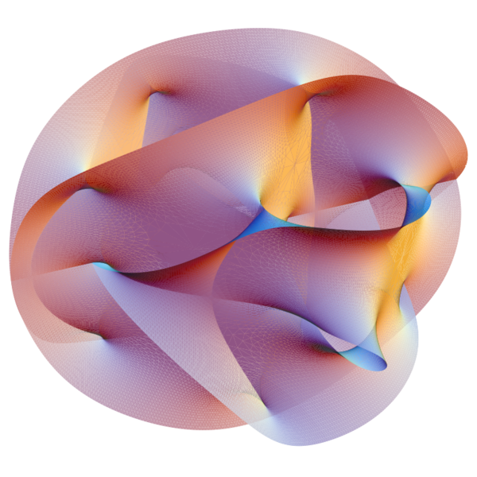
(5) M-theory as ToE ?
M-theory*): p-brane in 11 dimension for the unification of SM+Gravity in a Theory of Everithing (ToE)
A p-brane is a physical object that generalizes the notion of a point particle to higher dimensions. For example, a point particle can be viewed as a brane of dimension zero, while a string can be viewed as a brane of dimension one.
Branes are dynamical objects which can propagate through spacetime according to the rules of quantum mechanics. They have mass and can have other attributes such as charge. A p-brane sweeps out a (p+1)-dimensional volume in spacetime called its worldvolume. Physicists often study fields analogous to the electromagnetic field which live on the worldvolume of a brane.
This image of the en:Calabi–Yau manifold appeared on the cover of the November 2007 issue of en:Scientific American.
*) http://en.wikipedia.org/wiki/M-theory
Notes:
The fundamentl constituent of the particle physics evolve from point-like objects to 9 dimension string till 11 dimension p-brane !

Slide 19

Beyond SM:
Scientific program at LHC 2015 -...

Slide 20
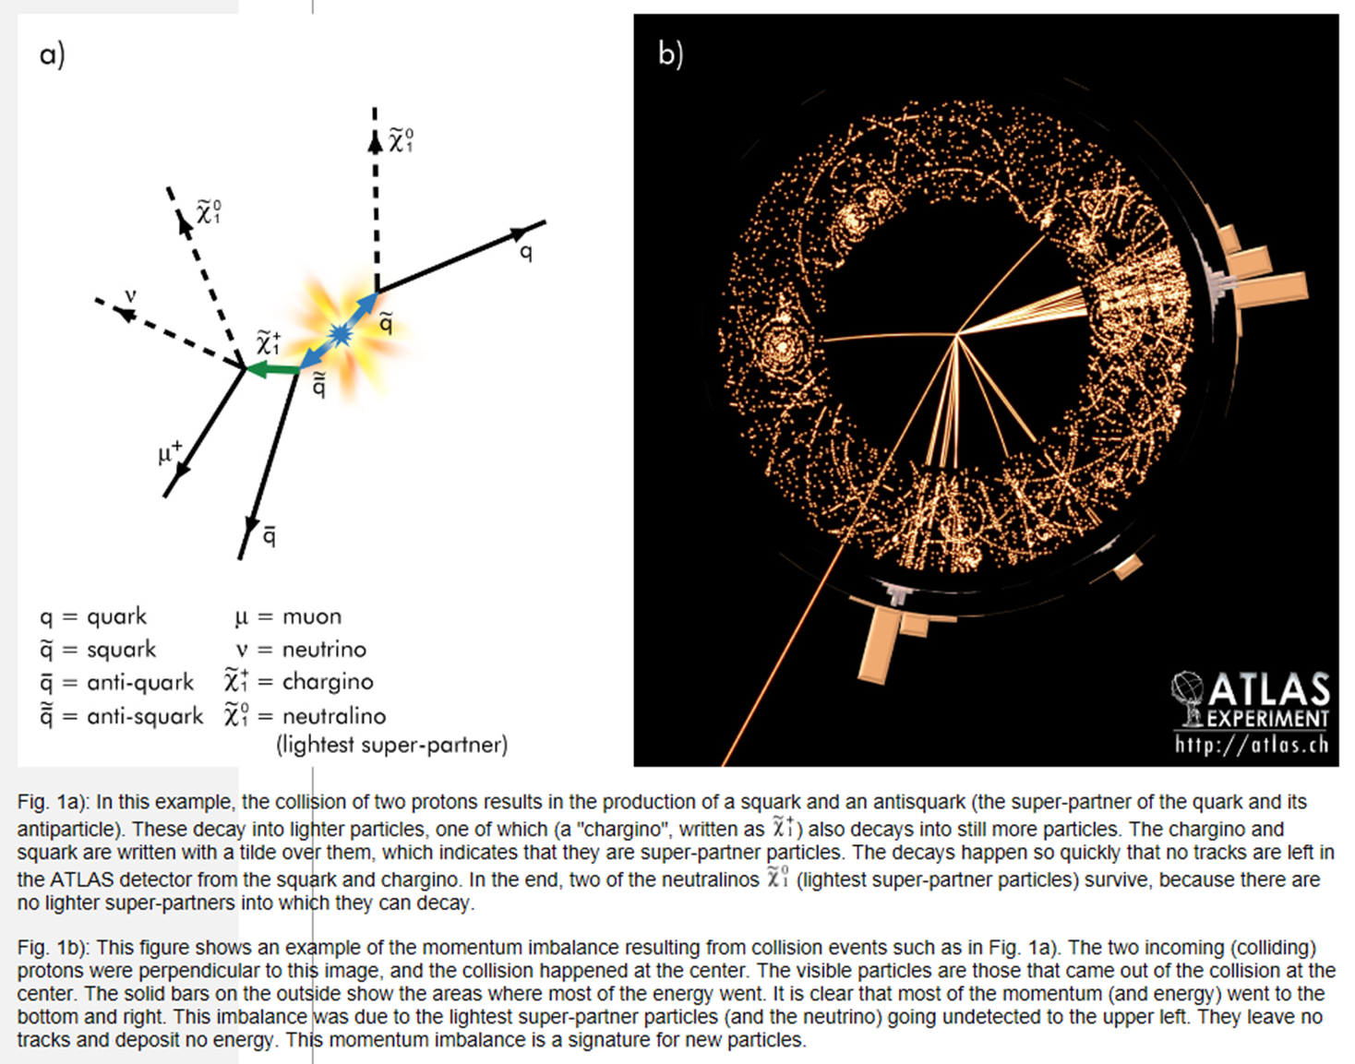
ATLAS and CMS on SUSY and extra dimensions
ATLAS and CMS
are investigating about the origin of mass, extra dimensions of space, microscopic black holes, and evidence for dark matter candidates in the Universe..
Supersymmetry
Events with substantial missing energy with high-energy electrons or muons will be indications for the production and decay of super-partners
Notes:
Other event signatures are possible. For example, if the LSP is the super-partner of the graviton, pairs of high-energy gamma rays or pairs of electrons or muons can result. Gamma rays can also be emitted in the decay chains if the LSP is the super-partner of the Higgs boson and the second lightest supersymmetric particle is the super-partner of the photon. By studying the types and characteristics of missing-energy events, physicists will be able to discern the properties of the super-partners that are being produced including their masses, and determine which super-partner is the LSP.
To really show that supersymmetry has been discovered and to determine the complete theory of supersymmetry chosen by nature, physicists will need to see a variety of signals, measure detailed information about each of them, and collect high statistics to assure accuracy.

Slide 21
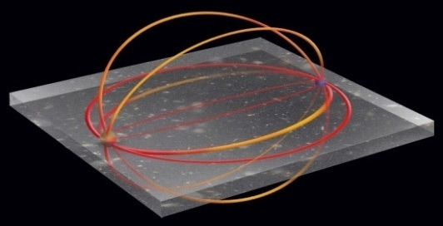
ATLAS and CMS probing Extra dimensions for gravity
ATLAS Experiment may see evidence that extra dimensions exist via collision events in which a graviton particle disappears into other dimensions. ATLAS would detect a large imbalance of energy in the event.
CMS: This is why the detector must be as “hermetic” as possible.
Notes:
We can only experience and therefore visualize the world in three space dimensions, even though it might well have more. An indication for extra dimensions may be the extreme weakness of gravity compared with the other three fundamental forces (gravity is so weak that a common refrigerator magnet can pick up a paper clip overwhelming the gravity of the entire Earth). This weakness may be due to gravity's force field spreading into other dimensions.
The ATLAS Experiment may see evidence that extra dimensions exist via collision events in which a graviton particle disappears into other dimensions. ATLAS would detect a large imbalance of energy in the event.
CMS: Two of the most fundamental laws of physics are that momentum and energy “are conserved”. In other words, the total momentum and energy before a collision is equal to the total momentum and energy after. So if we add these up in all the observed particles emerging from a collision (in the case of CMS we do this is the sideways “transverse” direction) and it does not equal the amount in the original particles, there must be a missing particle that carried away the momentum and energy: a lost piece leaving a hole in the jigsaw.
This is why the detector must be as “hermetic” as possible, that is, it must be able to catch, to the extent possible, every particle emerging from the collisions, so we can deduce that particles have genuinely disappeared, and have not just been missed by the detector.

Slide 22

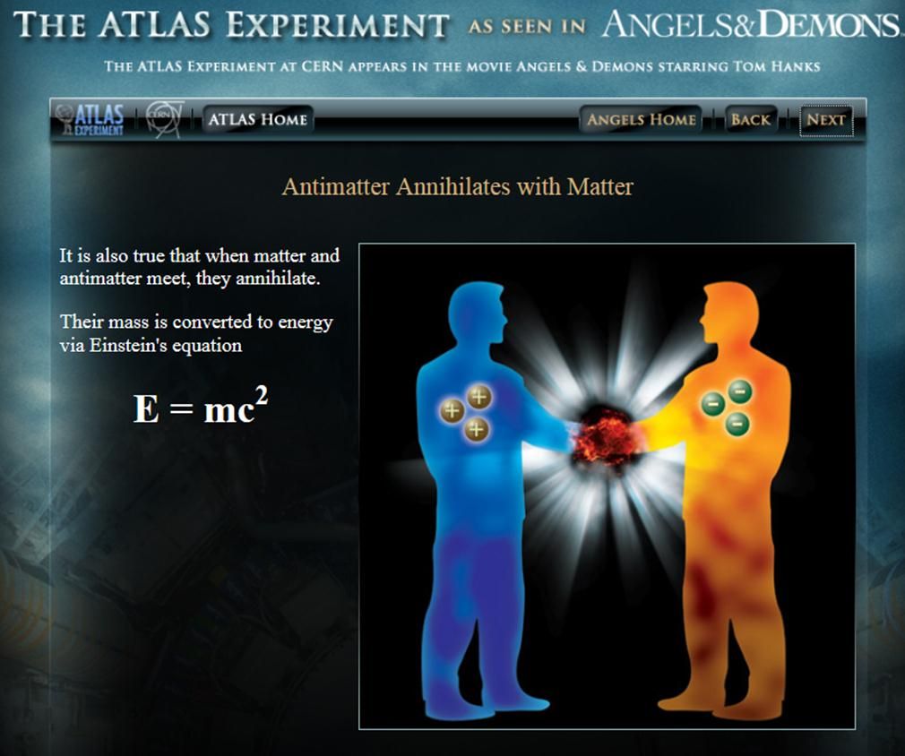
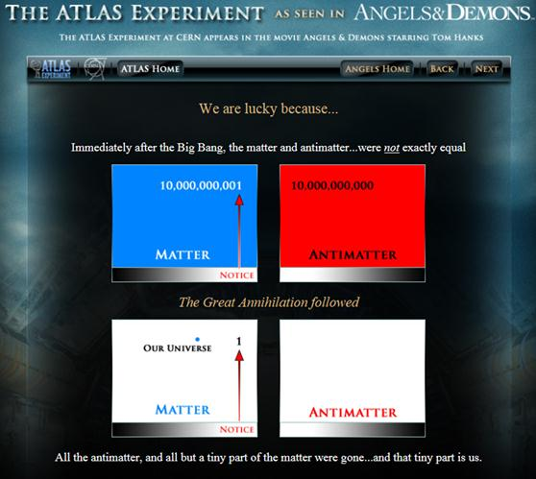
10⁻¹⁰ Matter-animatter asymmetry
LHCb (http://lhcb-public.web.cern.ch/lhcb-public/Welcome.html#EW2013) is dedicated to deeply investigate matter/antimatter asymmetry via decay of Beauty-particles (beauty-quark in) since weak interactions of matter differ subtly from those of antimatter. This may explain why the matter survived right after the Big-Bang.
ATLAS and CMS as well contribute on this topic
Notes:
LHCb is an experiment set up to explore what happened after the Big Bang that allowed matter to survive and build the Universe we inhabit today

Slide 23
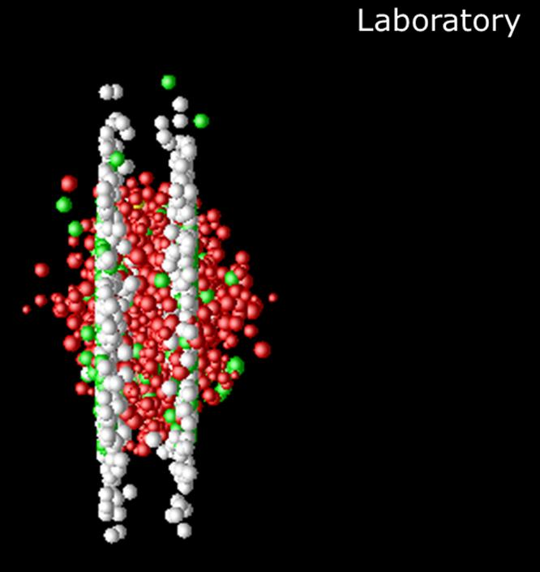
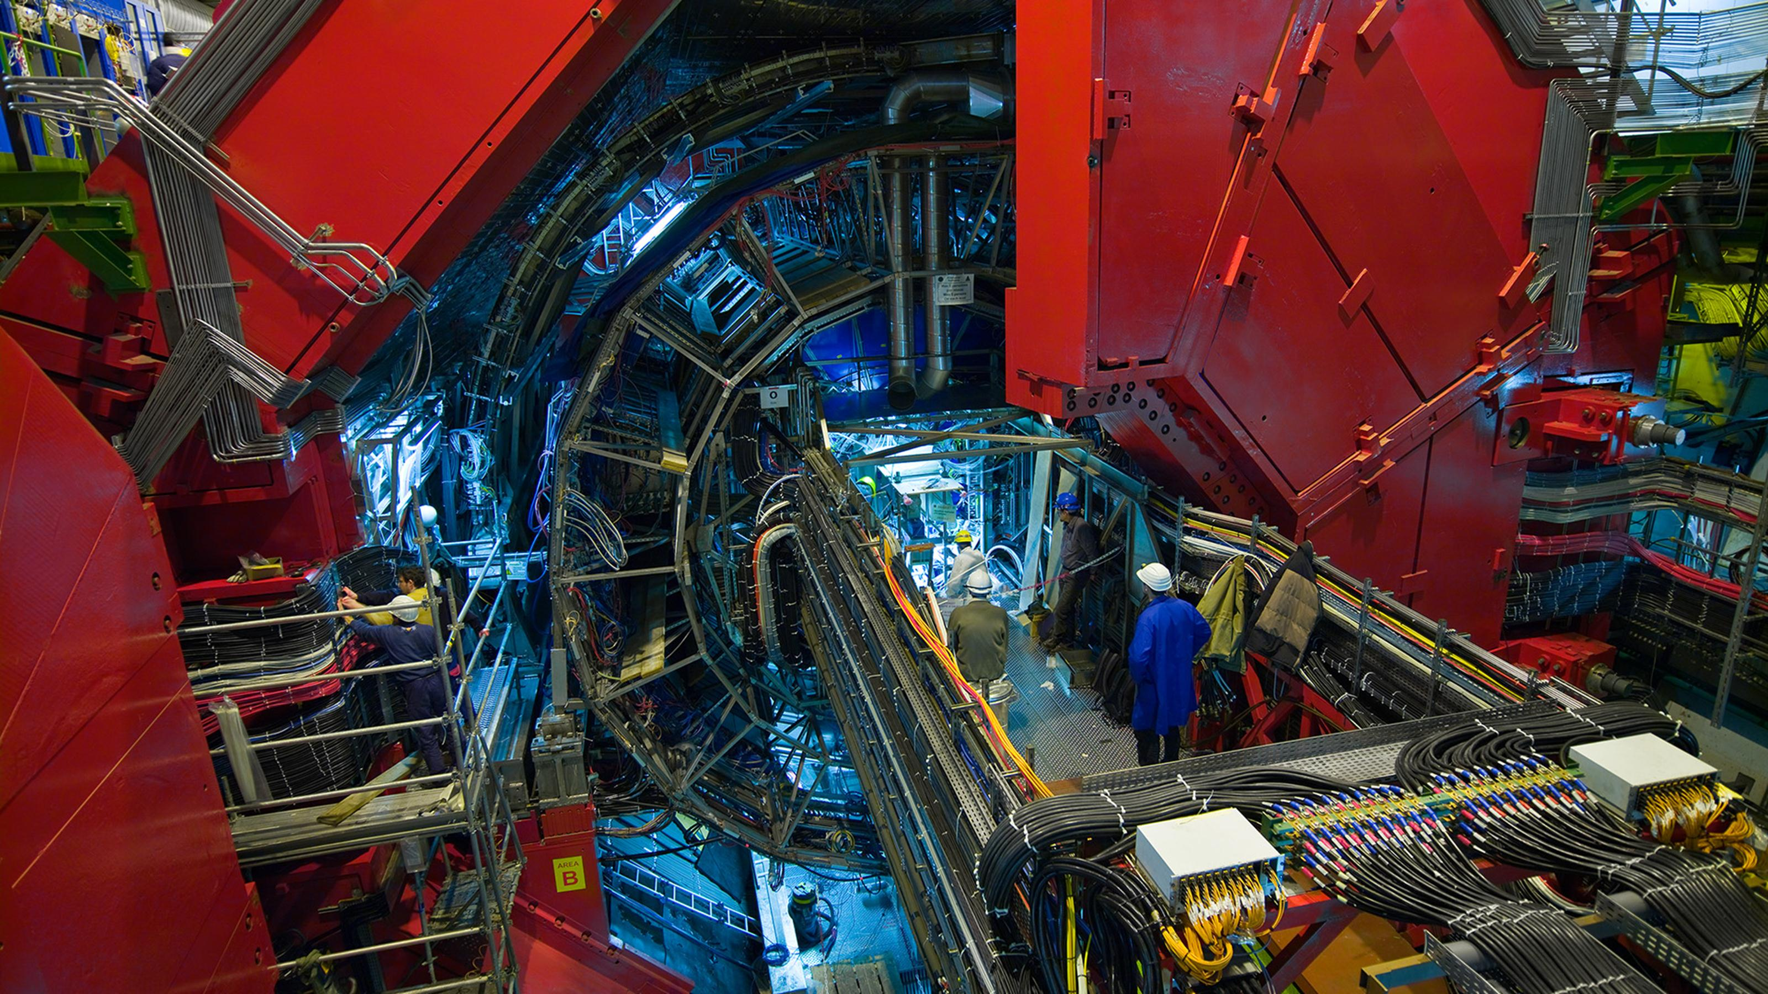
ALICE probing the quark-gluon plasma
Two relativistic lead-ion collision in the laboratory frame
The long term goal of the ALICE experiment is to provide a precise characterization of the high-density (10¹¹ kg/cm³), high-temperature (5 10 ¹² K )phase of strongly interacting matter;
To achieve this goal, high-statistics precision measurement are required. The general upgrade strategy for the ALICE detector is conceived to deal with this challenge with expected Pb-Pb interaction rates of up to 50 kHz during future operation of LHC
Notes:
The long term goal of the ALICE experiment is to provide a precise characterization of the high-density, high-temperature phase of strongly interacting matter. To achieve this goal, high-statistics precision measurement are required. The general upgrade strategy for the ALICE detector is conceived to deal with this challenge with expected Pb-Pb interaction rates of up to 50 kHz
Confinement
No quark has ever been observed in isolation: the quarks, as well as the gluons, seem to be bound permanently together and confined inside composite particles, such as protons and neutrons. This is known as confinement. The exact mechanism that causes it remains unknown.
Generation of mass
Protons and neutrons are known to be made of three quarks, but by adding together the masses of the three quarks one gets... only about 1% of the proton or neutron mass. Where does the remaining 99% come from?
Is the mechanism that confines quarks inside protons and neutrons also responsible for the generation of most of the mass of ordinary matter?
A detailed investigation of the properties of strongly interacting matter at high temperature, are the principal aims of the ALICE scientific program.

Slide 24
Summary
The SM doesn’t account for dark matter, dark energy,....... And as input it requires several parameters. Nevertheless it accounts for many experimental observations!
Theories beyond standard model try to unify Gravity and the particle world:
    GUT
    Supersymmetry
    Kaluza-klaine
    String and M theories
  Anyway so far no experimental evidence of predicted new particles;
  But, 2015 confirmation of the gravitational waves!! Data useful to study the graviton properties!
A long way to go! Young and smart students required!

