Slide 1
Inputs for today’s discussion
Zhen / Hide

Slide 2
Schedule
3 | 4 | 5 | 6 | 7 | 8 | 9 | 10 | 11 | 12 | 1 | 2
To be started ASAP
Discussion
Funding to be secured
Commissioning
in USTC
Shipping
Commissioning
in CERN
Need:
Build Veto Counter
Add mechanical support to align the AHCAL on axis
Update trigger logic including LHC clock
Establish install/assembly procedure
Consider operation model (DAQ/DCS)
etc
Installation
Only 4 weeks at max available
2 weeks in December and 2 weeks in January
More in the next talk
See next page in more detail

Slide 3
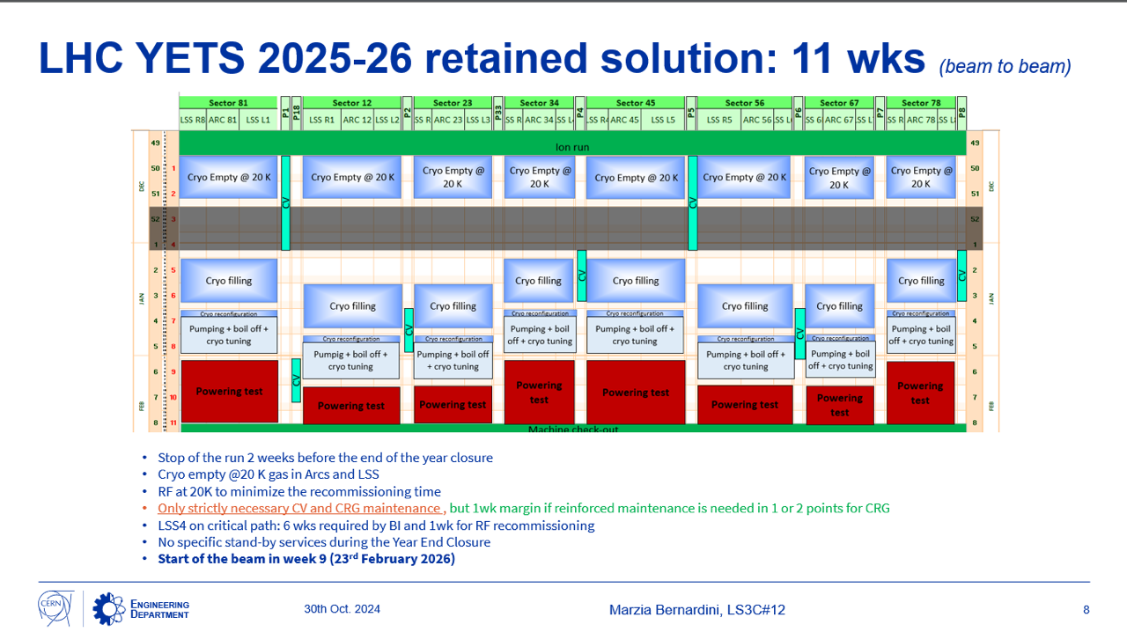

Slide 4
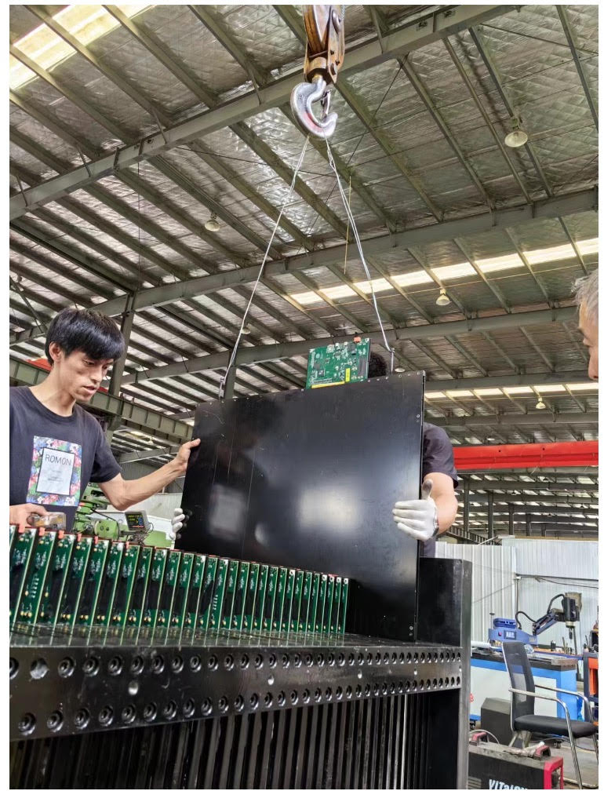
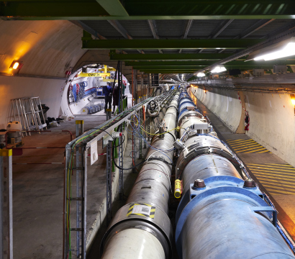
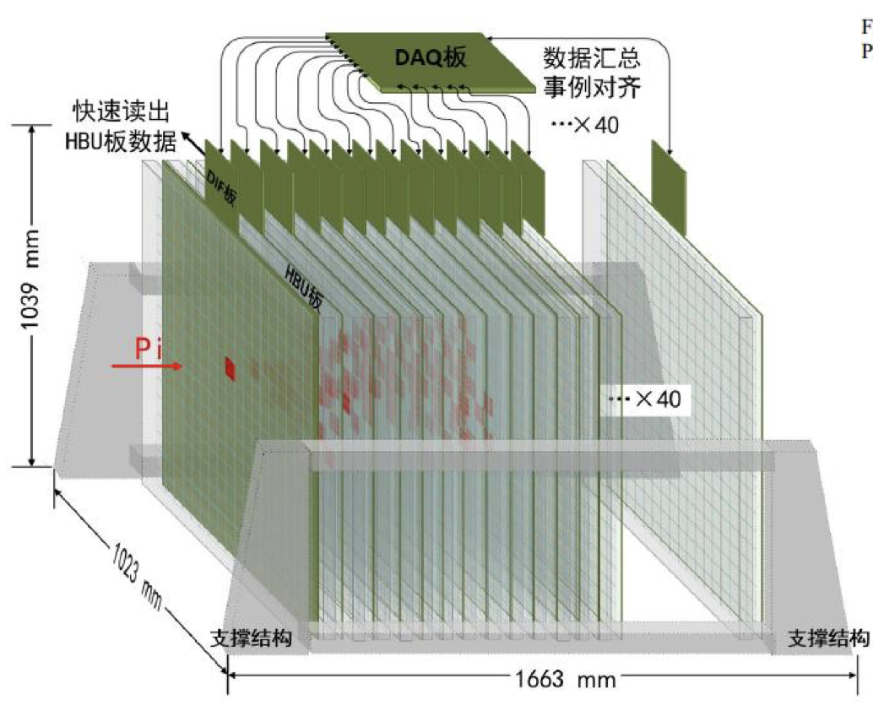
Need precise dimension of AHCAL
Jamie discussed with CERN transpiration team.
The width should be less than 1.1 m to go along with the LHC.
Width 1.1 m
at max
Weight 2 ton at max
How much height is needed?
Happy if the width is 1023 mm
CERN Transportation team needs precise dimension of AHCAL

