Slide 1
New baseline performance updates & DA

Slide 2
Round optics
Run | Year | Old baseline (PU_{max}=132) | New baseline (PU_{max}=170 in Run 5) | PU_{max}=170 from 2031 | PU_{max}=170 gradual increase starting from Run 4
4 | 2030 (30 cm, CC OFF, 1.8e11 ppb, 175 μrad) | 37.9 (PU_{max}=101) | 37.9 (PU_{max}=101) | 37.9 37.9 (PU_{max}=101) | 37.9 (PU_{max}=101)
 | 2031 (25 cm, CC ON, 2.2e11 ppb, 195 μrad) | 212.0 (PU_{max}=132) | 212.0 (PU_{max}=132) | 238.0 (PU_{max}=170) | 212.0 (PU_{max}=132)
 | 2032 (20 cm, CC ON, 2.2e11 ppb, 215 μrad) | 241.4 | 241.4 | 274.9 | 249.4 (PU_{max}=140)
 | 2033 (20 cm, CC ON, 2.2e11 ppb, 215 μrad) | 238.3 | 238.3 | 271.4 | 263.6 (PU_{max}=160)
5 | 2036 (15 cm, CC ON, 2.2e11 ppb, 250 μrad) | 208.1 | 238.9 (PU_{max}=170) | 238.9 | 238.9 (PU_{max}=170)
 | 2037 | 271.0 | 311.4 | 311.4 | 311.4
 | 2038 | 275.7 | 316.8 | 316.8 | 316.8
 | 2039 | 275.7 | 316.8 | 316.8 | 316.8
 | 2040 | 228.5 | 262.5 | 262.5 | 262.5
 | 2041 | 283.6 | 325.8 | 325.8 | 325.8
 | Run4 + Run5 | 2272.1 | 2501.6 | 2594.2 | 2534.9
 | + 520 | 2792.1 | 3021.6 | 3114.2 | 3054.9
 | W.r.t to baseline % (absolute) | -9.2% (-229.5 fb⁻¹) |  | +3.7% (+92.6 fb⁻¹) | +1.3% (+33.3 fb⁻¹)
Standard beams, 110 mb losses, 0.04 μm/h emittance growth, + CC noise when applicable, LHCb at 2e33 Hz/cm²

Slide 3
Flat optics
Run | Year | 7.5/18 cm | 8/18 cm | 9/18 cm | 11/18 cm
4 | 2030 (18/60cm, CC OFF, 1.8e11 ppb, 175 μrad) | 39.6 | 39.6 | 39.6 | 39.6
 | 2031 (14/40cm, CC ON, 2.2e11 ppb, 195 μrad) | 215.1 | 215.1 | 215.1 | 215.1
 | 2032 (CC ON, 2.2e11 ppb, 215 μrad) | 256.3 | 255.6 | 254.4 | 252.1
 | 2033 (CC ON, 2.2e11 ppb, 215 μrad) | 253.0 | 252.4 | 251.2 | 248.9
5 | 2036 (CC ON, 2.2e11 ppb, 250 μrad) | 250.1 | 249.0 | 247.0 | 243.0
 | 2037 | 325.3 | 324.0 | 321.4 | 316.4
 | 2038 | 330.9 | 329.6 | 327.0 | 321.9
 | 2039 | 330.9 | 329.6 | 327.0 | 321.9
 | 2040 | 274.6 | 273.4 | 271.2 | 266.9
 | 2041 | 340.3 | 339.0 | 336.3 | 331.1
 | Run4 + Run5 | 2616.1 | 2607.4 | 2590.2 | 2557.0
 | + 520 | 3136.1 | 3127.4 | 3110.2 | 3077.0
 | W.r.t to baseline % (absolute) | +4.6% (114.5 fb⁻¹) | +4.2% (+105.8 fb⁻¹) | +3.5% (+88.6 fb⁻¹) | +2.2% (+55.4 fb⁻¹)
Standard beams, 110 mb losses, 0.04 μm/h emittance growth, + CC noise when applicable, LHCb at 2e33 Hz/cm²

Slide 4
Impact of LHCb upgrade on ATLAS/CMS
Run | Year | LHCb 1e34 Hz/cm² in Run5 with 1.5/1.5 m, losses 110 mb Run4 & 5 | LHCb 1e34 Hz/cm² in Run5 with 0.5/1.5 m, losses 110 mb Run4 & 5 | LHCb 1e34 Hz/cm² in Run5 with 1.5/1.5 m, losses 110 mb Run4, 130 mb in Run5 | LHCb 1e34 Hz/cm² in Run5 with 0.5/1.5 m, losses 110 mb Run4, 130 mb in Run5
4 | 2030 (30 cm, CC OFF, 1.8e11 ppb, 175 μrad) | 37.9 (PU_{max}=101) | 37.9 (PU_{max}=101) | 37.9 (PU_{max}=101) | 37.9 (PU_{max}=101)
 | 2031 (25 cm, CC ON, 2.2e11 ppb, 195 μrad) | 212.0 (PU_{max}=132) | 212.0 (PU_{max}=132) | 212.0 (PU_{max}=132) | 212.0 (PU_{max}=132)
 | 2032 (20 cm, CC ON, 2.2e11 ppb, 215 μrad) | 241.4 | 241.4 | 241.4 | 241.4
 | 2033 (20 cm, CC ON, 2.2e11 ppb, 215 μrad) | 238.3 | 238.3 | 238.3 | 238.3
5 | 2036 (15 cm, CC ON, 2.2e11 ppb, 250 μrad) | 235.2 | 234.5 | 223.4 | 222.6
 | 2037 | 306.4 | 305.5 | 291.0 | 290.1
 | 2038 | 311.7 | 310.8 | 296.1 | 295.1
 | 2039 | 311.7 | 310.8 | 296.1 | 295.1
 | 2040 | 258.3 | 257.6 | 245.3 | 244.5
 | 2041 | 320.6 | 319.7 | 304.6 | 303.5
 | Run4 + Run5 | 2473.5 | 2468.5 | 2386.1 | 2380.5
 | + 520 | 2993.5 | 2988.5 | 2906.1 | 2900.5
 | W.r.t to baseline % (absolute) | -0.9% (-28 fb⁻¹) | -1.1% (-33 fb⁻¹) | -3.8% (-115 fb⁻¹) | -4% (-121 fb⁻¹)
Standard beams, 110 mb losses, 0.04 μm/h emittance growth, + CC noise when applicable

Slide 5
LHCb integrated luminosity
Run | Year | New baseline | LHCb 1e34 Hz/cm² in Run5 with 1.5/1.5 m, losses 110 mb Run4 & 5 | LHCb 1e34 Hz/cm² in Run5 with 0.5/1.5 m, losses 110 mb Run4 & 5 | LHCb 1e34 Hz/cm² in Run5 with 1.5/1.5 m, losses 110 mb Run4, 130 mb in Run5 | LHCb 1e34 Hz/cm² in Run5 with 0.5/1.5 m, losses 110 mb Run4, 130 mb in Run5
4 | 2030 (30 cm, CC OFF, 1.8e11 ppb, 175 μrad) | 2.3 | 2.3 | 2.3 | 2.3 | 2.3
 | 2031 (25 cm, CC ON, 2.2e11 ppb, 195 μrad) | 8.8 | 8.8 | 8.8 | 8.8 | 8.8
 | 2032 (20 cm, CC ON, 2.2e11 ppb, 215 μrad) | 10 | 10 | 10 | 10 | 10
 | 2033 (20 cm, CC ON, 2.2e11 ppb, 215 μrad) | 9.9 | 9.9 | 9.9 | 9.9 | 9.9
5 | 2036 (15 cm, CC ON, 2.2e11 ppb, 250 μrad) | 7.8 | 31.5 | 36.6 | 29.9 | 34.8
 | 2037 | 10.4 | 42 | 48.6 | 39.8 | 46.3
 | 2038 | 10.6 | 42.8 | 49.5 | 40.5 | 47.1
 | 2039 | 10.6 | 42.8 | 49.5 | 40.5 | 47.1
 | 2040 | 8.6 | 34.8 | 40.3 | 32.9 | 38.3
 | 2041 | 10.9 | 44 | 50.9 | 41.7 | 48.4
 | Run4 + Run5 | 89.8 | 268.9 | 306.4 | 256.3 | 293.0
Integrated lumi for LHCb computed at t_{opt} based on IP1/5
Standard beams, 110 mb losses, 0.04 μm/h emittance growth, + CC noise when applicable

Slide 6
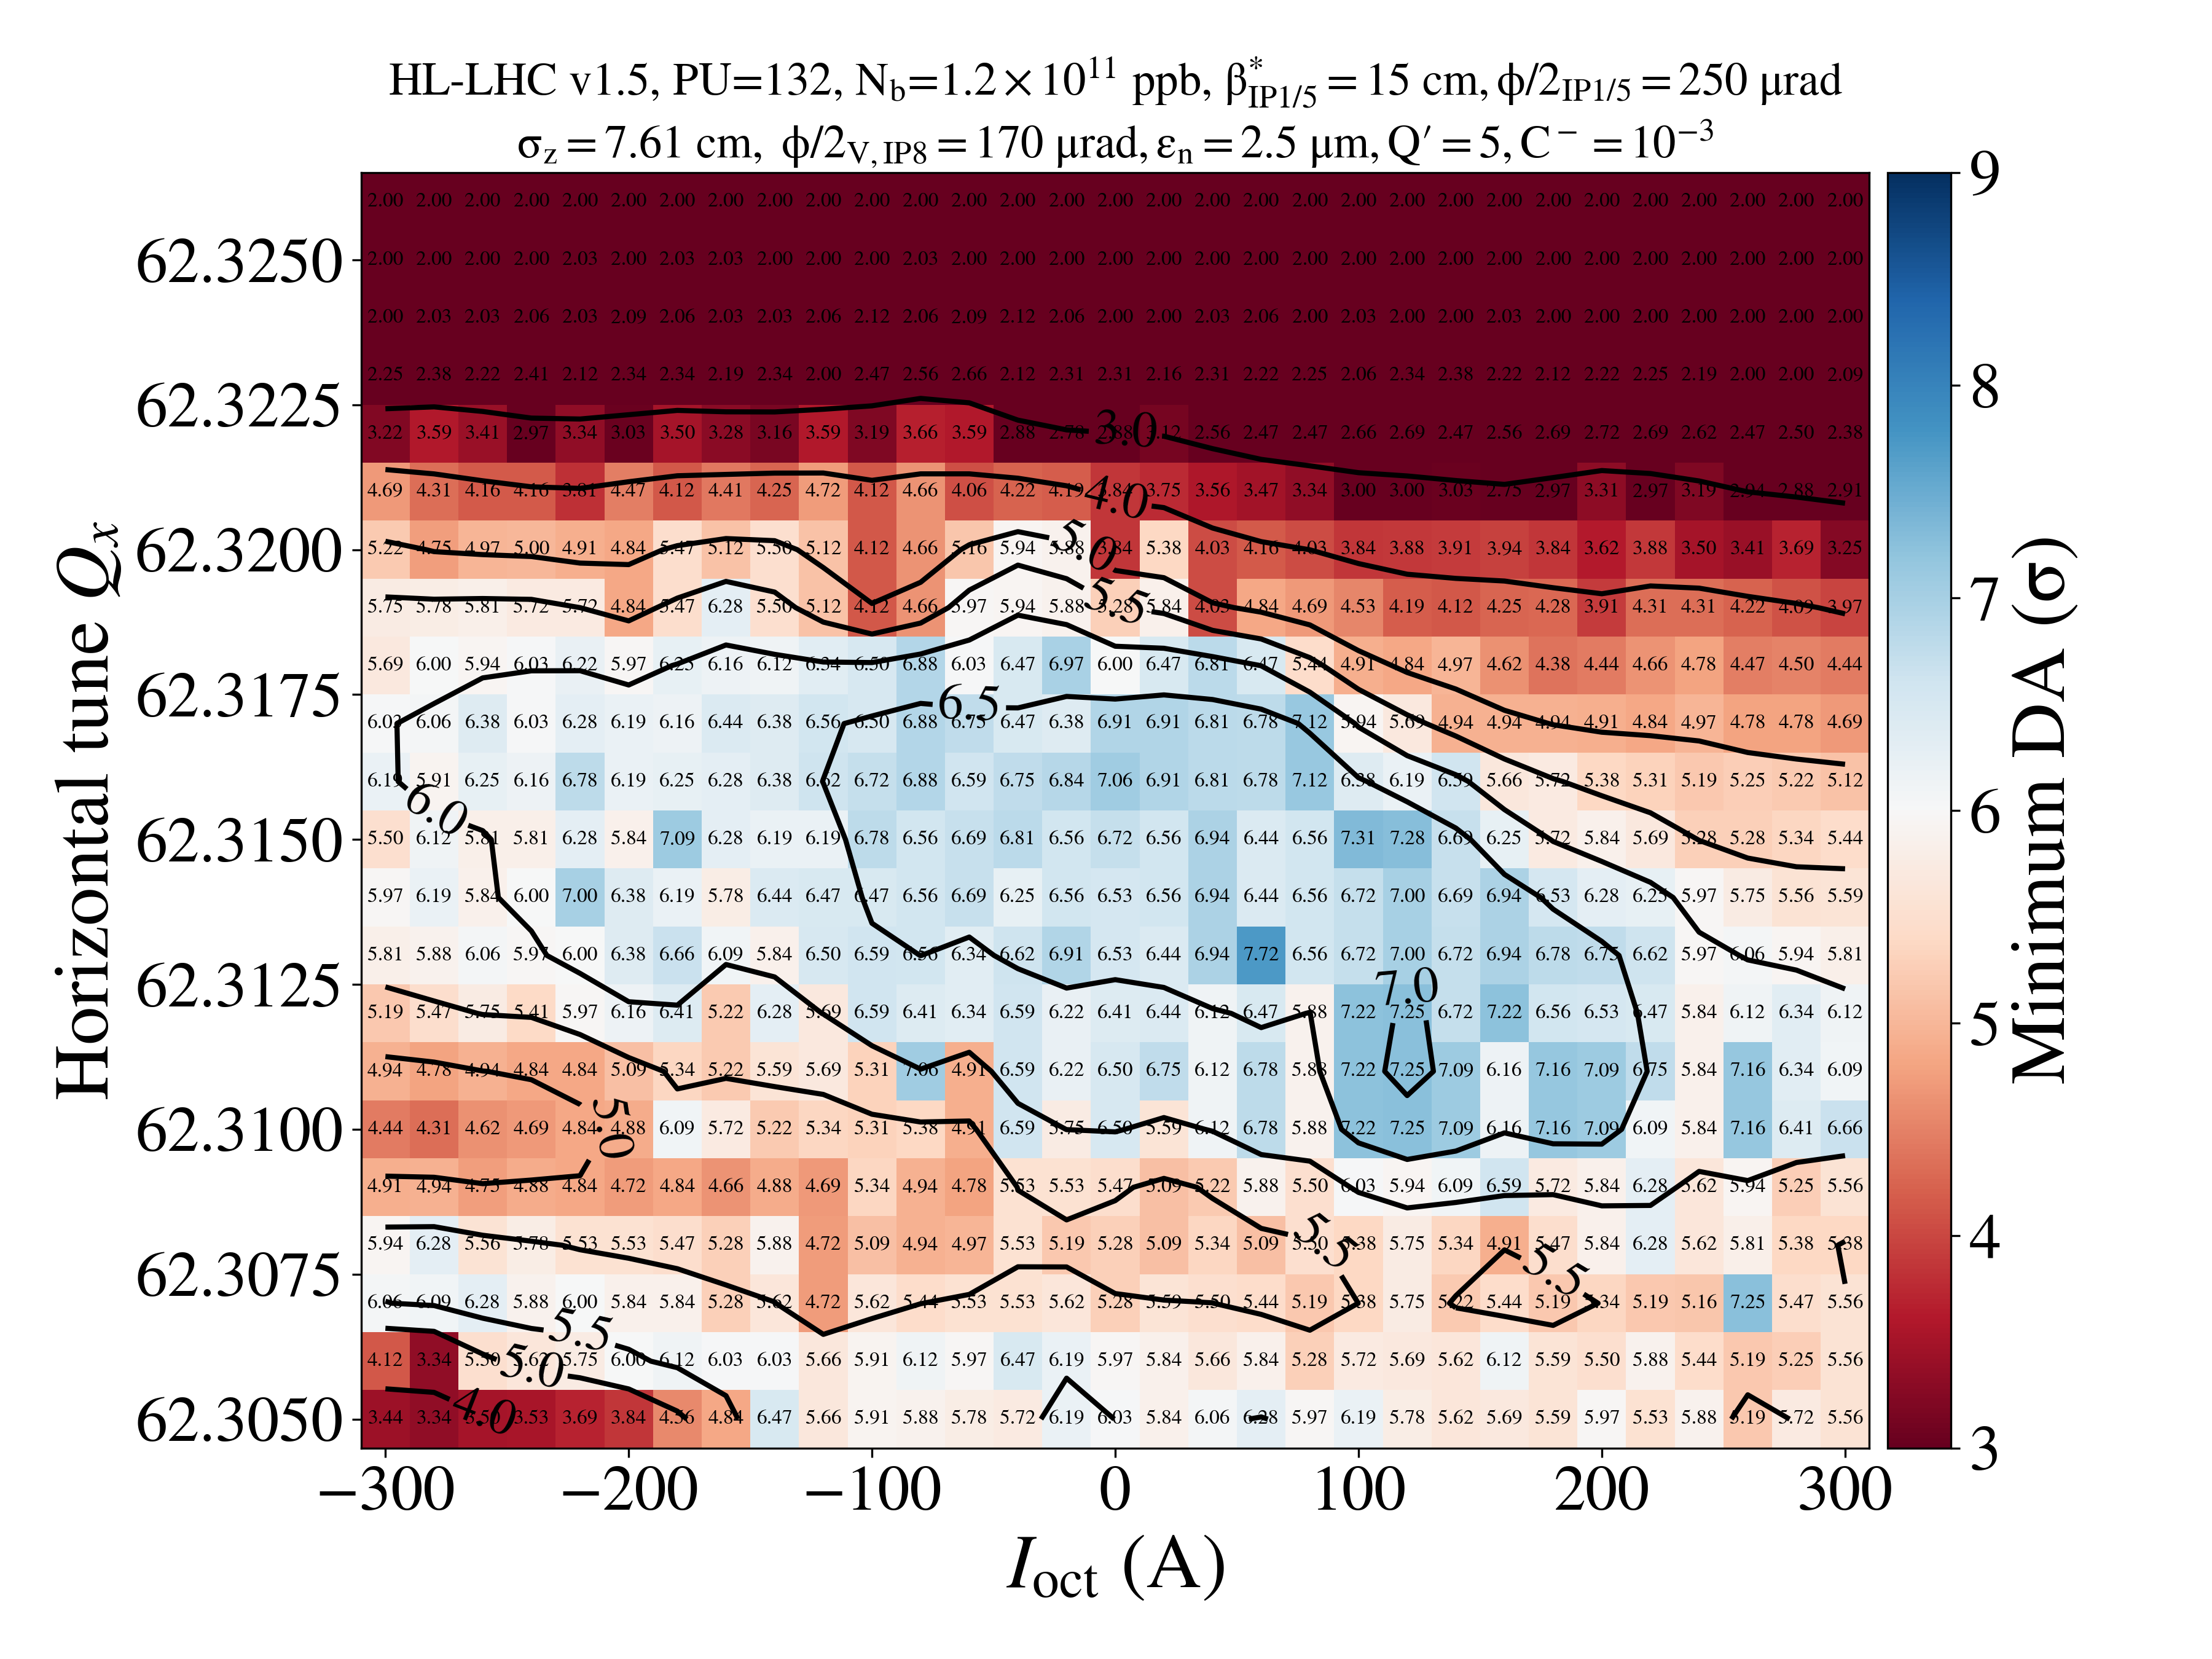
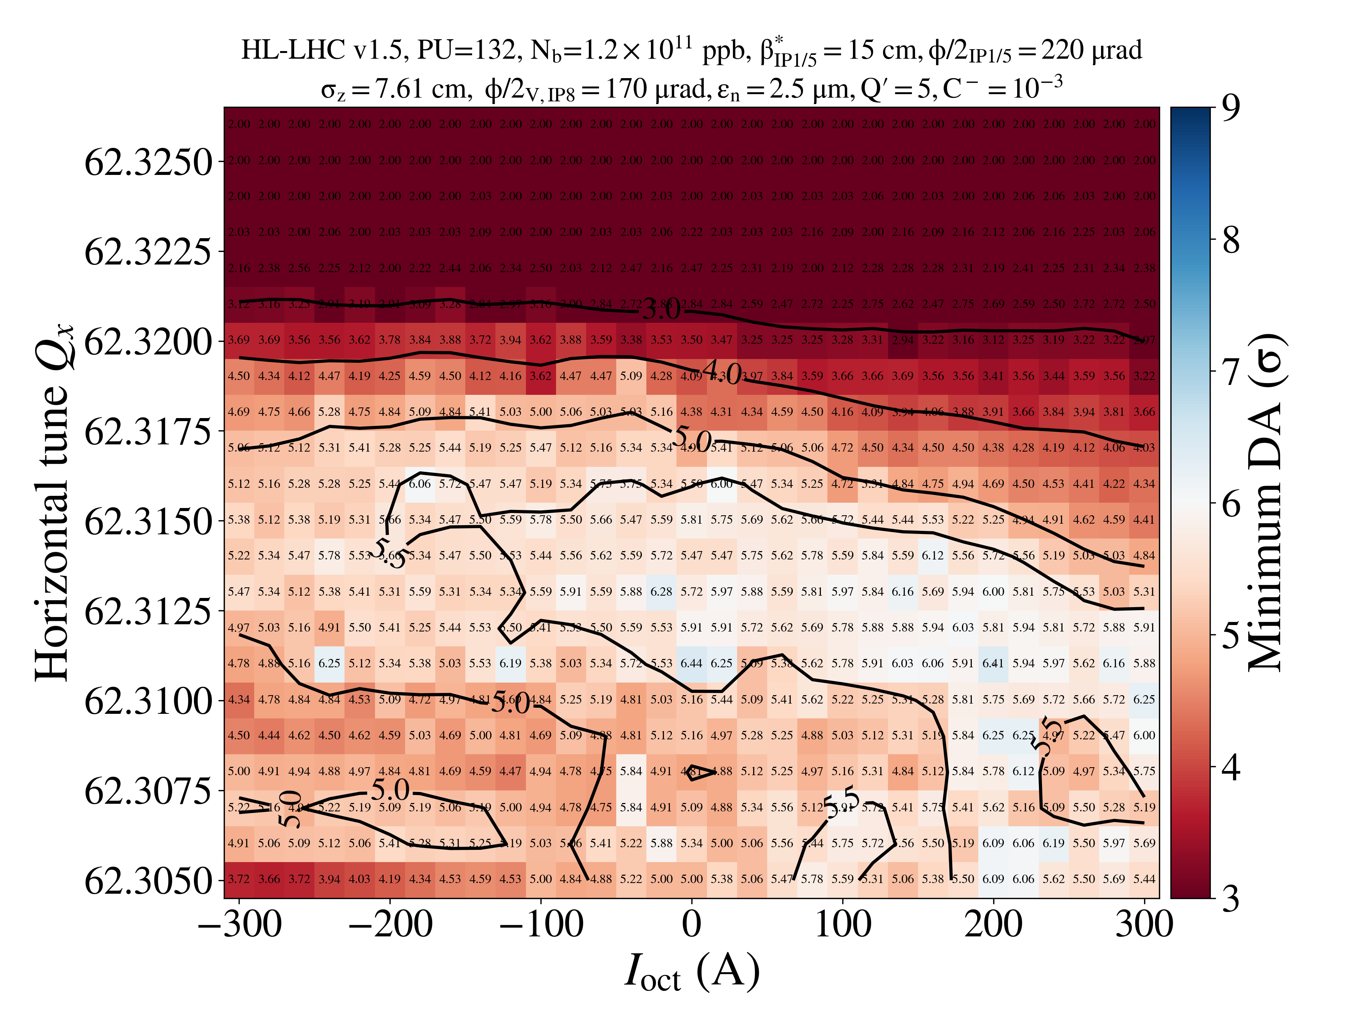
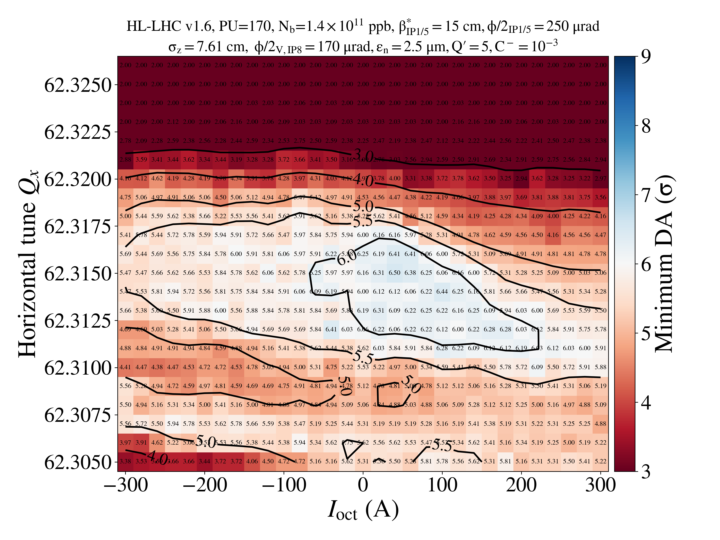
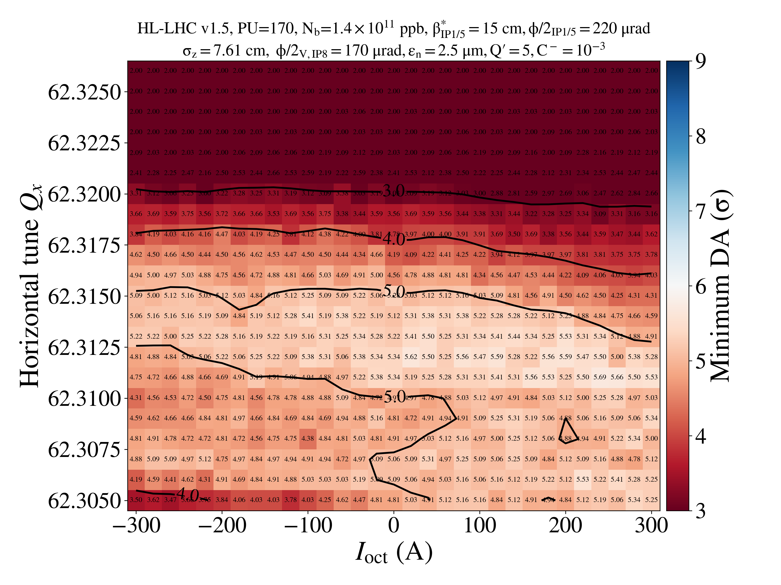
Round optics EOL
xing = 250
xing = 220
PU = 132
Round 15 cm, cannot reduce lower than 250 with PU=170
PU = 170

Slide 7
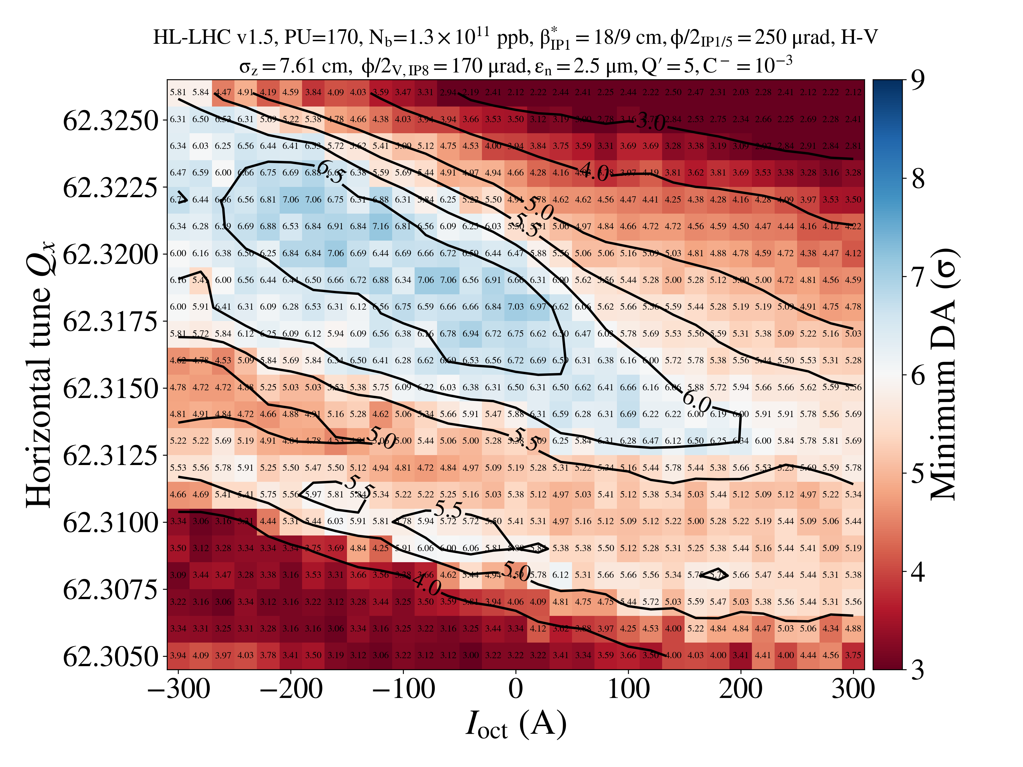
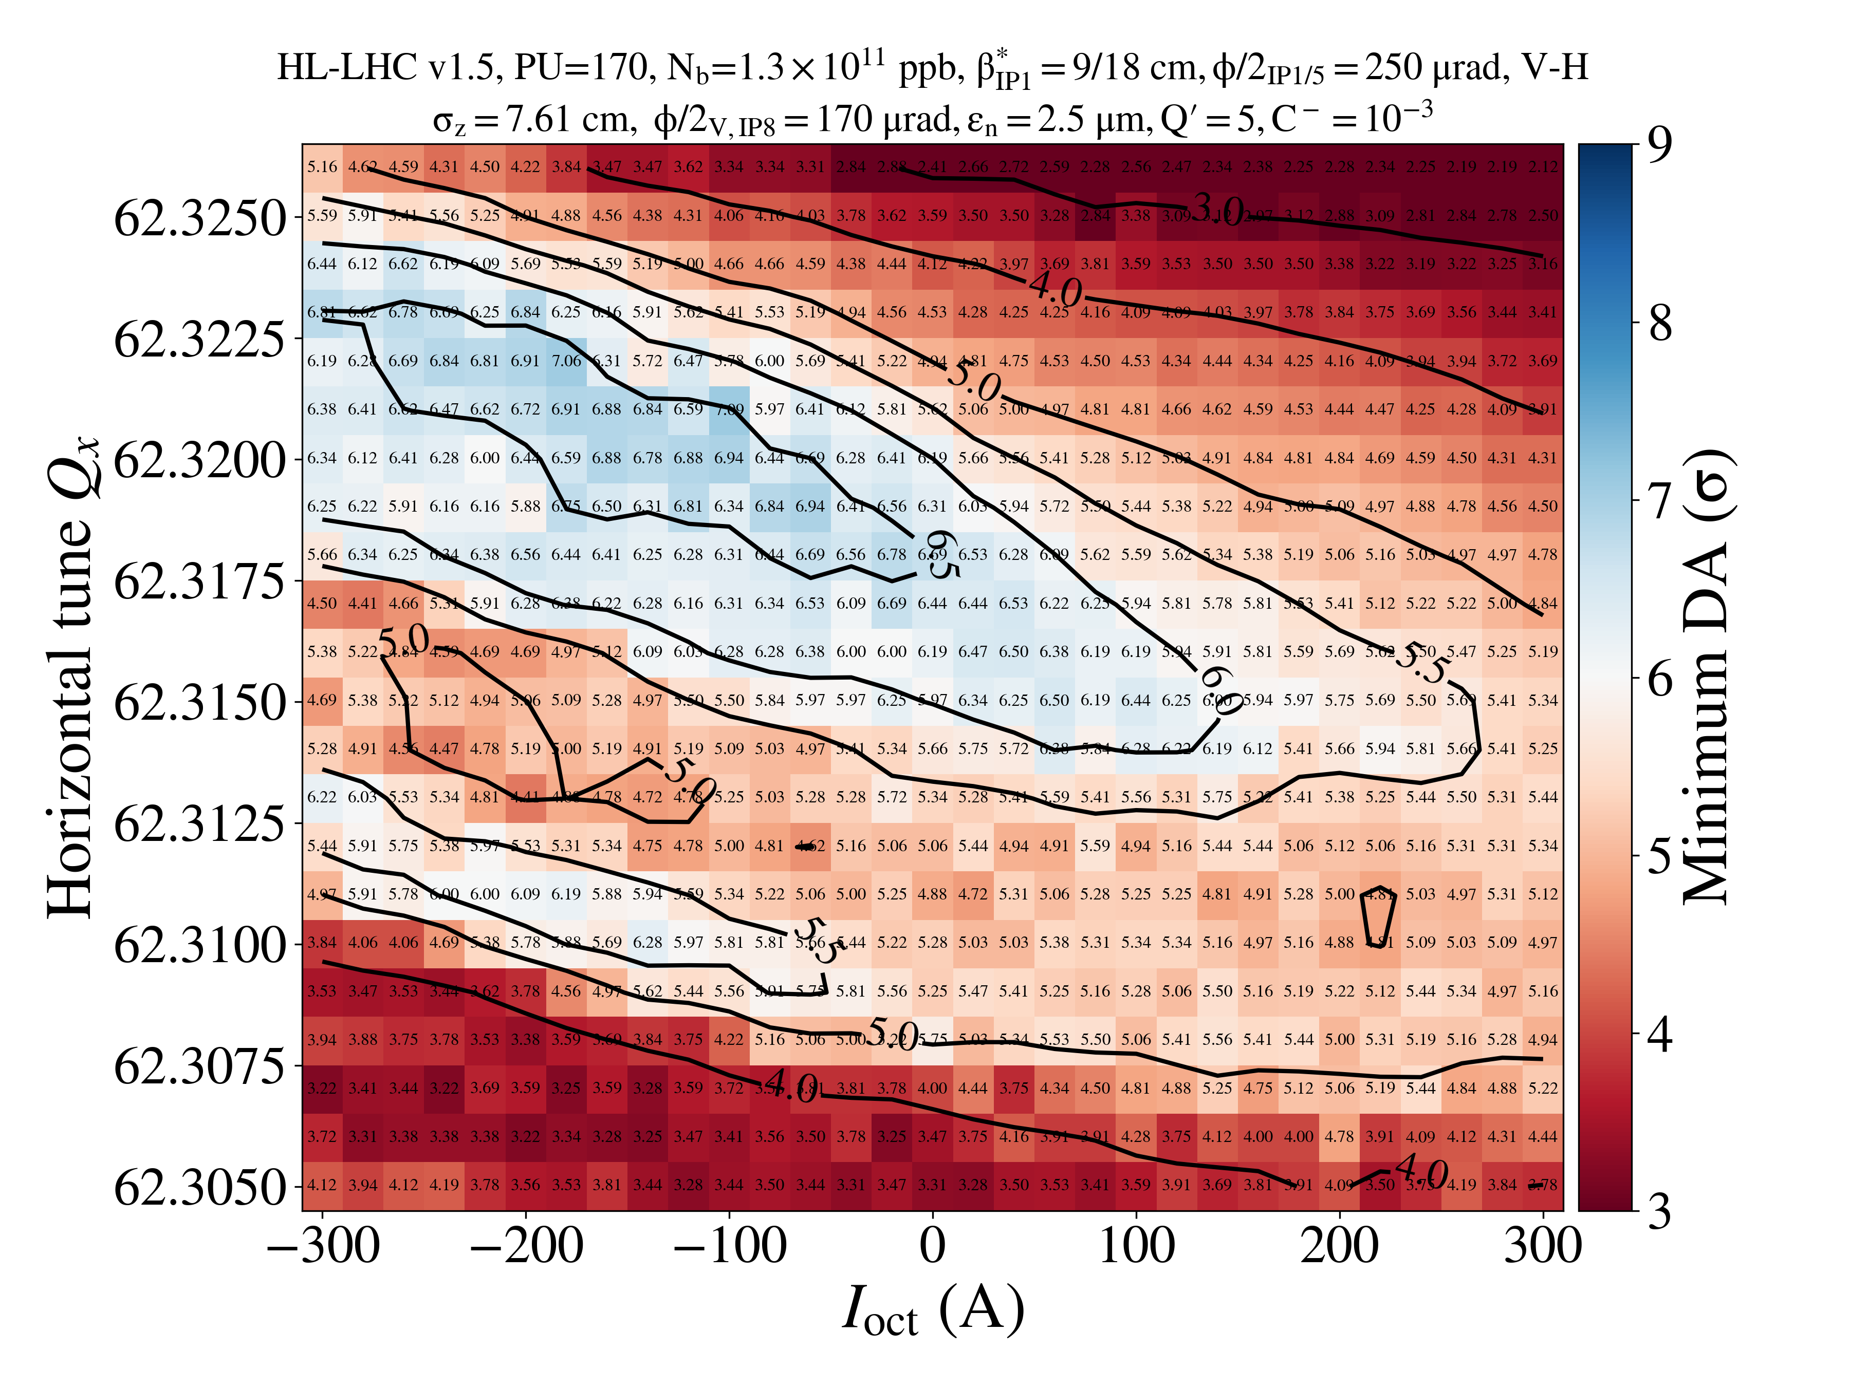
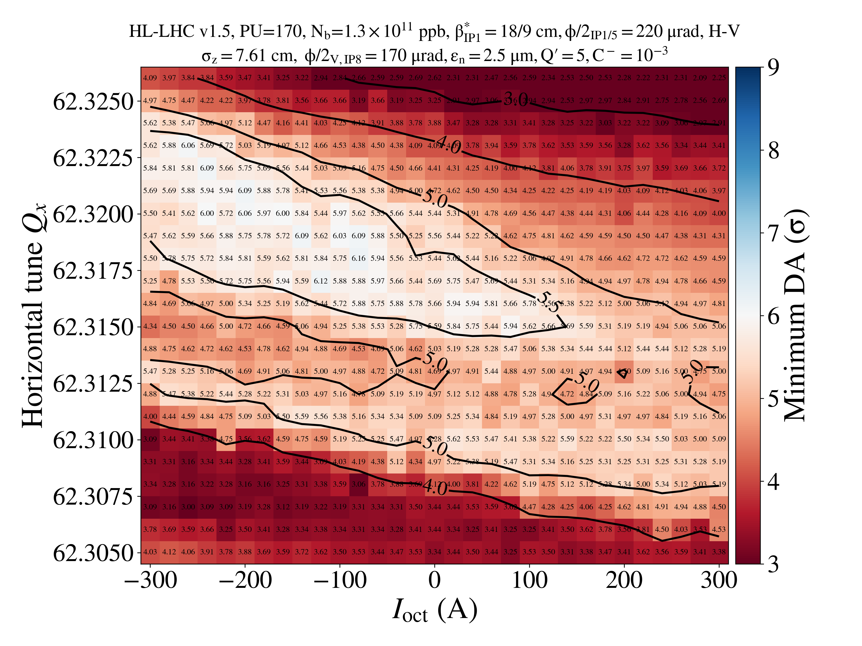
Flat optics EOL
H/V
V/H
xing = 250
PU = 170
No difference in terms of DA between H/V and V/H.
More comfortable DA with flat, possibility to increase octupoles if needed on top of gain in luminosity performance.
Crossing angle can be reduced to ~230
xing = 220

