Slide 1
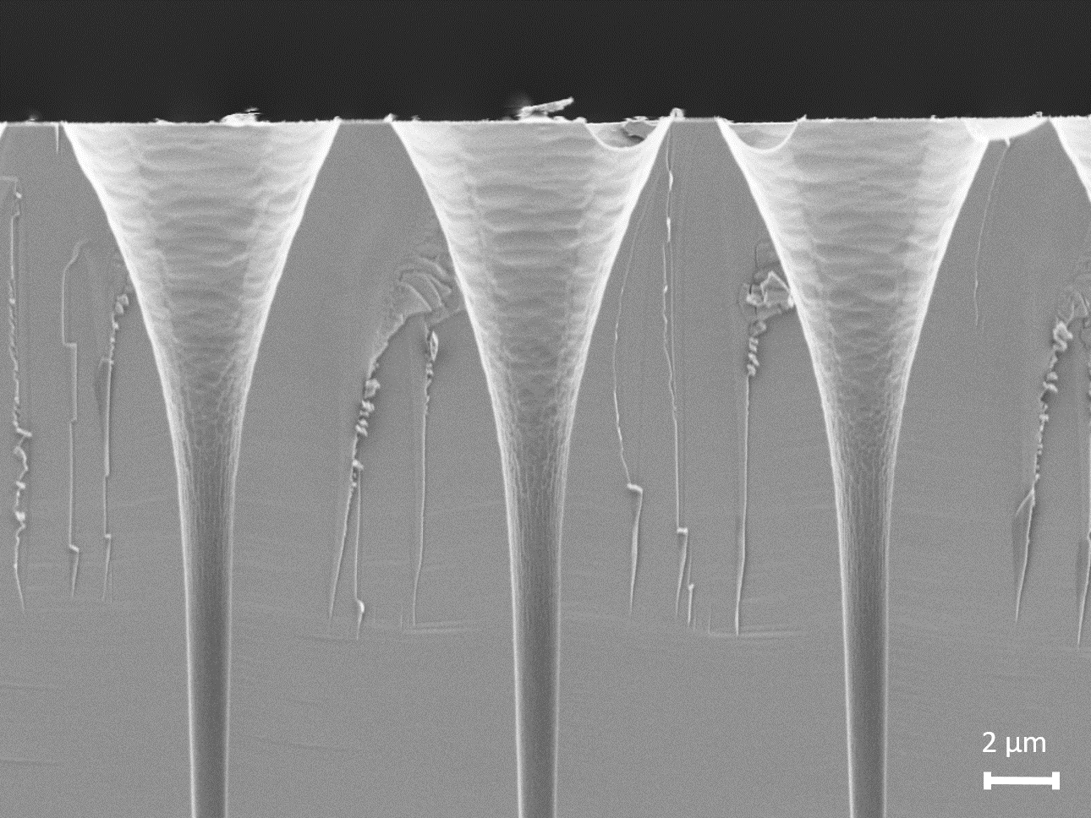


A GEANT4-based Monte Carlo model for MCPs
Georgios Konstantinou, Sara El Akel, Nicolas Wyrsch

Slide 2
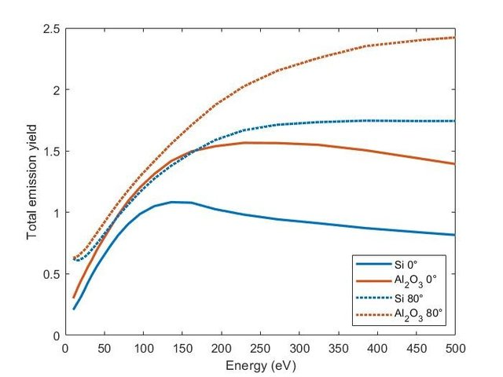
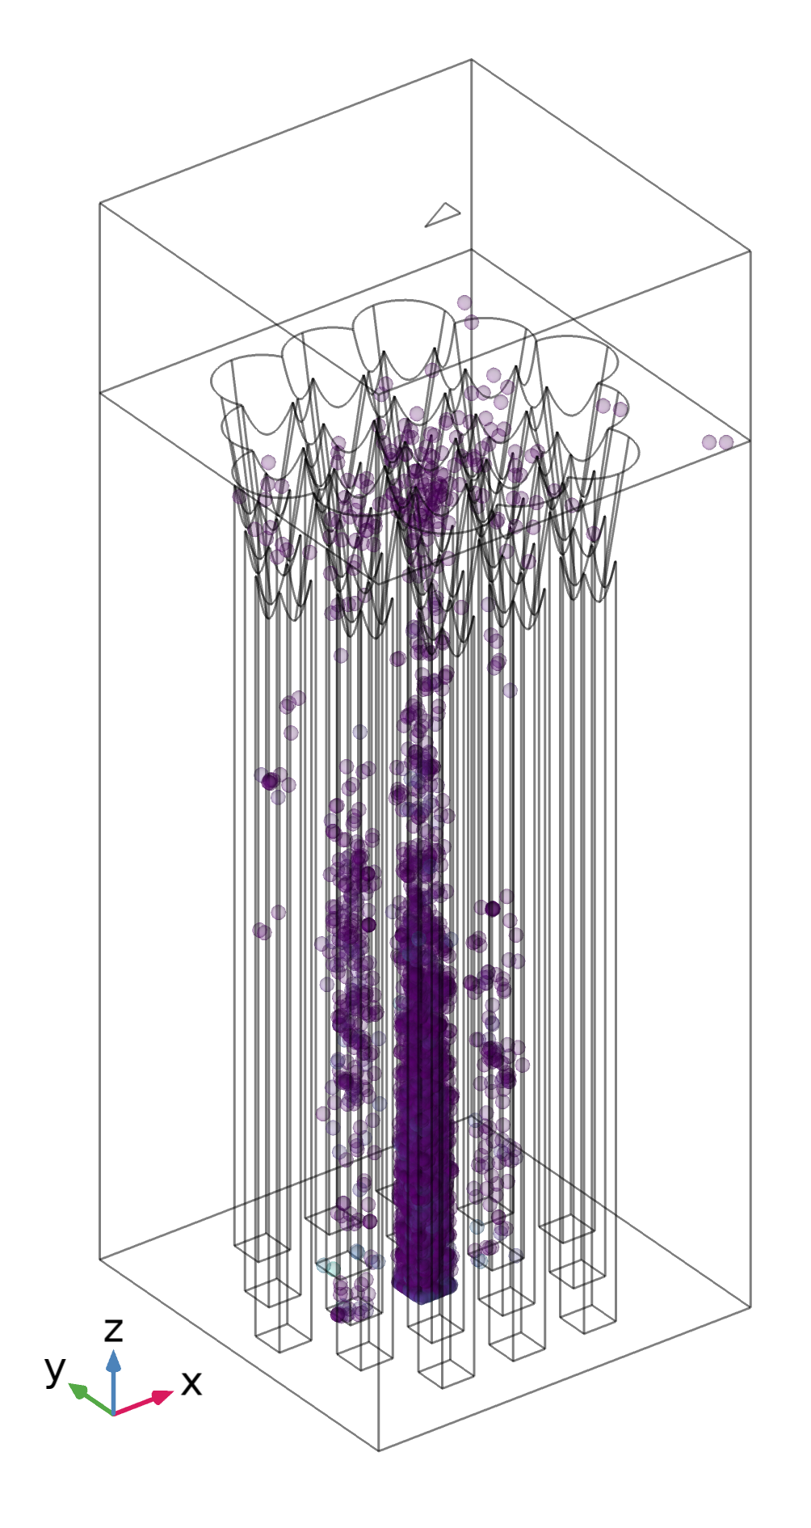

Existing models: COMSOL
Main tool for simulations since ~10 years
Agreement with measurement
Manual model development
Limited geometry/architecture
Invoking Matlab for complex physical processes
Problems with seeding
Not open-source, licensed, expensive (including Matlab)
Löffler, J., Thomet, J., Frey, S., Ballif, C., & Wyrsch, N. (2022). Single photon detection with amorphous silicon-based microchannel plates: A Monte Carlo model. Nuclear Instruments and Methods in Physics Research Section A: Accelerators, Spectrometers, Detectors and Associated Equipment, 1032, 166589.

Slide 3
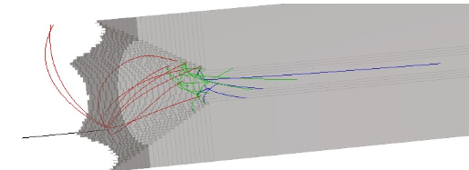
Existing models: SimIon
Slight underperformance compared to measurement, model needs some work more
Computational limitation in geometrical area
Development not in house
Not open source
No community
https://simion.com/
https://en.wikipedia.org/wiki/SIMION

Slide 4
Development of an open-source MCP model
GEANT4 as the community favorite
Significant flexibility in modeling
Geometry flexibility
Field model
Electron model
Silicon (or base material model)
Electron-Silicon interactions
?
?

Slide 5
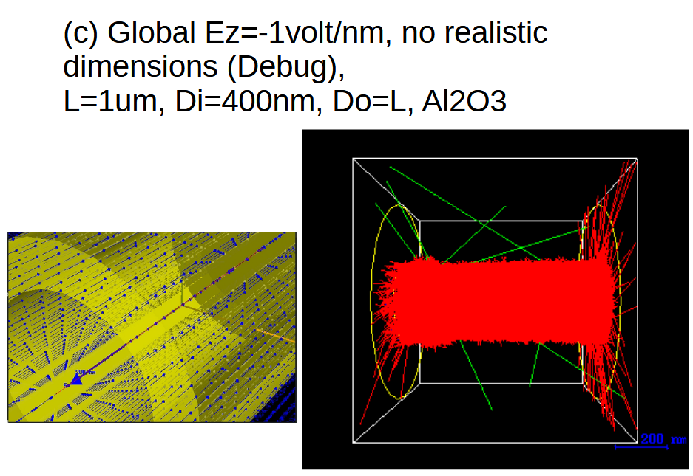
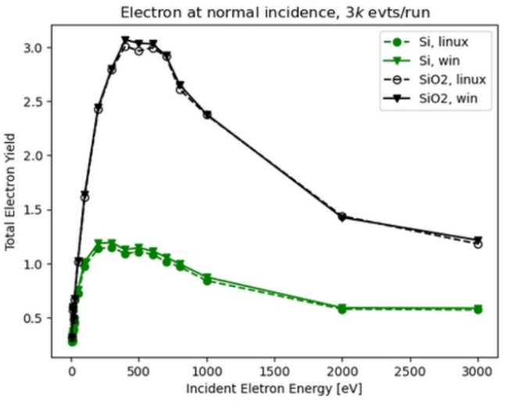
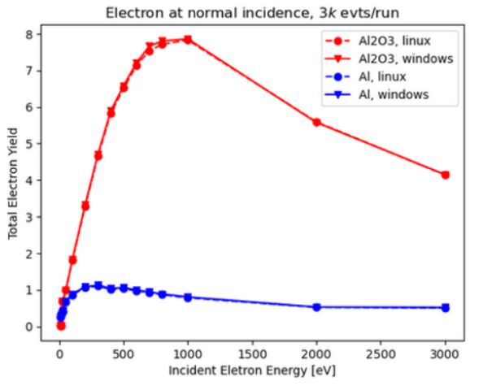
Two model possibilities
Scattering/backscattering (full)
  G4 low energy
  Onera-CEA microelectronics
    Optimization for stopping power
    Work function
    Phonon interactions (when needed)
Courtesy Henso Abreu
Our own COMSOL model

Slide 6
Two model possibilities
Scattering/backscattering (full)
  G4 low energy
  Onera-CEA microelectronics
    Optimization for stopping power
    Work function
    Phonon interactions (when needed)
Stochastic
  Cuts and Precision Controls (Production cut, Energy cut, Max step size)
  Secondary Electron Yield (SEY) Table (for various primary angles)
  Energy Distribution of Secondaries
  Angular Distribution of Secondaries
Courtesy Henso Abreu
Our own COMSOL model

Slide 7
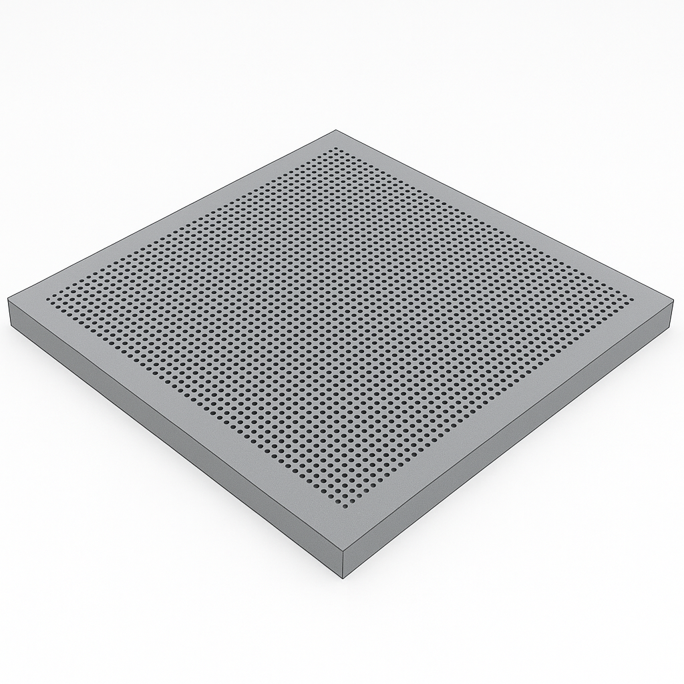
Hybrid approach
Could the full model be too heavy to simulate multi-electron events/ expanded geometries?
Use full model to calculate necessary input for stochastic model
Create a database/library with necessary model parameters
Use stochastic model for expansive simulations

Slide 8
Collaboration structure
At the moment, we are in regular contact with in2p3 (Lyon) and exchanged preliminary code
We have significant computational resources to use for this project (EPFL cluster)
We could use the common https://gitlab.cern.ch/drd4 or an openly accessible github for the project
There are at least 2 more groups that have shown interest
We will be happy to have interested colleagues participate in this effort with experience, ideas or resources

