Slide 1
Spatial Analyzer getting started
P. Bestmann
27/03/2025

Slide 2
Overview
2 Day training on SA & AT930/960
Day 1
  Very short introduction and overview of the training, Software & Instrument
  What you absolutely need to know before starting
  Practical examples & explanations on the job following the skeleton
  Q&A
Day 2
  Q&A
  Setting up of your equipment
  Full day of practical examples based on your applications and Instruments (2 Groups)

Slide 3
Contents
Getting started
  Installation, Licences, Licence Files, Drivers
  Programm overview, units, templates
  Instruments, connections, instrument window, simulation
  Organisation of a Job in Folder, collections, groups
A first measurement
  Preparations, mesurement profiles and reflectors
  Multiple stations & Network
  Gravity link
Multiple station measurements
  How to link them
    Network Layout
    Best fit, Bundle adjustment, USMN

Slide 4
Contents
Instrument controls
  Tracker Pilot
  Two face check
Measurement controls
  Closing controls, Drift checks
  RMS window
Relationships
  Dynamic constructions
  Geometrical relationshsips
Reports
  Simple reports and data export

Slide 5
Contents
Details
  Measurement profiles (always send points to SA!)
  Reflector choices and differences
  Reflector offsets
  Considerations for Point names
Constructions
  Frames
  Construct point/line/plane/circle/cylinder
  Projections & Bisects
  Geometry fits & relations, Reflector offsets
Alignments
  Theoretical points
  Watch windows & point at target

Slide 6

Getting started
Download Spatial Analyzer from kinematics.com
SpatialAnalyzer | SpatialAnalyzer (kinematics.com)
The download is free, without licence, the use is limited to the viewer functionality
Licences are linked to a Hardware Key and a licence file
Sometimes problems with the sentinel driver installation occur….
The program versions are not downwards compatible
Certain commands cannot be undone, if you are not sure, make a copy!
Consider that SA is not saving your data for you, do it!

Slide 7
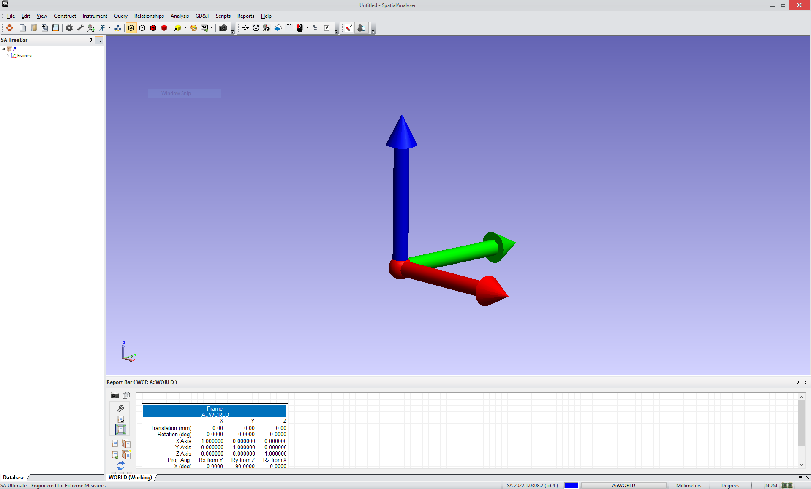
SA programm overview
Tree Bar
Report Bar

Slide 8
SA Tree bar
The tree bar is the structure of your job, keep it clean!
  Basic structure: Collection, Instruments, Point Groups, Features, Frames, Events….
Use structuring elements like Folders, Collections and Groups
  A good practice is to use one Collection per Instrument Station
  And one group per feature (Plane, Cylinder, Circle)
  Folders are nice for different epoches or workpieces
You can easily join points, but it is harder to separate at a later stage
  A good practice is to go as fine as possible
Be explicit with your Group AND Pointnames
  Common Pointnames are important for fitting
  Name Flanges, Circles and Planes accordingly

Slide 9
Important commands
Your favourite button is F2!
  Allows to select features depending on the context
  Confirm your choices with enter, always!
Import/Export
  ASCII: Predefined Formats
  Limitations
User Options
  Display & Units
Instruments and interfaces
Group Manager

Slide 10
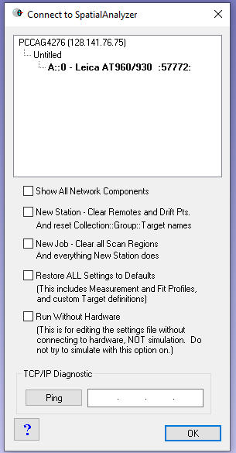
Add instrument
Instrument > add (Alt+i)
Run interface module (& connect)
  Runs the interface module with the last IP settings
Instrument window
  Interfaces
  Docking window

Slide 11
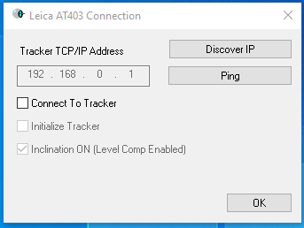
Virtual instruments & tracker pilot
Run without Hardware is NOT a simulation!
You can run a virtual instrument by just not connecting
  Untick the «connect to Tarcker option» and you run in simulation mode
You can make measurements of existing known points
  As if it was a real instrument
Tracker Pilot is your Hardware interface software
  Two face checks, calibrations, reflectors
  Your reflectors and compensations are stored on the controller!
  There is a web interface at the IP adress of the controller…..

Slide 12
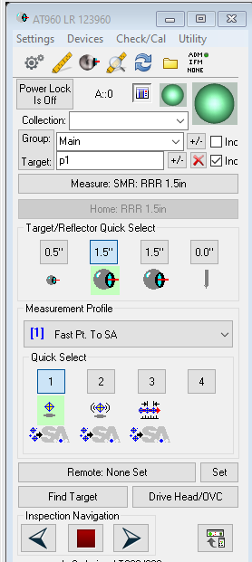
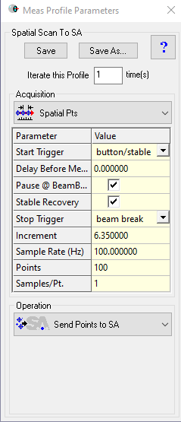
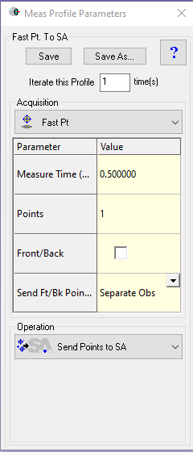
Instrument window
Measurement Profiles
  Measurement Time
  Front/Back
  Send points to SA
  Spatial Scans
  Stable points
  Geometry triggers
Devices
  Weather, Level, Temperature
  Levelling & Gravity Frame

Slide 13
First measurement
Setting Collection + Group
Setting profile and offsets
Measuring points / replacing points
Attaching points to Geometry
Multiple stations and common Network points

Slide 14
Instrument checks
How to check your instrument?
  Two face check
  Other controls
How to check your measurements?
  RMS window
  Opening / closing controls
  Drift checks
  Networks & adjustments

Slide 15
Constructions & Relationships
Simple constructions
  Cleaning data, setting reflector offsets
  Planes, Lines, Circles, Centers…..
  They have the major drawback of being static
Geometry relationships
  Planes, Lines, Circles….
  Combined relationships / projections
Group-Group Relationships
  Minimize relationships
  Displaying residuals
Cardinal Points

Slide 16
Alignment
Frames / Coordinate systems
  Definitions & priorities
Transforming & Working in Object Frame
  Best Fit
  Moving instrument & Objects
Creating theoretical geometry
  Importing coordinates
Watch window & Point at target
  Measured point
  Closest point
  Instrument

Slide 17
Bundle adjustment /USMN
Best fits, Bundle and USMN
  Difference of a Best fit, Bundle adjustment and USMN
  When do I use Best fits?
  What is going to move if you move the instrument or not?
  Moving corresponding group only, moving objects?
  Why does the USMN composite group not follow?
  What are my final results and how can I evaluate the precision?

Slide 18
Best Fit, Bundle & USMN
Best fits, Bundle and USMN
  Difference of a Best fit, Bundle adjustment and USMN
Measurement from last week
Measurement from today

Slide 19
Best Fit, Bundle & USMN
Best fits, Bundle and USMN
  Difference of a Best fit, Bundle adjustment and USMN
  How to minimize residuals?
  Minimizing coordinate differences or observations?
Perfect match
Remaining residuals

Slide 20
Reports
Report Template
  Reporting Options
Callouts & Viewpoints
Events (static)
Multiple frames in one Report
Automatic updates & locking objects

