Slide 1















ATTRACT Phase 2 Final Review
CERN, May 20-21, 2025
ULTRARAM™
Ultralow-power, Non-volatile, Random Access Memory Arrays for Datacentres
and Space Applications
Professor Manus Hayne
Department of Physics, Lancaster University and
Quinas Technology Ltd.

Slide 2

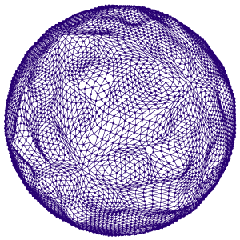
Presentation guidelines (1)
1. Please do not include this slide.
2. Use this font style with a minimum font size of 12.
3. Target for a presentation lasting no more than 20-25 minutes.
4. Slide “Reminder of the initial project objectives”: Please, in this slide, you should remind the reviewing panel about the objectives of your project as you defined them in the originally submitted proposal. Focus on the main objectives. The language should be understandable and simple. For example:
    Our project focused on fabricating a nano sensor for detecting air pollutants such as CO₂.
    The goal to detect them with 2 orders of magnitude more accuracy than existing nano sensors.
    Etc.
It is encouraged to accompany the text with pictures, drawings, etc. No more than 1 slide.
5. Slide “Final Results achieved (1)”: Please, in this slide focus on describing your main achieved results until now. Focus on the results concerning your whole technology and not in performance of components, materials, etc. The language should be understandable and simple. For example:
    The picture 1 shows a prototype of the nano sensor we have fabricated.
    The picture 2 shows how the prototype was tested by placing it in the exterior of a building in Rome.
    Etc.
It is encouraged to accompany the text with pictures, drawings, etc. No more than 1 slide.
6. Slide “Final Results achieved (2)”: Please, in this slide focus on describing your main achieved results regarding the performance of your technology. Focus on the main and most impacting aspects of it with a clear and simple language. For example:
    The graph 1 shows the concentration of CO₂ vs. time that our nano sensor detected when tested in a city.
    The graph 2 shows the minimum concentration of CO₂ that our nano sensor detected when several tests were done in a city.
    Etc.
It is encouraged to accompany the text with pictures, drawings, etc. No more than 1 slide.

Slide 3
Presentation guidelines (2)
1. Please do not include this slide.
2. Use this font style with a minimum font size of 12.
3. Slide “Final Results achieved (3)”: Please, in this slide focus on benchmarking your technology with similar ones existing currently in the market. Focus on those performance figures that are more impactful and clearly qualify and highlight your technology as better. The language should be understandable and simple. For example:
    The table 1 shows a comparison of the minimum CO₂ detected threshold of our nano sensor with the ones currently in the market.
    The table 2 shows a cost comparison of our nano sensor with respect to the ones currently in the market.
    Etc.
It is encouraged to accompany the text with pictures, drawings, etc. No more than 1 slide.
5. Slides “Final tests undertaken (1) and (2)”: Please, in this slides focus on describing the performance tests undertaken with your technology. Focus on those tests that show how your technology performed under as realistic as possible use cases. Do not focus on material science tests, reproducibility tests, etc. The language should be understandable and simple. For example:
    The graph 1 shows the concentration of CO2 vs. time that our nano sensor detected when tested in the cities of Rome, Amsterdam and Paris.
    The graph 2 shows the minimum concentration of CO2 that our nano sensor detected when several tests were done a chemical plant in Barcelona.
    Etc.
It is encouraged to accompany the text with pictures, drawings, etc. No more than 2 slides.

Slide 4
Presentation guidelines (3)
1. Please do not include this slide.
2. Use this font style with a minimum font size of 12.
3. Slide “Commercialization actions taken during ATTRACT”: Please, in this slide you should describe the concrete commercialization actions you have undertaken until now. The language should be understandable and simple. For example:
    The Company X in our project has fabricated 500 pilot units of our nano sensor already delivered to potential clients for testing.
    We have filed 2 International Patents concerning our nano sensor.
    We have passed the regulatory certificates X and Y.
It is encouraged to accompany the text with pictures, drawings, etc. No more than 1 slide.
4. Slide “Commercialization actions foreseen after ATTRACT”: Please, in this you should describe the concrete commercialization actions you have already foreseen after ATTRACT ends. Focus on real foreseen actions and not in “intentions”. The language should be understandable and simple. For example:
    We have elaborated a preliminary business plan for a full commercialization in 2026 including the fabrication of the first 10.000 nano sensors. This estimation is backed up by preliminary agreements with clients A and B.
    The consortium has taken the first steps for the constituency of a start-up company that will fully commercialise our nano sensor in 2027. In concrete, those steps are X, Y, Z.
    Etc.
It is encouraged to accompany the text with pictures, drawings, etc. No more than 1 slide.

Slide 5

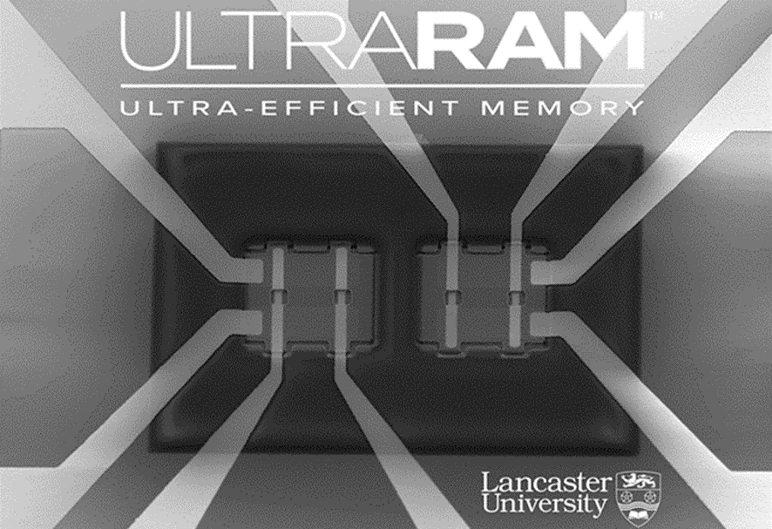
Reminder of the initial project objectives
To technically and commercially develop ULTRARAM™, a high-speed, high-endurance, charge-based non-volatile memory
  Develop a scalable ‘dry’ process (no wet chemical etching)
  Fabricate and test small arrays
  Explore operating temperature range
  Undertake radiation hardness testing
  Model ULTRARAM™, particularly at system level
  Draw up a commercialisation roadmap
Previously fabricated arrays using the old, non-scalable process

Slide 6
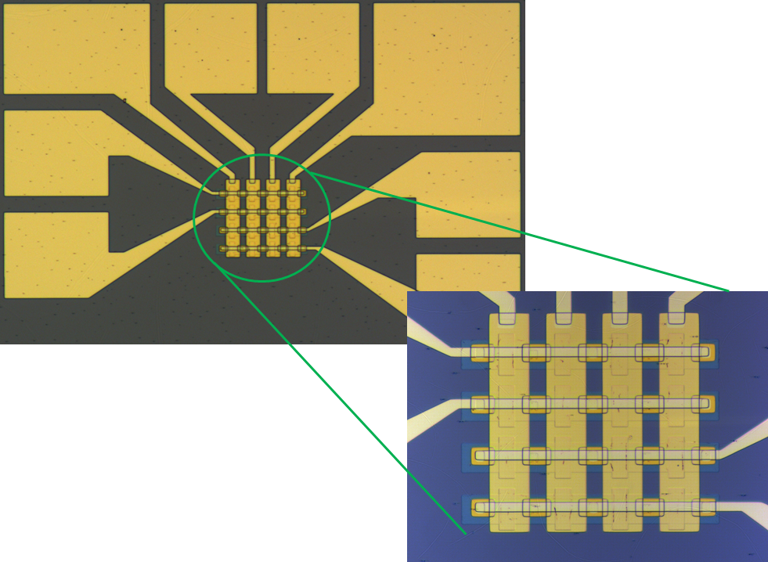
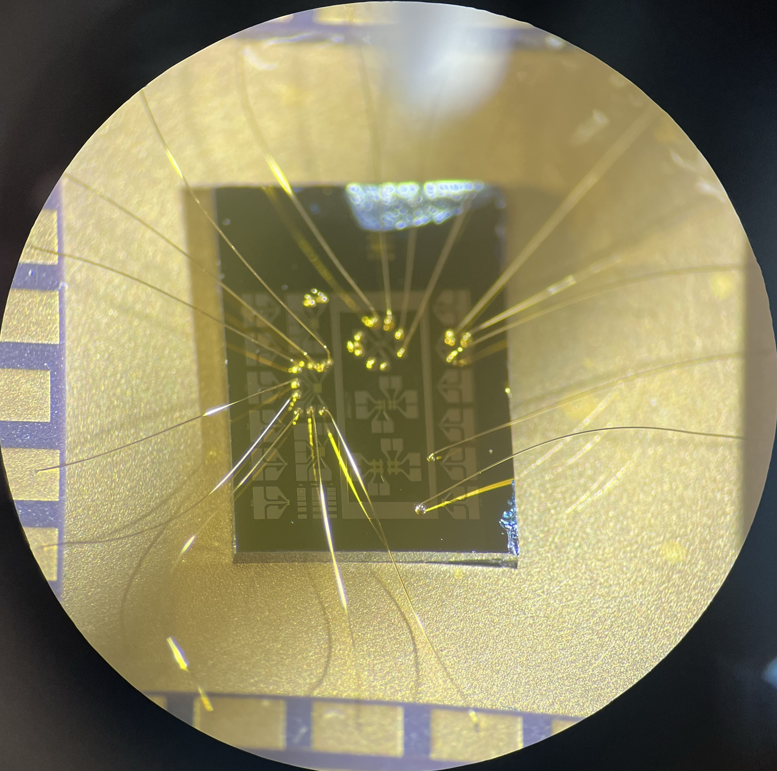
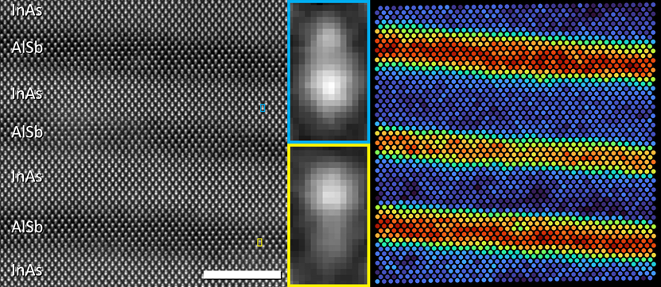




Final Results achieved (1 - Overview)
New dry, scalable process developed, including
  Improved atomic layer deposition (ALD) of dielectric
  Triple wavelength endpoint detection in collaboration with LayTec
  Self-aligned process with ten-fold reduction in gate stack to channel
  contact distance
  Atomic layer etching (ALE) with KAUST, Saudi Arabia (on going)
Multiple single devices, 4-bit and 16-bit arrays fabricated
Atomic resolution imaging of triple barrier resonant tunnelling structure (TBRT)
  Transmission electron microscopy by Integrity Scientific
  Scanning tunnelling microscopy (X-STM) by TU Eindhoven
  Modelling showed that TBRT operation is robust to intermixing of barrier
  and well material

Slide 7
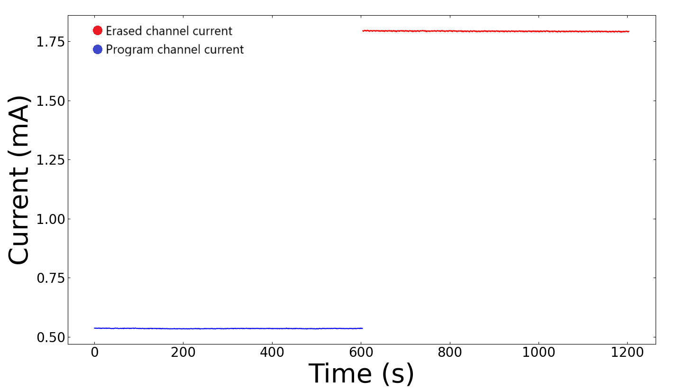
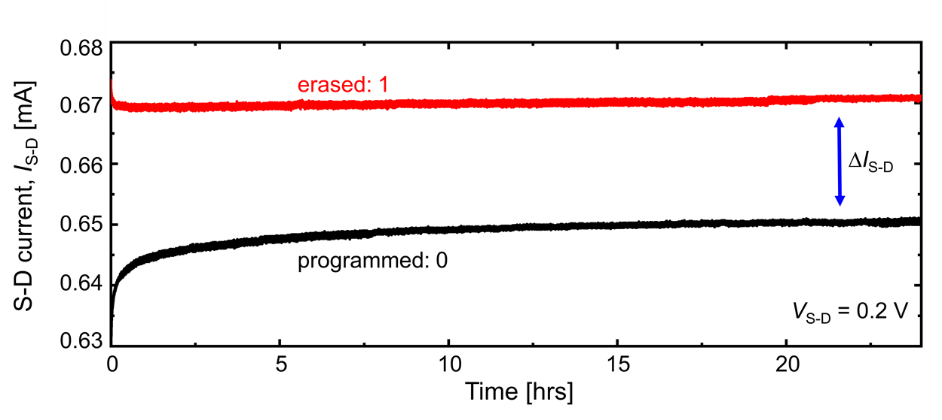
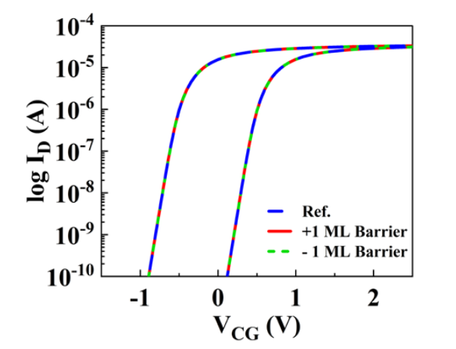

Final Results achieved (2 - Performance)
Up to 100x increase in memory window compared to previous results
‘Compact model’ of ULTRARAM™ developed in collaboration with IIT-Roorkee
  Confirmed physics of ULTRARAM™ operation
  On-going work includes small-array SPICE model and TCAD-style model
Novel compact field-effect inverter (FEI) logic device
  Required for decoding large arrays
  Patent now at national phase in US, Europe, China, Japan and S. Korea
  Modelled in 3 different materials systems: GaAs/AlGaAs, 6.1 Å and SiGe
  Room-temperature operation confirmed in prototype 6.1 Å material device
Old
New

Slide 8
Final Results achieved (3 - Benchmarking)
Parameter | DRAM | 3D NAND | MRAM | ReRAM | PCRAM
Storage time | ~60 ms | >10 years | >10 years | > 10 years | >10 years | >10 years | ■
Non-destructive read? | No | Yes | Yes | Yes | Yes | Yes | ■
Switching energy | 1 fJ | ~10 fJ | ~100 fJ | ~10 pJ | ~100 pJ | ~10 aJ^{(*)} | ■
Switching voltage | <1 V | >10 V | <1.5 V | <3 V | 1-3 V | ≤2.5 V | ■
Energy barrier | 0.5 eV | 1.6 eV | 1.5 eV | 1.4 eV | 2.4 eV | 2.1 eV | ■
Cell size | 6F² | <<4F² | 6F² | (4-12)F² | (4-30) | ≤6F² | ■
Switching time | 10 ns | >10 μs | 10-50 ns | 10-100 ns | 10-100 ns | ~1 ns^{(*)} | ■
Endurance | 10¹⁶ | 10⁵ | 10¹² | Up to 10¹² | Up to 10¹² | >10^{16 (**)} | ■
^{(*)}Current devices are at 10 μm node, which limits speed and increases switching energy by a factor of ~10⁶
^{(**)}Current measured endurance is experiment not device limited

Slide 9
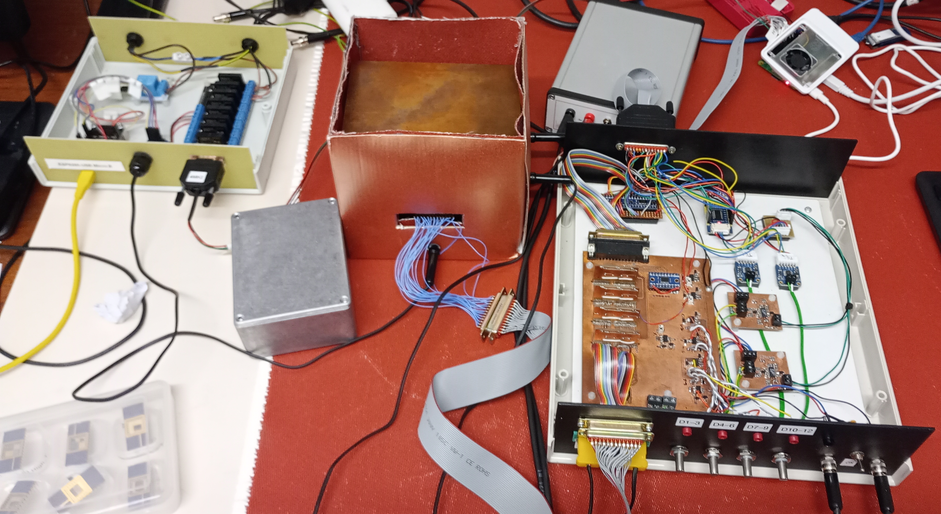
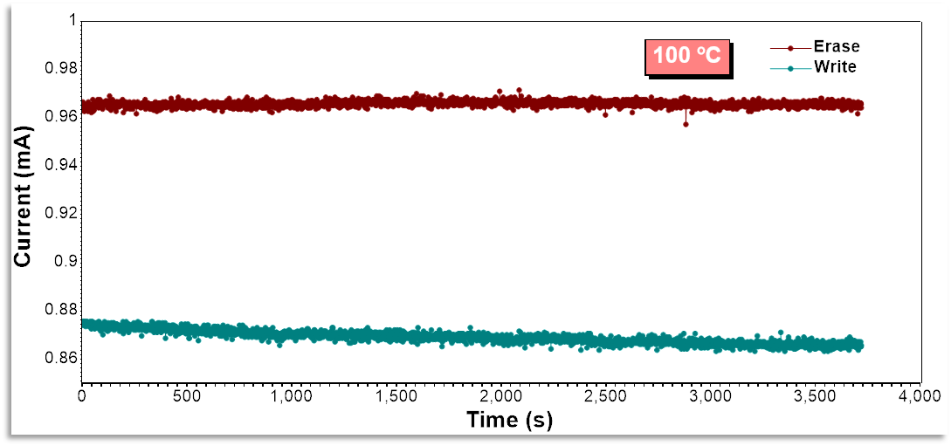
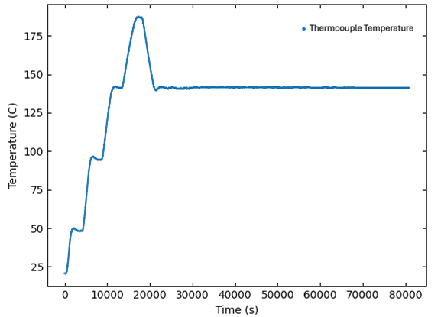


Final tests undertaken
Unprecedented operating temperature range (space)
  Space is cold (2.7 K), but in direct sunlight objects can get quite hot!
  Channel conductivity has been confirmed down to 1.3 K (-272°C)
  Robust data retention (no observable loss) at 100°C
  Higher temperature measurements, up to 185°C, planned
Radiation hardness testing pending (space)
Whole computing system simulations by ETH Zurich (datacentres)
  ULTRARAM™ as a ‘drop-in’ replacement for DRAM
  Laptop computing tasks of different intensities
  Given certain scaling assumptions ULTRARAM™ can
  match DDR5 speed and save ~30% energy
  This saving is from eliminating refresh

Slide 10
Final tests undertaken (2)

Slide 11

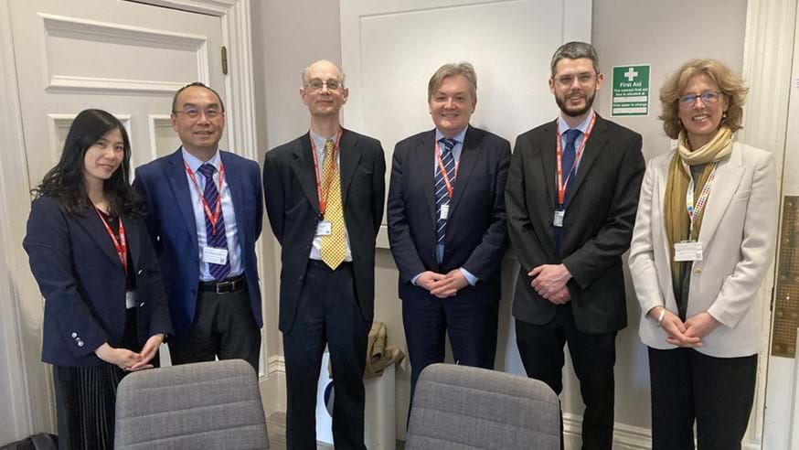
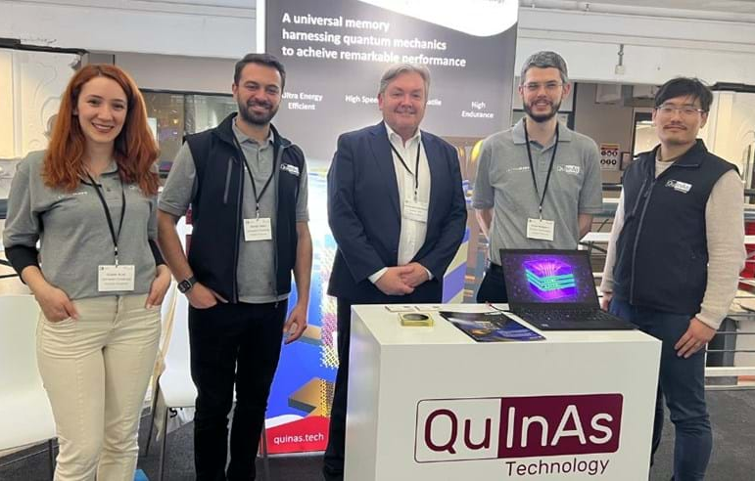






Commercialization actions taken during ATTRACT
Formed spinout company Quinas Technology Ltd
Quinas has coordinated £1.4M of Innovate-UK projects
£1.1M 1-year project with IQE, world’s leading compound semiconductor epitaxy foundry & ATTRACT 1 partner, to scale up epitaxy to 6” GaAs, as a first step to volume manufacture
Four patents awarded in as many territories, making five in total
Three new patent (families) submitted, making 8 patents pending in 6 territories
Extensive international exposure: visited USA (x6), Taiwan (x4), S Korea (x4), India (x2), Japan and Singapore, with most travel funded by UK Government or Innovate UK
Exhibited at many events including: UK Quantum Technologies Showcase (2023, 2024); Semicon Taiwan (2023, 2024); SEDEX S. Korea (2024); FMS, USA (2023, 2024)
Multiple innovation prizes: Elektra Awards Electronics Weekly Readers Award University Research Group of the Year (2023), Flash Memory Summit Most Innovative Startup (2023), IC Taiwan Grand Challenge (2024), finalist in WIPO Global Awards (2025)

Slide 12
Commercialization actions foreseen after ATTRACT
Complete £2M pre-seed round (£230M in convertible loans already secured)
Submit new Innovate-UK bid with IQE
Continue to secure IP (patents)
Immediate Tasks
Minimum viable digital product is a 512 kbit to 1 Mbit NVRAM package, with 8- or 16-bit parallel interface
Everspin sell NVM products of this size or smaller (e.g. 256 kbits), ST’s ZEROPOWER® NVM is available in sizes upwards from 16 kbits, whilst Infineon sells FeRAM at sizes as small as 4 kbits!
Product will consist of ULTRARAM™ array including decoding logic ‘piggy backed’ on Si-CMOS memory controller chip utilising chip bonding and advanced packaging
The ULTRARAM™ array will be grown on 8” wafers by IQE, the largest size currently available for compound semiconductor epitaxy
Processing will use spare capacity in lower-cost 8” fabs, e.g. PSMC, implying production at 100-nm node
At 100-nm node ULTRARAM™ will already have access times that match or exceed competing NVM products
For space applications larger nodes offer greater protection against single event effects
Towards MVDP (TRL9)

Slide 13


Thank you, any questions?
This project has received funding from the European Union’s Horizon 2020 research and innovation programme under grant agreement No. 101004462

