Slide 1

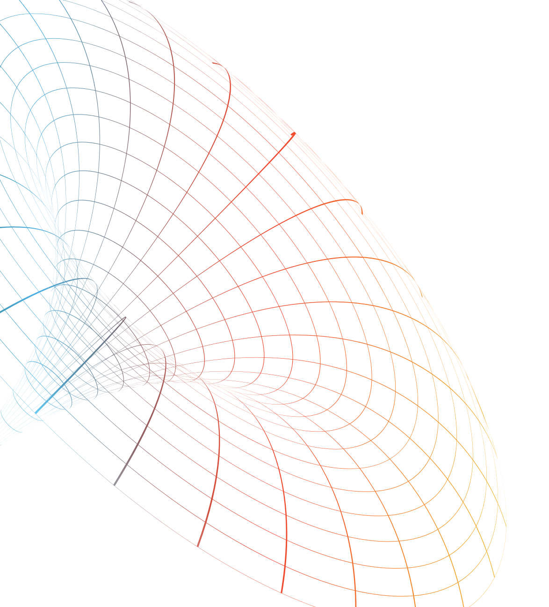

























ATTRACT Phase 2 Final Review
CERN, May 20-21, 2025
In-silico quantum generation of random bit streams
Massimo Caccia
Università dell’Insubria
massimo.caccia@uninsubria.it
SECO s.p.a.
WEEROC
IMASENIC
NAGRAVISION s.a.
Random Power s.r.l.
Università dell’Insubria
AGH- University of Krakow
Fondazione Bruno Kessler
E4 - computer engineering

Slide 2


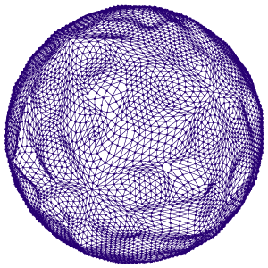
Reminder of the initial project objectives
Technology-wise: Develop a (hardware) platform for producing random bit streams:
  Embody advanced functionalities in the single generator board resulting by the ATTRACT Phase 1
  Develop a multi generator board
  Embed the Random Power principle in an ASIC
Exploitation-wise: maximise usability
  Deploy a Randomness Farm
  Design a procedure for the fast & controlled re-filling of the Linux Entropy Pool
  Embody the Random Power stream in the NumPy library
Revise the Business plan
Disseminate the activities

Slide 3
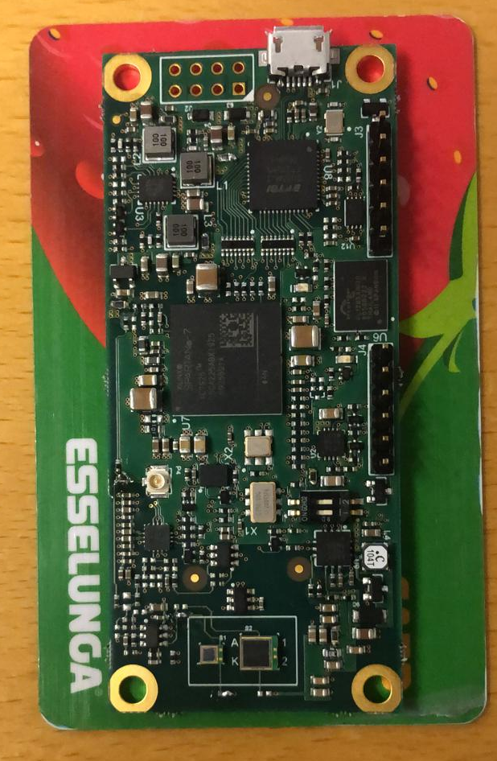
Final Results achieved (1/4): the single generator board
  The starting point (ATTRACT Phase 1):
  Advanced features & Developments:
statistical tests based on NIST MONOBIT & RUNS implemented in sw & fw
SHA256 NIST “vetted” function fw implemented
“proto-farm” based on 10 boards commissioned and 1.5Tb data recorded
bit stream qualified with the NIST test suite + TESTU01 by Pierre l’Ecuyer (with customised libraries)
Interfaced to Numpy at input bit level, providing the possibility to generate rnd number according to any probability distribution function
First “daemon” to refill the LINUX entropy pool tested - dropped after the latest kernel release [useless]
Bits-on-pin upon request
MONOBIT: asymmetries between 0 & 1 in a string
FTDI chip for USB routing
RUNS: statistics of the no. bit flips in a string
FPGA (Spartan-7) with proprietary TDC
8 cm
Amplification & discrimination
Single generator O(100 kbps)
3.5 cm

Slide 4
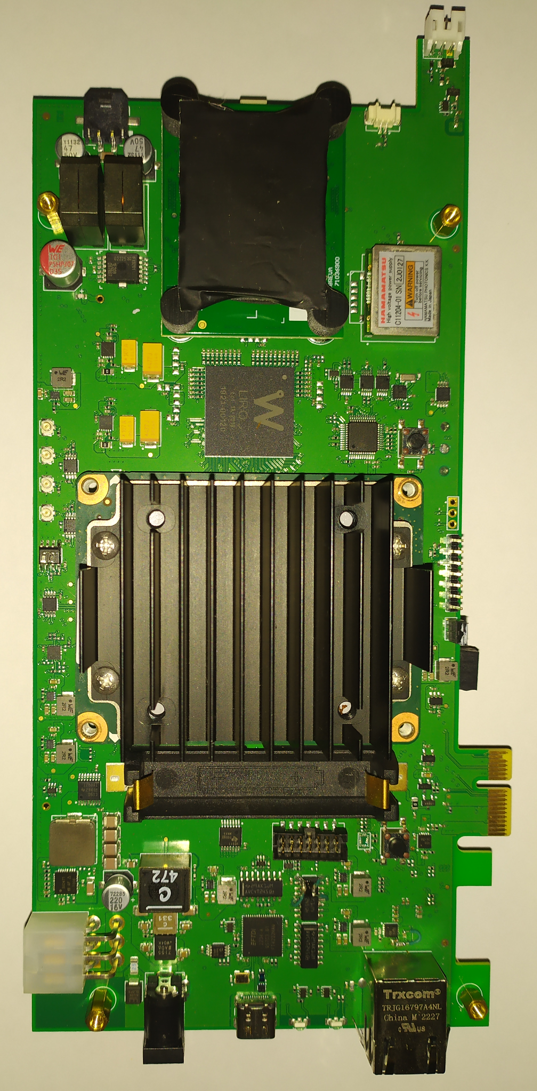
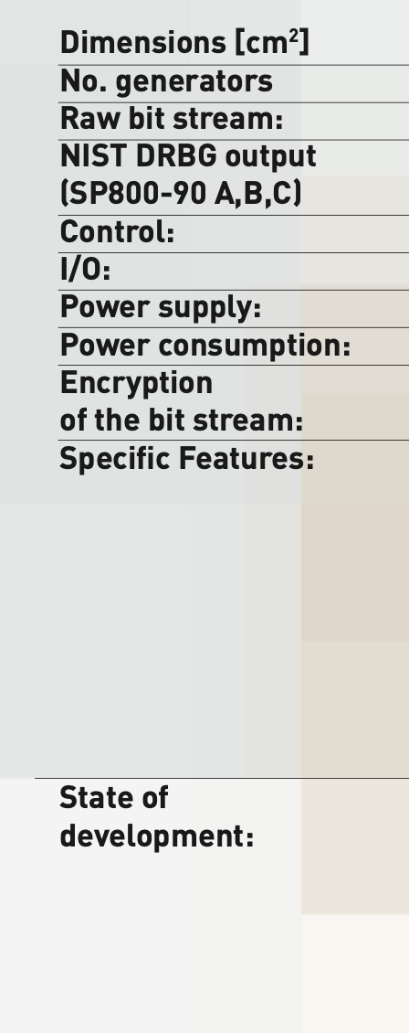
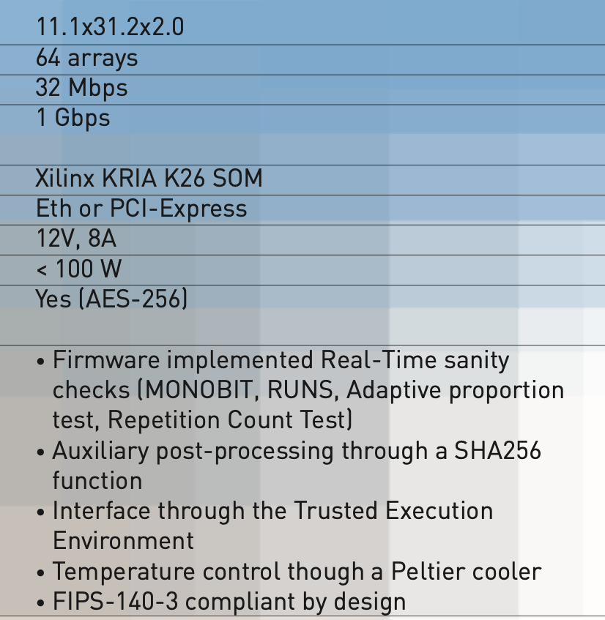
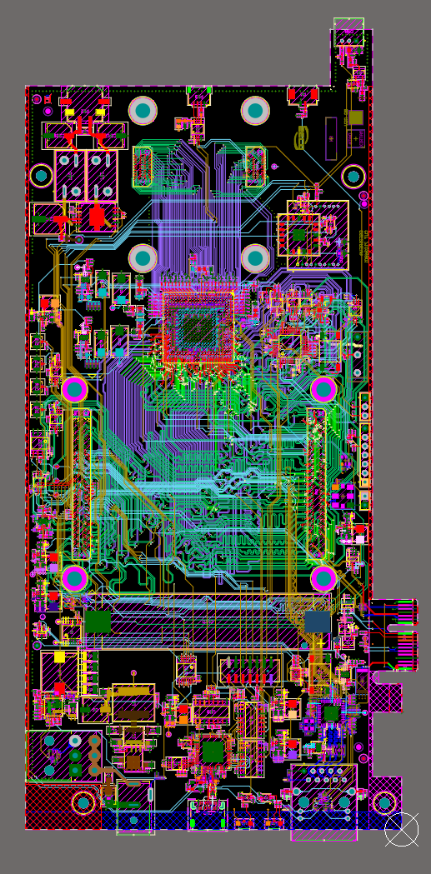
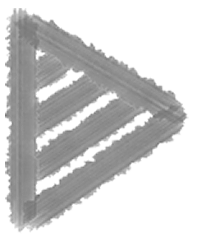
Final Results achieved (2/4): the 64x generator board
20W
31 cm
64 FPGA TDC inside with 30 ps granularity
v1.0 delivered in July 2023, qualified
v2.0, product grade, delivered in September 2024, being qualified [8 pieces]
software architecture under development
11 cm

Slide 5
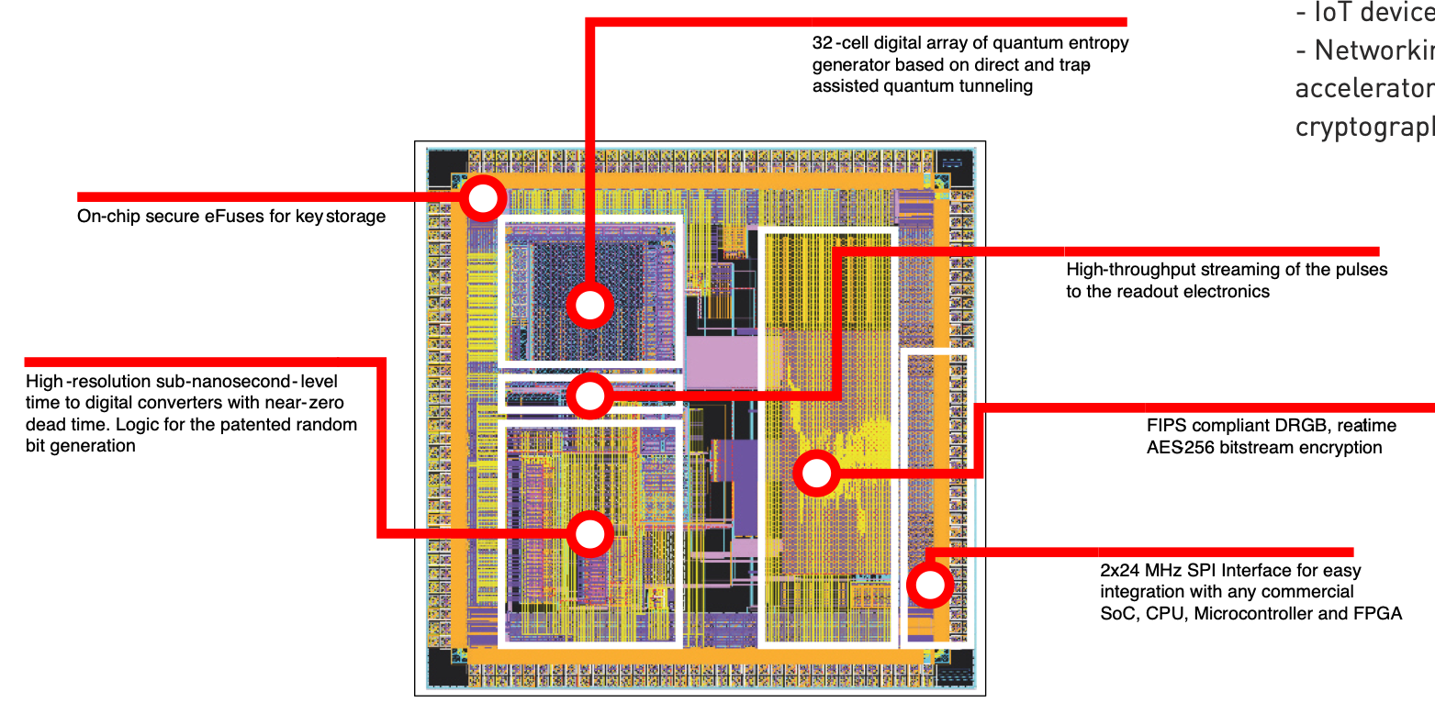
Final Results achieved (3/4): the RaP! ASIC
32x
Key generation at 3 levels, starting by a Silicon embedded primary key and a Key Derivation Function
Access though a “crypto-officer” password
12 wafers in 4 implantation dose profiles delivered in June 2024
Qualification close to completion
Packaging (QFN100) on the way
CAVP (Cryptographic Algorithm Validation Program completed)
6 more wafers on the way
AES-256 encryption and authentication of the bit stream
FIPS-140-3 compliant by design (possibly the ONLY existing one!)

Slide 6


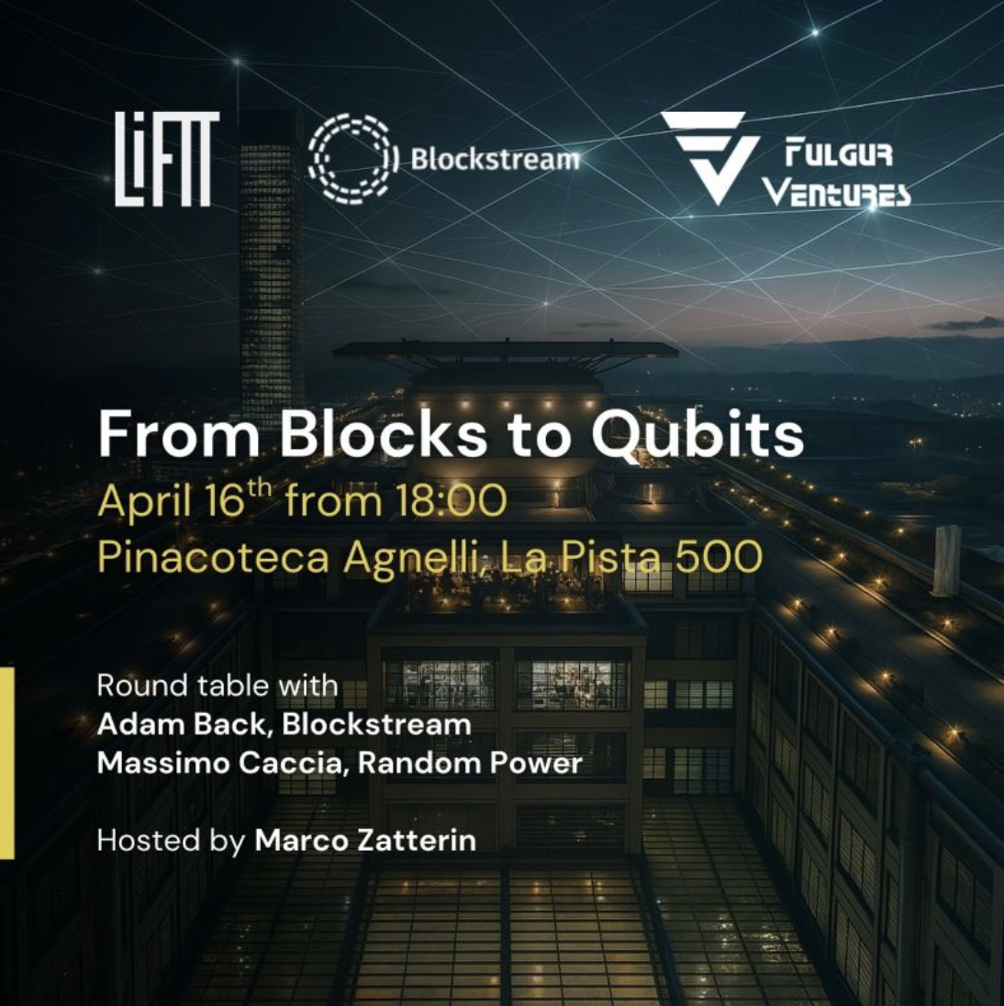

Final Results achieved (4/4)
Dissemination actions:
project presented at O(15) conferences and workshops
and 3 PhD schools (Barcelona, CERN, Gran Sasso)
and in a few seminars
posts on LinkedIn with a valuable number of views
award at the Falling Wall worldwide competition (2022)
1 best paper award
Updated 3 year business plan finalised and submitted to investors

Slide 7
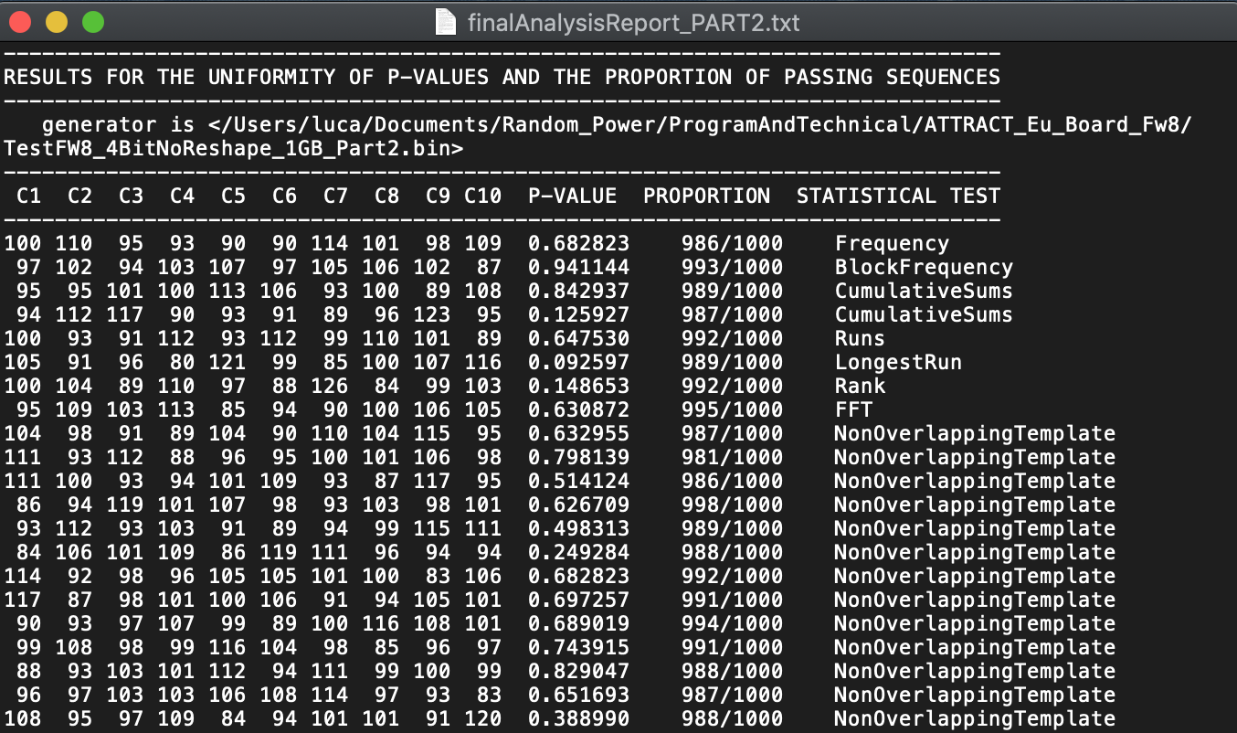
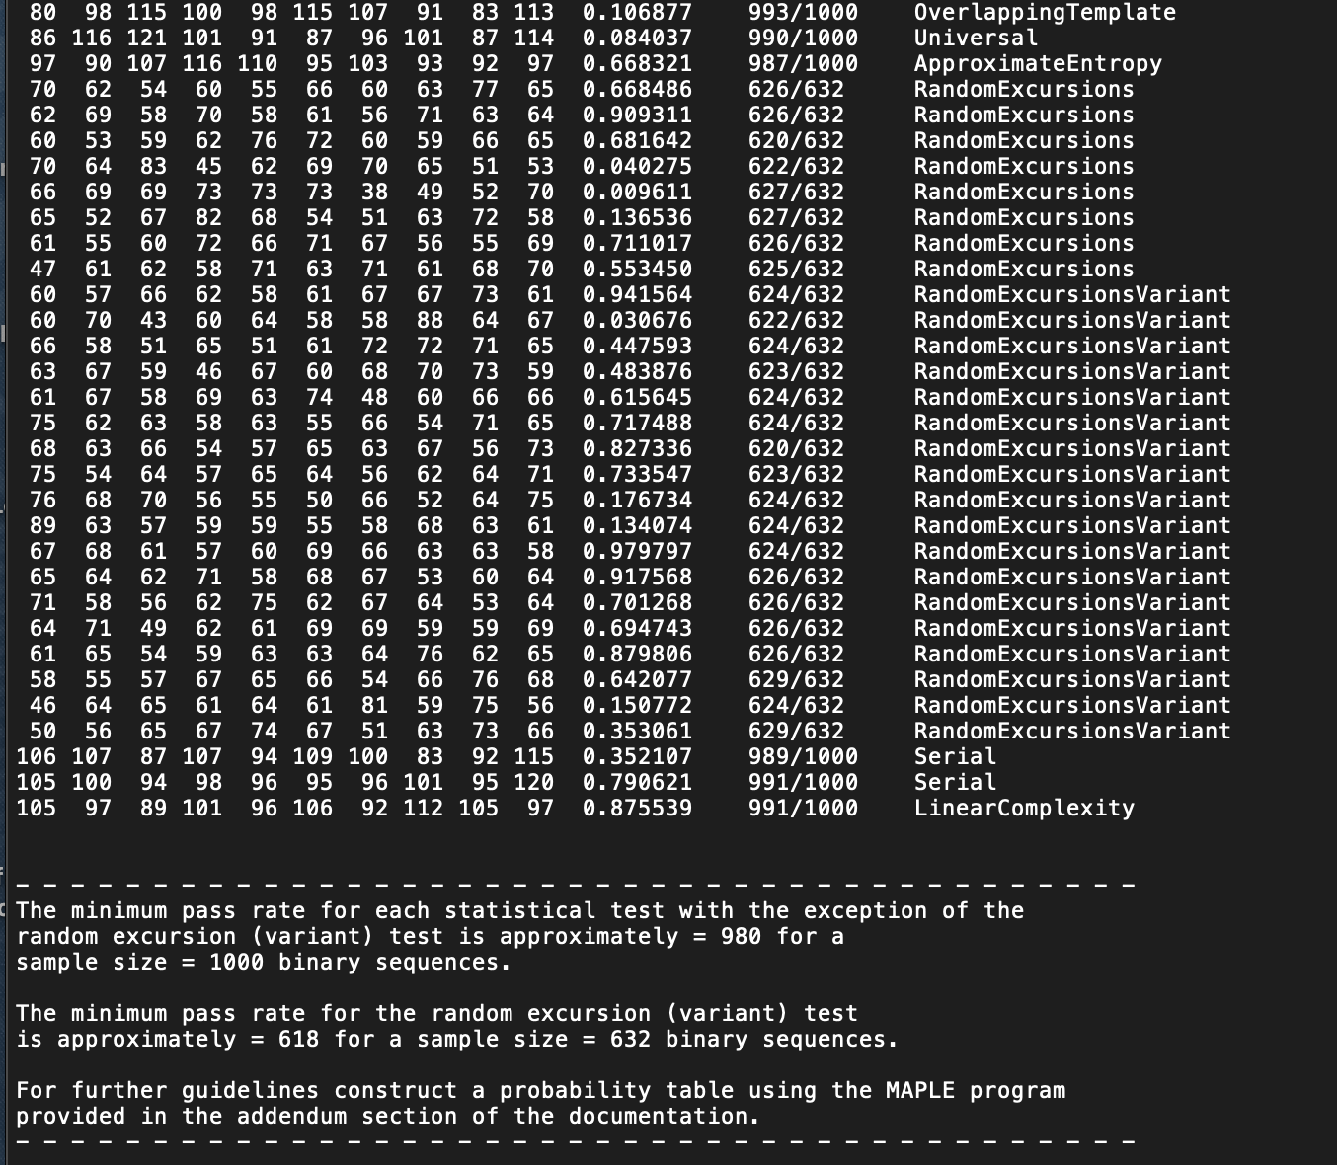
Final tests undertaken (1/2):
randomness qualification through the NIST and TESTU01 suites (1236 tests every 40 Gb):
series of tests on non-overlapping templates
A proto-randomness farm based on 10 boards have been collecting about 1.5 Tb, qualified through the NIST and TESTU01 suites
Results show that the stream looks extremely “white”, essentially with no failures on the raw data beside what can be statistically expected.

Slide 8
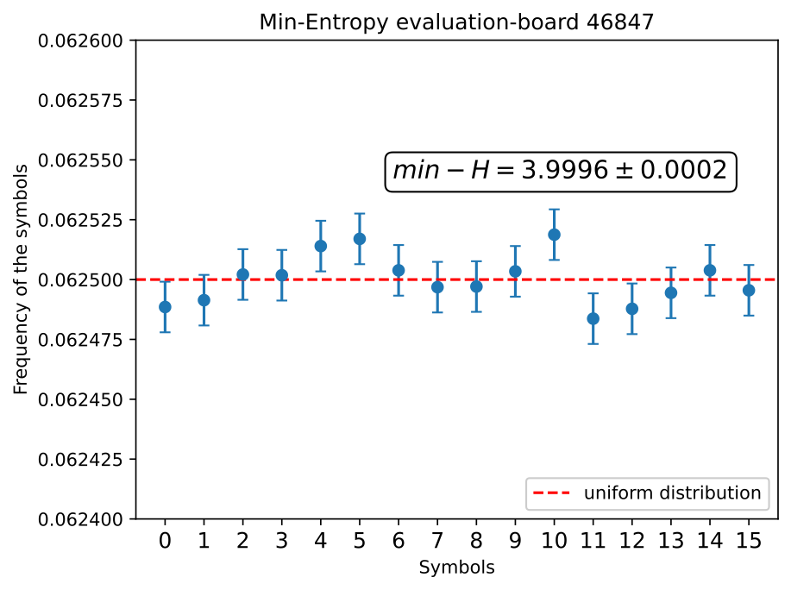
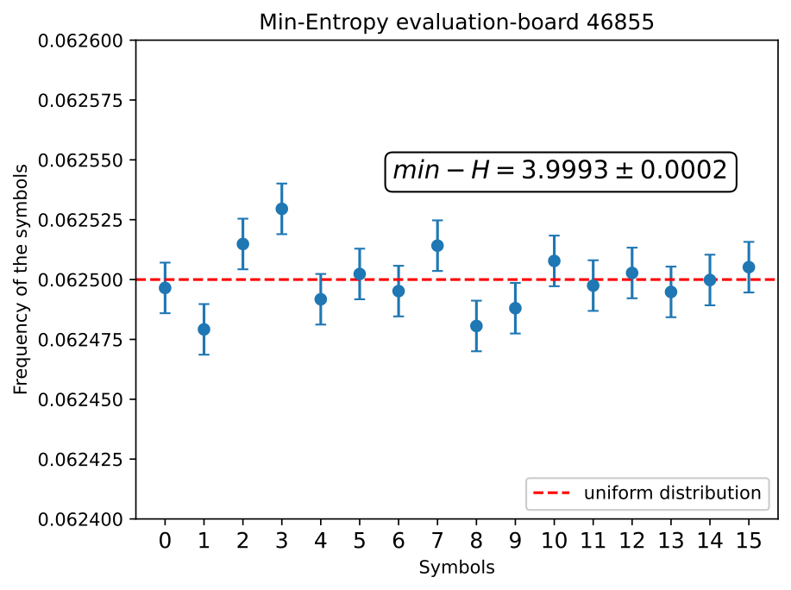

Final tests undertaken (2/2):
measurement of the raw entropy (keep in mind we generate streams of 4 bits)
To our knowledge, the best results worldwide as of today

Slide 9




Commercialization actions taken during ATTRACT
participation to selected trade fairs:
2024
2025
market analysis completed
go-to market strategy finalised
patent granted in Europe, US, Japan, China (still pending in South Korea)
SOLD 3 SINGLE GENERATOR BOARD TO A NATIONAL SECURITY AGENCY
established contacts with a number of potential co-developers and customers
selected for 2 national grants for innovation development (300 kEUR)
started the procedure for a seed investment
2024 & 2025

Slide 10





Commercialization actions foreseen after ATTRACT (or maybe beforehand…)
Closing of a 2 340 000 EUR seed investment
Proceed with the FIPS-140-3 certification (step 1 (Cryptographic Algorithm Validation Program, CAVP) taken already; next in line: Entropy Source Validation (ESV)

Slide 11


Thanks and Questions
This project has received funding from the European Union’s Horizon 2020 research and innovation programme under grant agreement No. 101004462

