Slide 1












ATTRACT Phase 2 Final Review
CERN, May 20-21, 2025
UNICORN Dx
Universal Electrochemical Nanosensors for Next-generation Diagnostics
Pepijn Beekman
ECsens
Consortium:
ECsens (EC), Interfluidics (IF), Johannes Kepler Universität (JK), CNRS (CN), KeySight (KS), University of Twente (UT)

Slide 2

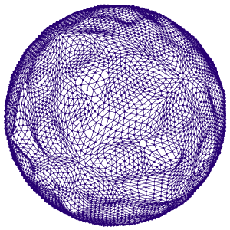
Presentation guidelines (1)
1. Please do not include this slide.
2. Use this font style with a minimum font size of 12.
3. Target for a presentation lasting no more than 20-25 minutes.
4. Slide “Reminder of the initial project objectives”: Please, in this slide, you should remind the reviewing panel about the objectives of your project as you defined them in the originally submitted proposal. Focus on the main objectives. The language should be understandable and simple. For example:
    Our project focused on fabricating a nano sensor for detecting air pollutants such as CO₂.
    The goal to detect them with 2 orders of magnitude more accuracy than existing nano sensors.
    Etc.
It is encouraged to accompany the text with pictures, drawings, etc. No more than 1 slide.
5. Slide “Final Results achieved (1)”: Please, in this slide focus on describing your main achieved results until now. Focus on the results concerning your whole technology and not in performance of components, materials, etc. The language should be understandable and simple. For example:
    The picture 1 shows a prototype of the nano sensor we have fabricated.
    The picture 2 shows how the prototype was tested by placing it in the exterior of a building in Rome.
    Etc.
It is encouraged to accompany the text with pictures, drawings, etc. No more than 1 slide.
6. Slide “Final Results achieved (2)”: Please, in this slide focus on describing your main achieved results regarding the performance of your technology. Focus on the main and most impacting aspects of it with a clear and simple language. For example:
    The graph 1 shows the concentration of CO₂ vs. time that our nano sensor detected when tested in a city.
    The graph 2 shows the minimum concentration of CO₂ that our nano sensor detected when several tests were done in a city.
    Etc.
It is encouraged to accompany the text with pictures, drawings, etc. No more than 1 slide.

Slide 3
Presentation guidelines (2)
1. Please do not include this slide.
2. Use this font style with a minimum font size of 12.
3. Slide “Final Results achieved (3)”: Please, in this slide focus on benchmarking your technology with similar ones existing currently in the market. Focus on those performance figures that are more impactful and clearly qualify and highlight your technology as better. The language should be understandable and simple. For example:
    The table 1 shows a comparison of the minimum CO₂ detected threshold of our nano sensor with the ones currently in the market.
    The table 2 shows a cost comparison of our nano sensor with respect to the ones currently in the market.
    Etc.
It is encouraged to accompany the text with pictures, drawings, etc. No more than 1 slide.
5. Slides “Final tests undertaken (1) and (2)”: Please, in this slides focus on describing the performance tests undertaken with your technology. Focus on those tests that show how your technology performed under as realistic as possible use cases. Do not focus on material science tests, reproducibility tests, etc. The language should be understandable and simple. For example:
    The graph 1 shows the concentration of CO2 vs. time that our nano sensor detected when tested in the cities of Rome, Amsterdam and Paris.
    The graph 2 shows the minimum concentration of CO2 that our nano sensor detected when several tests were done a chemical plant in Barcelona.
    Etc.
It is encouraged to accompany the text with pictures, drawings, etc. No more than 2 slides.

Slide 4
Presentation guidelines (3)
1. Please do not include this slide.
2. Use this font style with a minimum font size of 12.
3. Slide “Commercialization actions taken during ATTRACT”: Please, in this slide you should describe the concrete commercialization actions you have undertaken until now. The language should be understandable and simple. For example:
    The Company X in our project has fabricated 500 pilot units of our nano sensor already delivered to potential clients for testing.
    We have filed 2 International Patents concerning our nano sensor.
    We have passed the regulatory certificates X and Y.
It is encouraged to accompany the text with pictures, drawings, etc. No more than 1 slide.
4. Slide “Commercialization actions foreseen after ATTRACT”: Please, in this you should describe the concrete commercialization actions you have already foreseen after ATTRACT ends. Focus on real foreseen actions and not in “intentions”. The language should be understandable and simple. For example:
    We have elaborated a preliminary business plan for a full commercialization in 2026 including the fabrication of the first 10.000 nano sensors. This estimation is backed up by preliminary agreements with clients A and B.
    The consortium has taken the first steps for the constituency of a start-up company that will fully commercialise our nano sensor in 2027. In concrete, those steps are X, Y, Z.
    Etc.
It is encouraged to accompany the text with pictures, drawings, etc. No more than 1 slide.

Slide 5
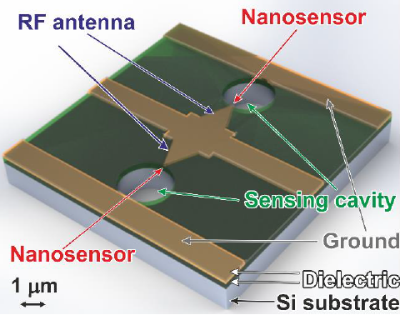
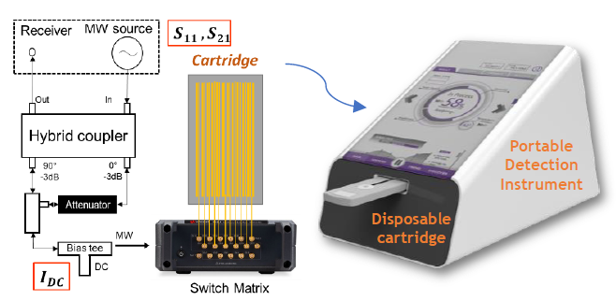
Reminder of the initial project objectives
Antibody selection and integration using SPR
  IF will select the best antibody panel using SPRi and apply it spotting tools for
  multi-target sensing
Develop integrated point-of-care system for pathogen detection
  Combined sensing technology will be integrated with accompanying portable readout instrument (UNICORN system)
Develop multi-modal digital biomarker detection
  Single particle detection (EC+UT) will be combined with GHz Surface Resonance (JK/CN/KS)
Validate system
  UNICORN system will be validated on patient samples
Scale up fabrication, quality control
  Mass producible concept design will be made.
  Quality way of working will be set up.

Slide 6
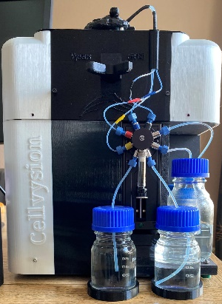
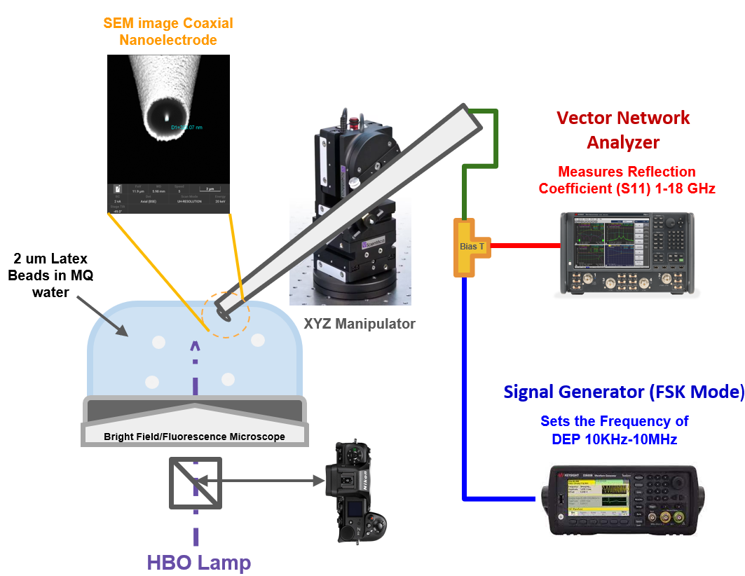
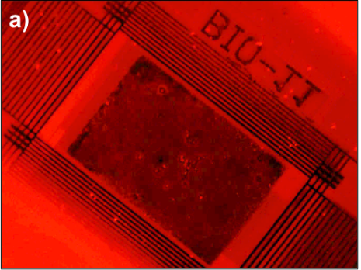
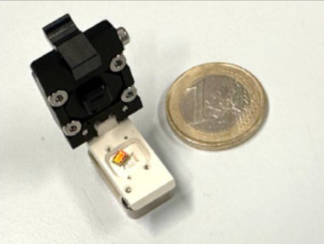
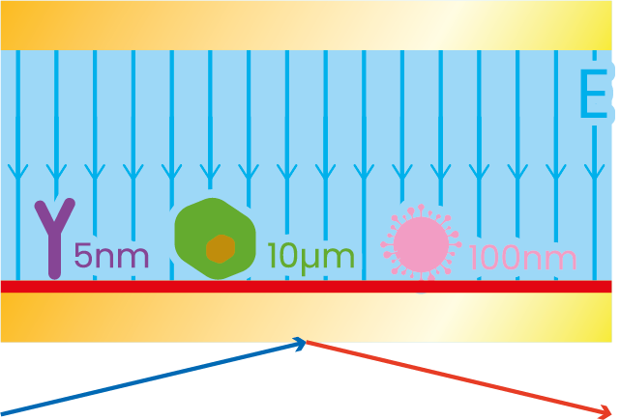
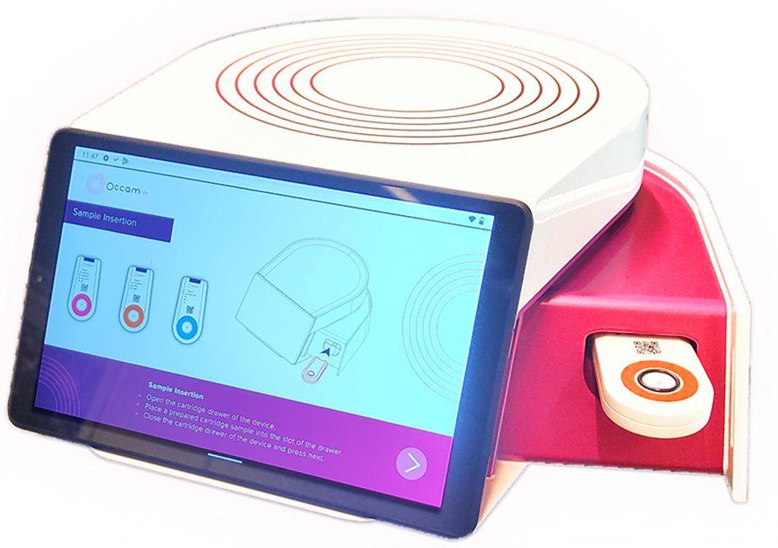
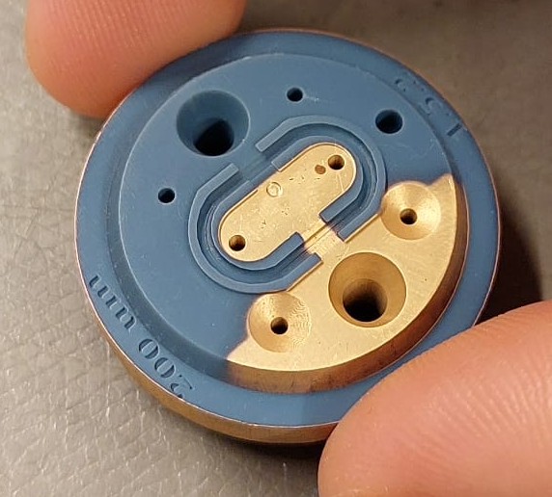
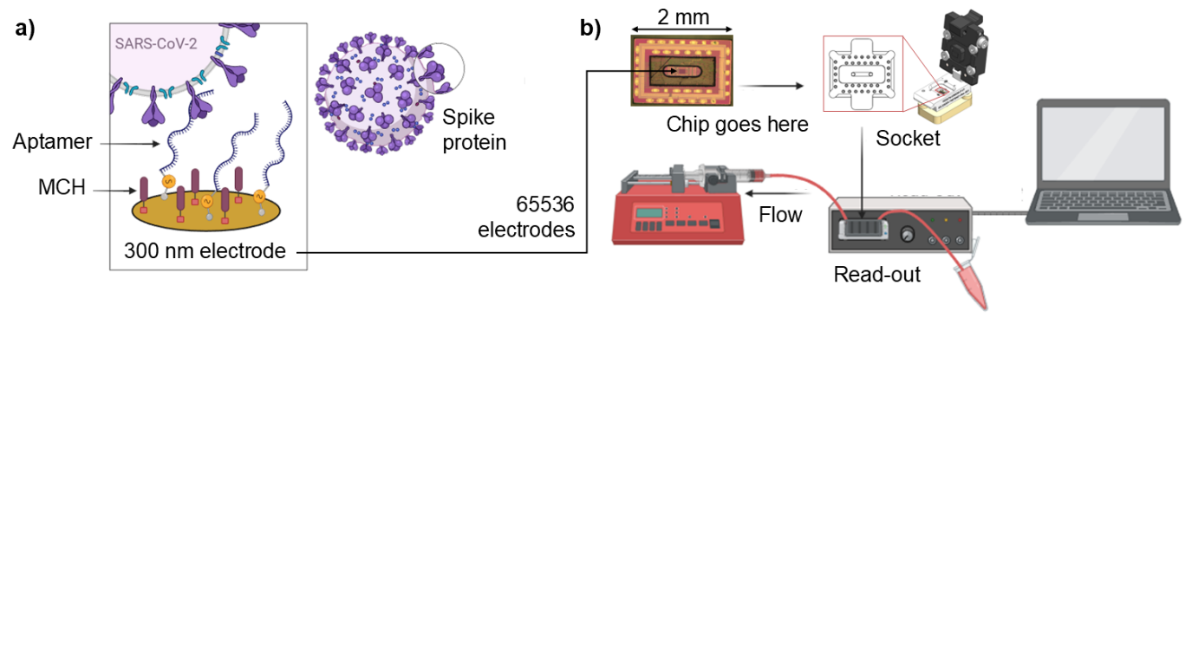
Final Results achieved (1)
Prototypes built and tested of several very different systems (see report)
ESPR: combination of SPR, electrophoresis and single particle detection
Several units built and tested on-site with big biotech users
New analytical modes available to test affinity
  First ever platform to give this type of information (pharma, bio research)
Enhance mass transport to improve throughput by 10³ – 10⁶
Demonstrated ultrafast particle manipulation
and detection

Slide 7
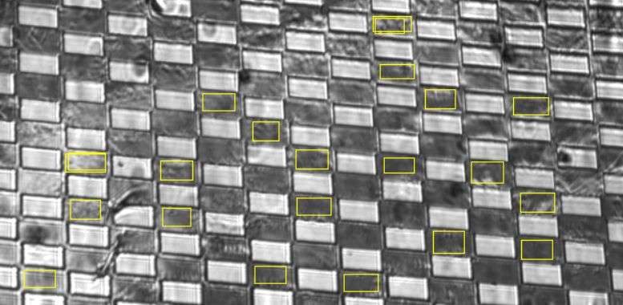
Final Results achieved (2)
Report: highly parallel molecule + single SARS-CoV-2 virion detection
with CMOS sensor
Report: single particle detection with scanning capacitance microscopy
5mm² sensing area where “every pixel is a sensor”
Particles migrate to sensor in <2s
Repeated attraction/repulsion
  → advanced analysis techniques
Individual cell detection
Extracellular vesicle detection
  limit of detection 10/ul
  can be enhanced with optics

Slide 8
Final Results achieved (3)
Alternative (but different) high-end platforms:
Luminex: leading multiplexing cytometry platform.
+ Can do multiplex molecular assays on homogeneous samples.
- Does not do multimodal analysis.
BioMérieux: PCR platforms for diagnostics.
+ Excellent molecular analysis
- Does not detect individual pathogen particles
Cepheid: leading point-of-care PCR platforms
+ Wide portfolio of panel tests
- Does not measure molecules and pathogens in one test
Cytiva: leading SPR developer
+ Very sensitive characterization of biomolecular interactions
- It would take hours to find a pathogen in a sample (slow diffusion)

Slide 9
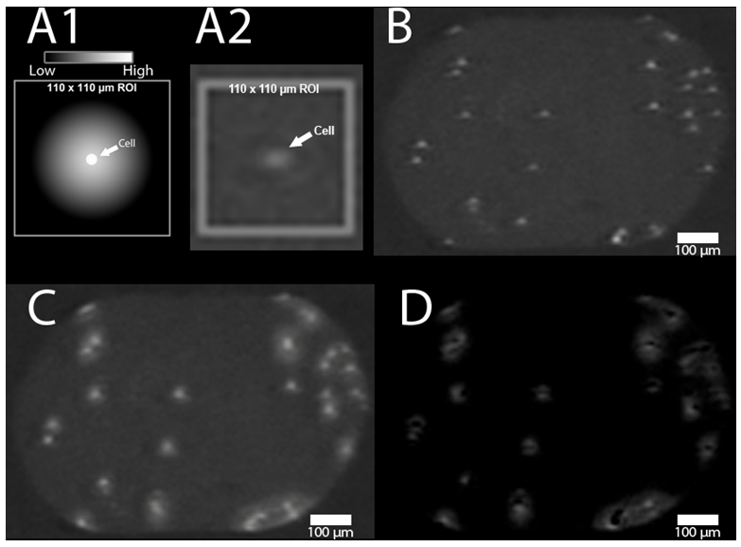
Final tests undertaken (1)
Tested with:
  Polystyrene beads
  Cells
    individual specific cell detection
    Information on binding kinetics!
  Extracellular vesicles
    Limit of detection 10/ul
    Specific detection
    Information on binding kinetics!
  Molecules
    limit of detection comparable to Cytiva
    + “tipping point” shows critical density for binding
      polymers
      enzymes
      antigens
      antibodies

Slide 10
Commercialization actions taken during ATTRACT
Product development concept phase: readout instrument and cartridge Ecsens
Scanning probe patent pending
Incorporation of Vysens B.V.
3 patents pending
2 patents after negotiations
Demo’s at Sanquin, Innatoss and pharma companies
Redefined business plan: license platform to assay developers

Slide 11
Commercialization actions foreseen after ATTRACT
3.5 M€ project ECsens + Vysens + UTwente + Innatoss
50% public, 50% private
ECsens: electrophoresis module, ESPR chips
Vysens: SPR instrument
UTwente: coating
Innatoss: Lyme disease validation
Strategy:
  Innatoss launching customer: validate their assay using selected antibodies on our ESPR platform
  User has implementation expertise, takes implementation liability

Slide 12


Thank and Questions
This project has received funding from the European Union’s Horizon 2020 research and innovation programme under grant agreement No. 101004462

