Slide 1











ATTRACT Phase 2 Final Review
CERN, May 20-21, 2025
HYGER
Highly efficient IR detection unit based on high-purity black germanium technology
Hele Savin
Aalto University (Finland)
Baltic Scientific Instruments Ltd. (Latvia)
Umicore Inc. (Belgium)

Slide 2


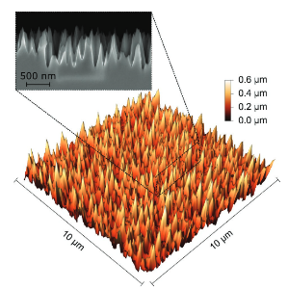
Reminder of the initial project objectives
Demonstrate superior SWIR photoresponse in commercially exploitable products
  Wavelength of interest: SWIR (1.1 µm – 1.8 µm) and low energy X-rays.
  Performance indicators to go beyond s-o-t-a: Responsivity and leakage current.
Utilise ATTRACT phase-1 material-level discoveries on germanium substrates
  (1) Nanostructured coating for antireflection
  (2) Dopant-free charge collecting junction
Integrate the above into two P-O-C devices
  photodiode chips, operation at RT
  complete high-purity Ge detector module, operation at LN temperature (~ 77K)
Understanding the overall business models and market potential of SWIR Ge detectors
Inversion
n-Ge
−
−
−
−
−
E_{c}
−
−
E_{F}
−
−
+
+
E_{v}
Al₂O₃
−
+
+
+
+
+
+

Slide 3
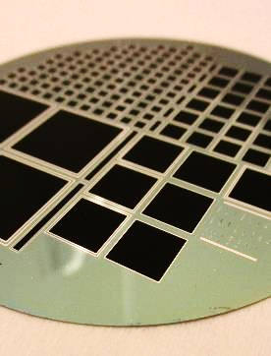
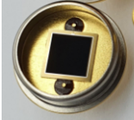
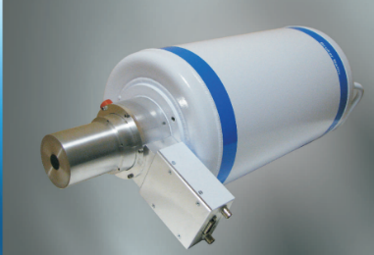
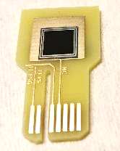
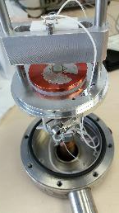
Final Results achieved (1)
Pictures of the prototype of the NIR sensor chip that we have fabricated targeted to work at RT
Picture below shows how the prototype was tested by placing it in the interior of the high-purity Ge detector module, targeted to operate at LN temperature (~ 77K)

Slide 4
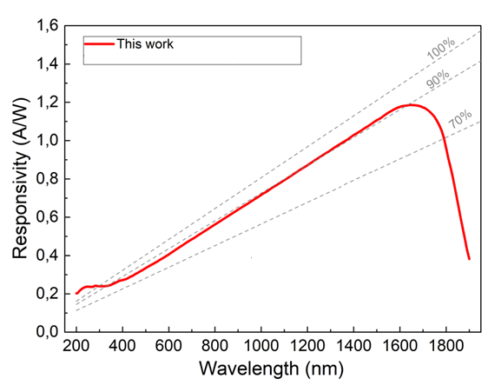
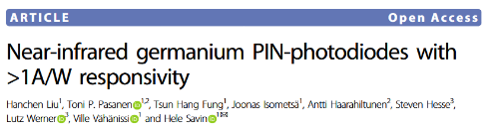
Final Results achieved (2)
Photodiodes with photoresponse exceeding s-o-t-a at 0.2 – 1.8 µm (with zero bias)
Record-low dark current for Ge photodiodes at RT, 76 µA/cm2 measured at a reverse bias of 5 V
4 x Journal articles (all published), including Nature LSA
quantum efficiency

Slide 5
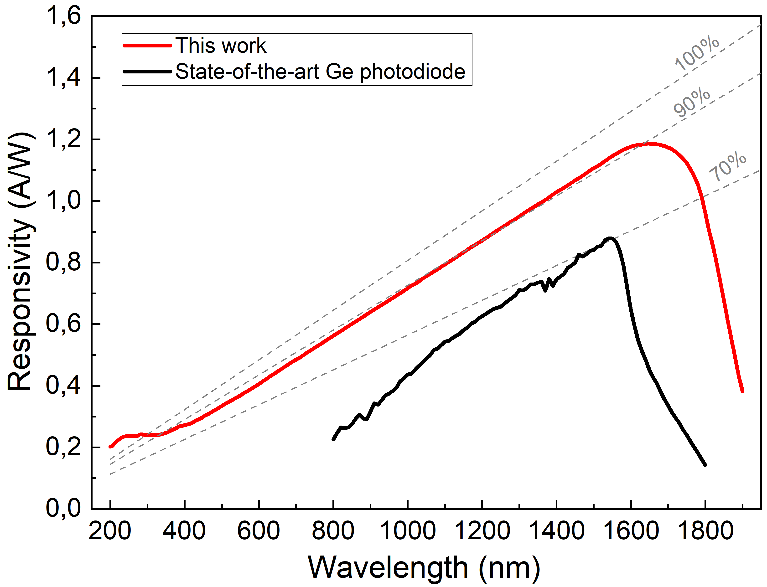
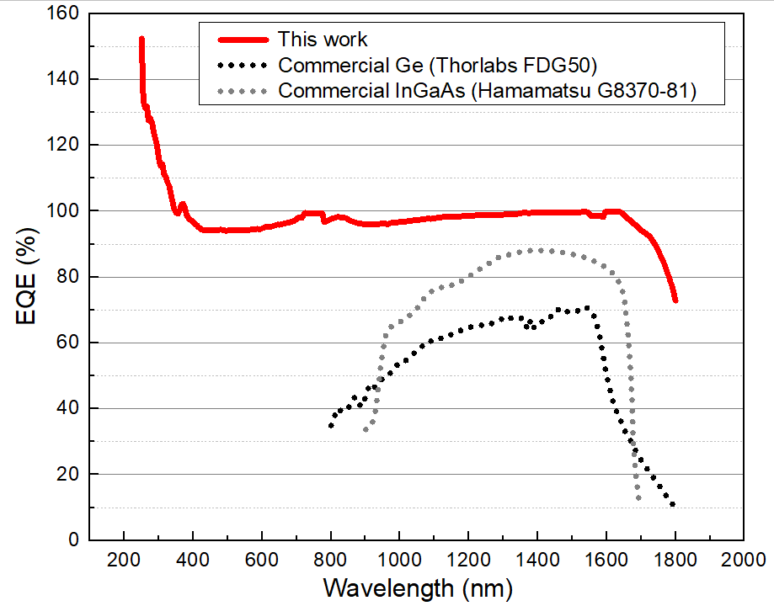
Final Results achieved (3)
quantum efficiency

Slide 6
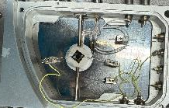
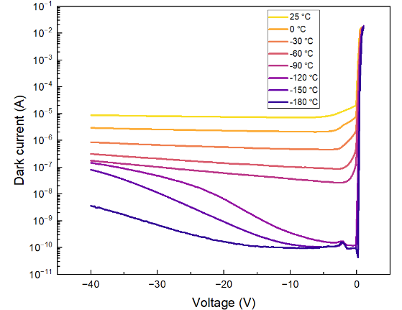
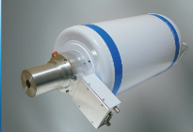
Final tests undertaken (1)
IR spectroscopy requires high voltages and low temperature
X
Inverted p⁺ layer
b-Ge
Al₂O₃
Al
n-Ge
p⁺-Ge
n⁺-Ge
SiO₂

Slide 7
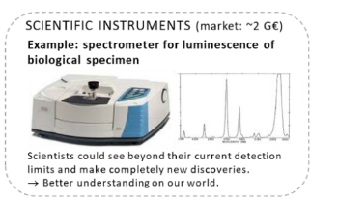
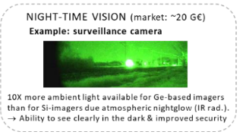
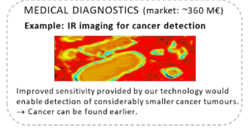
Commercialization actions taken during ATTRACT
Technology is already patented in several countries
BSI has integrated our b-Ge photodiode into their existing products. They have already existing customers bringing the product directly to the market.
Compatibility tests with foundries for mass-production of chips (in collaboration with ElFys)
Several companies have directly approached us for their interest in HYGER technology and various feasibility tests have been carried out.

Slide 8





Commercialization actions foreseen after ATTRACT
ElFys Inc. is close to launch the commercial product “Product development is already moving along, and we expect to release our first germanium IR sensors during 2025,” says CEO Mikko Juntunen.
NIR spectroscopy for astronomers (ESO), a new value chain formed, project funding applied together
LASER COMPONENTS Nordic AB interested to combine HYGER detectors with their products and into their customers’ products (performance driven, not cost driven applications)
NIR CMOS cameras, ESA funding applied with companies

Slide 9


Thank and Questions
This project has received funding from the European Union’s Horizon 2020 research and innovation programme under grant agreement No. 101004462

