Slide 1












ATTRACT Phase 2 Final Review
CERN, May 20-21, 2025
HIPMED
Hyperspectral Imaging for Precision MEdicine in cancer Diagnostics
Boaz Brill
PentaOmix
Consortium members: Technion, Sheba, Ben-Gurion U., PentaOmix

Slide 2

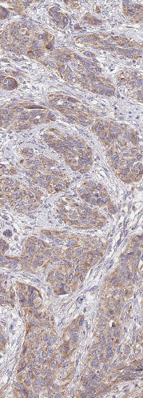
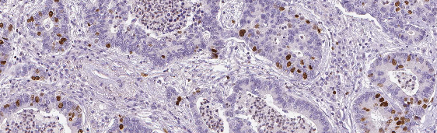


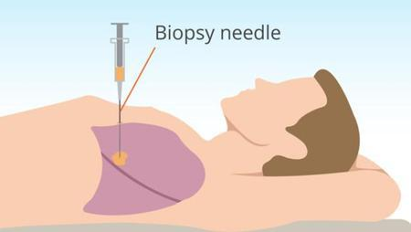
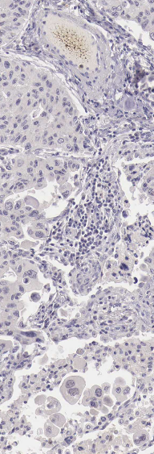

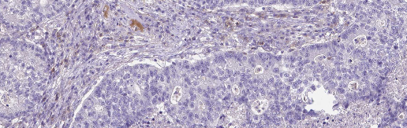
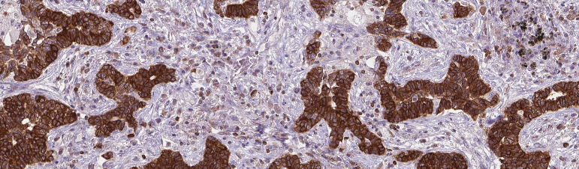
Current Cancer Diagnosis: One marker per slide
Different tissue sections for each marker
Standard IHC
Diagnosis Report
Biopsy

Slide 3
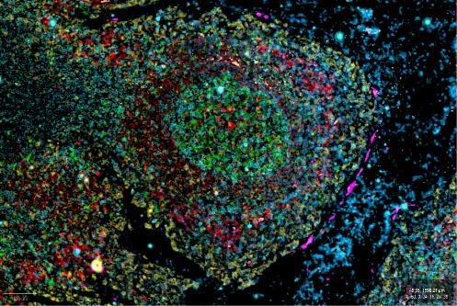

Future: Multiplex Imaging
All the required markers are on the same tissue section
Diagnosis Report
Biopsy
Multiplex IHC
Decision support
AI
Benefits of multiplex IHC for clinical use:
Preserving Precious Tissue
Better diagnosis – considering the tissue microenvironment
Faster time to treatment
Reduced workload
AI-based decision support tools

Slide 4
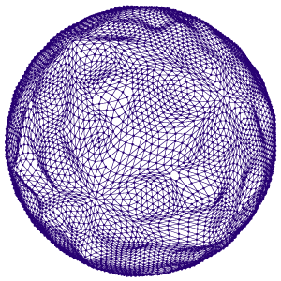
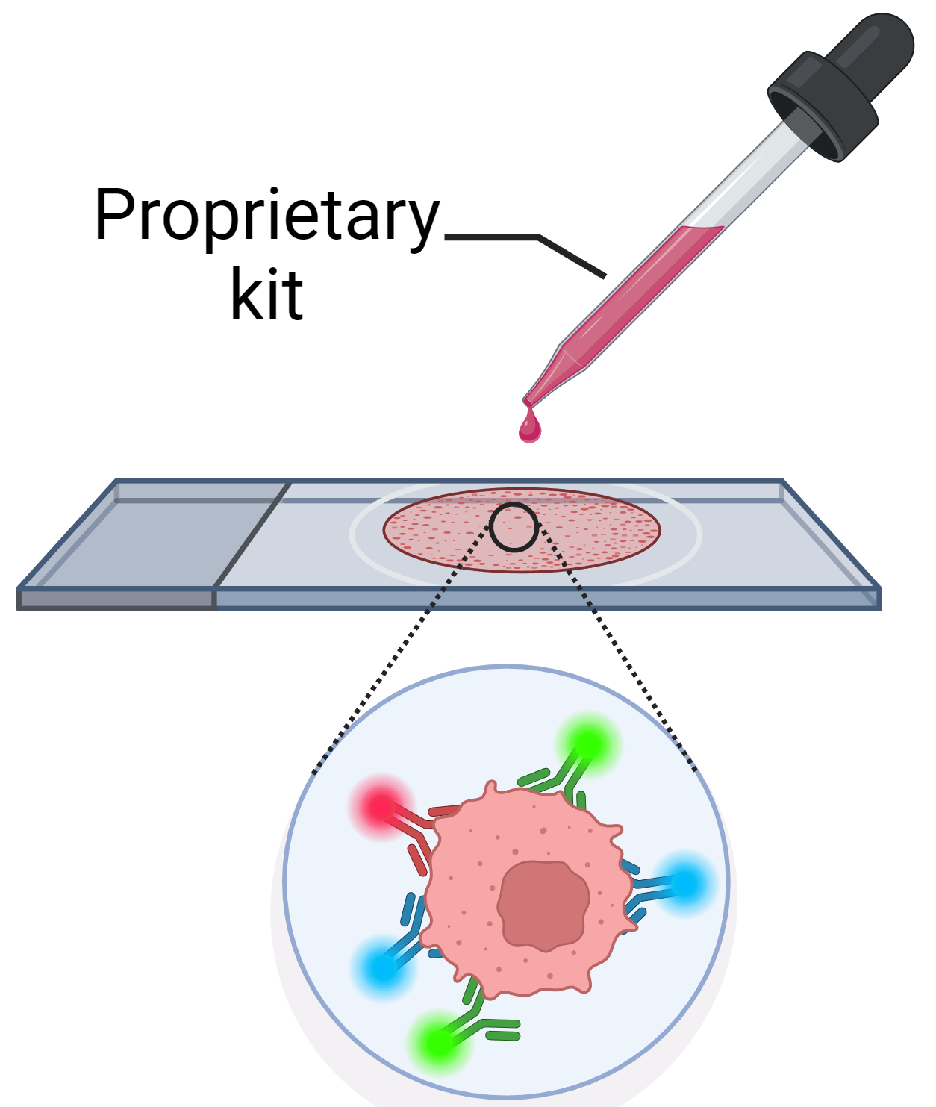

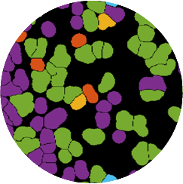
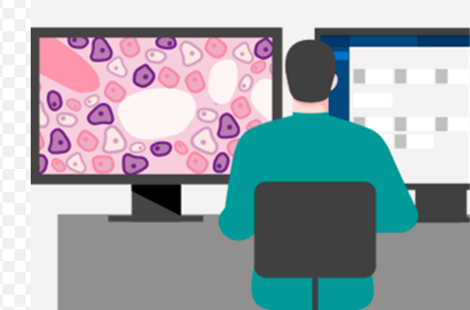



Reminder of the initial project objectives
Our System:
Staining Panels
HyperSpectral
Scanner
Image Analysis Algorithms (AI)
Viewing Tool
B-Cell
T-Cell
Cancer Cell
Stromal Cell
Proprietary staining kits, each tailored for a specific cancer type
An innovative fast hyperspectral scanner, enabling to scan up to 15 markers (colors) in one scan
Decision support tools helping the pathologist.
Project Objectives:
Develop a hyperspectral imaging scanner
Demonstrate the clinical value of the system for relevant applications
Develop advanced algorithms supporting better functionality and decision support tools

Slide 5
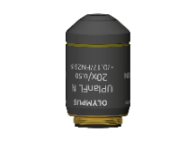
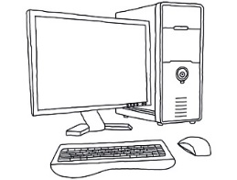
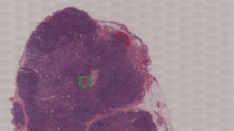
Our Technology
Fast HyperSpectral Imaging
Fluorescent tag
In the staining panel, each antibody is attached to a unique fluorescent color
Antibody
Protein
Cell
Our hyper-spectral scanner measures the full emission spectrum at each point, enabling the extraction of the intensity of each color (spectral peak).
CD3 CD4 Ki67 CD8 PD-L1 CD20
Our proprietary optics and algorithms allow the
extraction of the full spectrum using a computational
method (FFT), without using any filter!
  Fast
  Flexible
  Reliable
  Affordable -
Scanning
Proprietary optics
Camera
Processing

Slide 6
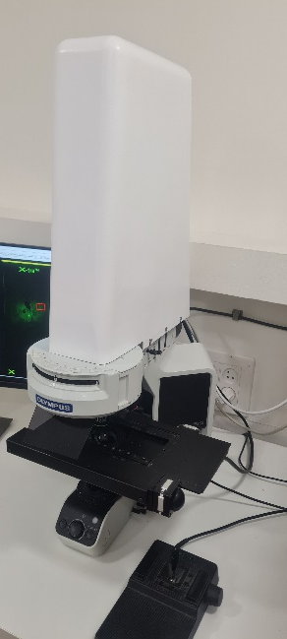
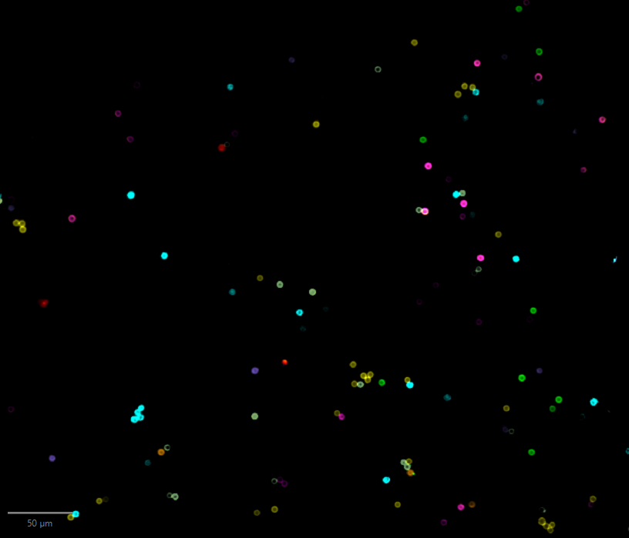
Final Results achieved (1) – Scanner Technology PoC
A working prototype of the hyperspectral scanner has been developed, including:
  Innovative new optics )incl. a patent pending monolithic interferometer)
  Signal processing, calibrations algorithms, operation software,…
PoC of the technology

Slide 7
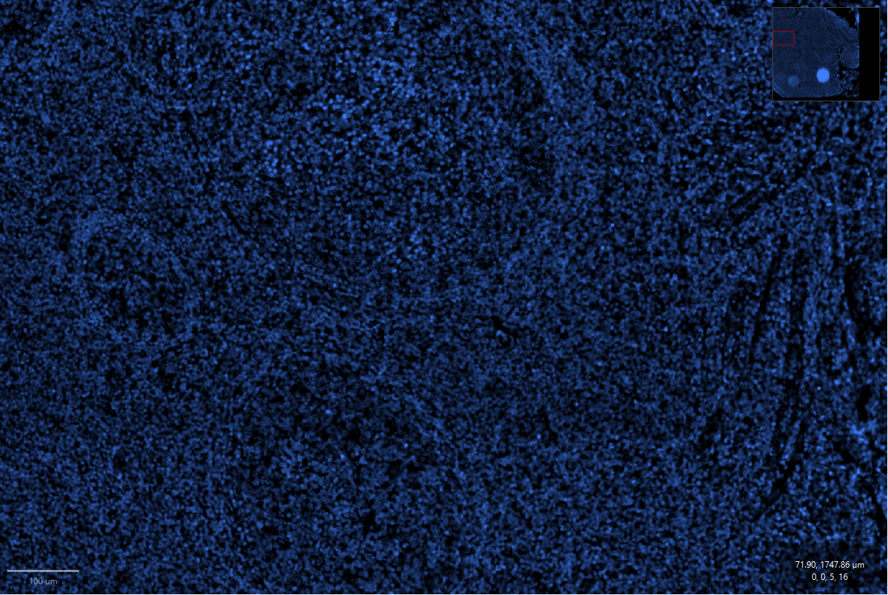
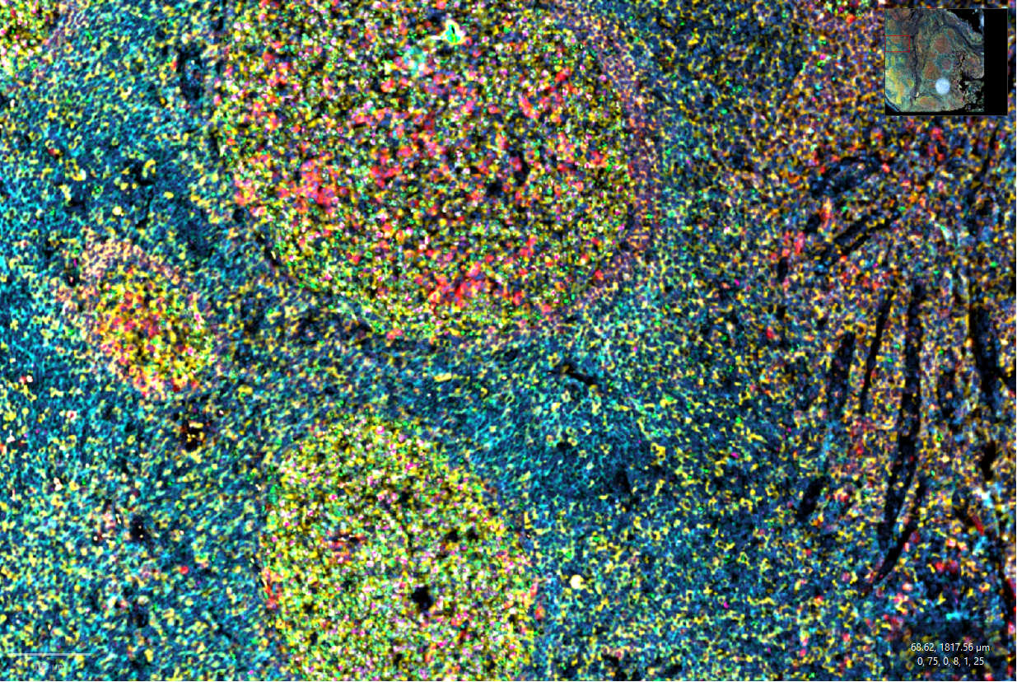
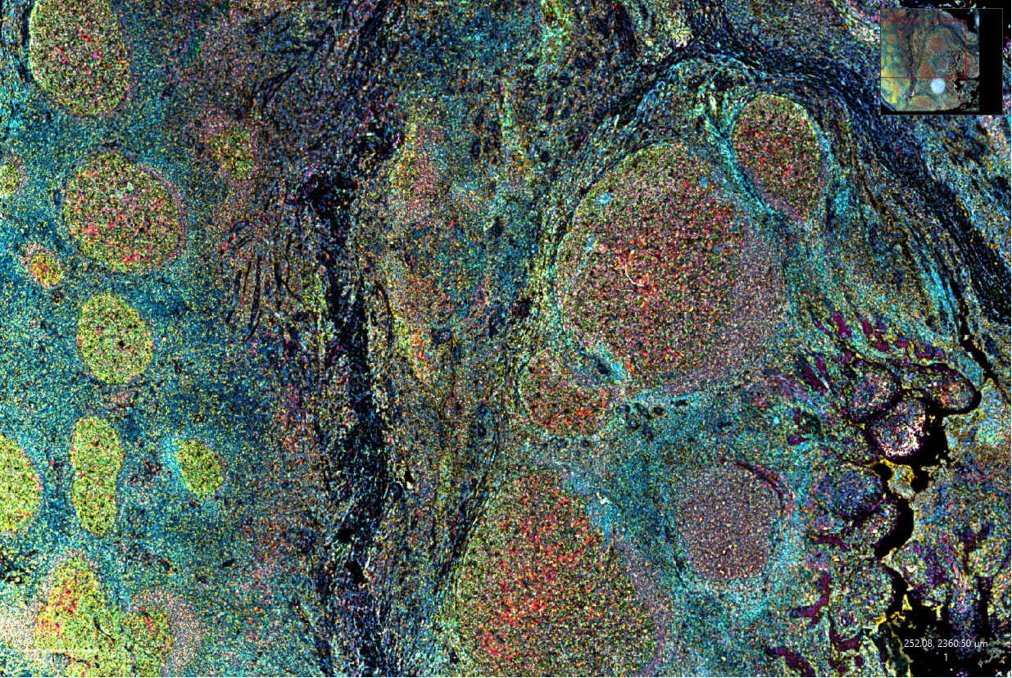
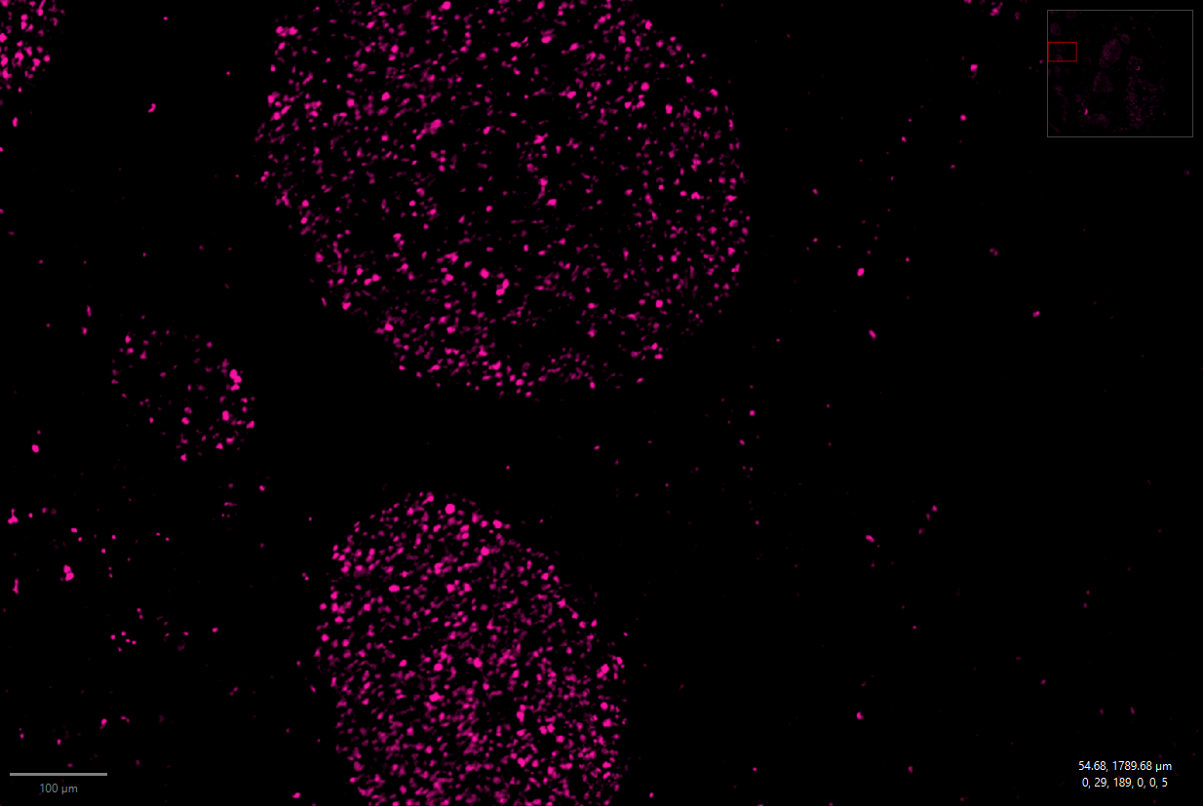
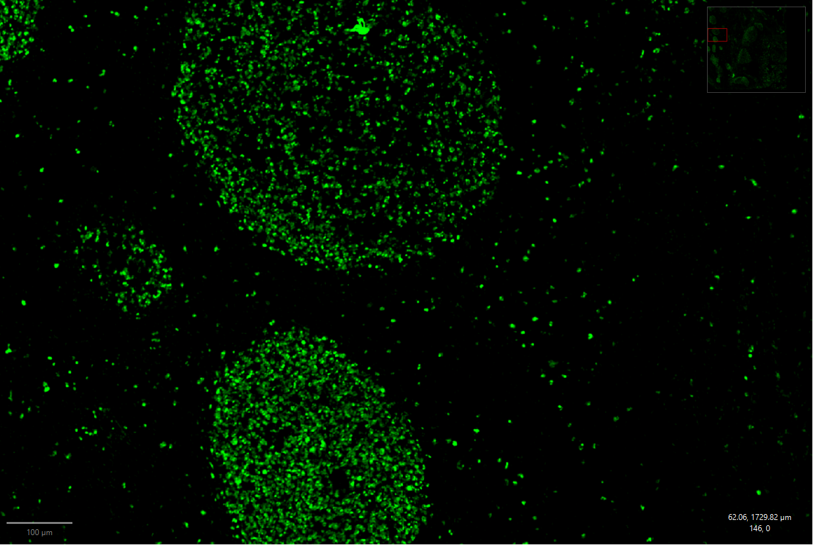
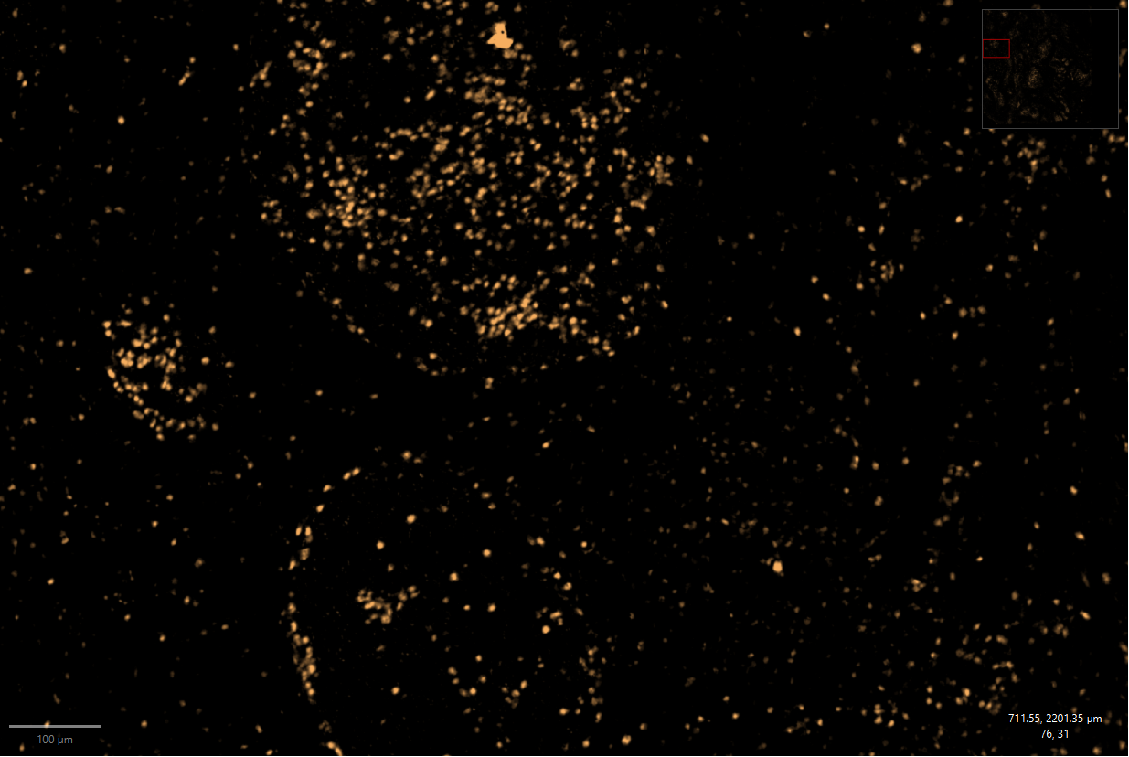
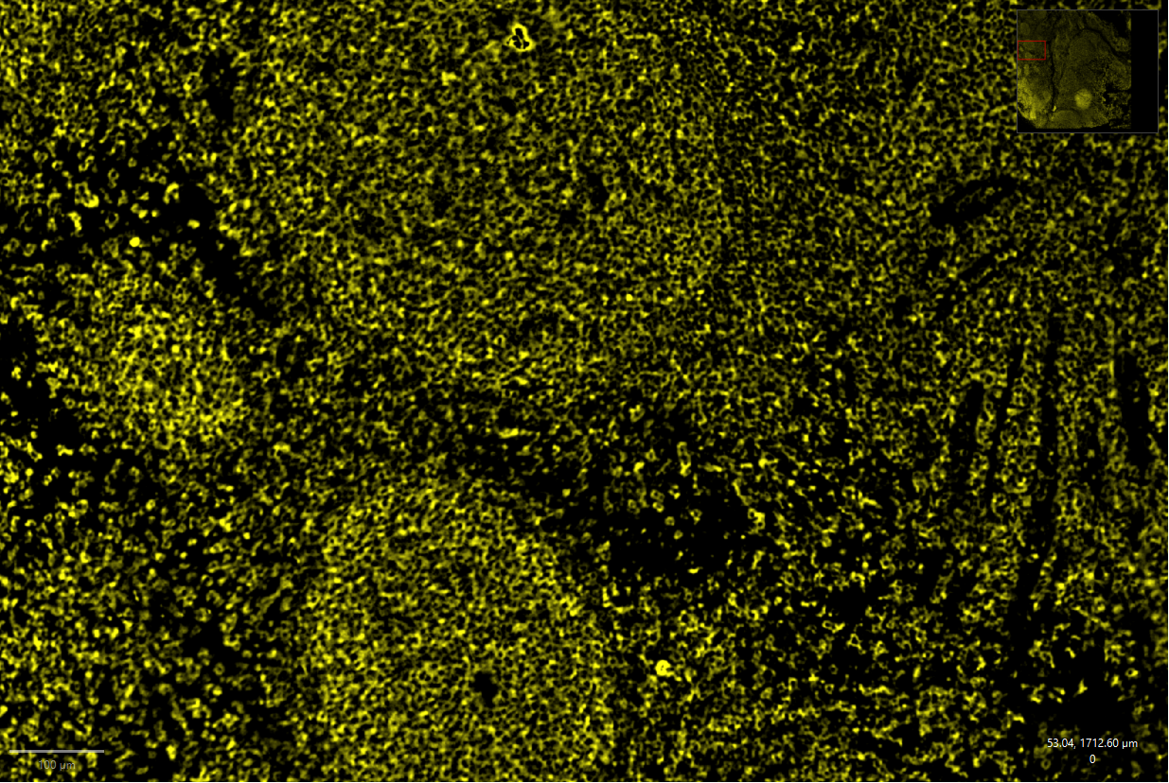
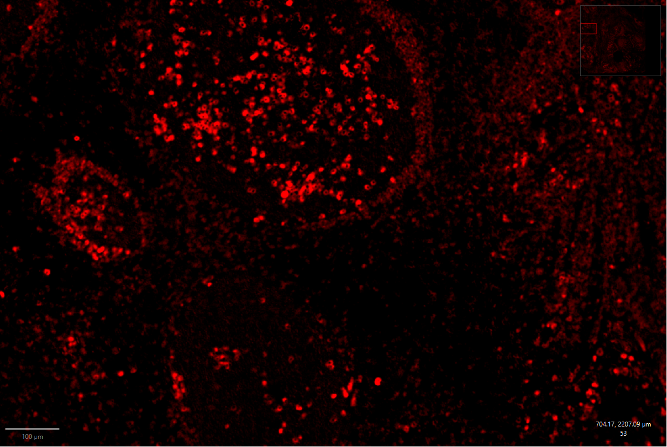
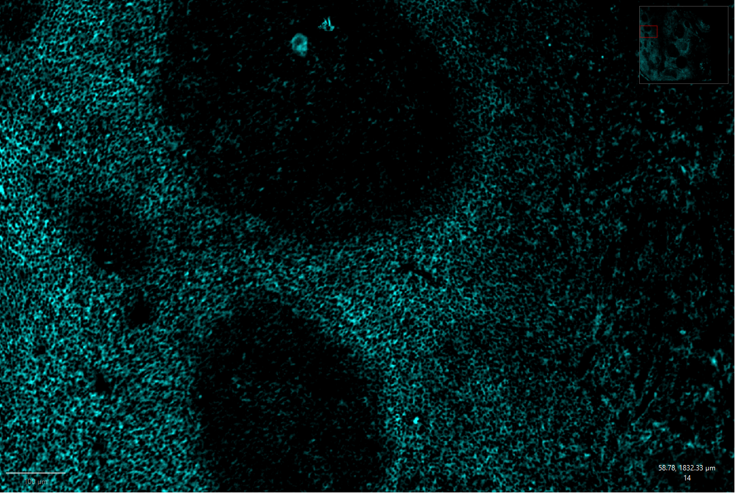
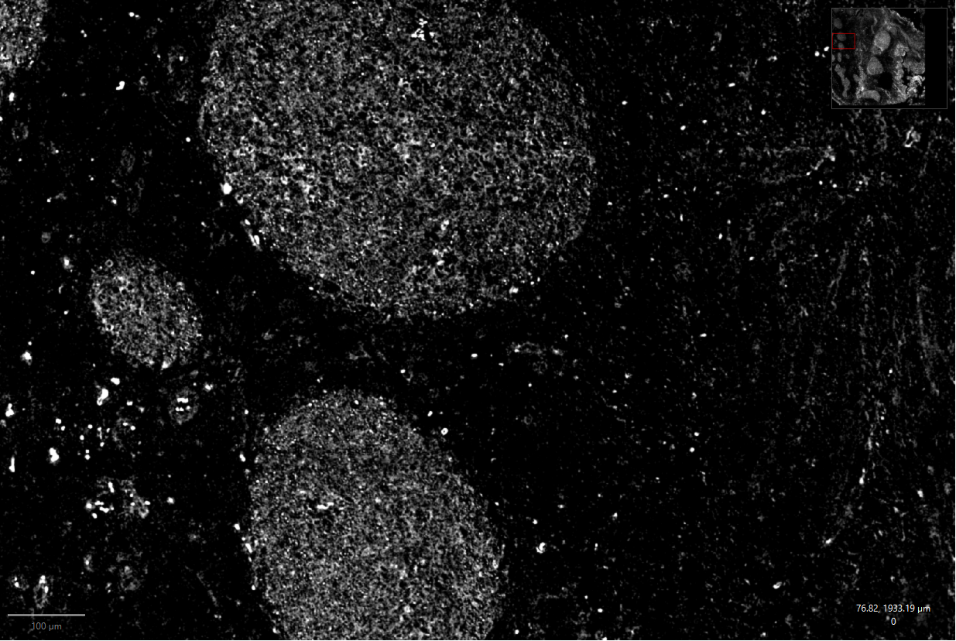
Final Results achieved (2) – PoC on relevant samples
Nuclear
BCL6
Ki67
MUM1
CD20
CD79a
CD3
CD10

Slide 8
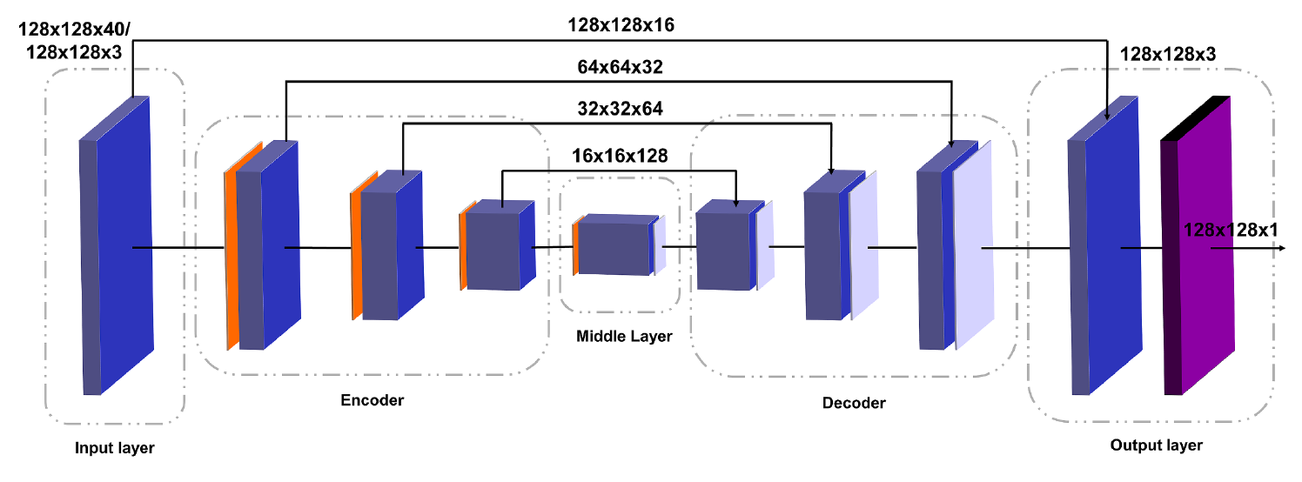
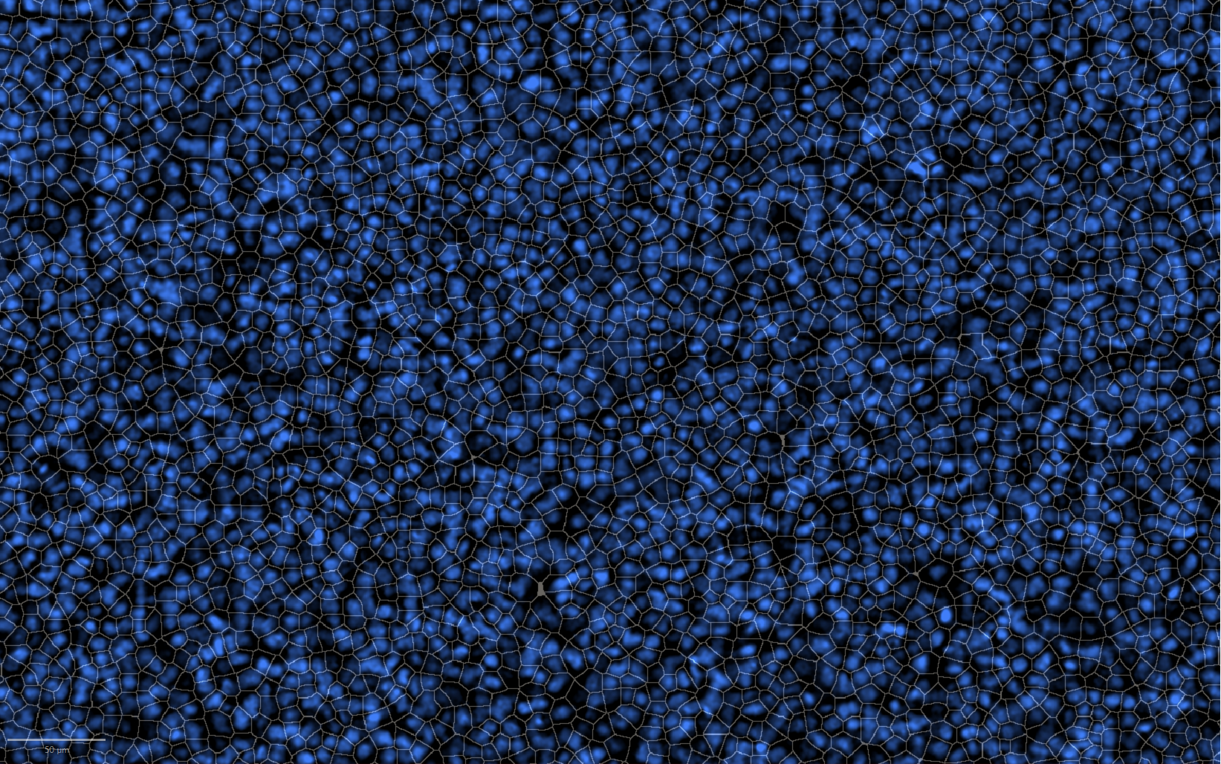
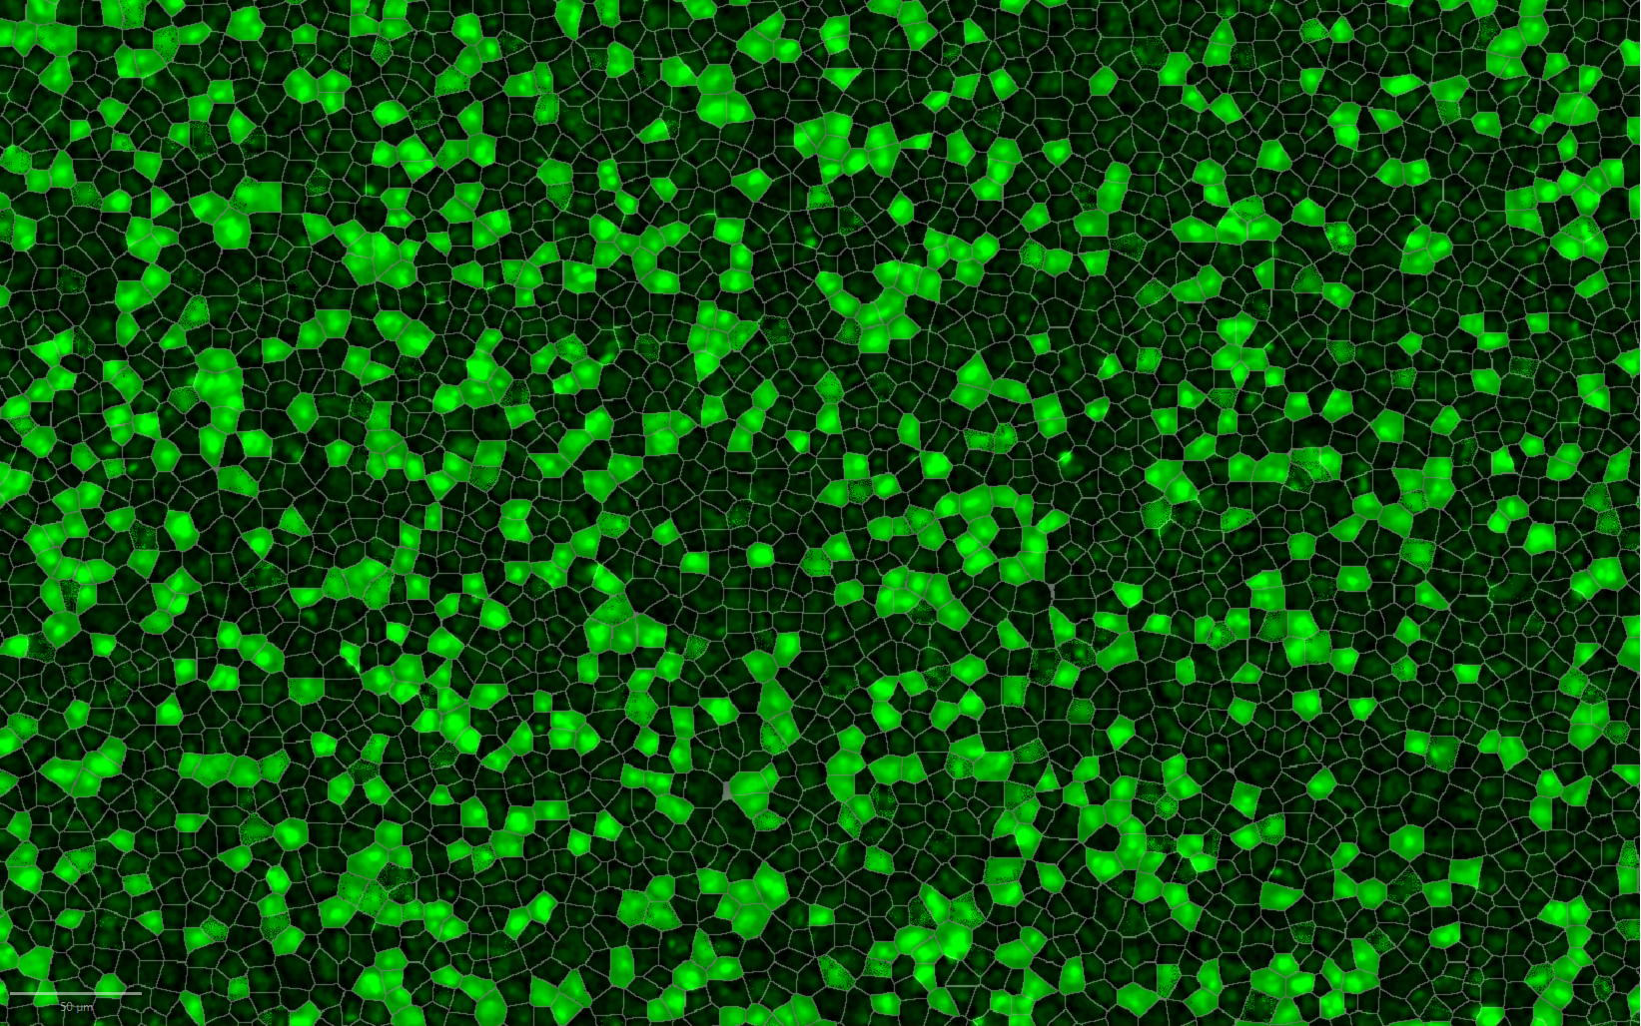
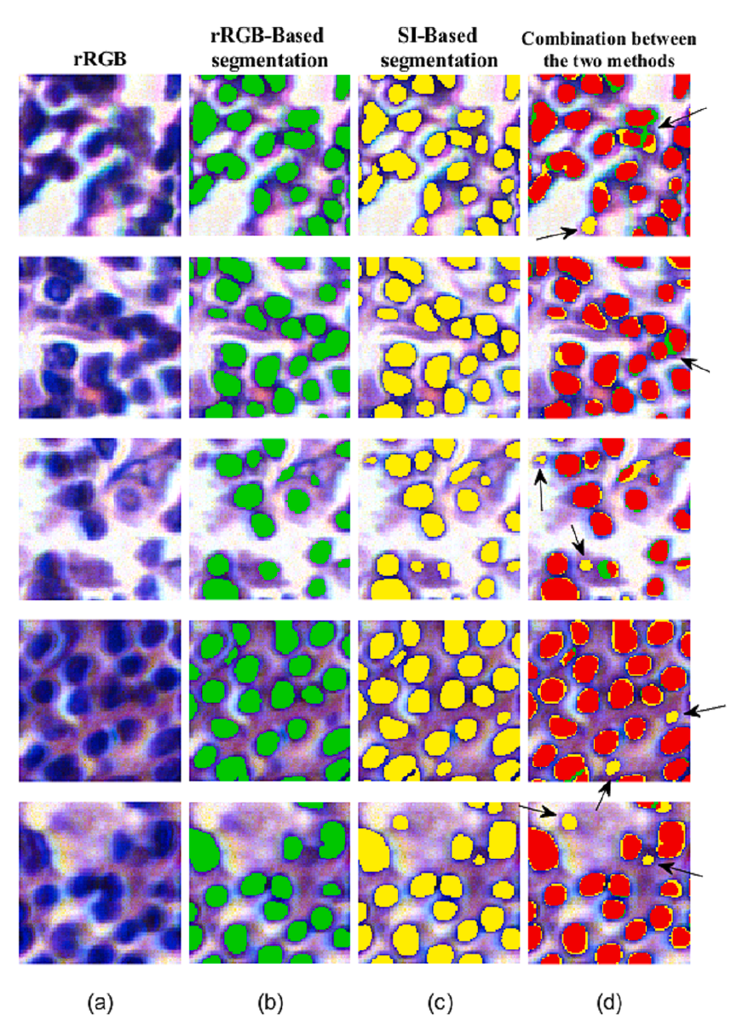
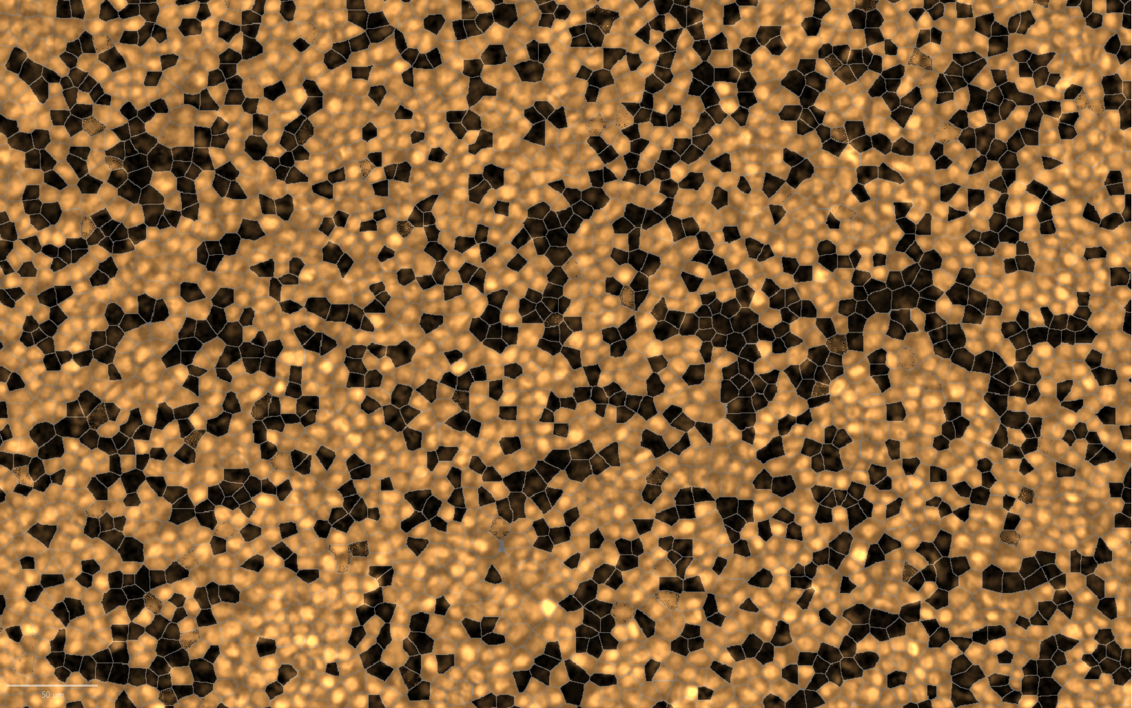
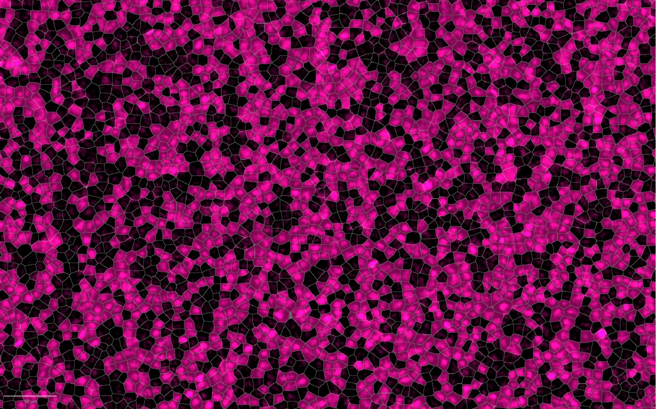
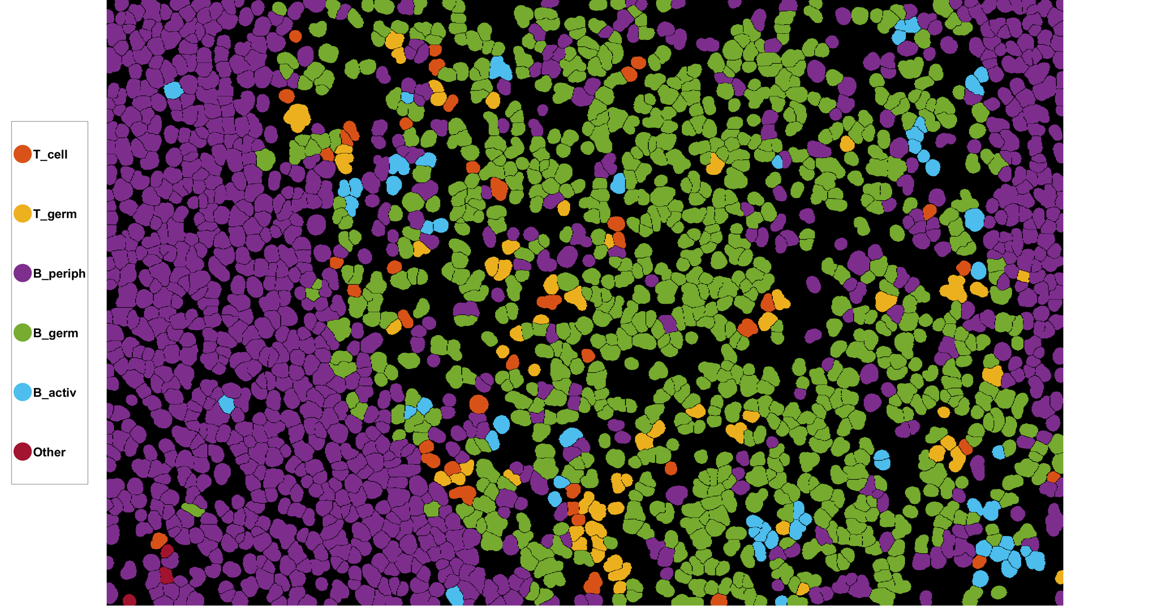
Final Results achieved (3) – Algorithms
Image analysis :
  Using raw spectral data (Technion):
    Nuclei segmentation
  Using unmixed (final) images (PentaOmix):
    Cell counting
    Cell classification
Compressive Sensing (Ben-Gurion):
  Deep learning techniques used to optimize the sensing process and the reconstruction algorithm
Nuclear
Ki67 33%
MUM1 60%
BCL6 52%

Slide 9
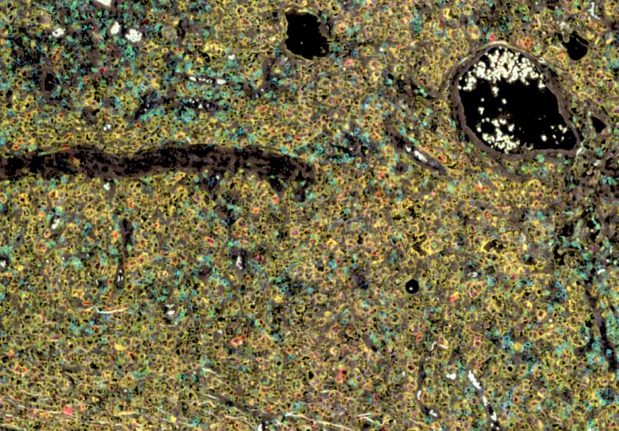
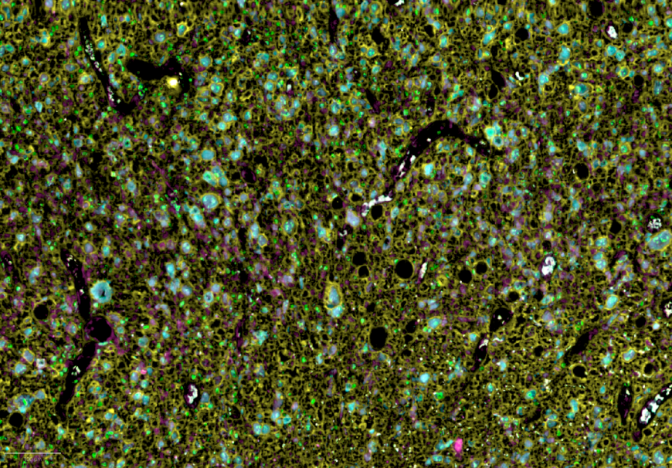

Final tests undertaken (1) – Lymphoma Clinical Study
Ki67
Ki67
Study Design:
Goal: diagnose diffuse large B-cell lymphoma (DLBCL)
N=30
8 markers:
Ki67, CD3, CD10, CD20, CD79a, BCL6, MUM1, Nuclear
Results: diagnosis is compatible to standard IHC reference in 100% of cases.
Publication: USCAP 2024 conf.
CD3
BCL6
CD20
CD20
CD79a
MUM1
MUM1
AutoFl
Cancer B-cells
Normal B-cells

Slide 10
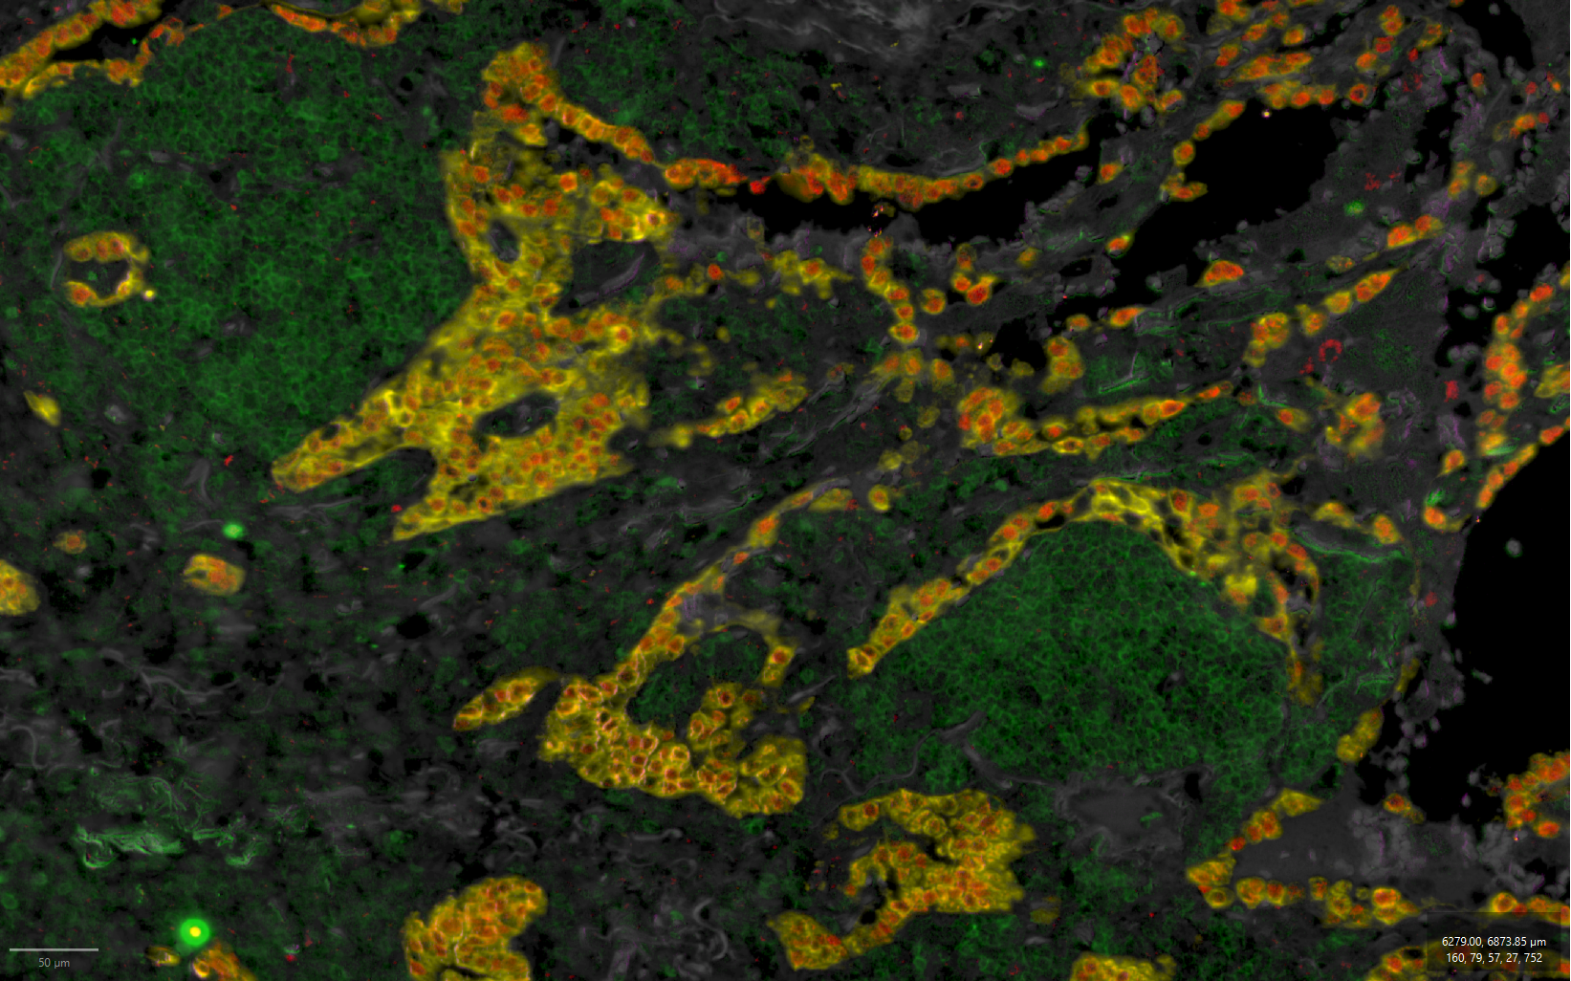
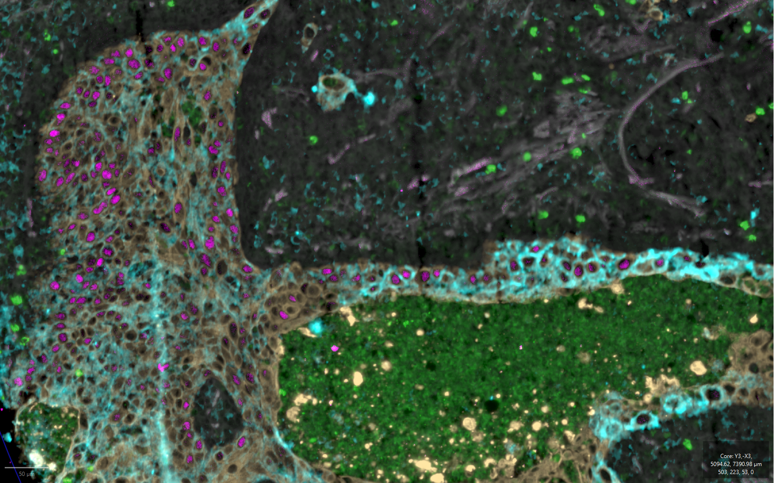
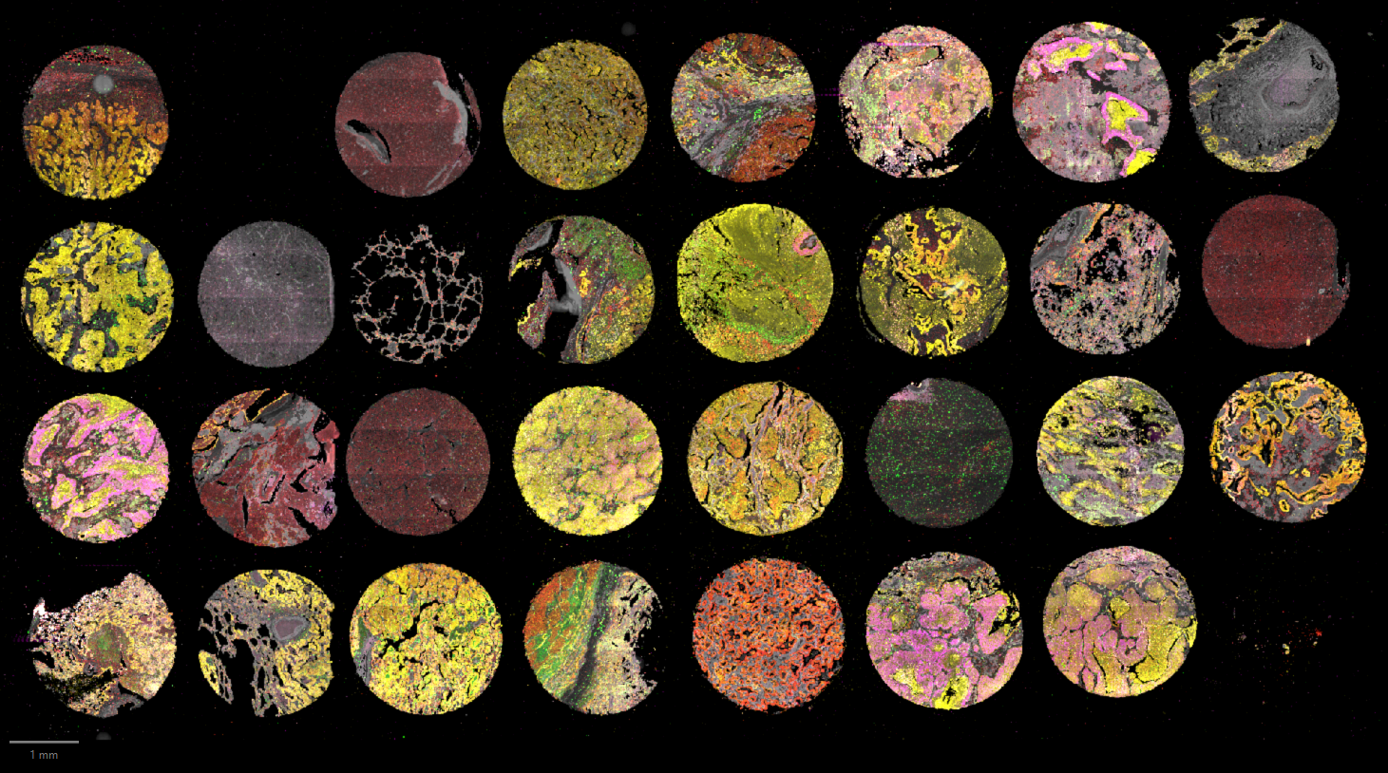
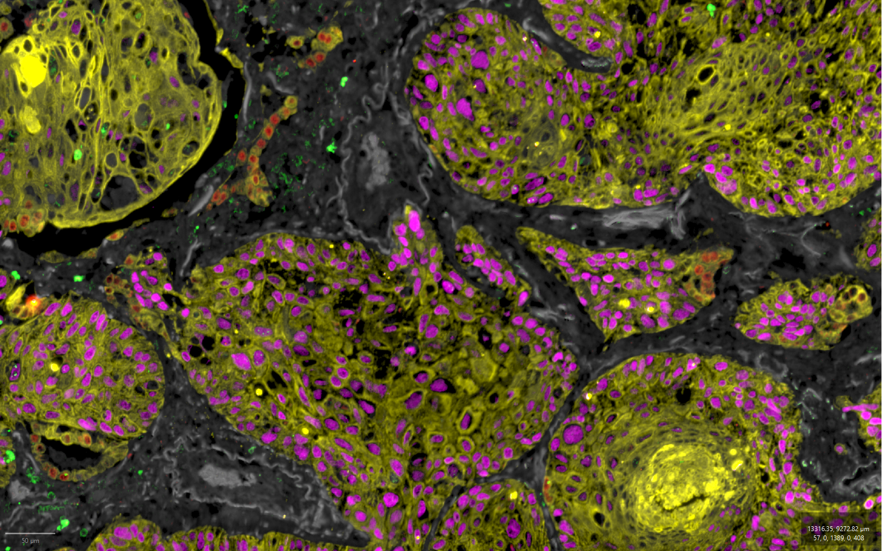
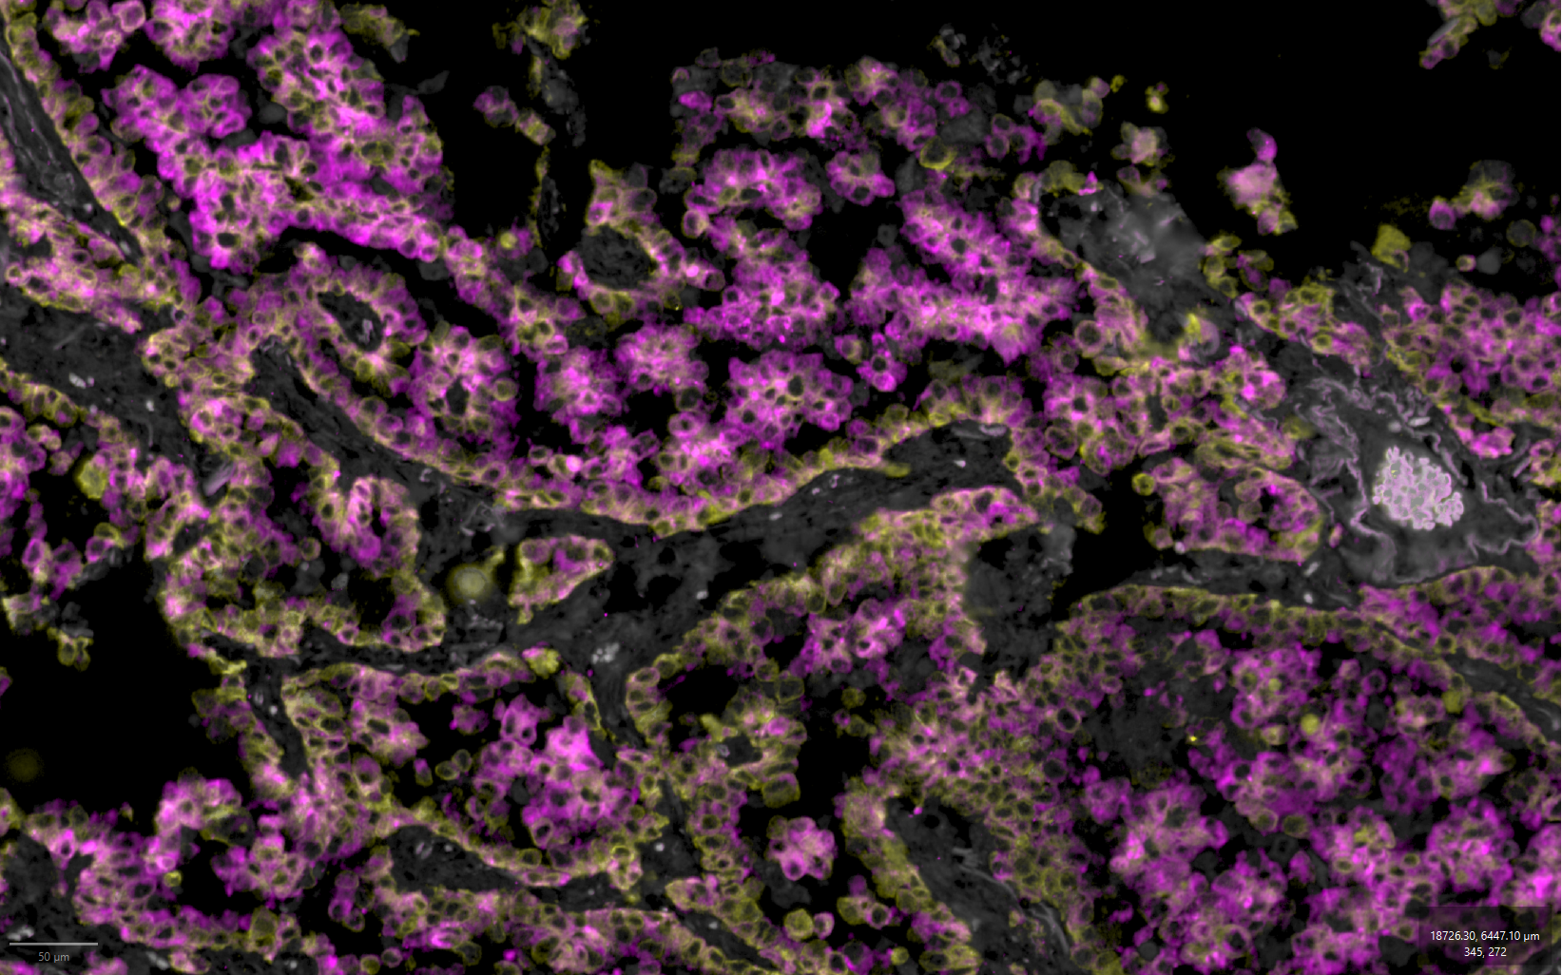


Final tests undertaken (2) – Lung Cancer Clinical Study
Adenocarcinoma
PD-L1 expression
Study Design:
Goal: diagnose Non-Small Cell Lung Cancer (NSCLC)
N=20
7 markers:
p40, TTF1, PanCK, PD-L1, ALK, CD45, Nuclear
Results: diagnosis is compatible to standard IHC reference in 100% of cases.
Publication: USCAP 2025 conf.
PanCK
PD-L1
TTF1
PanCK
p40
p40
CD45
CD45
AF
AF
Squamous Cell Carcinoma
ALK expression
PanCK
ALK
TTF1
TTF1
p40
AF
CD45
RedBC
AF
PanCK
TTF1
p40
CD45
AF

Slide 11
Commercialization actions taken during ATTRACT
Company, team, lab
Two patents filed, one accepted
Business plan
Business model
Collaborations
Potential first beta site

Slide 12
Commercialization actions foreseen after ATTRACT
Raising seed funding (partially secured)
Select first application to market
Upgrade prototype to an MVP (Minimum Viable Product)
Start beta site
Regulation

Slide 13
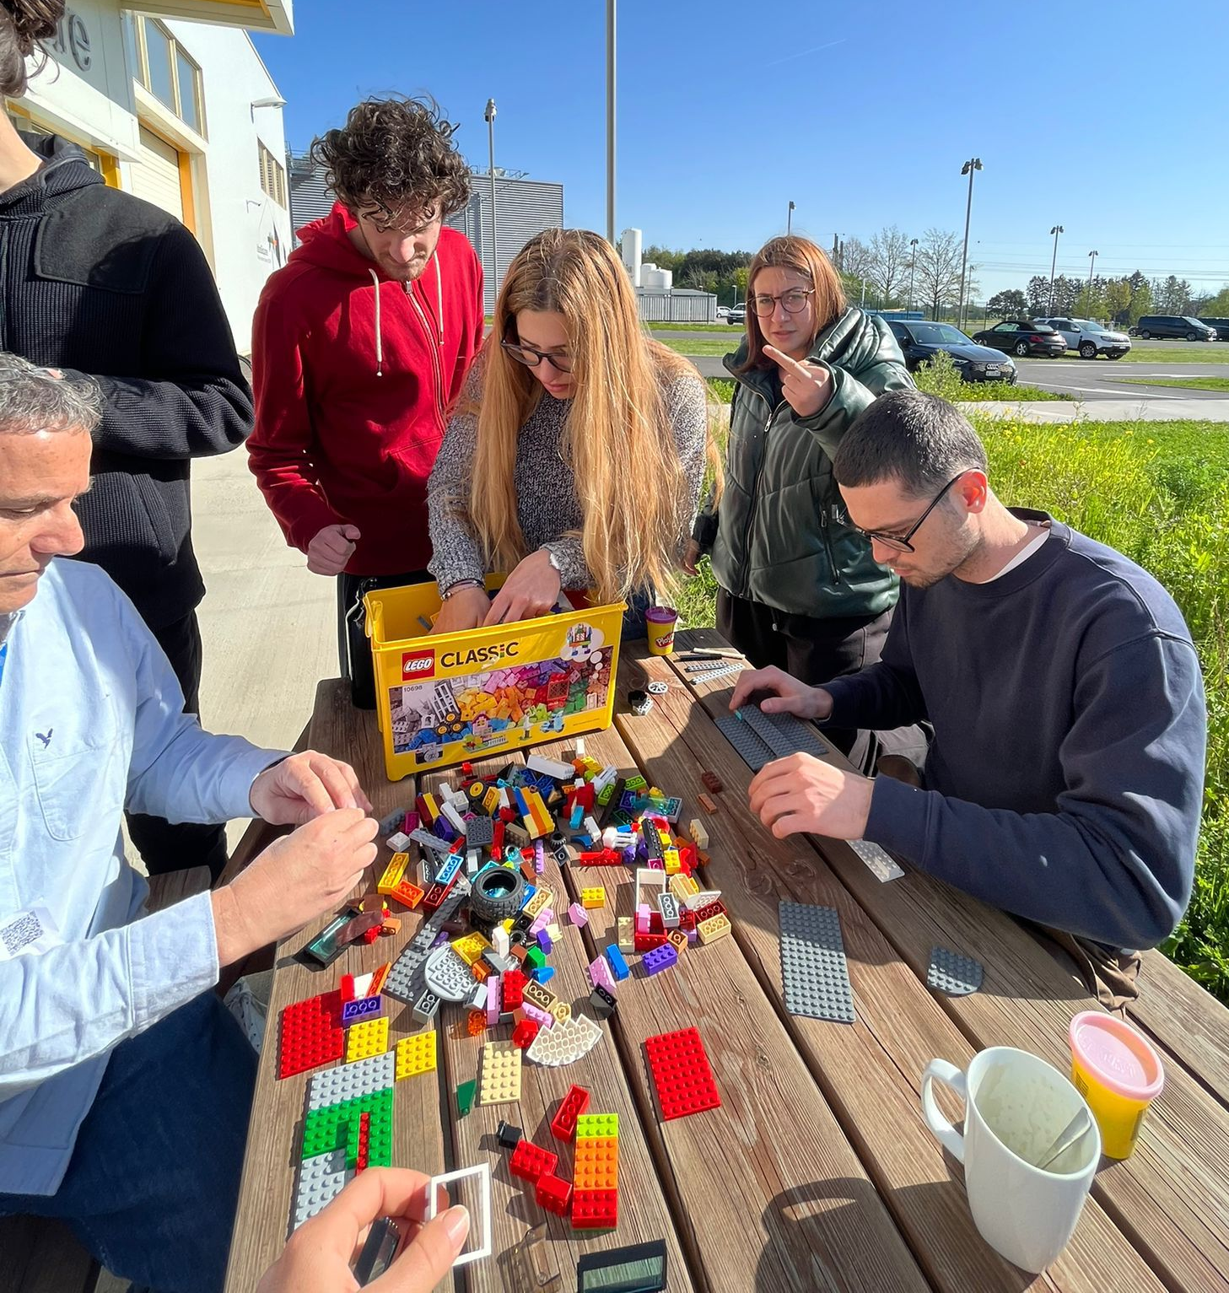
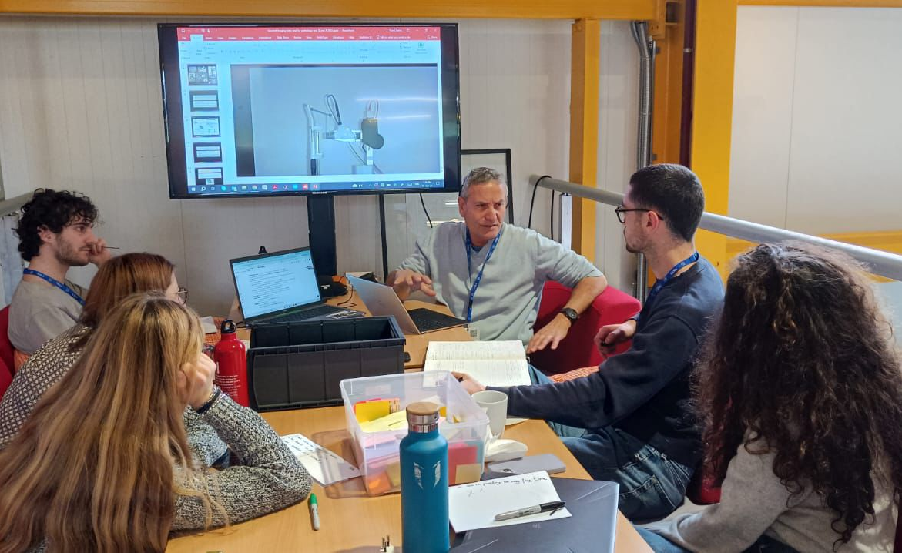
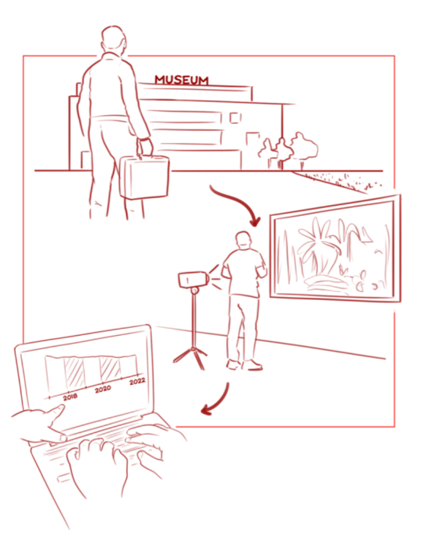
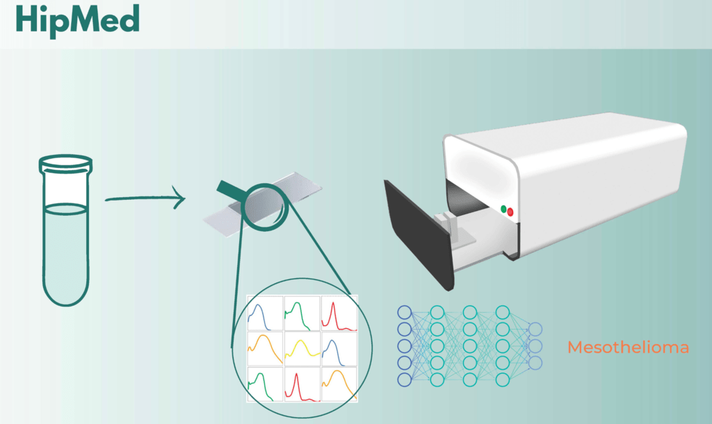
Interaction with ATTRACT Academy Students
Interaction with 3 educational projects in 4 programs:
  Chroma - Hyperspectral Imaging For Art Monitoring, TU Delft.
  CBI A3: Interacting with Prof. Christine Thong.
  Monitoring asbestos in the air, ESADE, Barcelona, Spain
  CBI.ATTRACT at the Universities of Bologna, Italy (Prof. Matteo Vignoli)
  Design Factory Melbourne, Swinburne University of Technology (Prof. Christine Thong).
  Laurea University of Applied Sciences, Finland (Ms. Virpi Kaartti).
Art inspection system
Asbestos detection system
Thoughts:
Great interaction. Students learned a lot on the axis of technology–application.
A few ideas that are really worth checking were raise
The interaction between high-tech and education can benefit all.

Slide 14


Thank You. Questions?
This project has received funding from the European Union’s Horizon 2020 research and innovation programme under grant agreement No. 101004462

Slide 15
AI-based Decision Support Tools
Predicting Drug Response
Nuclear
Ki67 33%
AI-Based Second Opinion Dx
Cell Classification
MUM1 60%
BCL6 52%
Quantifying expression
Images for pathologist interpretation
Nuclear
BCL6
Ki67
MUM1
CD20
CD79a
CD3
CD10

