Slide 1












ATTRACT Phase 2 Final Review
CERN, May 20-21, 2025
HYLIGHT
Prototyping a light-sheet microscope for the diagnostic of embryo implantation based on hyperspectral phasor analysis
Samuel Ojosnegros
Institute for Bioengineering of Catalonia (IBEC)

Slide 2

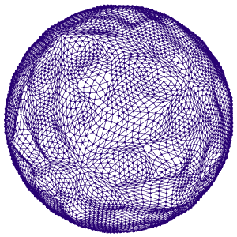
Reminder of the initial project objectives
The overarching goal was that to develop a clinical diagnostic tool enabling embryologists to select competent embryos in an unbiased way through the following steps:
Develop a high-throughput protocol for safe, robust, and reproducible HS imaging of embryos on PoC device
Develop an AI-based software to evaluate the implantation capacity of embryos
Prototyping: design the minimal light sheet system specification to carry out HS imaging of embryos
Validate the performance of the prototype

Slide 3
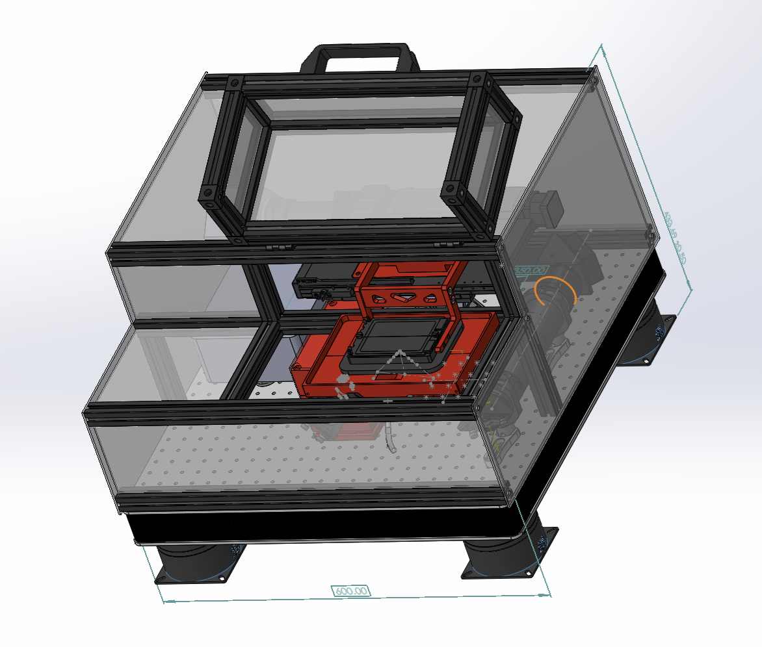
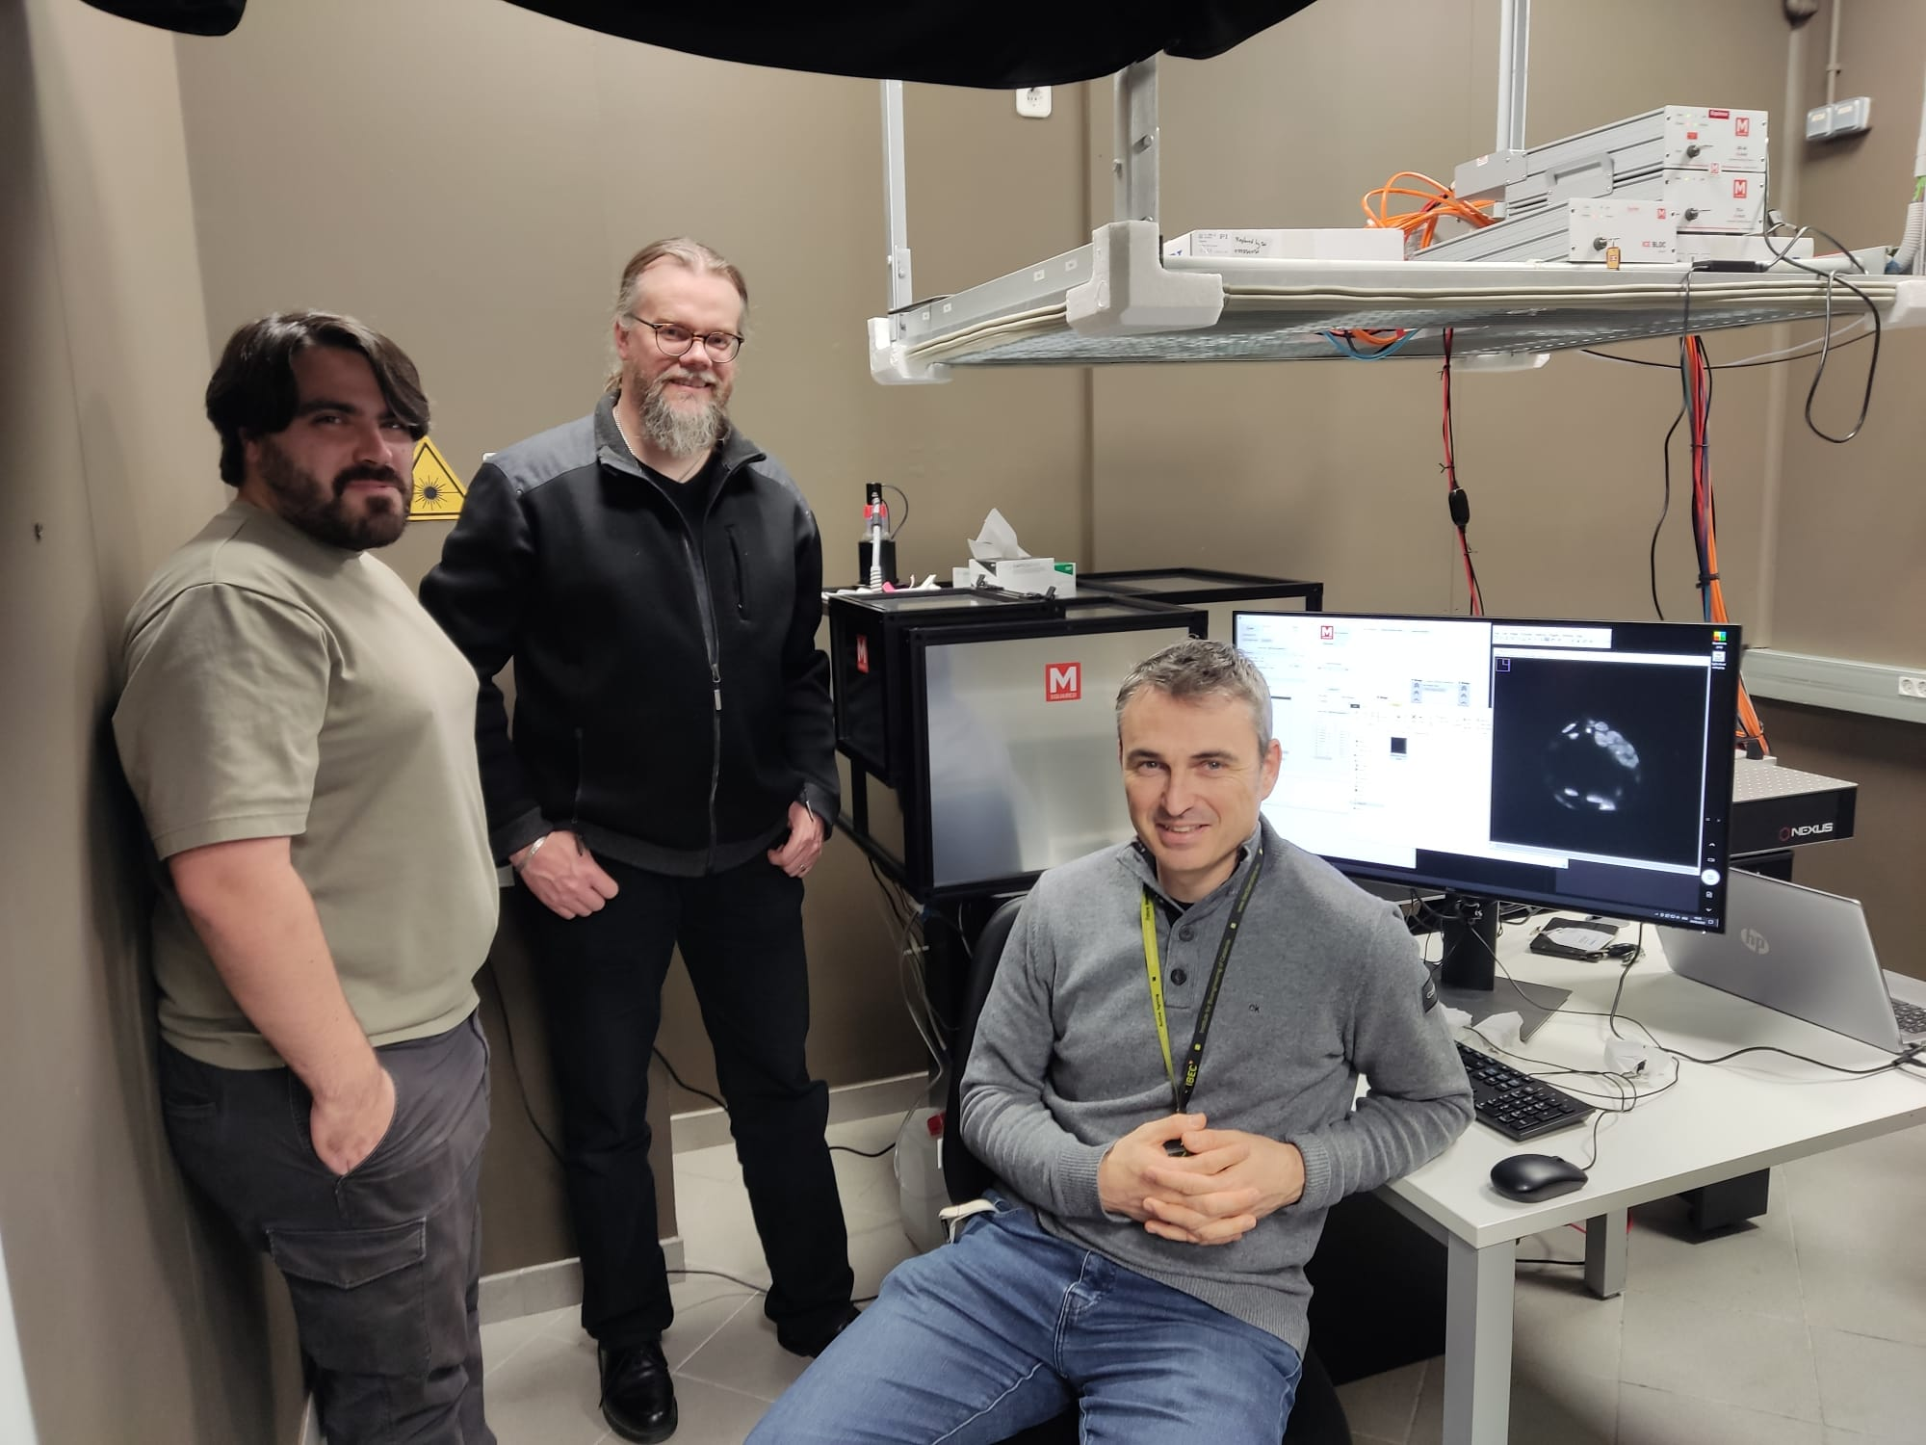
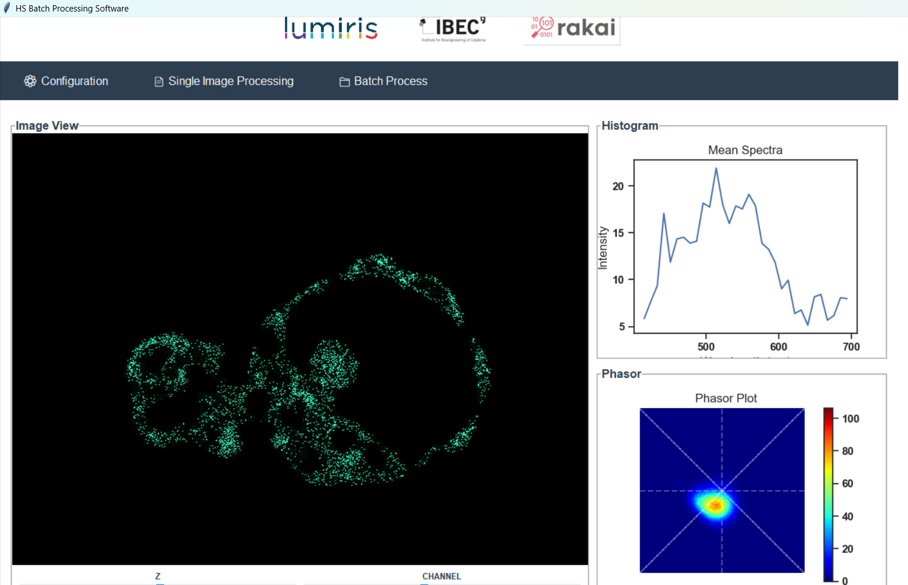
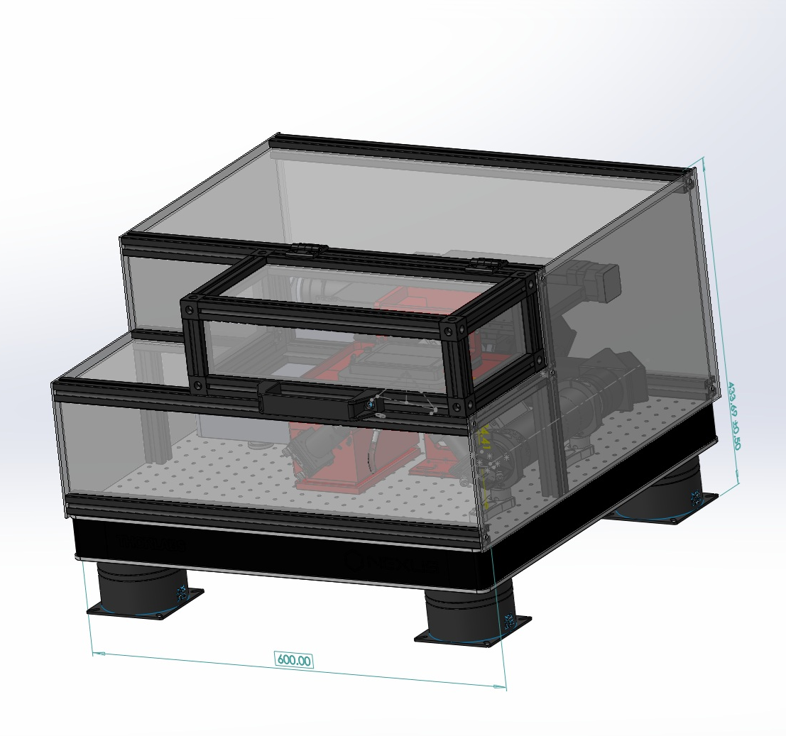
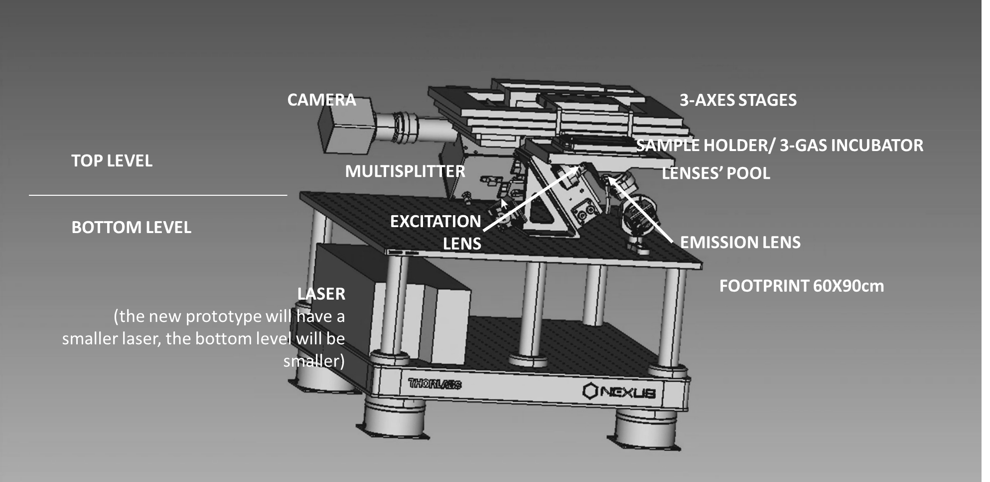
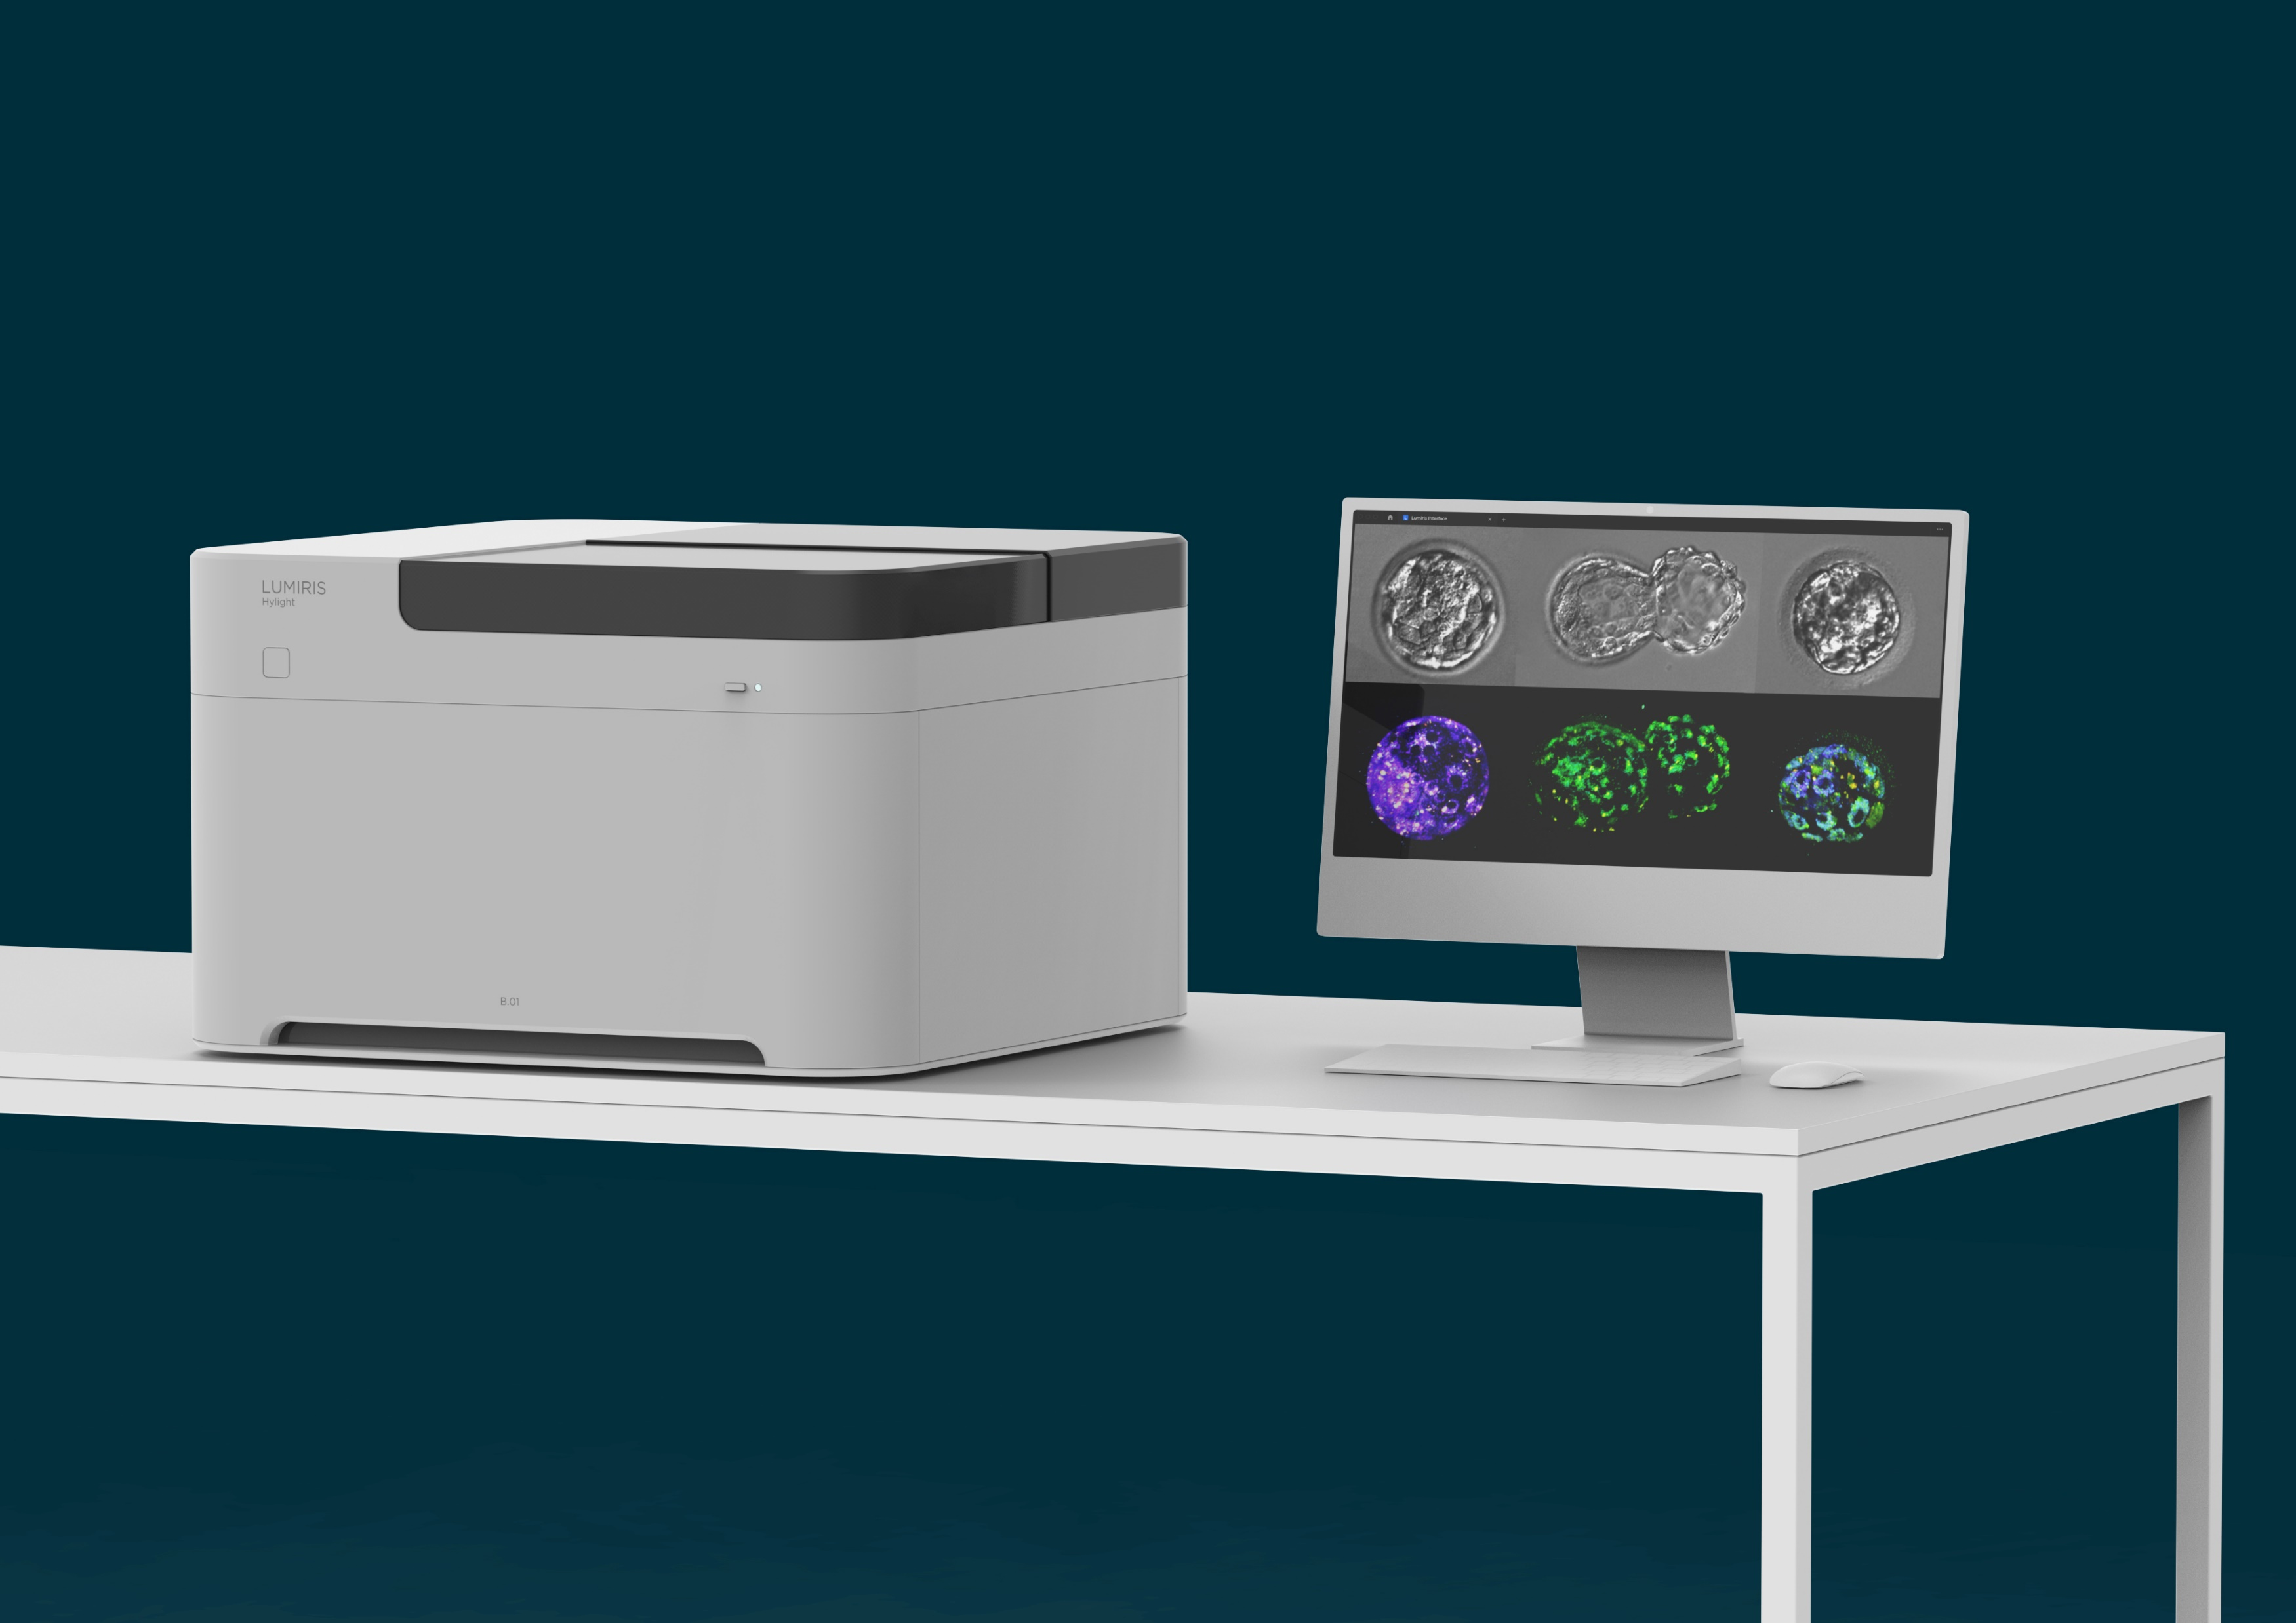
Final Results achieved (1)
How can we go from here?
METAPHOR: Metabolic Evaluation through Phasor-based Hyperspectral Imaging and Organelle Recognition
To here?
43cm
METAPHOR software GUI
60cm
60cm

Slide 4
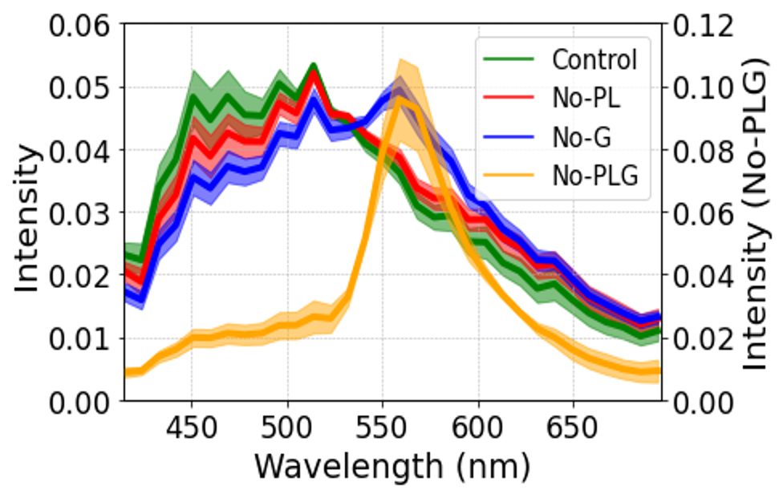
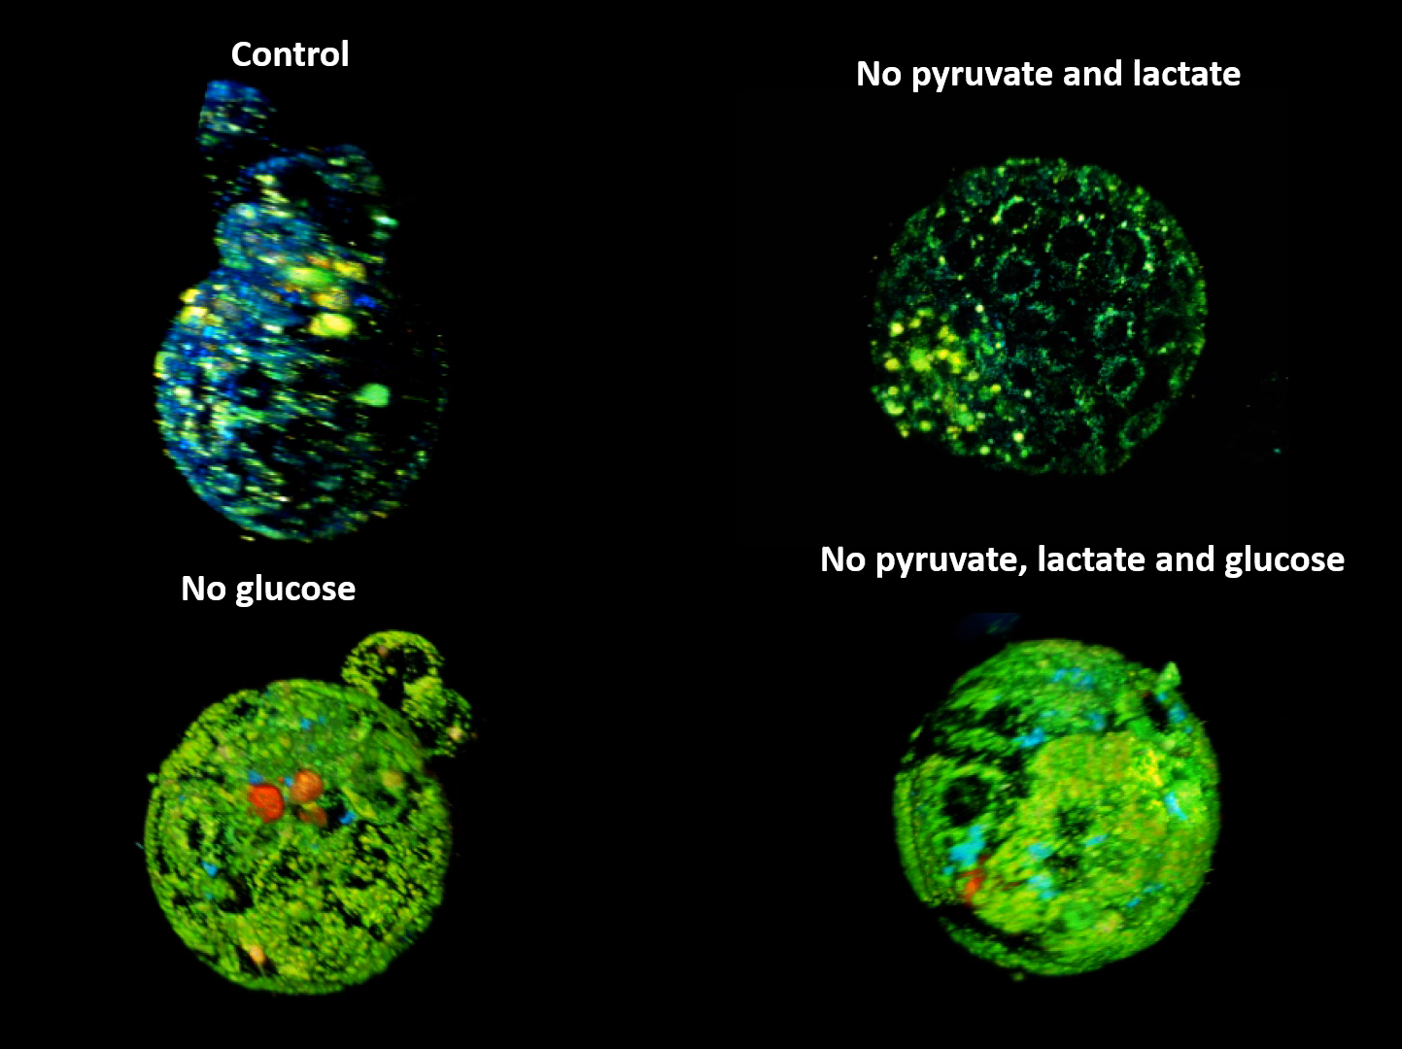
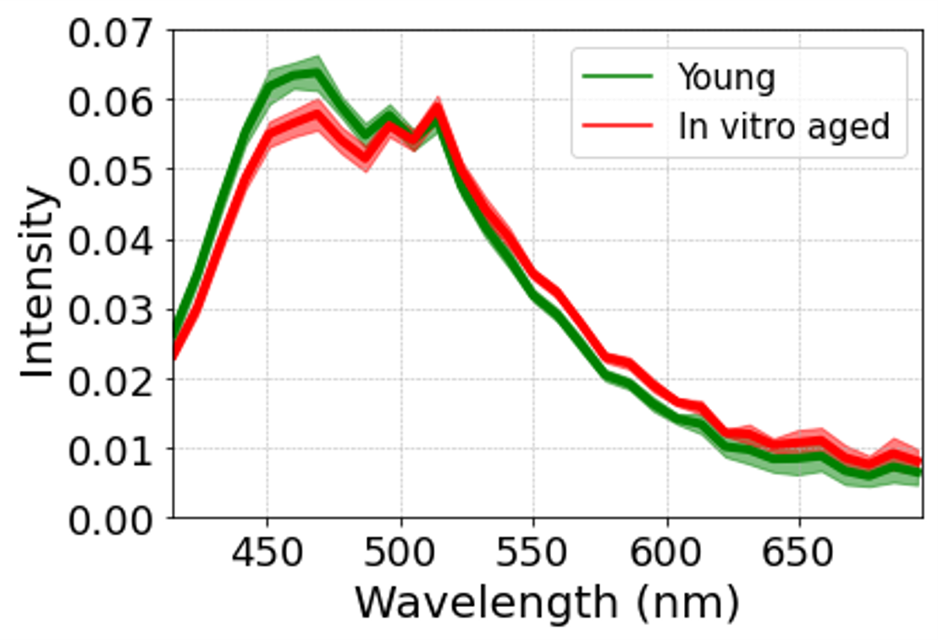
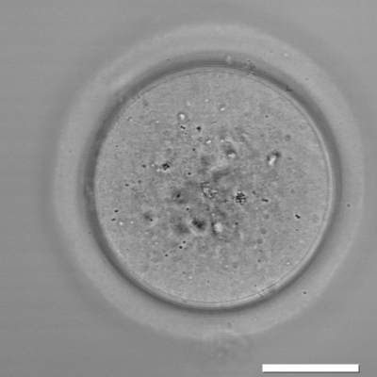
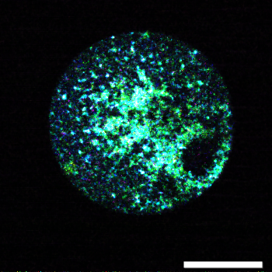
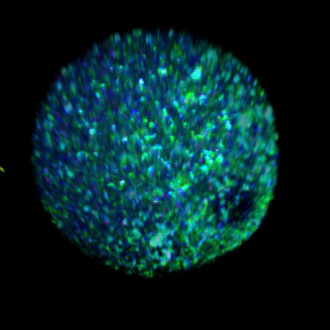
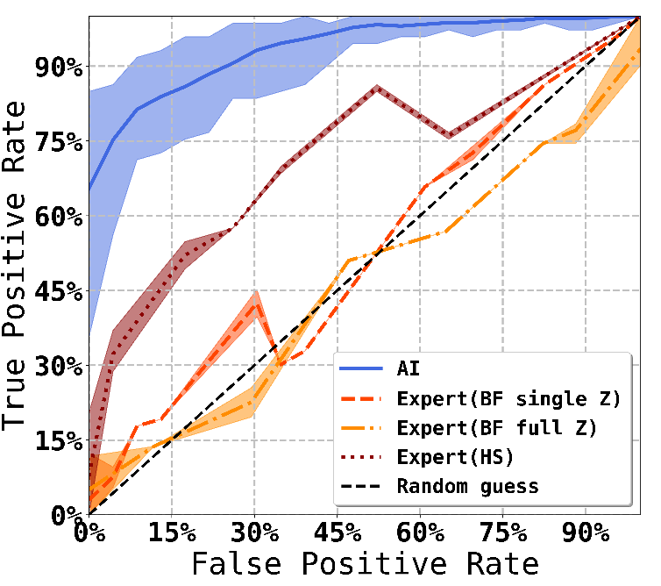
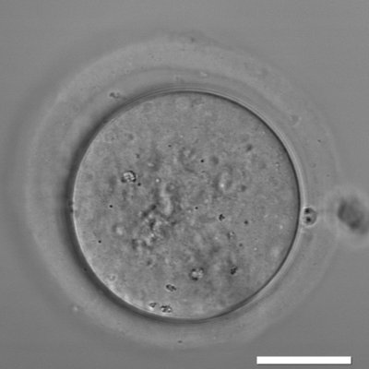
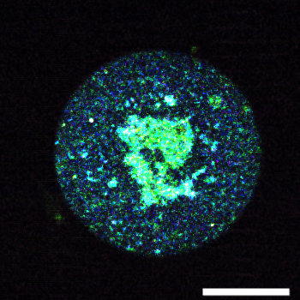
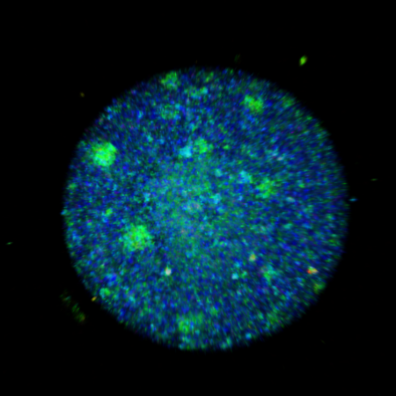
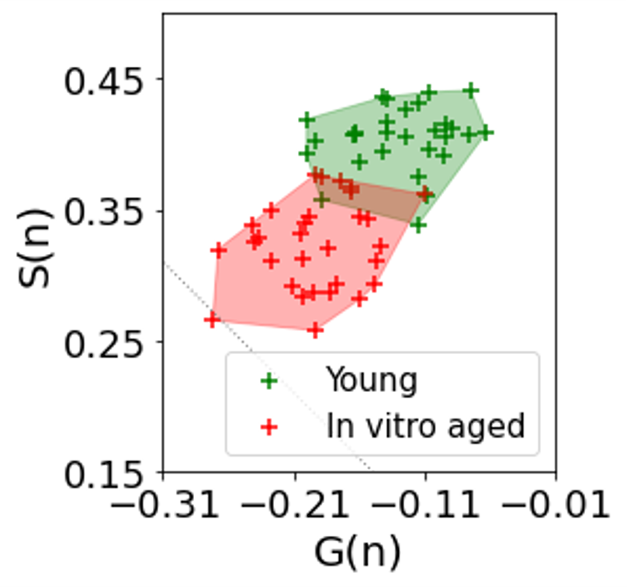
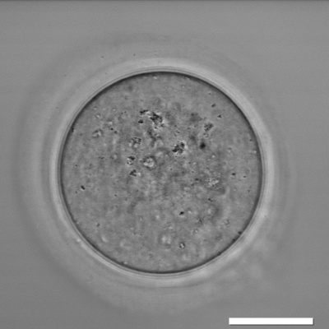
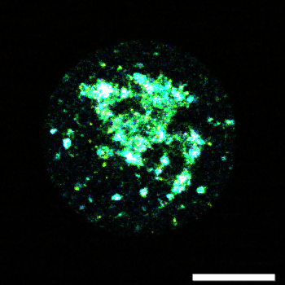
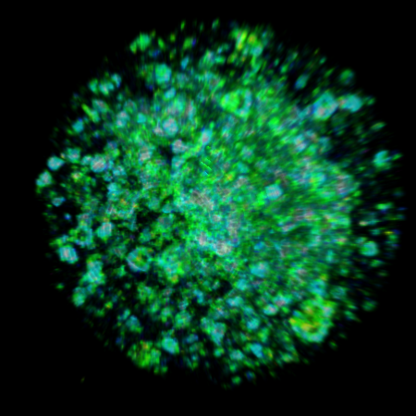
Final Results achieved (2)
Metabolic imaging of mouse oocytes and embryos using the METAPHOR pipeline
Spectral Hystogram
MOUSE EMBRYOS
MOUSE OOCYTES
Spectral Hystogram
Brightfield image
Z slide view
3D view
Young mice oocytes
Embryo Classification
CoM distribution
Old mice oocytes
In-vitro aged oocytes
HS-PHASOR-AI
HUMAN GRADERS HS
HUMAN GRADERS BF

Slide 5
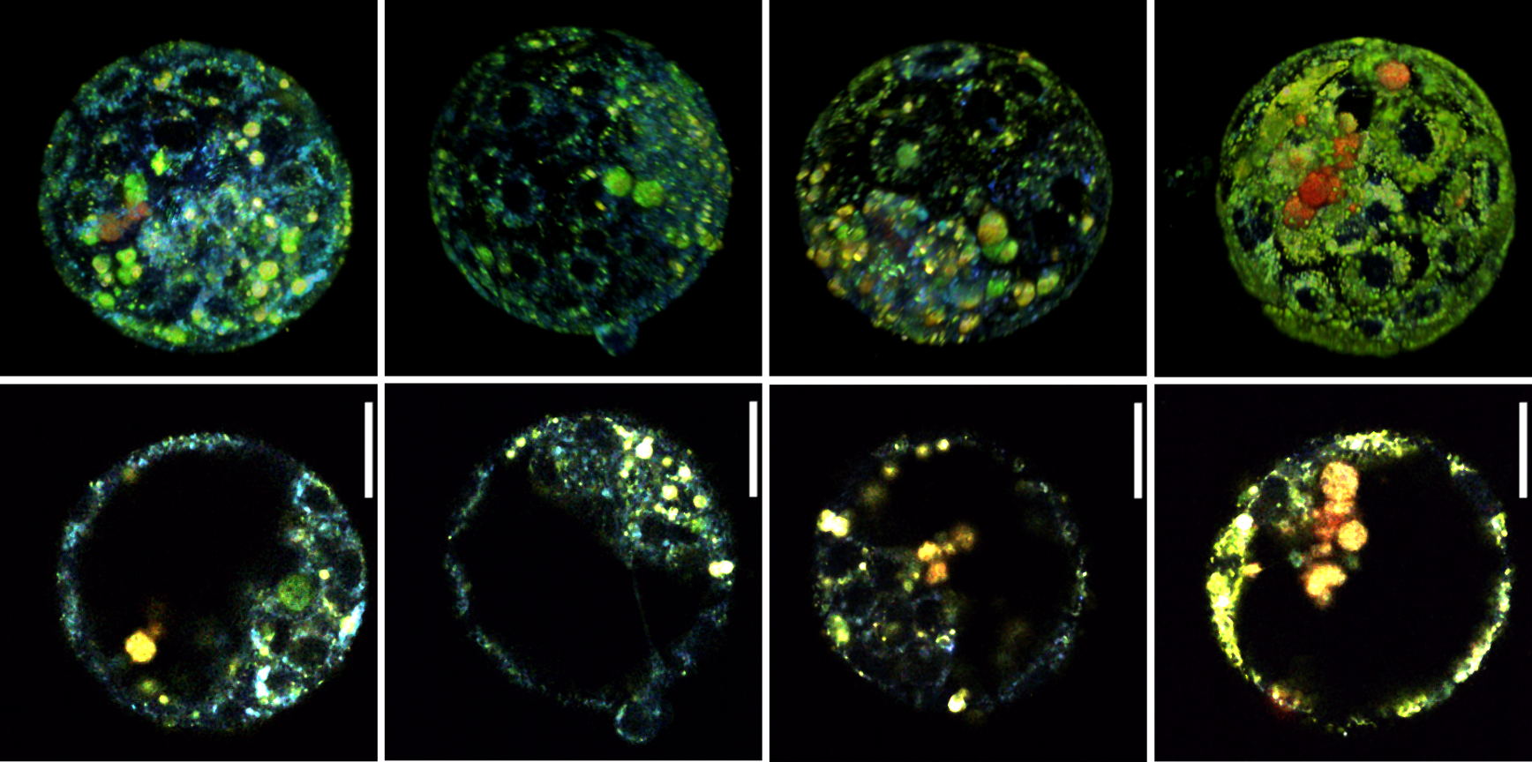
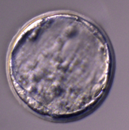
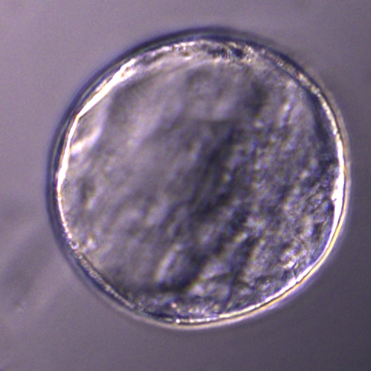
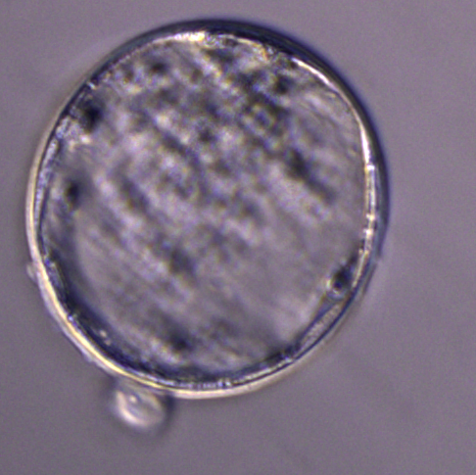
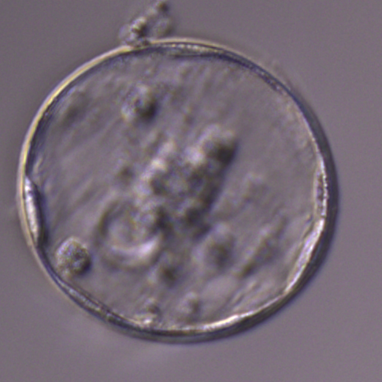
Final Results achieved (3)
Metabolic imaging of embryos provide a superior level of information about embryo quality than just morphology
RANKING:
Simplified guideline:
blue=good green=bad red=very bad

Slide 6
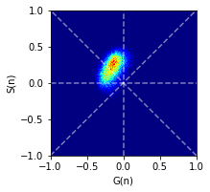
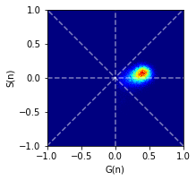
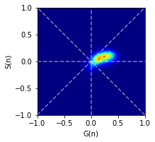
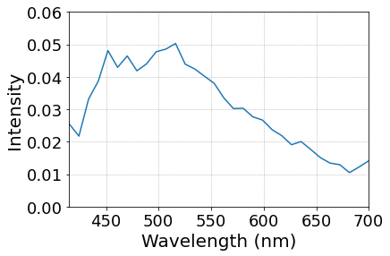
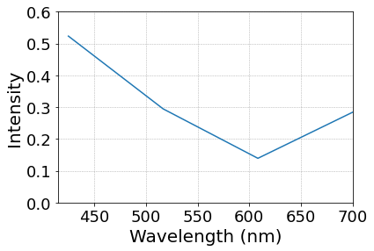
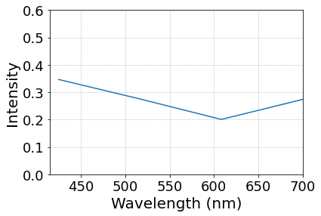
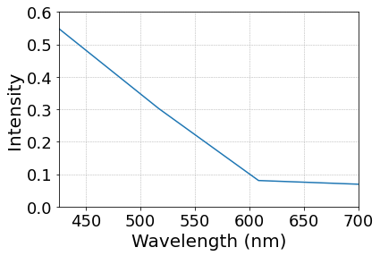
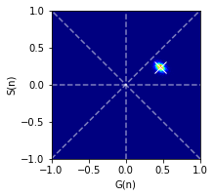
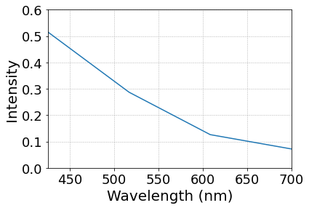
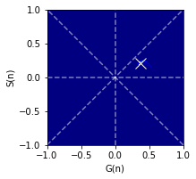
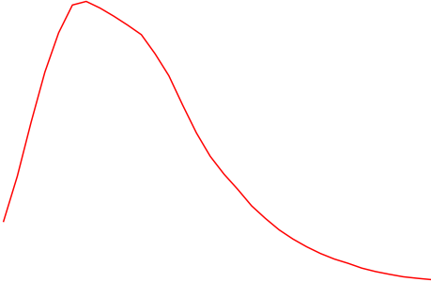
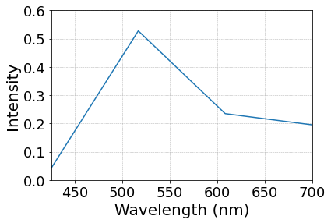
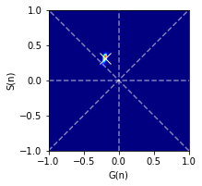
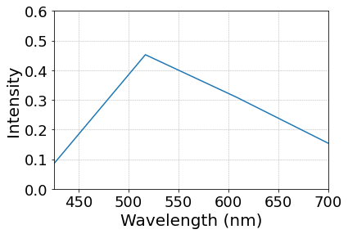
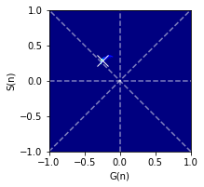
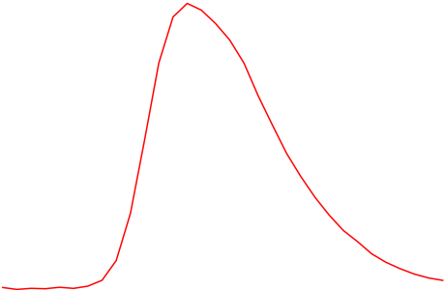
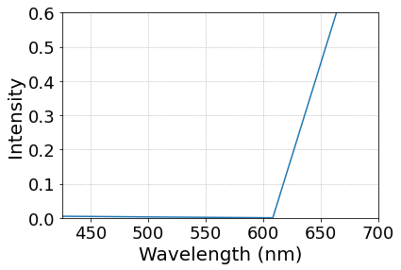
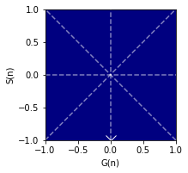
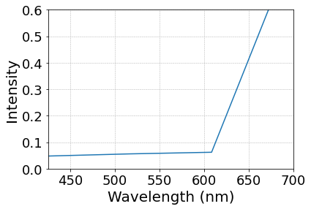


Mouse embryo
Final tests undertaken (1)
Two-photon light-sheet HS prototype imaging
Confocal
Prototype
32-Channels
4-Channels
Metabolites
NADH-free
Virtual 4-channels
Prototype
FAD
PPIX

Slide 7
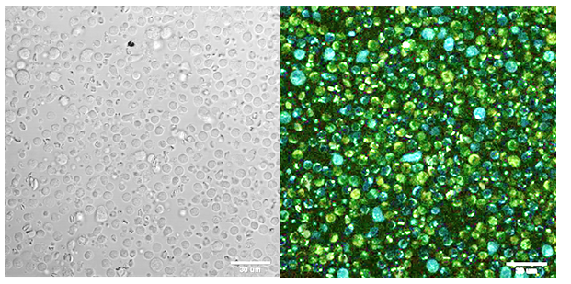
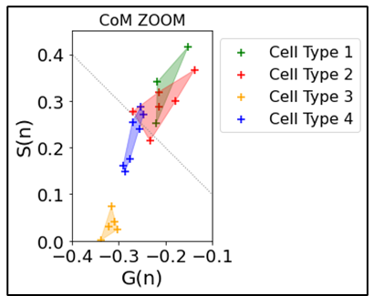
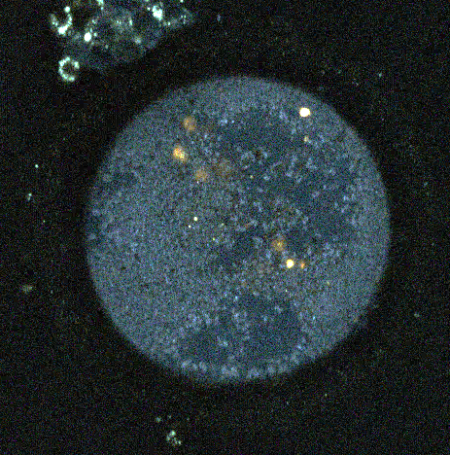
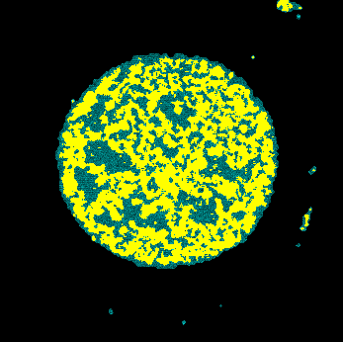
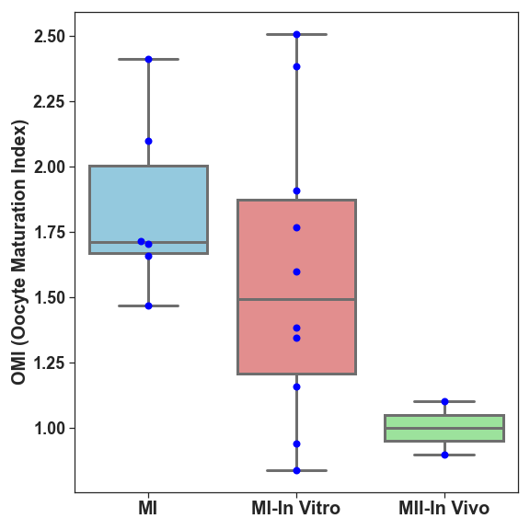







Final tests undertaken (2)
Human Oocytes
PBMC Peripheral Blood Mononuclear cells
Mitochondria staining
HS imaging
Mitochondria segmentation
Determination of cell type
MI
Immature
Oocyte maturation index
Healthy Donor PBMCs
Immunodeficiency Donor PBMCs
Metabolic shift after drug treatment
MII
Matured in vitro
MII
Matured in vivo
Several immunodefficiencies have a metabolic component
The effect of drug treatments can be assessed in real time and live imaging.
PBMC can be routinely screened for shifts in metabolic profils of specific cell types or in the entire cell composition

Slide 8






Commercialization actions taken during ATTRACT
Lumiris Spectral Solutions SL was established in December 2023.
The company has raised €1,5 M on a seed investment round on Q4 2024.
The technology has been filed for patent protection (WO/2023/161375), has entered the national phase in several jurisdictions, and has been published in some of these countries (EU, China, India).
PARTNERS

Slide 9



Commercialization actions foreseen after ATTRACT
Early revenue generation through selling alpha instruments into R&D IVF companies (RUO device (research use only)
Early interest obtained from companies
Regulatory pathway started by negotiating with a consultant company for RUO and Medical Device
Started contacts with VC and industrial partners for future Series A (leading to alpha program, to be explained in person).
2025
2026
Series A (8-10M€)
2027
2028
2029
External validation
and refinement phase
Regulatory and
Commercialization phase
Sales phase MARKET
Licensing/manufacturing
agreement with M2
Design Clinical protocol
CE Mark obtention
NEW!
Enter clinical clinical validation
ALPHA PROGRAM
Early revenue generation through sales of RUO in Industry R&D departments
Final Clinical Prototype FROZEN DESIGN
Enter clinical preclinical validation

Slide 10


Thank and Questions
This project has received funding from the European Union’s Horizon 2020 research and innovation programme under grant agreement No. 101004462

