Slide 1














ATTRACT Phase 2 Final Review
CERN, May 20-21, 2025
MicroQuaD-Material science
Microscopy with Multielement Quantum Detectors
Mario Castaneda
Single Quantum

Slide 2

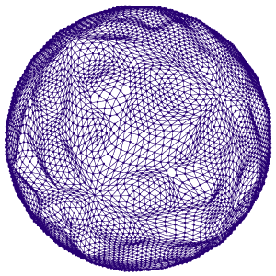
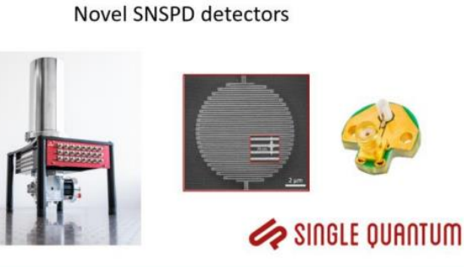
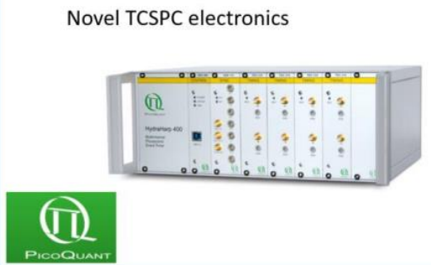
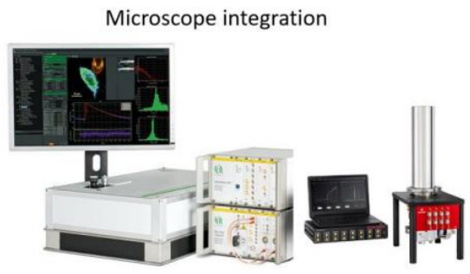

Reminder of the initial project objectives
    Our project targeted:
    Establish technical, industrial and market requirements for the full system.
    Fabricating and Developing a new detectors for applications in Material science (SQ).
    Develop multichannel Electronics from PQ.
    Integration of the developed detector in PQ Microscope – Demonstrator.
    Exploration of new multielement detectors: 8pix - interleaved.

Slide 3
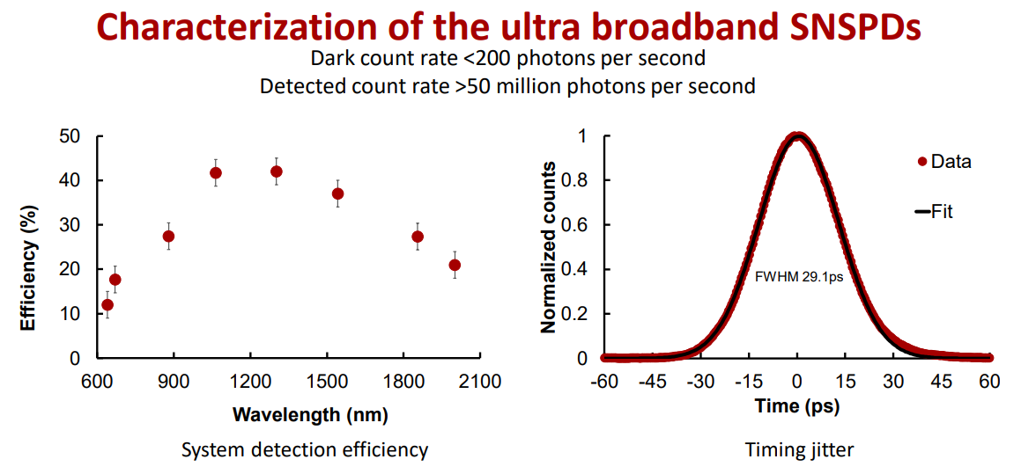
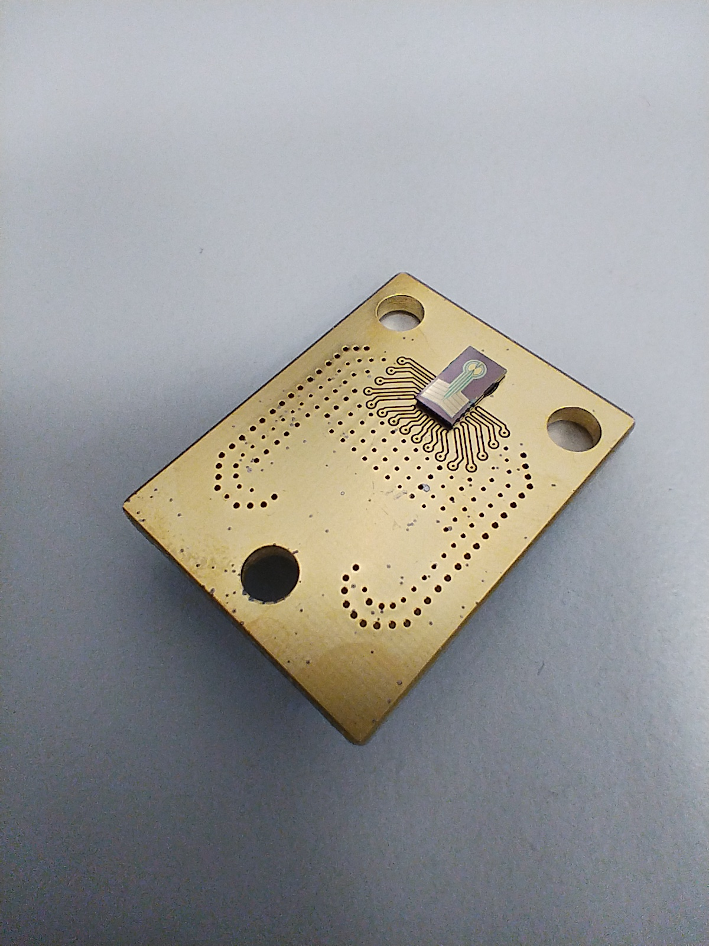
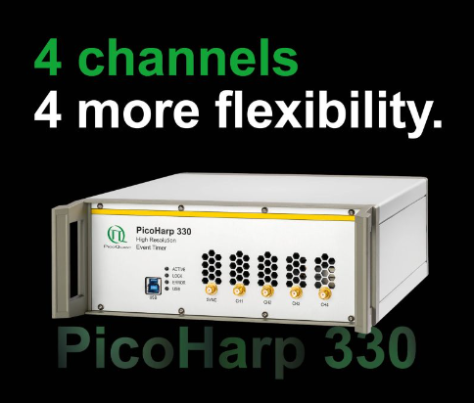
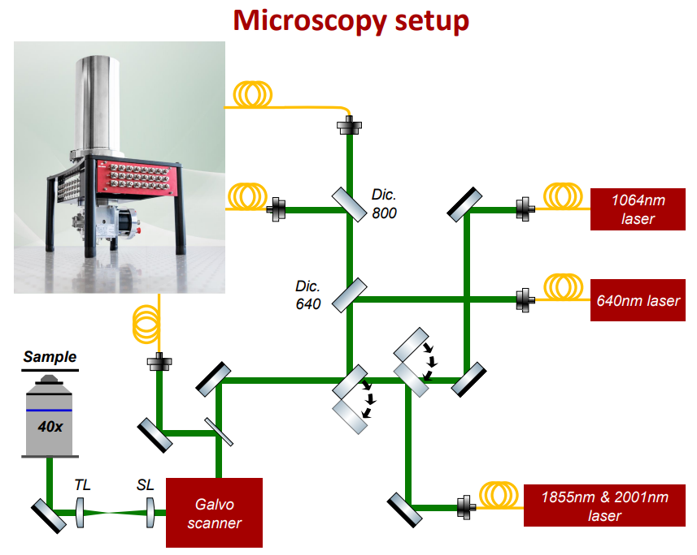
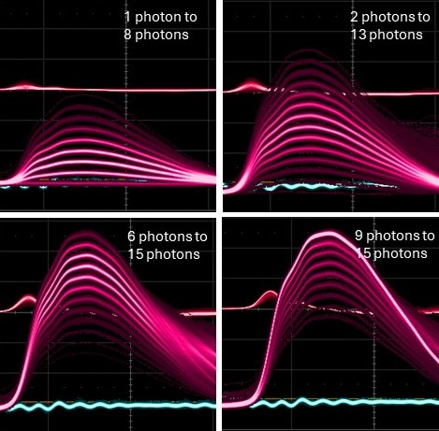
Final Results achieved (1)
    Broadband (BB) system assembled and validated at SQ and PicoQuant (TRL 5)
    Material science validation of an integrated system - PAPER publication.
    UltraBroadband (UBB) detector designed, tested and validated (TRL5)
    Multichannel TCSPC (PicoHarp 330) system validated (TRL5-6)
    Multielement detector designed, fabricated and validated (TRL 4)
    Advancements in commercialization: Shortest development to market (4months to first sale!!)

Slide 4
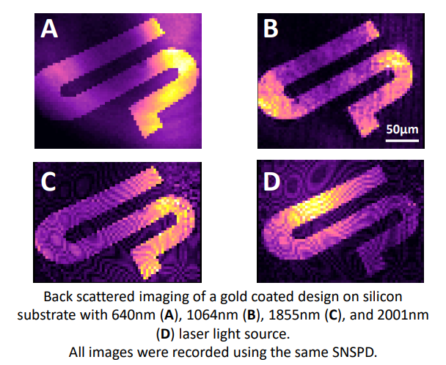
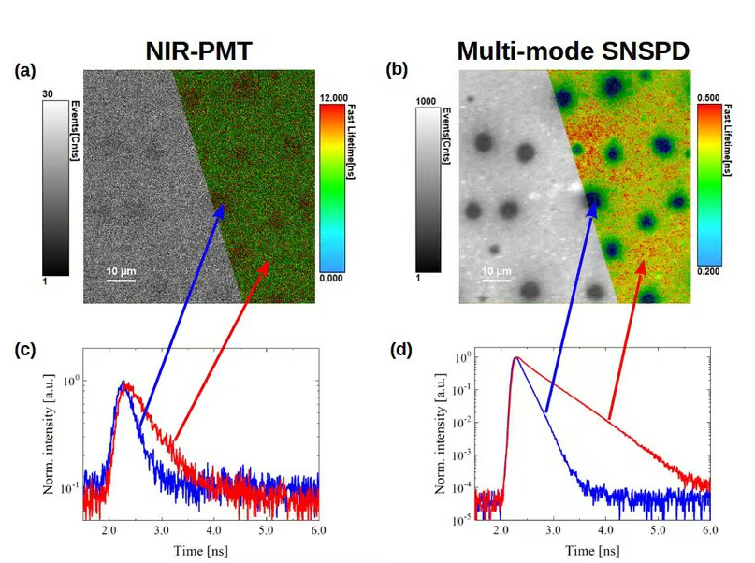
Final Results achieved (2) – PERFORMANCE
    Broadband (BB) detector designed, tested and validated (TRL5)
    Broadband system assembled and validated at SQ and PicoQuant (TRL 5)
    Multielement detector designed, fabricated and validated (TRL 4)
    Multichannel TCSPC (PicoHarp 330) system validated (TRL5-6)
    Material science validation of an integrated system.

Slide 5
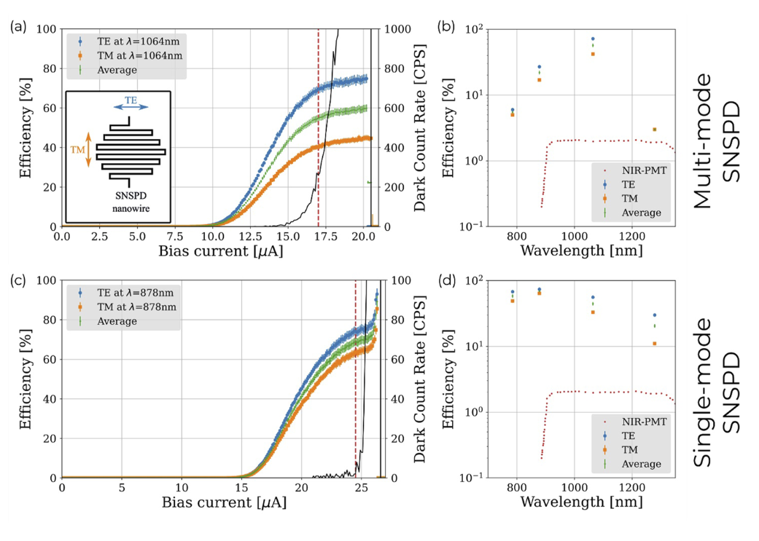
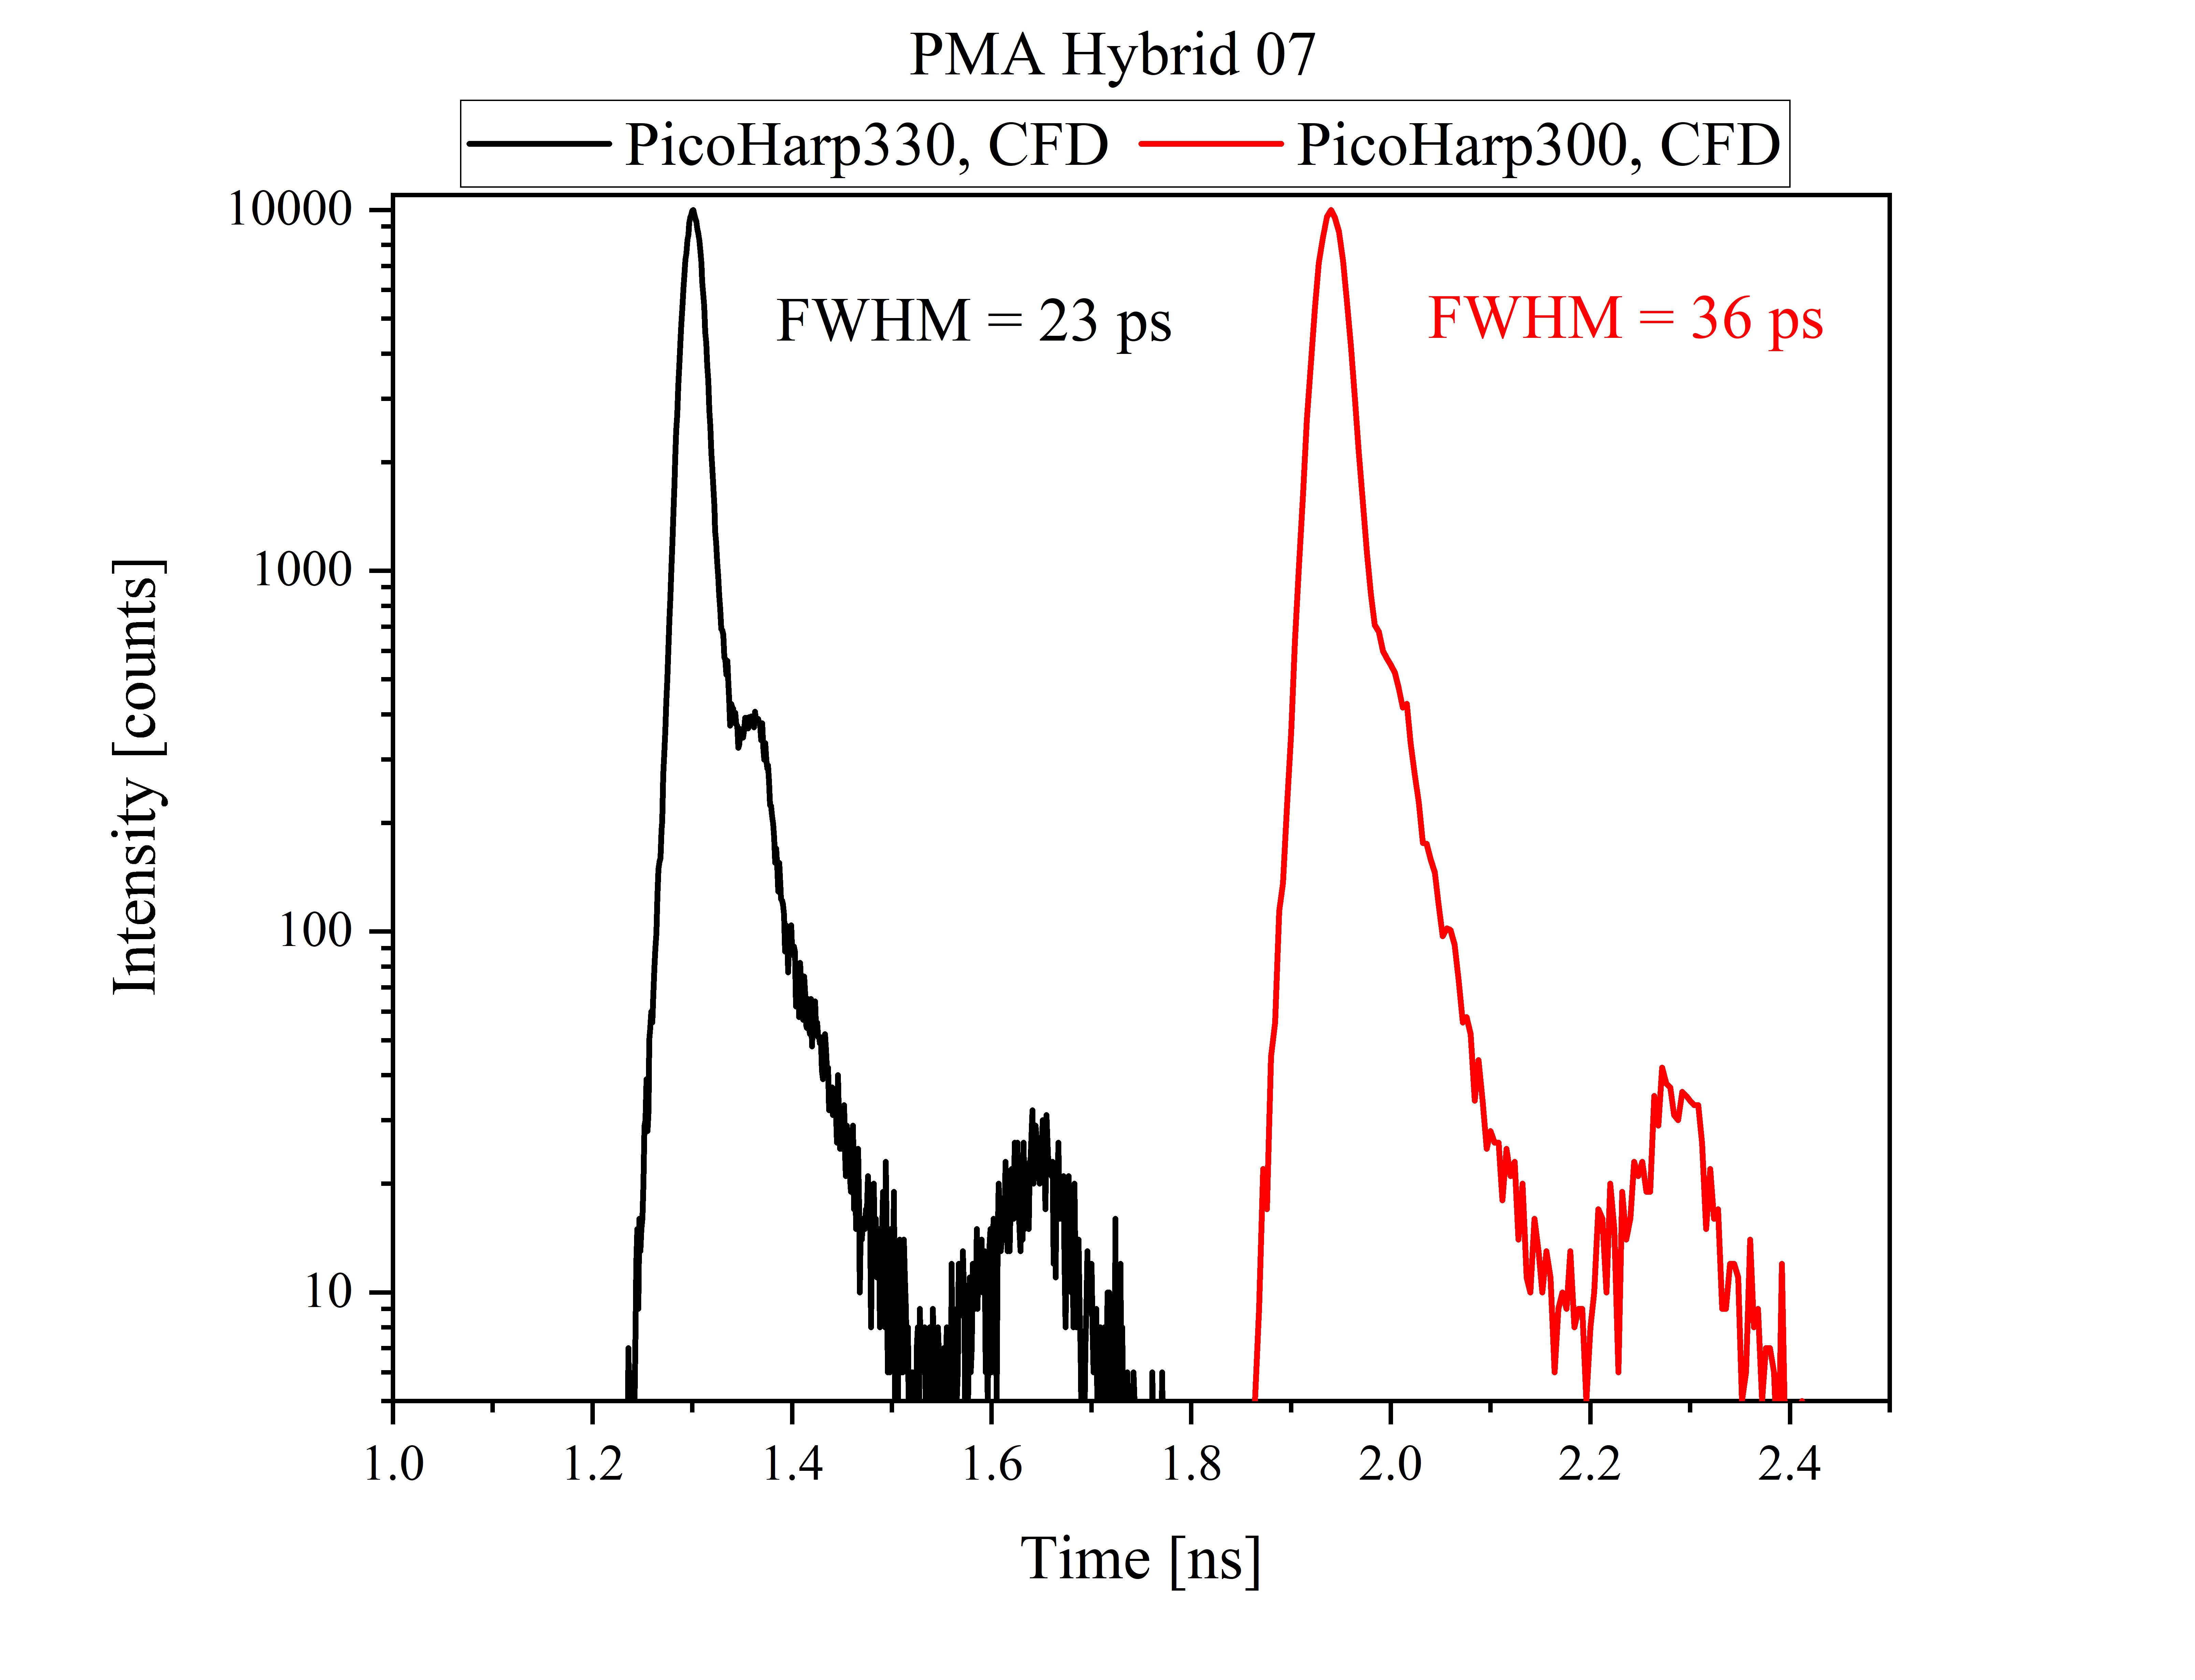
Final Results achieved (3) - BENCHMARKING
Original detectors in paper
Ultrabroadband
Multichannel TCSPC tested at PQ:
From:
Rev Sci Instrum 94, 033703 (2023) – our paper, result of this project

Slide 6
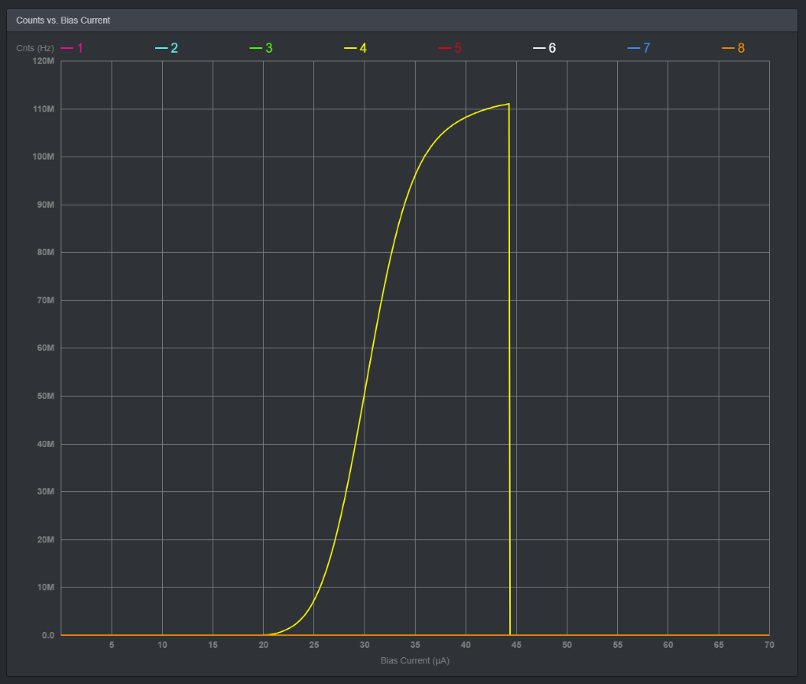
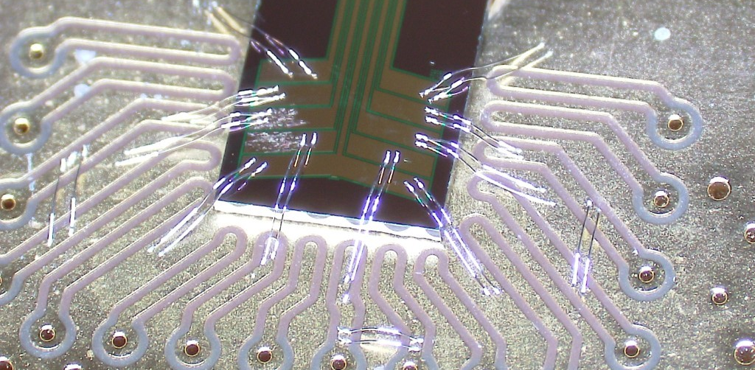
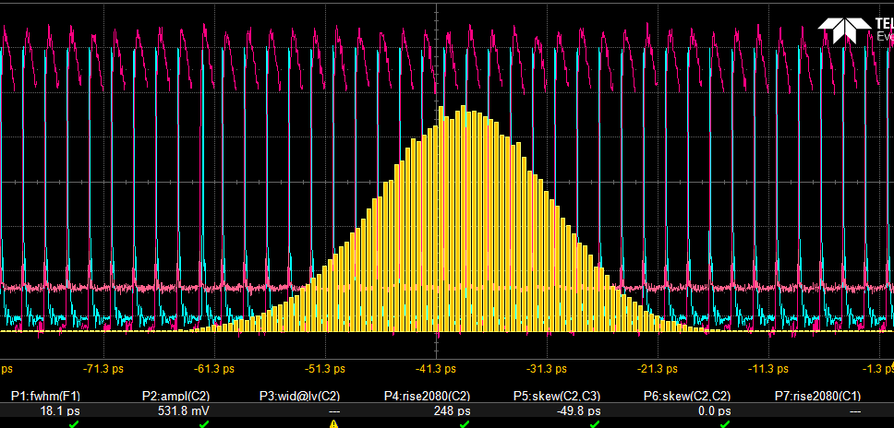
>100MCounts per sec.
Final tests undertaken (1)

Slide 7
Final tests undertaken (2)

Slide 8
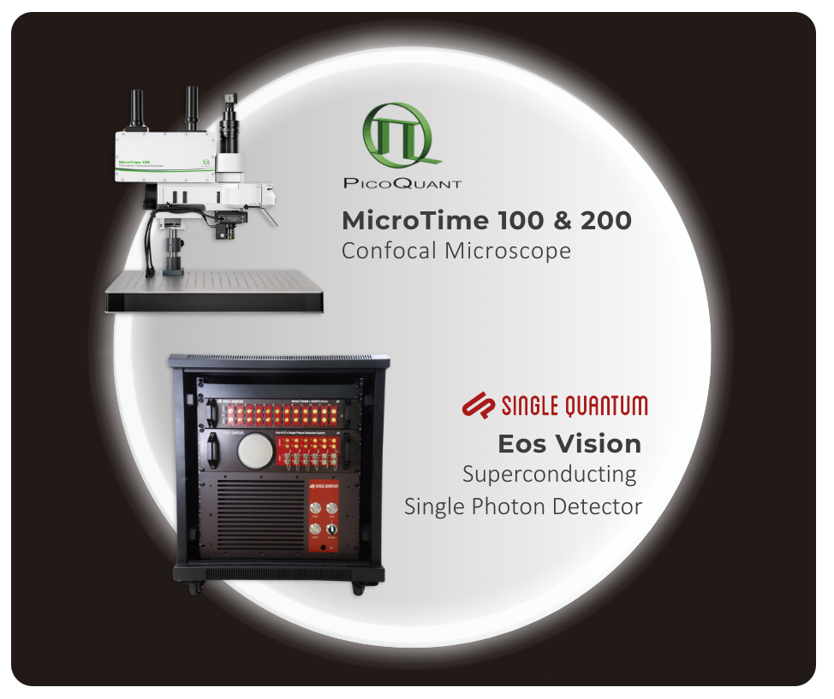
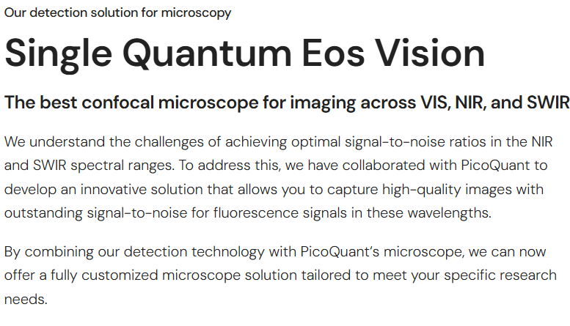
Commercialization actions taken during ATTRACT
https://www.singlequantum.com/solutions/imaging-line/

Slide 9
Commercialization actions taken during ATTRACT
https://www.singlequantum.com/solutions/imaging-line/

Slide 10
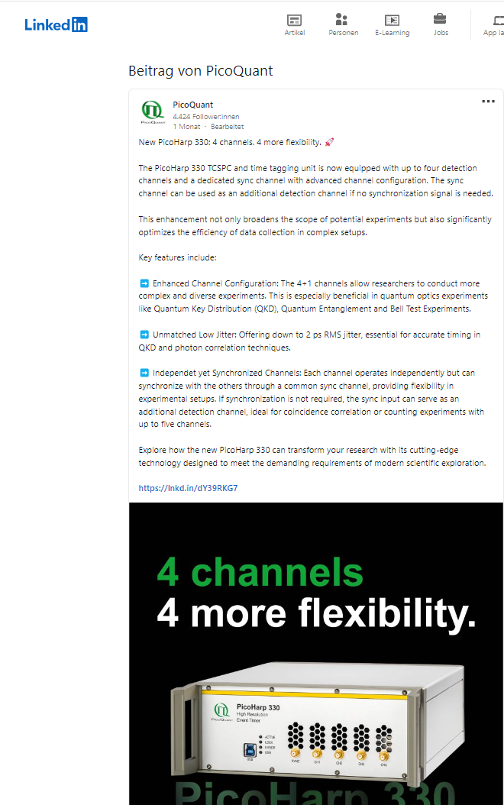
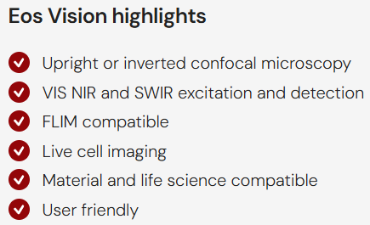
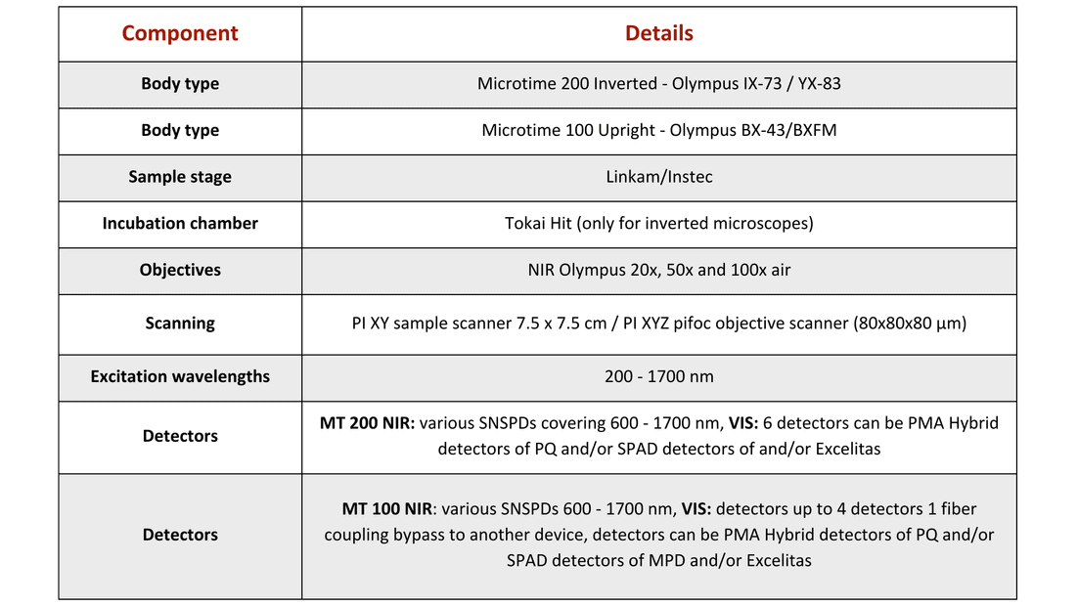
Commercialization actions taken during ATTRACT

Slide 11
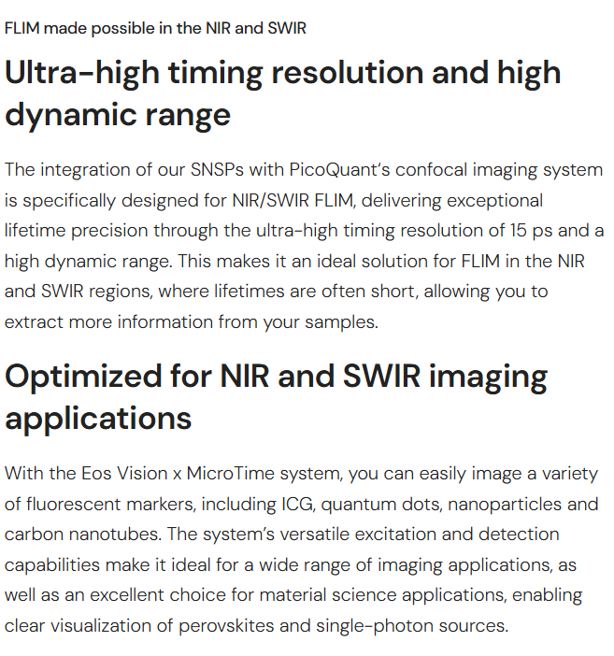
Commercialization actions taken during ATTRACT
https://www.singlequantum.com/solutions/imaging-line/

Slide 12
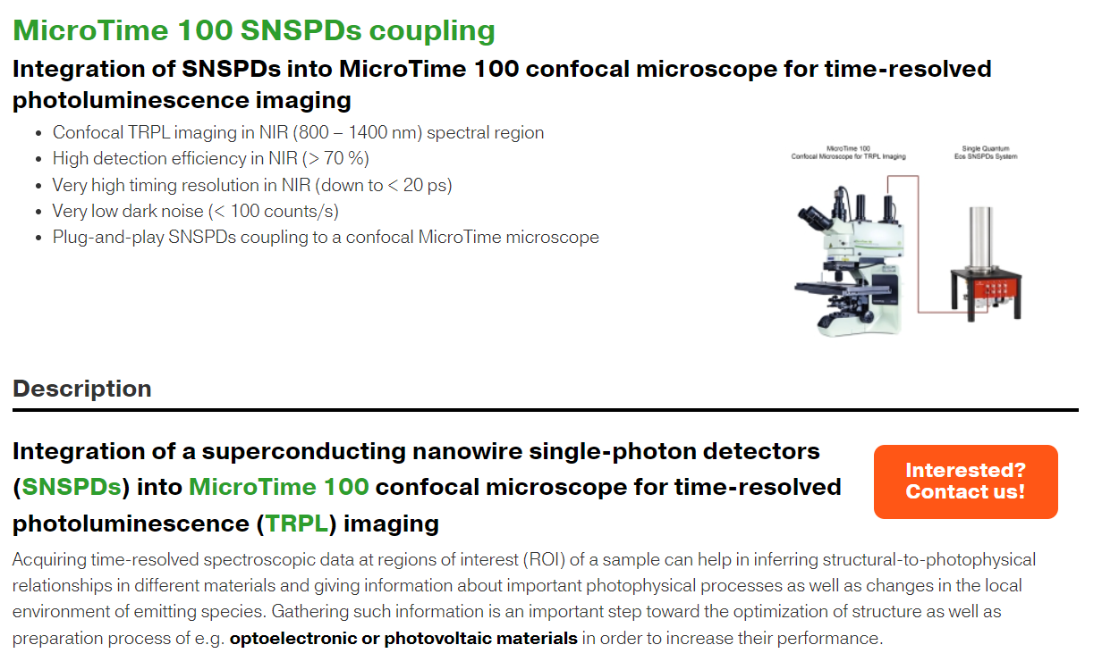
https://www.picoquant.com/scientific/product-studies/microtime-100-snspds-coupling
Commercialization actions taken during ATTRACT

Slide 13
Commercialization actions during ATTRACT
    SQ Sales of ultrabroadband:
    3 sales - shortest development to market (4months to first sale!!)
    SQ Sales of Multielement detectors:
    10 commercial leads for 8/16 pixels
PQ strategy for TCSPCs: scalable setup - 4 channel TCSPC PicoHarp 330 (now available) 8/16 channel TCSPC HydraHarp 500. The concept for the HydraHarp 500 was extended to allow stacking of upto 4 16 channel units to get even 64 channels. With this scalability of hardware and pricing we have increased our chances for commercialization in this demanding market.
    Common demonstration at customer site (upcoming): Bochum Univ. microtime 200 + UBB system for carbon nanotubes, replacing PMTs.

Slide 14
Commercialization Roadmap post-ATTRACT
Assessment of final results, identification of key markets/customers.
Common demonstration/new paper/white paper for marketing.
Common marketing plan update.
Set sales agreements in place to exploit each others markets, global presence and brand recognition.

Slide 15
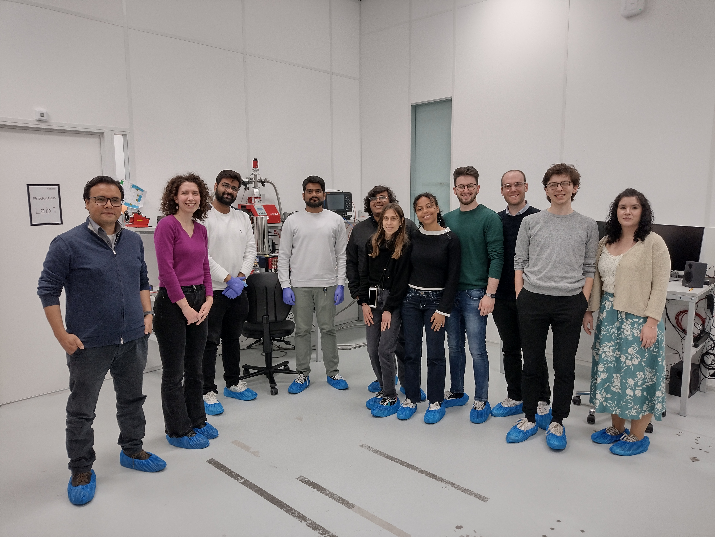
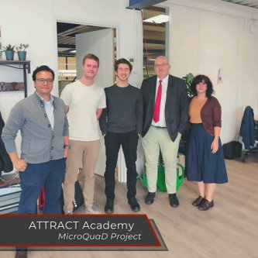
Interaction with ATTRACT Academy Students
We already interacted with 3 teams of student projects (out of the total 5):
  CBI-FP (SP5), Coordinator: Sonia Navarro – Spain. SQ visited them in Barcelona.
  CBI-Attract (SP9), Coordinator: Matteo Vignoli – Italy. The students visited SQ and are in contact with PQ.
  ACISS (SP7), Coordinator: Sem Carree – Netherlands. The students visited SQ.
MicroQuaD +
ACISS (SP7)
Meeting at SQ
MicroQuaD +
CBI-Attract (SP9)
Meeting at SQ
Notes:
Andreas: Would be nice to see some pictures here.
15

Slide 16
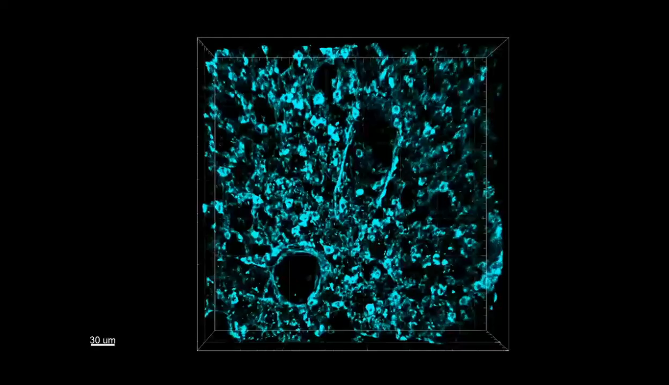
Broadband detector results shared from a customer
3D image of tissue from the intestine of a mouse

Slide 17


Thank and Questions
This project has received funding from the European Union’s Horizon 2020 research and innovation programme under grant agreement No. 101004462

Slide 18
Dissemination and Outreach
The following Papers and Posters have been published:
Article in the Review of scientific instruments: Integration of a superconducting nanowire single-photon detector into a confocal microscope for time-resolved photoluminescence (TRPL)-mapping: Sensitivity and time resolution (http://dx.doi.org/10.1063/5.0134451)
Poster at SPIE PhotWest: Integration of a superconducting nanowire detector into a confocal microscope for TRPL-mapping: sensitivity and time resolution (https://doi.org/10.1117/12.2647548)
Poster at MRS : Time-Resolved Photoluminescence Mapping of CIGS Devices Using a Combination of a Superconducting Nanowire Detector and a Confocal Microscope (https://www.mrs.org/meetings-events/presentation/2023_mrs_spring_meeting/3835677-202304110900)
Poster at HOPV: (https://www.mrs.org/meetings-events/presentation/2023_mrs_spring_meeting/3835677-202304110900)
Notes:
18

