Slide 1
Cité des métiers (City of trades)
Switzerland’s largest exhibition on careers and training
Tuesday 25 to Sunday 30 November, 2025 at Palexpo
Free admission
Fabienne Landua
April 15, 2025

Slide 2
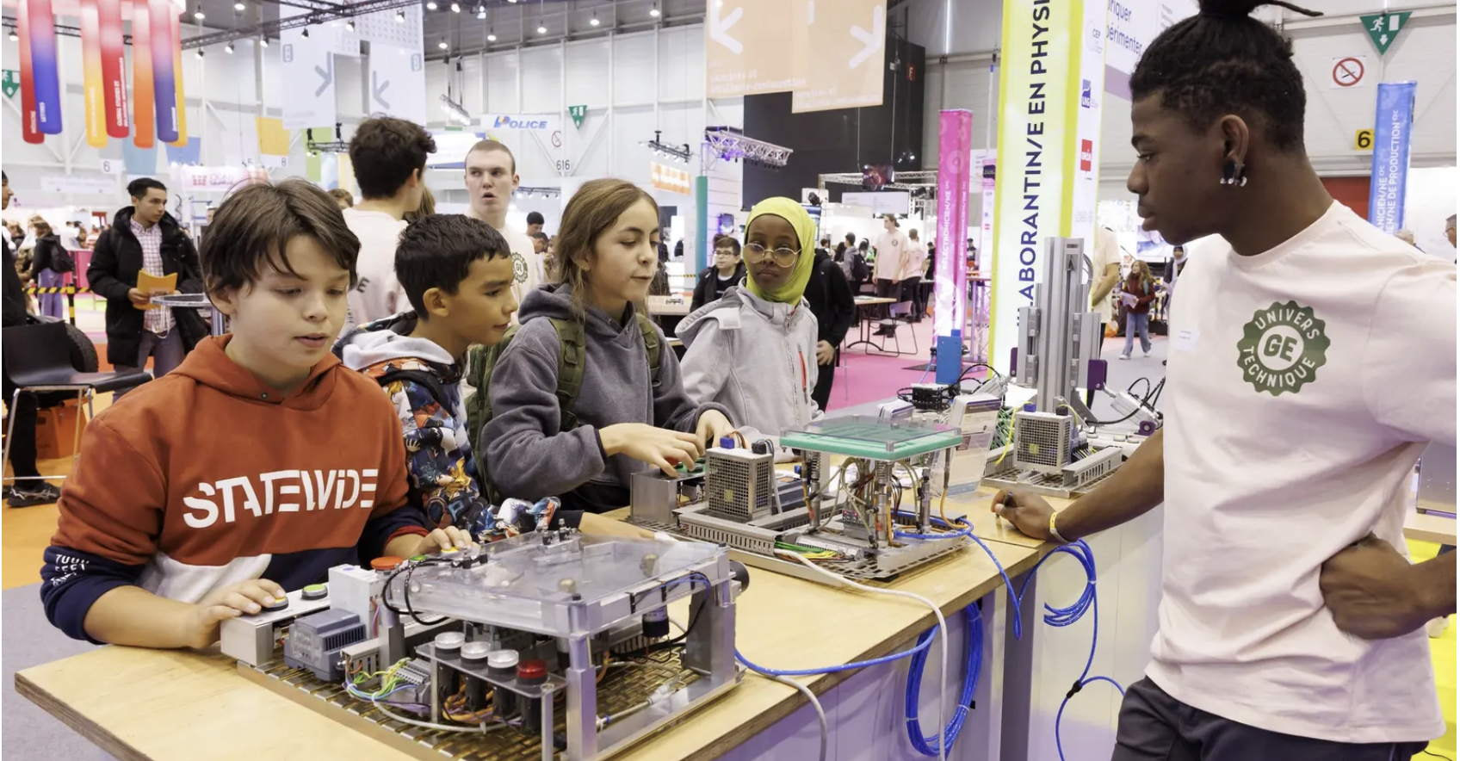
"Switzerland's largest education exhibition gave 30,000 students the opportunity to discover more than 400 professions".
Tribune de Genève photo edition 2022
Image : Tribune de Genève, KEYSTONE/SALVATORE DI NOLFI

Slide 3
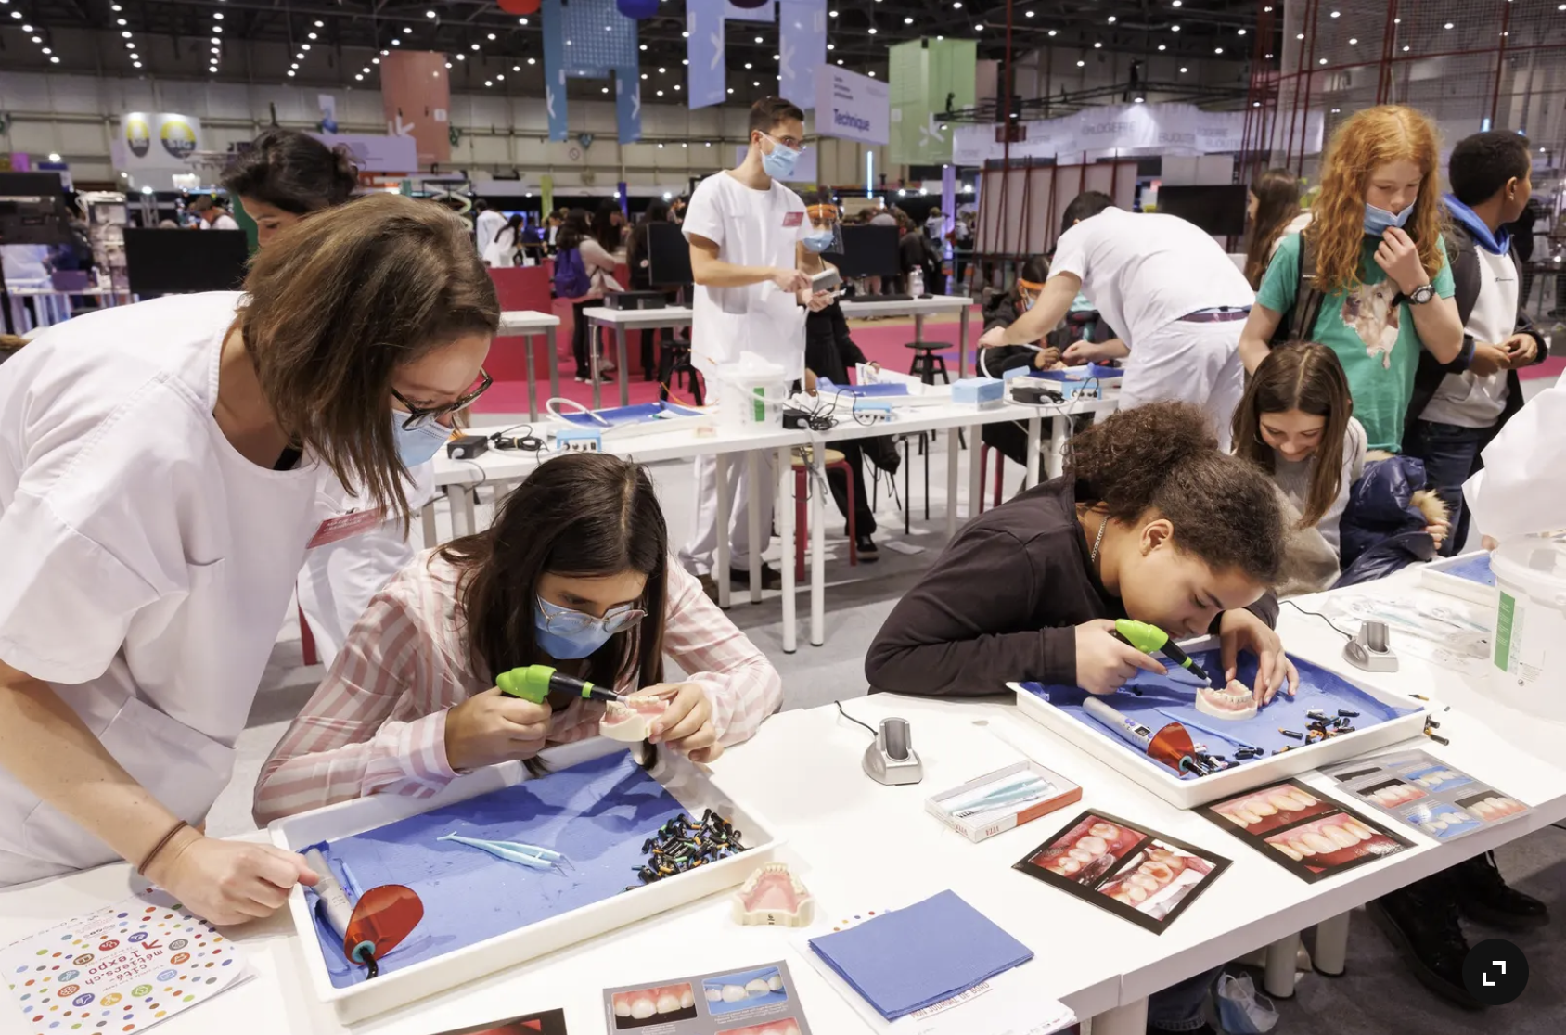
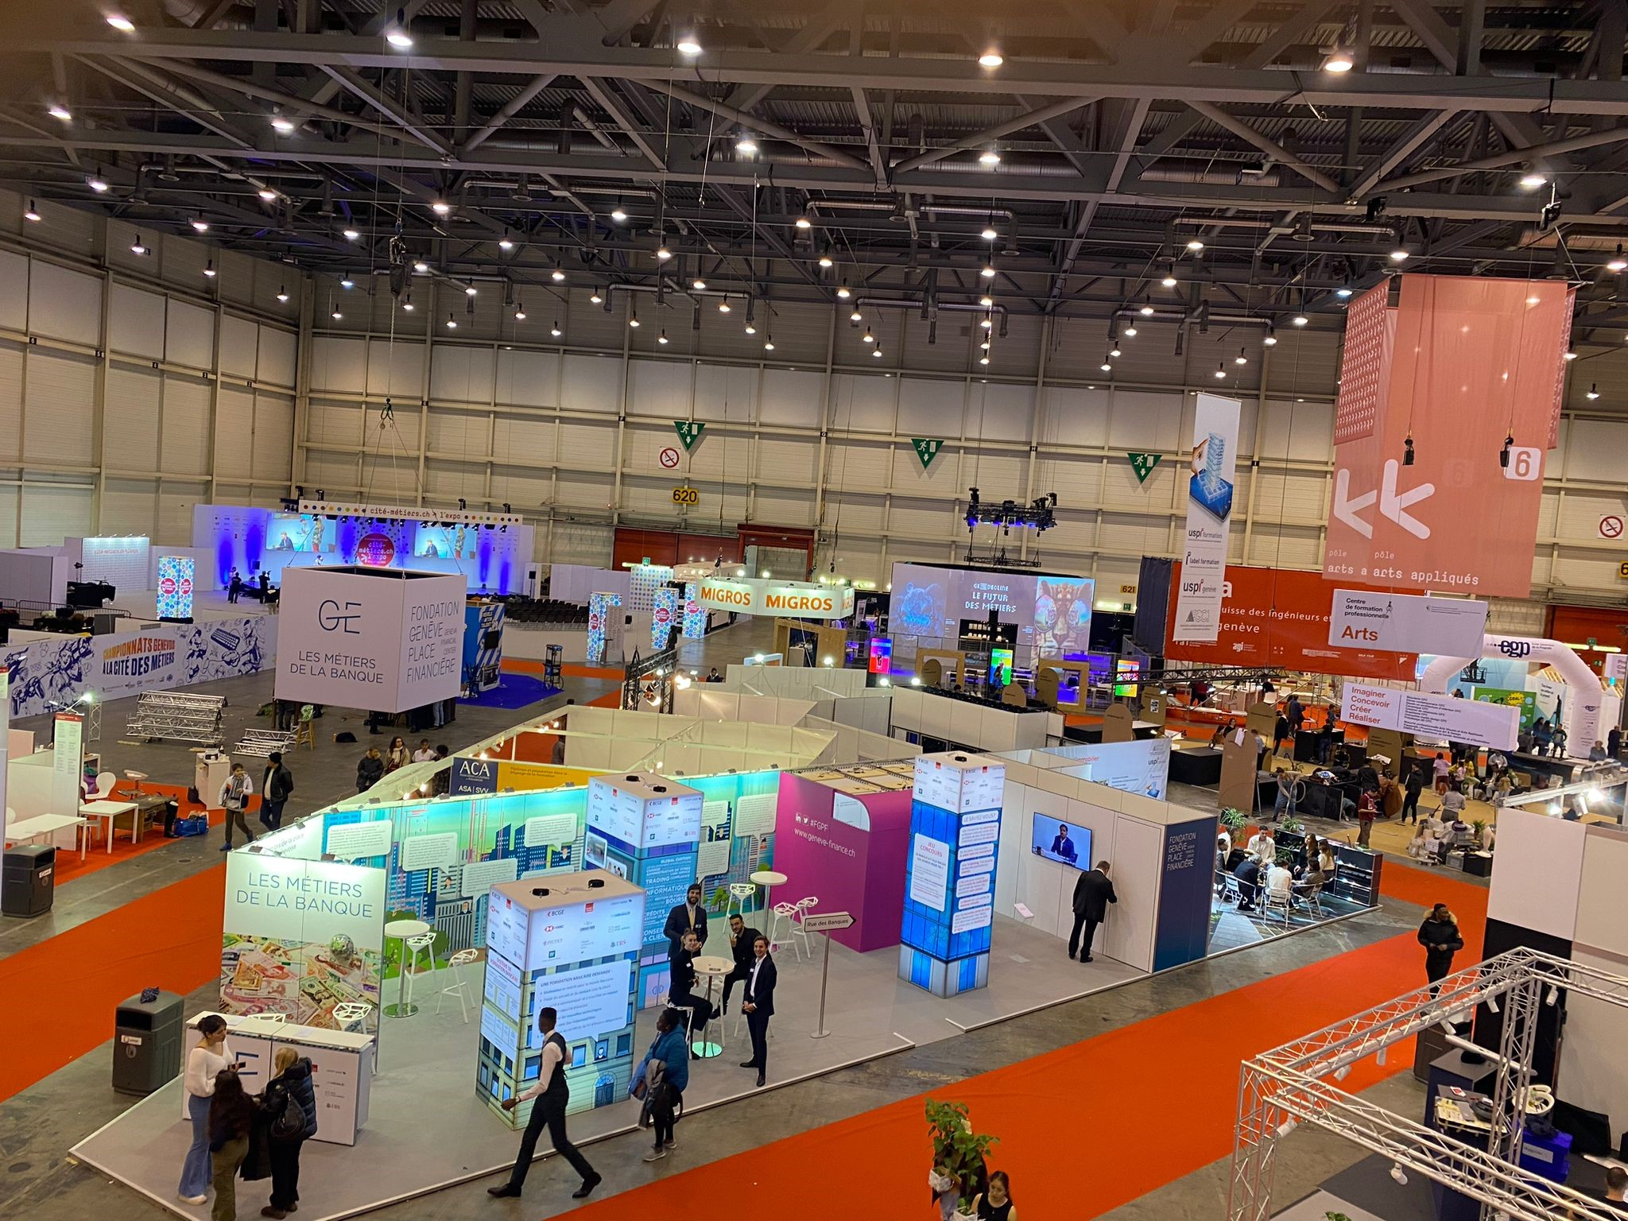
What is the Cité des Métiers?
1) Objectives > to enable young people and adults:
  discover trades in actions
  exchange ideas with apprentices and professionals
  obtain career guidance
2) Key figures (2022):
100 000 visitors
  27 000 m²
  400 trades represented
  3) Organisation > tripartite comprising the Department of Public Education, Training and Youth, the Union of Geneva Employers' Associations and the Geneve Community of Trade Union Action.
Images : Tribune de Genève, KEYSTONE/SALVATORE DI NOLFI

Slide 4
CERN is guest of honor 2025
CERN, accélérateur de futurs talents
CERN, accelerating future talent
1) Stand space at Palexpo : 828m²
recalibrated in an exhibition on the first floor of the Globe 350 m², inauguration around December 9
2) Budget > MTP validation
3) Creation of a dedicated project > project meetings every 2 weeks since January.
4) To reinforce educational values, a local design school, interior design section, works on our stand as part of their study project.
Follow up with the school:
Analysis and concept 20.03.2025
Development 17.04.2025
Project 12.06.2025
Image : Shutterstock, image de la semaine

Slide 5
Stand contents (Bilingual FR + GB)
Exhibition and demonstrations:
Focus on interactions with CERN people
For different jobs: e.g. "Which job matches with you? "dating style app
Screens with professionals talking about their day-to-day work
3 demonstration areas for workshops
Space for learning centre
Space for HR
Introduction to Future Colliders and promotion of Science Gateway
Lectures, guides, interactive games, interactive tunnel
Storage areas
Constraints and opportunities
Respect for the environment, use of the modular system, reuse of supports after the event
Accessibility, mobility, circulation, legibility

Slide 6

Organizers' communication plan
Mini-series in early July
Official spots for parents and teachers and a special for young people
Poster in progress
Press release at the start of the school year in September
Website with dedicated program area early September
Inauguration
From the show and our stand on Tuesday November 25 between 10:00 and 12:00
In the presence of Anne Hiltpold, State Councillor, Canton of Geneva, and Federal Councillor Guy Parmelin
Image : Shutterstock, image de la semaine

Slide 7

Save the date!
Tuesday 25 to Sunday 30 November, 2025 at Palexpo
We'll need your input beforehand
and you on the CERN stand

