Slide 1

High Pressure (HP) TPCs with Micromegas detectors
Zhiyong Zhang
On behalf of USTC MPGD research group
University of Science and Technology of China
12th symposium on LTPCs， December 15th-17th，2025

Slide 2

contents
01
Why high pressure (HP)
02
Micromegas detectors for HP operation
03
The HP-TPCs of PandaX-III and MeGaT

Slide 3

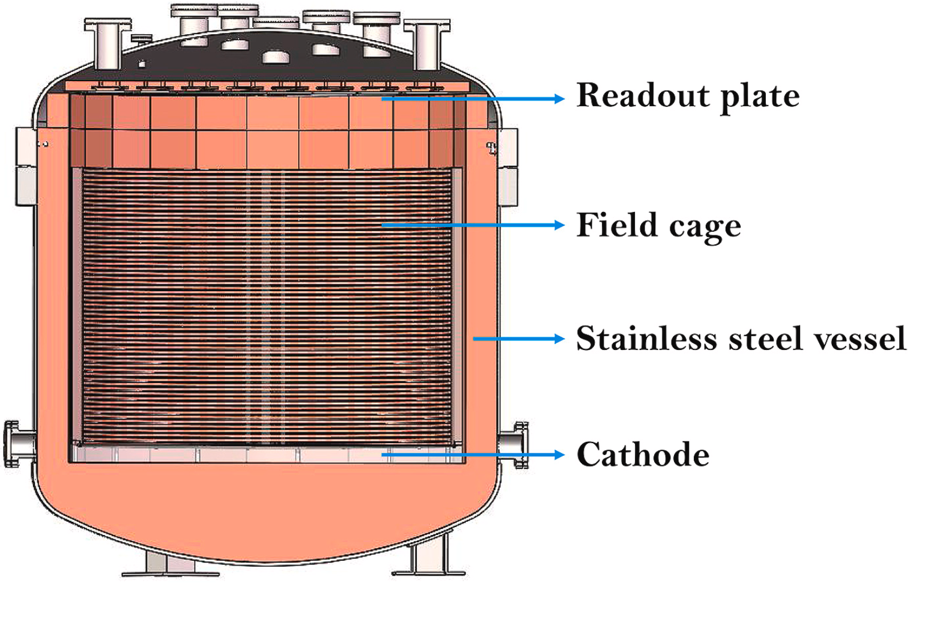
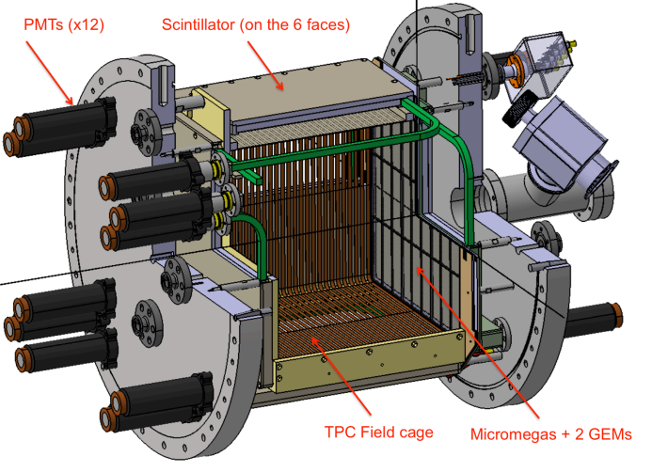
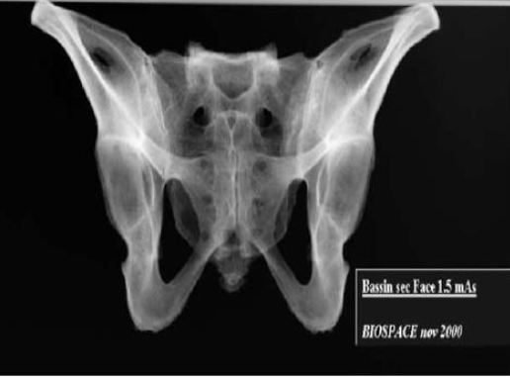
Why do we need high pressure?
Extend dynamic range for energy measurements of charged particles
From keV to MeV: dark matter, neutrino energy spectrum etc.
While maintaining the tracking capability compared with liquid one
Enrich target materials for rare event searches
Dark matter, 0νββ Decay etc.
Improve the detection efficiency for X-ray/γ-rays
For astrophysics, Medical/industrial imaging etc.
PandaX-III
HARPO
X-ray imaging （75KeV）

Slide 4
Demands for high pressure TPC
Experiments and applications using high pressures
Physics/application scenarios | Experiment name | Technical features
Dark Matter (Low-Mass WIMPs) | TREX-DM | 10 bar，Micromegas(low background)
0νββ Decay (¹³⁶Xe) | NEXT、PandaX-III | 10 bar, SiPM、PMT、Micromegas(low background)
Gamma-ray astrophysics | SMILES、MeGaT、HARPO | 3-5 Bar, Micromegas/μPIC
Medical imaging/Industrial inspection | X-ray Imaging/Inspection | High pressure for efficiently imaging with high resolution and single photon counting capability

Slide 5
contents
01
Why high pressure (HP)
02
Micromegas detectors for HP operation
03
The HP-TPCs of PandaX-III and MeGaT

Slide 6

Micromegas detectors for HP operation
01
The thermal bonding Micromegas and its performance
02
Optimization for HP operation

Slide 7
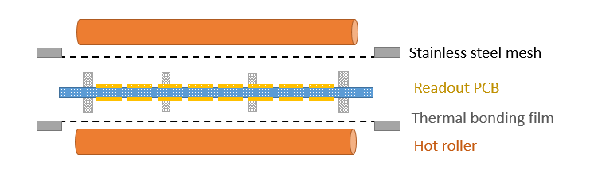
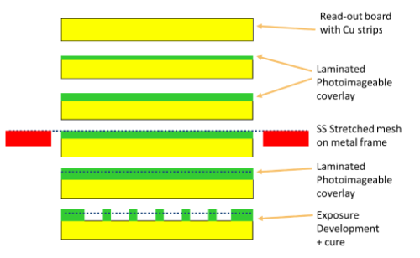
The thermal bonding method
It provides a concise and etching-free technology for fabricating Micromegas-like detectors.
Micromegas in a Bulk
Thermal bonding processing
User-friendly for laboratory operations
Convenient for constructing new structures
Low cost
Spacer diameter: Φ0.5mm to Φ1mm, with a pitch of ~10mm
Suitable for large-area fabrication
Spacer area: less than 1%
Jianxin Feng et al,. NIM-A 989 (2021) 164958.

Slide 8
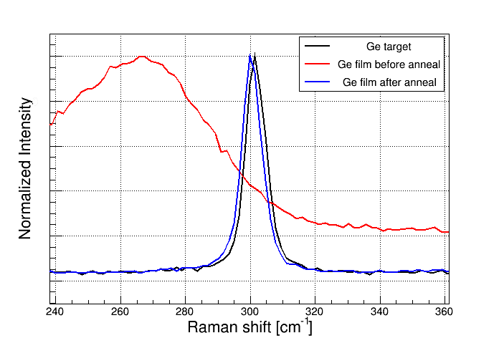
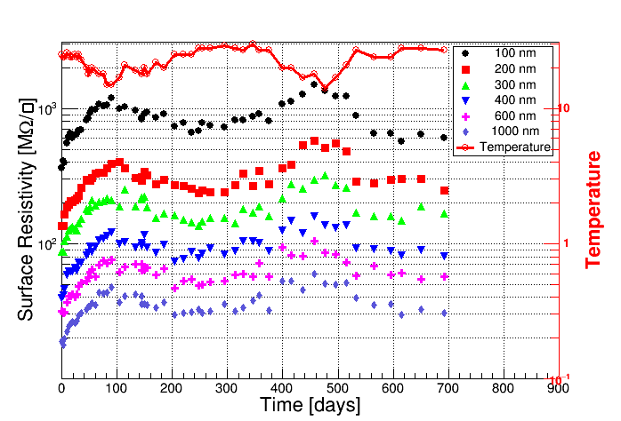
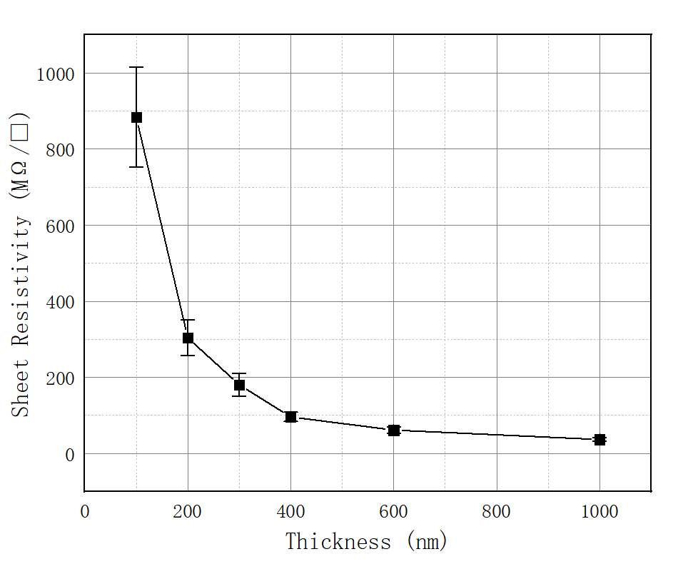
Germanium films
Ge films as the resistive anode
~ m² coating area, 100 nm -1 μm film thickness
Amorphous
Crystal Ge
Raman spectrum of Ge films
Sheet resistivity versus temperature and film thickness
Coated by vacuum evaporation on low temperature, rough substrate
Crystalline Ge
Amorphous Ge
(Low resistivity)
annealing treatment (high temperature)
(1000 times higher)
Jianxin Feng, Zhiyong Zhang, Jianbei Liu et al., NIM-A 1031 (2022) 166595.
Notes:
single crystal Ge

Slide 9
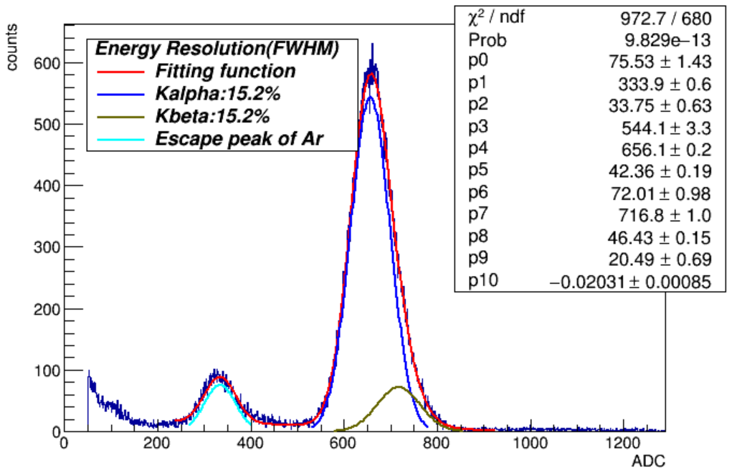
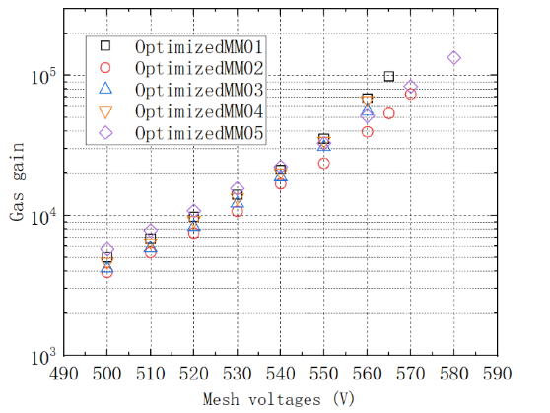
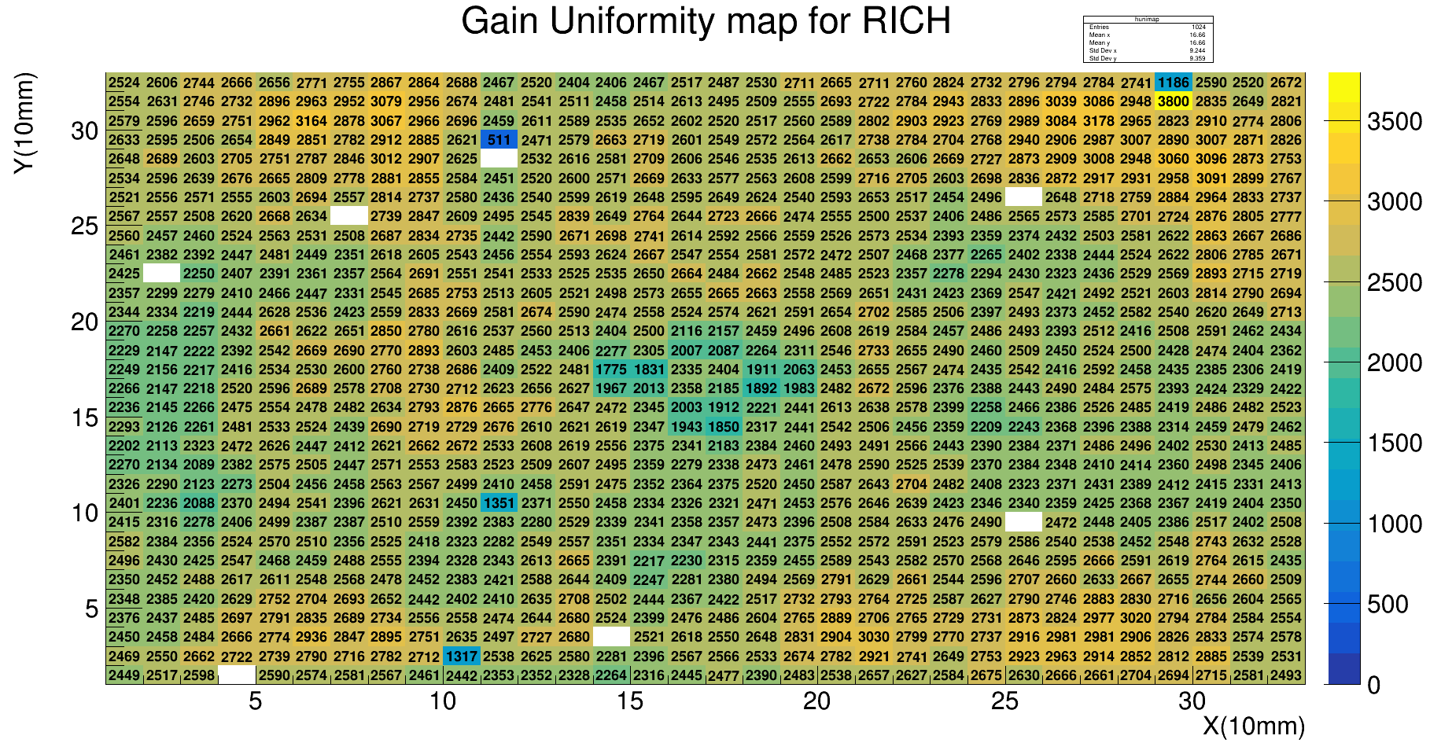
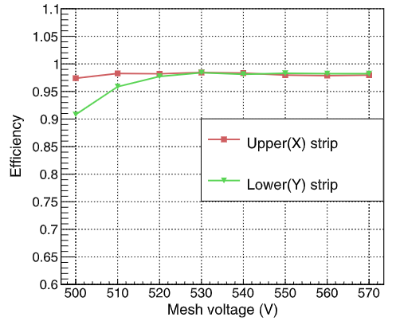
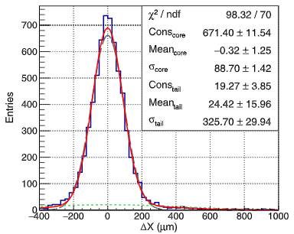
Basic performance
X-ray test（5.9 keV）
Gas gain：~10⁵ (Ar+7%CO₂)
Energy resolution：~15% (FWHM)
Non-uniformity: ~5% for 30×30 cm²
Electron beam（5 GeV）
Efficiency：>98%
Spatial resolution：65μm
~10⁵
~15% (FWHM)
ε >98%
RMS/MEAN=~5%
Jianxin Feng, Zhiyong Zhang, Jianbei Liu et al., NIM-A 989 (2021) 164958.
σ_{X}=65 μm

Slide 10


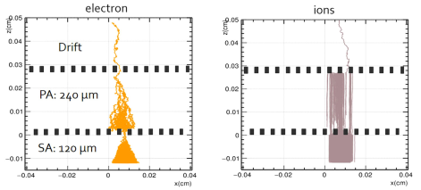
High gain, low IBF with DMM/TMM
DMM：Double Micro-Mesh gaseous structure
TMM：Triple Micro-Mesh gaseous structure
Drift region
~1-3 mm
Drift region
~3-5 mm
~0.2 mm
PA
~0.2 mm
PA
SA
~0.2 mm
SA
~0.1 mm
TA
~0.1 mm
DMM: ~0.03% IBF for high rate TPC
TMM: ~0.003% IBF at gas gains exceeding 1 × 10⁵ for visible light detection.
Zhiyong Zhang et al., NIM-A 889 (2018) 78–82
Binbin Qi et al., NIM-A 976 (2020) 164282
Kunyu Liang, et al., NIM-A,1070 (2025) 170033.

Slide 11
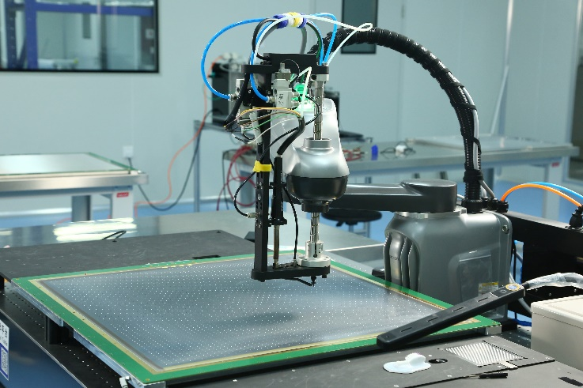
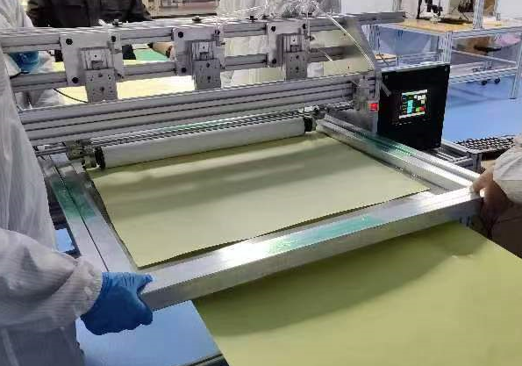
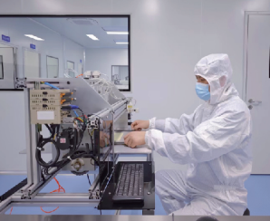
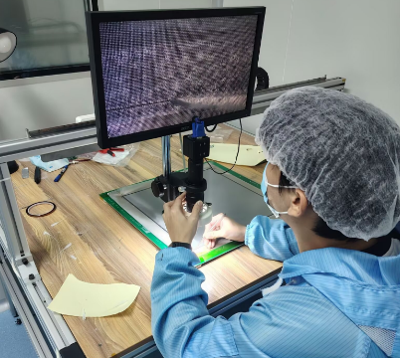
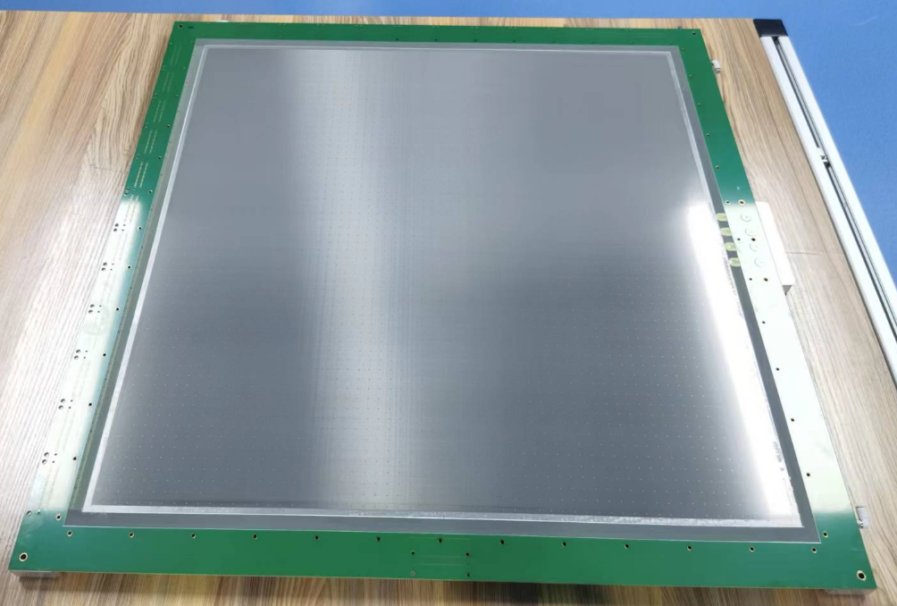
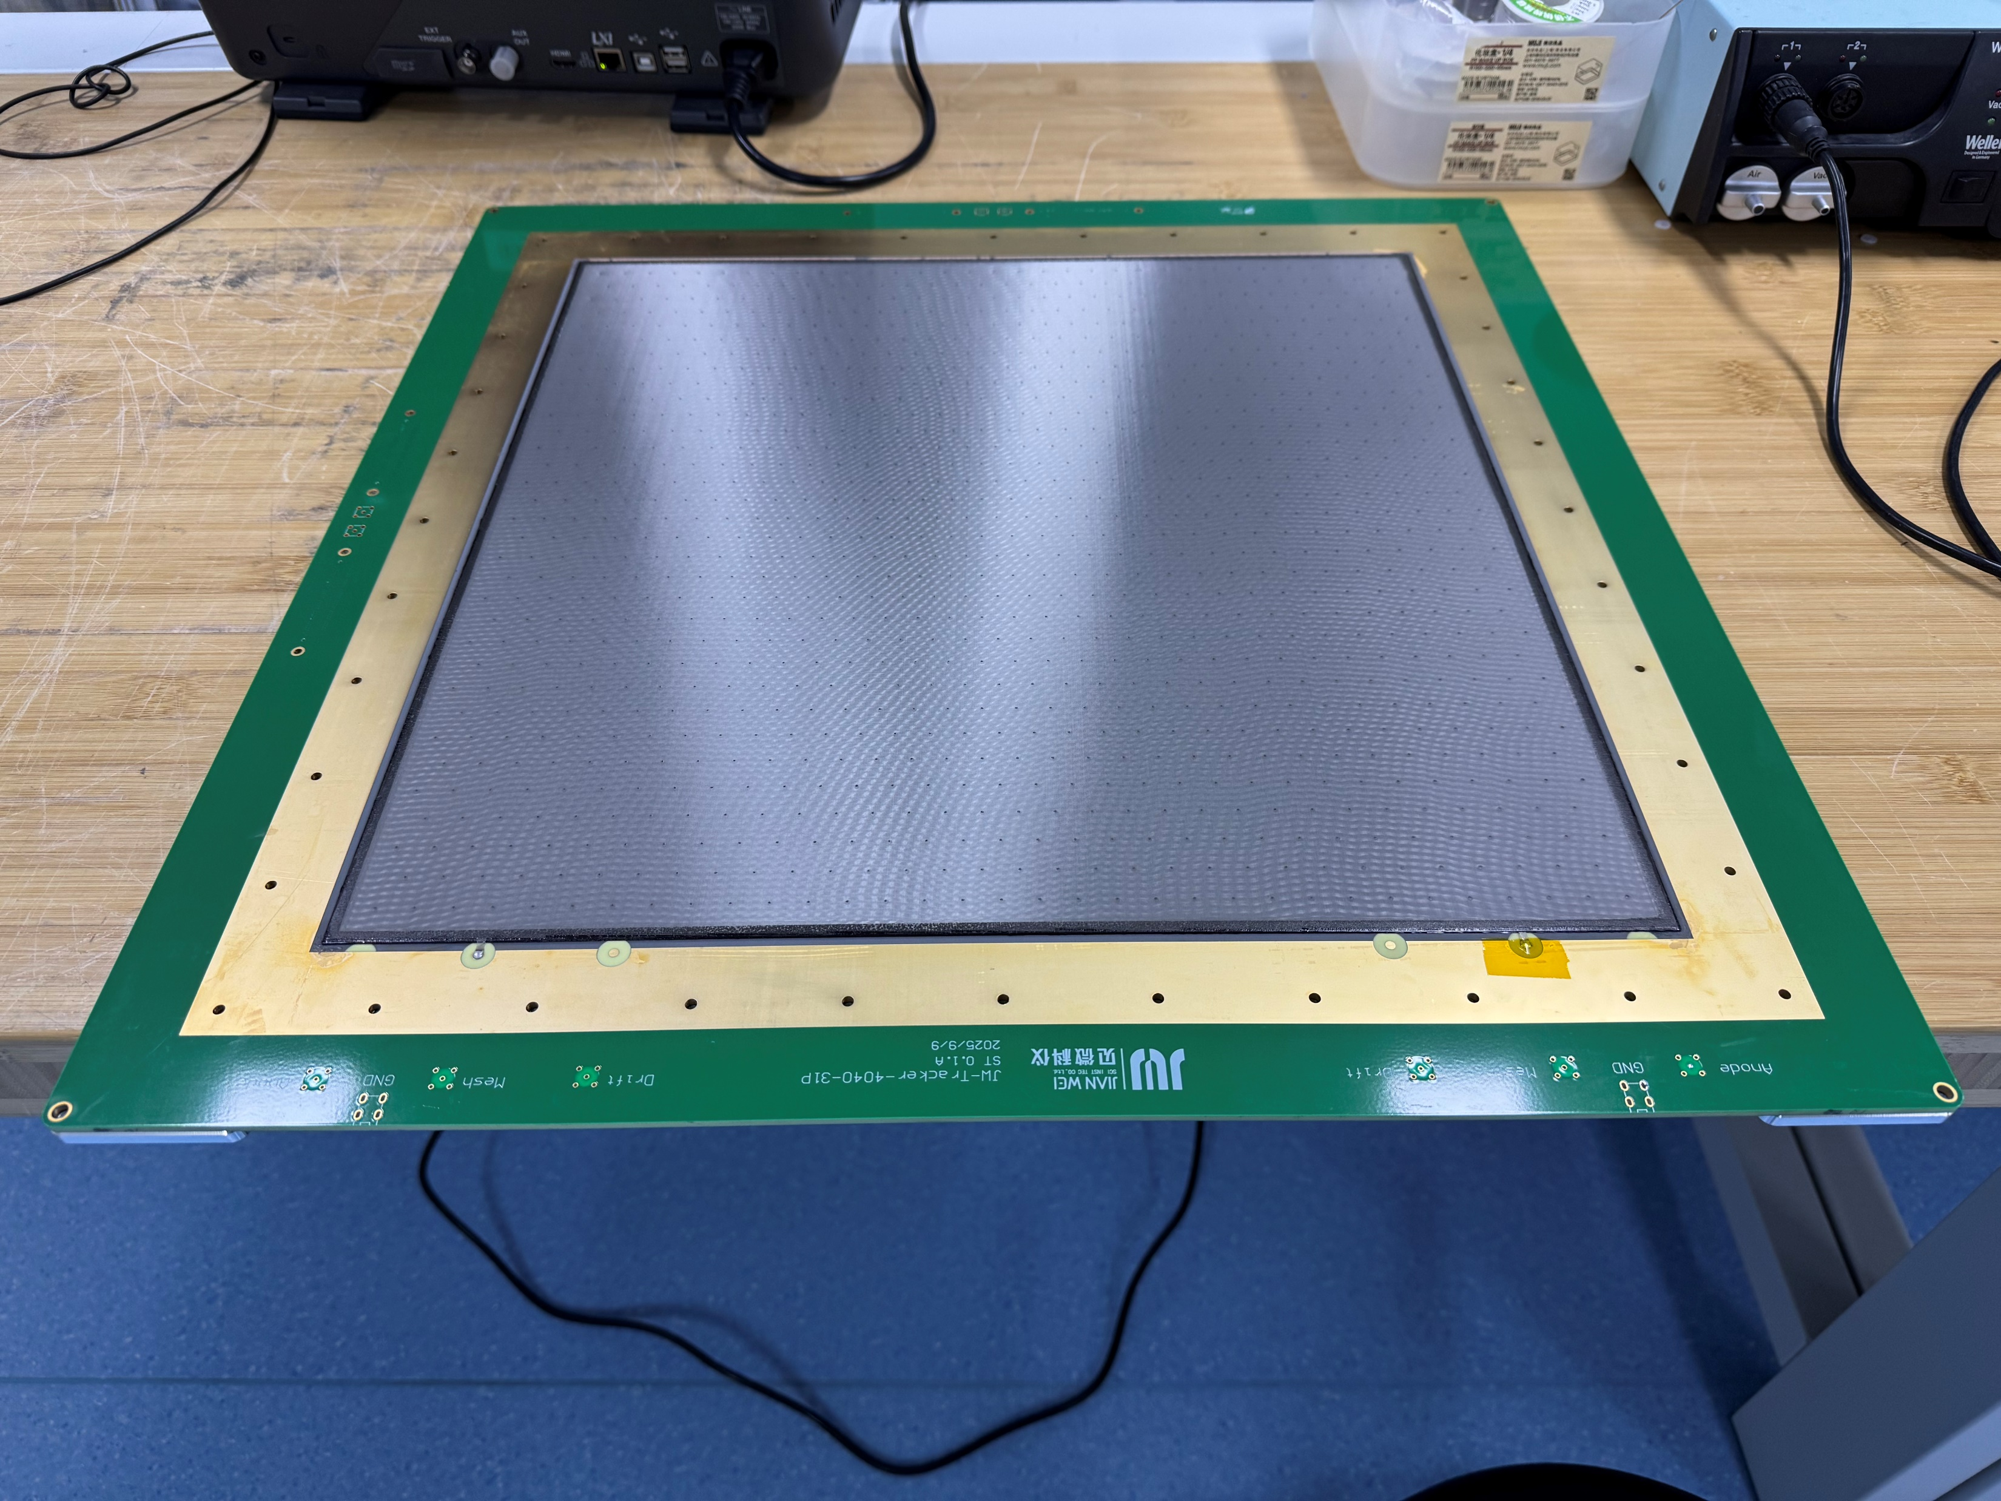
Detector production
60 × 60 cm²
Micromegas
40 × 40 cm²
Double Micromegas

Slide 12
Micromegas detectors for HP operation
01
The thermal bonding Micromegas and its performance
02
Optimization for HP operation

Slide 13
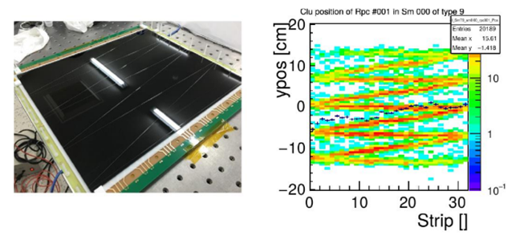
Optimization for HP operation
Spark occurs in local regions with abnormally strong electric fields or high charge densities.
Optimizing spacers to avoid overflow glue
Higher field
Similar phenomenon observed in MRPC
(by Ingo Deppner for CBM-TOF)
Higher field

Slide 14
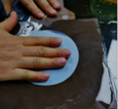
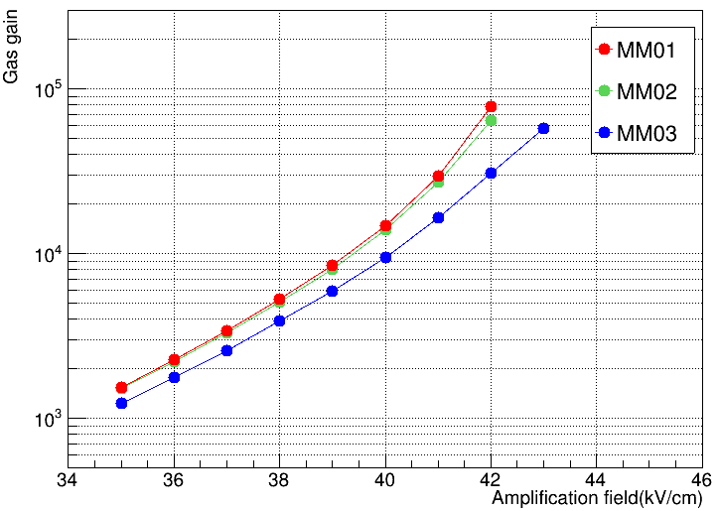
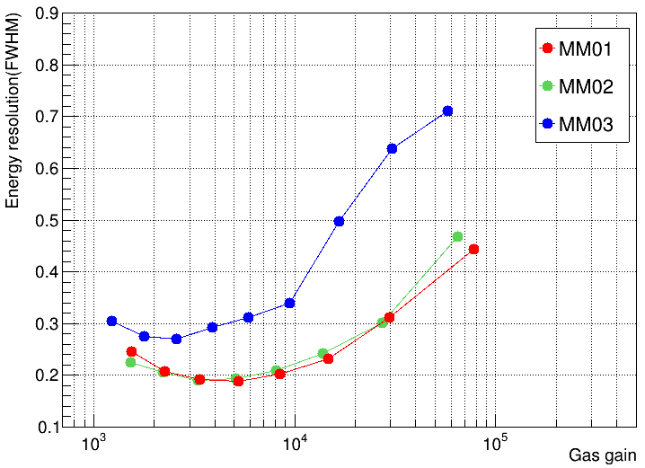
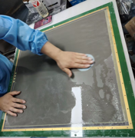
Optimization for HP operation
Polishing anode plane to get a smooth surface without burrs
MM03 was not polished
Gas gain curves (left) ; The energy resolution (FWHM) versus the gas gain(right)
Before coating Ge film anode …
Sicheng Wen, et al., NIM-A 1062(2024) 169206.

Slide 15
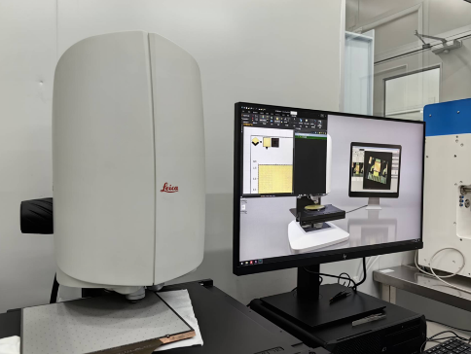
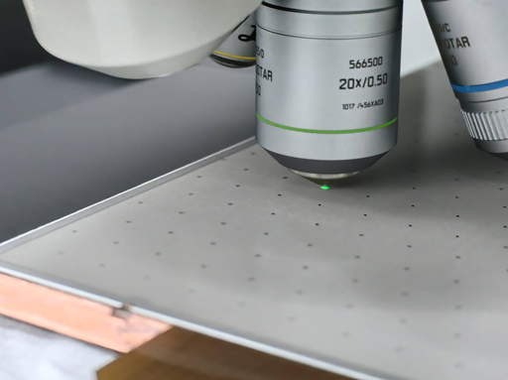
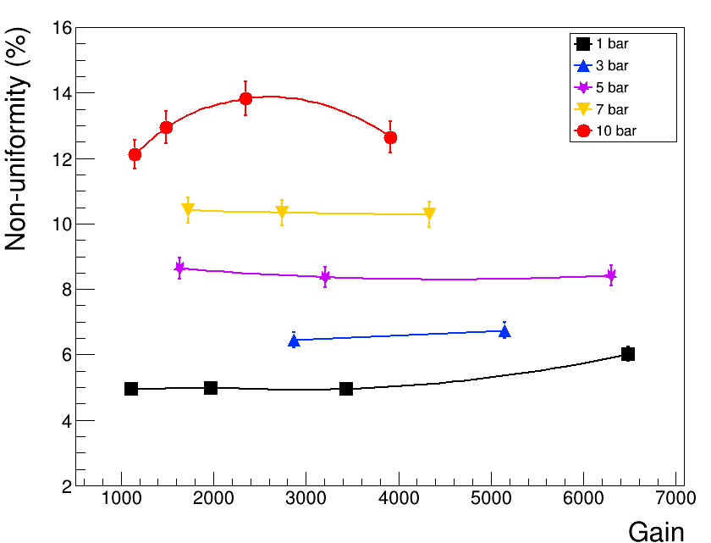
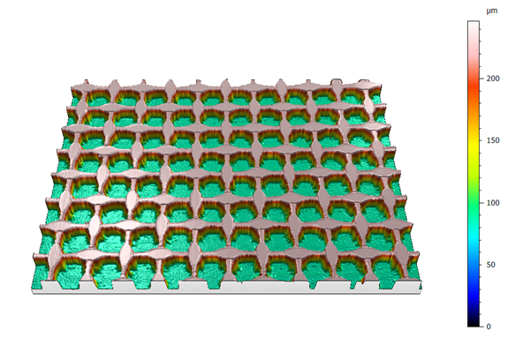
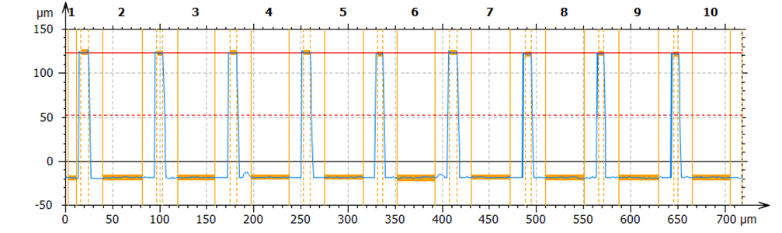
Optimization for HP operation
Larger gain fluctuation needs better gap uniformity
A Leica digital confocal microscope device
Non-uniformity versus gains at different gas pressures (using 37Ar source).
Reconstructed 3D、2D imaging for the avalanche structure

Slide 16
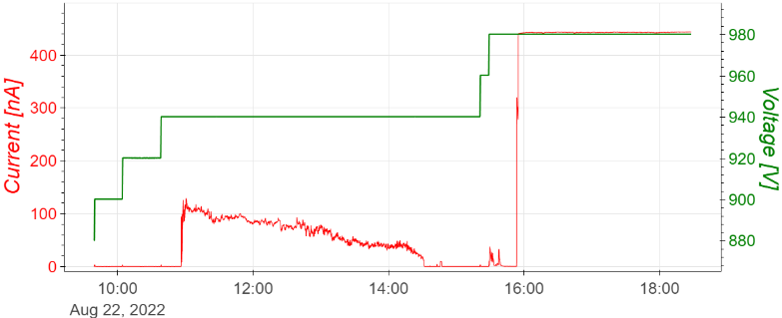
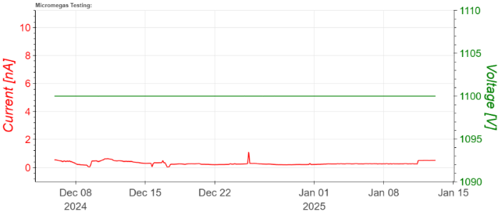
Optimization for HP operation
Results for long-term operation before and after Optimization
During 8 days
Over 40 days
<1 nA
The voltages and leakage currents versus time in 10 bar Ar/Iso (97.5/2.5)
Yunzhi Peng, Zhiyong Zhang, Sicheng Wen and Jianbei Liu, 2025 JINST 20 C09014.

Slide 17
contents
01
Why high pressure (HP)
02
Micromegas detectors for HP operation
03
The HP-TPCs of PandaX-III and MeGaT

Slide 18
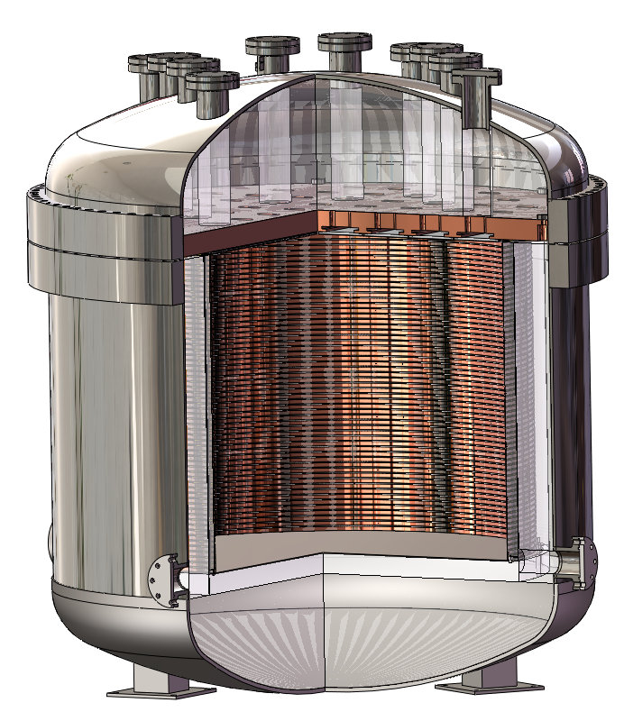
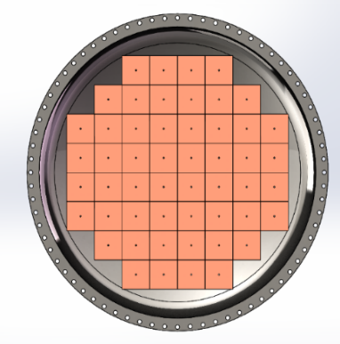
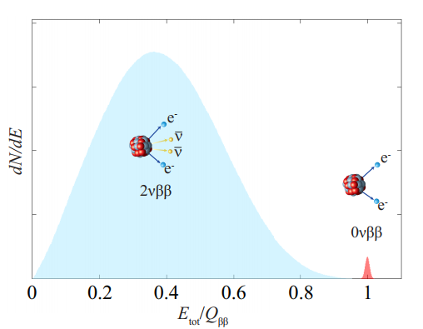
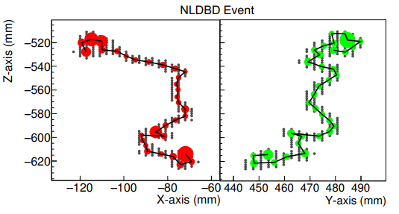
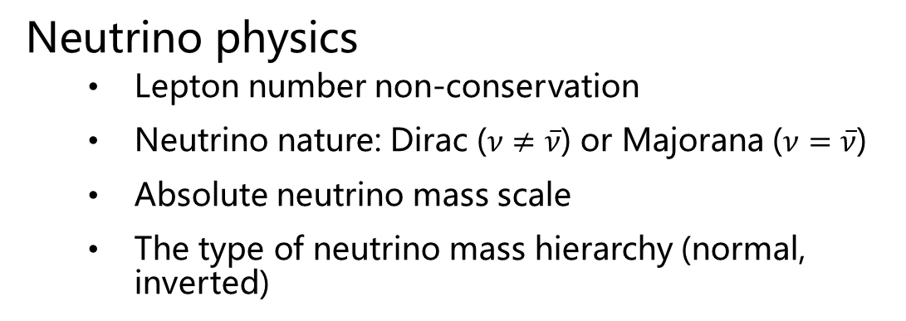
HP-TPC of PandaX-III experiment
Neutrino physics
Lepton number non-conservation
Neutrino nature: Dirac ($ν≠\overline{ν}$) or Majorana ($ν=\overline{ν}$)
Absolute neutrino mass scale
The type of neutrino mass hierarchy (normal, inverted)
Requirements for detectors
Low radioactive background
Long-term stability at 10 bar Xenon (1%TMA)
Energy resolution 3% @ 2.458 MeV
20×20 cm² MMs for charge readout (52)

Slide 19

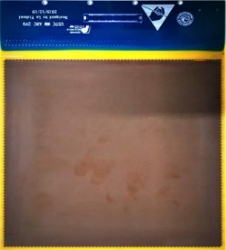
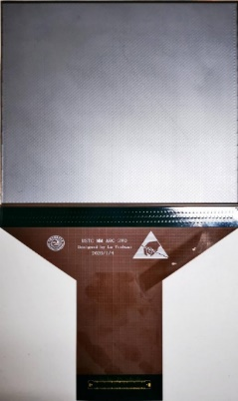
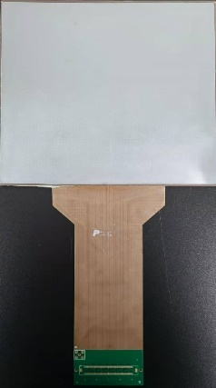
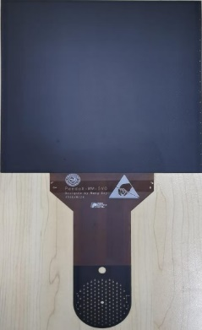
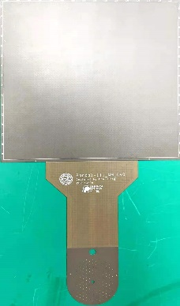
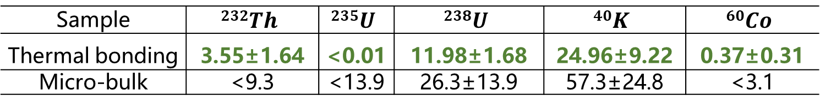
Low background Micromegas in high pressure gas
Development of high radiopurity Micromegas
12/2019
02/2020
04/2020
08/2020
11/2020
06/2021-now
V1
V2
V3
V4
V5
V6
Stainless steel mesh
Thermal bonding film
Flexible PCB
Ge anode
Copper strip
Pure copper substrate
Very low background rate: μBq/cm²
Sample | $$232Th$$ | $$235U$$ | $$238U$$ | $$40K$$ | $$60Co$$
Thermal bonding | 3.55±1.64 | <0.01 | 11.98±1.68 | 24.96±9.22 | 0.37±0.31
Micro-bulk | <9.3 | <13.9 | 26.3±13.9 | 57.3±24.8 | <3.1
Sicheng Wen, et al., NIM-A 1062(2024) 169206

Slide 20
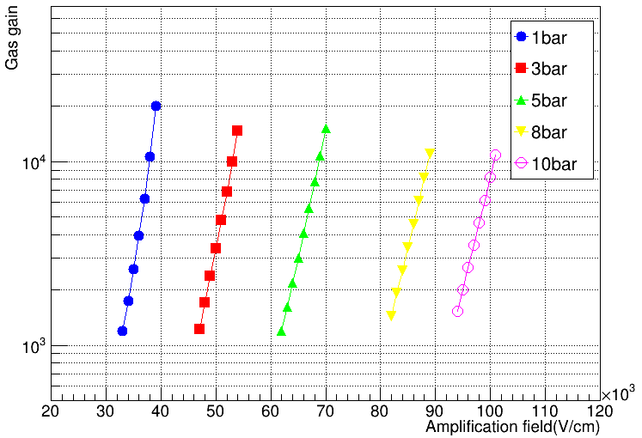
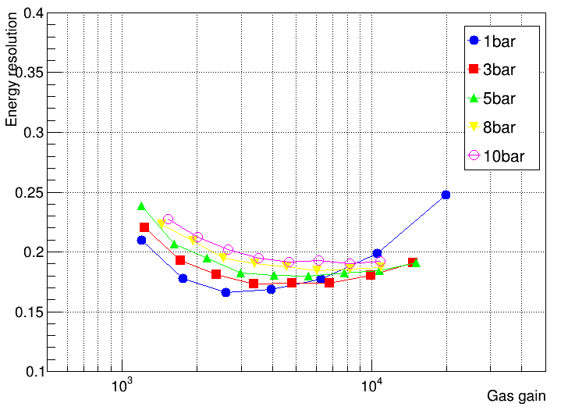
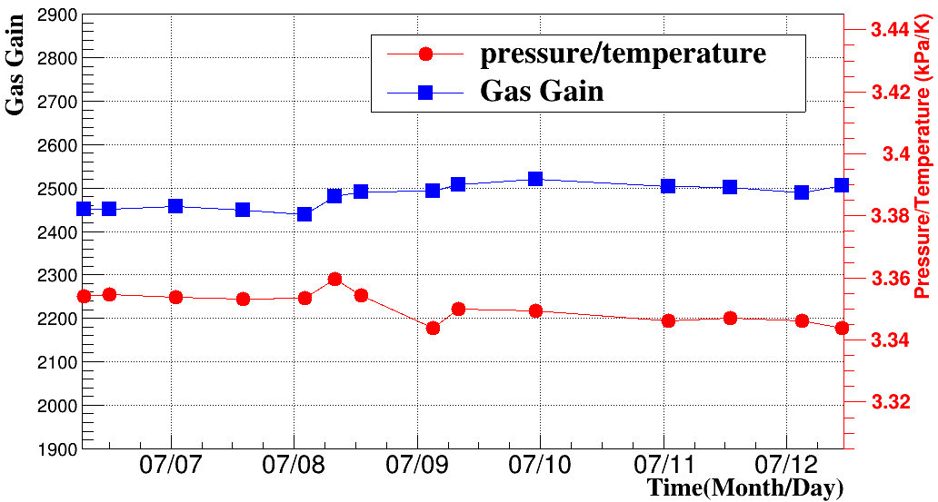
Micromegas performance for high pressure
Test results in high pressure gas
>10000 gas gain
<20% (FWHM) energy resolution
>150 hours
Test at 10bar Ar(2.5% Iso) with a 5.9 keV X-ray source
Sicheng Wen, et al., NIM-A 1062(2024) 169206

Slide 21
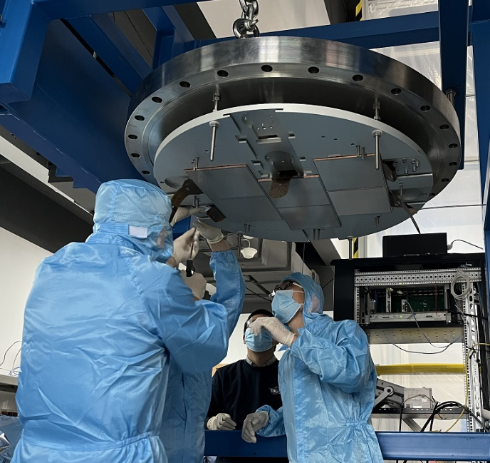
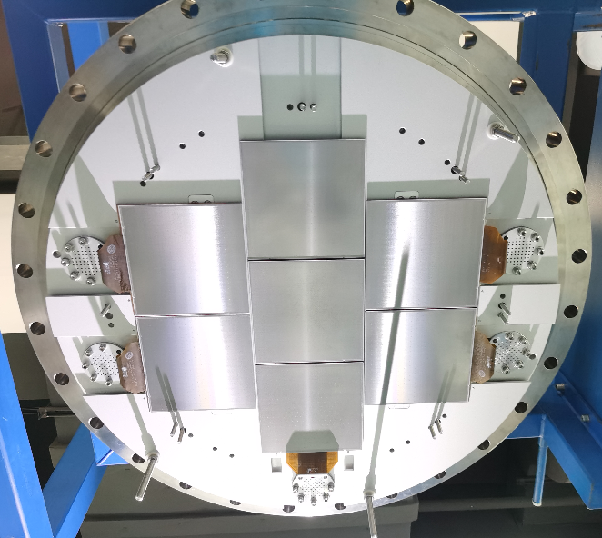
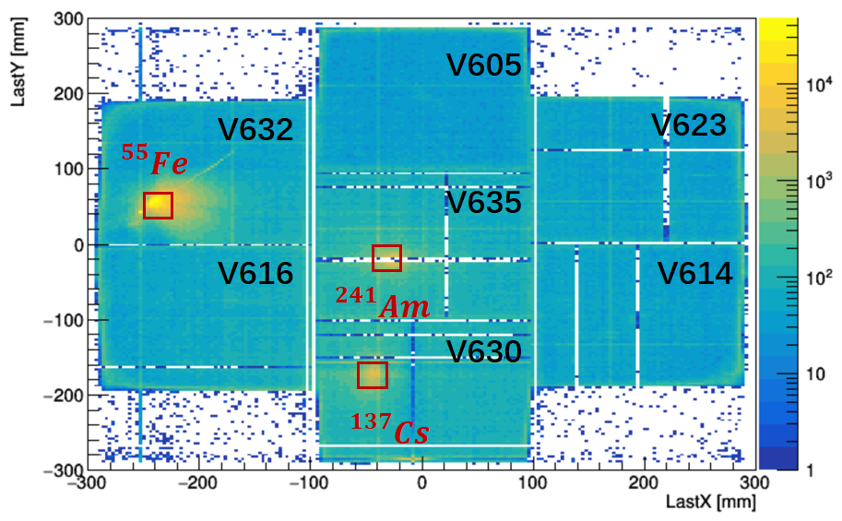
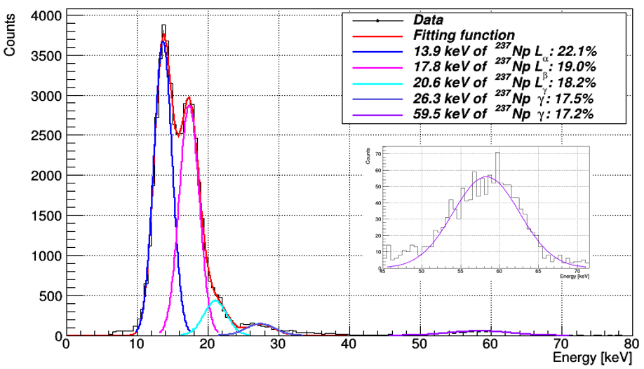
Construction and test of the HP-TPC
1-10 bar Ar+2.5%Iso gas
Using X-ray sources of ⁵⁵Fe, ²⁴¹Am, ¹³⁷Cs
No-signal channels due to the bad connections

Slide 22



Construction of 52 detector prototype
Readout plane with 52 Micromegas
Detectors installation completed
There are still many efforts need to be conducted before we can start
Scientific runs

Slide 23







HP-TPC for MeV Gamma ray Telescope (MeGaT)
T. Takahashi et al., Astroparticle Physics 43 (2013) 142–154
Fermi-LAT
EGRET
Comptel
Comptel (1991-2000) 63 sources 1-30MeV
EGRET (1991-2000) 271 sources>100MeV
Fermi (2008-) 6000+ sources>100MeV
The great scientific potential for MeV gamma-ray gap.

Slide 24


Compton camera with HP-TPC
The energy is too high to be collimated
It is difficult to measure 3D trajectories of electrons, which are produced in Compton scattering and pair conversion due to Coulomb multi-scattering.
Astroparticle Physics 97 (2018) 10-18
PSD
ARM
It is practical to improve the e-tracking measurement by reducing the material density with gas detectors

Slide 25


MeV Gamma ray Telescope (R&D)
Detector design and prospective sensitivity
TPC+CZT： 50×50× 50 cm³，3-5 bar
preliminary
Expected Performance:
√Wide Energy Range: 0.3 MeV – 100 MeV; √High Angular Resolution (PSF): 2° @ MeV, 0.5° @ 100 MeV; √ Gamma Polarization Measurement

Slide 26



Gas options
Good sensitivity needs good angle resolution and high effective area (efficiency)
$$S=E^{2}Φ=\frac{N_{σ} σ_{θ} E^{2}}{ε_{68} ΔE}\sqrt{\frac{π\int{B\left(E\right)dE}}{A_{eff} T }}$$
When electrons pass through 1cm thick 5 bar gas
Gas | z | Scattering angle (σ)
 |  | 0.5MeV | 1MeV | 2MeV
Ar | 18 | 24.2° | 13.4° | 7.4°
CF₄ | 42 | 26.6° | 14.6° | 8.1°
Kr | 36 | 50.4° | 28.4° | 15.3°
Xe | 54 | 73.5° | 44.3° | 23.9°
multi-scattering effect:
σ= $\frac{\text{13.6}\text{MeV}}{βcp}z\sqrt{\frac{X}{X_{0}}}[1+0.038\ln{(}\frac{X}{X_{0}})]$
$$A_{eff}\left(E,θ,φ\right)=A_{geom}\left(θ,φ\right)∙ε\left(E,θ,φ\right)$$
➔ ∝z
We need gas with low scattering effect and high equivalent z value

Slide 27


Detector challenges
Operated in high pressure CF4 gas
Strong electron attachment regions are formed when the relatively weak drift field transitions to the avalanche field.
CF4 is quite special: its electron attachment coefficient increases with the enhancement of the electric field, and this trend precedes the increase in the Townsend coefficient.

Slide 28


Optimization for CF4 gas operation
To enhance electron collection (simulation)
1 bar
11 μm
14 μm
19 μm
3 bar
A typical energy spectrum tested with 55Fe in 1 bar:
~30% FWHM
Electron transparency
5 bar
Counts
Opening rate is optimized to ~40%
Mesh densities (Lines Per Inch)
High density, thin meshes have better transparency by narrowing the attachment region!
ADC channel

Slide 29







Progress on the MeGaT TPC construction
Construction and test of TPC from 1bar to 5bar
A vessel chamber with very thin stainless steel window (0.4mm) has been built for HP of >5 bar operation
A 30×30×30 cm³ prototype has been developed, and is now under testing

Slide 30

Summary
HP-TPC has excellent potential in physics experiments and industrial fields
Dark matter, 0νDBD, neutrino physics and X-ray imaging, etc.
As the operating pressure increases, almost all aspects of the detector's performance become worse
Optimization on the spacers, mesh type, electrodes, and other components are conducted
We developed thermal bonding Micromegas for HP operation, indicating high potential in many experiments

Slide 31

Thank you for your attention!

