Slide 1
Requirements and comparison of readout architectures
Jüri Jõul on behalf of the BGI team
10.04.2025

Slide 2
Introduction
Overview of the system, data rates and requirements

Slide 3
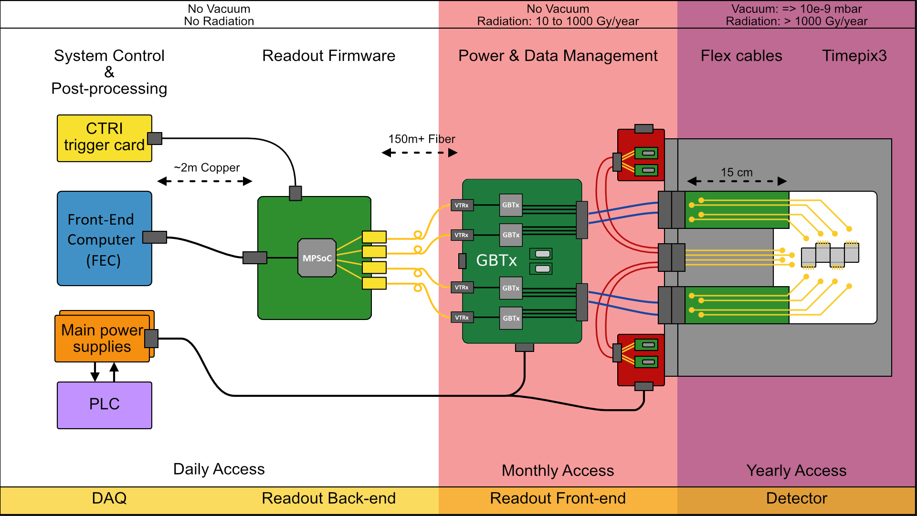
Overview of the BIPXL readout system today

Slide 4
Simplified diagram
Users
Profiles
Publishing
Event processing
Raw data readout
Raw data
Slow control
Slow control

Slide 5
Requirements
Along with expected data rates

Slide 6
Definitions/explanations
“Event” = Timepix or timing data packet with additional metadata from the FPGA
  1 event == 128 bits (b) == 16 bytes (B)
“Processing” = constructing beam profiles from raw data.
  Does not include additional post-processing such as ML-based beam loss removal
  Does not directly apply to the telescope (another Timepix-based system)

Slide 7
Requirements and data rates
BGI
Publish beam profiles every basic period
3–15 Mevents/s
  At least ~1 Mevent/s signal
  At least ~2 Mevent/s beam loss
  Corresponds to at least ~45 MB/s ~= 360 Mbit/s
Almost real-time
Telescope
Perform track reconstruction during measurement
~36 Mevents/s
  All signal
  Corresponds to 550 MB/s ~= 4,400 Mbit/s
Order of 5 seconds of delay between measurements

Slide 8
Event and data rates explained (BGI)
Assumptions and facts:
  A cycle is at least one basic period (1.2 s) long
  1000 events needed to form a usable profile
  Maximum 1000 profiles per cycle. Therefore, for the worst-case scenario, we should consider the shortest cycle of only one basic period with the maximum number of profiles.
  Beam loss occurs at roughly 5% of the profiles
  Maximum beam loss event rate 43000 events/ms
  An acquisition can cover up to 100% of the cycle's duration. This is not strictly true, considering that we limit the acquisitions not to start before the injection, but for a worst-case scenario, it is good enough.
  This, in turn, means that the duration of each profile is at most 1.2 s / 1000 = 1.2 ms
  The amount of events per profile during beam loss can be up to 43000 events/ms * 1.2 ms = 51600 events
Resulting event and data rates:
    95% or 950 profiles have 1000 events per profile: total of 950,000 events per basic period.
    5% or 50 profiles have 51600 events per profile: total of 2,580,000 events per basic period.
    In total, this amounts to 3,530,000 events per basic period (slightly under 3 Mevents/s).
    Considering that unpacked, each event is composed of 16 bytes (128 bits), we can expect a data rate of up to 56,480,000 B/Basic Period or 47,066,667 B/s ~= 54 MB/BP or 45 MB/s ~= 431 Mb/BP or 360 Mb/s.

Slide 9
Event and data rates explained (telescope)
Assumptions and facts:
  The beam rate is up to 10 million particles/spill
  One spill is of the order of 5 seconds
  This results in a particle rate of ~2 million/s during the spill
  Each particle optimally triggers a cluster with 3 hits on a single detector
  The telescope has six planes, that is six detectors
Resulting event and data rates:
  Total event rate is therefore ~36 Mevent/s
  Considering again the event size of 128 bits or 16 bytes, the corresponding data rate is ~550 MB/s ~= 4400 Mb/s

Slide 10
Candidate architectures
Quick overview followed by an in-depth comparison

Slide 11
Quick overview of architectures
ATS SoC (standalone)
Hosted SoC (FEC + PCIe SoC)
Storage + offline DP
Optional CCR server
for raw data storage and offline processing
(alternative to TN)
Storage + offline DP
Dedicated 10 GbE link
FESA (SC + online DP)
PS
ATS SoC as FEC
Regular FEC
FESA (SC + online DP)
FPGA
PL
PCIe
+ hosted SoC
FPGA
PS
PL
8 fibres (GBTX)
Readout frontend
(link to detectors)
Readout frontend
(link to detectors)
Abbreviations:
SC – Slow Control
DP – Data Processing

Slide 12
Processing capabilities
Device | CPU | CPU-Mark (MT) | CPU-Mark (ST) | Mevents/s (ST)
HP-FEC | AMD EPYC 9124 | 43,681 | 2,690 | ???
CAD Machine | Intel Xeon W-2225 @ 4.10GHz | 10,486 | 2,642 | 11.4–18.3
FEC (Siemens) | Intel Core i5-8500 @ 3.00GHz | 9,537 | 2,444 | 9.8–16.3
FEC (Kontron) | Intel Core i5-3550S @ 3.00GHz | 4,434 | 1,941 | 8.0–13.2
ATS SoC | ARM Cortex-A53 4 Core 1199 MHz | 407 | 181 | 1.3–2.5

Slide 13
Raw data offloading (recommended by review)
ATS SoC (standalone)
Hosted SoC (FEC + PCIe SoC)
IPbus
    Limited to ~600 Mbit/s == ~75 MB/s == <5 Mevent/s
Alternative: 10 GbE port exposed to PS
    Theoretically possible, feasibility unknown
10 GbE NIC
    Throughput likely limited by disks when using NFS
      <550 MB/s* == <36 Mevents/s
    Straightforward implementation
*Based on experiences with the Head-tail monitor (Tom Levens)

Slide 14
Maintainability and scalability
ATS SoC (standalone)
Hosted SoC (FEC + PCIe SoC)
Maintainability:
Forced gateware updates ~1/year?
    Likely involves new tooling
    Likely involves regeneration and revalidation
Processing scalability:
Online: none
Offline: external processing (CCR server)
Maintainability:
FEC: standard FEC
PCIe card: see Mark’s talk
Processing scalability:
Online: upgrade to high-performance FEC (HP-FEC)
Offline: external processing (CCR server)

Slide 15
Comparison table
 | ATS SoC (standalone) | Hosted SoC (FEC + PCIe SoC)
Processing capability | 2.5 Mevents/s | 16 Mevents/s
Raw data availability | Currently up to 5 Mevents/s | Order of 36+ Mevents/s (limited by disks!)
Maintainability | Standard platform Forced gateware updates | FEC: standard PCIe card: see Mark’s talk
Scalability | Online: none Offline: CCR server | Online: HP-FEC Offline: CCR server

Slide 16
Our preferred architecture
Hosted SoC/FPGA (FEC + PCIe SoC)
Main advantages:
  High performance
    Meets and potentially exceeds BGI performance requirements
    Could offer almost real-time processing for the telescope
    Could support almost real-time beam loss removal (HP-FEC with GPU)
  Scalability: future-proof architecture for LHC BGI and other Timepix4 applications
  Standard solution in particle physics community (e.g. ATLAS)
  Proven environment (FEC)
  Straightforward raw data offloading
  No forced gateware updates
Main disadvantages:
  As of today, no ATS “standard” PCIe carrier board with a suitable FPGA → see Mark’s talk
  Slightly more work on the gateware required

Slide 18
Backup slides

Slide 19
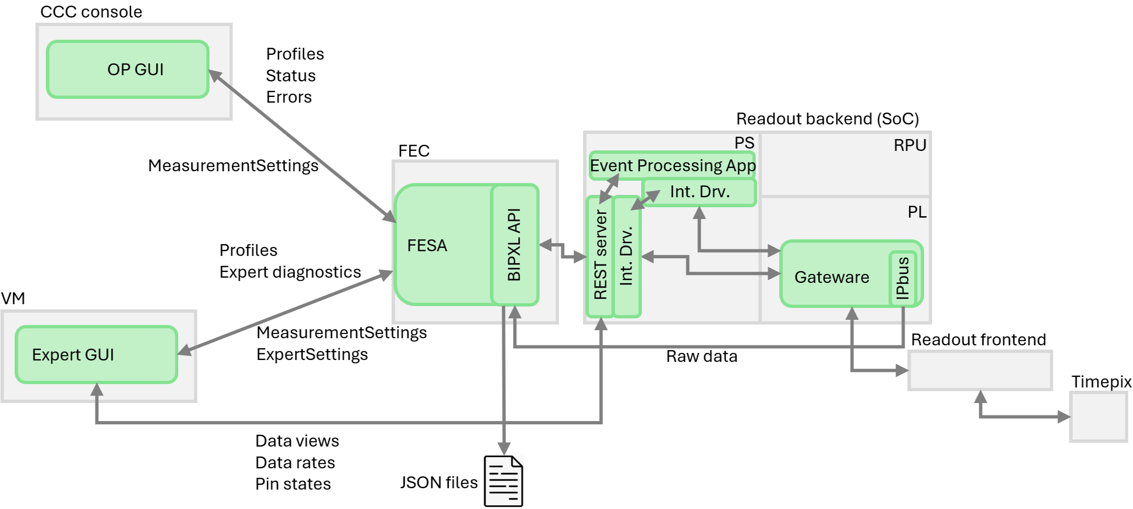
Software layout of the readout system
Original diagram by Steen Jensen

Slide 20
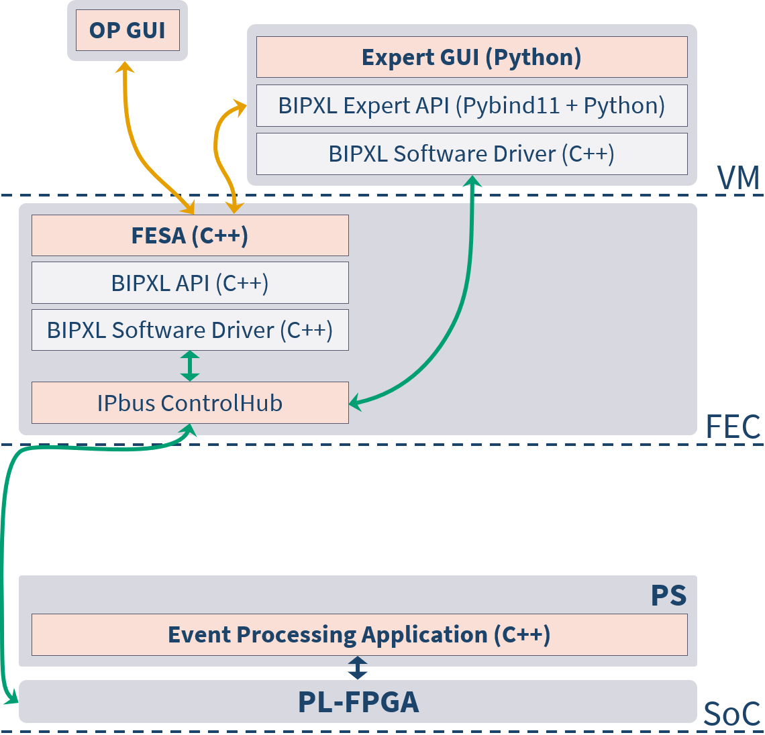
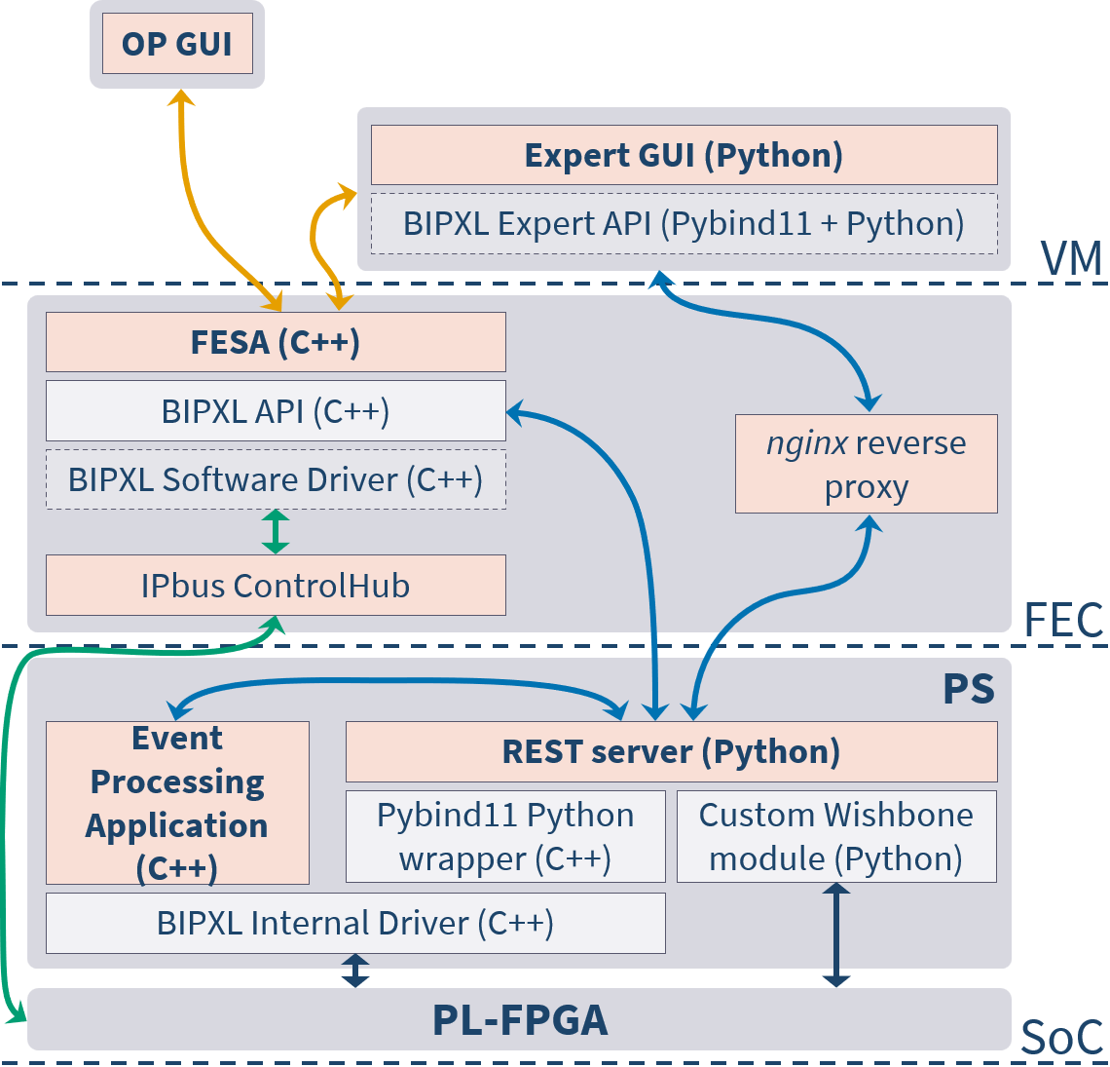
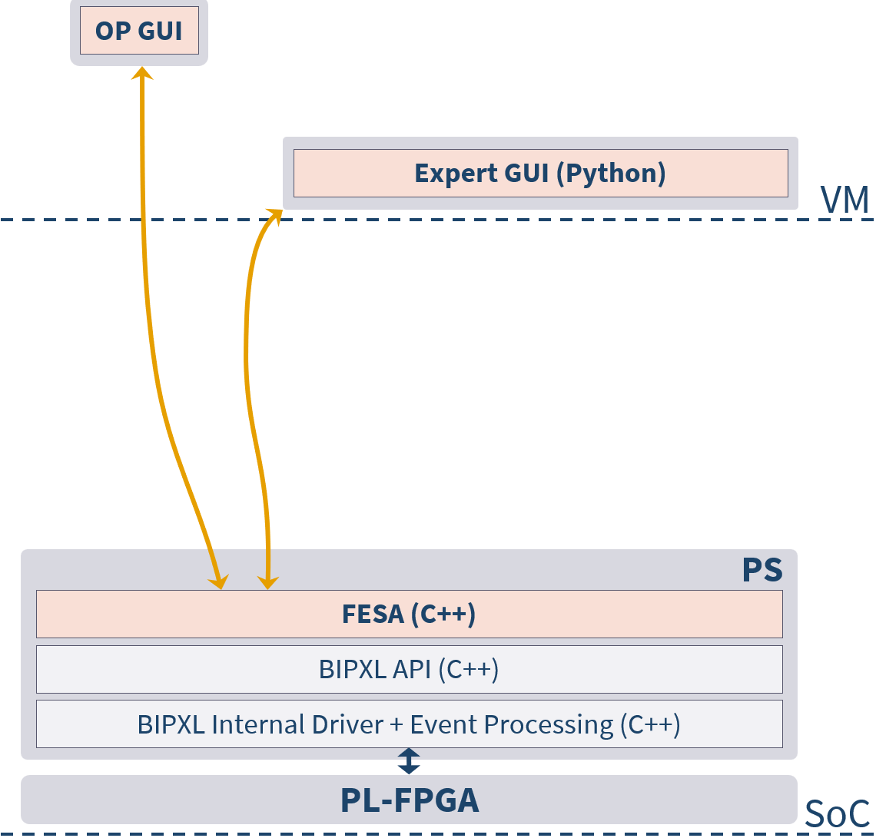
Readout versions
HTTP
Application
Utility process
PyJapc
Library
IPbus
Legacy library
V2–V3
V4
V5

